Slide 1
Endocrine Anatomy
Caroline Palmer, MPAS, PA-C
Assistant Professor
Physician Assistant Department

Slide 2
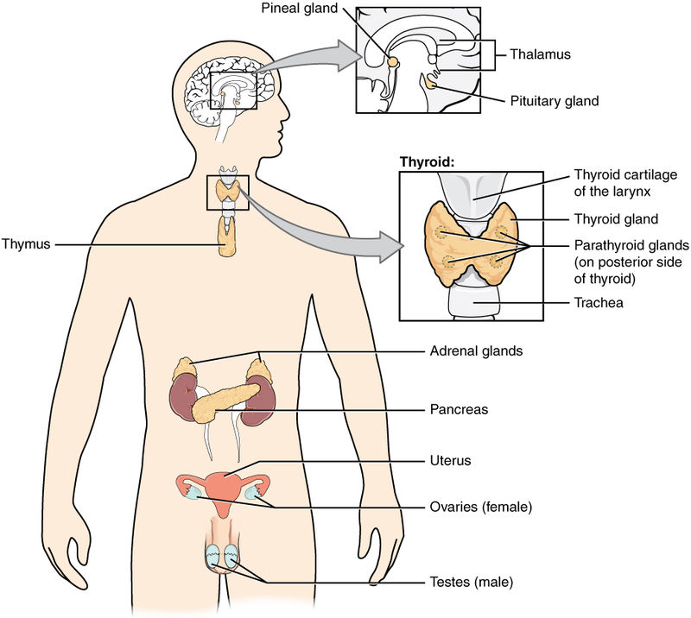
Endocrine System

Slide 3
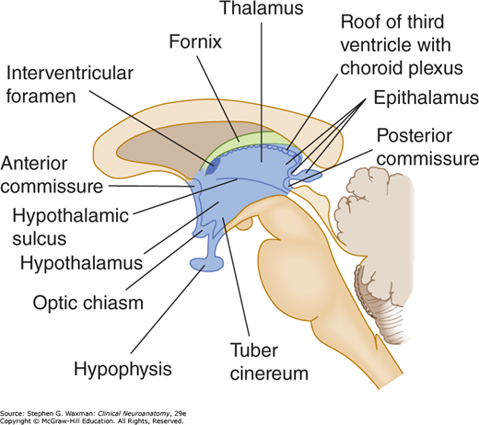

Slide 4
Hypothalamus
Portion of the brain that maintains homeostasis
Link between the endocrine and nervous systems via pituitary gland
Produces releasing hormones that stimulate or inhibit the secretion of other hormones from the pituitary gland
Helps control heart rate/blood pressure, body temperature, fluid & electrolyte balance (including thirst), appetite and body weight, glandular secretions of stomach/intestines, influences pituitary to release hormones, fatigue and sleep cycles
Notes:
Help make hormones that control other parts of endocrine system

Slide 5
Hypothalamus
Located below the thalamus but above the pituitary gland
Tells the anterior pituitary to synthesize its own hormones
Primary stimulating hormones:
  Thyrotropin releasing hormone (TRH)
  Corticotropin-releasing hormone (CRH)
  Gonadotropin-releasing hormone (GnRH)
  Growth hormone-releasing (GHRH)
Primary inhibiting hormones:
  Somatostatin/Growth hormone-inhibiting hormone (GHIH)
  Dopamine/Prolactin-inhibiting hormone (PIH)
Notes:
Stimulating = releasing hormoes

Slide 6
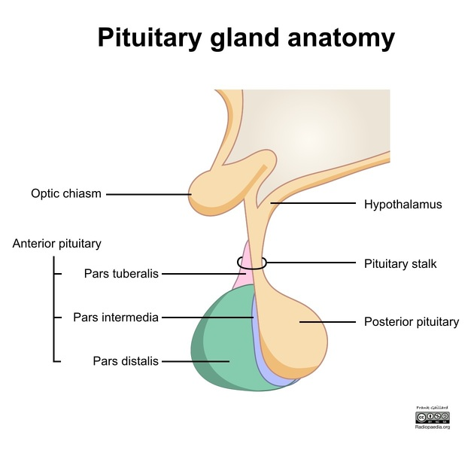

Slide 7
Pituitary Gland
(aka – Hypophysis Cerebri)
“Master gland” of the Endocrine System
Located in the “Sella Turcica” of the Sphenoid bone just below the optic chiasm
Connected to the hypothalamus via the infundibulum (stalk)
Consists of two separate lobes – anterior and posterior (each of which has separate functions and controls)

Slide 8
Pituitary Gland
Anterior:
  Thyroid-stimulating hormone (TSH)
  Adrenocorticotropic hormone (ACTH)
  Follicle stimulating hormone (FSH)
  Luteinizing hormone (LH)
  Growth hormone (GH)
  Prolactin
Posterior:
  Oxytocin
  Vasopressin (ADH)

Slide 9
Anterior Pituitary
Stimulating hormones
TRH → TSH → Thyroid hormone
CRH → ACTH → Cortisol
GnRH → FSH and LH → Sex hormones (Estrogen, Progesterone, Testosterone) and helps with maturation of gametes
GHRH → GH → Bone and tissue growth
Notes:
When thyroid hormones increases, then it sends an inhibitory response so halts production when needed

Slide 10
Anterior Pituitary
Inhibiting hormones
Prolactin inhibiting hormone → X Prolactin
During breastfeeding, it sends a message to the brain to halt production of PIH thus inhibiting it and allowing production of Prolactin

Slide 11
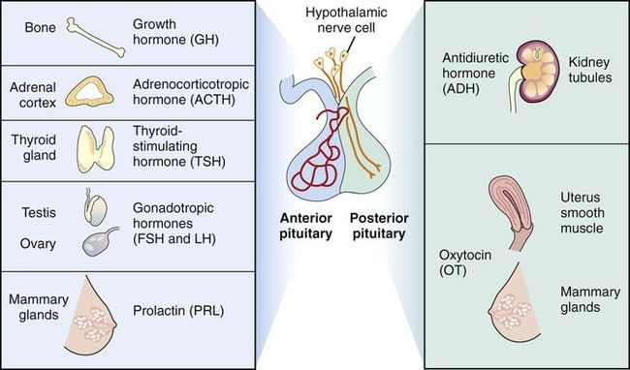
Pituitary Gland

Slide 12
Posterior Pituitary
Antidiuretic hormone (ADH)
  Signal from hypothalamus usually low blood volume
  Retains water from urine and causes vasoconstriction of blood vessels which helps increase blood pressure
Oxytocin
  Dilates cervix and stimulates uterine contractions during childbirth as well as helps muscles contract during breastfeeding

Slide 13
Pituitary Gland
Arterial supply
  via the superior & inferior hypophyseal arteries, branches off the internal carotid arteries
Venous return
  via the right & left hypophyseal veins directly to the right & left cavernous sinuses

Slide 14
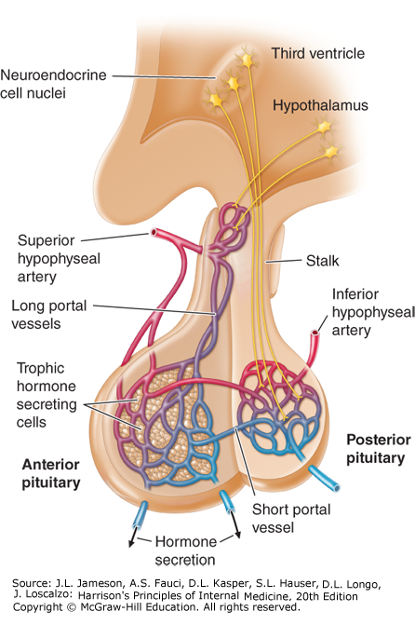
Pituitary Gland

Slide 15
Sella Turcica
Saddle shaped depression in sphenoid bone
Three parts
  Tuberculum sellae (horn of saddle)
    Anterior boundary of the hypophysial fossa
  Hypophysial fossa (pituitary fossa)
    Median depression in the body of sphenoid that accommodates the pituitary gland
  Dorsum sellae (back of saddle)
    Square plate of bone projecting superiorly from the body of the sphenoid that forms the posterior boundary of the sella turcica
    Posterior clinoid processes on each side

Slide 16
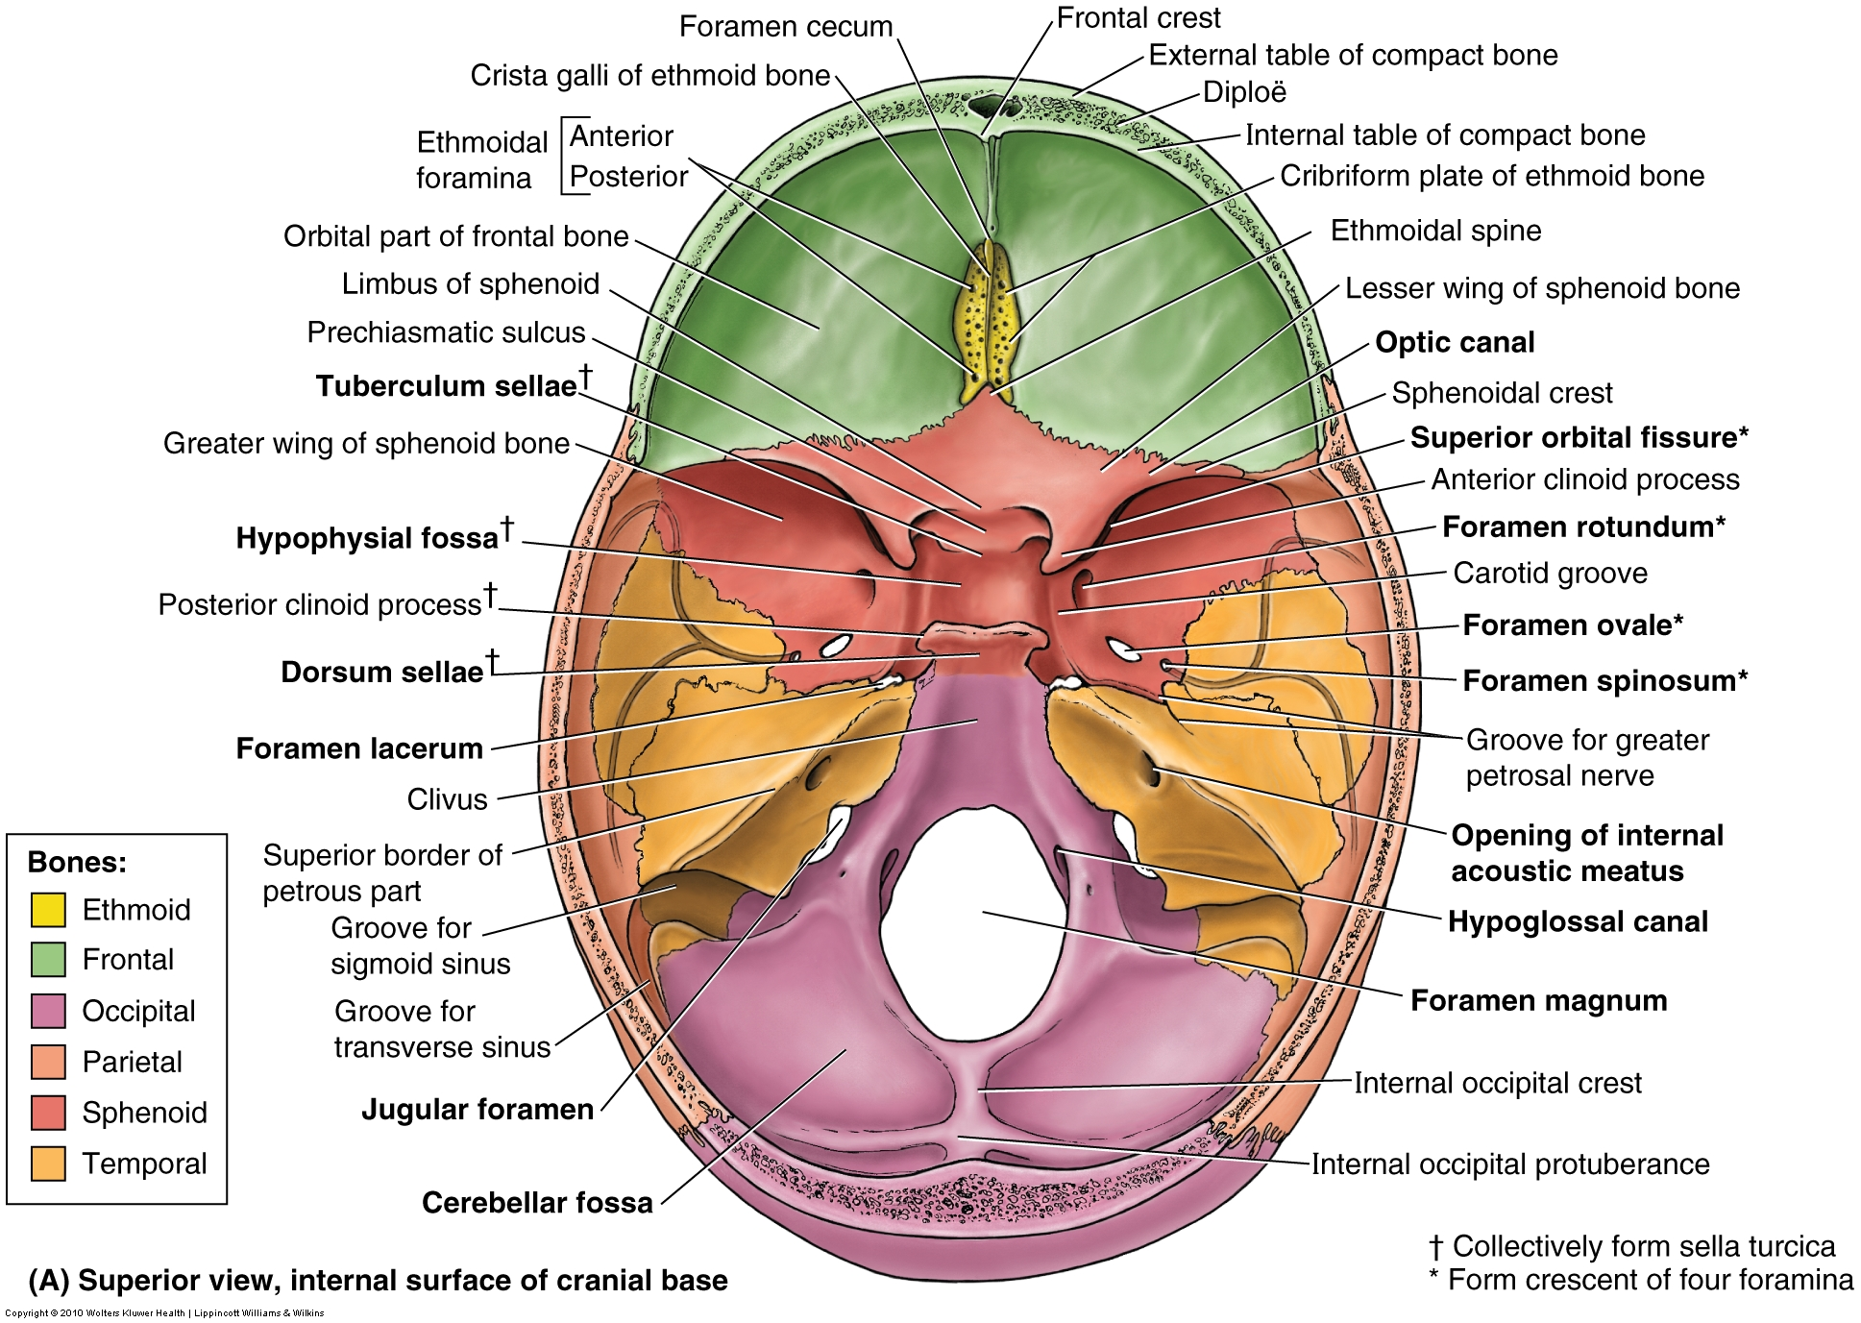

Slide 17
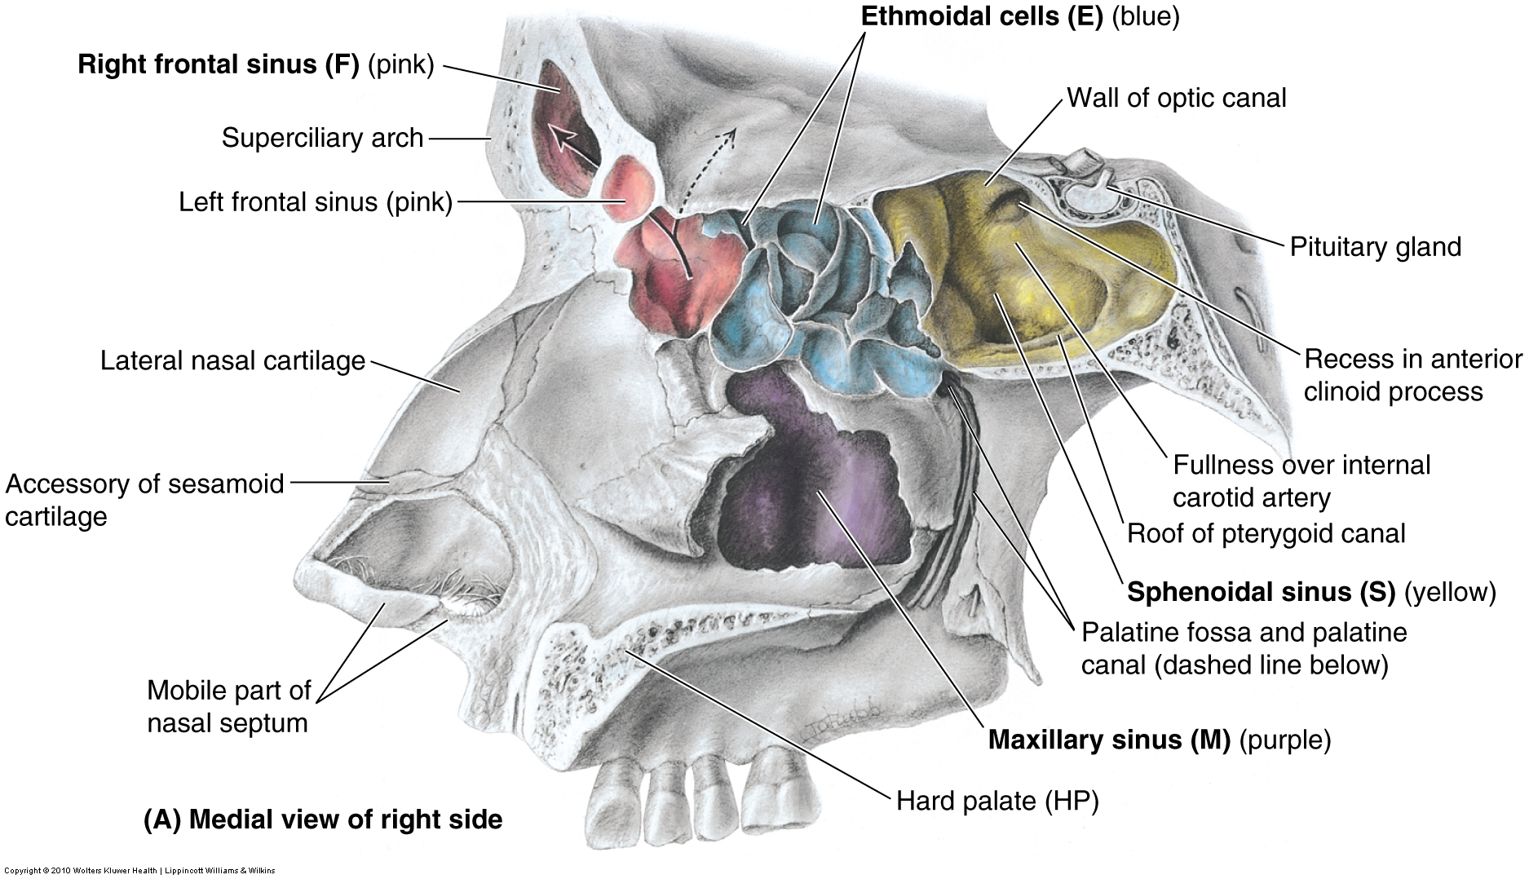
Optic Chiasm
NOTE: floor of sella turcica is very thin next to the sphenoid sinus. Infection of the sinus can cause disruption of this bony layer causing problems with the pituitary. Also, note the roof is narrow where the “infundibulum” of the pituitary doesn’t allow for expansion of any tumors of the pituitary.

Slide 18
Sella Turcica
Clinical significance
  Sinus invasion
    Infection of the sphenoid sinus can impact the pituitary gland during infection
  Pituitary tumor
    The tumor usually extends upward and can result in compression of the optic chiasm
      This leads to bitemporal hemianopsia → pathognomonic for a pituitary tumor

Slide 19
Cavernous sinus
Dural venous sinus
Is located on either side of the pituitary fossa and body of the sphenoid bone
Structures passing through the sinus:
  Oculomotor nerve (CN 3)
  Trochlear nerve (CN 4)
  Ophthalmic branch of CN 5
  Maxillary branch of CN 5
  Internal carotid artery
  Abducens nerve (CN 6)

Slide 20
Cavernous sinus
Clinical significance
  The pituitary gland lies between the paired sinuses
  An abnormal pituitary adenoma expands into the cavernous sinus
    Can cause ophthalmoplegia (weakness or paralysis of one or more extraocular muscles) and sensory loss from compression of ophthalmic or maxillary nerve

Slide 21
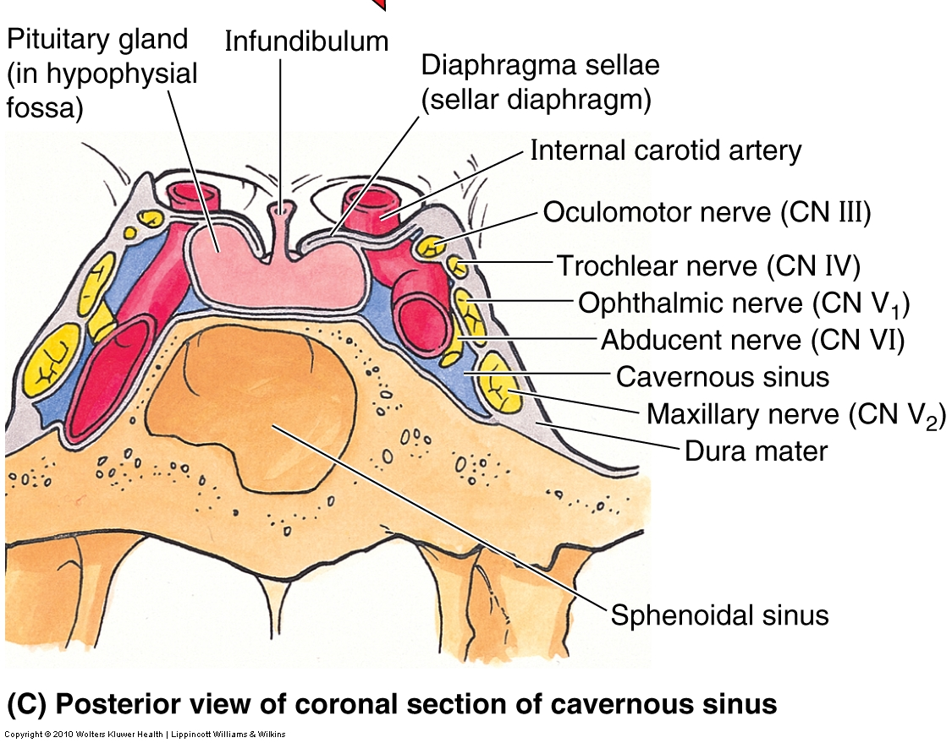

Slide 22
Pineal Gland
Small endocrine gland in the brain
Located in epithalamus near the center of the brain between two hemispheres
Very small pinecone shaped gland
May appear calcified in radiographs in older people due to deposits of fluoride, calcium, & phosphorus
Hormone – Melatonin (secretion dictated by light exposure): two functions – help control circadian rhythm and regulate reproductive hormones

Slide 23
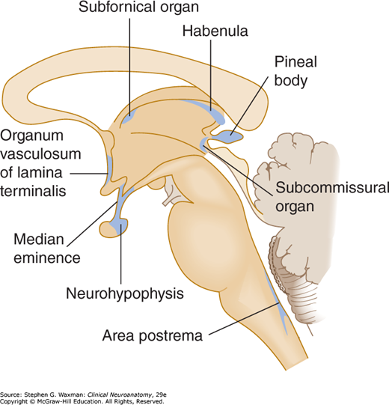
Pineal Gland

Slide 24
Adrenal Glands
(aka – suprarenal glands)
Located on top of each kidney (hence “suprarenal”)
Right adrenal is more “pyramidal shaped”, while left is “crescent shaped”
Separated from kidneys by a thin septum
  Important for renal transplants
Enclosed by renal fascia by which are attached to the crura of the diaphragm
Each gland has an inner medulla and outer cortex, each of which have different endocrine functions
Each gland has a hilum where veins and lymphatics exit, but the arterial and nerve supply enter at various sites

Slide 25
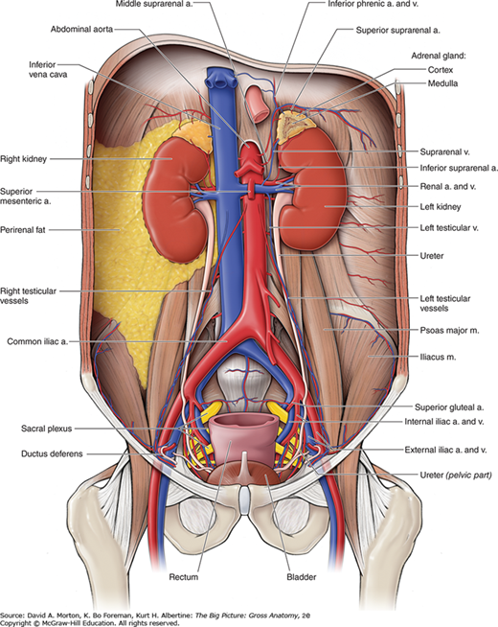
Adrenal Glands

Slide 26
Adrenal Glands
Suprarenal cortex
  Secretes aldosterone, cortisol, and precursors for sex hormones
    Aldosterone causes the kidneys to retain sodium and water in response to stress, increasing the blood volume and blood pressure
    Cortisol secreted during “fight or flight” situations
Suprarenal medulla
  Chromaffin cells of medulla are related to sympathetic ganglion neurons
    Secrete catecholamines (mostly epinephrine) into the bloodstream in response to signals from presynaptic neurons
    Epinephrine and norepinephrine active the body to a flight-or fight status in response to traumatic stress
      Increase HR and BP, dilate bronchioles, and change blood flow patterns

Slide 27
Adrenal Glands
Arterial supply is VERY abundant
  Due to endocrine functional needs
The suprarenal arteries branch freely before entering the gland so that 50-60 branches penetrate the capsule covering the surface of gland
Arterial supply:
  Superior suprarenal- from inferior phrenic arteries
  Middle suprarenal- from the abdominal aorta near the level of celiac trunk
  Inferior suprarenal- from the renal arteries

Slide 28
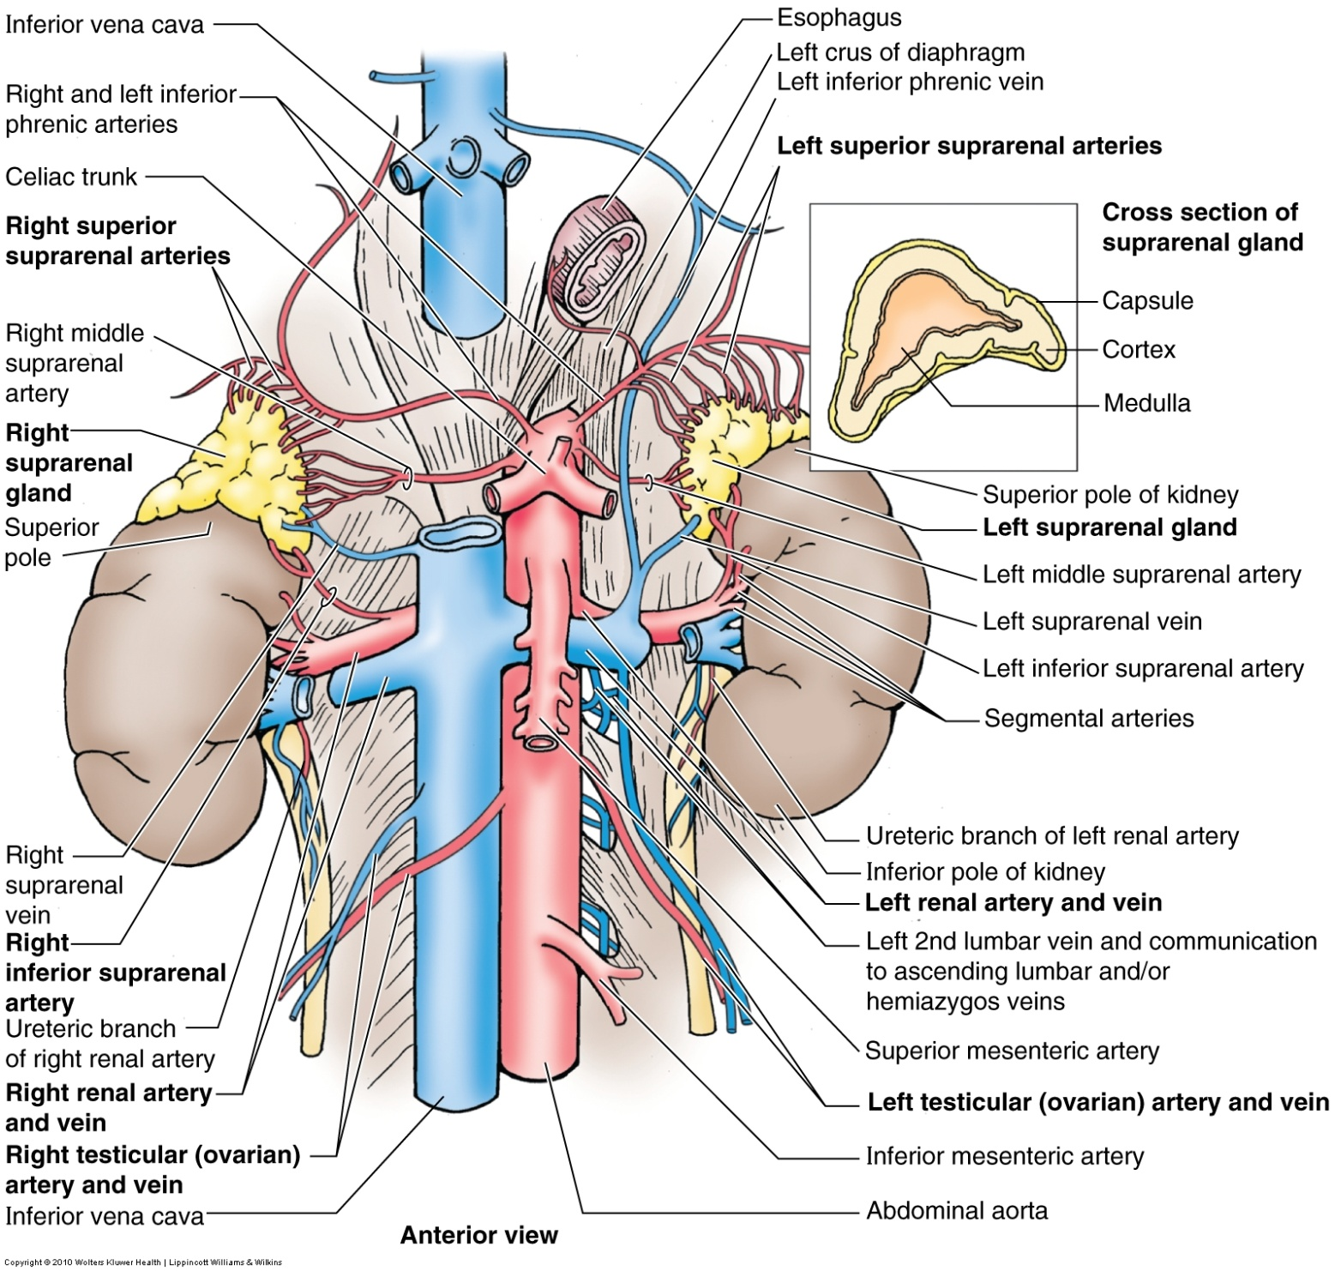

Slide 29
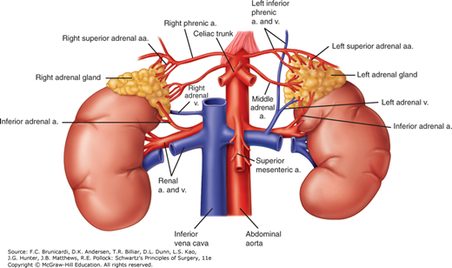

Slide 30
Adrenal Glands
Venous return is via suprarenal veins – right empties into the IVC and the left into the left renal vein.
Rich nerve supply from celiac plexus and abdominopelvic splanchnic nerves supply the cortex, while presynaptic sympathetic fibers (mainly from spinal cord levels T10-L1) supply the medulla.
Many lymphatic vessels leave the adrenals from a deep plexus in the cortex and another from the medulla and drain to the lumbar lymph nodes.

Slide 31
Pancreas
An elongated, accessory digestive gland
Lies posterior to the stomach between the duodenum on the right and spleen on the left
Both exocrine (digestion) and endocrine (insulin & glucagon) functions
When blood sugar is high, beta cells secrete insulin into the blood to help cells take in glucose and use for energy (lowering blood sugar)
When blood sugar is low, alpha cells secrete glucagon which binds to receptors on the liver activating a breakdown of glycogen which releases glucose into the bloodstream cells to be used between meals

Slide 32
Pancreas
Divided into 4 parts:
  Head of the pancreas lives in the C of the duodenum and uncinate process (projection of the head) extends posteriorly to the superior mesenteric artery (SMA)
  The neck overlies the superior mesenteric vessels and adjacent to the pylorus of the stomach
  The body lies to the left of the superior mesenteric vessels passing over the aorta and L2 vertebra
  The tail lies anterior to the left kidney and projects toward the LUQ and the spleen

Slide 33
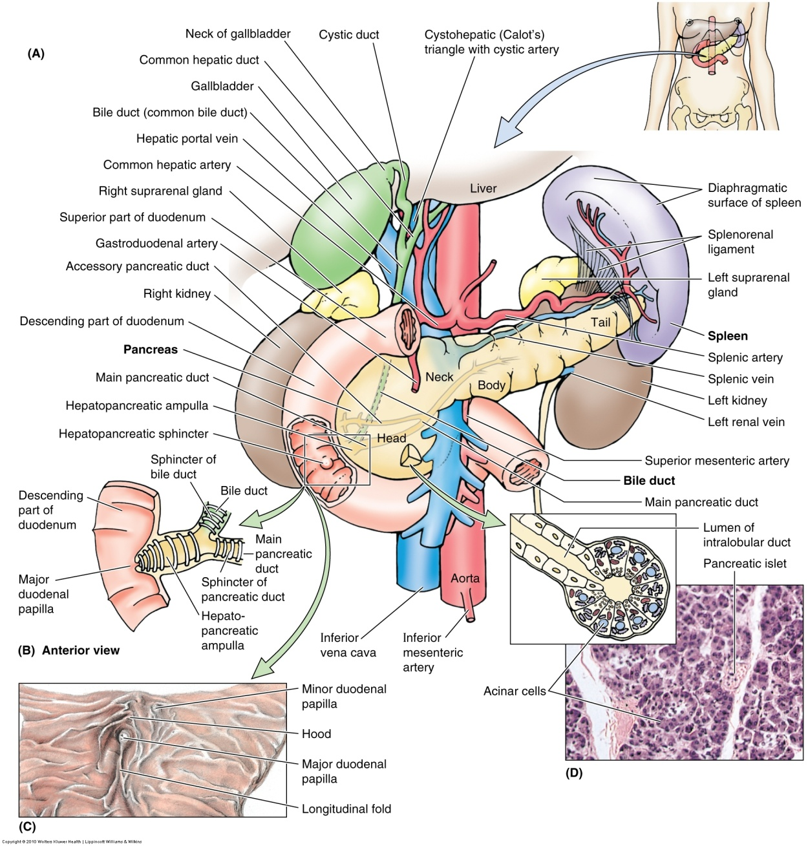
“Ampulla of Vater”
“Sphincter of Oddi”

Slide 34
Pancreas
Main pancreatic duct
  Begins at the tail of the pancreas and runs through the gland to the head
  The pancreatic duct and bile duct unite to form the hepatopancreatic ampulla (of Vater) which opens into the duodenum
  Its controlling sphincter is called the Sphincter of Oddi
The sphincter is smooth muscle and controls the flow of bile and pancreatic juice into the ampulla and prevents reflux of duodenal content into the ampulla
The accessory pancreatic duct joins with the main pancreatic duct

Slide 35
Pancreas
Arterial supply
  Mainly from branches of splenic artery (body and tail) and branches from gastroduodenal and superior mesenteric arteries (head and neck)
Venous drainage
  Occurs through the pancreatic veins into the splenic and superior mesenteric veins that empty into the hepatic portal system
Nervous supply from vagus and splanchnic passing through the diaphragm

Slide 36
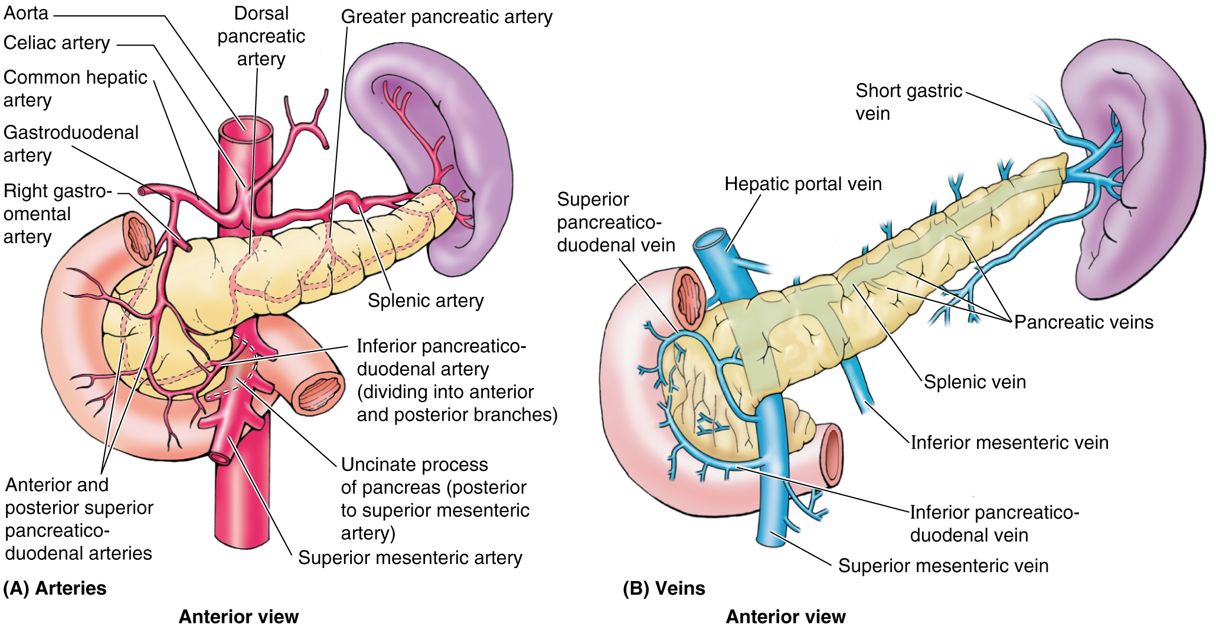

Slide 37
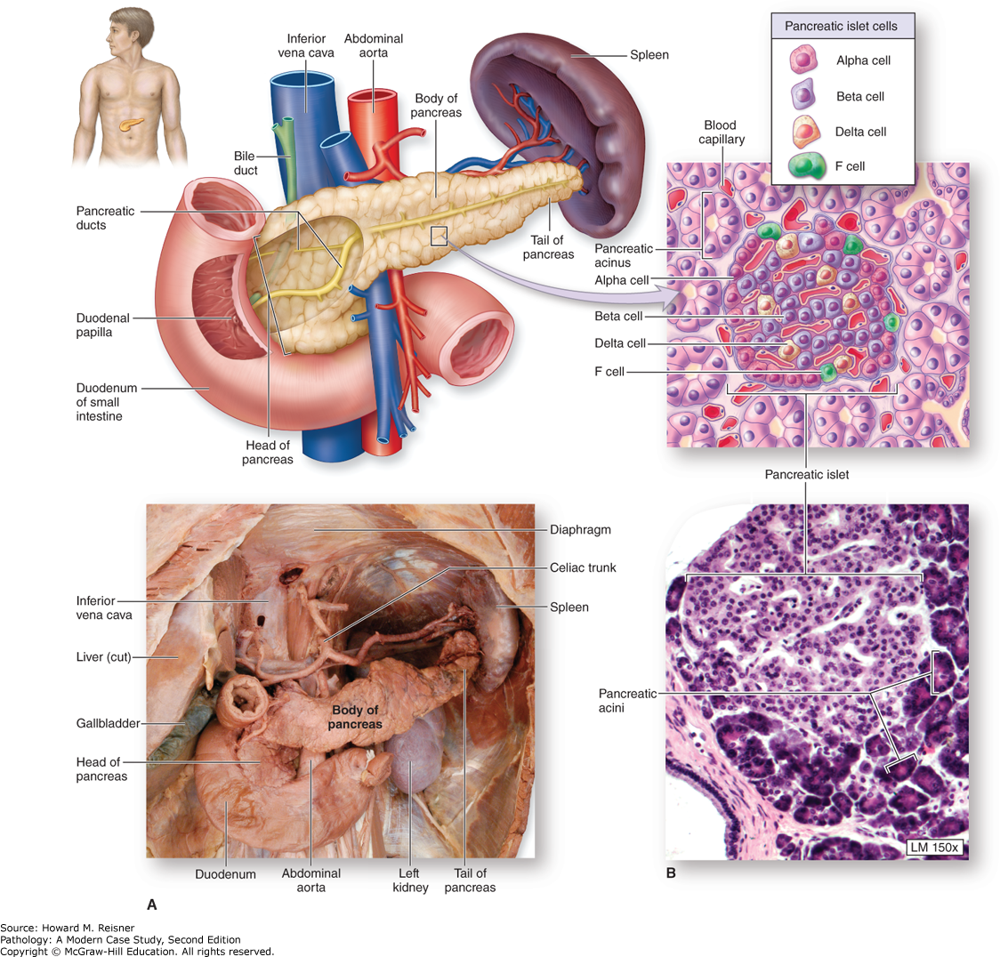

Slide 38
Thymus Gland
A primary lymphoid organ located in the inferior part of the neck
Located behind sternum between lungs (superior anterior mediastinum)
Active only until puberty
Thymosin is its hormone and it stimulates the development of T-cells

Slide 39
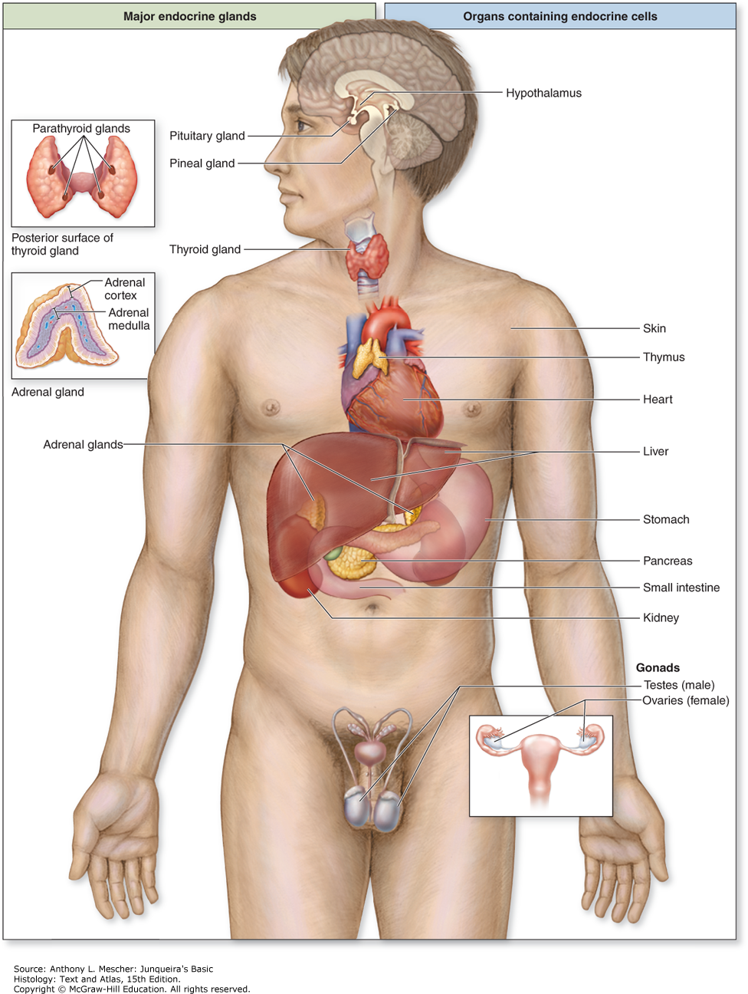

Slide 40
Thyroid Gland
Body’s largest endocrine gland
Affects all areas of the body except for itself, spleen, testes, and uterus
Produces:
  Thyroid hormone
    Controls rate of metabolism
  Calcitonin
    A hormone controlling calcium metabolism
Notes:
Parafollicular cells in between produce Calcitonin

Slide 41
Thyroid Gland
Located anteriorly in the neck at C5-T1
Consists mostly of left and right lobes, anterolateral to the larynx and trachea
The isthmus joins the lobes over the trachea just inferior to the cricoid cartilage of larynx over the tracheal rings
Lobes project superiorly from there on the lateral aspect of the thyroid cartilage of the larynx

Slide 42
Thyroid Gland
Gland is surrounded by a thin fibrous capsule and dense connective tissue attaches the capsule to the cricoid cartilage and tracheal rings
External to the capsule is a loose sheath formed by visceral portion of the pretracheal layer of deep cervical fascia
May or may not be palpable, but if is – is consistency of muscle.

Slide 43
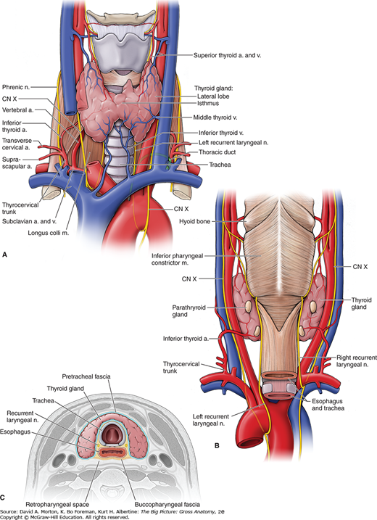

Slide 44
Thyroid Gland
Arterial supply
  Highly vascular supplied by the superior and inferior thyroid arteries
  The superior thyroid artery branches off the external carotid and supplies the anterosuperior part while inferior thyroid artery (off the right subclavian artery) supplies the posteroinferior part
  10% of population have thyroid ima artery
    Arises from brachiocephalic trunk, but can also arise from arch of the aorta, right common carotid, subclavian, or internal thoracic
    Supplies trachea and thymus

Slide 45
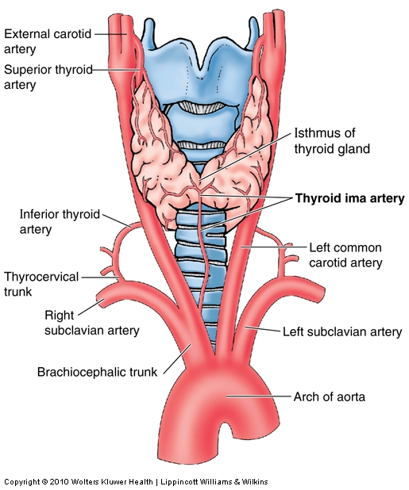

Slide 46
Thyroid Gland
Venous supply
  Superior, middle, inferior thyroid veins
Nerves
  Cardiac and laryngeal branches of the vagus nerve control the vascular beds of the thyroid
  External laryngeal & recurrent laryngeal lie very close to the thyroid and may be injured if not careful during thyroid surgery, causing the patient to become permanently hoarse (due to paralyzed vocal cords)
Lymphatic
  Superior deep and inferior deep cervical nodes

Slide 47
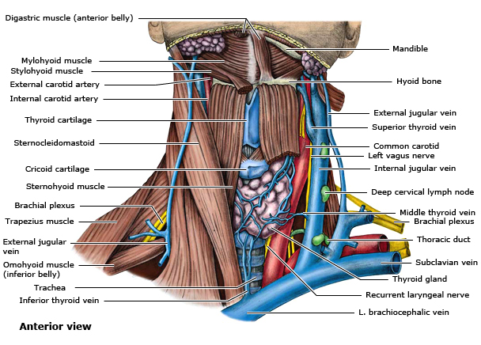
https://www.uptodate.com/contents/image?imageKey=SURG%2F58086&topicKey=SURG%2F15033&source=see_link

Slide 48
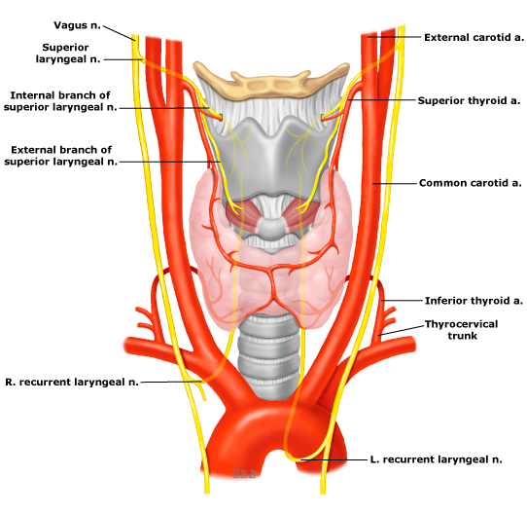
https://www.uptodate.com/contents/image?imageKey=SURG%2F82397~SURG%2F61802&topicKey=SURG%2F15843&source=see_link

Slide 49
Parathyroid glands
Small flattened, oval glands (4 of them)
Located on the posterior surface of the thyroid gland on right and left lobes (superior and inferior) on the external capsule
Participate in calcium level regulation (acts on bone directly to release more CA²⁺ into bloodstream)

Slide 50
Parathyroid Glands
Blood supply – usually branches of the inferior thyroid artery but can vary. Parathyroid veins drain into thyroid venous plexus
Lymphatic vessels – drain into thyroid lymph vessels which drain into deep cervical nodes
Nerve supply – abundant; derived from thyroid branches of the cervical sympathetic ganglia

Slide 51
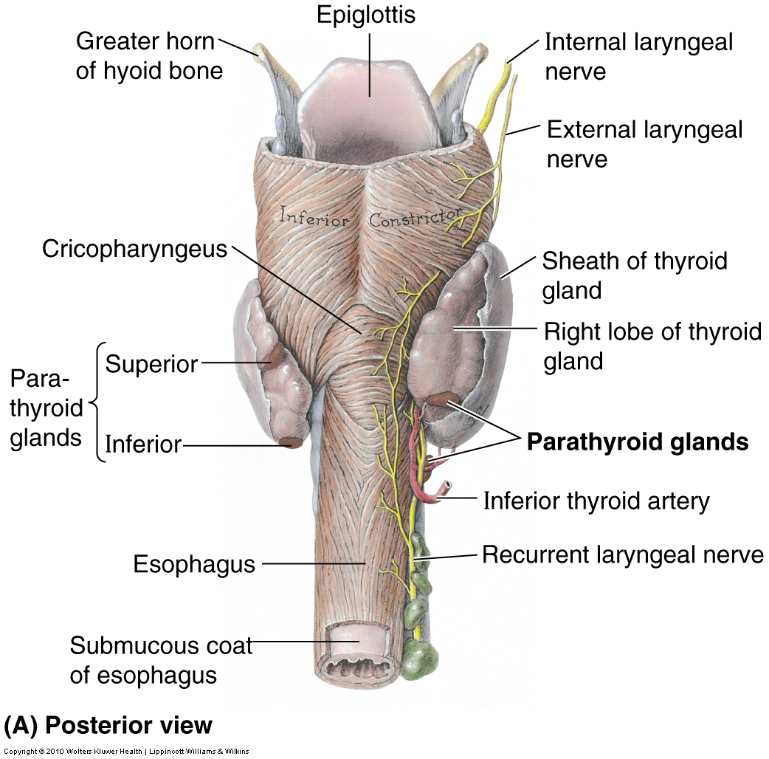

Slide 52
Gonads (Ovaries)
Oval shaped about the size of a large grape
Located on either side of the uterus attached to the fimbria
Hormones: Estrogens (Estradiol, Estrone, Estriol) & Progesterone
Controlled by the FSH & LH

Slide 53
Gonads (Testes)
Twin Oval-shaped organs about the size of a large grape
Located in scrotum to aid in temperature control for sperm production
Testosterone is the hormone necessary for physical development in boys, growth of body and facial hair, lowering of voice, increase in height & muscle mass; maintains libido, sperm production, & bone density
Testosterone production controlled by FSH and LH

Slide 54
