Slide 1
Pituitary Diseases
Breanna Veal, MHS, PA-C

Slide 2
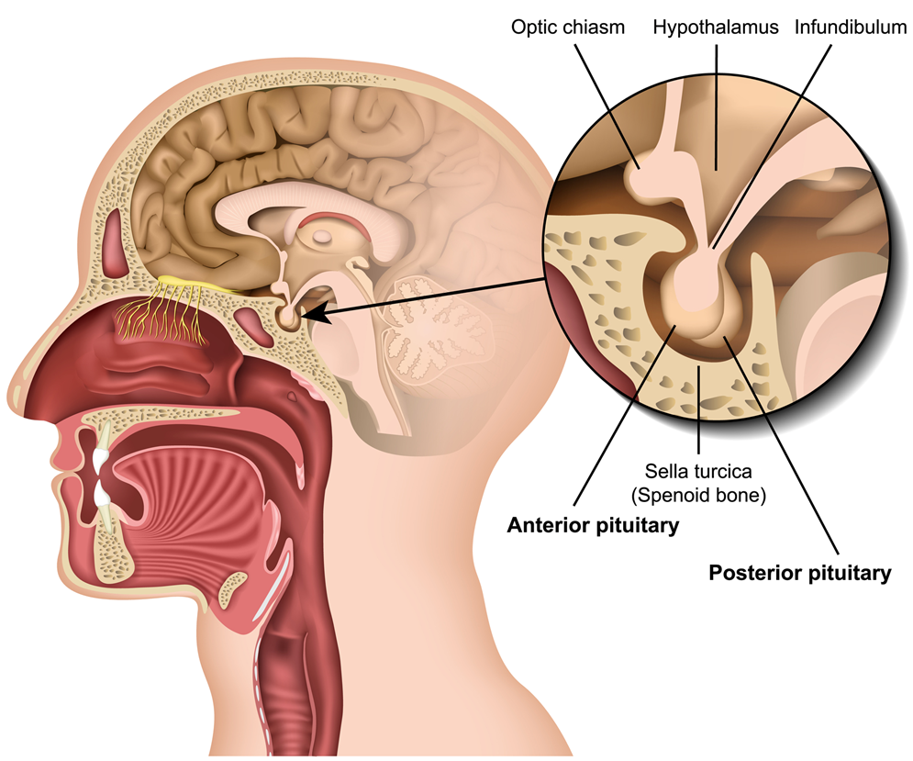
Anatomy and Physiology Review
The pituitary gland is a pea-sized gland that sits at the base of the brain directly below the hypothalamus.

Slide 3
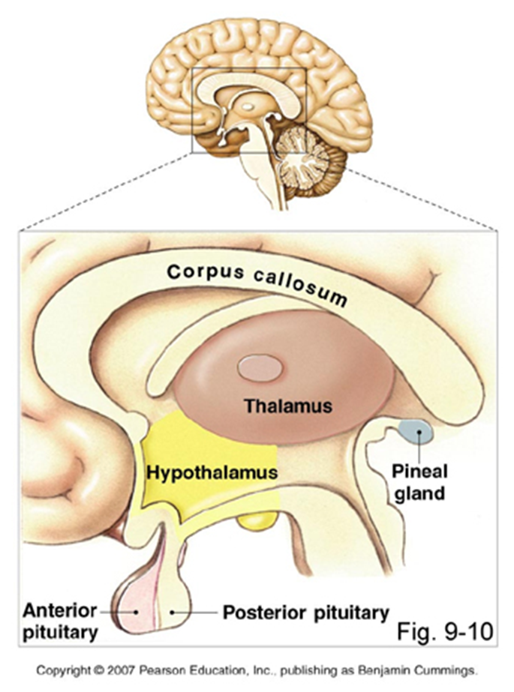
Anatomy and Physiology Review
The hypothalamus is located above the pituitary gland and below the thalamus
It is composed of multiple small nuclei linking nervous system to endocrine system
It acts as the “coordinating center” by consolidating signals from the brain, environment, etc. and delivering signals to the pituitary gland for hormone release

Slide 4
Anatomy and Physiology Review
The hypothalamus produces the following hormones:
  Corticotropin-releasing hormone (CRH)
  Thyrotropin-releasing hormone (TRH)
  Gonadotropin-releasing hormone (GnRH)
  Growth hormone-releasing hormone (GHRH)
  Somatostatin
  Prolactin inhibitory factor (PIF/Dopamine)

Slide 5
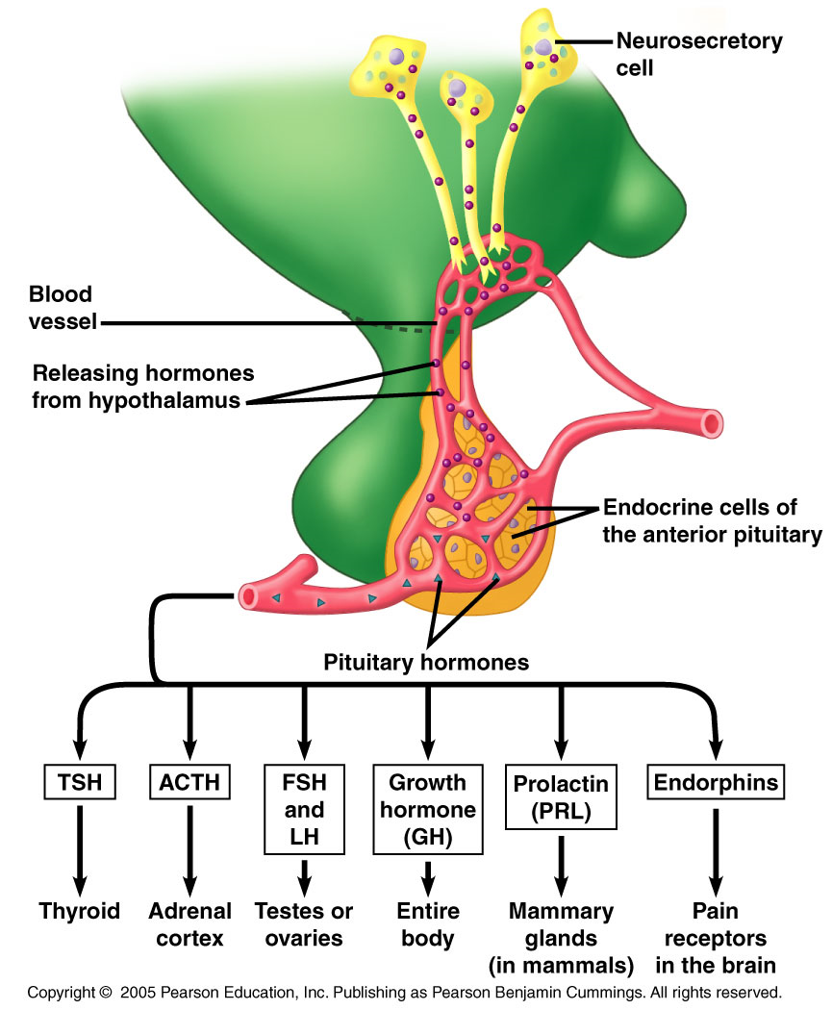
Anatomy and Physiology Review
Any hormones produced in the hypothalamus and sent to the anterior pituitary gland are sent via pituitary portal circulation

Slide 6
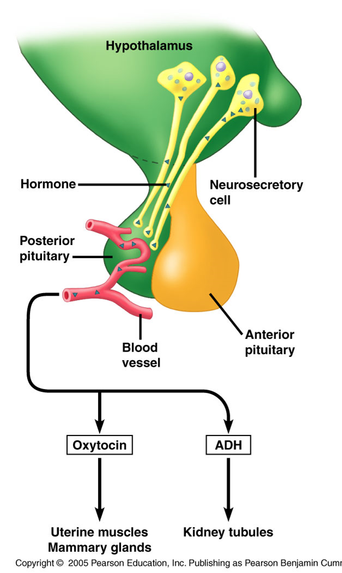
Anatomy and Physiology Review
Hormones made to stimulate the posterior pituitary are transported via a neural network in the pituitary stalk

Slide 7
Anatomy and Physiology Review
Hypothalamus Releasing Hormone | Pituitary Cell Type | Anterior Pituitary Hormone Produced
Corticotropin-releasing hormone (CRH) | Corticotroph | Stimulates adrenocorticotropic hormone (ACTH)
Growth hormone-releasing hormone (GHRH) | Somatotroph | Stimulates growth hormone (GH) release
Growth hormone inhibitory hormone (GHIH; also known as somatostatin) | Somatotroph | Inhibits GH release
Gonadotropin-releasing hormone (GnRH) | Gonadotroph | Stimulates luteinizing hormone (LH) and follicle-stimulating hormone (FSH) release
Prolactin-inhibiting factor (PIF; also known as dopamine) | Lactotroph | Inhibits prolactin release
Thyrotropin-releasing hormone (TRH) | Thyrotroph | Stimulates thyroid-stimulating hormone (TSH) and prolactin release

Slide 8

Anatomy and Physiology Review
Anterior Pituitary Hormones and Function
ACTH | Trophic to adrenal cortex Stimulates synthesis and secretion of cortisol, aldosterone, and androgens
FSH | Promotes sperm maturation via Sertoli cells in testes Stimulates ovarian follicle development
GH | Acute metabolic effects oppose insulin Chronic growth-promoting effect via insulin-like growth factor 1 (IGF-1)
LH | Stimulates Leydig cells of testes to secrete testosterone LH surge important for ovulation and formation of corpus luteum
Prolactin | Required in lactation for mammary growth, initiation of milk secretion, and maintenance of milk production
TSH | Stimulates synthesis and secretion of thyroid hormones

Slide 9
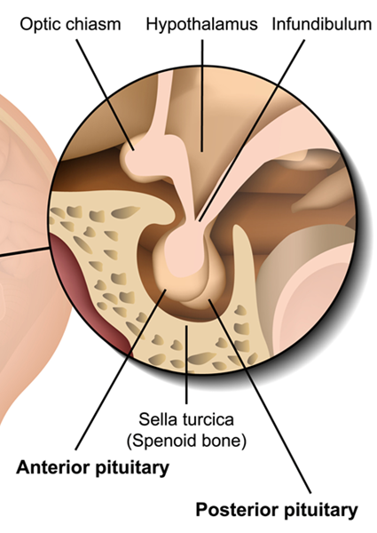
Anatomy and Physiology Review
The posterior pituitary gland (neurohypophysis) transmits two hormones:
  Vasopressin (Antidiuretic hormone/ADH): Acts on renal tubules to reduce water loss and concentrate urine
  Oxytocin: Stimulates milk letdown in response to suckling during nursing

Slide 10
Anatomy and Physiology Review
The hypothalamus and pituitary gland form a unit that exerts control over target glands:
  1. Adrenal glands (HPA Axis)
  2. Thyroid gland (HPT Axis)
  3. Gonads (HPG Axis)
  4. Liver (HPS (GH) Axis)
The fundamental feature in these units is feedback control
  Levels of a certain hormone (or lack thereof) stimulate production or halt production of another

Slide 11
Hypothalamic-Pituitary-Adrenal Axis (HPA)
The hypothalamus produces corticotropin-releasing hormone (CRH) in response to sympathetic nervous system activation
Increased CRH levels trigger the pituitary gland to release adrenocorticotropic hormone (ACTH)
ACTH binds to receptors on the adrenal cortex, stimulating the secretion of cortisol
Once a certain level of cortisol is achieved, negative feedback shuts off secretion of CRH and ACTH

Slide 12
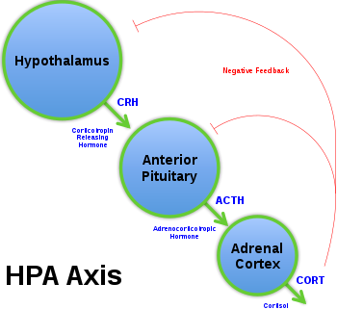

Slide 13
Hypothalamic-Pituitary-Thyroid Axis (HPT Axis)
The hypothalamus produces hypothalamic thyrotropin-releasing hormone (TRH)
TRH stimulates pituitary production of thyroid stimulating hormone (TSH)
TSH stimulates the thyroid gland to produce T3 and T4
T3 and T4 shut off production of TSH and TRH via negative feedback

Slide 14
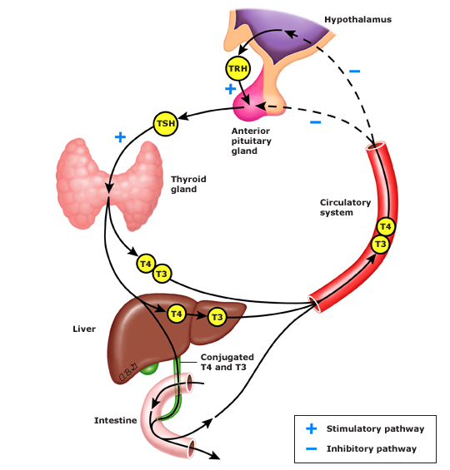
HPT Axis

Slide 15
Hypothalamic-Pituitary-Gonadal Axis (HPG)
The hypothalamus secretes gonadotropin-releasing hormone (GnRH).
GNRH stimulates pituitary production of luteinizing hormone (LH) and follicle-stimulating hormone (FSH)
LH stimulates production of testosterone from the testicles in males; FSH stimulates estrogen production in females by the ovaries
Presence of testosterone in males and estrogen/ progesterone in females shuts off production of GnRH and LH/FSH

Slide 16
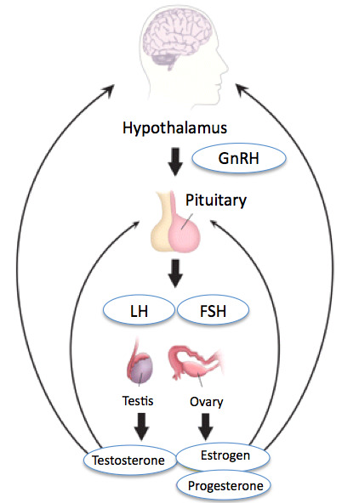
HPG Axis

Slide 17
Hypothalamic-Pituitary-Somatotropic Axis (HPS)
AKA: Hypothalamic-pituitary-growth axis
The hypothalamus produces growth hormone-releasing hormone (GHRH)
GHRH stimulates the pituitary production of growth hormone (GH)
Secretion of growth hormone stimulates production of insulin-like growth factor 1 (IGF-1) in the tissues, primarily the liver

Slide 18
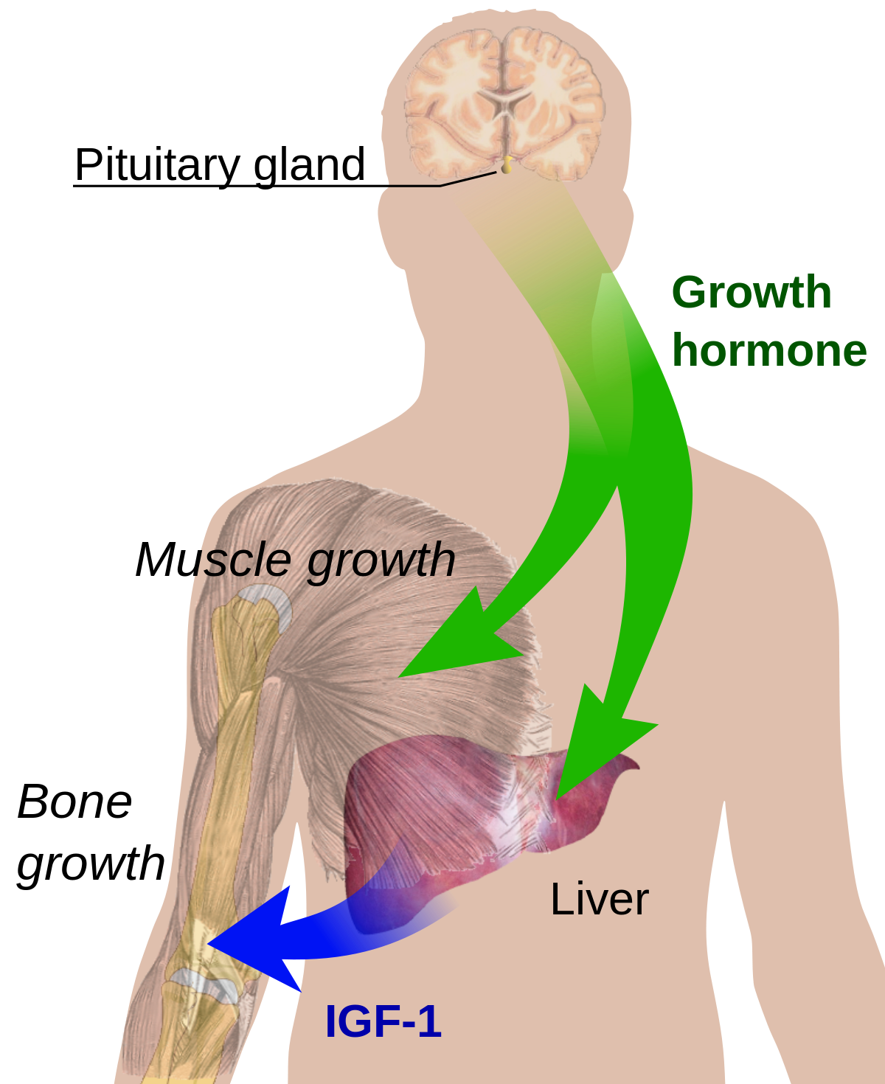
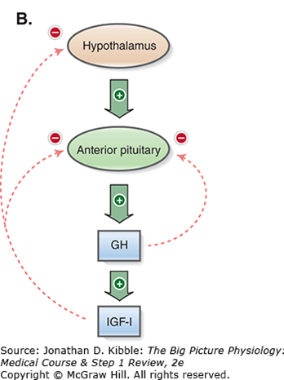
HPS Axis

Slide 19
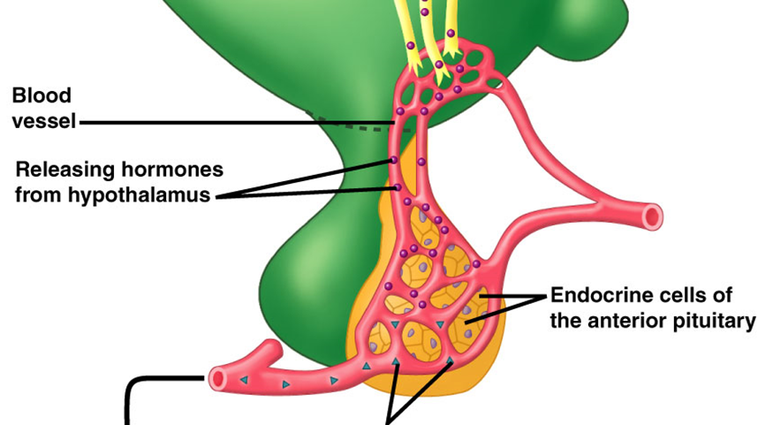
Hypothalamic Inhibitory Hormones
Somatostatin: produced by the hypothalamus, it binds to somatotrophs in the anterior pituitary and inhibits the production of growth hormone (GH)
Prolactin inhibitory factor (PIF/Dopamine): secreted into portal blood from the hypothalamus and binds to lactotrophs, inhibiting synthesis and secretion of prolactin
GH or Prolactin release inhibited

Slide 20

Hypothalamic-pituitary Axes: Posterior
Vasopressin (ADH): produced in the hypothalamus, transported via axons to the posterior pituitary, then released into the blood
  Target organs: Kidneys
Oxytocin: produced in the hypothalamus, transported via axons to the posterior pituitary and released in the blood
  Target organs: Breasts and uterus

Slide 21
Classification of Endocrine Dysfunction

Slide 22
Classifying Endocrine Dysfunction
Hypofunction: Insufficient hormone secreted by the gland
Hyperfunction: Excess hormone secretion by the gland
Level of the hypothalamic-pituitary-target organ axis at which the problem originates:
  Primary (most common): Caused by the endocrine gland itself
  Secondary: Dysfunction from abnormal pituitary activity
  Tertiary: Dysfunction originating at the level of the hypothalamus

Slide 23
Common Causes of Pituitary Dysfunction
Hormone deficiency: autoimmune glandular destruction, infection, inflammatory disease, genetic mutations, surgery, mass effect
Excess hormone production: benign tumors, neoplasm, autoimmune disease, excess hormone administration, genetic activating mutations
Resistance to hormones: genetic defects cause dysfunctional membrane receptors and signaling

Slide 24
Hypopituitarism

Slide 25
Hypopituitarism
Inadequate production of one or more anterior pituitary hormones from disease of the pituitary or hypothalamus
Diagnostic lab pattern – a LOW pituitary hormone level in the setting of a LOW target hormone level
  Ex: a low TSH with a low T4 level
Treatment typically involves hormone replacement therapy
Congenital cases often present gradually, with short stature and growth failure due to GH and TSH deficiency
  Followed by lack of pubertal development due to LH/FSH deficiencies
Patients with long-standing hypopituitarism tend to have dry, pale, fine, wrinkled facial skin and an apathetic affect.

Slide 26
Hypopituitarism Etiologies
Mass lesions: Pituitary adenomas, cysts
Pituitary surgery/radiation
Infiltrative disease: Sarcoidosis, hemochromatosis
Infection: TB, syphilis
Infarction: Sheehan Syndrome (postpartum necrosis)
Genetic mutations

Slide 27
Hypothalamic Etiologies
Mass lesions: Benign (craniopharyngiomas) or malignant metastatic lesions
Radiation: CNS or nasopharyngeal cancers
Infiltrative disease: Sarcoidosis
Infections: TB, syphilis
Other: Traumatic brain injury, stroke

Slide 28
Hypopituitarism: Clinical Manifestations
The clinical manifestations depend on the cause as well as the type and degree of hormonal insufficiency.
Patients may be asymptomatic, present with symptoms related to specific hormone deficiency or mass lesion, or present with nonspecific symptoms (fatigue).

Slide 29
Growth Hormone (GH) Deficiency
GH is the most abundant anterior pituitary hormone
GH promotes linear growth in children by stimulating cartilage growth, particularly at the epiphyseal plate.
Regulates metabolism in adults, particularly glucose control, while also contributing to muscle development, bone density, cholesterol levels and brain function

Slide 30
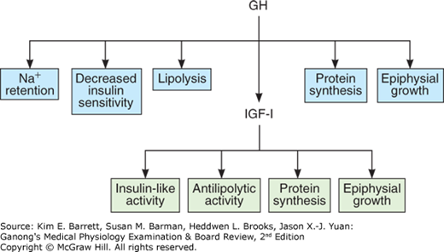
GH Function
Many of GH physiologic effects are mediated through IGF-1 and the liver is a major source of circulating IGF-1

Slide 31
Growth Hormone Effects
Bones
  Children: GH stimulates longitudinal growth by increasing the formation of new bone and cartilage, beginning gradually during the 1st year of life and peak at puberty
  Adults: Increases bone turnover leading to bone formation and to a lesser extent bone resorption
Adipose tissue- Release and oxidation of free fatty acids by breaking down stored triglycerides.
Skeletal muscle- GH stimulates amino acid uptake to be used for protein synthesis and cell proliferation of skeletal muscle while limiting breakdown of existing protein

Slide 32
Growth Hormone Effects
Liver
  GH stimulates IGF-1 production and release
  GH reduces glucose uptake in the liver and promotes gluconeogenesis resulting in increased hepatic glucose output
Immune system- GH influences the responses of antibody production by B-cells, T-lymphocyte function, macrophage activity and natural killer cell activity
CNS- GH modulates mood and behavior

Slide 33
GH Deficiency Children
“Pituitary Dwarfism”
Clinical Manifestations
Congenital GH deficiency: presents in newborns with hypoglycemia, jaundice, and decreased rate of growth later (6-12 months)
Acquired GHD in children: presents with severe growth failure, delayed bone age, and increased weight: height ratios
  Causes of acquired GHD include intracranial tumors, cranial irradiation, and head trauma

Slide 34
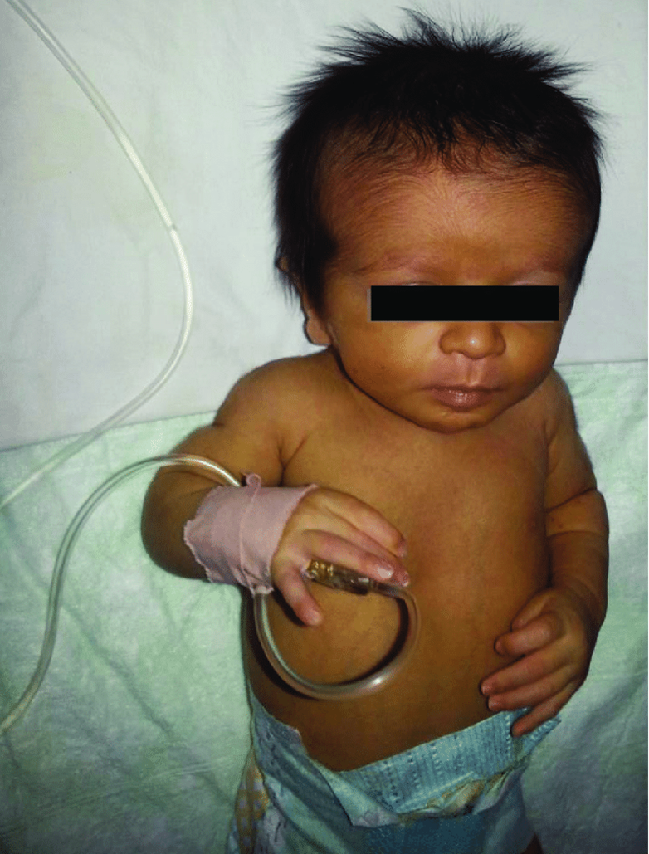
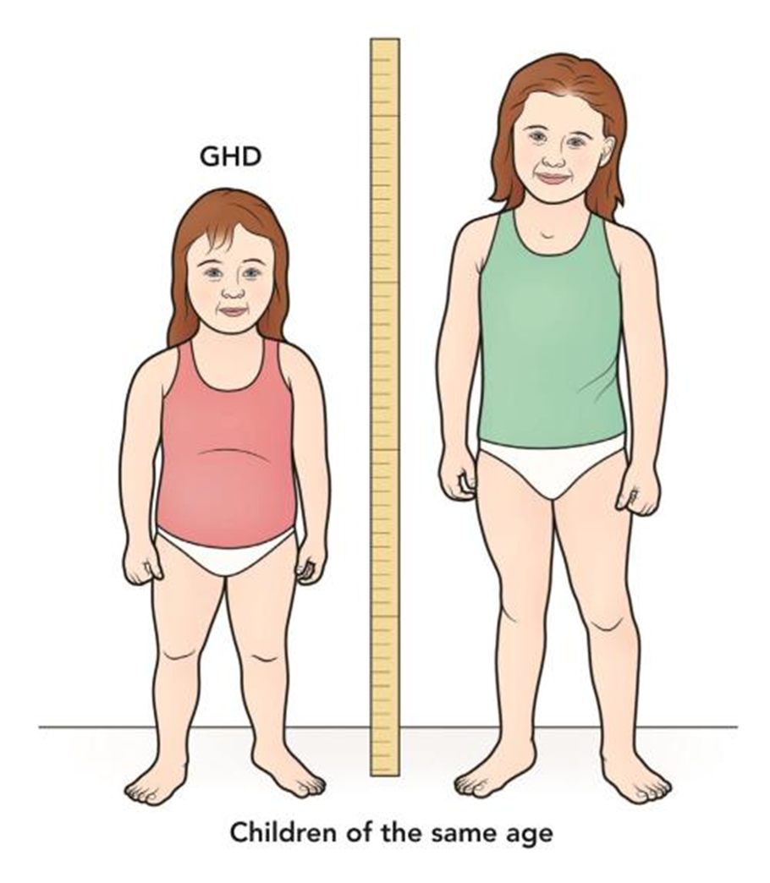

Slide 35
GH Deficiency: Why are children hypoglycemic?
GH has anti-insulin activity - GH suppresses the ability of insulin to stimulate uptake of glucose in the tissues; GH also stimulates gluconeogenesis in the liver
Therefore, in GH deficiency, there is unopposed insulin activity allowing for hypoglycemia

Slide 36
Hypopituitarism: GH Deficiency Workup
GH is secreted in a pulsatile manner and peaks ~1hr after falling asleep
  Therefore, it may be undetectable when drawn between pulses
Diagnosis involves clinical assessment, growth analysis, bone age study and IGF-1 testing
  PRO: IGF-1 levels are stable throughout the entire day
  CON: IGF-1 levels alone are not specific to GH deficiency, as they are also low in GH insensitivity, fasting state, malnutrition, hypothyroidism, diabetes, or renal and hepatic disease
When congenital the diagnosis can be made if noted severe growth failure, delayed bone age, and very low serum concentrations of GH, IGF-1

Slide 37
Hypopituitarism: GH Deficiency Workup
Pituitary MRI should be performed to eval for structural defects or masses
When diagnosis is in doubt, provocative stimuli can be used to aid in the diagnosis.
  Glucagon induced hyperglycemia or insulin-induced hypoglycemia will provoke GH secretion to a level > 7μg/L in children without deficiency
If pituitary insufficiency is found, test for and correct any additional hormone deficits
Diagnosis is excluded in children with normal bone age study and height velocities

Slide 38
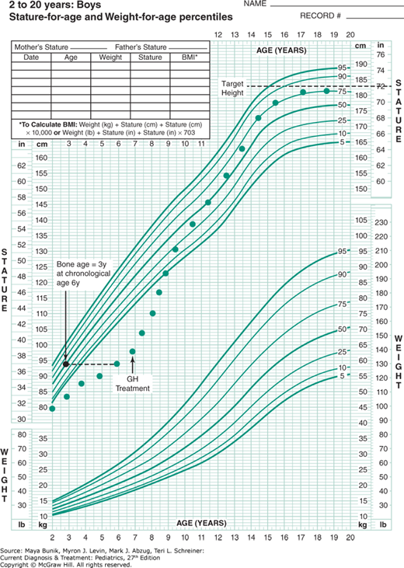
Pediatric Growth Chart

Slide 39
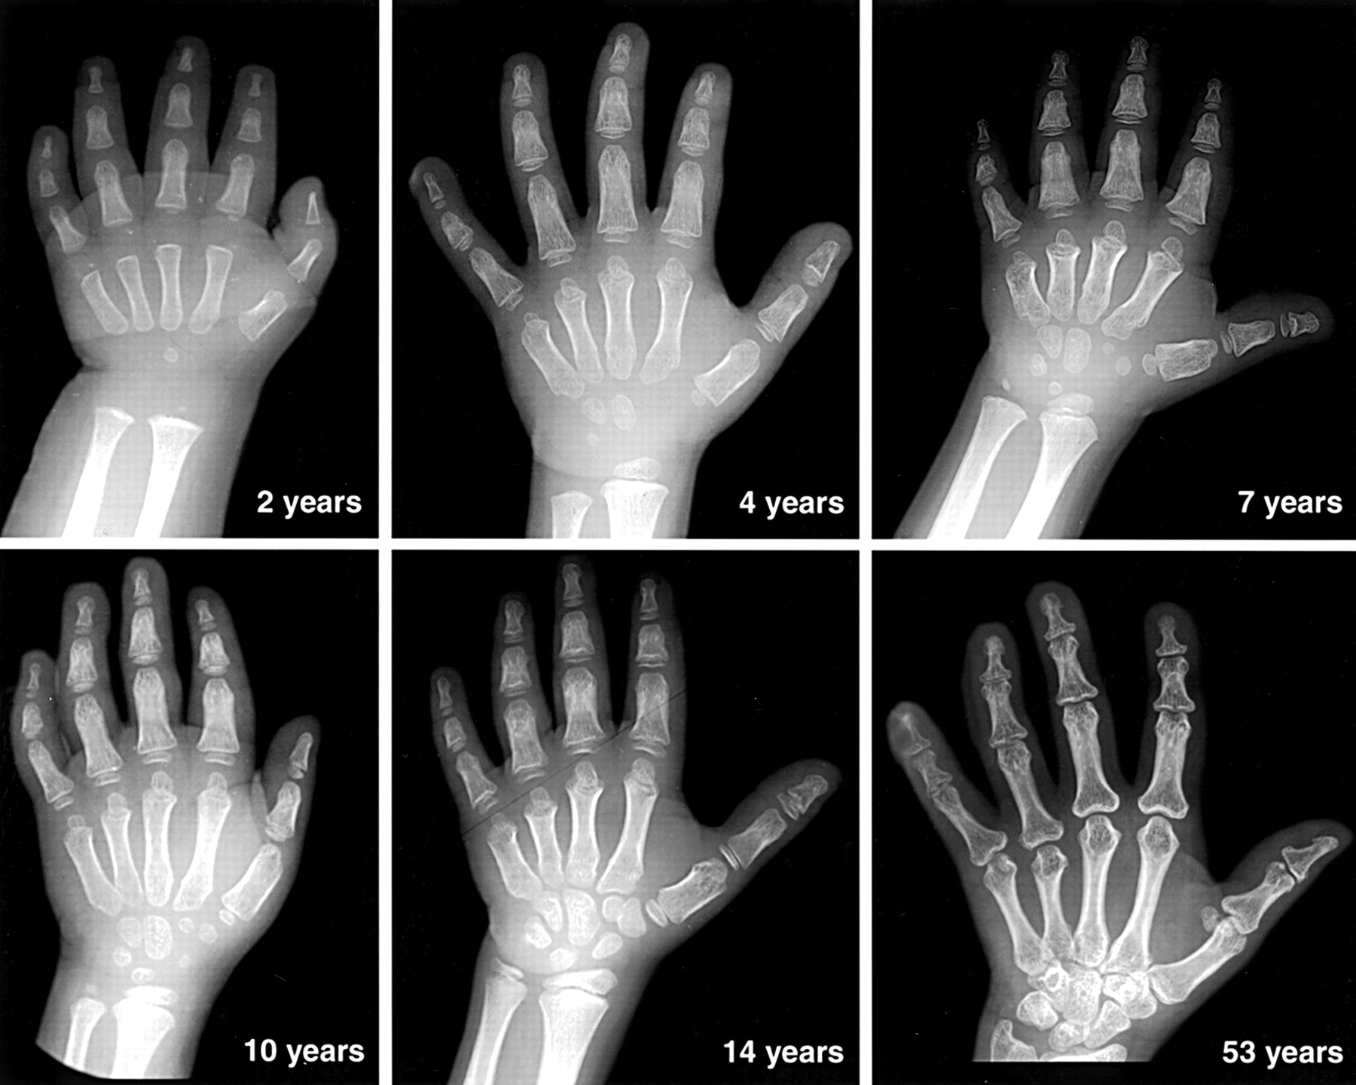
Bone age study: comparison of X-ray appearance of hand and wrist to a standard

Slide 40
GH Resistance
“Pituitary Dwarfism”
Laron Syndrome – an autosomal recessive disorder resulting in GH-resistance and a severe deficiency of IGF-1, resulting in short stature (dwarfism) and its characteristic features:
  Affected individuals have a prominent forehead, depressed nasal bridge, small mandible, and central obesity
  They may have recurrent hypoglycemic seizures

Slide 41
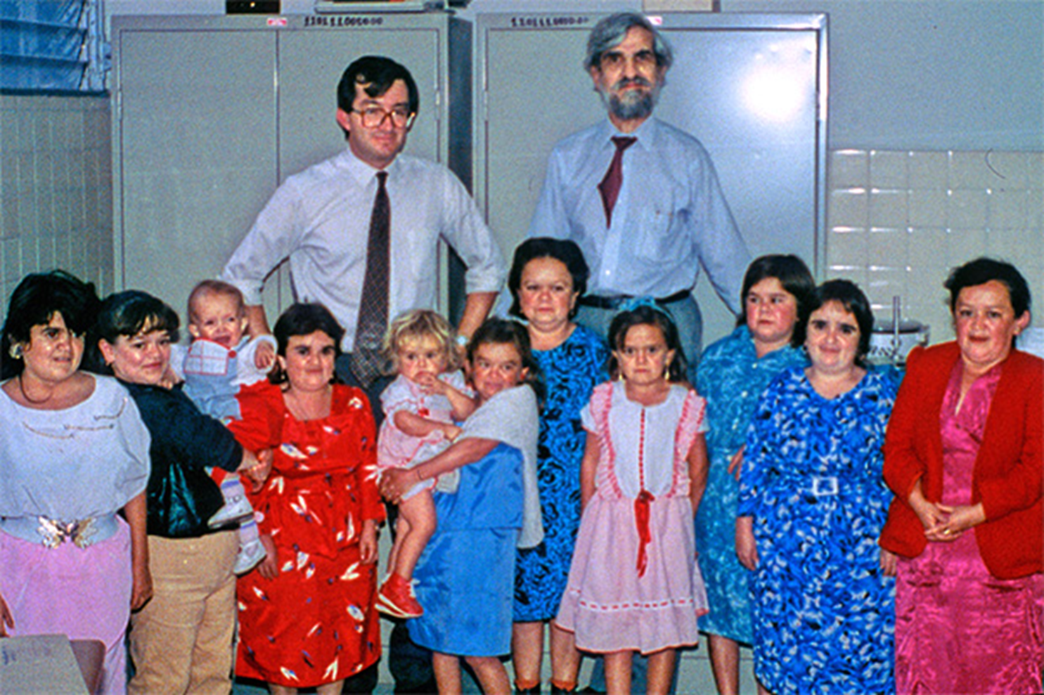

Slide 42
Treating GH Deficiency and Resistance in Children
Replacement therapy with daily recombinant human growth hormone (rhGH) via subcutaneous injection restores growth velocity
  Continued until linear growth is completed
In patients with GH insensitivity and growth retardation due to mutations of the GH receptor, treatment with biosynthetic IGF-I bypasses the dysfunctional GH receptor.

Slide 43
GH Deficiency in Adults
Often caused by acquired hypothalamic or pituitary somatotrope damage and often undiagnosed
  Why?
Causes reflect general hypopituitarism etiologies
  Pituitary tumor or consequence of treatment of a tumor (76%)
  Extrapituitary tumor (ex: craniopharyngioma) (13%)
  Unknown cause (8%)
  Sarcoidosis (1%)
  Sheehan Syndrome (0.5%)

Slide 44
GH Deficiency in Adults
Symptoms and Clinical Manifestation
Variable symptoms: central obesity, reduced physical and mental energy, impaired concentration and memory, depression, low self esteem
  Patients may also have reduced muscle mass, ↑ LDL levels, LV dysfunction and reduced cardiac output with exercise. (↑cardiovascular disease and related mortality)
  Chronic GH deficiency leads to osteopenia and an increased risk of fractures.

Slide 45
Evaluating for GH deficiency in Adults
Overall GHD in adults is rare
Reserve testing for patients with any of the predisposing factors:
  1. Pituitary surgery
  2. Pituitary or hypothalamic lesion
  3. History of cranial irradiation
  4. Radiologic evidence of pituitary lesion
  5. Childhood requirement for GH replacement therapy
GH deficiency is present in 96% of patients and can be diagnosed if 3+ other pituitary hormone deficiencies + a low serum IGF-1 <84mcg/L.

Slide 46
Evaluating for GH Deficiency in Adults
Approx. ¼ GH-deficient adults have low-normal IGF-1
Glucagon Stimulation Test
  Administer 1mg glucagon IM, weight<90kg or 1.5mg>90kg fasting for 8-9hr
  GH sampled before administration and every 30min for 4hr
  GH <3mcg/L diagnostic

Slide 47
Evaluating for GH Deficiency in Adults
Insulin-induced hypoglycemia test
  Administer 0.05-0.1U/kg regular insulin, IV
  When glucose levels reach ~40 mg/dL, GH will surge, peaking at
  60 mins and remaining elevated for 2 hours
  Adult GHD is defined by a peak GH< 3 μg/L
  Contraindicated in the following: patients with diabetes,
  ischemic heart disease, cerebrovascular disease, or epilepsy and
  in elderly patients

Slide 48
GH deficiency in Adults: Treatment
Recombinant human growth hormone (rhGH) injections 3x weekly
  Dose is titrated until IGF-1 levels are normal
  Side effects: reversible dose-related fluid retention, joint pain, and carpal tunnel syndrome (30%); myalgias and paresthesia (40%).
  Treatment is associated with increased muscle mass, decreased body fat, and an improvement in some parameters of cardiac function.

Slide 49
Dwarfism due to Achondroplasia
The most common cause of short-limb dwarfism
A bone dysplasia resulting from genetic mutation of fibroblast growth factor receptor 3 (FGFR3) gene
  Spontaneous mutation in 80% of cases and then autosomal dominant when passed to offspring
  Not pituitary in nature
Characteristic features: short arms and legs, an enlarged head, and an average-sized trunk.

Slide 50


Slide 51
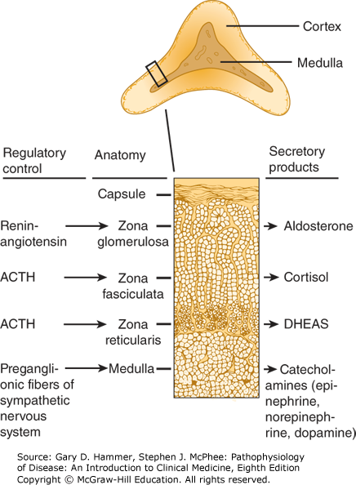
Adrenocorticotropic Hormone (ACTH) Deficiency
Primarily stimulates the production and release of cortisol and androgens (DHEA) by the adrenal cortex
  To a lesser degree stimulates mineralocorticoid (Aldosterone)
Cortisol is the primary stress hormone involved in regulation of the body’s stress response, glucose regulation, metabolism and more

Slide 52
Hypopituitarism: ACTH Deficiency
Low cortisol production due to destruction or compression of the pituitary gland can lead to secondary adrenal insufficiency
  Pathogenesis: Damage of the pituitary gland leads to functional atrophy of the adrenal cortex within 2 weeks, resulting in diminished cortisol production
ACTH deficiency may occur in isolation or in conjunction with other anterior pituitary hormone deficiencies

Slide 53
Causes of ACTH Deficiency
MC- withdrawal of chronic glucocorticoid treatment (typically ≥5mg prednisone daily for greater than 2wk
Hypopituitarism etiology- (slide 26-27)
Isolated ACTH deficiency: Rare
  Autoimmune disease (most common)
  Genetic mutations (rare)
Drugs –
  High dose progestins (Megestrol acetate) used in metastatic breast cancer treatment and appetite stimulant in patients with cancer anorexia. This drug binds to glucocorticoid receptors and exerts some activity however with withdrawal can cause secondary adrenal insufficiency.
  Chronic opiate use- interferes with cortisol secretion

Slide 54
Secondary ACTH Deficiency: Symptoms
Patients tend to have symptoms of chronic adrenal insufficiency or signs of deficient secretion of other anterior pituitary hormones
However, adrenal crisis can occur when the loss of pituitary function is sudden and severe, as in pituitary apoplexy
  The symptoms in these patients are due mainly to acute cortisol deficiency and present as shock
  Pt may c/o severe headache and visual change (loss or reduced visual fields)

Slide 55
Secondary ACTH Deficiency: Symptoms
Symptoms: fatigue, weakness, anorexia, nausea, vomiting, weight loss, myalgias/arthralgias, occasional hypoglycemia
  Others: amenorrhea, psychiatric symptoms
  Mild symptoms may only be seen when under stress
In contrast to primary adrenal failure (Addison’s disease), secondary is not accompanied by hyperpigmentation or aldosterone deficiency
  There is also less hypovolemia than in primary disease

Slide 56
ACTH Deficiency: Initial Evaluation
Serum cortisol level (8 am) and plasma ACTH level
  A LOW ACTH level + LOW cortisol level <3mcg/dL indicates secondary (or tertiary) adrenal insufficiency
    Cortisol level between 3-18mcg/dL is inconclusive and requires ACTH stimulation test
    Cortisol level >18mcg/Dl excludes adrenal insufficiency
ACTH Stimulation test: Administration of IM or IV cosyntropin 0.25mg(synthetic ACTH) followed by serum cortisol level measurement 45min after injection
  Testing requires all corticosteroids be held for 18-24hr prior to lab draw.
  Cortisol <18mcg/dL indicates probable adrenal insufficiency
  Atrophied adrenal cortex will cause a suboptimal rise of cortisol

Slide 57
ACTH Deficiency: Additional Evaluation
Additional labs:
  Hyponatremia (70-80%) - can occur early in secondary adrenal insufficiency and may be the initial manifestation
  Low DHEA helps to confirm
Assess for additional anterior pituitary hormone deficiencies
Consider MRI of the brain for pituitary tumors

Slide 58
Treating ACTH Deficiency
Treatment involves corticoid replacement with PO hydrocortisone or PO Prednisone
  Hydrocortisone (short acting) is divided into 2-3 daily doses to mimic normal diurnal rhythm and not likely to exceed 20mg daily
  Prednisone (long acting) 5mg daily
  Doses must be increased in times of acute illness or stress
Treat any additional hormone deficiencies
  Replacement of thyroid hormone without replacement of glucocorticoids can precipitate acute adrenal insufficiency.

Slide 59

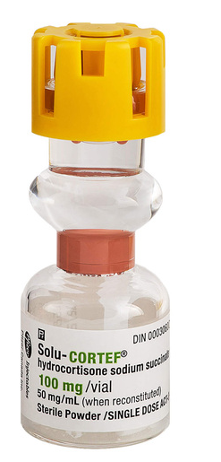
Patient Education
Patients should wear medical alert bracelets and/or carry identification cards with information about their glucocorticoid requirements.
Provide injectable glucocorticoid with vials of saline and educate patient and family about use
  Administer IM in the following scenarios: an injury with substantial blood loss or fracture, nausea and vomiting with inability to tolerate PO intake, symptoms of acute adrenal insufficiency, unresponsiveness

Slide 60
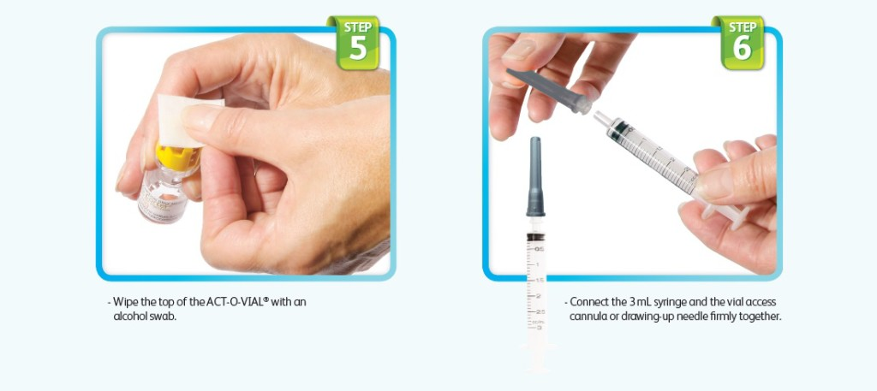
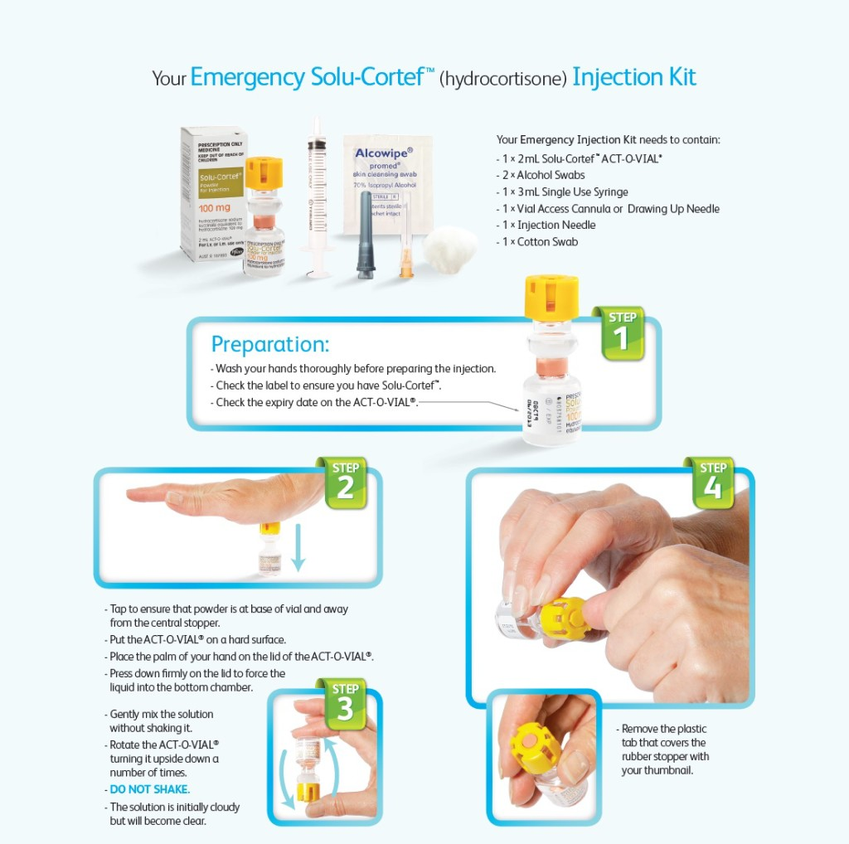
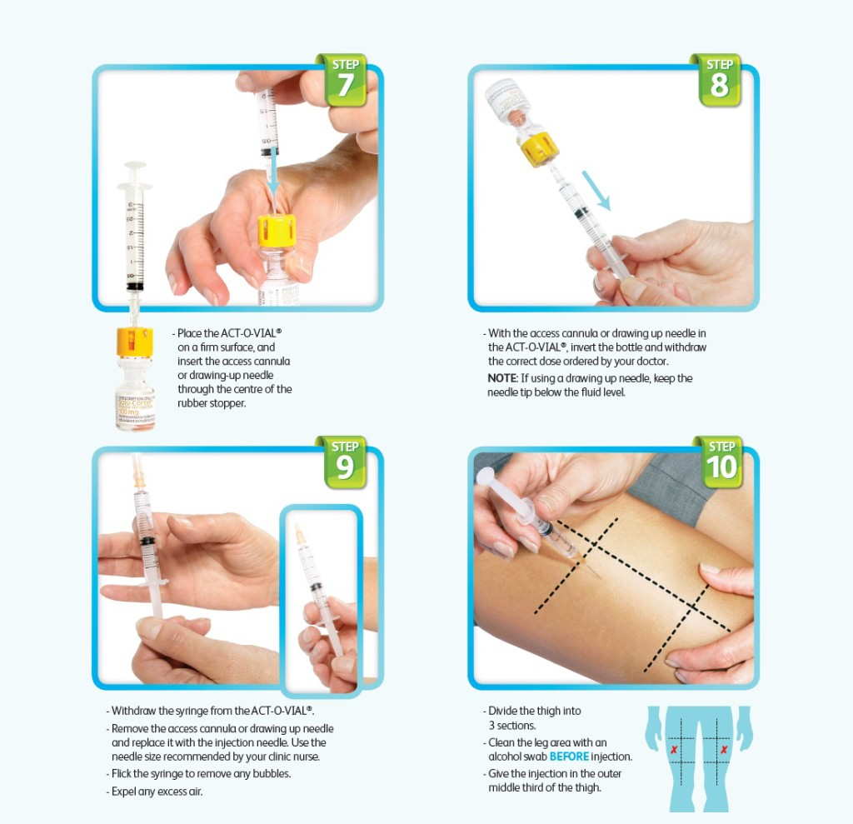

Slide 61
Patient Education
3x3 rule: During minor illnesses (ex: URIs), increase the dose of glucocorticoid to 2-3x the usual daily dose for three days
Patients are more likely to have complications as a result of fasting during Ramadan.
  Implement sick day rules, optimize steroid dosing, and consider alternative fasting (nonconsecutive or trial fasting) if high risk
  Pregnant or breastfeeding patients should avoid fasting
  Secondary adrenal insufficiency carries lower risk than primary

Slide 62
Gonadotropin Deficiency
AKA: Hypogonadotropic Hypogonadism
Hormones of the anterior pituitary, follicle stimulating hormone (FSH) and luteinizing hormone (LH) that regulate ovarian and testicular function
  FSH- regulate ovarian estrogen production and ovarian follicle development in women. Spermatogenesis in men
  LH- regulate ovulation and maintenance of corpus luteum in women and testosterone function of men

Slide 63
Congenital Gonadotropin Deficiency Clinical Manifestations
Insufficiencies of LH and FSH cause hypogonadism and infertility
  Congenital gonadotropin deficiency: caused by genetic mutation
    Micropenis at birth in males, partial or complete lack of pubertal development, abnormal olfaction
    Girls potential amenorrhea or, menarche followed by amenorrhea
    Midline craniofacial defects-cleft palate, cleft lip, absent nasal cartilage
    Neurologic deficits- decreased cognition, ataxia, neurosensory hearing loss, oculomotor dysfunction, color blindness
    MSK malformation-pectus excavatum, syndactyly

Slide 64
Acquired Gonadotropin Deficiency Clinical Manifestation
Acquired Hypogonadism- caused by any disease process that affects the hypothalamus-pituitary axis.
Acquired Hypogonadism is the most common manifested presentation of hypopituitarism in adults
In premenopausal women: diminished ovarian function -oligomenorrhea or amenorrhea, infertility, decreased vaginal secretions, decreased libido, and breast atrophy.
In adult men: decreased libido and potency, infertility, decreased muscle mass with weakness, reduced beard and body hair growth, soft testes, and characteristic fine facial wrinkles
Osteoporosis occurs in untreated women and men

Slide 65
Acquired Secondary Hypogonadism
A mass lesion in the pituitary or hypothalamus is more likely to diminish secretion of gonadotropins than corticotropin (ACTH) or TSH.
  Therefore, patients may present with isolated hypogonadism
Other causes of secondary hypogonadism: hyperprolactinemia, chronic steroid use, chronic opioid use, critical illness (surgery), anorexia nervosa, starvation, extreme exercise, stress, damage to gonadotroph cells

Slide 66
Gonadotropin Deficiency Workup
Males: draw fasting labs between 8-10 AM
  They will have low testosterone with a low/normal serum LH
  Sperm counts will also be low
Females: suspected in nonpregnant women with amenorrhea or oligomenorrhea (in the absence of acute illness, hyperthyroidism or hyperandrogenism)
  Low serum estradiol with a low/normal serum FSH

Slide 67
Gonadotropin Deficiency Workup
Evaluate for additional hormonal abnormalities
  Prolactin- hyperprolactinemia can result in negative feedback on gonadotropins
  Cortisol and thyroid function
Men with isolated hypogonadotropic hypogonadism should consider genetic testing, esp. if fertility is desired
Pituitary MRI should always be performed if there are other pituitary hormone abnormalities, visual field deficits or neurologic symptoms

Slide 68
Treating Gonadotropin Deficiency
Treatment of puberty and sex characteristics: testosterone replacement in males; cyclical estrogen and progesterone replacement in females
If fertility is desired:
  Women: FSH injections are used for follicular development followed by LH injection for ovulation induction
  Men are treated with pulsatile GnRH therapy (infusion pump)

Slide 69
Thyrotropin Deficiency
Thyroid Stimulating Hormone (TSH) released from the anterior pituitary following stimulation by Thyrotropin-Releasing Hormone (TRH) from the hypothalamus
TSH stimulates release of T3 and T4 which are responsible for metabolism, weight, temperature regulation, energy levels, and skin, hair and nail health

Slide 70
Hypopituitarism: TSH Deficiency Symptoms
Common symptoms: fatigue, cold intolerance, muscle cramps, headache, and weight gain
  Symptoms may be milder than those of primary disease
Growth hormone replacement therapy in GH deficient adults may unmask central hypothyroidism

Slide 71
Hypopituitarism: TSH Deficiency
TSH deficiency is a rare cause of central hypothyroidism
Pituitary mass lesions, especially pituitary adenomas, are the most common cause of central hypothyroidism
  Compression of pituitary thyrotrophs result in ↓ TSH secretion
  Etiologies also include the other hypopituitarism etiologies
Patients with central hypothyroidism frequently have other pituitary hormone deficiencies.

Slide 72
Hypopituitarism: TSH Deficiency Lab & Treatment
Patients will have a low T4 with a TSH that may be low, normal or mildly elevated
  Normal or elevated is partly due to TSH that is secreted but has abnormally reduced biologic activity
  Suspicious labs warrant MRI imaging of the hypothalamic-pituitary region
Treat with Levothyroxine (Synthroid)
  Special consideration: Treat after the patient is assessed for cortisol deficiency or is already receiving corticosteroids.

Slide 73
Pituitary Growths

Slide 74
Sellar Masses
Mostly benign growths of pituitary or nonpituitary origin
Approximately 90% of sellar masses are pituitary adenomas.
Sellar masses also include craniopharyngiomas (solid or mixed solid-cystic tumors), meningiomas, cysts, or malignant/metastatic tumors

Slide 75
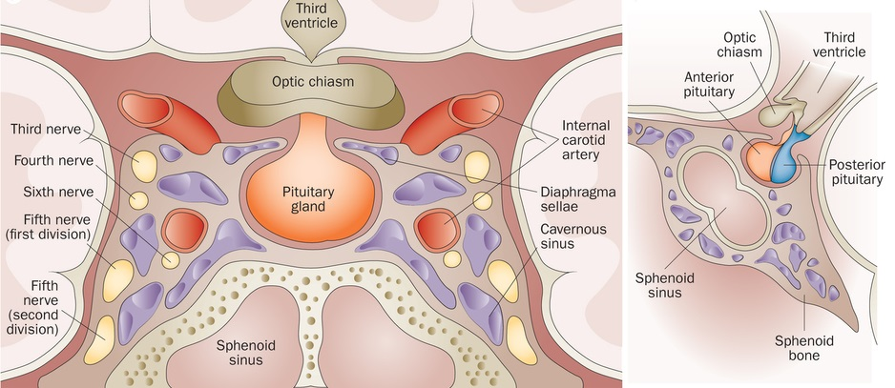
Sellar Region

Slide 76
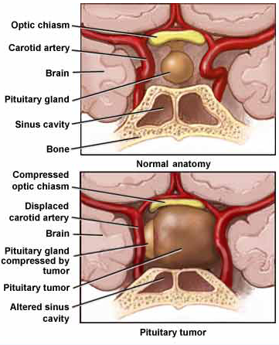
Sellar masses:
Mass effect
As the mass expands, it first compresses intrasellar pituitary tissue, then invades dorsally to lift the optic chiasm or laterally to the cavernous sinuses, cranial nerves.
Pituitary compression leads to hypopituitarism and optic chiasm compression leads to bitemporal hemianopia

Slide 77
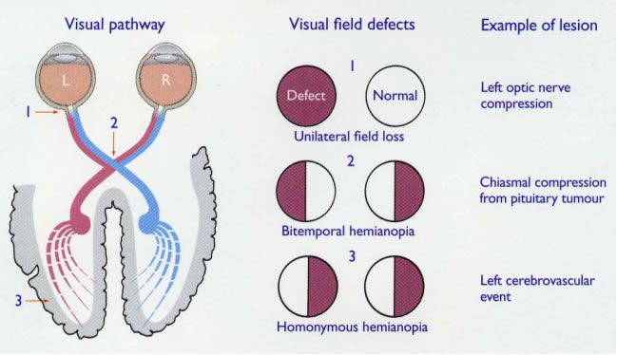
Visual Pathway – Bitemporal Hemianopia

Slide 78

Bitemporal Hemianopia

Slide 79
Sellar Masses: Other Manifestations
Headaches (increased pressure on the dural diaphragm)
Diplopia (compression of CN III, IV, VI)
Facial pain/numbness (compression of trigeminal nerve (V))
Partial complex seizures (temporal lobe compression)
Hydrocephalus (compression of third ventricle)
They may also present with symptoms of hormone excess if the mass is a functional pituitary adenoma

Slide 80
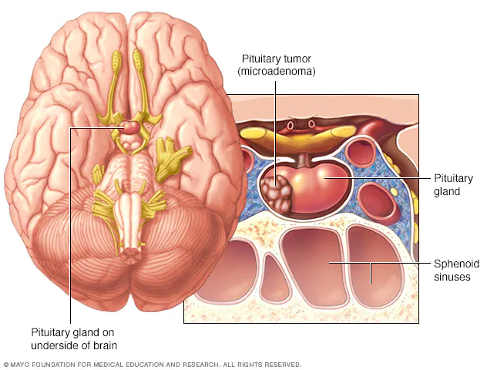
Pituitary Adenomas
Most common benign tumor of the pituitary gland
Adenomas are benign neoplasms that typically arise from one of the five anterior pituitary cell types
Most adenomas are nonfunctional but can cause pituitary hypersecretion and hyposecretion syndromes

Slide 81
Pituitary Adenomas
If functional, tumors arising from anterior pituitary cells hypersecrete their respective hormones
  The most common hypersecretion syndrome is that of lactotroph cells, resulting in hyperprolactinemia

Slide 82
Pituitary Adenomas
Also classified by size
  Microadenoma – up to 1 cm
    If functional, most commonly secrete prolactin (PRL)
  Macroadenoma – greater than 1 cm
    If functional, most commonly secrete growth hormone (GH)

Slide 83
Pituitary Adenoma Work-up
Often times pituitary adenomas are found incidentally (pituitary incidentaloma) on imaging obtained for other reasons
MRI with contrast is the test of choice to evaluate sellar masses
If adenoma is ≥1cm:
  Refer optho for formal visual acuity and fields
  Eval for hypersecretion: prolactin, IGF-1, ACTH and 24h-urine cortisol
  Eval for hypopituitarism
If adenoma is <1cm eval prolactin
Refer to neurology

Slide 84
Hyperpituitarism

Slide 85
Functional Pituitary Adenomas
Pituitary Cell Type | Hormone Product | Clinical Syndrome
Lactotrope | Prolactin (PRL) | Hyperprolactinemia: hypogonadism, galactorrhea
Somatotrope | GH | Acromegaly/Gigantism
Corticotrope | ACTH | Cushing’s Syndrome
Thyrotrope | TSH | Thyrotoxicosis
Gonadotrope | FSH, LH | Hypogonadism or silent
Characterized by autonomous hormone secretion with diminished feedback responsiveness to physiologic inhibitory pathways

Slide 86
Prolactin Hypersecretion
Primarily responsible for milk production and the development of mammary glands within breast tissue.
Serum prolactin concentrations normally increase substantially during pregnancy and to a lesser degree in response to nipple stimulation during breastfeeding, physical exertion, and stress.

Slide 87
Hyperprolactinemia
The most common pituitary hormone hypersecretion syndrome in both men and women
  Microprolactinomas, are more common in women and typically do not grow even with pregnancy or oral contraceptives
  Aggressive macroprolactinomas are more common in men and can spread into the cavernous sinuses and suprasellar areas

Slide 88
Hyperprolactinemia Clinical Presentation
In women: amenorrhea, galactorrhea, and infertility are hallmark symptoms
  Patients may also complain of decreased libido, weight gain, and mild hirsutism
In men: gynecomastia, diminished libido, erectile dysfunction, infertility, and visual loss (optic nerve compression)
  Pathogenesis: gonadotropin suppression leads to reduced testosterone, impotence, and oligospermia

Slide 89
Hyperprolactinemia: Diagnosis
Elevated fasting AM prolactin levels
  Normal is < 20mcg/L
Evaluate for other causes of hyperprolactinemia:
  Pregnancy (hCG), primary hypothyroidism (TSH + T4), kidney disease (Cr, BUN), cirrhosis (LFTs); medications (antipsychotics-Haldol, Risperdal; Metoclopramide; Verapamil)
Pituitary prolactinomas may cosecrete GH

Slide 90
Diagnosing a Prolactinoma
A prolactinoma is likely with a PRL level >200 mcg/L
  After exclusion of physiologic, medication-induced or other medical conditions that cause elevated PRL
  Levels < 100 mcg/L may be caused by microadenomas or other causes of elevated PRL
Pituitary MRI should be performed in all patients with hyperprolactinemia

Slide 91
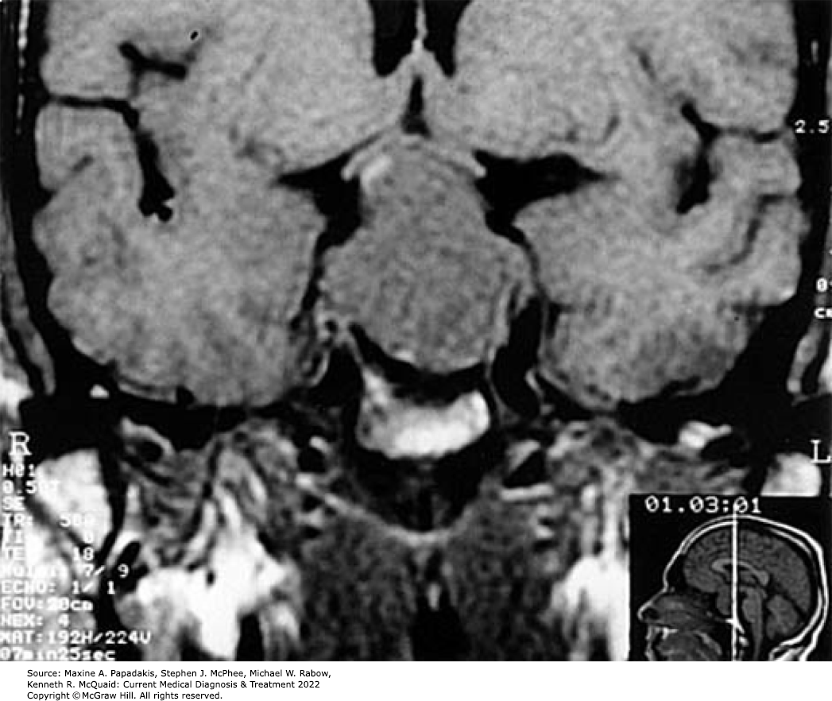
Pituitary Adenoma on MRI

Slide 92
Prolactinomas: Treatment
Because microadenomas rarely progress to become macroadenomas, no treatment may be needed if patients are asymptomatic, and fertility is not desired
  Monitor: regular serial PRL measurements and MRIs
Symptomatic patients: dopamine agonists – titrated to normal PRL levels and resumption of fertility
  Cabergoline (Dostinex) or
  Bromocriptine (Parlodel)

Slide 93
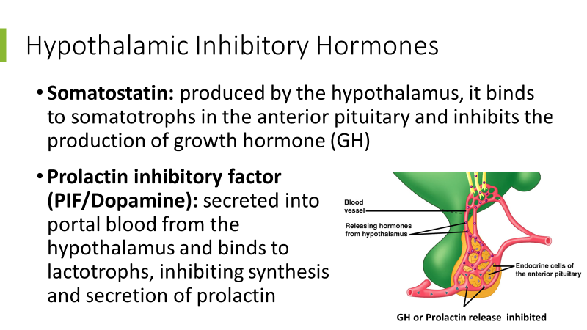
Why dopamine agonists?

Slide 94
Prolactinomas: Treatment
In patients with microadenomas who have achieved normoprolactinemia and significant reduction of tumor mass, the dopamine agonist may be withdrawn after 2 years.
  Monitor for recurrence
About 20% of patients (especially males) are resistant to dopaminergic treatment

Slide 95
Prolactinomas: Treatment
Transsphenoidal pituitary surgery is the treatment of choice for the following scenarios:
  Large pituitary adenoma with severe vision compromise or apoplexy
  Patients with dopamine resistance or intolerance
  The presence of an invasive macroadenoma with compromised vision that fails to improve after drug treatment

Slide 96
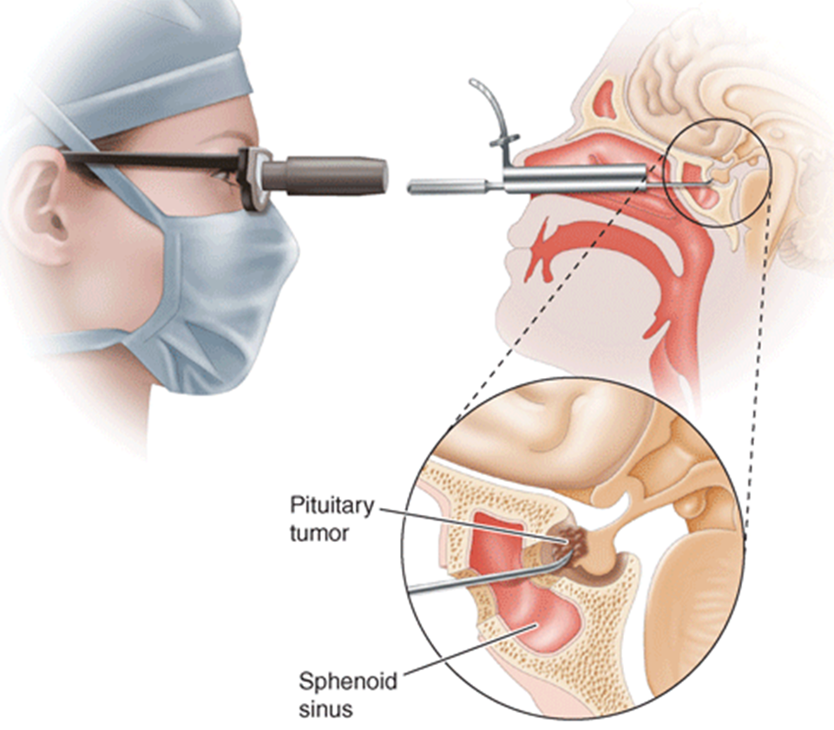
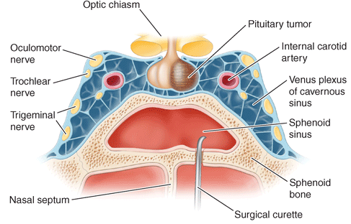
Transsphenoidal Surgery

Slide 97
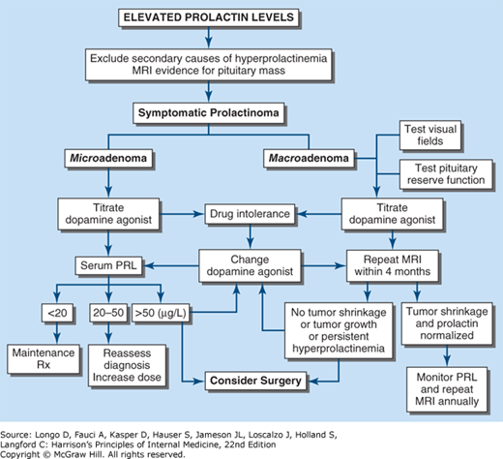

Slide 98
Growth Hormone Hypersecretion
If functional, macroadenomas most often secrete growth hormone (GH), which leads to secretion of IGF-1
Excessive GH causes tall stature and gigantism if it occurs in youth, before closure of epiphyses.
After closure of long bone epiphyses in adults, acromegaly results
  Long bones cannot get any longer, but they do get larger

Slide 99
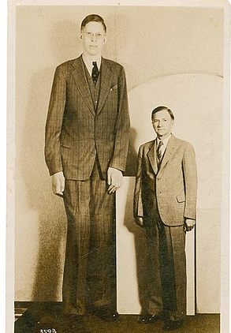
Gigantism
Very rare (only ~ 100 known cases)
Characterized by dramatic linear growth acceleration
Other, less common causes:
  Neurofibromatosis
  McCune-Albright syndrome (MAS)
  Carney complex
  Multiple endocrine neoplasia type 1

Slide 100
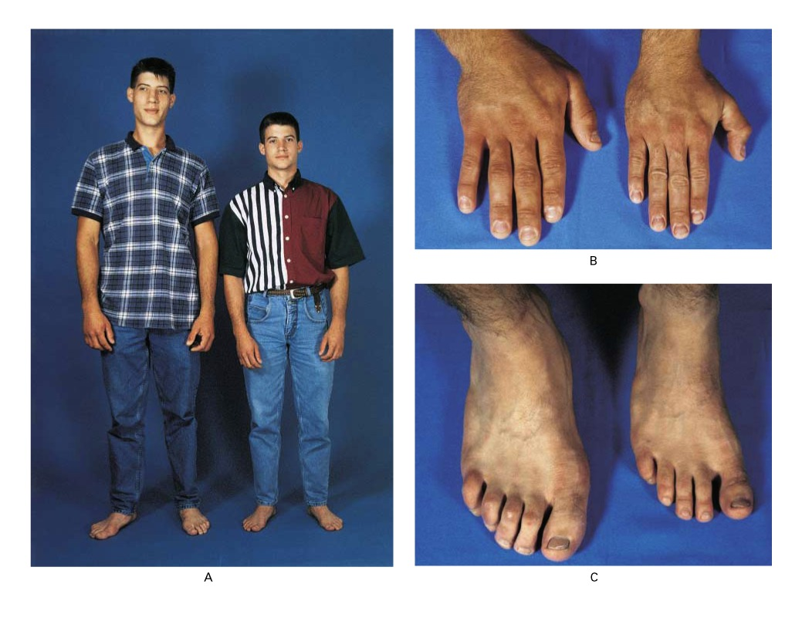
Gigantism: Clinical Manifestations
Abnormally tall stature
Abnormal growth of face, hands and feet
Thickened facial features
Irregular menstrual cycle
Excessive perspiration
Delayed puberty
Double vision
Deafness

Slide 101
Acromegaly
The onset is insidious, and progression is usually very slow (average 12 years to diagnosis)
Characteristic findings: enlarged jaw (macrognathia) and enlarged, swollen hands and feet
  Patients note increasing shoe and glove size and the need to enlarge rings
These patients do not get taller

Slide 102
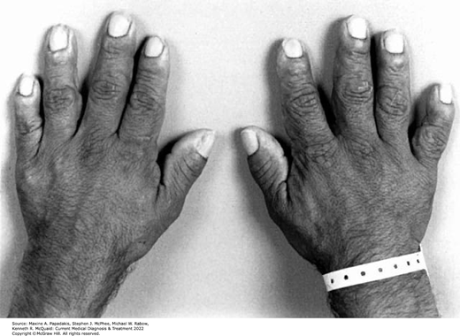
Acromegaly

Slide 103
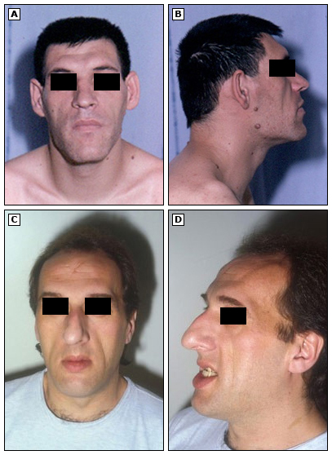
Acromegaly
Facial features become coarse, with enlargement of the nose and frontal bones as well as the jaw, and the teeth become spread apart
Pts also have deepening of the voice, hyperhidrosis, macroglossia and thyroid enlargement

Slide 104
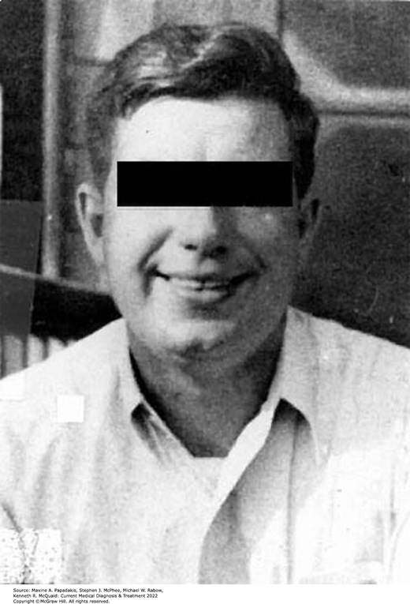
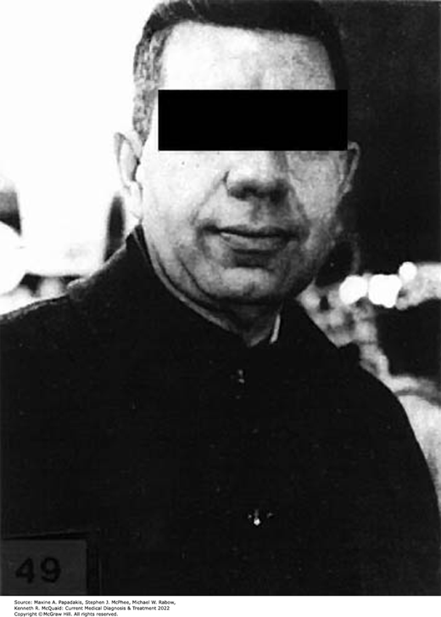
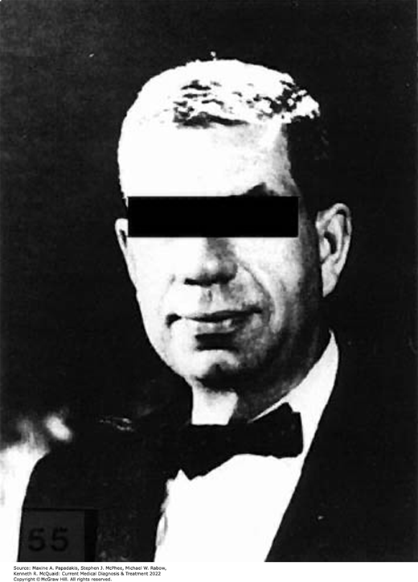
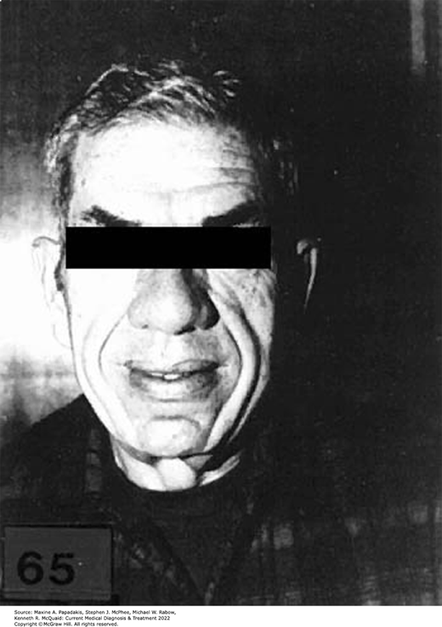
Acromegaly: A slow progression
Note the gradual increase in size of the nose, lips, and skin folds

Slide 105
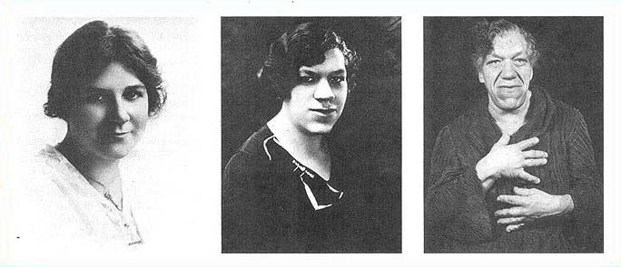
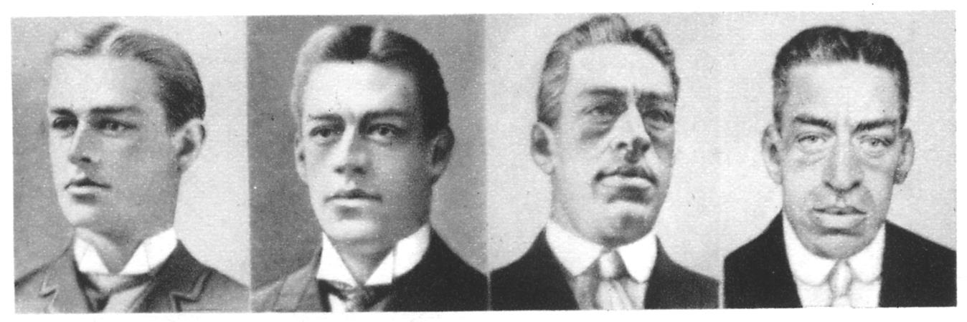
Acromegaly: A slow progression

Slide 106
Acromegaly: Complications
Cardiomyopathy with arrhythmias, LVH, decreased diastolic function, and HTN (most patients if untreated)
Upper airway obstruction and sleep apnea (>60%)
Diabetes mellitus (25%)
  Most patients are intolerant of a glucose load
Increased risk of colon polyps and mortality from colonic malignancy

Slide 107
Gigantism/Acromegaly : Diagnosis
For screening, a random serum IGF-1 can be obtained
  If it is normal for age, acromegaly is ruled out.
If serum IGF-1 is elevated, the gold standard for diagnosis is the GH suppression test
  An oral glucose load 75g is given, followed by GH test 2 hours later
  Diagnosis is made if GH is greater than 1 ng/mL
Once confirmed, obtain an MRI with contrast to evaluate for a pituitary adenoma

Slide 108
Gigantism/Acromegaly: Treatment
Pituitary transsphenoidal surgery is the treatment of choice
  Achieves remission in about 70% of patients
  Complications: CSF leak, infection, postop diabetes insipidus, hyponatremia
For those who have residual disease after surgery:
  Somatostatin analogues (octreotide and lanreotide) suppress GH and normalize IGF-1 levels

Slide 109
Other Functional Adenomas
Corticotropic adenomas: ACTH secreting, result in elevated cortisol levels
  Clinical syndrome: Cushing’s Disease
Gonadotroph adenomas: Normal puberty and fertility
  Most common type of non-functioning adenoma
  Clinical syndrome is often due to compression: visual changes or hypogonadism (compression of cells then decreases FSH and LH secretion)

Slide 110
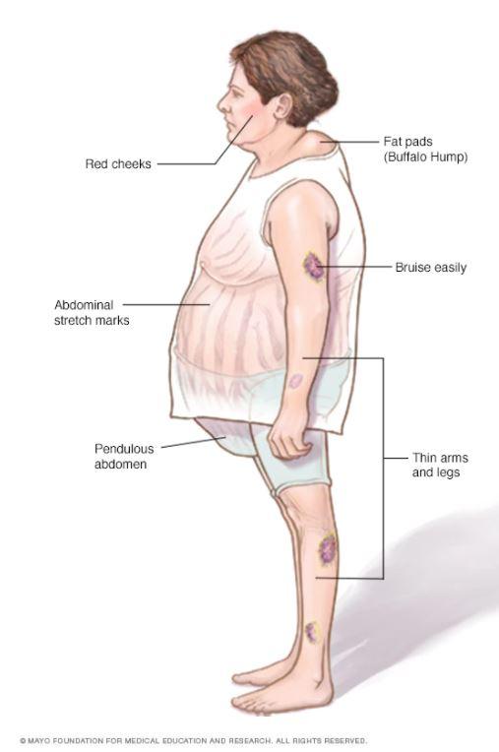
Cushing’s Disease
Body habitus: “moon facies”, “buffalo hump,” protuberant abdomen, thin extremities (muscle atrophy)
Metabolic: glucose intolerance
Skin: Purple striae (trunk, breasts, abdomen), skin atrophy, easy bruising
CV: HTN, ↑ CV mortality risk
Reproductive: abnormal menstrual cycles

Slide 111
Other Functioning Adenomas
TSH-secreting adenomas – very rare but often large and locally invasive when they occur
  Presentation: thyroid goiter and hyperthyroidism
  Diagnosis: ↑ free T4 levels + inappropriately normal or high TSH levels + MRI evidence of a pituitary adenoma
  Treatment: remove or debulk the tumor mass surgically, followed by thyroid ablation, antithyroid medications (methimazole, propylthiauracil) or somatostatin analogues (octreotide)

Slide 112
Other Sellar Masses
Craniopharyngiomas – benign, suprasellar cystic masses that are often large, invasive and recurrent
  Derived from Rathke’s Pouch and grow near the pituitary stalk
  > 50% present before age 20, with signs of increased intracranial pressure, hypopituitarism (90%) or DI (10%)
  Treatment: transcranial or transsphenoidal surgical resection followed by postoperative radiation of residual tumor
Meningiomas – Mostly benign tumor arising from the meninges that are slow growing and always nonfunctional

Slide 113
Other Sellar Masses
Pituitary metastases occur in ~3% of cancer patients
  Most cases arise from breast cancer (50%), followed by lung and gastrointestinal cancers
  Found almost exclusively in the posterior pituitary which results in diabetes insipidus
  Also present with mass effect (visual deficits, headache)

Slide 114
Posterior Pituitary

Slide 115
Disorders of the Posterior Pituitary
The posterior pituitary releases two hormones: vasopressin (AVP, ADH) and oxytocin
Hormones are produced by the hypothalamus and sent to the pituitary gland via axons that make up the pituitary stalk

Slide 116
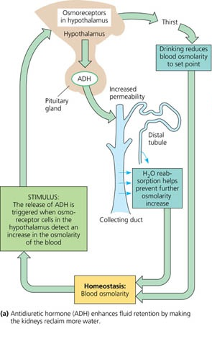
Vasopressin Pathway
Elevated blood osmolality is sensed by the hypothalamus
The hypothalamus triggers the sense of thirst and signals posterior pituitary to secrete ADH
ADH acts to increase water reabsorption from the kidney and concentrate urine while you drink water to quench thirst
Together, increased water intake + increased reabsorption decreases plasma osmolarity

Slide 117
Diabetes Insipidus (DI)
DI is defined as the passage of large volumes of dilute urine and comes in two forms:
  Central DI – due to decreased secretion of ADH
  Nephrogenic DI – decreased ability to concentrate urine because of resistance to ADH at the level of the kidneys
Patients with untreated central diabetes insipidus (CDI) typically present with polyuria, nocturia, and polydipsia

Slide 118
Polyuria
Generally defined as > 3L output of urine per day
Normal urine output is 800 -2000 mL of urine per day with fluid intake of approximately 2L
Differential Dx:
  Diabetes Insipidus
  Diabetes mellitus – Osmotic diuresis secondary to glucosuria
  Primary Polydipsia – A psychologic disorder involving excessive water intake

Slide 119
Diabetes Insipidus (DI) Etiology
Idiopathic (30-50%) – likely an autoimmune process involving destruction of the hypothalamic cells or destruction of neurons in pituitary stalk and posterior pituitary gland
Primary tumors – craniopharyngioma, pituitary adenomas
Infiltrative disease – Langerhans histiocytosis
Neurosurgery (usually transsphenoidal) or head trauma – usually transient
Secondary cancers – lung cancer, leukemia, or lymphoma

Slide 120
Diabetes Insipidus (DI)
Sodium is often in the high-normal range (to provide the ongoing stimulation of thirst to replace the urinary water losses)
  Most patients can maintain fluid balance by continuing to ingest large volumes of water
  However, in patients without free access to water or with a damaged hypothalamic thirst center and altered thirst sensation, DI may present with hypernatremia and dehydration

Slide 121
Diabetes Insipidus Workup
Consider when urinary frequency, nocturia, enuresis, persistent thirst occurs in the absence of glucosuria
Begin with plasma osmolality
  Psychogenic polydipsia: plasma osmolality <280mOsm/kg
  Central or nephrogenic DI: plasma osmolality >300mOsm/kg
24-hour urine collection w/ unrestricted fluid intake
  A urine volume of < 2 L/24 h (in the absence of hypernatremia) rules out DI
  Urine osmolarity of < 280 mosmol/L and volume >2 L/24h suggests DI and should be evaluated further to determine which type

Slide 122
Diabetes Insipidus Workup
Next: Fluid restriction and “desmopressin challenge test”
Fluid restrict until a sodium of 145 is achieved (overnight or for up to 12 hours); check sodium and urine osmolarity
If still dilute, administer Desmopressin 5-10mcg intranasally or 1mcg SC/IV; measure urine osmolarity
  In central DI, Desmopressin will increase urine osmolarity and resolve the patient’s excessive thirst and urination
  In nephrogenic DI, the patient will not respond to Desmopressin

Slide 123
Diabetes Insipidus (DI) Workup
Finally, differentiating central DI from primary polydipsia usually requires a pituitary MRI to evaluate for the “bright spot”
  A hyperintense signal emitted by the posterior pituitary that is visible on T1 midsagittal images in heathy adults and children.
  “Bright spot” is almost always present in patients with primary polydipsia but is always absent or abnormally small in patients with pituitary DI

Slide 124
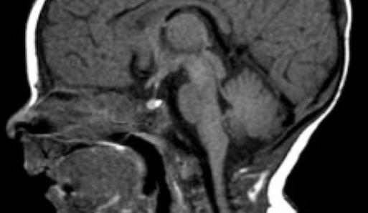
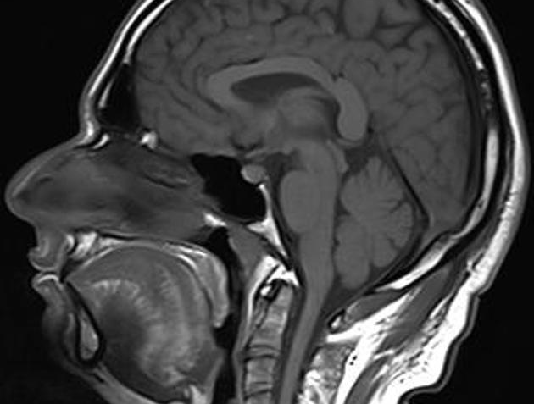
Pituitary Bright Spot
Normal bright spot of posterior pituitary
Absence of bright spot in central DI

Slide 125
Diabetes Insipidus (DI): Treatment
Desmopressin (DDAVP) is the treatment of choice for central DI
  DDAVP is a synthetic analogue of AVP
  Administered every 12-24 hours as needed for thirst and polyuria (Available as IN, PO, IV and SubQ)
  Patients must be on a low salt diet and have access to water
Nephrogenic DI is treated with low solute diet and HCTZ (thiazide diuretic) +/- Amiloride (K sparing diuretic)

