Slide 1
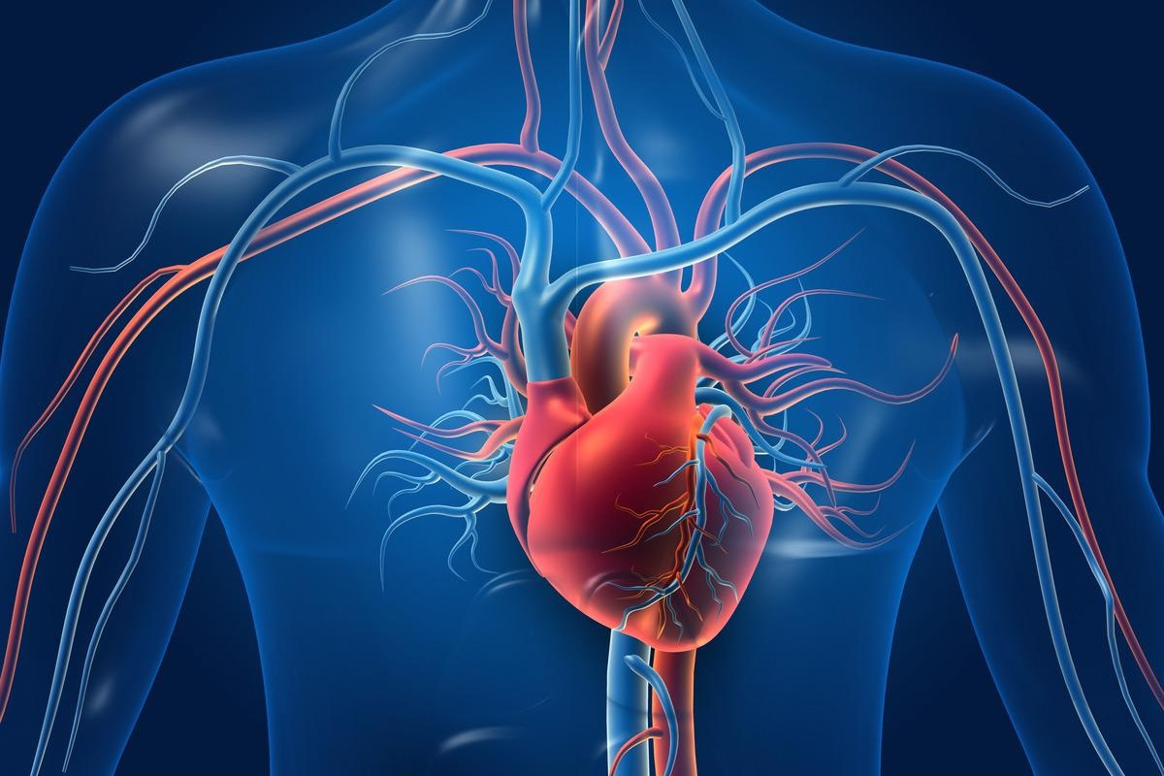
Cardiovascular
H&P
Christine Marriott, PA-C

Slide 2
Cardiovascular
History

Slide 3
Approaching the Cardiovascular Disease History
Is the blood supply to the heart adequate?
Is the electrical system of the heart functioning normally?
Is the heart adequately moving blood through circulation and supplying the organs?

Slide 4
Common Symptoms of Cardiovascular Disease
Angina (chest pain)
Palpitations
Shortness of breath: dyspnea, orthopnea, paroxysmal nocturnal dyspnea
Edema
Peripheral vascular (pain, skin changes, hair changes, etc.)
Syncope
Abdominal, back, flank pain

Slide 5
Angina (Chest Pain)
One of the most serious of all patient complaints
Patients with ACS (acute coronary syndrome) may present with classic symptoms of angina
  Classic symptoms include exertional pain, pressure, or discomfort in chest
  However, females (particularly those over the age of 65) are more likely to report atypical symptoms that may go unrecognized
    Upper back pain, neck pain, jaw pain, shortness of breath, paroxysmal nocturnal dyspnea, nausea, vomiting, and/or fatigue
  Careful history taking is especially important

Slide 6
Angina (Chest Pain)
Begin with open ended questions
  “Please tell me about any symptoms you might be having in your chest.”
  Ask the patient to point to the pain
Then start to ask more associated questions as you start to relate to more likely diagnoses
  Does the pain get worse or better with exertion?
  How would you characterize the pain?
  Does it radiate into your shoulder, back, or down your arm?
  Do you have SOB, sweating, palpitations, or nausea?
  Does it ever wake you up at night?

Slide 7
Palpitations
An unpleasant awareness of the heartbeat
Patients use various terms to describe palpitations:
  Skipping
  Racing
  Fluttering
  Pounding
  Stopping of the heart
May be irregular, rapidly slow down or accelerate, or arise from increased forcefulness of cardiac contraction
May ask the patient to tap out the rhythm they experience with a hand or a finger (or investigate their smart watch!)

Slide 8
Palpitations
Clues in the history (need EKG to confirm):
  Transient skips and flip-flops: possible premature contractions
  Rapid regular beating of sudden onset and offset: possible paroxysmal supraventricular tachycardia
  Rapid regular rate of <120 beats per minute, especially if gradually starting and stopping: possible sinus tachycardia

Slide 9
Shortness of Breath (SOB)
Dyspnea: an uncomfortable awareness of breathing that is inappropriate to a given level of exertion
  Common in cardiac or pulmonary problems
Orthopnea: dyspnea that occurs when the patient is supine and improves when the patient sits up
  Do they sleep with lots of pillows at night?
Paroxysmal nocturnal dyspnea (PND): episodes of sudden dyspnea and orthopnea that awaken the patient from sleep, usually 1-2 hours after going to bed, prompting the patient to sit up, stand up, or go to a window for air

Slide 10
Edema (Swelling)
Accumulation of excess fluid in the extravascular interstitial space
Focus on the location (unilateral vs. bilateral), timing, and setting of the swelling and any associated symptoms
Consider asking patients who retain fluid to record daily morning weights because edema may not be obvious until several liters of extra fluid have accumulated
Causes are frequently cardiac or pulmonary but can also be nutritional and/or positional

Slide 11
Peripheral Vascular
Pain or cramping in legs with exertion (clarify how far they can walk before pain comes on) or at rest
  Peripheral arterial disease (PAD)
Associated edema
  Deep venous thromboembolism (DVT)
  Venous insufficiency
Coldness, numbness, pallor, or discoloration of extremities or hair loss particularly over anterior tibial surfaces
  Decreased arterial perfusion

Slide 12
Syncope
Transient loss of consciousness followed by recovery
Most common cause is neurocardiogenic
  Vasovagal syncope (most common), postural orthostatic tachycardia syndrome (POTS), carotid sinus syncope, and orthostatic hypotension
  Cardiac arrhythmias: especially ventricular tachycardia and brady arrhythmias

Slide 13
Abdominal, Back, Flank Pain
Acute symptoms raise suspicion of arterial thrombosis
May also be related to oxygen supply-demand mismatch (i.e., pain worse with eating when abdominal viscera needs greater oxygen supply)
Sudden tearing pain suggests concern for abdominal aortic dissection

Slide 14
Cardiovascular Health History: General Questions
Have you ever had any problems with your heart?
Have you ever had angina or a heart attack?
Have you ever had a stress test? If so, when? What were the results?
Have you ever had a cardiac catheterization or heart surgery? If so, when?
Do you currently have or have had a history of high blood pressure? Do you take blood pressure medication?
Have you ever been told you have an irregular heartbeat? If so, do you take any medications for it?
Have you ever been told you had a heart murmur or had rheumatic fever?

Slide 15
Cardiovascular Health History: General Questions
Do you have chest pain on exertion (walking up the stairs)?
Is your chest pain worse in cold weather?
Have you ever noticed bluish colored skin?
Do you have any shortness of breath?
Do you ever wake up at night feeling short of breath (paroxysmal nocturnal dyspnea)?
How many pillows do you sleep on at night (orthopnea)?
How far can you walk before you become short of breath?

Slide 16
Cardiovascular Health History: General Questions
Have you ever had pain or swelling in your legs?
When did you first notice the pain or swelling?
Did it appear suddenly or gradually?
Is the swelling worse in the morning or evening?
Are you taking any medications for swelling? If so, which ones?

Slide 17
Cardiovascular Health History: General Questions
Have you been told by a provider that you have a blood vessel circulation problem in your feet or legs?
Have you had a vascular bypass of the blood vessels in your feet or legs?
Are you bothered by cold feet?
When you sit with your shoes and socks off, what color is the skin on your feet?
Have you ever had a slow healing ulcer on your legs or feet?
Have you had a leg, foot, or toe amputation?

Slide 18
Cardiovascular Health History: General Questions
Assessing cardiovascular risk factors:
  Hypertension
  Atherosclerosis
  Diabetes
  Dyslipidemias
  Metabolic syndrome
  Smoking
  Obesity
  Family history

Slide 19
Pain Complaints
Onset
Location
Duration
Character
Aggravating/Alleviating factors
Radiation
Timing
Severity

Slide 20
Example: Questions for Angina
When did the pain first start?
Where is the pain (point)?
How long does it last?
How would you describe the pain (burning, pressing, stabbing, crushing, dull, aching, throbbing, sharp, constricting)?
Does anything make the pain feel worse or better?
Does the pain occur at rest, with exertion, with stress, after eating, when moving your arms, or during intercourse?
Does the pain radiate? If so, where?
How often do you have the pain? Did it come on suddenly or gradually?
How severe is the pain? Is it limiting your daily activities?
Do you have any other symptoms with the pain such as SOB, diaphoresis, palpitations, N/V, coughing, fever, leg pain?

Slide 21
Obtain Historical Context
In addition to using OLDCARTS, asking the patient questions to understand the context of their symptoms can be helpful
  Where were you when the symptoms began?
  What were you doing when the symptoms started?
  Have you ever had symptoms like this before?
  Have you had any recent travel?
  Have you had any recent lifestyle changes?

Slide 22
Chronic Care Questions
Can use acronym OCHMEDPRA
  Onset of condition
  Current concerns
  Home readings
  Medications (compliance and side effects)
  Exercise
  Diet
  Previous imaging/procedures
  Risk factors
  Associated symptoms

Slide 23
Chronic Care Questions
Onset: When was the chronic condition diagnosed?
Current concerns: Does the patient have any concerns or problems regarding/relating to their chronic condition they were hoping to discuss today?
Home readings (if applicable): Did the patient bring their readings/documentation they take from monitoring at home?
  Hypertension: home blood pressure readings
  Heart failure: home weights
  Note how the readings were taken, how frequently they were taken, what the numbers are showing (averages, highest, and lowest readings), what time of day readings are taken, etc.

Slide 24
Chronic Care Questions
Medications (compliance and side effects): Are they taking their medications as prescribed? Are they having any side effects or problems with their medications?
Exercise: Are they sticking to a regular exercise regimen? What is their activity like?
Diet: Are they eating healthy, unhealthy, or following a specific diet plan? How do they feel that is affecting their chronic condition? Is there anything this patient should be watching out for in their diet with relation to their chronic condition?

Slide 25
Chronic Care Questions
Previous related imaging or procedures: Have they had any testing related to their chronic condition? Labs (cholesterol, AIC), stress test, echo, cardiac cath, etc.?
Risk factors: What are their risk factors that may worsen their condition or increase their likelihood of further complications from this chronic condition?
Associated symptoms: Are they having any new symptoms related to their chronic condition?
  Specifically ask about symptoms including headaches, vision changes, chest pain/pressure, shortness of breath, difficulty sleeping, fatigue, leg swelling or pain, etc.

Slide 26
History Documentation Example: Cardiovascular
Patient denies history of chest pain or pressure. No history of palpitations. No history of blood clots. Denies dyspnea, PND, orthopnea, cyanosis, peripheral edema, claudication, varicosities, or ulcerations. Denies color change in fingertips or toes during cold weather. Denies history of murmur, rheumatic fever, hypertension, coronary artery disease, or syncope. States last EKG and echocardiogram were in 2024 by Dr. Goodheart, cardiologist, and all results were within normal limits.

Slide 27
Cardiovascular
Physical Exam

Slide 28
Cardiovascular Exam Considerations
Gown open to the front
Stand at the patient’s right side
Keeping the right chest draped, ask the patient to gently lift or displace the left breast to assist you in examining the cardiac system
Bed positioned at 30 degrees (learn how to maneuver the various exam tables, i.e., gurney, table, etc.)
Listen stethoscope to skin

Slide 29
Key Components of Cardiovascular Exam
Note general appearance and vitals related to CV exam
Assess skin related to cardiovascular exam
Identify the point of maximal impulse (PMI)
Inspect and palpate chest wall
Auscultate S1, S2, and any extra sounds (S3, S4)
Augment any murmurs
Estimate jugular venous pressure (JVP)
Palpate and auscultate pulses
Perform special tests

Slide 30
Surface Landmarks
Midsternal line
Midclavicular line
Anterior axillary line
Midaxillary line
Posterior axillary line

Slide 31
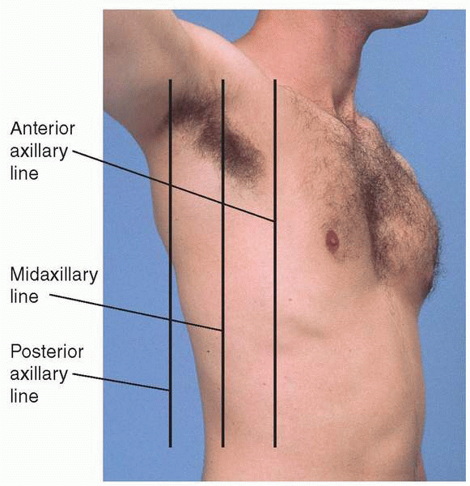
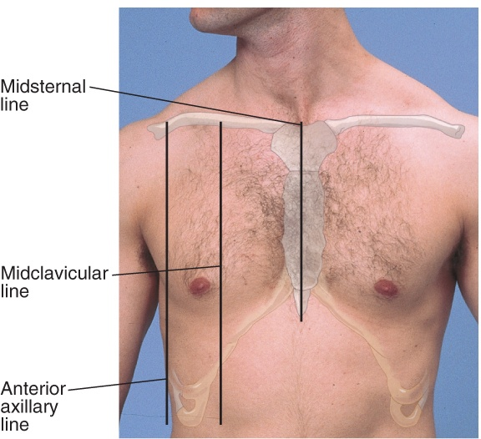
Surface Landmarks

Slide 32
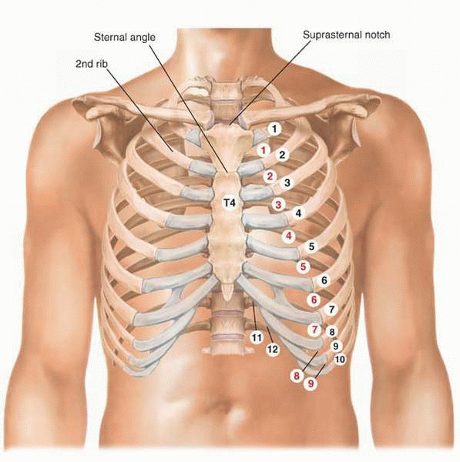
Surface Landmarks: Interspaces
To count interspaces, find the suprasternal notch and sternal angle
Once you find the sternal angle, you can move laterally to find the second rib in line with the sternal angle
Move down from there and you fall into the 2nd intercostal space

Slide 33
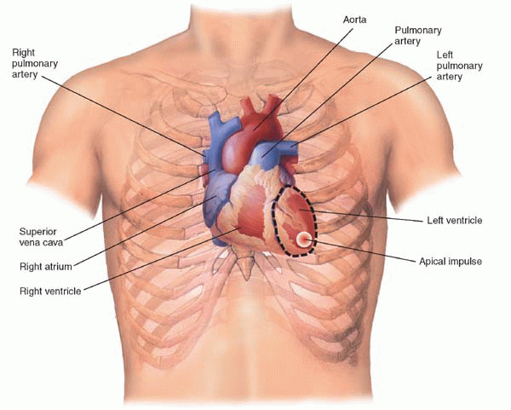
Visualize Anatomy Beneath Chest Wall

Slide 34
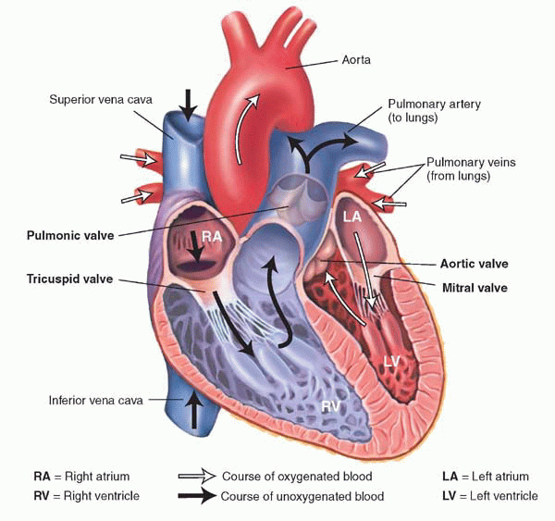
Visualize Chambers of the Heart and Important Great Vessels

Slide 35
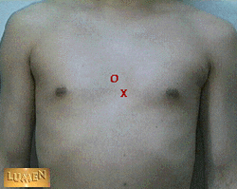
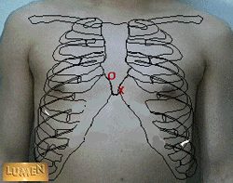
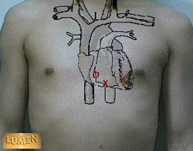
Tricuspid Valve in Relationship to Heart Sounds
O = surface projection of valve location
X = auscultation point of valve
white arrow = direction of blood flow and sound
Surface projection of sound: behind right side of sternum at 4th to 5th intercostal junction
Valve auscultated: left side of sternum in left 5th intercostal space

Slide 36
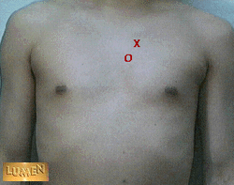
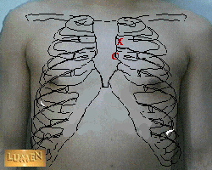
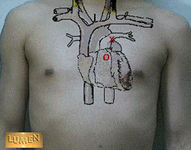
Pulmonic Valve in Relationship to Heart Sounds
O = surface projection of valve location
X = auscultation point of valve
white arrow = direction of blood flow and sound
Surface projection of sound: left side of sternum opposite left 3rd intercostal junction
Valve auscultated: left side of sternum in left 2nd intercostal space

Slide 37
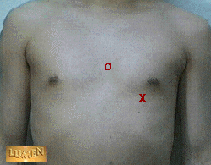
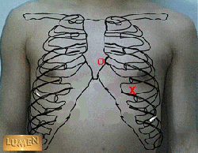

Mitral Valve in Relationship to Heart Sounds
O = surface projection of valve location
X = auscultation point of valve
white arrow = direction of blood flow and sound
Surface projection of sound: left of sternum at 4th intercostal junction
Valve auscultated: 5th intercostal space in mid-clavicular line

Slide 38
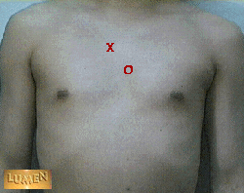
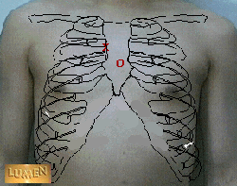
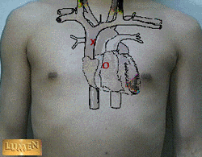
Aortic Valve in Relationship to Heart Sounds
O = surface projection of valve location
X = auscultation point of valve
white arrow = direction of blood flow and sound
Surface projection of sound: behind sternum opposite 3rd intercostal space
Valve auscultated: right side of sternum in 2nd intercostal space

Slide 39
Assess Skin
Skin examination in relation to cardiovascular system
  Assess for ulcers, nonhealing wounds, or abnormal venous patterns and examine skin color and hair distribution
Observe fingernails for clubbing: bulbous swelling of the soft tissue at the nail base seen in hypoxic conditions and certain heart conditions
Check capillary refill in fingernails and toenails: greater than 5 seconds suggest poor peripheral circulation
Observe lips for cyanosis: bluish-tinged lips suggest hypoxia

Slide 40
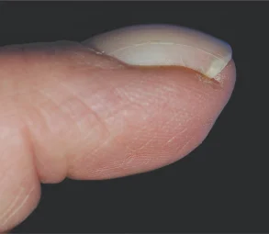
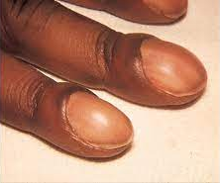
Fingernail Clubbing

Slide 41
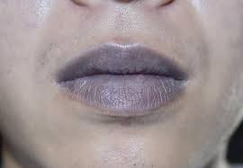
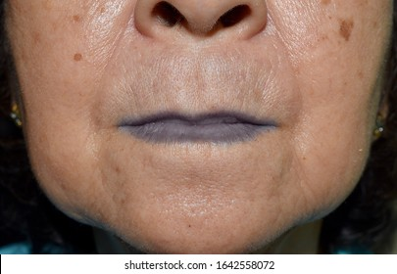
Cyanotic Lips

Slide 42
Assess Skin
Palpate for lower extremity edema by pressing firmly but gently with your thumb for 1-2 seconds over the dorsum of each foot, behind each medial malleolus, and over the anterior tibia
Look for pitting: a depression caused by pressure from your thumb
  No pitting = normal
  1+ = barely detectable impression (< 2 mm) when finger is pressed into skin
  2+ = slight indentation (2-4 mm), 15 seconds to rebound
  3+ = deeper indentation (4-6 mm), 30 seconds to rebound
  4+ = very deep indentation (6-8 mm), > 30 seconds to rebound

Slide 43
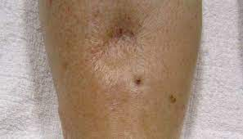
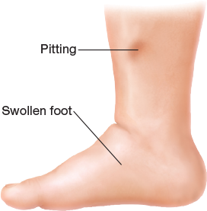
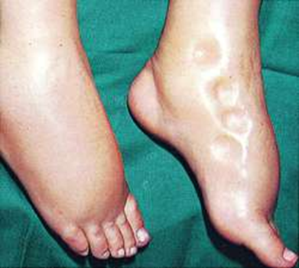
Pitting Edema

Slide 44
Identify Point of Maximal Impulse (PMI)
Inspect the left anterior chest for a visible PMI
Using your finger pads, palpate at the apex for the PMI
Locate the PMI by intercostal space (usually the 5th or 4th, gives vertical location) and the distance in centimeters from the midclavicular line (gives horizontal location)
  Assess the diameter of the PMI: should occupy one interspace and be less than 2.5 cm
  Assess the amplitude and duration of the PMI: should be brisk and non-sustained

Slide 45
Identify Point of Maximal Impulse (PMI)
The PMI may be:
  Tapping: normal
  Forceful and terminates quickly: suggests hyperkinesis from hypermetabolic states or aortic regurgitation
  Diffuse and/or displaced: suggests a dilated ventricle from heart failure or cardiomyopathy

Slide 46
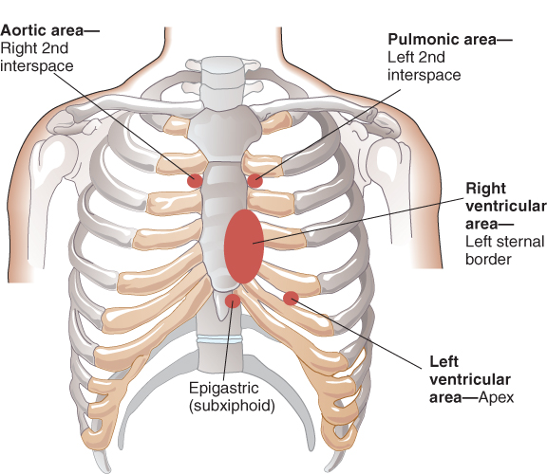
Inspect the Chest Wall
Inspect for lifts/heaves using tangential light: produced by forceful cardiac contractions
  Aortic
  Pulmonic
  Left 3rd interspace
  Apex (PMI)

Slide 47
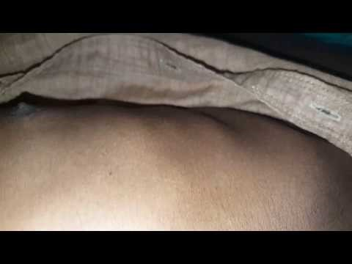
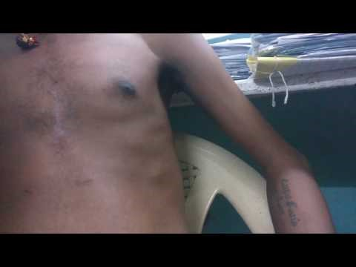
Cardiac Heaves

Slide 48
Palpate the Chest Wall
Palpate for heaves/impulses using finger pads: produced by enlarged right or left ventricle and ventricular aneurysms
  Aortic
  Pulmonic
  Apex (PMI)

Slide 49
Palpate the Chest Wall
Palpate for thrills using ball/heel of hand: produced by underlying turbulent flow
  Left sternal border (4th/5th interspace)
  Apex (PMI)

Slide 50

Auscultate the Heart
The diaphragm is best for detecting high-pitched sounds like S1, S2, the murmurs of aortic and mitral regurgitation, and pericardial friction rubs
  Auscultate over 2nd right ICS (aortic), 2nd left ICS (pulmonic), 3rd left ICS, 4th left ICS, 5th left ICS (tricuspid), and apex (mitral)
The bell is best for detecting low-pitched sounds like S3, S4, and the murmur of mitral stenosis
  Auscultate over 4th left ICS, 5th left ICS (tricuspid), and apex (mitral)
Pericardial Friction Rub

Slide 51
Auscultation
DIAPHRAGM of Stethoscope

Slide 52
Auscultation
BELL of Stethoscope

Slide 53
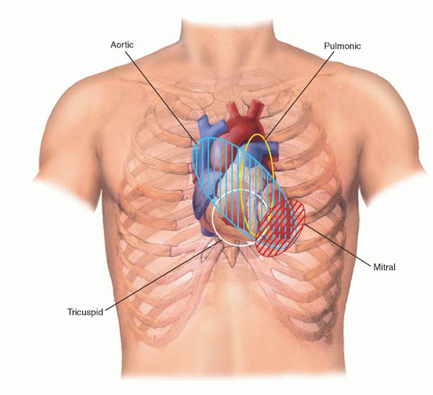
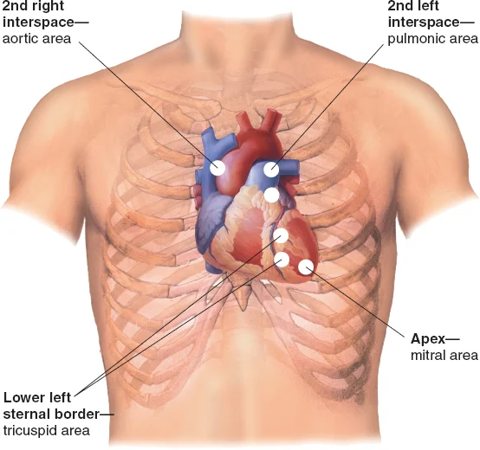
Cardiovascular Auscultation Fields

Slide 54
S1 Heart Sound
Generated by the closure of the mitral and tricuspid valves
Identified during the cardiac cycle by auscultation of the heart while palpating the carotid pulse
  S1 falls just before the carotid upstroke
  S2 follows the carotid upstroke
Best heard with the diaphragm of the stethoscope
Best heard in the left fifth intercostal space at the midclavicular line at the PMI

Slide 55
S2 Heart Sound
Generated by the closure of the aortic (A2) and pulmonic valves (P2)
Best heard with the diaphragm of the stethoscope over the left second intercostal space close to the sternal border
Intensity of the S2 heart sound is usually single during expiration
Separation of A2 and P2 may occur during inspiration, this is referred to as the “physiological split”

Slide 56
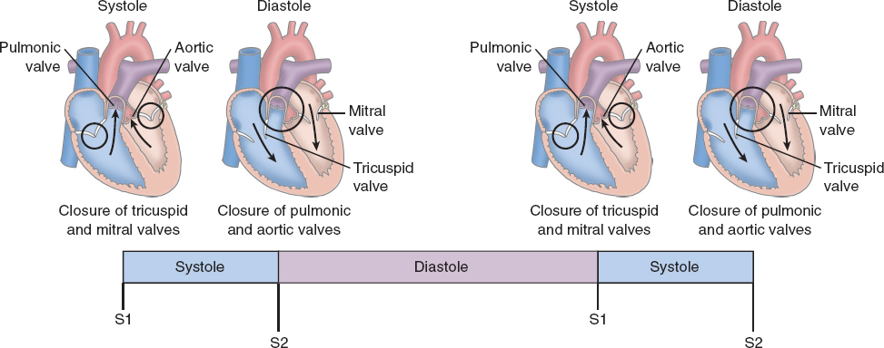
S1 and S2 Heart Sounds

Slide 57
S3 Heart Sound
Also called the ventricular diastolic gallop
Low-pitched sound occurring at the beginning of diastole shortly after S2
Best heard at the cardiac apex with the bell and with the patient in the left lateral decubitus position
Produced by blood entering the ventricle during the rapid filling phase of diastole
  Heard in hyperdynamic states, where it likely results from rapid early diastolic filling
Maneuvers that increase venous return accentuate S3 and maneuvers that decrease venous return soften S3

Slide 58
S4 Heart Sound
Also called the atrial diastolic gallop
Low-pitched sound occurring at the end of diastole immediately before S1
Best heard at the cardiac apex with the bell of the stethoscope
Produced by the sound of blood being forced into a stiff or hypertrophic ventricle
  Heard in left ventricular hypertrophy, (i.e., hypertension, aortic stenosis, hypertrophic cardiomyopathy), acute myocardial ischemia, and hyperkinetic states
Frequently, S4 is also palpable at the cardiac apex

Slide 59
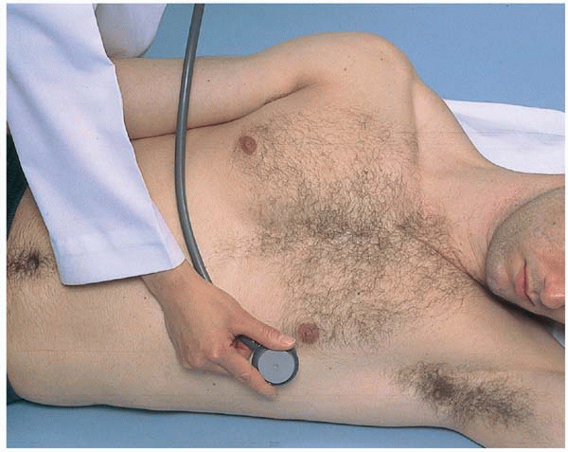
Augment Murmurs: Mitral Stenosis
Ask the patient to roll partly onto the left side into the left lateral decubitus position, bringing the left ventricle close to the chest wall
Place the bell of your stethoscope on the apical impulse

Slide 60
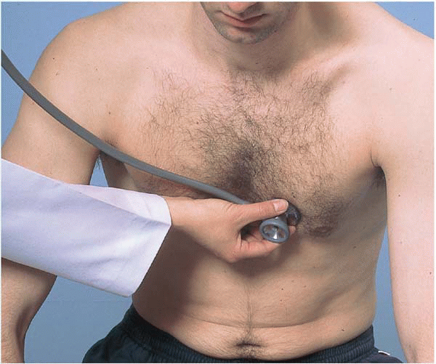
Augment Murmurs: Aortic Regurgitation
Ask the patient to sit up, lean forward, exhale completely, and pause breathing in expiration
Place the diaphragm of your stethoscope along the left sternal border (3rd/4th interspaces) and at the apex

Slide 61
Estimate Jugular Venous Pressure (JVP)
Reflects right atrial pressure, which, in turn, equals central venous pressure and right ventricular end-diastolic pressure
Best estimated from the right internal jugular vein, which has the most direct channel into the right atrium
Find the highest point of oscillation in the right internal jugular vein (near where it appears to then collapse)

Slide 62
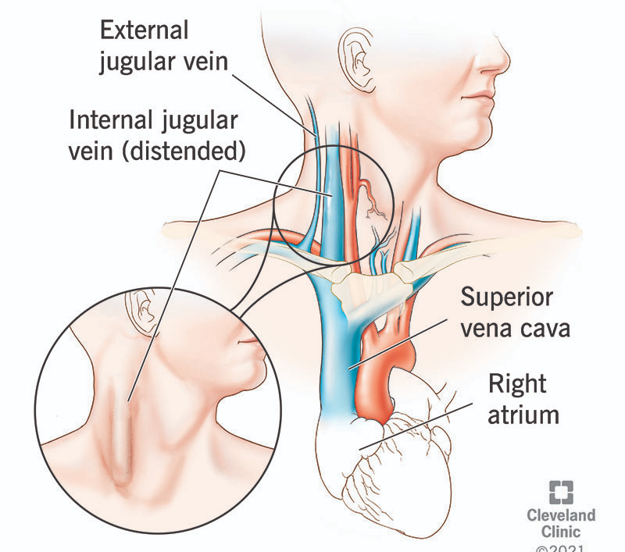
Estimate Jugular Venous Pressure (JVP)

Slide 63
Estimate Jugular Venous Pressure (JVP)
Raise the head of the bed or examining table to about 30°, turn the patient’s head slightly away from the side you are inspecting, and ensure they are comfortable to relax the SCM muscles
Use tangential lighting and examine both sides of the neck to identify the internal jugular venous pulsations
If necessary, raise or lower the head of the bed until you can see the oscillation point or meniscus of the internal jugular venous pulsations in the lower half of the neck

Slide 64
Estimate Jugular Venous Pressure (JVP)
Look for pulsations in the suprasternal notch, between the attachments of the SCM muscle on the sternum and clavicle, or just posterior to the SCM
Distinguish the pulsations of the internal jugular vein from those of the carotid artery

Slide 65
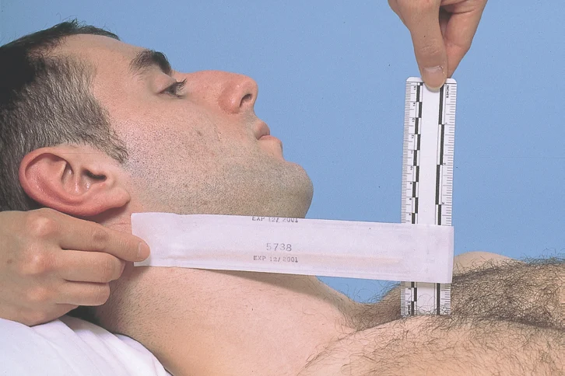
Estimate Jugular Venous Pressure (JVP)
Identify the highest point of pulsation in the right jugular vein
Extend a long rectangular object horizontally from this point and a centimeter ruler vertically from the sternal angle, making an exact right angle
Measure the vertical distance in centimeters above the sternal angle where the horizontal object crosses the ruler
Add to this distance 5 cm (the distance from the sternal angle to the center of the right atrium) to get the JVP
  Normal is 6 to 8 cm

Slide 66
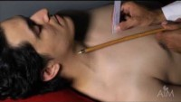
Estimate Jugular Venous Pressure (JVP)

Slide 67
Palpate Pulses
Use the pads of your second and third fingers and compare bilaterally
  Temporal, carotid, brachial, radial, ulnar, femoral, popliteal, posterior tibialis, dorsalis pedis
Use the entire hand to palpate the aortic pulse by pressing deeply in the upper abdomen, slightly left of midline
Grade pulses based on the amplitude
  3+ = bounding
  2+ = brisk, expected (normal)
  1+ = diminished, weak
  0 = absent, cannot palpate

Slide 68
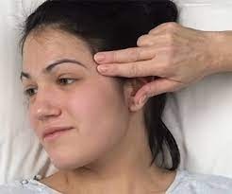
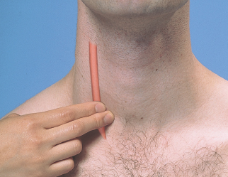
Temporal Pulse
Carotid Pulse

Slide 69
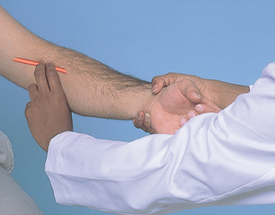
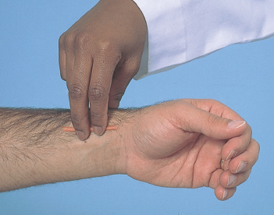
Brachial Pulse
Radial Pulse

Slide 70
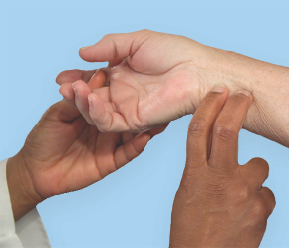
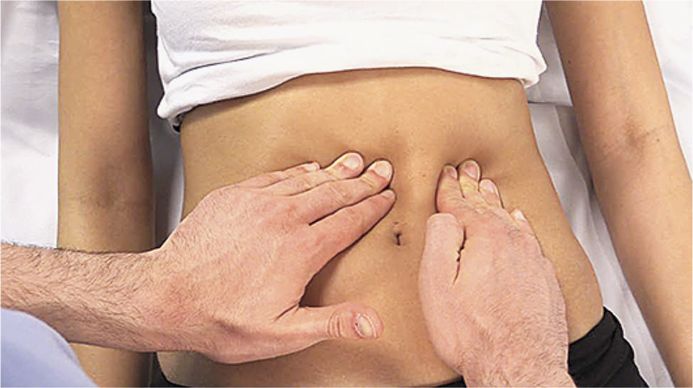
Ulnar Pulse
Aortic Pulse

Slide 71
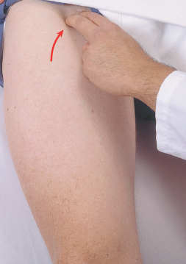
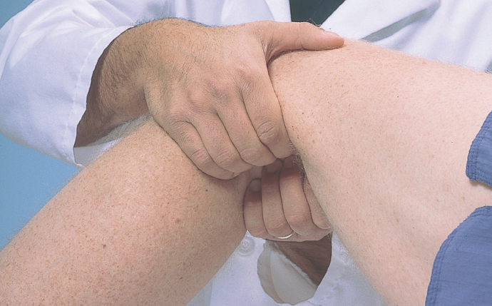
Femoral Pulse
Popliteal Pulse

Slide 72
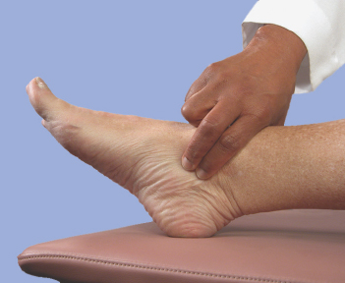
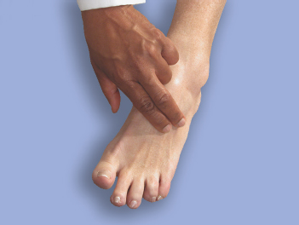
Posterior Tibialis Pulse
Dorsalis Pedis Pulse

Slide 73
Auscultate Pulses
Auscultate pulses for bruits
  Temporal, carotid (hold breath), aortic, renal, iliac, femoral
Use the bell of the stethoscope
Carotid Bruit

Slide 74
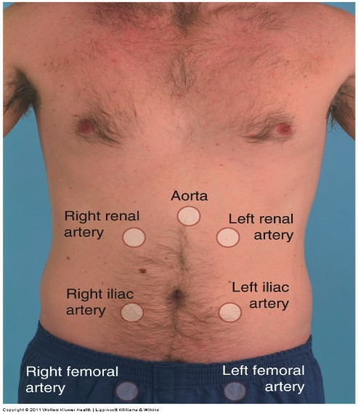
Auscultate Pulses

Slide 75
Special Tests: Allen Test
Compares patency of ulnar and radial arteries
  Performed before an arterial blood gas (ABG) to ensure patency
Ask patient to make tight fist with one hand
Compress radial and ulnar arteries firmly between thumb and fingers
Ask patient to open hand into relaxed, slightly flexed position
Release compression on radial artery and look for blood return to hand (3-5 seconds)
Repeat compression of both arteries again, but the second time, release the ulnar artery compression

Slide 76
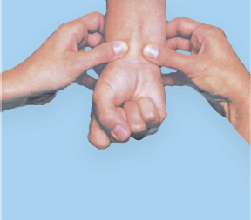
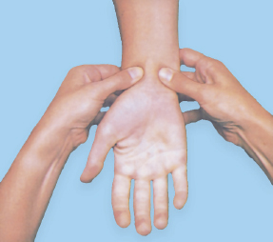
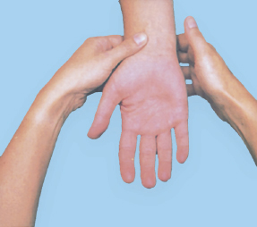
Special Tests: Allen Test

Slide 77
Special Tests: Thigh and Calf Circumference
Used to evaluate for edema and occlusion
Measure 15 cm from the proximal patella (thigh) and 15 cm from the distal patella (calf) and compare bilaterally
  > 1 cm difference is abnormal

Slide 78
Special Tests: Thigh Tenderness
Suggests venous insufficiency or large deep venous thrombosis (DVT)
With an appropriate pressure, squeeze the back of the thigh for tenderness
Repeat bilaterally

Slide 79
Special Tests: Homan Sign
Not very sensitive or specific, but can help determine next step in diagnosing DVT
Dorsiflex foot and palpate calf for tenderness
Repeat bilaterally

Slide 80
Special Tests: Stemmer Sign
Assess for lymphedema
Pinch and lift skin fold at base of second toe and second finger
If you cannot pinch the skin of the dorsum of the foot or hand, then this positive finding is associated with lymphedema

Slide 81
Special Tests: Lower Extremity Arterial Insufficiency Test
Assess for arterial insufficiency in lower extremities, such as in peripheral arterial disease (PAD)
Patient begins by laying supine on the examination table
Examiner raises both legs to 60° until maximal pallor of the feet develops (usually within 30-60 seconds)
Examiner lowers legs as patient sits up, so legs dangle down over the table
Compare both feet, noting the time required for return of color to the feet
  Normal is < 10 seconds

Slide 82
Special Tests: Ankle Brachial Index
Tests for subclinical or suspected peripheral arterial disease (PAD)
Quick and noninvasive test
Detects stenosis of 50% or more in major vessels of legs

Slide 83
Special Tests: Ankle Brachial Index
Compares lower extremity systolic BP to upper extremity systolic BP using Doppler ultrasonography
  Right ABI = highest pressure obtained in right foot divided by the highest pressure obtained in either arm
  Left ABI = highest pressure obtained in left foot divided by the highest pressure obtained in either arm

Slide 84
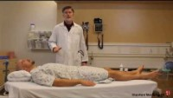
Special Tests: Ankle Brachial Index

Slide 85


Special Tests: Ankle Brachial Index

Slide 86

Special Tests: Ankle Brachial Index

Slide 87
Physical Exam Documentation Example: Cardiovascular
Heart is regular rate and rhythm. No lifts or heaves. Crisp S1 and S2 with no murmurs, rubs, or gallops. PMI is tapping and located at 5th interspace at MCL. JVP measured at 6 cm with head of bed elevated to 30 degrees. Carotid upstrokes are brisk without bruits. Symmetric and 2+ temporal, carotid, brachial, radial, ulnar, aortic, popliteal, posterior tibial, and dorsalis pedis pulses palpated. Temporal, carotid, aortic, renal, iliac, femoral pulses auscultated without bruits. Allen test demonstrates patency of radial and ulnar arteries bilaterally. Negative Homan sign. Negative Stemmer sign.

Slide 88
Cardiovascular
Cultural Considerations

Slide 89
Cardiovascular Cultural Considerations
Minorities have been shown to receive inferior healthcare in areas such as referral for cardiac diagnostics and care for heart failure (among others)
Minorities also have less health insurance coverage, less healthcare access, more acute and chronic illnesses, and lower life expectancies
There may also be less effective communication with ethnic minorities
For groups who have been historically marginalized based on their race or ethnicity, mistrust in the healthcare system may be borne out of experiences of discrimination

Slide 90
Cardiovascular Cultural Considerations
Studies have shown that compared with non-Hispanic white patients, non-Hispanic Black and Hispanic patients are more likely to report mistrust in health professionals
Researchers found a strong association between perceived discrimination and medical mistrust as well as not having a consistent health professional correlated with greater levels of mistrust
Drawing on previous research, researchers suggest that this mistrust is due to implicit racial and ethnic bias in health professionals
Solution is multilevel community- and theory-based training models to counter implicit bias

Slide 91
Cardiovascular Cultural Considerations
Ethnic groups from Asia or South Asia may report feeling like their “heart is empty” or “there is a fire elevation” in their chest to describe emotionally upsetting conditions not necessarily related to cardiac symptoms
Eliciting a history may require a “talk story” (Hawaiian term): chat and converse about patients’ lives to establish rapport before asking medical symptoms (which may give you valuable family history or social history)
The lifestyle of certain ethnic groups may increase risk of coronary artery disease

Slide 92
Cardiovascular Cultural Considerations
The cardiac exam involves exposing the chest, requiring protection of patients’ modesty
Be cognizant of patients’ ethnic or personal background when asking permission to expose patients for the exam
  Keep in mind that private or erotic zones may differ among cultural groups and require additional sensitivity and respect to preserve the dignity and comfort of patients
  Also consider the differences in “personal space” among various ethnic groups

Slide 93
Cardiovascular Cultural Considerations
Patients may request examination by the same gender if possible
  If not possible, consider having a nurse of the same gender or family member present for the exam (with permission of course) to ease the patient’s discomfort
Patients have the right to refuse any exam, which then must be documented accordingly

