Slide 1
Cardiovascular Physiology
Caroline Palmer, MPAS, PA-C
Assistant Professor
Physician Assistant Department

Slide 2
Organization of the Circulatory System
Pulmonary circulation
  Right side of heart & pulmonary vessels (arteries, capillaries, & veins)
  Smaller of two circulations, lower pressures allow blood to move slowly through lungs to improve gaseous exchange
Systemic circulation
  Left side of heart & peripheral vessels & lymphatic system
  Larger of two circulations and higher pressures

Slide 3
Central vs Peripheral
Blood in the heart and pulmonary circulation is called Central Circulation.
Blood outside of the central circulation is called Peripheral Circulation. This is mainly peripheral blood vessels and lymphatic vessels.

Slide 4
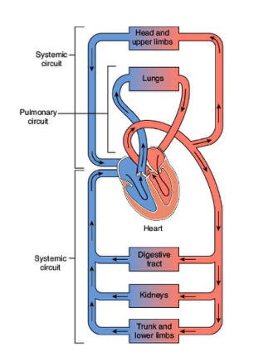
Organization of the Circulatory System

Slide 5
Organization of the Circulatory System
Right Heart – pumps blood thru gas exchange into vessels in lungs
Left heart – pumps blood to rest of body
Atria – upper receiving chambers; assist filling of ventricles; right receives from body & heart, pumps to right ventricle; left receives from pulmonary circuit; pumps to left ventricle
Ventricles – lower pumping chambers; right pumps to lungs; left pumps to body

Slide 6
Principles of Blood Flow
(Hemodynamics)
Pressure, Resistance, & Flow
Laminar vs. Turbulent Flow
Wall tension, Radius & Pressure
Distensibility & Compliance

Slide 7
Pressure, Resistance, & Flow
Flow, a volume measurement, determined by difference of pressure at each end of a vessel or group of vessels.
Resistance is opposition to that flow; caused by friction between blood components and vessel walls. Blood viscosity is part of resistance.
  Resistance of all vessels combined is termed Peripheral Vascular Resistance or Systemic Vascular Resistance.
Pressure is determined by force from behind and against the vessel walls by the blood volume
Flow = Change in pressure
Resistance

Slide 8
Laminar vs. Turbulent Flow
Laminar flow is smooth or streamlined flow which requires less pressure to move forward
Turbulent flow creates a movement of flow in all directions and requires greater pressure to move forward.
Atherosclerotic plaque disrupts the smooth vessel lining creating a turbulent flow and thus raises pressure in order to move blood forward
Higher viscosity (friction between molecules of a flowing fluid) also creates increased turbulence
Heart murmurs result from turbulent blood flow through a diseased heart valve. The turbulence of the flow is what you perceive as the sound of a murmur

Slide 9
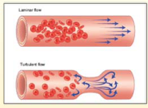
Laminar vs. Turbulent Flow
Laminar Flow
Turbulent Flow

Slide 10
Wall Tension, Radius & Pressure
Wall tension = force in vessel wall that opposes distending pressure inside.
Pressure inside vessel MUST be higher than wall tension pressure of vessel wall or it will collapse. This is called critical closing pressure.
Circulatory shock - pressure drops in small vessels to the point of “critical closing pressure” and perfusion of tissues lessens.

Slide 11
Distensibility & Compliance
Distensibility = ability of vessel to be stretched and accommodate increase in volume of blood
Compliance = total quantity of blood that can be stored in a given portion of the circulation for each millimeter mercury rise in pressure
Compliance = Change in volume
Change in pressure
The higher the compliance of a structure, the more easily it can be stretched

Slide 12
Distensibility and Compliance
Contraction of ventricles ejects blood into the pulmonary and systemic arteries during systole
If there was an equal quantity of blood flow, the volume of blood in the arteries would remain constant and arterial pressure would not change
  Only a 1/3 of stroke volume leaves the arteries and the rest remains during systole which distends them and increases the pressure
  When ventricular contraction ends, the stretched arterial walls recoil and blood continues to be driven into the arterioles during diastole
  As blood leaves the arteries, the arterial volume and pressure slowly fall but the next ventricular contraction occurs, so pressure does not fall to 0

Slide 13
Heart as a “Pump”
Pericardium
  Sac surrounding heart that protects it from rubbing on external structures
  Anchors heart & large vessels to diaphragm and mediastinum
  Fibrous layer and serous layer
  Narrow space between the parietal and visceral layer of pericardium filled with fluid that helps lubricate as heart moves
Epicardium
  Membrane closely affixed to the heart
Endocardium
  Thin layer of cells that line chambers of heart and is continuous with endothelium of blood vessels
  Reduces friction and hence, turbulence

Slide 14
Heart as a “Pump”
Myocardium
  The muscle layer, thickest in left ventricle for more contraction power
  Cardiac muscle combines properties of both skeletal and smooth muscle
    Cells are striated (thick myosin and thin actin filaments)
  Intercalated disks join individual muscle cells to make depolarization faster
  Cells depolarize so as to contract as a unit, squeezing from superior to inferior in atria and inferior to superior in ventricles, thus moving blood efficiently

Slide 15
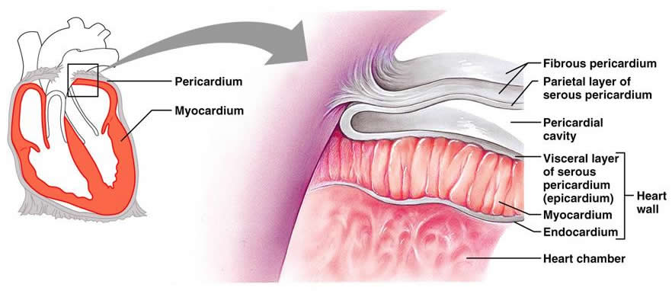

Slide 16
Cardiac Conducting System
The sinoatrial (SA) node “normally” is the initiator of the “pace” or rate of the heart
Its depolarization generates the action potential that leads to depolarization of all other cardiac muscle cells
  Its discharge rate determines the heart rate
    Number of times the heart contracts per minute
It depolarizes at a rate of 60 to 100 times per minute (which is faster than other myocardial cells)
Impulse from the SA node travels through the internodal pathways in both atria to the Atrioventricular (AV) node, while causing depolarization of the atrial myocardium and thus contraction.

Slide 17
Cardiac Conducting System
Within the AV node, atrial fibers connect with junctional fibers of the node itself
These connections, the zone surrounding, and the AV node is referred to as the AV junctional area
Depolarization is very slow through these fibers before arriving at the AV node itself, which also delays the depolarization of the ventricles
This allows the atria to complete its depolarization and contraction fully

Slide 18
Cardiac Conducting System
As depolarization continues, it passes through the AV node into the AV bundle (Bundle of His) and down the right and left bundle branches in the respective ventricular septal walls to the Purkinje fibers in the ventricular walls.
From here depolarization of the ventricles begins and contraction progresses from the apex toward the base.

Slide 19
Cardiac Conducting System
If SA node does not fire, AV node CAN fire on its own BUT at its internal rate of 40 to 60 times per minute
If there is a problem with the AV node not firing, the Purkinje fibers themselves can fire, but at a rate between 15 and 40 per minute.
Disruption anywhere along the conducting system can be seen on the tracings of an ECG.

Slide 20
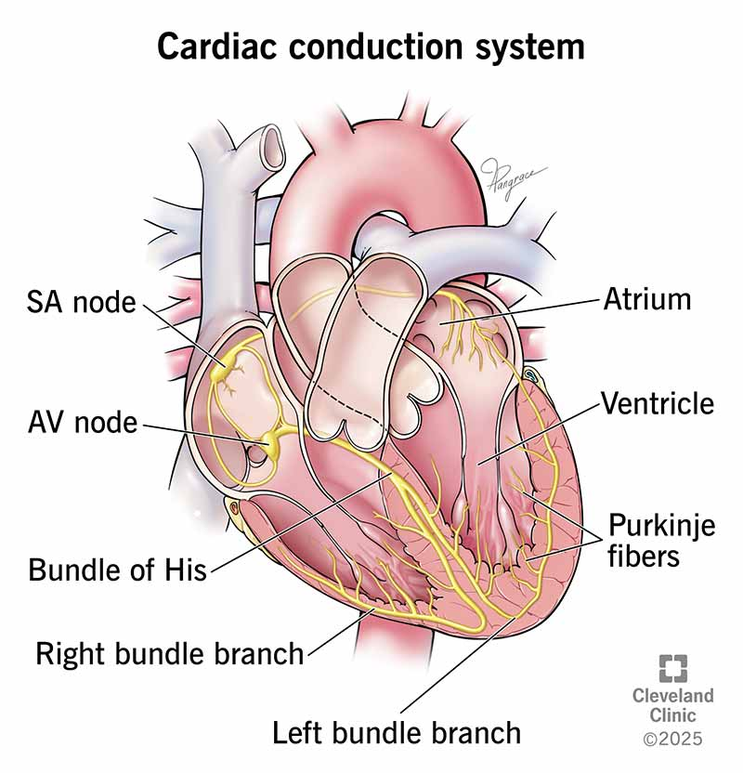

Slide 21
Action Potentials of Myocardium
Major charge (+) carriers in myocardial cells are Sodium (Na⁺), Potassium (K⁺), and Calcium (Ca²⁺)
They change the polarity of the myocardial cell membrane depending on the opening of the ion channels
The “action potential” of each cell membrane is divided into 5 phases of state of ion movement (starting with phase 0)

Slide 22
Action Potentials of Myocardium
Phase 0 – rapid depolarization
Phase 1 – early repolarization
Phase 2 – the plateau
Phase 3 – rapid repolarization
Phase 4 – resting membrane

Slide 23
Action Potentials of Myocardium
Three types of ion channels in myocardial cells
Fast sodium channels
Slow calcium-sodium channels
Potassium channels
Phase 0- fast sodium channels open allowing rapid inflow of sodium
  Changing the membrane potential from -90 mV to +20 mV and rapid depolarization begins.

Slide 24
Action Potentials of Myocardium
Phase 1 – is at the peak of the action potential and inactivation of the rapid sodium channels
Phase 2 – slow opening of calcium channels occurs thus extending the action potential by 3 to 15 times longer than that of skeletal muscle, thereby extending contraction
  This is called the “plateau” phase

Slide 25
Action Potentials of Myocardium
Phase 3 - Rapid repolarization occurs
  Calcium/Sodium channels close and Potassium channels open allowing K+ to move to the extracellular space thus reversing the polarity of the cell membrane.
Phase 4 – Resting phase
  Sodium/Potassium pump returns sodium to the extracellular space and Potassium back intracellular.
Then the phases all start again

Slide 26
Absolute & Relative Refractory Periods
Absolute Refractory Period – the period of time in the action potential curve where NO stimuli can generate another action potential
  This includes Phases 0, 1, 2, and part of 3. This period is almost as long as the contraction, thus blocking another contraction from occurring until the first is over.
Relative Refractory Period – repolarization has returned membrane potential to a level just below that of threshold potential, but cell is capable of re-depolarization to a greater than normal stimulus.
Supernormal Excitatory Period – very short time during which a weak stimulus can evoke a response. Period where arrhythmias can develop.

Slide 27
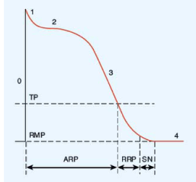
Absolute & Relative Refractory Periods
TP = Threshold Potential
RMP = Resting Membrane Potential
ARP = Absolute Refractory Period
RRP = Relative Refractory Period
SN = Supernormal Excitatory Period
Numbers represent Phases of Action Potential (0 to 4)
Notes:
Relative refractory period- cell is capable of responding to a greater than normal stimulus. It begins when membrane potential is phase 3 reaches TP and ends just before end of phase 3
SN- a weak stimulus can evoke a response

Slide 28
Cardiac Cycle
Divided into two distinct parts – Systole & Diastole
Systole = phase of ventricular contraction and pumping of blood out of the ventricles.
Diastole = phase of ventricular relaxation and filling of the ventricle with blood.
During Systole the AV valves are closed preventing backflow into the atria and forcing blood out the open Semilunar valves
During Diastole the AV valves open allowing blood to fill the relaxed ventricles while the Semilunar valves shut preventing backflow of blood from the vessels.

Slide 29
Ventricular Systole & Diastole
Systole – divided into two phases –
  “isovolumetric contraction period” & “ejection period”
“Isovolumetric contraction period” – begins with closing of AV valves (1st heart sound) but before opening of semilunar valves. Contraction begins and intraventricular fluid pressure rises.
“Ejection period” – once pressure in ventricles exceeds the aorta and pulmonary trunk, the semilunar valves open and ejection period occurs
  It continues until pressure in great vessels becomes higher than in the ventricles thus causing semilunar valves to close (2nd heart sound).

Slide 30
Ventricular Systole & Diastole
Diastole – also divided into two phases
“Isovolumetric relaxation period”
  Begins with the closing of the semilunar valves and ventricles begin relaxing
  Intraventricular pressures fall below that of the atria and AV valves open
“Rapid filling phase”
  Begins with opening of AV valves and ends with complete filling of ventricles
  If a person has an over-distended or non-compliant ventricle, a 3rd heart sound may be heard. It is a sound heard at the end of the filling phase due to vibrations that are caused by abrupt cessation of blood entering the ventricles, but before the atria contract at the end of diastole
  A 4th heart sound may be heard during the last 1/3rd of diastole when the atria contract and the rush of blood is turbulent.

Slide 31
Atrial Filling & Contraction
NO valves between the great veins and the atria.
Blood enters atria during both systole and diastole due to such low pressures. This allows ease of flow into the atria.
Three main phases of atrial pressure waves – “C-wave”, “V-wave”, & “A-wave”

Slide 32
Atrial Filling & Contraction
“C-wave” – begins at start of systole when AV valves close and bulge into atria causing an increase in atrial pressure and stopping inflow of blood for a very short time.
“V-wave” – begins toward the end of systole with the AV valves still closed, but pressure from systemic vessels is greater than atrial pressure and a filling with blood occurs.
“A-wave” – during the last phase of diastole and the AV valves are open and the atria contract to push the last amount of blood they can push.

Slide 33
Atrial Filling & Contraction
Right atrial pressure can be seen in the internal jugular veins as pulsations. These can be measured to assess cardiac function.
Right atrial pressure/filling is predicated on the ability of the right ventricle to pump blood out to the lungs
  When the heart pumps strongly, atrial pressure drops which increases filling.
Right atrium pressures also affected by intrathoracic pressures. Decreased with inspiration. Increased with coughing or forced exhalation.

Slide 34
Regulation of Cardiac Performance
Cardiac Output – amount of blood the heart pumps per minute (Liters/minute)
Stroke volume – amount of blood ejected by each ventricle with each beat
Heart rate – number of beats per minute
Cardiac Output = Stroke volume x Heart rate
CO = SV x HR
Normal adult CO = 4.0 to 8.0 L/min.

Slide 35
Regulation of Cardiac Performance
Cardiac Reserve – maximum increase in CO that can be achieved above normal CO.
Normal young healthy adult – 300 to 400% above normal CO.
Heart’s ability to increase CO mainly depends on 4 factors – the preload, the afterload, cardiac contractility, & heart rate.

Slide 36
Preload
Preload = volume work of the heart
  Called Preload because it is the work or load that the heart does BEFORE (Pre) the ventricular contraction begins
  It is the amount of blood the heart must pump with each beat or the volume of blood stretching the ventricular muscle fibers at the end of diastole (End Diastolic Volume)

Slide 37
Frank-Starling Mechanism
(Starling Law)
The increased force of contraction that accompanies an increase in ventricular end-diastolic volume is called the Frank-Starling Mechanism or Starling Law
  The ventricle contracts more forcefully during systole when it has been filled to a greater degree during diastole

Slide 38
Afterload
The pressure or tension work of the heart. The pressure the heart MUST generate to move blood into the aorta.
Called Afterload because it is the work (Load) presented to the heart AFTER the contraction has commenced.
Systemic & Pulmonary B/P is main source of afterload for left and right ventricles respectfully.

Slide 39
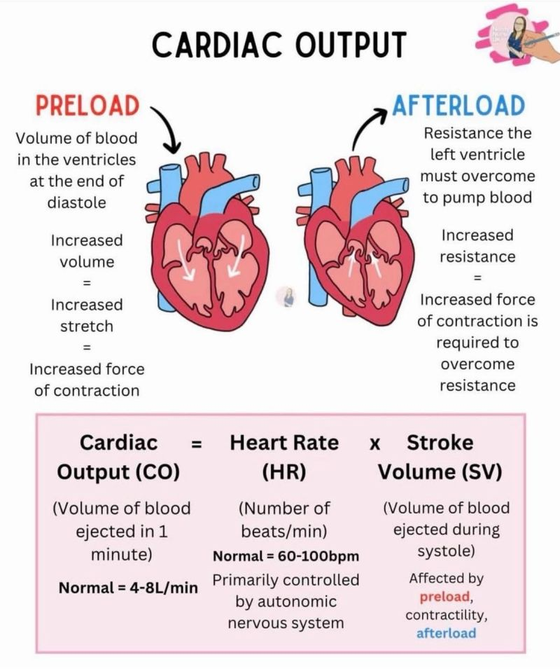

Slide 40
Cardiac Contractility
“Cardiac Contractility” = ability of the heart to change its force of contraction without changing its resting length
Contractility increases CO independent of preload and afterload
Interaction between actin and myosin filaments during cardiac muscle contraction and relaxation requires energy supplied by the breakdown of ATP and presence of calcium ions

Slide 41
Heart Rate
Depends on the frequency of ventricular contractions AND time spent in diastolic filling
Faster the rate, the less time to fill
Less time to fill, less blood fills
Less blood fills, less CO
Less CO, less oxygen and nutrients for cells of body
Less oxygen & nutrients, cells don’t like it and potentially can die

Slide 42
Systemic Circulation
Function is to deliver oxygen & nutrients to tissues and return carbon dioxide & wastes.
Consists of arteries, arterioles, capillaries, venules, and veins.
Dynamic structures that constrict and relax to adjust B/P & flow to meet varying demands of tissues and organ systems.

Slide 43
Blood Vessels
All vessels (except capillaries) have 3 layers or coats called tunicae.
Outer layer, loose connective tissue, is called Tunica externa or adventitia. Controls diameter of vessel.
Middle layer, smooth muscle tissue, is called Tunica media.
Inner layer, epithelial tissue, is called Tunica intima. Smoothness prevents platelet adherence & blood clotting.

Slide 44
Vascular Smooth Muscle
Tunica media is in control of vasoconstriction and vasodilation.
Smooth muscle contracts slowly and generates high forces for long periods of time with low energy requirement (uses 1/10 to 1/300 the energy of skeletal muscle).
There is less developed sarcoplasmic reticulum for intracellular calcium storage, and very few fast sodium channels.
Depolarization for vasoconstriction therefore relies on extracellular calcium.

Slide 45
Vascular Smooth Muscle
Sympathetic nervous system control of vascular smooth muscle tone occurs thru receptor-activated opening & closing of the calcium channels.
Α_{1 & 2}-adrenergic receptors are excitatory, causing calcium channels to open producing vasoconstriction.
β₂-adrenergic receptors are inhibitory, causing calcium channels to close producing vasodilation.
Calcium channel blocking drugs cause vasodilation by blocking calcium entry thru calcium channels in smooth muscle.

Slide 46
Arterial System
High pressure system
Consists of large and medium-sized arteries and arterioles
Thick-walled vessels with lots of elastic fibers that allow for flexibility of vessel during systole & diastole
Arterioles (mostly smooth muscle) serve as resistance vessels for circulatory system and regulate B/P

Slide 47
Arterial System
Arterial Pulse Pressures – waves of pressure generated by intermittent ejection of blood from left ventricle into aorta and large arteries along the entire length of the vessels.
When taking a pulse, it is this pulse pressure that you are feeling.

Slide 48
Arterial System
Pulse pressure wave gets smaller & smaller the further down the system you move until at the capillaries, there is not much left, just enough to keep the capillaries open.
Local tissue control can open the system wider for more blood flow to occur (such as with a cut finger) such that you may feel a “pulsing” in the finger. This is allowing more blood to get there to help in healing process.

Slide 49
Venous System
Low pressure system
Returns blood from capillaries via venules to veins to right atrium.
Pressure in the right atrium (normal being 0mmHg) is called Central Venous Pressure.
This pressure is regulated by the ability of the right ventricle to pump blood to the pulmonary circulation AND flow unimpeded into the right atrium.

Slide 50
Venous System
Veins & Venules are thin-walled, distensible, and collapsible.
Veins can enlarge and store large quantities of blood.
Veins still have muscle layer that allows for contraction and relaxation based on tissue demand.
Veins in the extremities (arms & legs) have one-way valves (cups like the semilunar valves) that prevents retrograde flow of blood.
Muscles in the extremities contract intermittently to help move the blood forward toward the heart. This is called the venous or muscle pump.

Slide 51
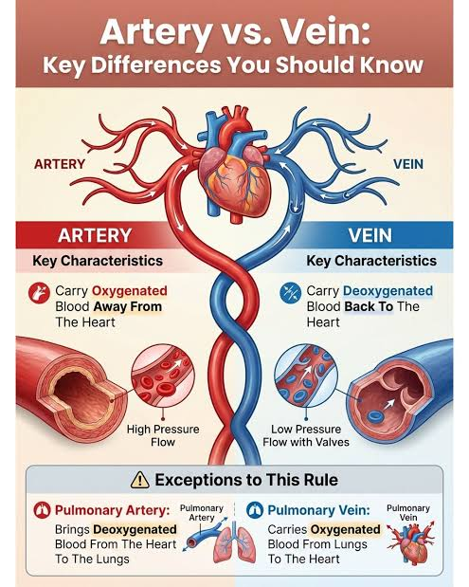

Slide 52
Microcirculation & Lymphatic System
Arterioles, capillaries, & venules referred to as the microcirculation
Arterioles channel blood into the capillaries via precapillary sphincters that open based on venous pressures and local tissue needs
Capillaries are the site of gas, nutrients, & waste exchange

Slide 53
Microcirculation & Lymphatic System
Oxygen & Nutrients leave the capillary into the extracellular space where they are then picked up by individual cells for use
Carbon Dioxide & Waste products leave the cells into the extracellular space where it is either picked up by capillaries, if the products are small enough to fit into the pores of the capillary OR by the lymphatic vessels that can channel larger products back to the venous system via the Thoracic duct into the left subclavian vein or the Right lymphatic duct into the right subclavian
Lymph nodes are interspersed along lymphatic vessels to help filter bacteria via B & T cell lymphocytes (which also mature from differentiation).

Slide 54
Local & Humoral Control of Blood Flow
Autoregulation
Endothelial Control
Humoral Control

Slide 55
Autoregulation
Local control of blood flow governed by nutritional needs of the local tissue.
Heart, brain, & kidneys blood flow stays relatively constant, even when systemic B/P changes even over a range from 60 to 180 mmHg. This preserves the vital organ function.
Mediated by changes in blood vessel tone or local tissue factors (such as low oxygen or accumulation of toxic metabolites).
Hyperemia (increased blood flow) is an example of autoregulation.

Slide 56
Endothelial Control
Important function of endothelial cells lining arterioles and small arteries is synthesis and release of factors that control vessel dilation
Endothelium produces nitric oxide which relaxes vascular smooth muscle and has direct vasodilation effects
Nitric oxide inhibits platelet aggregation and secretion of platelet contents which causes vasoconstriction
This is under control by several agonists – acetylcholine, bradykinin, histamine, and thrombin
Sheer Stress from increased blood flow or increased B/P can also cause release of nitric oxide

Slide 57
Endothelial Control
Endothelium also release vasoconstrictor substances – angiotensin II, prostaglandins, and endothelins
After a blood vessel is damaged, local endothelin is released to vasoconstrict the vessel and prevent extensive bleeding

Slide 58
Humoral Control
Vasoconstrictive & vasodilative hormones circulate in the blood vessels from distant glands OR from local tissue.
Important hormones are: norepinephrine, epinephrine, angiotensin II, histamine, serotonin, bradykinin, and the prostaglandins.

Slide 59
Humoral Control
Norepinephrine – powerful vasoconstrictor
Epinephrine – not as powerful a vasoconstrictor; in skeletal muscle acts as a vasodilator.
Released by sympathetic nerve endings as well as the adrenal medulla.
Nerve endings release causes immediate reaction while adrenal release takes longer due to circulatory time.
Notes:
Stimulation of the sympathetic nervous system during stress or exercise causes local constriction of veins and arterioles bc of release of norepi from sympathetic nerve endings

Slide 60
Humoral Control
Angiotensin II – powerful vasoconstrictor; acts on arterioles to increase peripheral vascular resistance thereby increasing B/P.
Histamine – powerful vasodilator of arterioles and increases capillary permeability. Derived from mast cells in injured tissues and basophils in the blood.

Slide 61
Humoral Control
Serotonin – released from aggregating platelets during clotting process; causes vasoconstriction, important role in controlling bleeding.
Bradykinin – causes intense vasodilation of arterioles, increased capillary permeability, and constriction of venules. Helps regulate blood flow in the skin, salivary glands, & GI tract.

Slide 62
Humoral Control
Prostaglandins – formed from constituents of cell membrane. Tissue injury incites release of these constituents which then initiates synthesis of prostaglandins. Some produce vasoconstriction while others produce vasodilation
Corticosteroids produce an anti-inflammatory response by blocking the release of constituents (arachidonic acid), preventing prostaglandin synthesis.

Slide 63
Neural Control of Circulatory Function
Neural control centers for regulation of cardiac function and B/P are in reticular formation of the lower Pons & Medulla of the brain stem, where integration of the ANS responses occur.
Both sympathetic and parasympathetic divisions of the ANS innervate the heart.
Parasympathetic via the vagus nerve (CN X) which produces a slowing of the heart rate. Little to no effect on the vasculature.
Sympathetic has excitatory effect on heart rate and contractility AND controlling smooth muscle tone of the blood vessels.

Slide 64
ANS Control of B/P
Intrinsic & Extrinsic reflexes work to assure adequate B/P.
Intrinsic = baroreceptors & chemoreceptors
Extrinsic = reflexes of pain and cold work to shunt blood to central body where it is needed most.

Slide 65
ANS Control of B/P
Baroreceptors – pressure sensitive receptors located in the walls of blood vessels and heart; respond to changes in stretch of vessel walls by sending impulses to CV center in brainstem.
Chemoreceptors monitor O₂ & CO₂ & H⁺ and located in the carotid bodies which lie in the bifurcation of the internal & external carotids; they communicate with both the respiratory and cardiovascular centers of the brainstem.

Slide 66
Quick quiz!
What does compliance mean in terms of blood vessels?
What is preload of the heart? Afterload?

