Slide 1
Arrhythmia Pharmacology
Tim Scanlon, MPAS, PA-C

Slide 2
Choose the drug by the rhythm
Use electrophysiology to predict the effect, then check rhythm, hemodynamics, and contraindications.
01
Regular AV-node–dependent SVT
TARGET
DRUG / INTERVENTION
Transient AV nodal block
Vagal maneuvers → adenosine
AVNRT / many orthodromic AVRT episodes
For a stable, regular narrow-complex rhythm; other AV nodal agents may be options.
02
AF / flutter rate control
TARGET
DRUG / INTERVENTION
Slower AV conduction
β blocker or diltiazem / verapamil
No ventricular pre-excitation
Digoxin is an option in selected contexts; account for EF and hemodynamics.
03
Selected rhythm-control / VT scenarios
TARGET
DRUG / INTERVENTION
Alter Na⁺ conduction or K⁺ recovery
Class I or Class III agents
Atrial or ventricular fast-response tissue
Choice depends on diagnosis, heart structure, QTc, renal function, and protocol.
SAFETY EXCEPTION / PRE-EXCITED AF
Avoid AV nodal blockers (adenosine, β blockers, verapamil/diltiazem, digoxin) and IV amiodarone.
BEFORE A DRUG CHOICE:
1 Is the patient unstable?
2 Is the rhythm irregular or pre-excited?
3 EF • structural disease • QTc • renal function
03

Slide 3
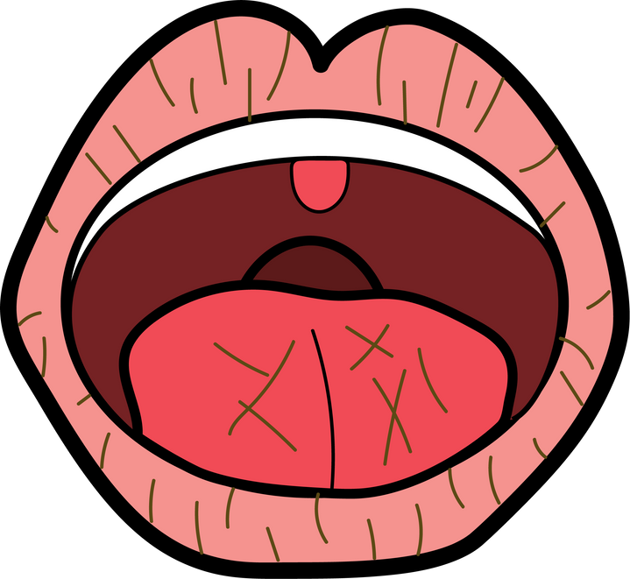
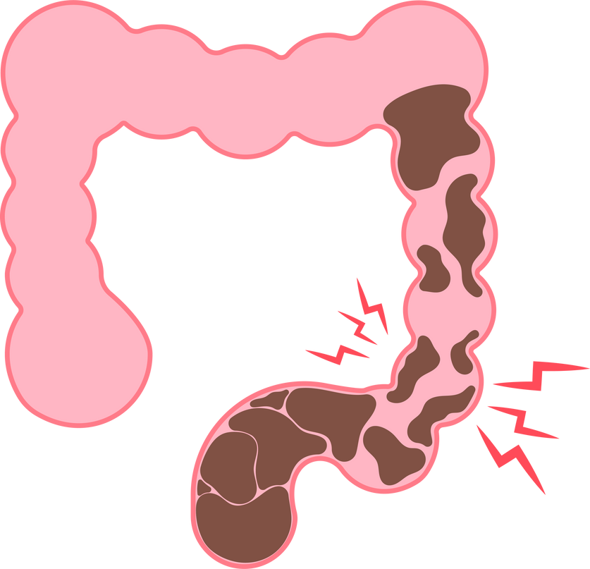
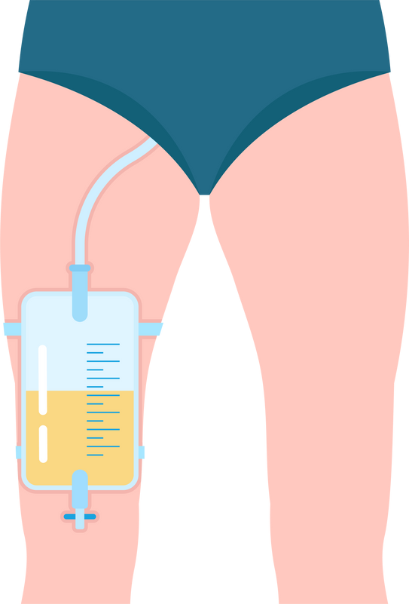
Atropine
  Class: Anticholinergic
  Indications:
    Symptomatic bradycardia
    AV Blocks (First degree and Second Degree Mobitz I)
  Dosing:
    IV: 1 mg every 3-5 minutes (max total 3 mg)
  Mechanism of Action:
    Blocks acetylcholine at:
      Smooth muscle
      Secretory glands
      CNS
    Effects:
      Increases cardiac output
      Dries secretions
  Onset:
    IV: Immediate effect, max effect in 0.7 - 4 minutes
  Side Effects:
    Tachycardia
    Dry eyes, dry mouth
    Blurred vision
    Constipation
    Urinary retention

Slide 4
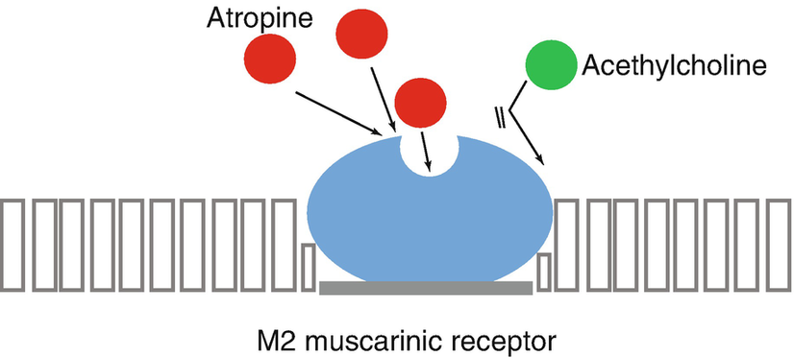
Acetylcholine in the Parasympathetic System
  Chief neurotransmitter of the parasympathetic nervous system
    Contracts smooth muscles
    Dilates blood vessels
    Increases bodily secretions
    Slows heart rate

Slide 5
  Acetylcholine
    Released due to increased vagal tone
  Role of Atropine
    Blocks acetylcholine at receptors
MOA of Atropine:
  Increased Parasympathetic Inhibition:
    Preexisting sympathetic stimulation predominates
    Increases heart rate
    Enhances SA node automaticity
    Improves AV node conduction
  Increases Cardiac Output

Slide 6
Atropine:
Additional Pharmacokinetics & Considerations
  Metabolism:
    Hepatic
  Excretion:
    Urine
  Geriatric Population:
    Half-life more than doubled

Slide 7
Atropine:
Additional Pharmacokinetics & Considerations
Caution
  Conditions to Watch:
    Acute angle glaucoma
    Pyloric obstruction
    Urinary retention (BPH)
    Mucus plugs (chronic lung diseases)
Toxicity
  Overdose Symptoms:
    Dilated pupils
    Warm, dry skin
    Tachycardia
    Tremor
    Ataxia
    Delirium
    Coma

Slide 8
Atropine: Additional Considerations
  Heart Transplant Recipients
    Atropine likely ineffective for bradycardia - due to lack of vagal innervation in the transplanted heart
Use with Caution
  Conditions:
    Myocardial ischemia
    Heart failure
    Hypertension
  Risks:
    Increased BP and tachycardia
    Potential ischemia, MI, or arrhythmia

Slide 9


Atropine: Additional Considerations
Ineffective for Certain AV Blocks
  Not used for:
    Second-degree AV block Mobitz II
    Complete heart block
      These blocks originate below the SA node and require pacing

Slide 10
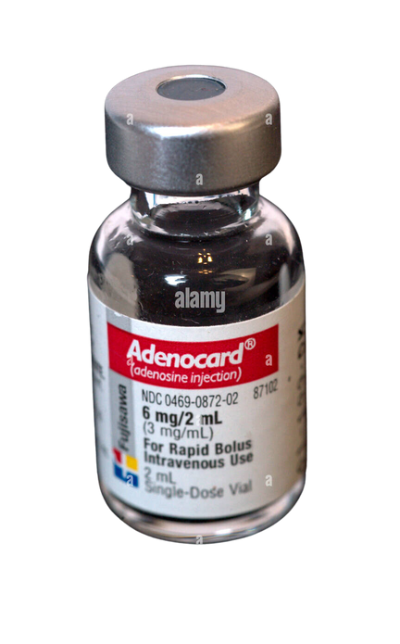
Adenosine
  Basics
    Brand Name: Adenocard
    Class: Miscellaneous antiarrhythmic agent
  Indications
    Primary Use: Supraventricular Tachycardia (PSVT - AVNRT, AVRT)

Slide 11
Adenosine
  Dosing
    Initial Dose: 6 mg IV
    If Ineffective (1-2 mins): 12 mg IV (may repeat once)
    Administration: Rapid IV push (1-2 seconds) followed by 20 mL saline flush
  Mechanism of Action
    MOA: Slows AV node conduction, interrupts re-entry pathways, restores NSR
  Onset and Duration
    Onset: Immediate
    Half-life: < 10 seconds

Slide 12
Adenosine
  Side Effects
    Skin flushing
    Lightheadedness
    Nausea
    Sweating
    Nervousness
    Numbness
    Feeling of impending doom

Slide 13
Adenosine: How it works
  Mechanism of Action
    Effect: Directly inhibits AV nodal conduction, increases AV nodal refractory period
  Cellular Action
    Potassium Channels: Activated, driving K+ out of cells (main effect)
    Calcium Influx: Inhibited, disrupting resting potential
  Resulting Effects
    Longer depolarization time - slowed conduction in cardiac myocytes

Slide 14
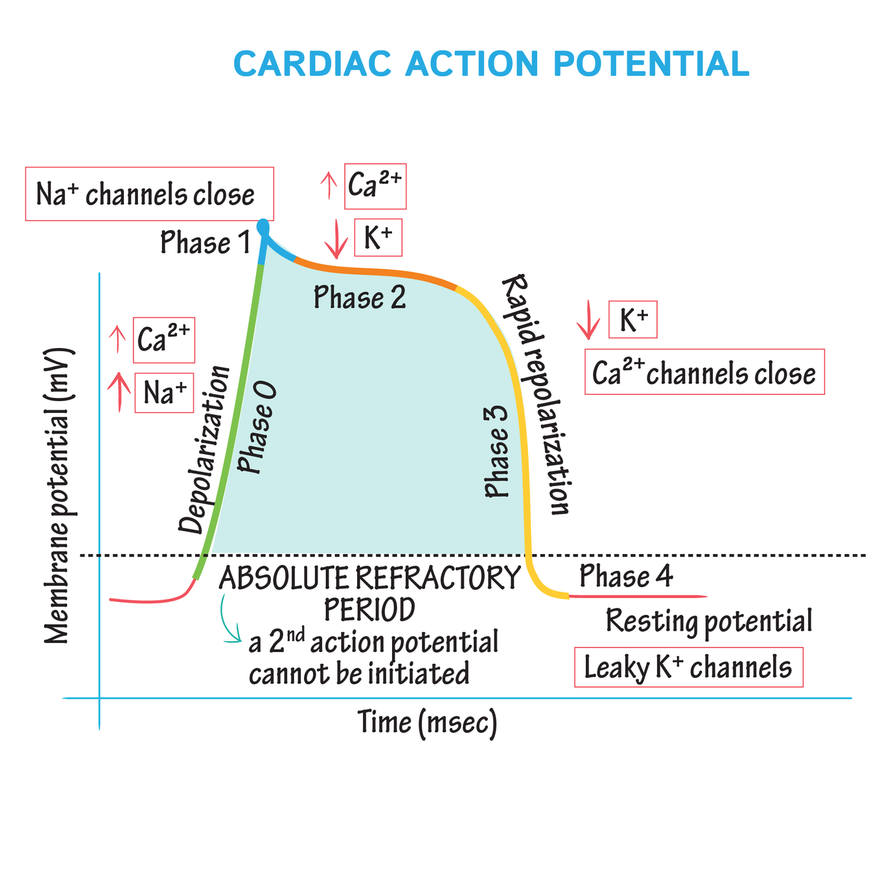

Slide 15
Contraindications & Precautions for Adenosine
  Contraindications
    Known hypersensitivity to adenosine
    Heart block
    Active bronchospasm (reactive airway disease, COPD, asthma)
  Appropriate Use
    Indication: Narrow complex PSVT, unless directed by expert consultation for select pts
    Avoid in: Wide complex PSVT or accessory pathways (WPW)
      Risk: Severe tachycardia, cardiac arrest
  Toxicity and Side Effects
    Due to Short Half-life: Minimal toxicity
    Reported Severe Effects:
      Prolonged asystole
      Development of heart block
      Cardiac ischemia

Slide 16
Digoxin
  Basics
    Brand Names: Digitek, Digox, Lanoxin
    Class: Antiarrhythmic agent, cardiac glycoside
Indications
  Primary Uses:
    Rate control in A-fib/flutter
    Treatment of heart failure with reduced EF (HFrEF)
    Off-label Use: Rate control in SVT (AVNRT)
  Mechanism of Action
    Suppresses AV node conduction (vagomimetic)
    Increases intracellular sodium, causing calcium influx
    Prolongs phases 4 and 0, increasing the refractory period

Slide 17
Digoxin
  Excretion and Half-life
    Excretion: Kidneys, based on GFR
    Half-life: 36-48 hours (longer in renal failure)
  Monitoring
    Plasma Levels: Must be checked regularly
    Therapeutic Range: 0.5-2 ng/mL

Slide 18
Digoxin Toxicity
  Overview of Digoxin Toxicity
    Risk: Can cause fatal cardiac arrhythmias
    Occurrence: 0.8-4% in chronic therapy patients
  Serum Concentration and Risk
    Increased Risk: When serum digoxin > 2.0 ng/mL
  Risk Factors for Toxicity
    Low body weight
    Advanced age
    Decreased renal function
    Hypokalemia

Slide 19
Digoxin Toxicity: Clinical Presentation
  Common Symptoms
    Nausea and vomiting
    Visual disturbances (halos, yellow or blurred vision)
    Lethargy
  Life-Threatening Arrhythmias
    Sinus bradycardia
    Paroxysmal atrial tachycardia
    AV block
    PVCs
    VT and VF (severe cases)
    Hyperkalemia

Slide 20
Digoxin Toxicity: Clinical Presentation
  Characteristic Arrhythmias
    Tachyarrhythmia with sinus or AV node suppression
    Atrial and junctional tachycardia with AV block
  EKG Changes
    ST depression “scooped” ST depression

Slide 21
Digoxin Toxicity: Treatment
  Antidote
    DSFab (Digibind, Digifab):
      Binds digoxin
      Indicated for life-threatening arrhythmias, potassium >5.5, or end organ damage (renal failure, AMS)
  Early Intervention
    Activated Charcoal:
      Beneficial within 1-2 hours of ingestion
      Dose: 1 g/kg (max 50 g)
      Ensure patient is alert and can maintain airway
  Temporizing Measures
    For Bradycardia: Atropine
    For Hypotension: IV fluids

Slide 22
Antiarrhythmics

Slide 23
Understanding Arrhythmias & Their Management
  Causes of Arrhythmias
    Abnormal Pacemaker Activity
    Abnormal Impulse Propagation
  Therapy Goals
    Reduce Ectopic Pacemaker Activity
    Modify Conduction/Refractoriness
    Disable aberrant movement in reentry circuits
  Antiarrhythmic Agents
    Classification: Four groups based on their influence on the cardiac cycle

Slide 24
Antiarrhythmic Class | Antiarrhythmic Agent | Antiarrhythmic Agent
Class I (Sodium channel blockers) | IA: procainamide, quinidine, disopyramide IB: lidocaine, mexiletine IC: flecainide, propafenone | IA: procainamide, quinidine, disopyramide IB: lidocaine, mexiletine IC: flecainide, propafenone
Class II (Beta Blockers) | Selective Metoprolol Atenolol Esmolol Bisprolol | Nonselective Carvedilol Propranolol Sotalol Labetalol Timolol
Class III (Potassium channel blockers) | Amiodarone Sotalol Dronedarone Ibutilide Dofetilide | Amiodarone Sotalol Dronedarone Ibutilide Dofetilide
Class IV (Calcium Channel Blockers) | Diltiazem Verapamil | Diltiazem Verapamil

Slide 25
ARRHYTHMIA PHARMACOLOGY / VENTRICULAR ELECTROPHYSIOLOGY
Fast-response action potential: ventricular myocardium
Phase 0 = Na⁺ influx • Phase 2 = Ca²⁺ plateau • Phase 3 = K⁺-dependent repolarization
Ventricular drug effects
FAST-RESPONSE VENTRICULAR TRACE
Schematic • not to scale
mV
CLASS I • Na⁺ channel blockers
Block fast phase-0 Na⁺ current → slower ventricular conduction.
+20
1
2
0
0
CLASS IV • Ca²⁺ channel blockers
↓ L-type Ca²⁺ current in ventricular phase 2.
Main antiarrhythmic effect: AV nodal slowing.
3
-60
CLASS III • K⁺ channel blockers
Prolong phase-3 repolarization → ↑ action-potential duration and refractory period.
-90
4
Time →
0 • Na⁺ in
1 • notch
2 • Ca²⁺ in
3 • K⁺ out
4 • stable rest
KEY DISTINCTION Ventricular phase 0 is fast Na⁺-dependent; SA/AV nodal phase 0 is Ca²⁺-dependent.

Slide 26
ARRHYTHMIA PHARMACOLOGY / NODAL ELECTROPHYSIOLOGY
Slow-response action potential: SA and AV nodes
Phase 4 = automaticity • Phase 0 = Ca²⁺-dependent depolarization • Phase 3 = K⁺-dependent repolarization
AV-nodal drug effects
SLOW-RESPONSE NODAL TRACE
Schematic • not to scale
mV
CLASS II • β blockers
+10
↓ SA phase-4 slope and ↓ AV nodal conduction; ↑ AV nodal refractoriness.
0
0
3
CLASS IV • verapamil / diltiazem
Block L-type Ca²⁺ current → slower nodal phase 0; ↑ AV nodal refractoriness.
~−40 mV threshold
-40
4
ADENOSINE • DIGOXIN
-60
Adenosine: brief A1-mediated AV block.
Digoxin: vagal AV slowing.
Time →
4 • automaticity
0 • Ca²⁺ influx
3 • K⁺ efflux
KEY DISTINCTION Nodal phase 0 is Ca²⁺-dependent; fast-response atrial/ventricular phase 0 is Na⁺-dependent.

Slide 27
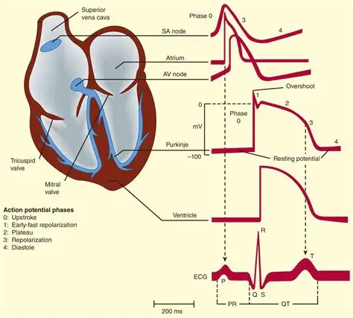

Slide 28
Class I: Sodium Channel Blockers
  Subdivisions based on Rate of Dissociation During Diastole:
    IA (Intermediate): Procainamide, Quinidine, Disopyramide
    IB (Rapid): Lidocaine, Mexiletine
    IC (Slow): Flecainide, Propafenone
  Additional Properties
    IA and IC: Also block potassium channels
      Effect: Slows repolarization, prolongs action potential
  Class IC Specifics
    Slow Dissociation: Flecainide, Propafenone
      Result: Increased effect at faster rates (use-dependence)
      Risk: Higher proarrhythmic activity, especially in diseased myocardium

Slide 29
Type IA: Procainamide
  Indications
    First Line: Antidromic wide complex AVRT (WPW)
    Refractory Treatment: Orthodromic narrow complex AVRT
    Stable V Tach: With a pulse
Dosing
  IV:
    10-17 mg/kg at 20-50 mg/min or 100 mg every 5 mins
    Maintenance: 1-4 mg/min
  PO:
    50 mg/kg/day, divided every 6 hours
Adverse Effects
    Cardiac toxicity (QRS, PR, QT prolongation)
    Bradycardia
    Hypotension
    Drug-induced lupus erythematosus-like syndrome
    Blood dyscrasias
    Slide 4: Monitoring
    Blood pressure
    Serial EKG

Slide 30
Type IB: Lidocaine
  Indications
    Treatment for Stable V Tach with Pulse
    Lidocaine or Amiodarone in ACLS for pulseless ventricular arrhythmias (VT and VF)
  Dosing
    Initial: 1-1.5 mg/kg
    Repeat: 0.5-0.75 mg/kg every 5-10 mins (max 3 mg/kg)
    Continuous Infusion: 1-4 mg/min
  Mechanism of Action
    Na+ channel bloackade: Primarily affects tissues with high depolarization rates (ventricular ectopic foci)
  Contraindications
    WPW syndrome
  Monitoring
    Liver function tests, Neurologic signs, mental status, ECG, BP
    Lidocaine concentrations

Slide 31
Lidocaine Toxicity
Nervous System Effects
  Common Symptoms:
    Tremor, tinnitus
    Insomnia or drowsiness
    Lightheadedness, slurred speech
    Ataxia, depression, agitation
    Hallucinations, memory impairment, emotional lability
  Notes:
    Usually mild and dose-dependent
    Resolve with reduced infusion rate or discontinuation
    High plasma concentrations can cause seizures

Slide 32
Lidocaine Toxicity
Cardiovascular Effects
  Infrequent Symptoms:
    Sinus slowing, asystole
    Hypotension, shock
  Notes:
    Typically, from overdosing or rapid IV administration
    Hepatic Dysfunction
  Caution:
    Severe hepatic dysfunction increases toxicity risk

Slide 33
Type IC: Flecainide (Tambocor)
  Indications
    Primary Use:
      Prevent sustained V tach in patients without structural heart disease
    Atrial Fibrillation/Flutter:
      Prevention in patients not candidates for ablation and other therapies have failed
    Alternative Use:
      Treat PVCs when other therapies have failed (off-label)
  Dosing
      Initial: 50-100 mg PO every 12 hours
      Increase: By 50 mg BID every 4 days
      Maximum: 400 mg/day
  Contraindications
      Avoid in: Patients with structural heart disease

Slide 34
Type IC: Flecainide (Tambocor)
  Adverse Effects
    Proarrhythmic activity
    Prolonged PR interval
    Second-degree heart block
    Dizziness
    Visual disturbances
    Dyspnea
  Monitoring
    ECG
    Blood pressure
    Heart rate
    Periodic serum trough concentrations (especially in renal or hepatic impairment)

Slide 35
Flecainide (Tambocor): Warnings
US Boxed Warnings
  Proarrhythmic Effects:
    Increased PVCs, V tach, V fib, and death reported in atrial fibrillation patients
    Not recommended for chronic atrial fibrillation
  Atrial Flutter:
    1:1 AV conduction risk
    Use preemptive negative chronotropic therapy (e.g., digoxin, beta-blockers)
Dietary Considerations
  Milk Interaction:
    Decreases absorption of flecainide
    Adjust dose if milk is removed from diet
    Monitor serum levels with changes in milk intake

Slide 36
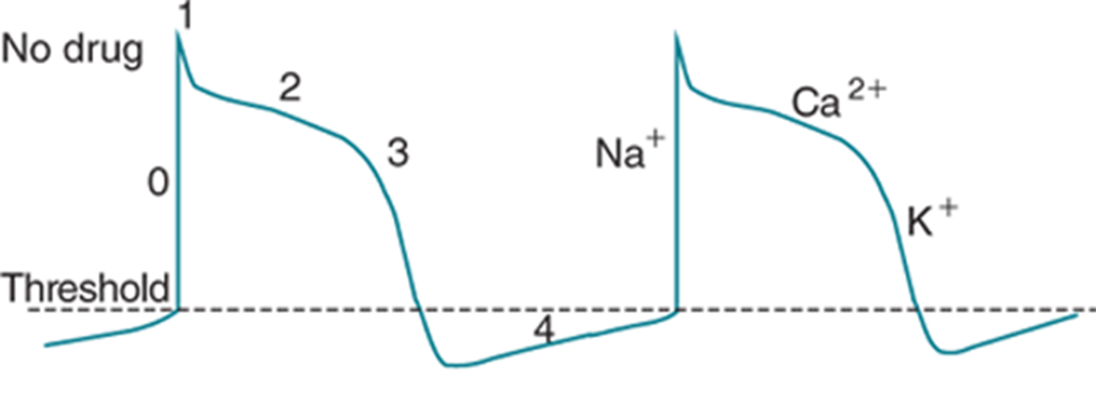
Class II: Beta Blockers
MOA involves Phase 4 of the action potential
By inhibition of sympathetic activity via beta-adrenergic blockade, conduction through the SA and AV nodes is slowed
Certain Beat Blockers have membrane stabilizing activity and increase refractory period.

Slide 37
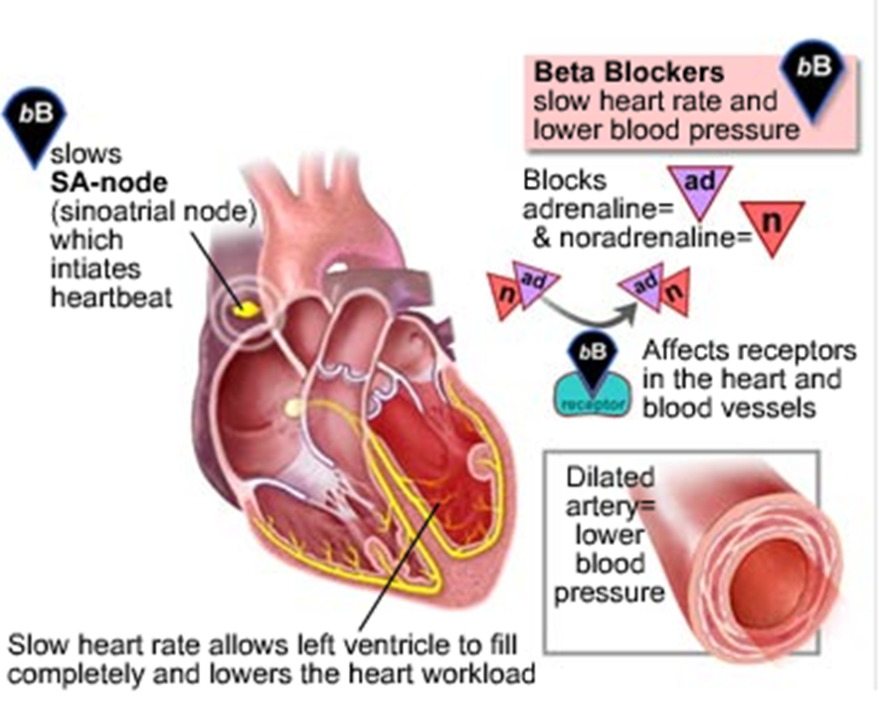
Mechanism of Beta Blockers

Slide 38
Classification of Beta Blockers
SELECTIVE BETA BLOCKERS
  TARGET: Β1 RECEPTORS (PRIMARILY IN CARDIAC TISSUE)
    Metoprolol (Lopressor)
    Atenolol (Tenormin)
    Esmolol (Brevibloc)
    Bisoprolol (Zebeta)
NONSELECTIVE BETA BLOCKERS
  TARGET: Β1 AND Β2 RECEPTORS
    Carvedilol (Coreg)
    Propranolol (Inderal)
    Sotalol (Betapace)
    Labetalol (Normodyne)
    Timolol

Slide 39
Beta Blockers: Adverse Reactions
AV BLOCK RISKS
  POTENTIAL BLOCKS:
    First-degree AV block
    Second-degree AV block
    Complete heart block
  MANAGEMENT: USUALLY RESOLVES WITH DOSE REDUCTION OR DISCONTINUATION
  BRONCHOSPASM
    Risk: Nonselective agents prevent bronchodilation
    Caution: Use carefully in patients with asthma and COPD
WITHDRAWAL EFFECTS
  RISKS: EXACERBATION OF ISCHEMIC SYMPTOMS IN CAD PATIENTS
    Potential acute MI
    Possible serious ventricular tachyarrhythmia
    Risk of sudden cardiac death

Slide 40
Beta Blocker Toxicity
  Attempted suicide or accidental overdose with beta blockers can result in bradycardia, hypotension, low cardiac output, cardiac failure, and cardiogenic shock
  Bronchospasm & respiratory depression may also occur due to severe circulatory impairment or a central drug effect.
  The myocardium in severe intoxications may become relatively refractory to pharmacologic & electrical stimulation, resulting in asystolic death.
  Changes in mental status, convulsions, and coma have also been described

Slide 41
Metoprolol (Lopressor, Toprol XL)
  INDICATIONS
    Ventricular Rate Control: Stable A fib/flutter with RVR
    Multifocal Atrial Tachycardia (MAT): In patients without heart failure or bronchospasm
    Symptomatic PACs and PVCs
    Third-Line Treatment: AVNRT and orthodromic AVRT after vagal maneuvers and adenosine
  DOSING
    IV: 5 mg every 5 mins (up to 3 doses)
    PO: 25 mg BID
  ADVERSE EFFECTS
    Depression, fatigue, sexual dysfunction
    Bradycardia, hypotension
    Decreased exercise tolerance
  CONTRAINDICATIONS
    SSS (Sick Sinus Syndrome)
    Second or third-degree heart block (without pacemaker)
    Decompensated heart failure
    Hypotension
    Documented hypersensitivity to the drug

Slide 42
Class III: Potassium Channel Blockers
Mechanism of Action
  Block Rapid Potassium Current:
    Prolong refractory period
    Prolong action potential duration (APD)
    No effect on phase 0 depolarization or resting membrane potential
  Effects on Myocytes
    Decreased excitability
    Prevents reentry mechanisms and ectopic foci
    Reduces tachyarrhythmias
  Included Medications
    Amiodarone (Cordarone, Pacerone)
    Sotalol (Betapace)
    Dronedarone (Multaq)
    Ibutilide (Corvert)
    Dofetilide (Tikosyn)

Slide 43
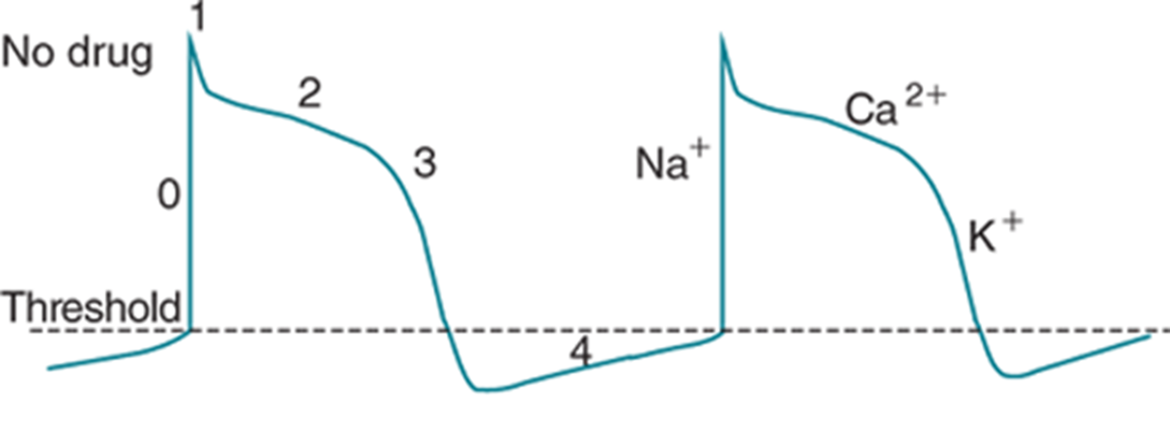
Class III: MOA
These drugs prolong repolarization and refractory period because K is transported back out of the cell slowly to reset the electrochemical gradient of the resting membrane potential

Slide 44
Class III: Potassium Channel Blockers
  Indications:
    Rhythm control in AF/flutter,
    Treatment/prevention of VT/VF
    Conversion of atrial arrhythmias
      Select based on structural heart disease, renal function, and torsades risk.
  Reverse Use Dependence
    Effect: Action potentials are more prolonged at slower heart rates
    Drugs Noted: Sotalol, Dofetilide, Ibutilide
  ECG Manifestations
    QT Interval Prolongation:
      Due to blockage of ventricular potassium currents
      Risk: Torsades de Pointes (polymorphic VT)

Slide 45
Amiodarone (Cordarone, Pacerone)
  Indications
    Cardiac Arrest: Post-defibrillation, compressions, and Epinephrine (VT without pulse, VF)
    Stable VT with Pulse
    Unstable VT with Pulse: Post-cardioversion
  Mechanism of Action
    Primary action is blockage of cardiac potassium channels
    Also has Na+, β-adrenergic blockade, and Ca2+ blockade
      Effects: Phase I, II, and IV

Slide 46
Amiodarone (Cordarone, Pacerone)
  Dosing
    ACLS:
      Initial: 300 mg IV rapid bolus
      Follow-up: 150 mg bolus
    Sustained VT with Pulse:
      150 mg IV over 10 minutes
      Then 1 mg/min for 6 hours
      Then 0.5 mg/min for at least 18 hours
    Oral (PO):
      400 mg every 8-12 hours for 1-2 weeks
      Maintenance: 200-400 mg daily

Slide 47
Amiodarone (Cordarone, Pacerone)
  Pharmacokinetics
    Metabolism: Hepatic
      Half-life (extended):
        IV: 9-36 days
        PO: 58 days (range 15-142 days)
Contraindications
  Patients with:
    SSS (Sick Sinus Syndrome)
    AV block
    SND (Sinoatrial Node Dysfunction)
    Bradycardia without pacemaker
    Cardiogenic shock
    Hypersensitivity to iodine

Slide 48
Amiodarone: Warnings
Amiodarone Adverse Effects and Monitoring
  Cardiac Effects
    Acute Hemodynamic Changes:
    Bradycardia
    Hypotension (especially with IV administration)
  Conduction Disruptions:
    AV block
    Sinoatrial arrest
  New Onset VT:
    Risk associated with use
Hepatotoxicity [US Boxed Warning]
  Monitoring:
    Baseline and periodic liver transaminases
  Action:
    Discontinue or reduce dose if liver enzymes >3x normal or double in patients with elevated baseline

Slide 49
Amiodarone: Warnings
Amiodarone Adverse Effects and Monitoring
Pulmonary Toxicity [US Boxed Warning]
  Risks:
    Pulmonary fibrosis
    Hypersensitivity pneumonitis
    Interstitial/alveolar pneumonitis (dose-related, potentially fatal)
  Monitoring:
    Baseline chest X-ray and pulmonary function tests
    Repeat chest X-ray every 3-6 months

Slide 50
Amiodarone: Other effects
  Thyroid Toxicity
    Mechanism: Blocks T4 to T3 conversion, high iodine content
    Risks: Hypothyroidism or hyperthyroidism
    Monitoring: Baseline and periodic thyroid function tests
  Ophthalmologic Effects
    Common: Corneal microdeposits (asymptomatic)
    Symptoms: Halos in peripheral vision
    Rare: Optic neuritis leading to blindness
  Skin Effects
    Photodermatitis
    Gray-blue skin discoloration in sun-exposed areas
    Photosensitivity
  Gastrointestinal Effects
    Nausea and vomiting (>10% of patients)

Slide 51
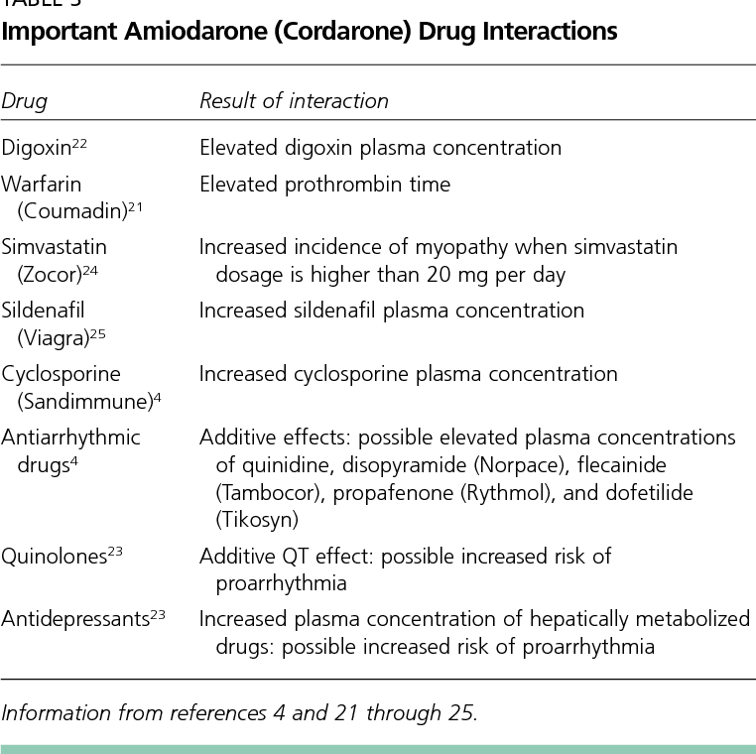
Amiodarone: Drug and Food Interactions
  Drug Interactions
    Significant Interactions: Always check the patient’s med list
    Includes: Beta-blockers and calcium channel blockers
  Food Interactions
    Absorption: Food increases the rate and extent of absorption
    Grapefruit Juice: Increases bioavailability by 50% (should be avoided)

Slide 52
Sotalol (Betapace)
Indications
  Primary Use:
    Life-threatening ventricular arrhythmias
    Maintenance of sinus rhythm in atrial fibrillation
  Off-Label Use:
    SVT
    Sustained stable monomorphic VT
    Symptomatic PVCs
Dosing – Based on renal function and QTc
    PO: 80 mg BID
    IV: Generally 60-80mg over 1-5 hours
Mechanism of Action
  Dual Action:
    β-adrenergic receptor-blocking (Class II)
    Action potential-prolonging (Class III)

Slide 53
Sotalol (Betapace)
  Adverse Effects
    Bradycardia
    Palpitations
    Fatigue
    Dizziness
    Dyspnea
    Weakness
    BB withdrawal symptoms with abrupt discontinuation
  Interactions and Contraindications
    Interactions: QT prolonging agents
  Contraindications:
    Baseline QTc > 450 msec
    CrCl < 40 mL/min
    Bronchial asthma or bronchospasm
    SSS (Sick Sinus Syndrome)
    AV block
    Bradycardia
    Decompensated heart failure
    Cardiogenic shock

Slide 54
Ibutilide (Corvert)
  Indications
    Conversion of: A fib/flutter
    Stable A fib/flutter with RVR: In patients with WPW
  Dosing
    IV:
      <60 kg: 0.01 mg/kg over 10 minutes
      ≥60 kg: 1 mg over 10 minutes
  Mechanism of Action
    Mildly slows sinus node
    Prolongs QT interval by enhancing slow inward sodium current and blocking potassium channels during repolarization
  Drug Interactions
    QT prolonging agents
  Adverse Effects
    Proarrhythmic effects (monomorphic VT, polymorphic VT, SVT, AV block)
    Headache
  Contraindications
    Hypersensitivity to Ibutilide

Slide 55
Dofetilide (Tikosyn)
  Primary Use:
    Acute termination of atrial fibrillation/flutter
    Prevention of atrial fibrillation/flutter recurrence
  Off-Label Use: Treatment of PSVT
    Note: Not recommended as first-line in patients who can take other antiarrhythmics
    May be used in Heart failure or prior MI
  Mechanism of Action
    Blocks outward potassium current
    Prolongs repolarization and QT interval

Slide 56
Dofetilide (Tikosyn)
  Adverse Effects
    Torsades de Pointes (TdP)
    Headache
    Chest pain
    Dizziness
    Ventricular tachycardia (VT)
    Ventricular fibrillation (VF)
  Contraindications
    Congenital long QT
    QTc over 440 msec
    Severe renal insufficiency
  Monitoring
    Initial Monitoring: Hospitalized for 3 days
    Parameters: CrCl, QT interval, and rhythm

Slide 57
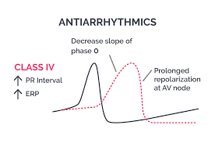
Class IV: Calcium Channel Blockers
  Drugs: Diltiazem (Cardizem), Verapamil (Calan, Verelan)
    Use: Antiarrhythmics, selective for myocardium
    Effect: Less systemic vasodilation
  Mechanism of Action
    AV Node: Slows conduction, increases refractory period
    Heart Rate: Decreases heart rate and conduction velocity

Slide 58
Diltiazem (Cardizem)
  Indications
    Ventricular rate control in A fib/flutter with RVR
    MAT treatment if underlying etiology not resolved in bronchospasm patients
    AVNRT treatment after vagal maneuvers and adenosine
    Orthodromic AVRT treatment after vagal maneuvers and adenosine
    Treatment of symptomatic PACs and PVCs
  Dosing
    IV:
      0.25 mg/kg bolus (usually 10-20 mg)
      5-10 mg/hr infusion, titrated to ventricular rate
    PO:
      120-480 mg/day in 3-4 divided doses

Slide 59
Diltiazem (Cardizem)
  Adverse Effects
    Bradycardia
    Cutaneous sensitivity reactions (maculopapular rash)
    Peripheral edema
    Dizziness
    Fatigue
    Vasodilation
  Contraindications
    A fib/flutter with accessory pathway (risk of VF)
    SSS
    AV block
    Hypotension
    Recent beta-blocker use
    Ventricular tachycardia
    Severe heart failure

Slide 60
Verapamil
  Indications
    Ventricular Rate Control: A fib/flutter with RVR
    MAT Treatment: If underlying etiology unresolved in bronchospasm patients
    AVNRT Treatment: After vagal maneuvers and adenosine
    Orthodromic AVRT Treatment: After vagal maneuvers and adenosine
    Symptomatic PACs and PVCs
  Dosing
    IV:
      5-10 mg over ≥2 minutes (repeat 10 mg after 15-30 mins if needed)
    PO:
      40 mg 3-4 times daily, titrate to rate control

Slide 61
Verapamil
  Adverse Effects
    Bradycardia
    LV block
    Decompensated heart failure and pulmonary edema
    Peripheral edema
    Constipation
    Headache
  Contraindications
    Concurrent beta blocker use
    Heart failure with reduced EF
    A fib/flutter with accessory pathway (WPW)
    SND, SSS, or AV block without pacemaker
    Ventricular tachycardia
    Hypotension

Slide 62
Questions?

