Slide 1
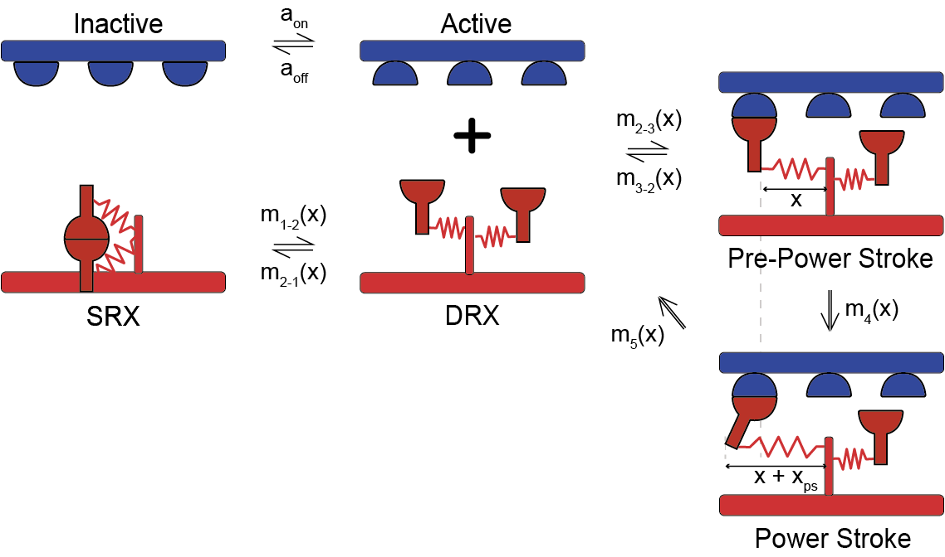
New kinetic scheme
Still force dependent

Slide 2
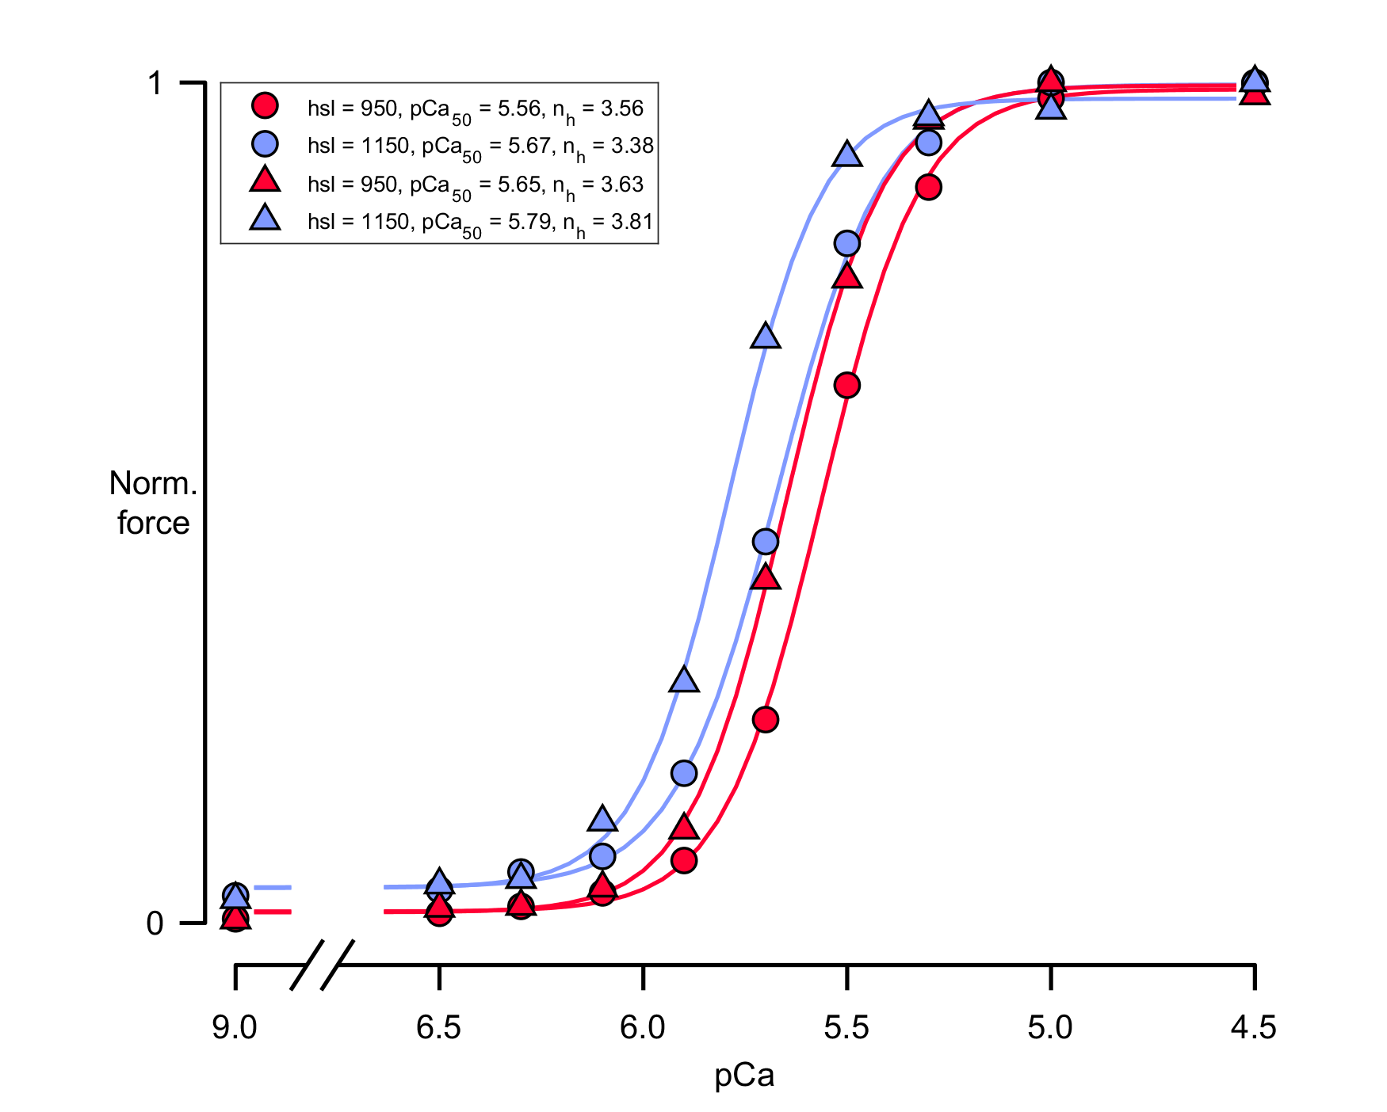
P and D zones : both dimer’s heads fast
C zone: 1 head fast, 1 head slow
Assumption: phosphorylation make slow heads in the C zone switch to fast ( so all the heads become fast across the entire filament )
Circles: before phosphorylation
Triangle: after phosphorylation

