Slide 1
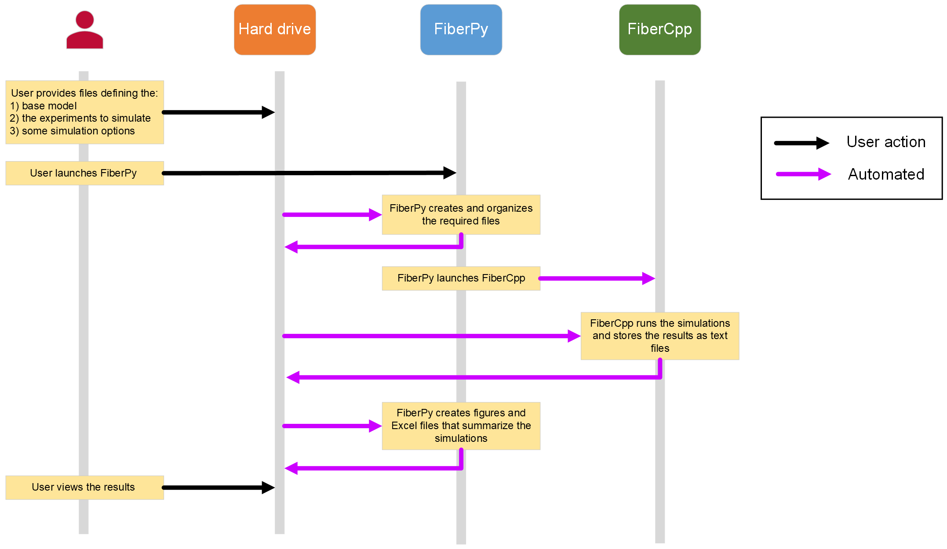
FiberSim is a spatially explicit model that track position and status of each contractile molecule in the myofilaments lattice.
Website: Home | FiberSim
Paper: FiberSim: A flexible open-source model of myofilament-level contraction - PMC

Slide 2
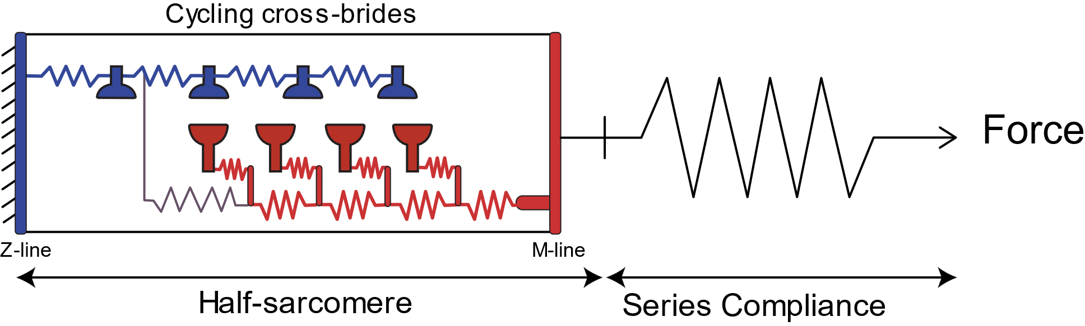
BaseModel: define half-sarcomere structure (json fomat file)
{
"FiberSim": {
"version": "2.1.0"
},
"muscle": {
"no_of_half_sarcomeres": 1,
"no_of_myofibrils": 1,
"initial_hs_length": 1100,
"prop_fibrosis": 0.0,
"prop_myofilaments": 0.5,
"m_filament_density": 0.407e15,
"sc_k_stiff": 3000
},
"lattice_parameters": {
"viscosity": 0.2e-4
},
"thick_structure": {
"m_n": 100,
"m_crowns_per_filament": 54,
"m_hubs_per_crown": 3,
"m_myosins_per_hub": 2,
"m_inter_crown_rest_length": 13.5,
"m_lambda": 80.0,
"m_starting_angle": 0.0,
"m_inter_crown_twist": 40.0,
"m_within_hub_twist": 20.0
},
"thin_structure": {
"a_strands_per_filament": 2,
"a_regulatory_units_per_strand": 27,
"a_bs_per_unit": 7,
"a_inter_bs_rest_length": 5.375,
"a_inter_bs_twist": 25.7143,
"a_bs_per_node": 2
"titin_structure": {
"t_attach_a_node": 21,
"t_attach_m_node": 54
},
"thin_parameters": {
"a_no_of_bs_states": 2,
"a_k_stiff": 2,
"a_k_on": 2e7,
"a_k_off": 100,
"a_k_coop": 10
},
"thick_parameters": {
"m_k_stiff": 2 },
"titin_parameters": {
"t_passive_mode": "linear",
"t_k_stiff": 6e-6,
"t_slack_length": 0
},
"extracellular_parameters": {
"e_passive_mode": "exponential",
"e_sigma": 0,
"e_L": 50,
"e_slack_length": 800
},
"m_parameters": {
"m_k_cb": 0.001,
"m_isotype_ints": [1, 2, 1, 2, 1, 2, 1, 2, 1, 2, 1, 2, 1, 2, 1, 2,…]
},

Slide 3
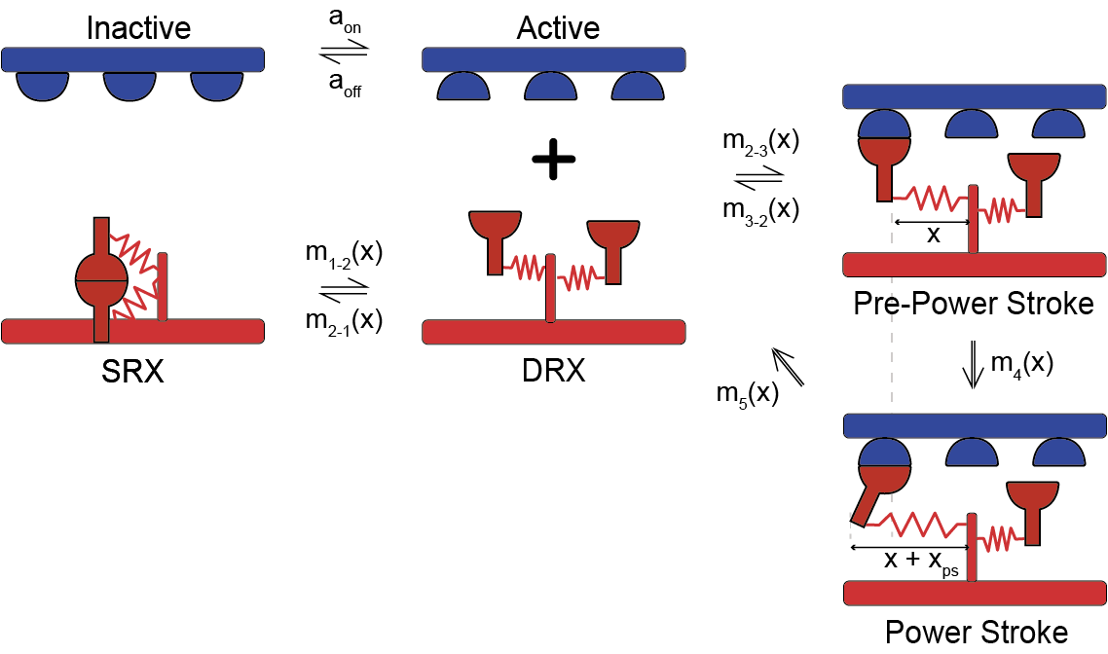
BaseModel: define kinetic scheme (json fomat file)
"m_kinetics": [
{
"state": [
{
"number": 1,
"type": "S",
"extension": 0,
"transition": [
{
"new_state": 2,
"rate_type": "force_and_mybpc_dependent",
"rate_parameters": [20, 100, 1, 1, 1, 1, 1, 1]
}
]
},
{
"number": 2,
"type": "D",
"extension": 0,
"transition": [
{
"new_state": 1,
"rate_type": "constant",
"rate_parameters": [ 50 ]
},
{
"new_state": 3,
"rate_type": "gaussian_hsl",
"rate_parameters": [ 60 ]
}

Slide 4
BaseModel: define kinetic scheme (json fomat file)
{
"number": 3,
"type": "A",
"extension": 0.0,
"transition": [
{
"new_state": 2,
"rate_type": "poly",
"rate_parameters": [ 75, 10, 4]
},
{
"new_state": 4,
"rate_type": "constant",
"rate_parameters": [ 75 ]
}
]
},
{
"number": 4,
"type": "A",
"extension": 5.0,
"transition": [
{
"new_state": 2,
"rate_type": "exp_wall",
"rate_parameters": [75, 0.5, 4, 7]
}

Slide 5
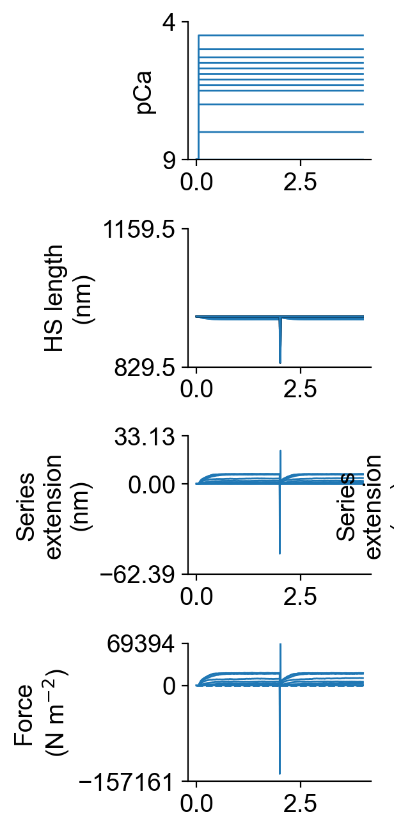
SetupFile: define the protocol that we want to simulate
In this case:
"type": "pCa_length_control",
"pCa_values": [9.0, 8.0, 7.0, 6.5, 6.3, 6.1, 5.9, 5.7, 5.5, 5.3, 5.0, 4.5],
"sim_duration_s": 4.0,
"time_step_s": 0.001,
"pCa_step_up_s": 0.05,
"k_tr_start_s": 2.0,
"k_tr_duration_s": 0.02,
"k_tr_ramp_s": 0.001,
"k_tr_magnitude_nm": 100,
"k_tr_fit_time_s": [2.025, 3.995],
"hs_lengths": [950, 1150]
Ktr at different pCa so we can have from the same input:
Ktr analysis
Force-pCa curves

Slide 6
SetupFile: in addition to the protocol, we can define the parameters of the basemodel that we want to tweak. We can differentiate between 2 different isotype
In this case:
{
"variable": "m_kinetics",
"isotype": 1,
"state": 4,
"transition": 1,
"parameter_number": 1,
"multipliers": [ 1.0, 0.5, 0.5 ],
" output-type": "float"
},
{
"variable": "m_kinetics",
"isotype": 2,
"state": 4,
"transition": 1,
"parameter_number": 1,
"multipliers": [ 1.0, 0.01, 1.0 ],
" output-type": "float"
},
{
"variable": "m_kinetics",
"isotype": 1,
"state": 2,
"transition": 2,
"parameter_number": 1,
"multipliers": [ 1.0, 2.0, 2.0 ],
" output-type": "float"
},
{
"variable": "m_kinetics",
"isotype": 2,
"state": 2,
"transition": 2,
"parameter_number": 1,
"multipliers": [ 1.0, 0.01, 1.0 ],
" output-type": "float"
}
"class": "muscle",
"variable": "m_kinetics",
"isotype": 1,
"state": 1,
"transition": 1,
"parameter_number": 1,
"multipliers": [ 1.0, 2.0, 2.0],
"output-type": "float"
},
{
"variable": "m_kinetics",
"isotype": 2,
"state": 1,
"transition": 1,
"parameter_number": 1,
"multipliers": [ 1.0, 0.01, 1.0 ],
"output-type": "float"
},
{
"variable": "m_kinetics",
"isotype": 1,
"state": 4,
"extension": 1,
"multipliers": [ 1.0, 2.0, 2.0 ],
"output-type": "float"
},
{
"variable": "m_kinetics",
"isotype": 2,
"state": 4,
"extension": 1,
"multipliers": [ 1.0, 0.01, 1.0 ],
"output-type": "float"
},
Not sure if this is useful or not , we will see
Extension change the time spent in the chosen state
2 sarcomere length (see slide above) with 3 multipliers for each parameter = 6 simulations

Slide 7
SetupFile: with the protocol, we can define the parameters of the basemodel that we want to investigate. We can differentiate between 2 different isotype
In this case:
{
"variable": "m_kinetics",
"isotype": 1,
"state": 4,
"transition": 1,
"parameter_number": 1,
"multipliers": [ 1.0, 0.5, 0.5 ],
" output-type": "float"
},
{
"variable": "m_kinetics",
"isotype": 2,
"state": 4,
"transition": 1,
"parameter_number": 1,
"multipliers": [ 1.0, 0.01, 1.0 ],
" output-type": "float"
},
{
"variable": "m_kinetics",
"isotype": 1,
"state": 2,
"transition": 2,
"parameter_number": 1,
"multipliers": [ 1.0, 2.0, 2.0 ],
" output-type": "float"
},
{
"variable": "m_kinetics",
"isotype": 2,
"state": 2,
"transition": 2,
"parameter_number": 1,
"multipliers": [ 1.0, 0.01, 1.0 ],
" output-type": "float"
}
"class": "muscle",
"variable": "m_kinetics",
"isotype": 1,
"state": 1,
"transition": 1,
"parameter_number": 1,
"multipliers": [ 1.0, 2.0, 2.0],
"output-type": "float"
},
{
"variable": "m_kinetics",
"isotype": 2,
"state": 1,
"transition": 1,
"parameter_number": 1,
"multipliers": [ 1.0, 0.01, 1.0 ],
"output-type": "float"
},
{
"variable": "m_kinetics",
"isotype": 1,
"state": 4,
"extension": 1,
"multipliers": [ 1.0, 2.0, 2.0 ],
"output-type": "float"
},
{
"variable": "m_kinetics",
"isotype": 2,
"state": 4,
"extension": 1,
"multipliers": [ 1.0, 0.01, 1.0 ],
"output-type": "float"
},
First column: “Normal” duty ratio. Both dimer heads have the same transitions rate for each state.
Second column: High duty ratio for Isotype 1, low duty ratio for Isotype 2. This is the way that I’m using to simulate faster phosphorylation of just 1 head of the dimer.
Third column: High duty ratio for Isotype 1, normal duty ratio for Isotype 2. Just want to cover all the bases.

Slide 8
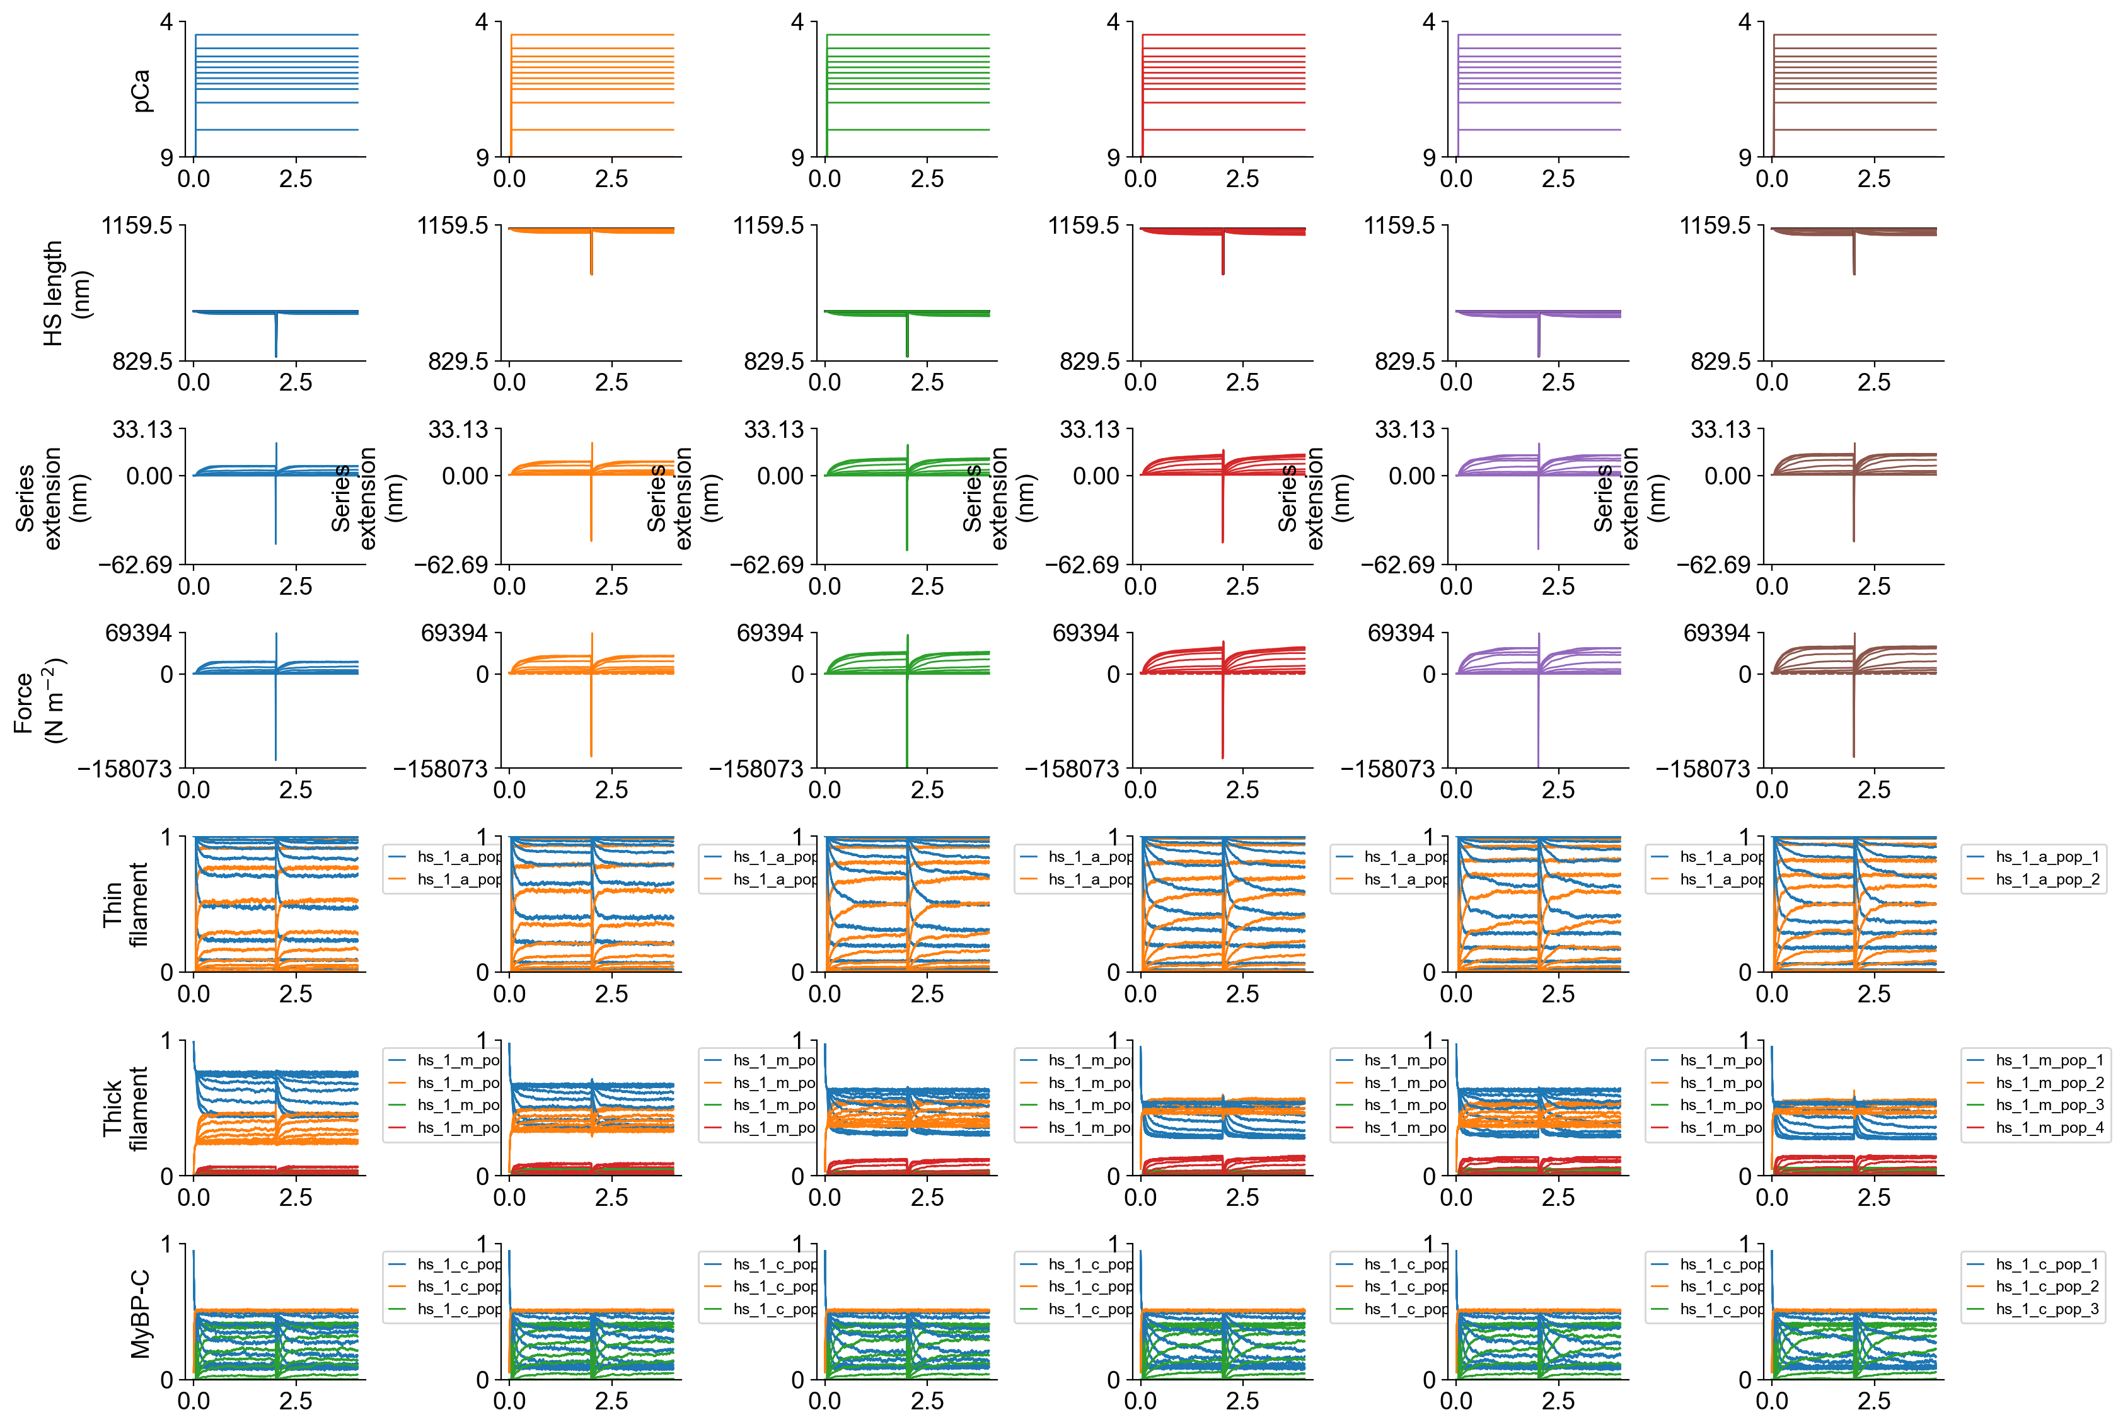
FiberSim output
Different SL

Slide 9
MasterFile: automatically runs three different models and generates the corresponding setupfiles.
"model_types":
[
{
"type": "uniform",
"relative_to": "this_file",
"model": "model_uniform.json"
},
{
"type": "C_zone_phosp",
"relative_to": "this_file",
"model": "model_c_zone.json"
},
{
"type": "D_zone_phosp",
"relative_to": "this_file",
"model": "model_d_zone.json"
}
],
D
C
P
B
12, 12, 12, 12, 12, 12
12, 12, 12, 12, 12, 12, 12, 12, 12, 12
12, 12, 12, 12
D
C
P
B
11, 11, 11, 11, 11, 11
12, 12, 12, 12, 12, 12, 12, 12, 12, 12
11, 11, 11, 11
D
C
P
B
12, 12, 12, 12, 12, 12
11, 11, 11, 11, 11, 11, 11, 11, 11, 11
11, 11, 11, 11

Slide 10
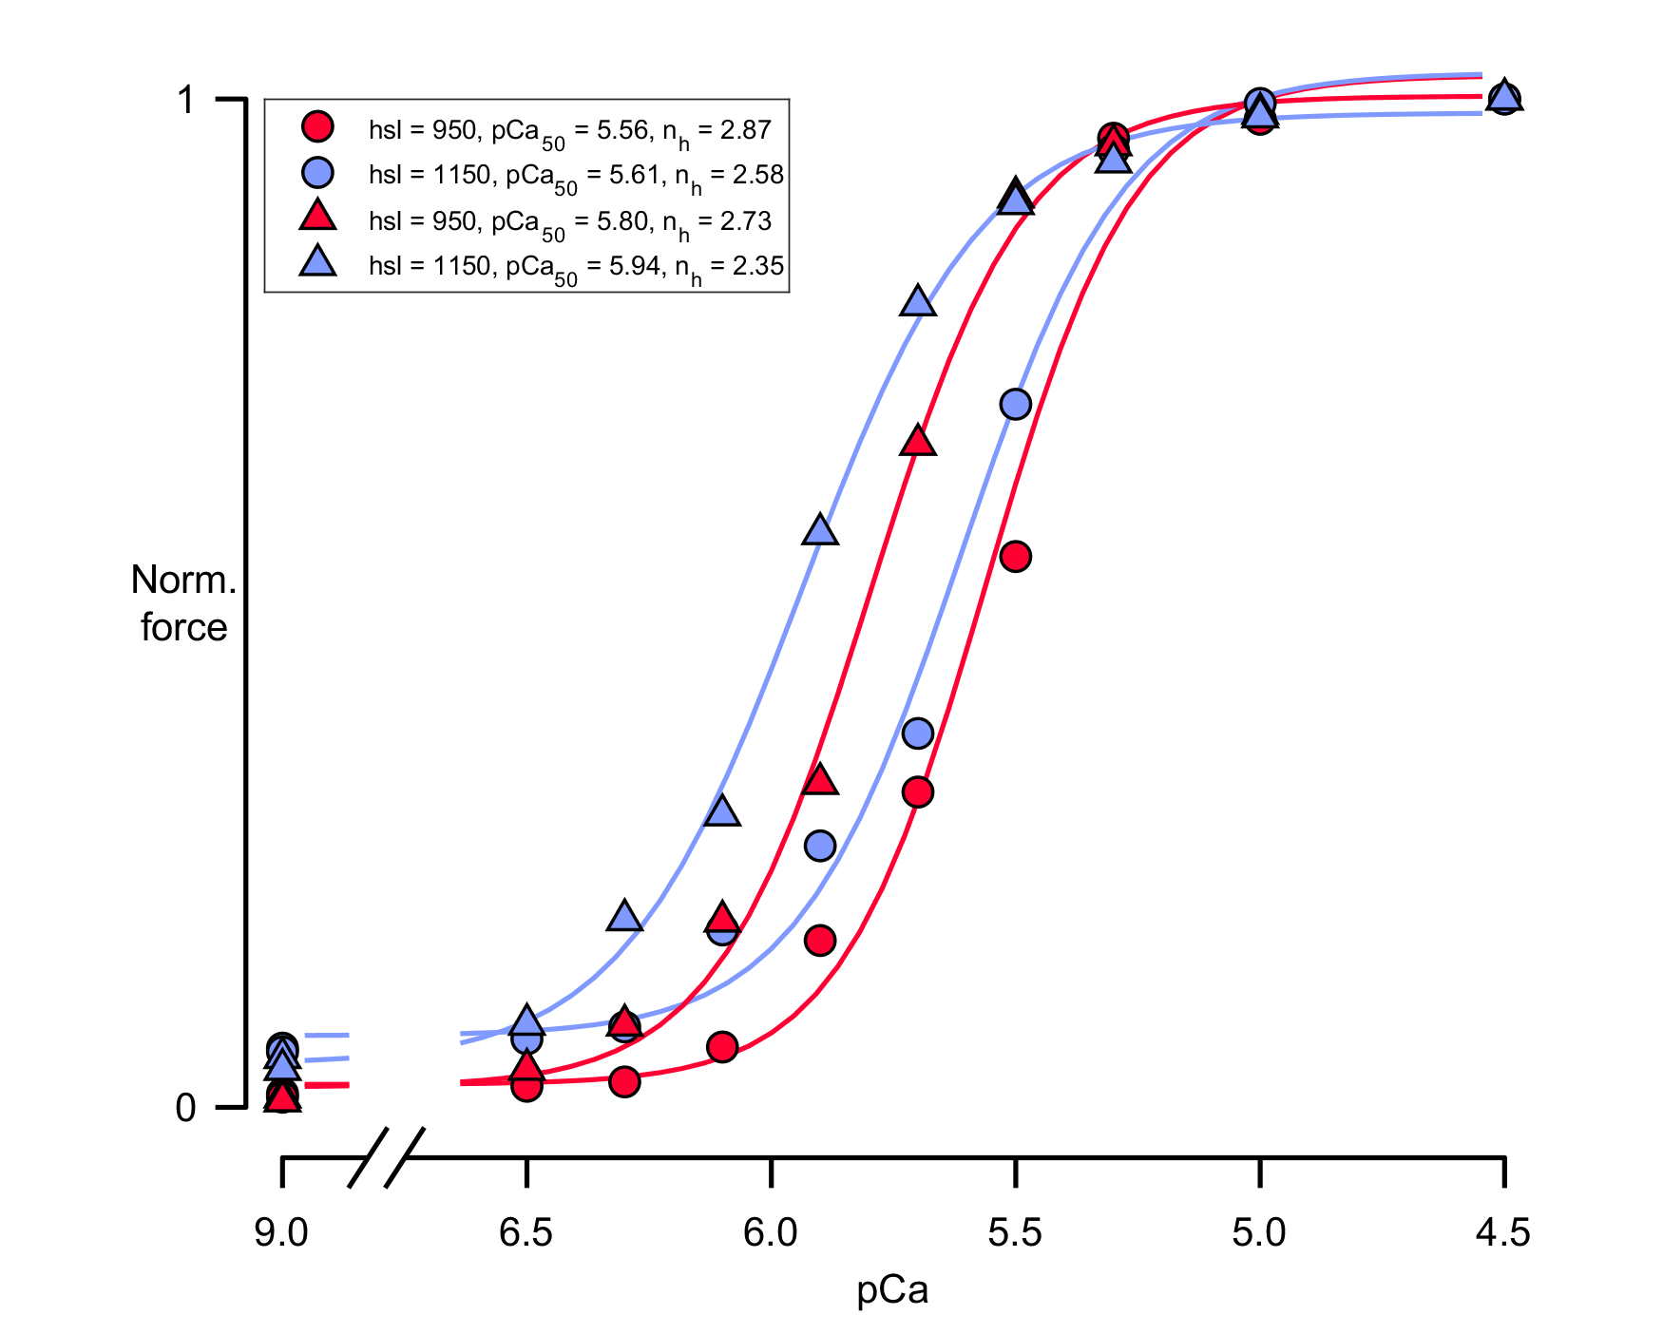
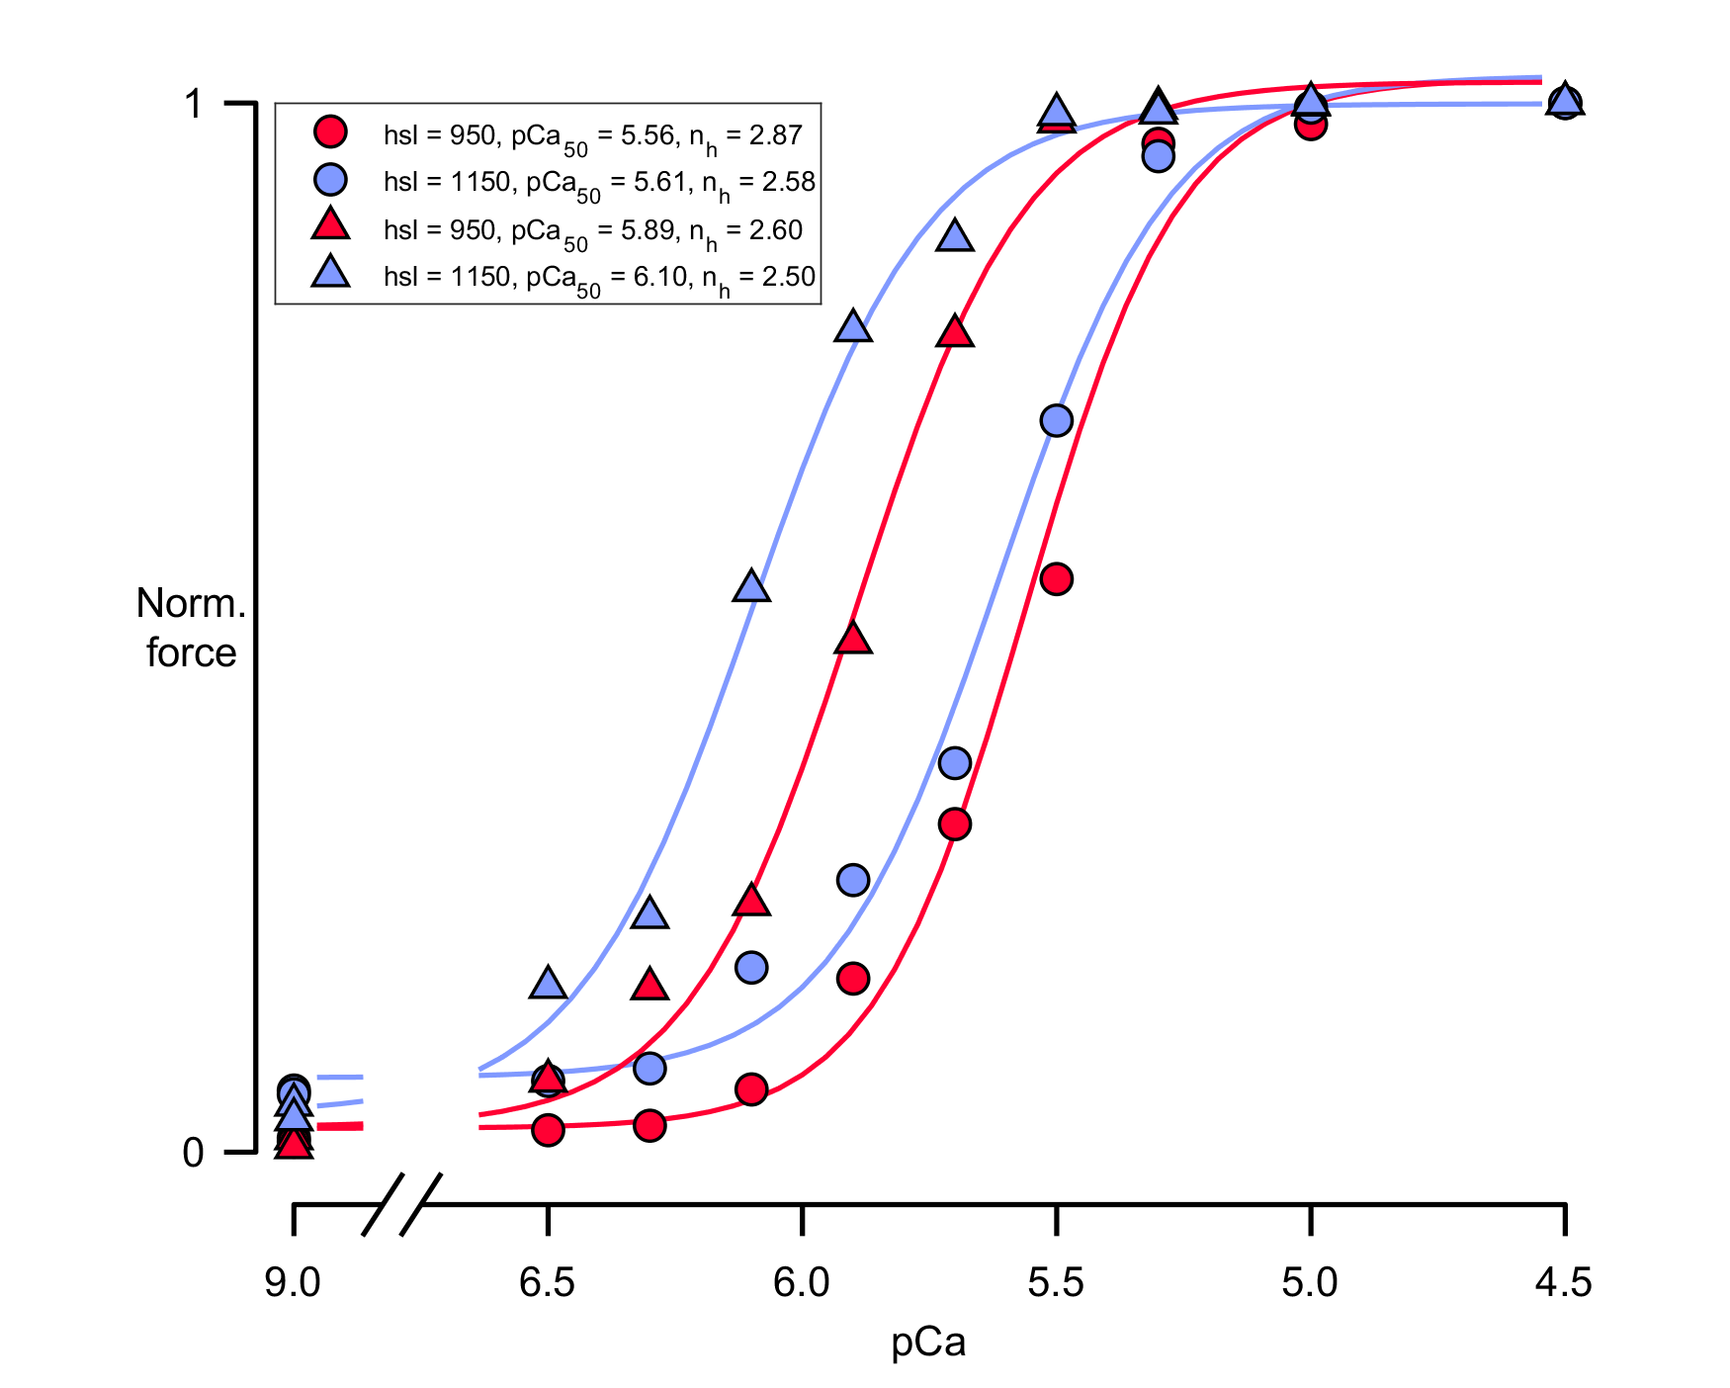
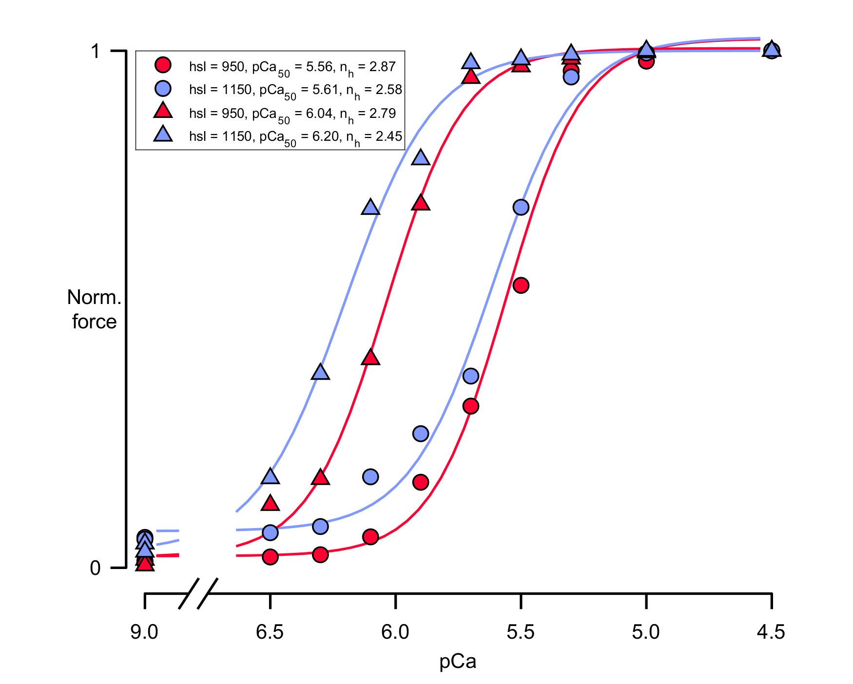
Results: Force-pCa curves
Uniform
C_zone
D_zone
Circles: normal duty ratio for both head
Triangles : Isotype 1 high, isotype2 low duty ratio
Second column: High duty ratio for Isotype 1, low duty ratio for Isotype 2. This is the way that I’m using to simulate faster phosphorylation of just 1 head of the dimer.

Slide 11
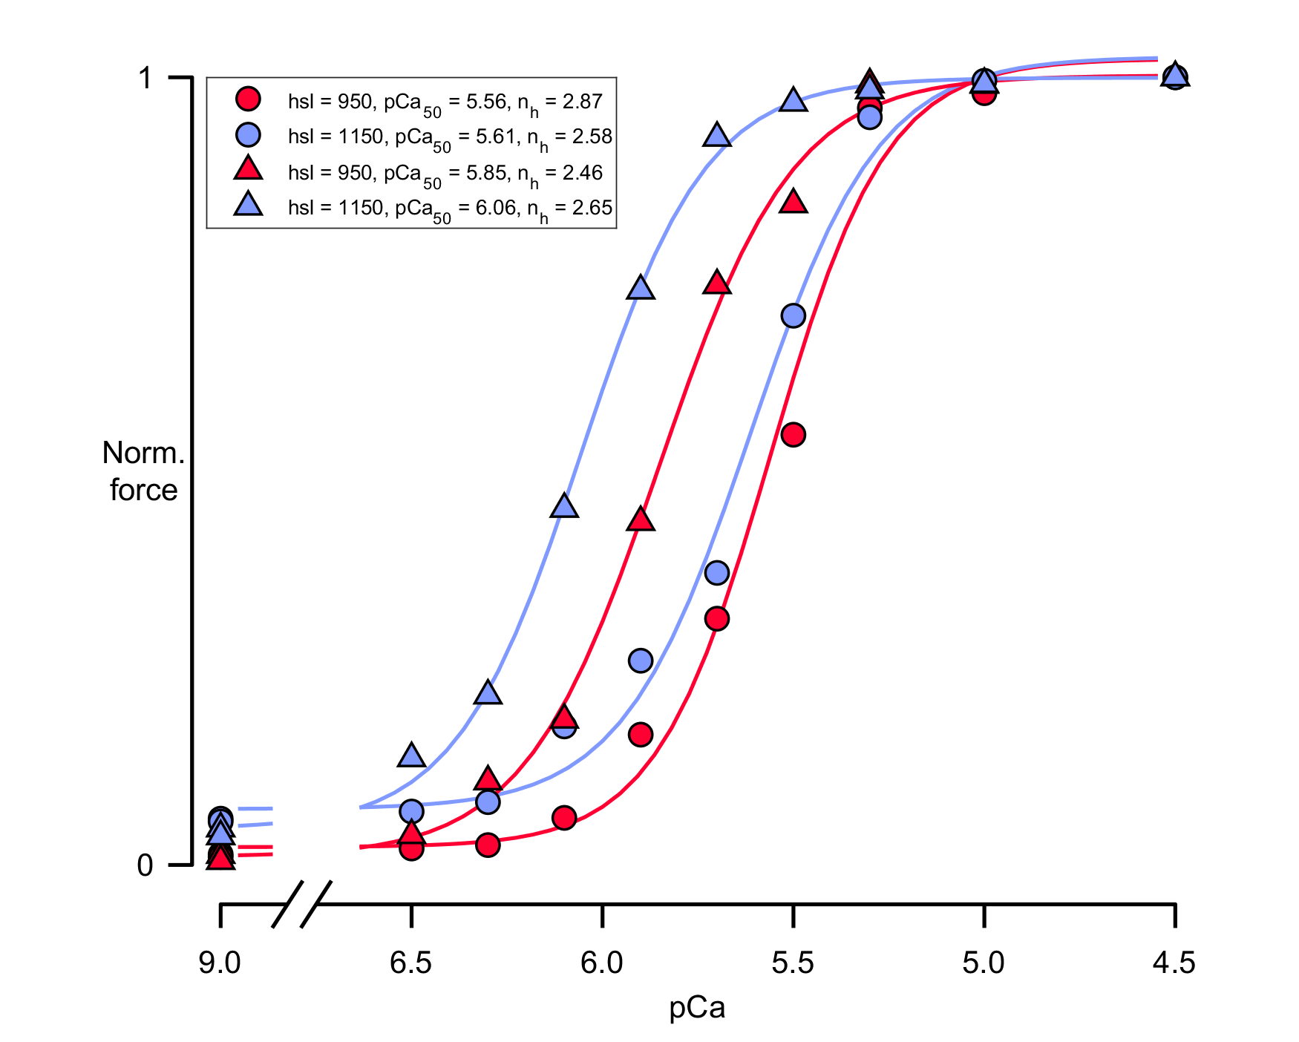
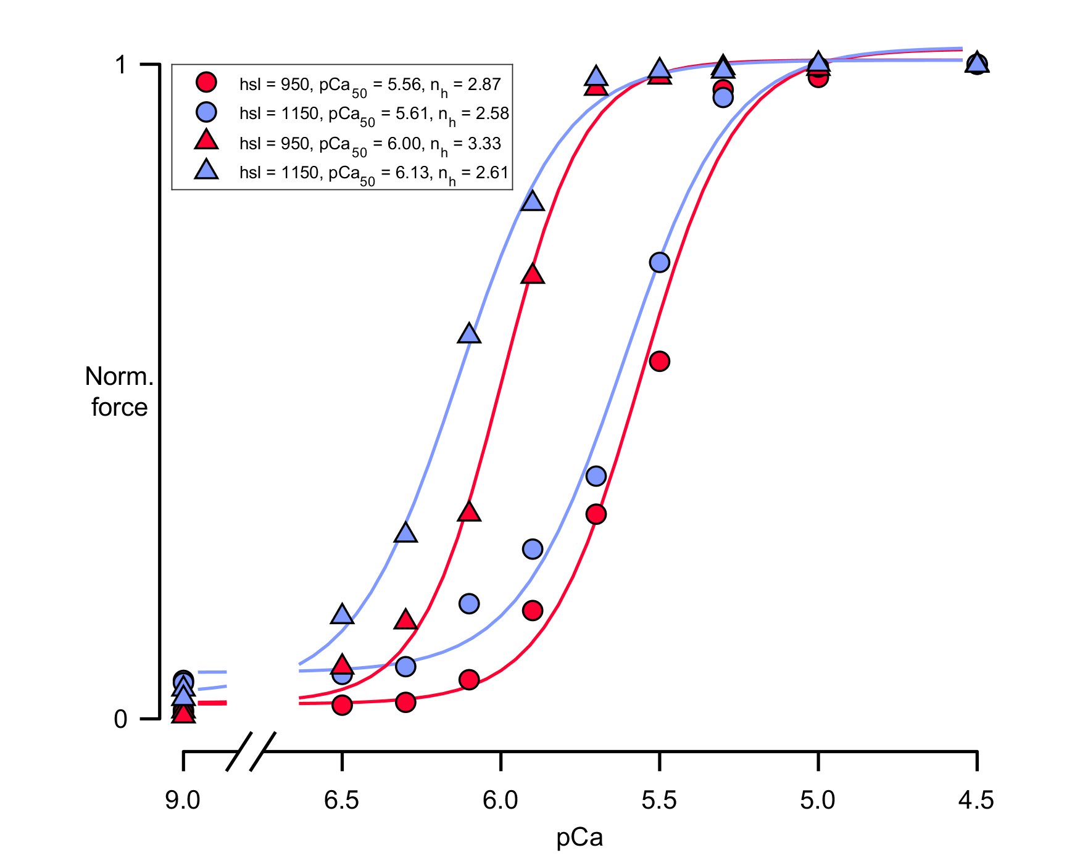
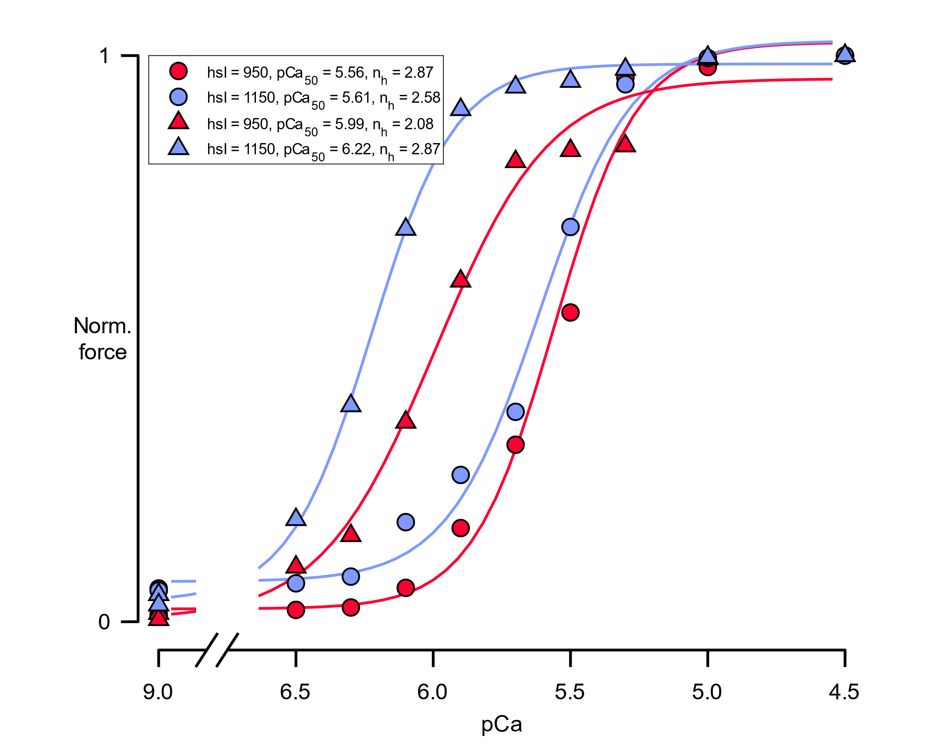
Results: Force-pCa curves
Uniform
C_zone
D_zone
Circles: normal duty ratio for both head
Triangles : Isotype 1 high, isotype 2 normal duty ratio
Third column: High duty ratio for Isotype 1, normal duty ratio for Isotype 2. Just want to cover all the bases.

Slide 12
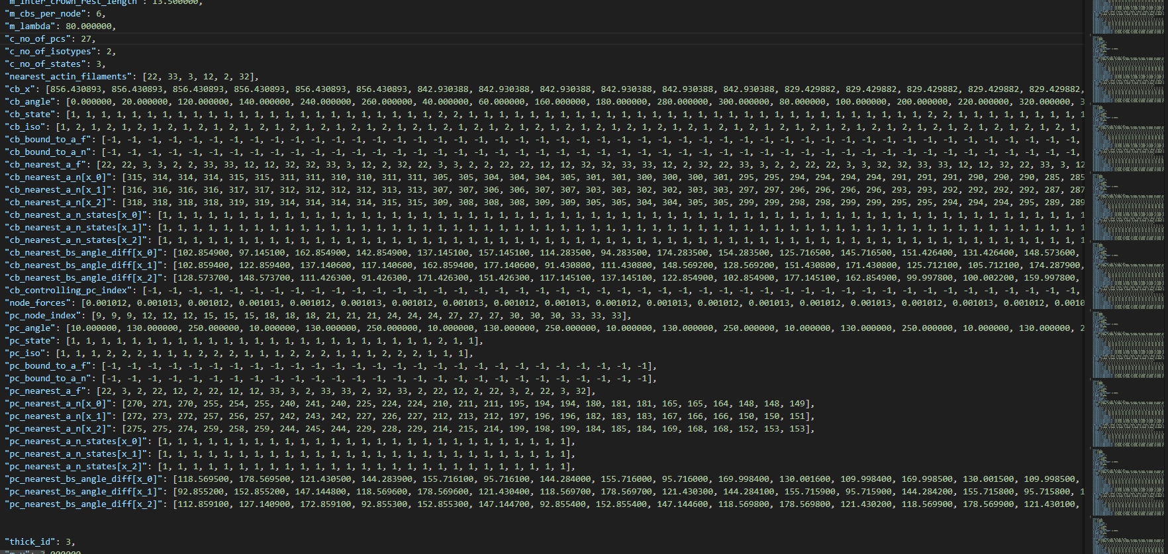
DumpFile: Huge json file with filaments information extracted at specific established time step. It’s like a sarcomere “screenshot”
I haven’t done anything with it yet but it’s part of the FiberSim output

