Slide 1
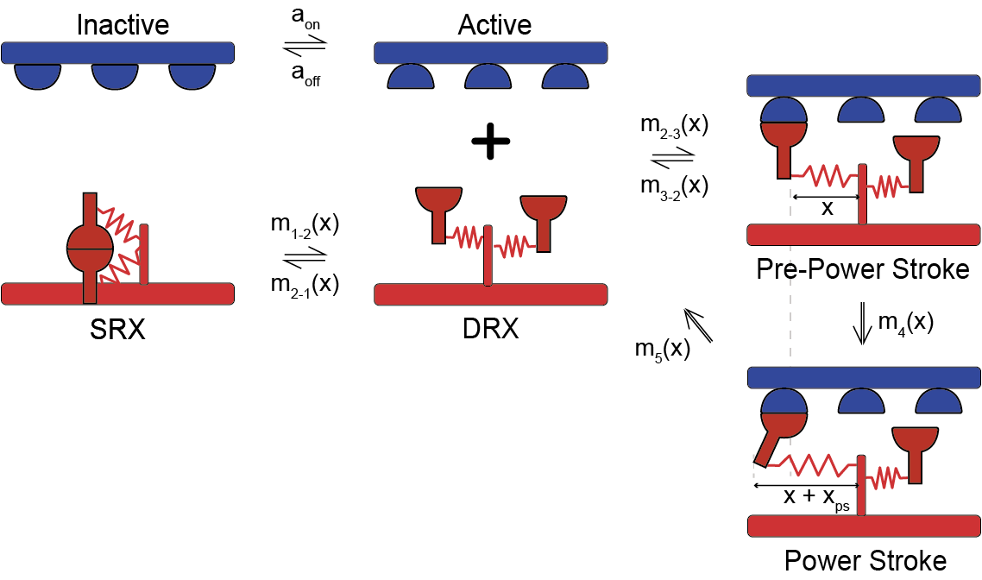
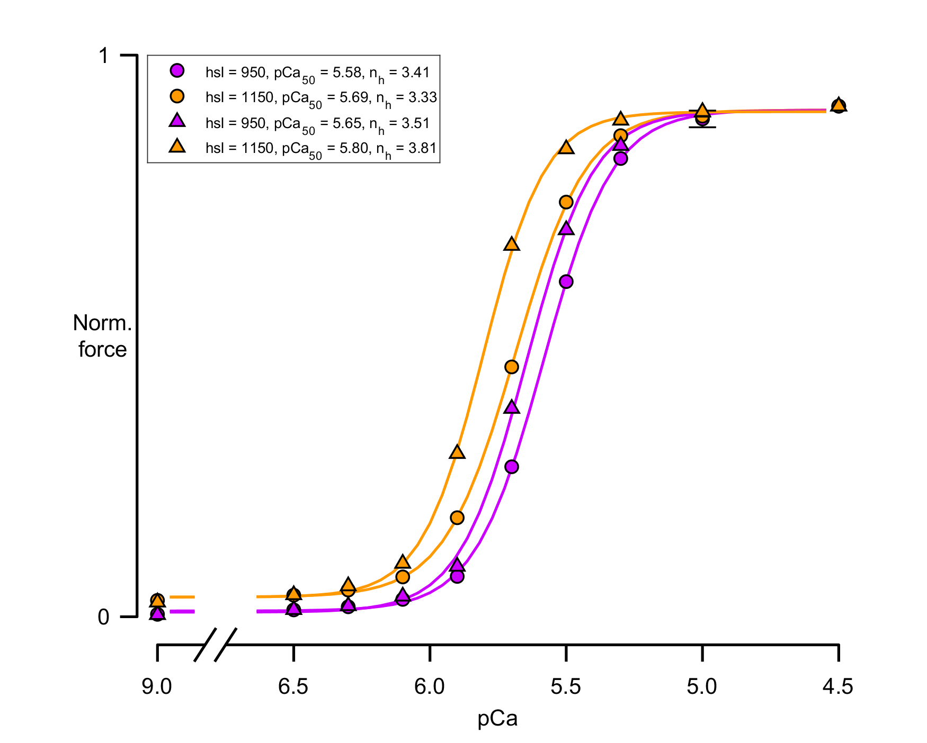
Kinetic scheme
Assumption: phosphorylation make slow heads in the switch to fast
D
C
P
B
11, 11, 11, 11, 11, 11
11, 11, 11, 11, 11, 11, 11, 11, 11, 11
11, 11, 11, 11
1
2
Force dependent
Dimers disposition (start)
D
C
P
B
11, 11, 11, 11, 11, 11
12, 12, 12, 12, 12, 12, 12, 12, 12, 12
11, 11, 11, 11
1 – fast head (fast transition from DRX1 to DRX2)
2 – slow head ( slow transition from DRX1 to DRX2)

Slide 2
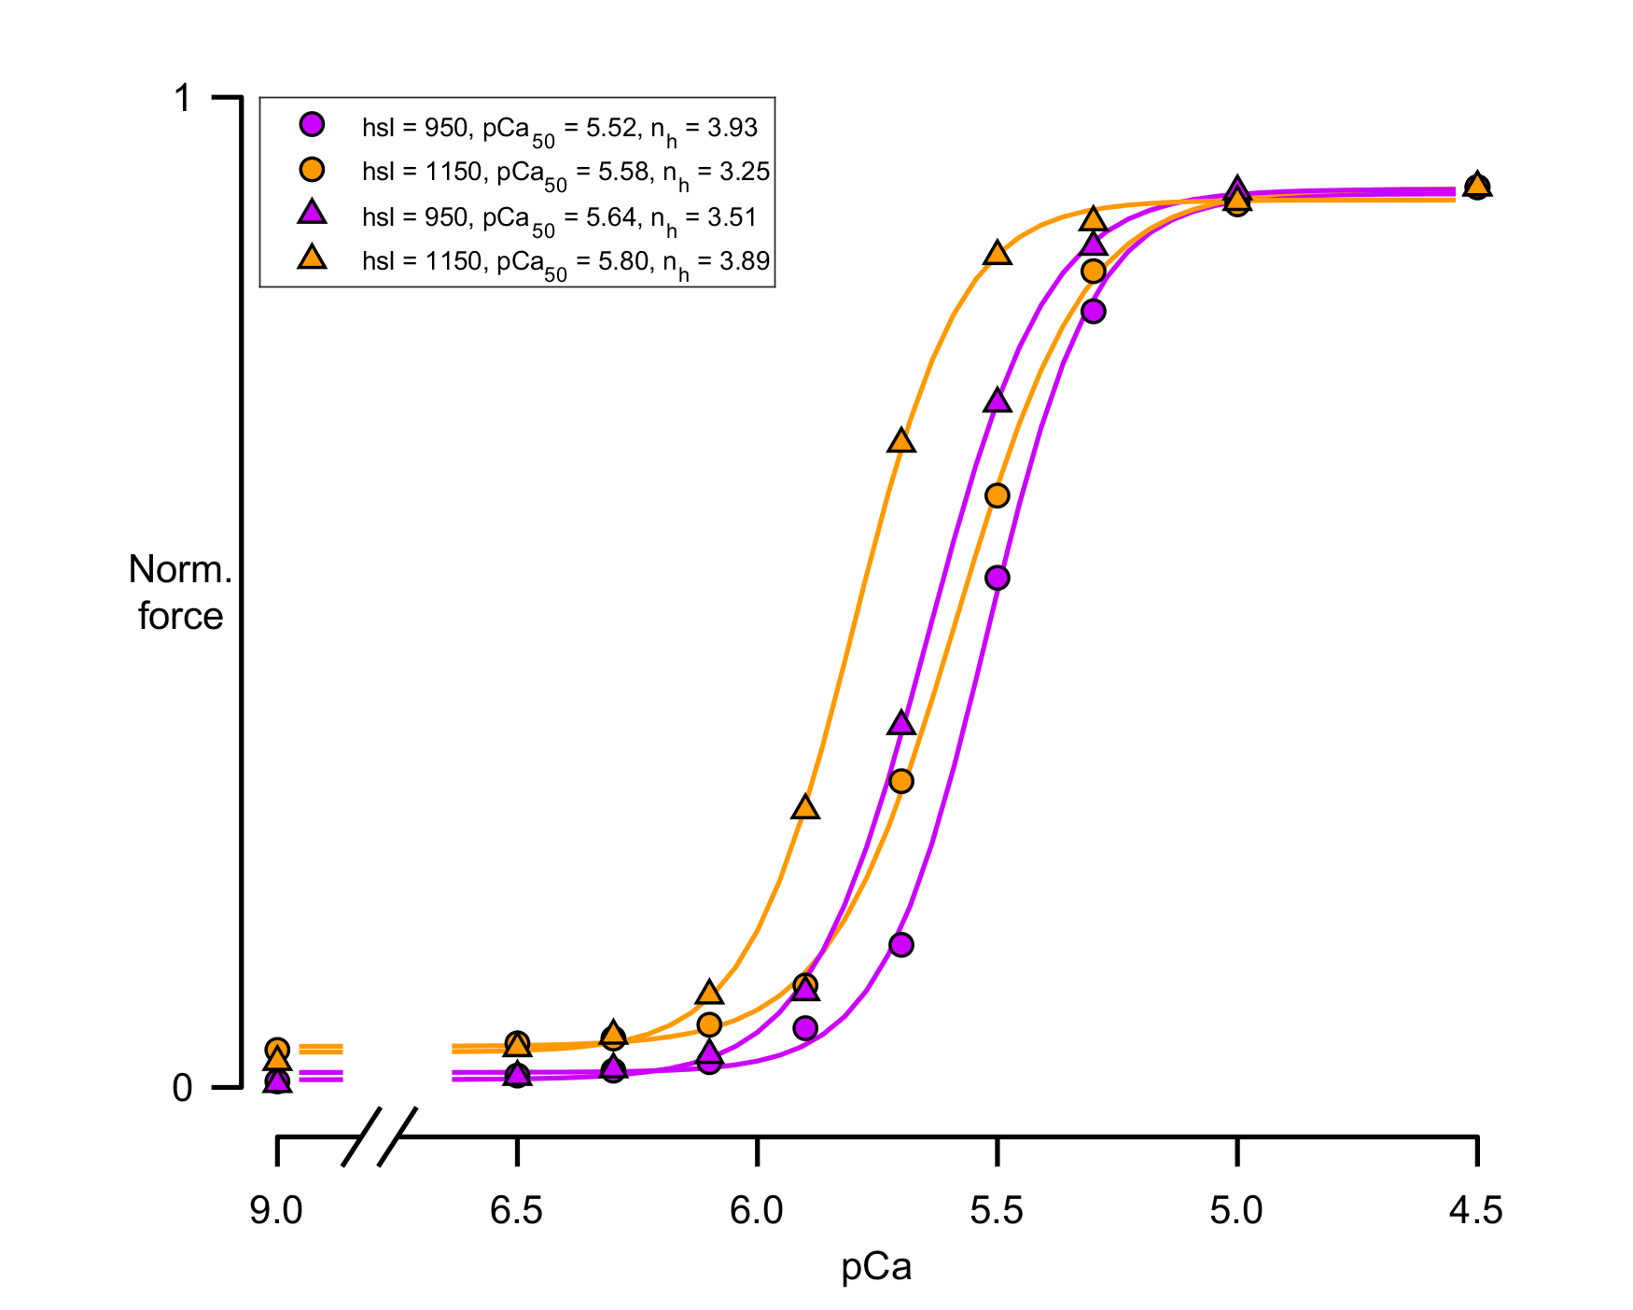
Kinetic scheme
Assumption: phosphorylation make slow heads in the switch to fast
D
C
P
B
11, 11, 11, 11, 11, 11
11, 11, 11, 11, 11, 11, 11, 11, 11, 11
11, 11, 11, 11
1
2
Force dependent
Dimers disposition (start)
D
C
P
B
12, 12, 12, 12, 12, 12
12, 12, 12, 12, 12, 12, 12, 12, 12, 12
12, 12, 12, 12
1 – fast head (fast transition from DRX1 to DRX2)
2 – slow head ( slow transition from DRX1 to DRX2)

Slide 3
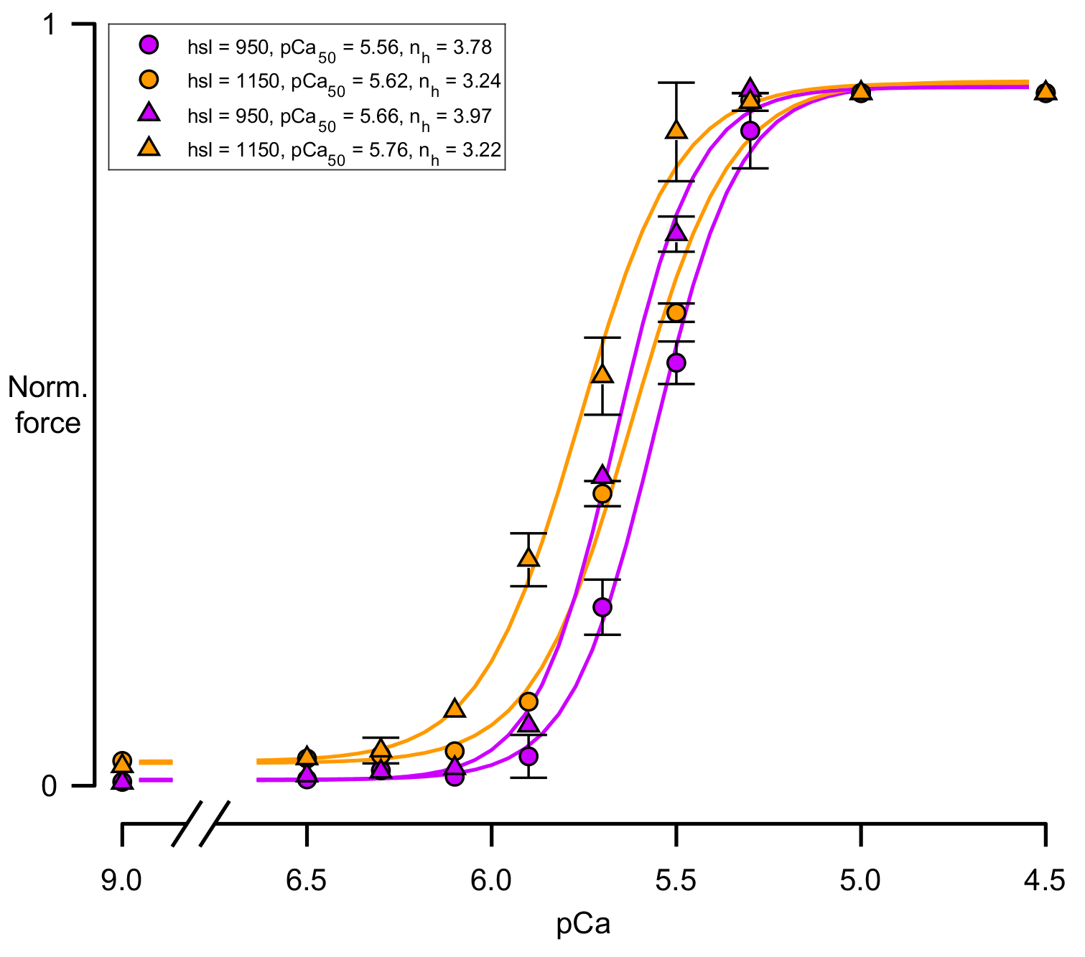
Dimers disposition
D
C
P
B
11, 11, 11, 11, 11, 11
12, 12, 12, 12, 12, 12, 12, 12, 12, 12
11, 11, 11, 11
1 – slow head ( DRX1 - DRX2 0.8 K_{force})
2 – blocked head ( DRX1 - DRX2 0.01 K_{force})
New assumption: phosphorylation make the 2 heads faster but with the blocked head more than the slow one
1 – slow head ( from 0.8 to 1.5 K_{force})
2 – blocked head ( from 0.01 to 2 K_{force})

Slide 4
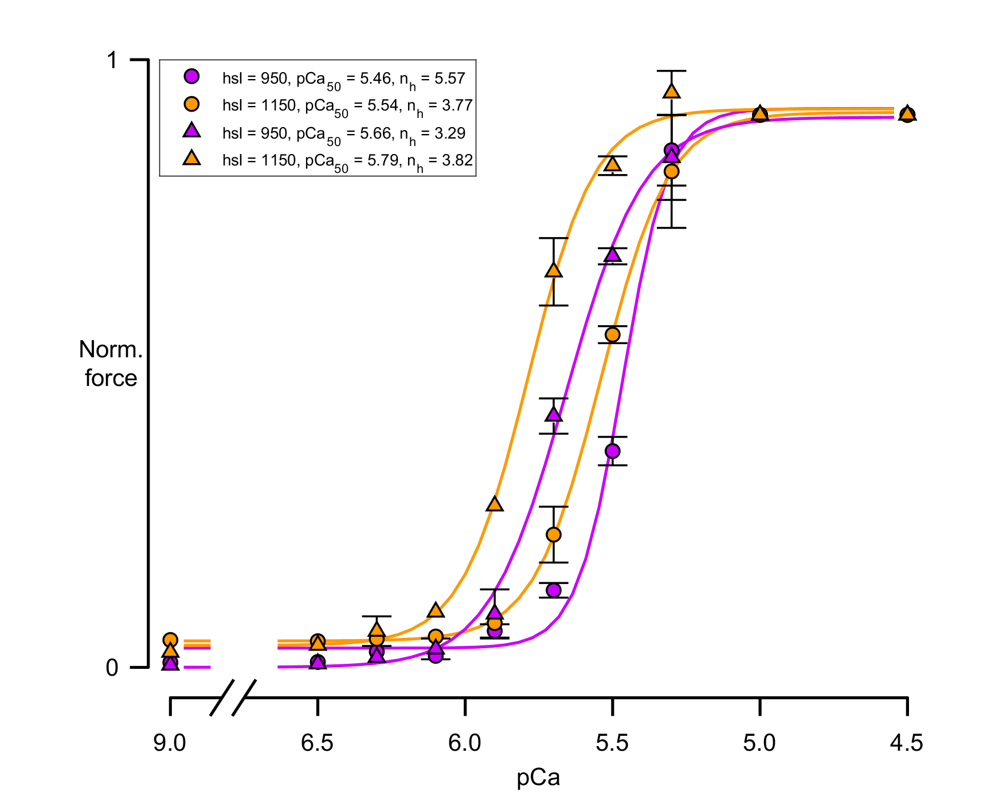
Dimers disposition
D
C
P
B
12, 12, 12, 12, 12, 12
12, 12, 12, 12, 12, 12, 12, 12, 12, 12
12, 12, 12, 12
1 – slow head ( DRX1 - DRX2 0.8 K_{force})
2 – blocked head ( DRX1 - DRX2 0.01 K_{force})
New assumption: phosphorylation make the 2 heads faster but with the blocked head more than the slow one
1 – slow head ( from 0.8 to 1.5 K_{force})
2 – blocked head ( from 0.01 to 2 K_{force})

Slide 5
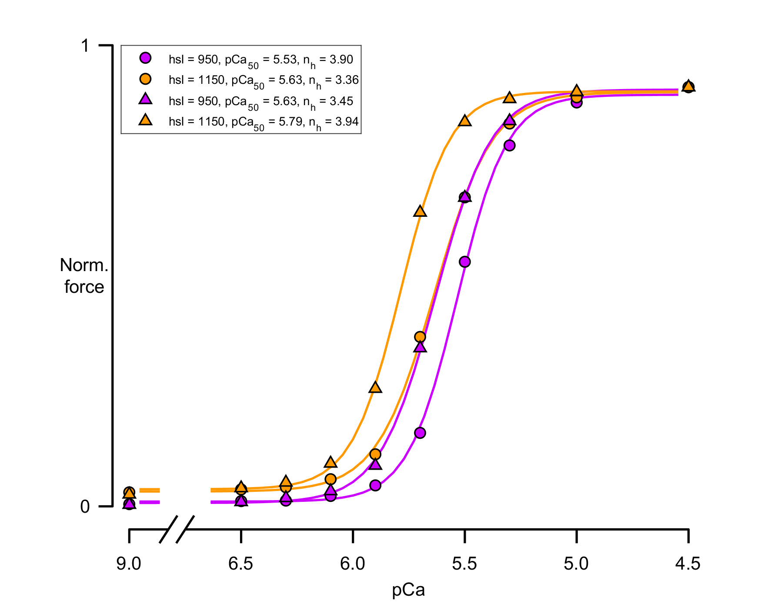
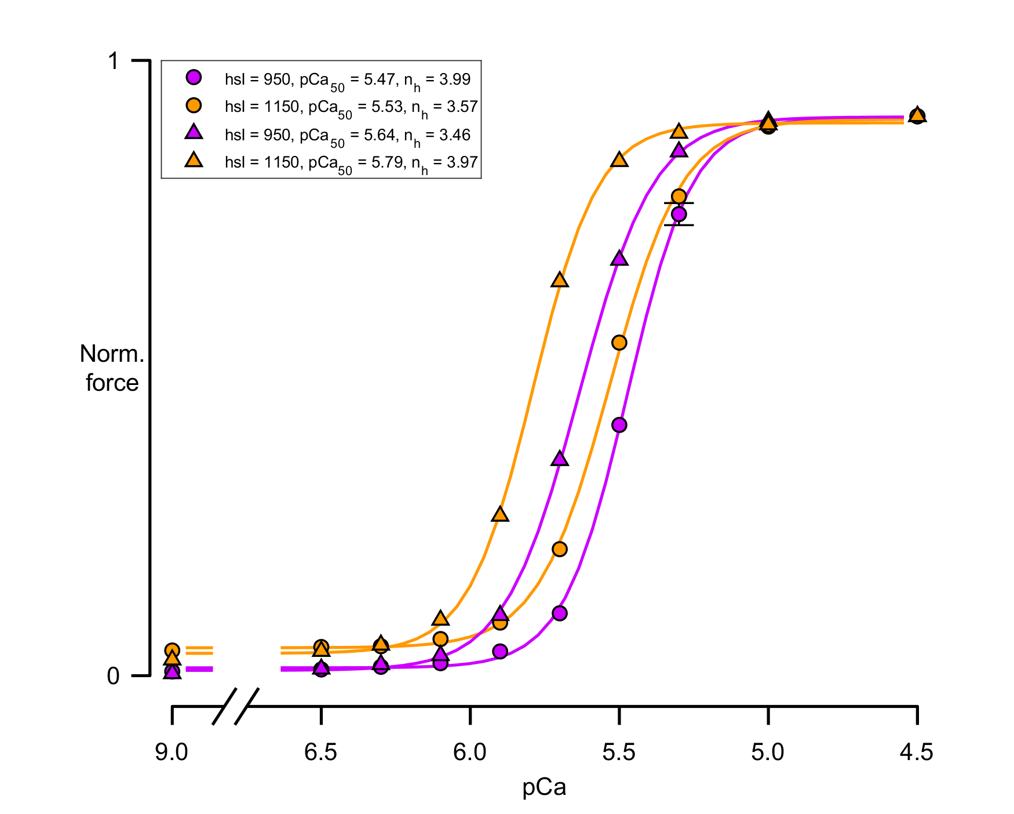
C zone
All filament

