Slide 1
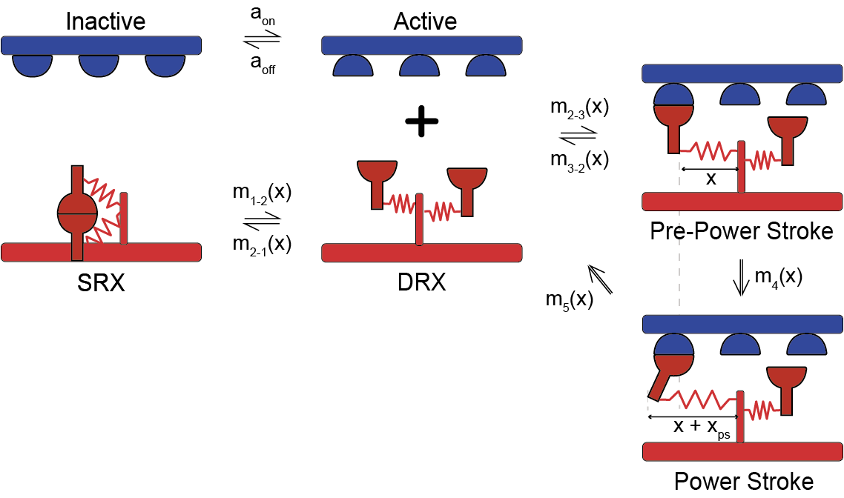
Kinetic scheme
Dimers disposition
D
C
P
B
1
2
11, 11, 11, 11, 11, 11
11, 11, 11, 11, 11, 11, 11, 11, 11, 11
11, 11, 11, 11
RLC phosphorylation
D
C
P
B
Force dependent
11, 11, 11, 11, 11, 11
12, 12, 12, 12, 12, 12, 12, 12, 12, 12
11, 11, 11, 11
Rate : K₁ (1 + K_{force} * F_{node})
Head 1: K_{force} = 0.3
Head 2: K_{force} = 300

Slide 2
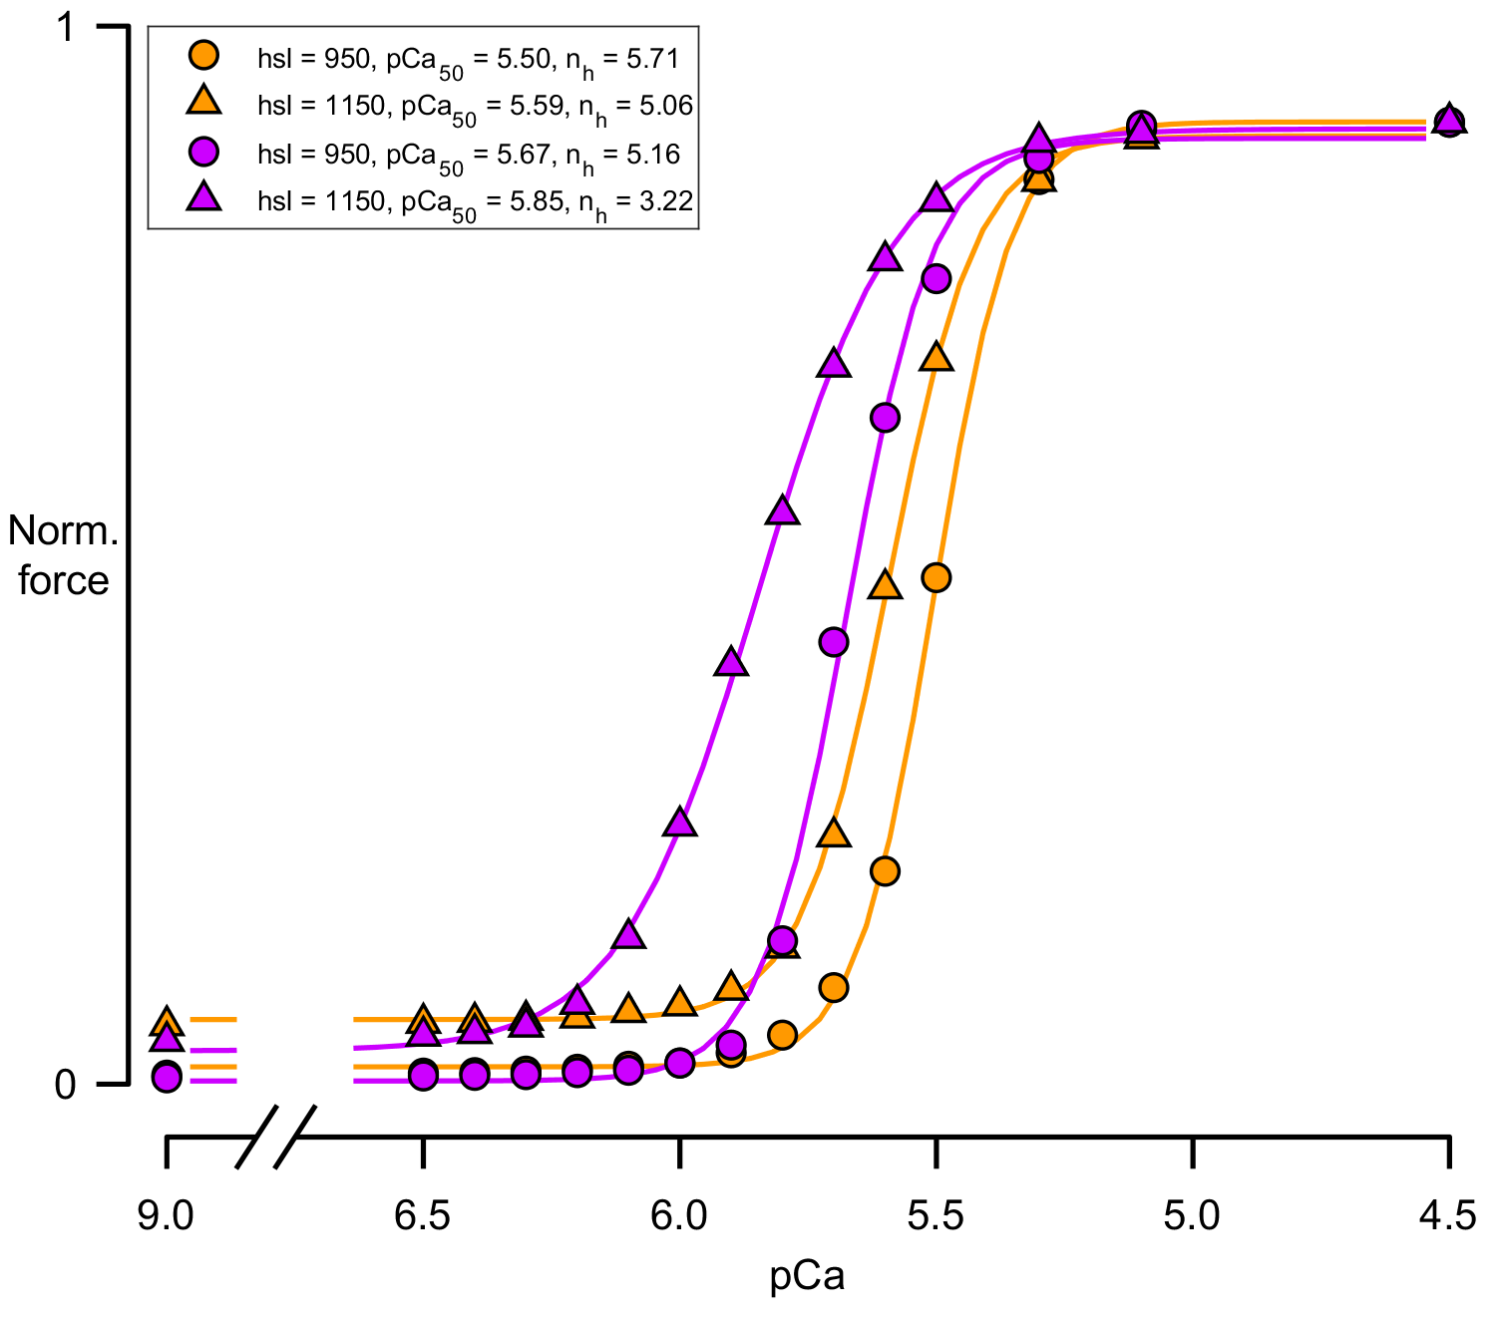
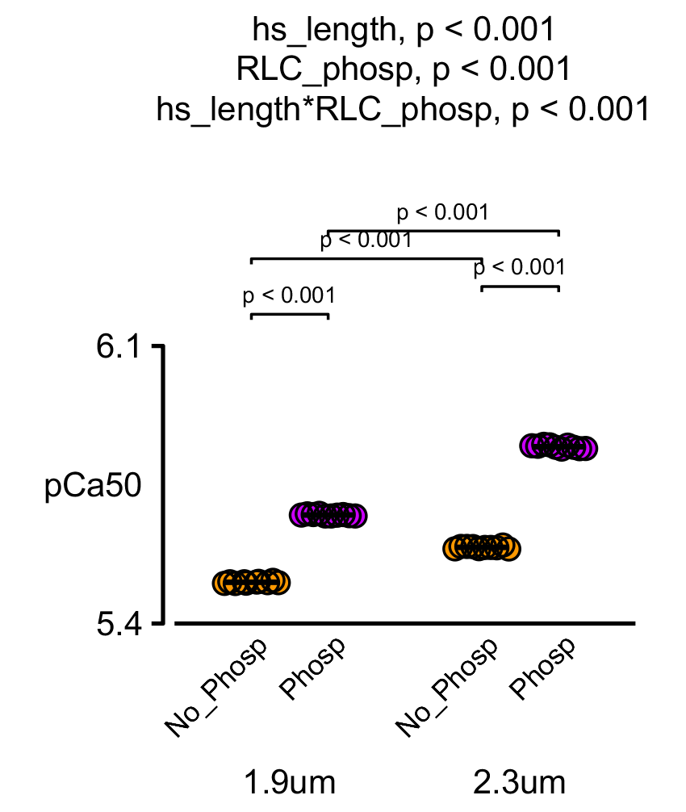
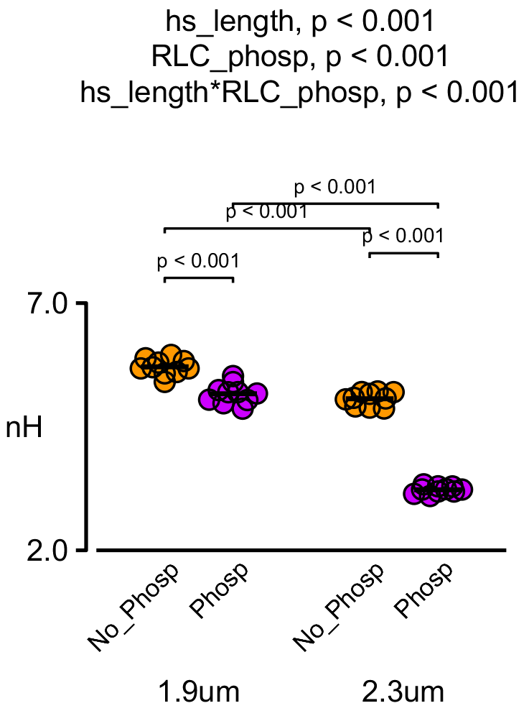
Before phosphorylation
After phosphorylation

Slide 3
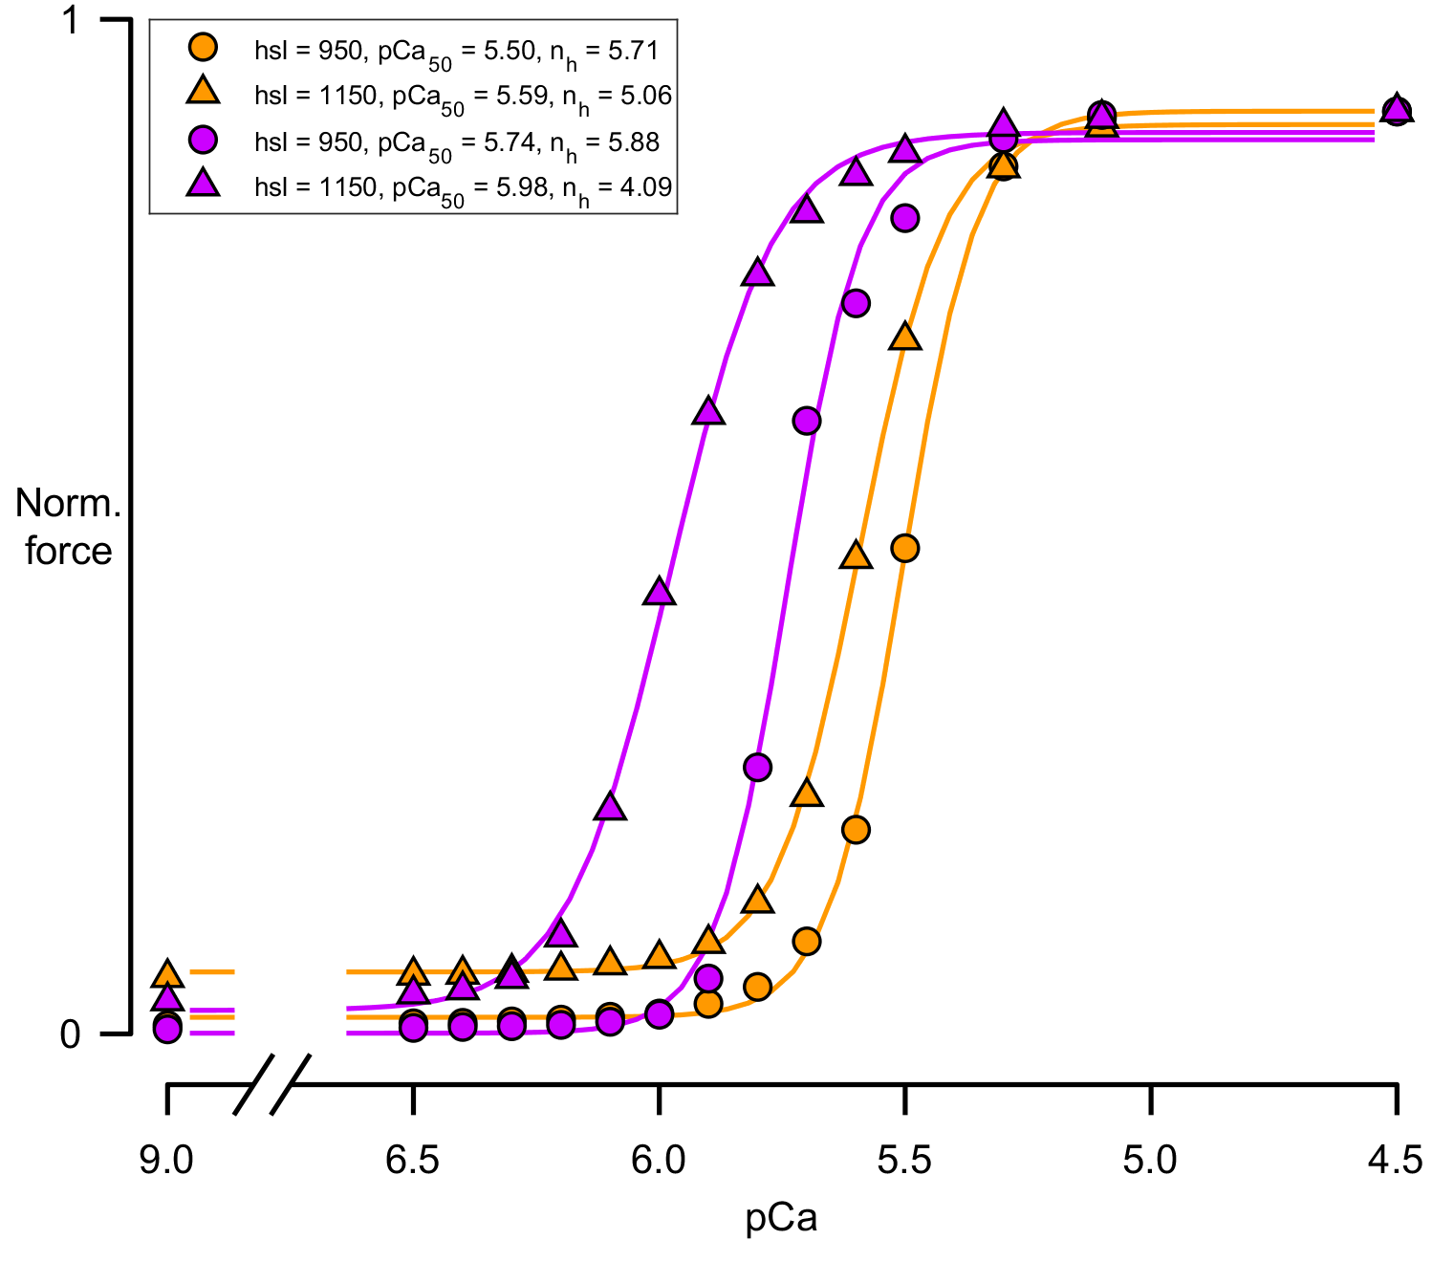
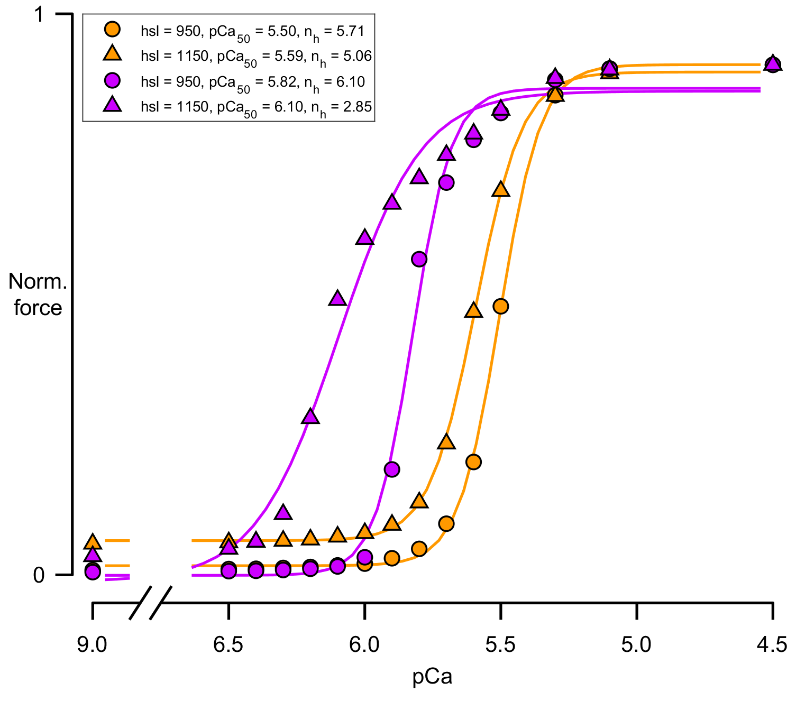
D
C
P
B
D
C
P
B
12, 12, 12, 12, 12, 12
12, 12, 12, 12, 12, 12, 12, 12, 12, 12
12, 12, 12, 12
11, 11, 11, 11, 11, 11
22, 22, 22, 22, 22, 22, 22, 22, 22, 22
11, 11, 11, 11

Slide 4
