Slide 1
PGY630: Quantitative methods for biomedical research Introduction Kenneth S. Campbell, PhD

Slide 2
Objectives for this lesson
Explain how the course is structured and assessed
Recall the learning outcomes for the course:
[From the syllabus] At the end of this course, a student should be able to use MATLAB or similar software to:
Import experimental data from text files, spread-sheets, images, and movies
Plot data in appropriate formats (including bar charts, scatter plots, surface plots)
Fit models to data (including straight lines, polynomials, and exponentials)
Perform and interpret hypothesis tests (including t-tests and ANOVA)
Segment images to detect features
Extract statistics about image features (including areas, colors, and eccentricities)
Analyze gels and immunoblots

Slide 3
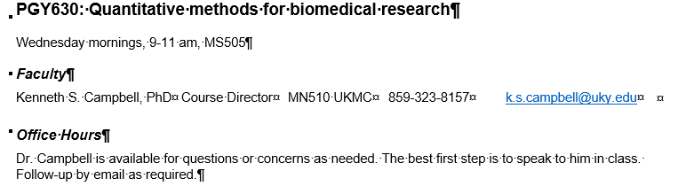
Syllabus available on Canvas
https://uk.instructure.com/courses/033529

Slide 4
Lesson plan
General area | Week | Topic | Additional details
Getting started | 1 | Introduction to the class | Setting goals for the class, introduction to GitHub
Basics | 2 | Data | Reading and writing data files, tables, filtering and sorting
 | 3 | Files | Organizing projects, batch processing
 | 4 | Plotting | Bar charts, scatter plots, jitter plots
Curve fitting | 5 | Linear regression | Fitting a straight line to data, Interpretation of p value and r
 | 6 | Non-linear regression | Fitting curves to data
Statistics | 7 | Statistics 1 | t-tests
 | 8 | Statistics 2 | ANOVA
 | 9 | Review of mid-term project
Image processing | 10 | Image basics | Bit resolution, color spaces, image formats
 | 11 | Image handling | Resizing, cropping, brightness and contrast
 | 12 | Segmentation | Thresholding
 | 13 | Binary image analysis | Shape statistics
 | 14 | Gels and immunoblots | Densitometry profiles, background correction
 | 15 | Movies | Reviewing of image formats, tracking objects
 | 16 | Review | Discussion of final projects

Slide 5
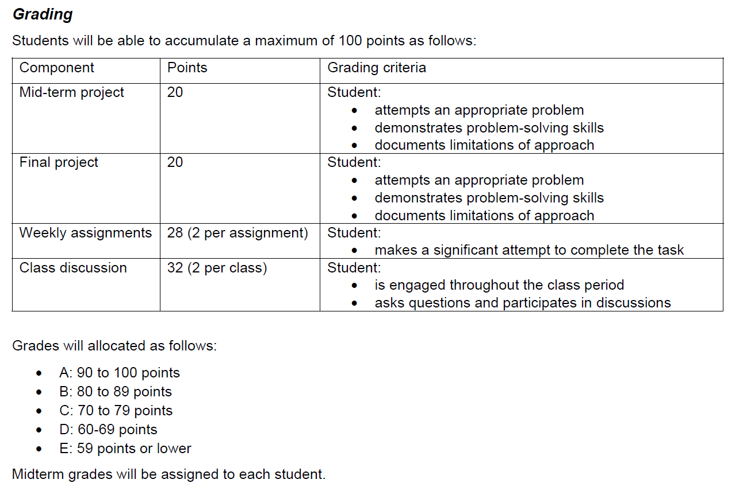
Grading

Slide 6
An example
Your lab has 3 to 5 blood samples from each of 20 mice stored in a freezer
A technician created an Excel file that lists the location (box number and coordinate) of the samples from each mouse
A former graduate student measured blood glucose levels and noted the sex and age of each mouse. That information is in another Excel file
For your project, you need to find all the samples from knock-out mice with a blood glucose level above 180 mg dl⁻¹

Slide 7
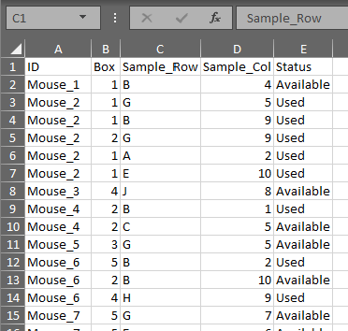
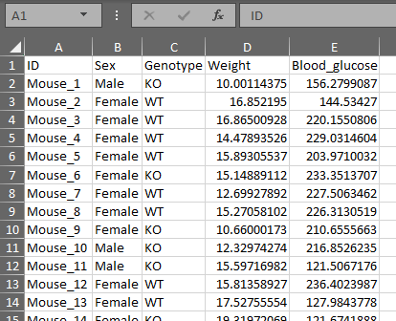
An example
Your lab has 3 to 5 blood samples from each of 20 mice stored in a freezer
A technician created an Excel file that lists the location (box number and coordinate) of the samples from each mouse
A former graduate student measured blood glucose levels and noted the sex and age of each mouse. That information is in another Excel file
For your project, you need to find all the samples from knock-out mice with a blood glucose level above 180 mg dl⁻¹
Inventory
data
Phenotype
data

Slide 8
An example
What are you going to do?
Your lab has 3 to 5 blood samples from each of 20 mice stored in a freezer
A technician created an Excel file that lists the location (box number and coordinate) of the samples from each mouse
A former graduate student measured blood glucose levels and noted the sex and age of each mouse. That information is in another Excel file
For your project, you need to find all the samples from knock-out mice with a blood glucose level above 180 mg dl⁻¹
Inventory
data
Phenotype
data

Slide 9
Potential strategies
Copy the “phenotype” data into the “inventory” file
Filter that
Copy the “inventory” data into the “phenotype” file
Filter that

Slide 10
Things to think about
How many mistakes will you make when you copy the data manually?
What will you do with the data you measure from your own experiments?
Put it into the original phenotype file?
Copy it to the inventory file?
Do both?
Will this work if you have 200 mice?
What about 2,000 mice?

Slide 11
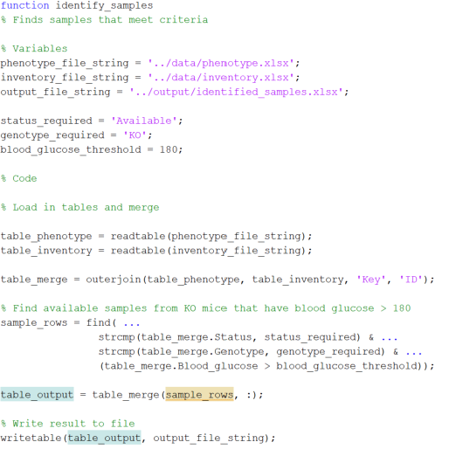
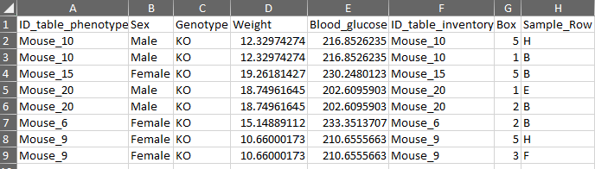
What Ken would do …
Write code that
Merges the inventory and phenotype files
Filters the merge
Writes the result to another file
Going forward
Keep the inventory and phenotypic data separate
Use code to combine and analyze as required
See GitHub lectures/Introduction/MATLAB_code

Slide 12
Thoughts to this point
You might think writing code for this was a lot of work … but
You created a method that solves a problem
This is an algorithm
The code approach is
Extensible - it will work with 2, 200, or 20,000 mice, and is easily modified
Easier to document
The code method is less susceptible to mistakes
Better science
More reproducible

Slide 13
Thoughts to this point
You might think writing code for this was a lot of work … but
You created a method that solves a problem
This is an algorithm
The code approach is
Extensible - it will work with 2, 200, or 20,000 mice, and is easily modified
Easier to document
The code method is less susceptible to mistakes
Better science
More reproducible
This is the hardest bit about scientific computing: working out what you want to do.
I suspect some of you will struggle with “how to do things” at first (this is called syntax) but you will learn that quickly if you persevere, and experiment with different strategies.

Slide 14
Ken’s unofficial goals for the class
Empower you to:
Analyze your data appropriately
Push back the boundaries of your science
Show you how to:
Gain more insights from your data
Process it more efficiently
Reduce subjectivity
Encourage you to understand how techniques work before you use them in your science
Help you to gain the confidence to implement new approaches

Slide 15
This course is not intended to …
Teach you how to program
While we will use computer programs to solve problems, the focus is on solving the problems, not on computer science
Teach you all the statistics you need
But it might help you gain more intuition into how the tests work and what tests you need for your own studies
Turn you into an expert in quantitative methods
But we hope it will be useful for your career

Slide 16
MATLAB is one of many tools for analyzing data
Data analysis is easier when you can use good tools
This class uses MATLAB because it’s:
Powerful
Easy
Works well with both numbers and images
Supported by excellent documentation
There are lots of other good tools, including:
Excel
R
Python
etc.
Lessons learned in this class should help you to get more out of other packages as well

Slide 17
Some thoughts on different software tools
As you gain experience, use the tool that works best for you and your situation
Normally possible to use more than one approach
No tool is “best” for every problem, but some tools are good for specific things
Excel
Easy and useful but limited for scientific purposes
Difficult to replicate tasks and reproduce workflows
SigmaPlot, Prism, Origin (examples of plotting/statistics packages)
Excel on scientific steroids?
Nice for figures but limited for other purposes
R
Very good for statistics
Good support for some types of bioinformatics
Python
Powerful for both numbers and images
Requires more “programming” than other approaches

Slide 18
How Ken learned enough to lead this class
Originally, in the last century, by reading books
Numerical computing by Cleve Moler
Intuitive Biostatistics by Harvey Motulsky
Digital Image Processing using MATLAB, by Gonzalez, Woods, & Eddins
Lots and lots and lots of hands-on experience
I want to do “x” for a paper – how would I get started?
Talking about scientific computing with other people
How does that method work?
How did you do that analysis?
How did you make that figure?
More recently, looking at websites and blogs
https://www.mathworks.com/matlabcentral/
https://blogs.mathworks.com/
Wikipedia

Slide 19
Other things you should know this week
Complete your assignments on Canvas
Marks are awarded for good-faith effort rather than final accomplishments
Options for getting help related to MATLAB
Type doc in the command window
https://www.mathworks.com/matlabcentral/index.html (MATLAB answers, and MATLAB blogs)
Google “MATLAB xxxx”
https://www.mathworks.com/support/learn-with-matlab-tutorials.html

Slide 20
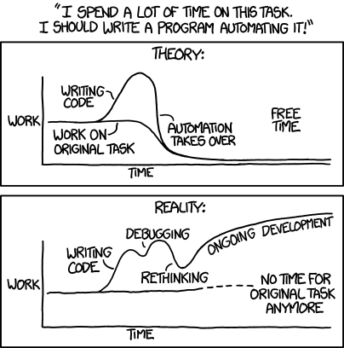
Finally, beware of mission creep
http://imgs.xkcd.com/comics/automation.png

