Slide 1
PGY630: Quantitative methods for biomedical research Kenneth S. Campbell, PhD

Slide 2
Objectives for this lesson
Show to read, search, filter, and write data files in Excel format

Slide 3

Random numbers
Computers can’t generate real random numbers but they can generate numbers that follow a sequence that looks pretty random
rand() produces numbers uniformly distributed between 0 and 1
Initialize the seed [use rng() ] if you want predictable results for testing
https://www.mathworks.com/help/matlab/ref/rand.html

Slide 4
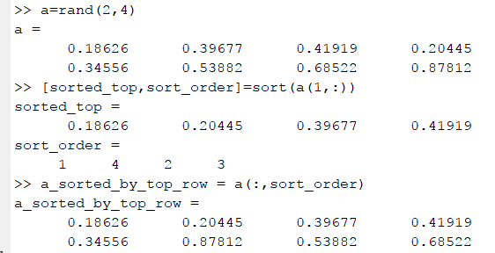
Sorting
The sort function is very powerful
https://www.mathworks.com/help/matlab/ref/sort.html

Slide 5
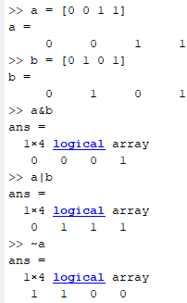
Logic
And (&), Or (|), Not (~) are logical operations
All and Any summarize the entire array
Super useful for checking conditions
https://www.mathworks.com/help/matlab/logical-operations.html

Slide 6
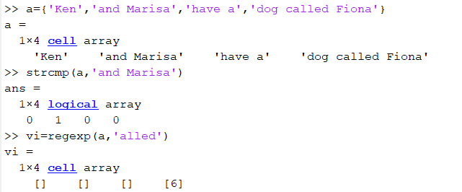
Character arrays and strings
strcmp and regexp are useful for searching text
https://www.mathworks.com/help/matlab/ref/regexp.html

Slide 7
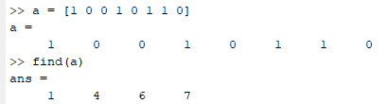
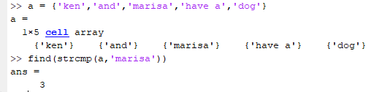
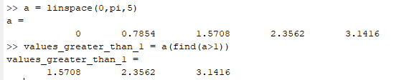
Find
Find returns the indices of non-zero entries
It’s amazing useful
https://www.mathworks.com/help/matlab/find.html

Slide 8
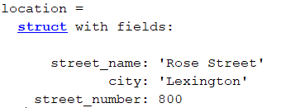
Data structures
Structures are useful ways of storing related information
For example:
Structures can store different data types (e.g. character arrays, and matrices)
More advanced: In object-oriented programming, you create objects which are a data structure and functions that operate on the data
https://www.mathworks.com/help/symbolic/data-structures.html

Slide 9
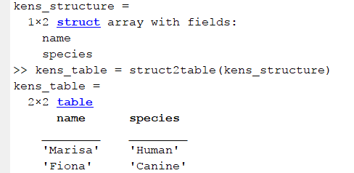
MATLAB Tables
Tables were added to MATLAB in 2013 and can be thought of as structures specialized for tabular data
For example:
MATLAB has lots of support for tables, e.g. readtable()
https://www.mathworks.com/help/matlab/ref/table.html

