Slide 1
Quantitative methods for biomedical research ANOVA Kenneth S. Campbell, PhD

Slide 2
Objectives
Recall that ANOVA (Analysis of Variance) tests for differences between the means of 2 or more groups
Recognize the difference between one-way and two-way ANOVA
Explain the difference between main effects and post-hoc tests
Write MATLAB code to perform ‘simple’ one-way and two-way tests
Appreciate that more sophisticated techniques (for example, repeated measures, linear mixed models, etc.) will provide enhanced statistical power for certain experimental designs

Slide 3
ANOVA
ANOVA compares the means of 2 or more groups
Technically, a t-test is just the special case of an ANOVA for 2 groups
Tests for differences in β_{i} where y_{i,j} = µ + β_{i} + ε_{i,j} where µ is the grand mean, β_{i} are deviations from the grand mean for each group, and ε_{i,j} are errors
First get the main effects to see if there are differences
Then run post-hoc tests to see where the differences are

Slide 4
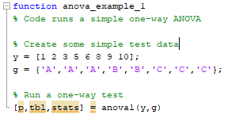
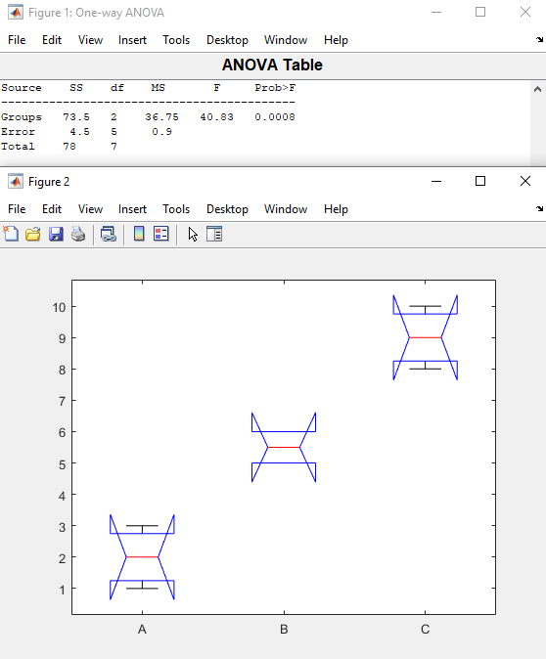
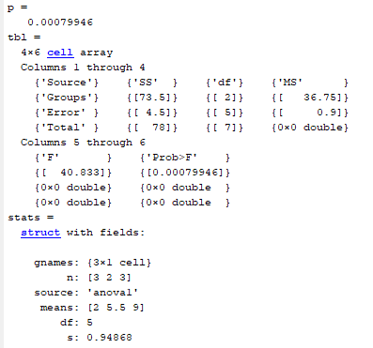
One-way ANOVA demo

Slide 5
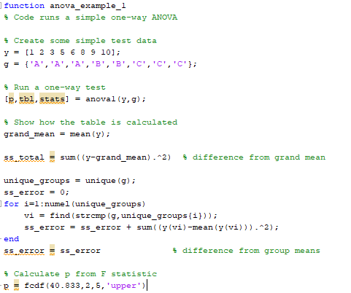

One-way ANOVA

Slide 6
One-way ANOVA
Ratio of left 2 columns
Ratio of 2 MS values
ss error
Deduced from F and df values
ss total
(No of groups -1)
(No of points – no of groups)
Sum of above

Slide 7
One-way ANOVA
If the variability within groups is comparable to the variability
between groups, the two MS values would be similar.
High F ratios occur when variability within groups is small

Slide 8
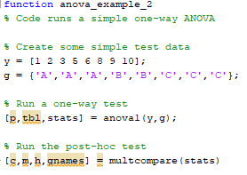
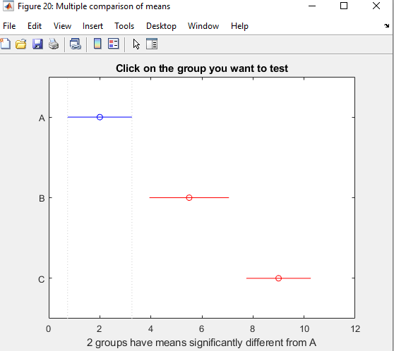
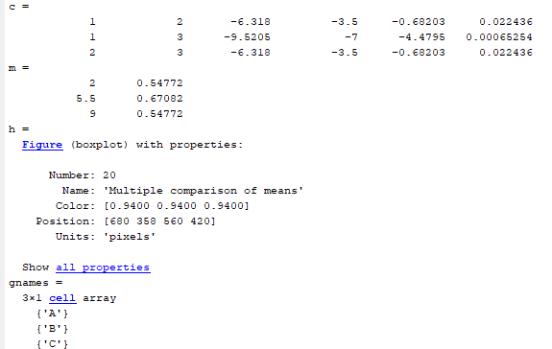
Post-hoc tests
Group
numbers
p-values

Slide 9
More on post-hoc tests
ANOVA tries to overcome the multiple comparison problem
which is roughly “Doing many pair-wise comparisons, each with a 5% chance of being interpreted incorrectly, can lead to trouble”
But there are different ways of correcting for multiple comparisons
Bonferroni – conservative (lower chance of getting p<0.05)
Fisher’s LSD – no correction for multiple comparison (don’t use this)
Tukey’s Honestly Significant Difference (MATLAB default, reasonable choice most of the time)

Slide 10
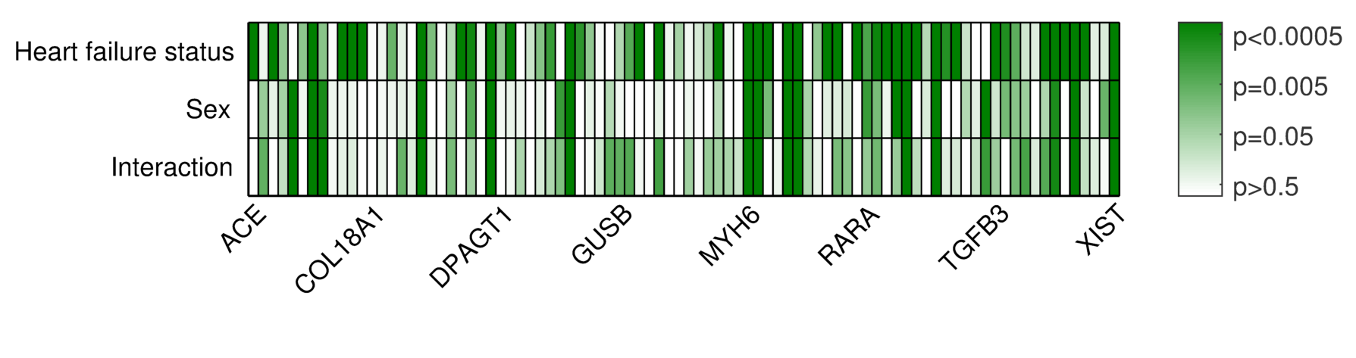
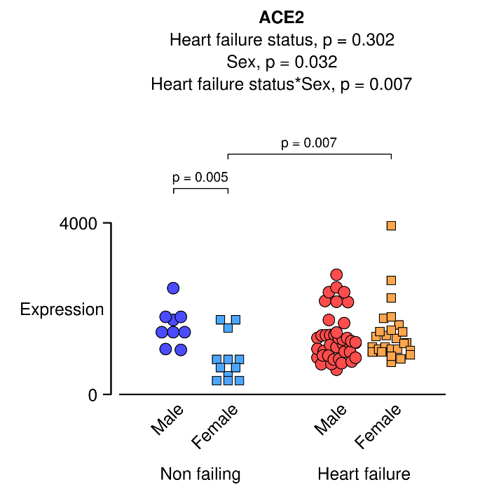
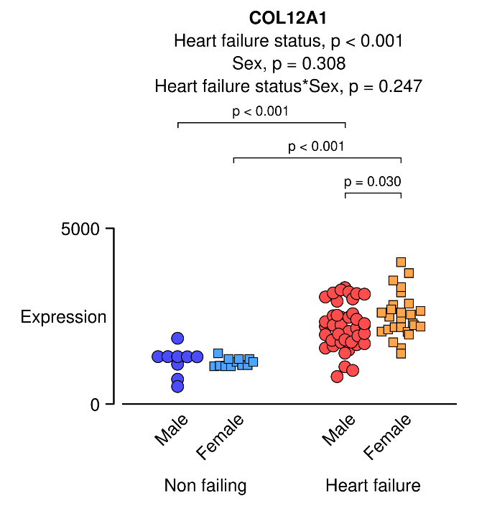
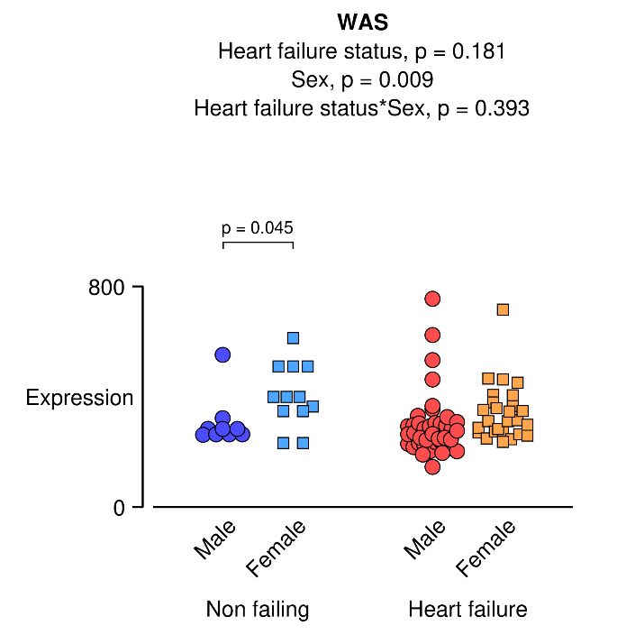
Sex-specific patterns of fibrotic gene expression

Slide 11
More on 2-way ANOVA
You can enhance statistical power (more likely to get a p-value < 0.05) by deciding IN ADVANCE you only want to perform a subset of the potential post-hoc tests
If you can match your data (for example, BMI in the same men and women before and after exercise) you can use repeated-measures tests to enhance statistical power
Compare with a paired t-test
Balanced designs have the same number of points in each group
Not all software packages offer all options
Linear mixed models are a general form of ANOVA that allow you to have multiple factors, with and without pairing, as well as unbalanced designs

Slide 12
More on statistical tests and software
Consult with an expert (e.g. CCTS BERD) if you are unsure
Running 2 or more factor ANOVA can be complicated in MATLAB
GraphPad Prism can be useful if you need to run a single test
SAS gives you ‘ultimate power’ and can be programmed to run thousands of tests (e.g. data from every file in a folder) but the learning curve is VERY steep
R is a computer programming language that specializes in statistics
It is powerful but another system to learn

