Slide 1
PGY630: Quantitative methods for biomedical research Gels and blots from an image analysis perspective Kenneth S. Campbell, PhD

Slide 2
Objectives
Recognize that scanning a gel or blot produces a “picture” that can be analyzed using image processing techniques
Recall that the image format is important because it defines how the data is stored (and could discard useful information)
Images should use as much of the dynamic range as possible without “clipping”
Realize that lanes can be analyzed using curve-fitting techniques

Slide 3
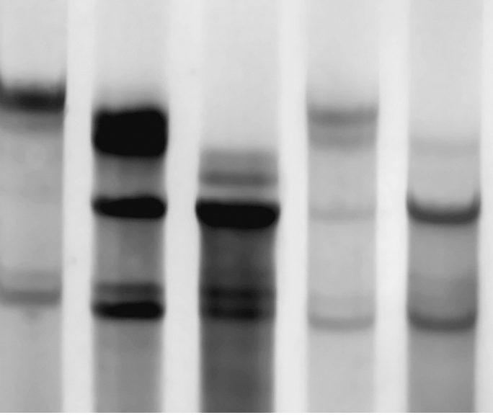
An example gel

