Slide 1
PGY630: Quantitative methods for biomedical research Image processing basics: file formats, bit depth, and compression Kenneth S. Campbell, PhD

Slide 2
Objectives
Explain how computers store image data, including details about the number of pixels, bit resolution and color-spaces
Recognize that different image formats have distinct strengths and weaknesses
Recall the difference between bitmap and vector-based formats and know when to use each

Slide 3
Raw data normally come as bitmaps
Cameras and scanners use many small sensors
Each sensor gives 1 pixel
For example, at one point in time, the iPhone camera had 8 megapixels (3264 x 2418)

Slide 4
Bitmaps

Slide 5
Bitmaps
0 | 0 | 1
1 | 0 | 0
0 | 1 | 1
1 | 0 | 0
1 | 0 | 1

Slide 6
Color schemes
Many possible schemes (L*a*b, HSV, HSL, CMYK)
Most common in our type of science is RGB
3 numbers to describe the amount of Red, Green and Blue
The maximum value of each number depends on the bit-depth
8-bit is, or at least used to be, the most common

Slide 7
What is bit-depth?
The number of binary digits for each color
8 bit means numbers can range from 0000 0000 to 1111 1111 (that is, 0 to 2⁸ = 255)
16 bit means numbers can range from 0000 0000 0000 0000 to 1111 1111 1111 1111 (that is, 0 to 2¹⁶ = 65,536)
More bits means more potential colors but requires more memory

Slide 8

An example of an 8 bit RGB image
255
127
255
Red
0
255
0
0
255
0
0
127
255
Green
0
255
127
255
0
0
0
127
0
Blue
255
255
127
0
255
0

Slide 9
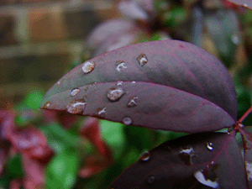
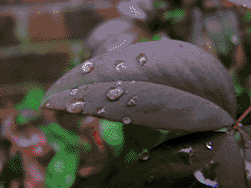
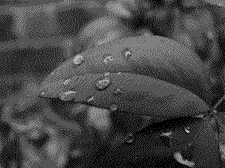
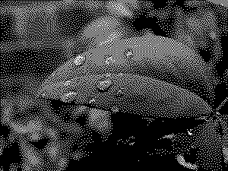
Examples of different bit-depths
24 bit
8 bit
4 bit
2 bit
1 bit
Wikipedia

Slide 10
Common sense rules about bit levels
You only have the information you collected in the original picture
Converting to higher bit level (e.g. 8 bit to 12 bit) uses more memory and takes more time but doesn’t give you anything extra
Converting to a lower bit level (e.g. 12 bit to 8 bit) throws away information

Slide 11
Compresion
Storing the picture in less memory than a straight pixel by pixel description
Lossless compression
Stores the same information (*.png)
Lossy compression
Stores a variant, thus can’t go back to the original
Generally takes less memory, and is thus quicker to send between computers (*.jpg)

Slide 12
Compression
0 | 0 | 0
0 | 0 | 0
0 | 1 | 0
0 | 0 | 0
0 | 0 | 0

Slide 13
Compression
0 | 0 | 0
0 | 0 | 0
0 | 1 | 0
0 | 0 | 0
0 | 0 | 0
or
Every pixel is black, except (3,2)

Slide 14
Image formats
Vector-based | Bitmap
 | Lossless | Lossy
Describes a picture using ‘geometrical primitives’ (lines, curves, polygons) | Describes a picture using pixels
Scalable (Can change size without problems) | Not scalable (Cannot change size without problems)
Interchangeable (can go from one to another and back) | Interchangeable | Not interchangeable (going from one to another and back, gives something new)

Slide 15
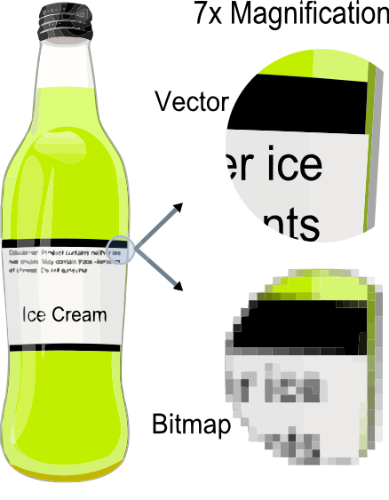
Vector versus bitmap
From Wikipedia

Slide 16
Image formats
Vector-based | Bitmap
 | Lossless | Lossy
.eps (Illustrator) | .tif (sometimes) | .jpg
.ai (Illustrator) | .png | .gif
.svg (InkScape | .bmp
.wmf (Win clipboard) | .psd (Photoshop)
.emf
.pdf
.pict (old Mac clipboard)

Slide 17
Common sense rules
Try to understand what you are doing
Don’t just copy what the person before did
If you only want 1 simple rule (but you probably shouldn’t after taking this class), it’s hard to beat the *.png format
Test your analysis to see if you get the same result with re-sized images
Smaller images will save computation time

Slide 18
Common sense rules 2
Use vector-based formats whenever possible
Illustrator, Inkscape are great for making figures
Export from SigmaPlot, Prism etc, into vector formats
If you have to use bitmaps, use lossless formats
Warning, formats have multiple options (For example, you can store jpgs inside tifs)
Use highest quality settings
Check quality – compare final versions to originals

Slide 19
Objectives
Explain how computers store image data, including details about the number of pixels, bit resolution and color-spaces
Recognize that different image formats have distinct strengths and weaknesses
Recall the difference between bitmap and vector-based formats and know when to use each
Write MATLAB code to create or open image files, resize images, and display them

