Slide 1
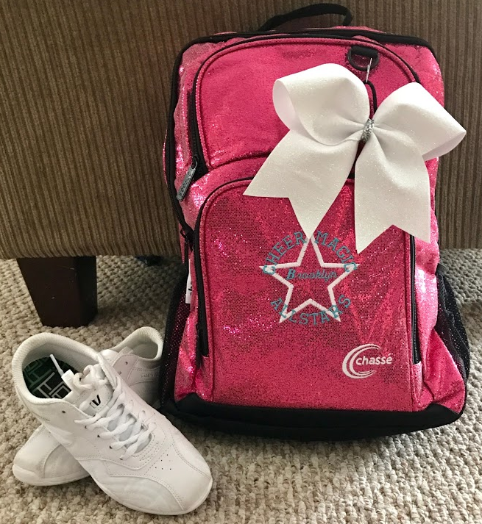
Sassy & Sweet Boutique
Camperina

Slide 2
Overview
Our design team has been working on an information system to be used by Sassy & Sweet Boutique to help streamline their order process. The following slides show example screens of the system we have created for the boutique.

Slide 3

Introduction
Sassy & Sweet Information System Highlights
Customer Profile
Online & Presale Orders
Customer Loyalty Rewards
Order Tracking
Reports (Store Use Only)
Notes:
For this project, I was tasked with developing an information system for both customers and employees to use for a local shop. This system streamlined the process for employees and made it easier for customers to view inventory and place orders online.

Slide 4
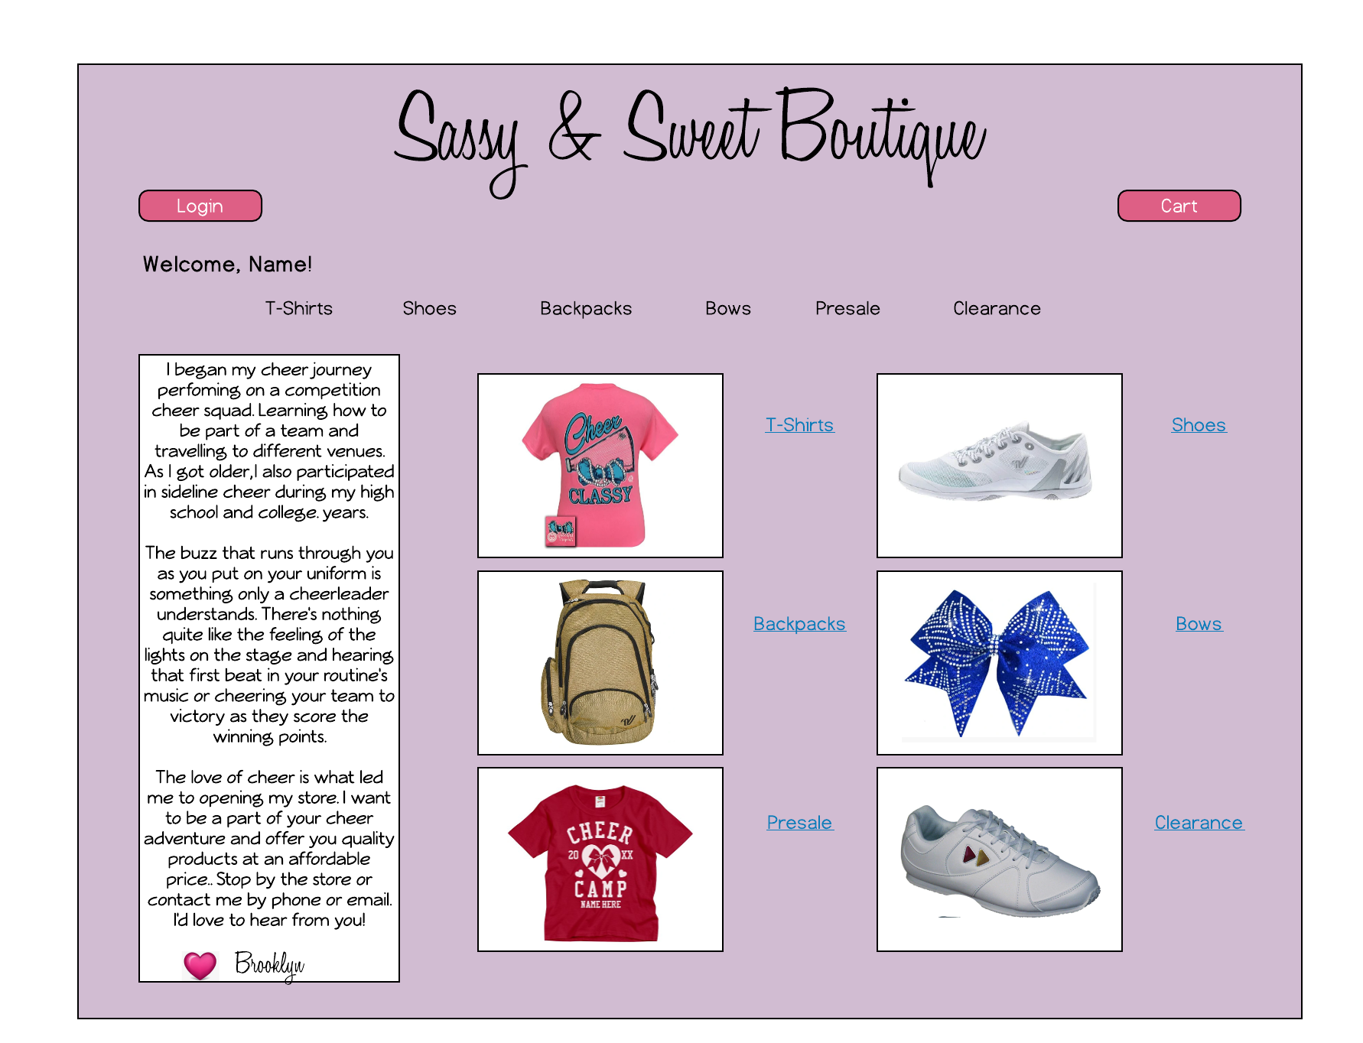
Homescreen
Notes:
From the homepage, a customer can login to their account, view their shopping cart, or click a link to visit a specific section of the website. Both the links across the top and next to the images will take you to that section of the site. The images rotate through the available inventory in each category. Once a customer logs into their account the welcome banner will be specific to the name registered to their account. If you are not logged int, it will only say “Welcome”.

Slide 5
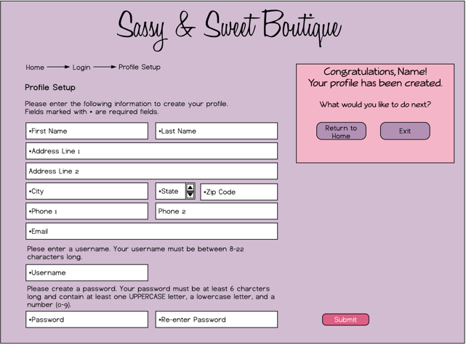
Customer Profile Setup
Notes:
This is the screen for a customer to create their profile. They will not be able to submit the information if any required fields are missing or if their username or password does not meet the specified requirements. If any information is missing or is incorrect, a pop-up will appear advising the customer what to correct. Once they have successfully submitted their profile, the pink congratulations box will appear in the center of the screen and have the customers name. (It is shown smaller and to the side in this screenshot so you can see all of the fields.)

Slide 6
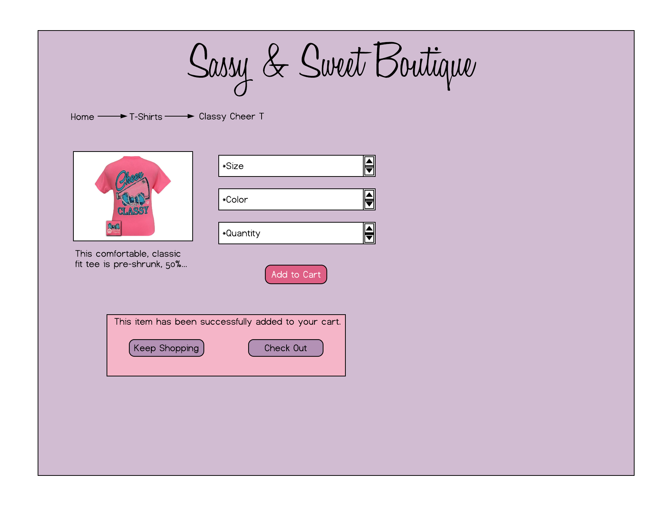
Customer Order Screen
Notes:
Once a customer clicks on an image, they will be directed to the order screen. They will be prompted to enter a size, color, and quantity before they can add an item to their cart. If a field is blank when they click submit, a pop-up will appear telling them which field must be entered. The pink confirmation box will appear once the item(s) has been added successfully to their cart. The customer can exit the order screen without ordered by clicking one of the previous headings in the page navigation.

Slide 7
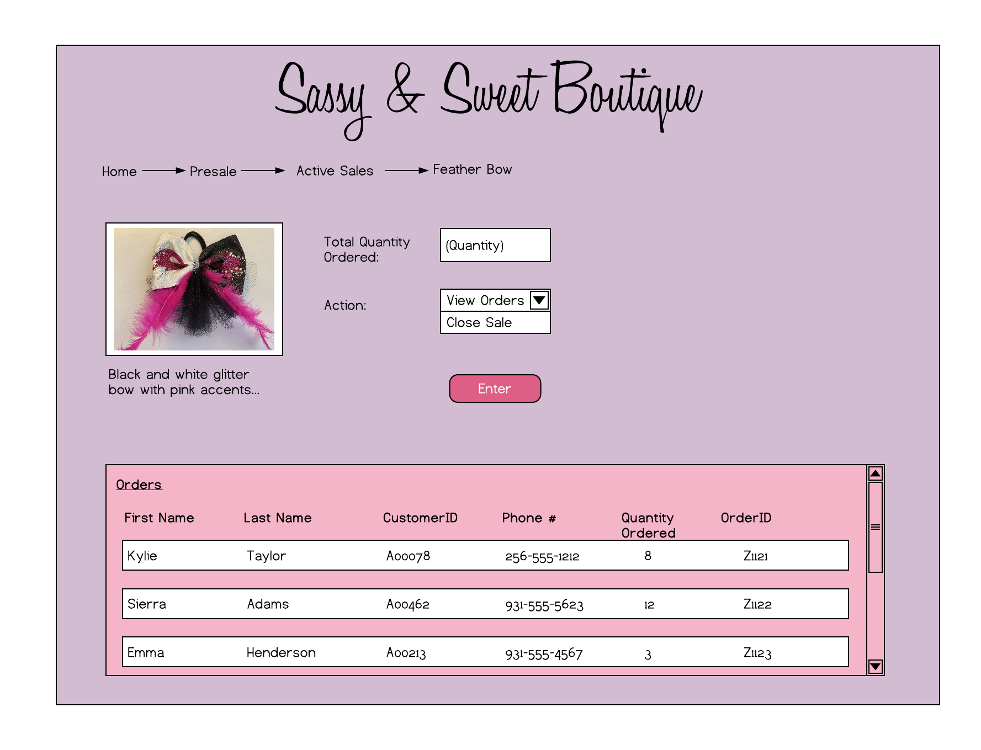
Employee Presale Order
Notes:
This screen is only for employees. They can go to active presale orders and select an item they wish to view. This is the item page. It will show a picture and description of the item, how many have been ordered so far, and the employee has the option to view the orders or close the sale. In this screen shot, the employee has chosen to view the orders. Once the employee hits the enter button the pink area at the bottom of the screen appears with a list of all orders for this item.

Slide 8
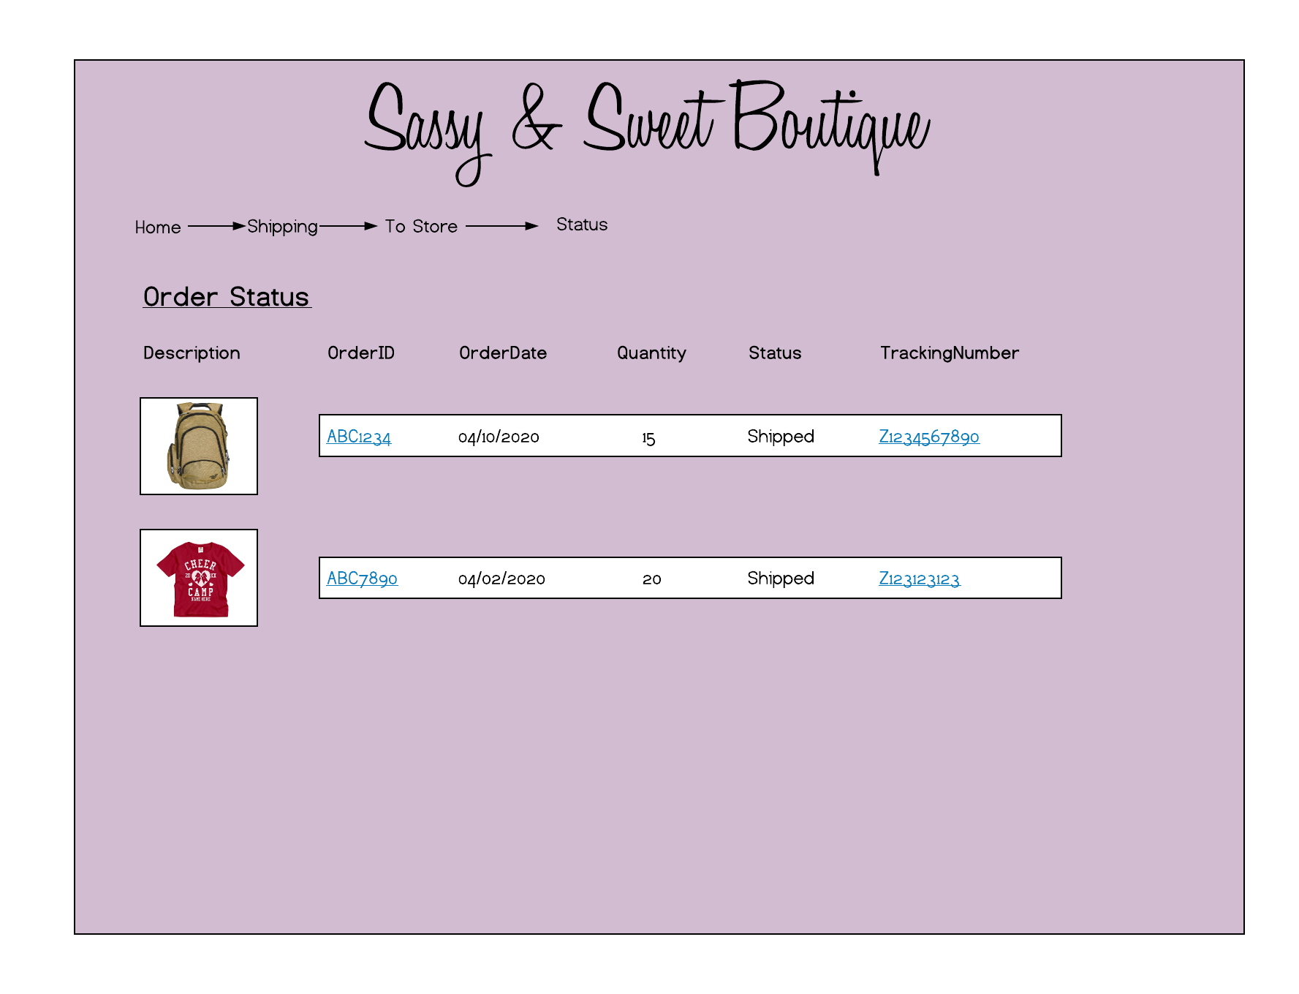
Employee Shipping Status
Notes:
This is the screen where an employee can check the shipping status of an order. Here you can see what has been ordered and some order details. The Order ID links to the actual order where more details can be viewed. The Tracking Number will link to the shippers website to tracking the order.

Slide 9
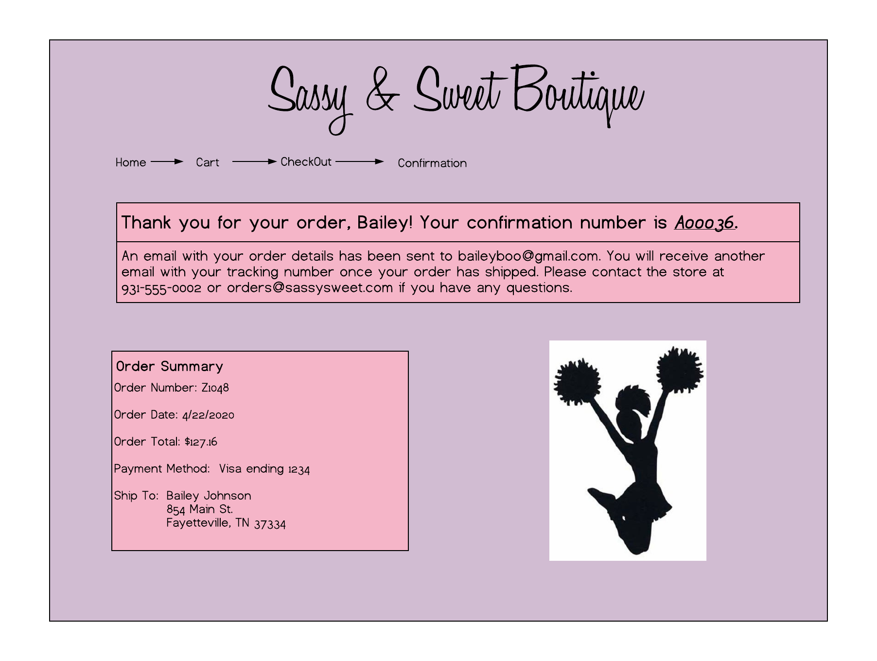
Customer Order Confirmation
Notes:
This is an example of the confirmation window once a customer places an order. The confirmation number is listed with bold font at the top of the page. The general order details are also listed

Slide 10
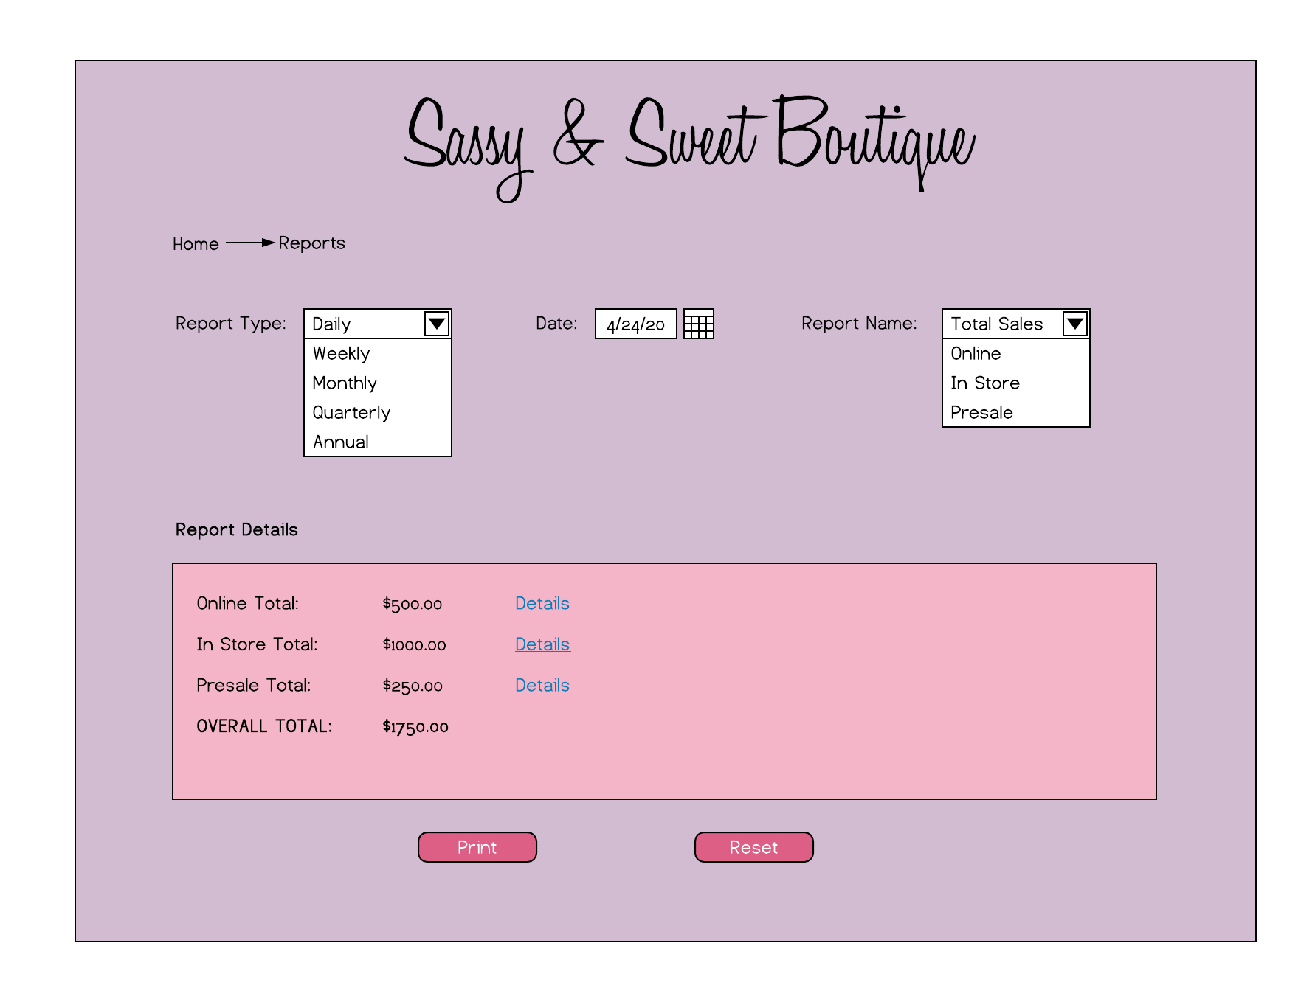
Employee Daily Sales Report
Notes:
This is the report menu which is only available to select store employees. This is an example of the daily sales report. It shows the total for each type of sale and a grand total for all sales for the day. The employee can click on the “details” link next to each total to see a breakdown of each sale in that category. At the bottom of the screen they have the option to print the report or reset all fields.

Slide 11

Questions?

Slide 12
References
https://www.simplycutetees.com/products/girlie-girl-originals-preppy-classy-cheer-cheerleading-pink-t-shirt
https://shop.varsity.com/collections/competition-cheer-shoes/products/varsity-ascend-cheer-shoe?variant=43702619335
https://shop.varsity.com/collections/backpacks-travel-bags/products/sparkle-backpack?variant=20992959623
https://cheerbowsetc.com/collections/rhinestone-cheerleading-bows/products/gigi-glitter-rhinestone-cheerleading-hair-bow
https://www.customizedgirl.com/design/3672119/Create+Custom+Cheer+Camp+T-Shirts

Slide 13
References (continued)
https://www.customizedgirl.com/design/3672119/Create+Custom+Cheer+Camp+T-Shirts
https://championteamwear.com/product/kaepa-cheerful-shoe?style=20207NG&Color=008&gclid=CjwKCAjw-YT1BRAFEiwAd2WRtsKcxTu7JQk9xKcZXRGvfqIZLkRbbrxxYLiq9Rc1vYlXg219SWVO5BoCvusQAvD_BwE
https://www.pinterest.com/pin/294422894386037346/

