Slide 1
Lab 2
Probability Distributions

Slide 2
Independence
X = Flip coin, Pr(X = heads) = ½
Y = Flip Coin, Pr(Y = heads) = ½
Z = Pr(exactly X or Y are heads (not both)) = ½
X | Y | Z = XOR(X,Y) | Pr
0 | 0 | 0 | ¼
1 | 0 | 1 | ¼
0 | 1 | 1 | ¼
1 | 1 | 0 | ¼

Slide 3
Independence
X | Y | Z = XOR(X,Y) | Pr
0 | 0 | 0 | ¼
1 | 0 | 1 | ¼
0 | 1 | 1 | ¼
1 | 1 | 0 | ¼
Pr(X,Z) pairwise independence:
Pr(X=0,Z=0) = Pr(X=0 )* Pr(Z=0 ) = ½ * ½ = ¼
Pr(X=0,Z=1) = Pr(X=0 )* Pr(Z =1) = ½ * ½ = ¼
Pr(X=1,Z=0) = Pr(X =1)* Pr(Z=0 ) = ½ * ½ = ¼
Pr(X=1,Z=1) = Pr(X =1)* Pr(Z =1) = ½ * ½ = ¼
NOT mutual independence
Pr(X=1,Y=1,Z=0) = ¼ where as Pr(X=1)*Pr(Y=1)*Pr(Z=0) = 1/8

Slide 4
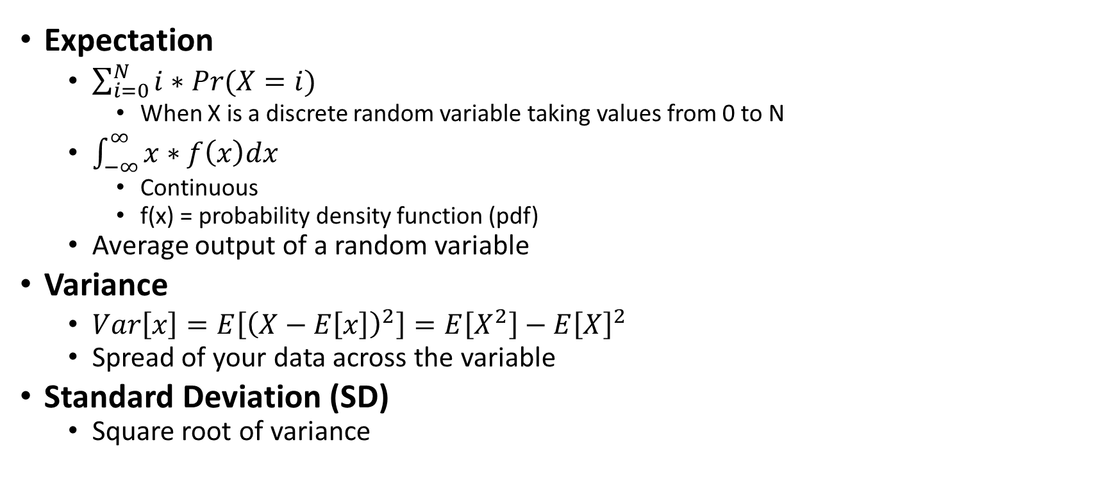
Definitions
Expectation
$\sum_{i=0}^{N}{i∗Pr(X=i)}$
When X is a discrete random variable taking values from 0 to N
$\int_{−∞}^{∞}{x∗f\left(x\right)dx}$
Continuous
f(x) = probability density function (pdf)
Average output of a random variable
Variance
$Var\left[x\right]=E\left[{\left(X−E\left[x\right]\right)}^{2}\right]=E\left[X^{2}\right]−E{\left[X\right]}^{2}$
Spread of your data across the variable
Standard Deviation (SD)
Square root of variance
Notes:
Var[X] = E[(X-E(X))^2] = E[X^2]-(E[X])^2

Slide 5

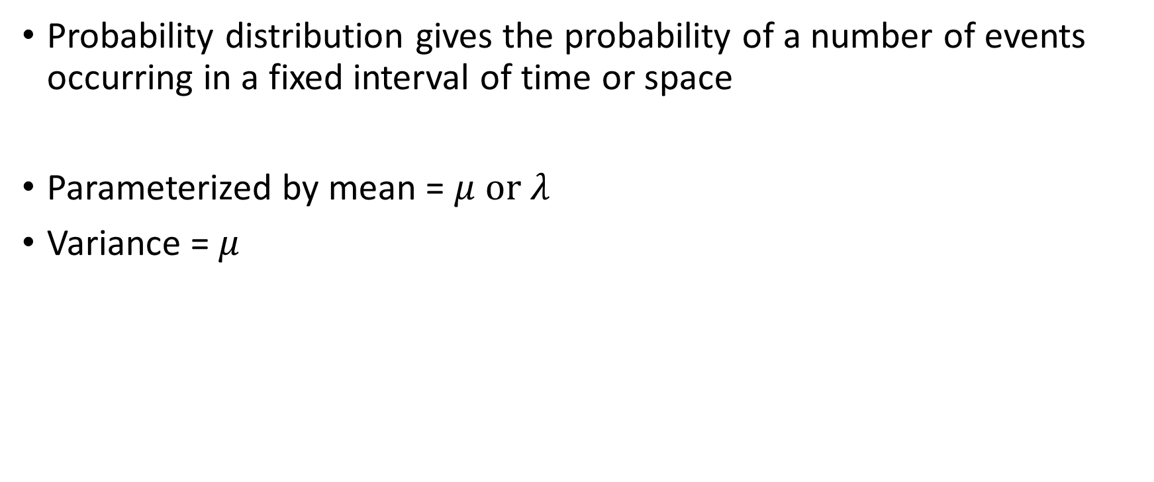
Poisson($μ$)
Probability distribution gives the probability of a number of events occurring in a fixed interval of time or space
Parameterized by mean = $μ or λ$
Variance = $μ$

Slide 6
Poisson Example
Example: You are “on call” at work. And every night between 12 and 8 AM you receive about 6 calls from customers
Question: What is the probability you receive a call from 2-4 AM?
Definitions: X~P(u) where X is a random variable with a Poisson distribution, and “u” is the mean for the interval
6 calls over an 8 hour window is about ¾ of a call every hour, our window is 2 hours, so our “u” value is 2*3/4 = 1.5
https://homepage.divms.uiowa.edu/~mbognar/applets/pois.html

Slide 7
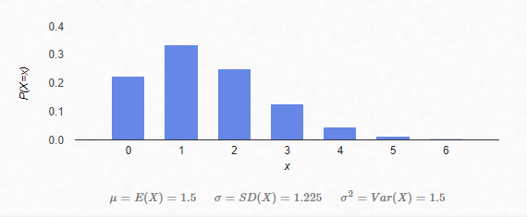
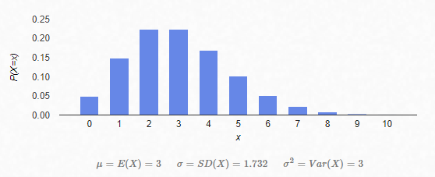

Poisson($μ$) Distribution

Slide 8
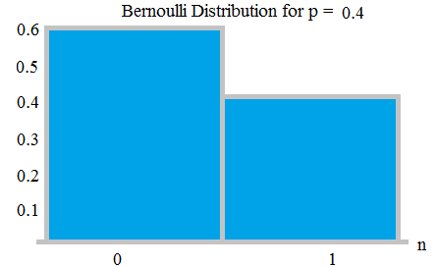
Bernoulli(p)
Discrete
Two outcomes: 0,1 || fail, success
Pr(X = 1) = p = 1-q
Pr(X = 0) = q = 1-p
Expectation:
E[x] = 1*p + (0)*(1-p) = p

Slide 9
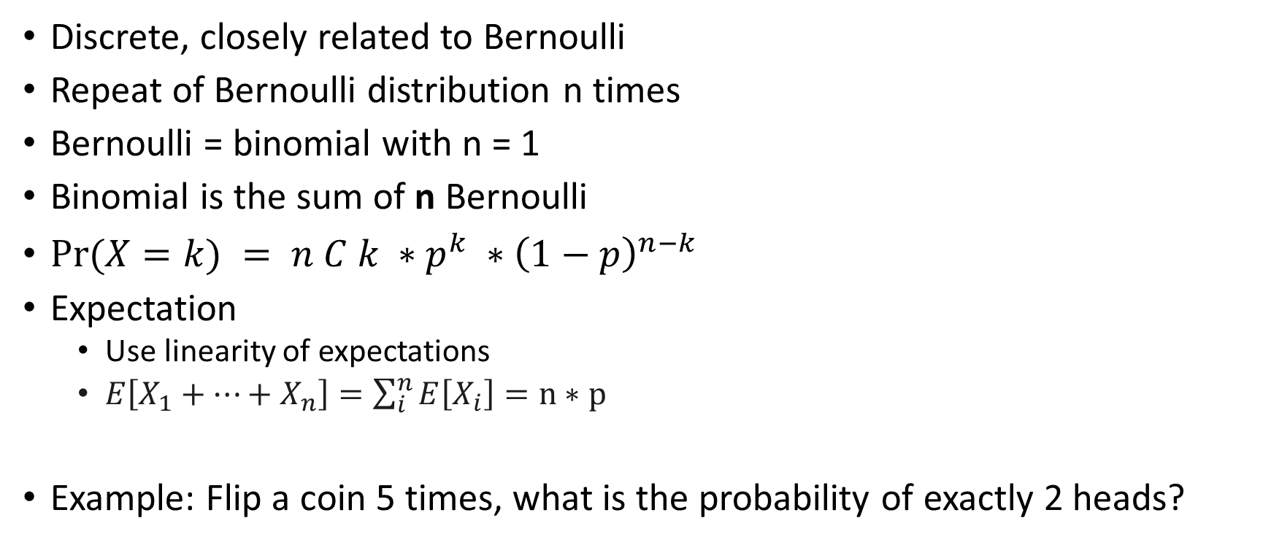
Binomial(n,p)
Discrete, closely related to Bernoulli
Repeat of Bernoulli distribution n times
Bernoulli = binomial with n = 1
Binomial is the sum of n Bernoulli
$Pr⁡(X=k) = n C k ∗p^{k} ∗{\left(1−p\right)}^{n−k}$
Expectation
Use linearity of expectations
$E\left[X_{1}+…+X_{n}\right]=\sum_{i}^{n}{E\left[X_{i}\right]}=n∗p$
Example: Flip a coin 5 times, what is the probability of exactly 2 heads?

Slide 10
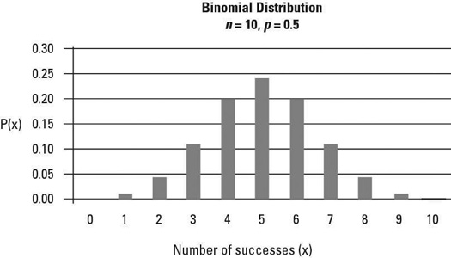
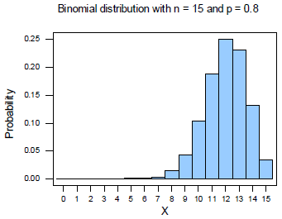
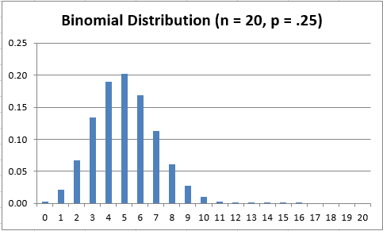

Binomial Distributions PDF
$$Pr⁡(X=k) = n C k ∗p^{k} ∗{\left(1−p\right)}^{n−k}$$

Slide 11
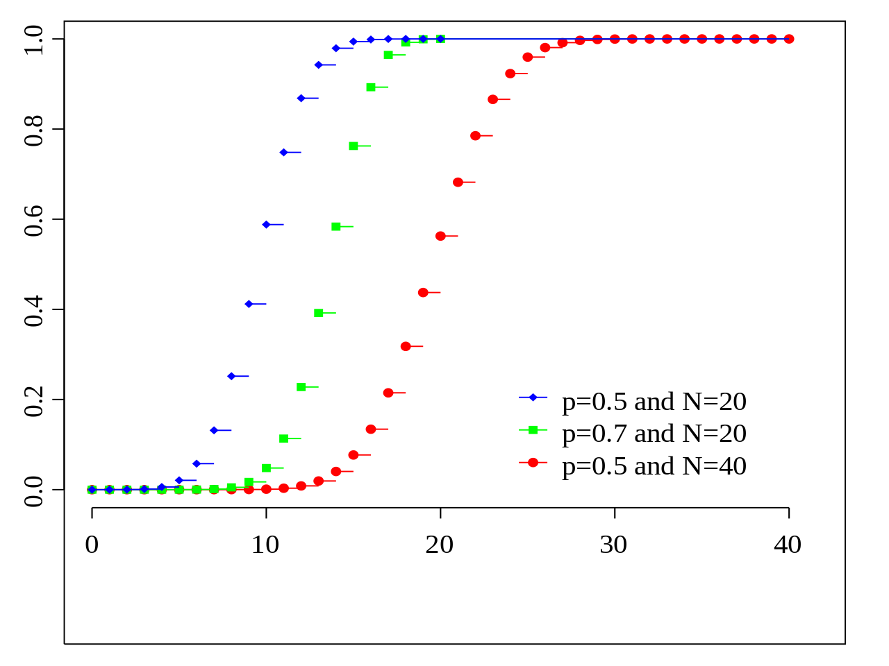
Binomial Distribution CDF
CDF: $F_{x}\left(t\right)=Pr⁡(X≤T)$

Slide 12
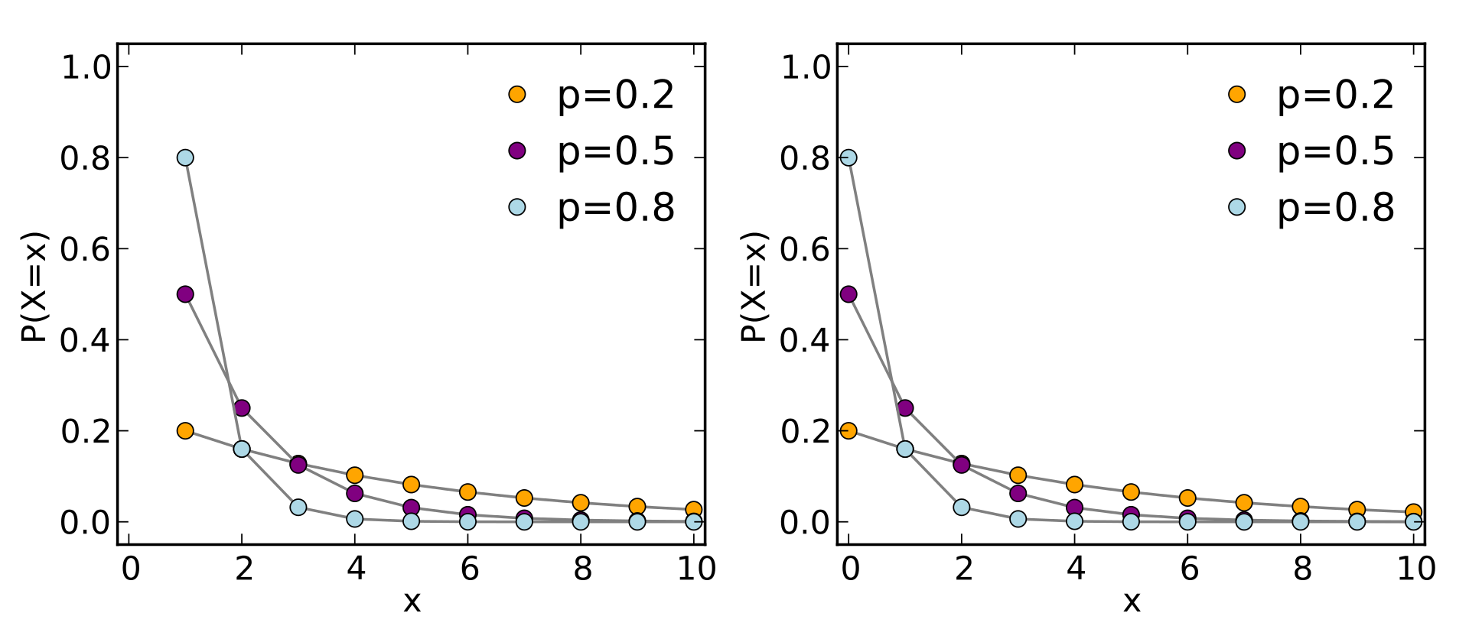
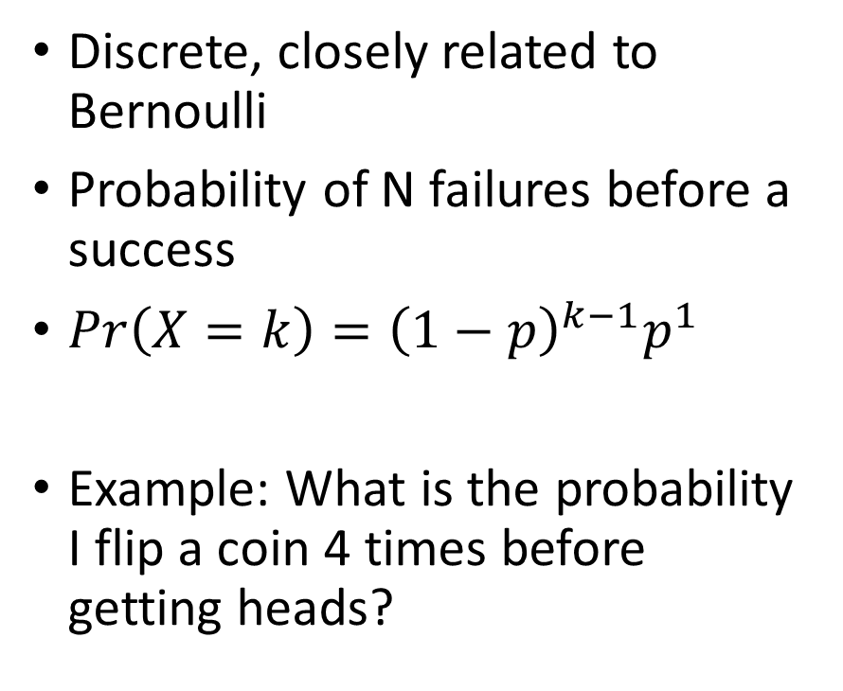

Geometric(p)
Discrete, closely related to Bernoulli
Probability of N failures before a success
$Pr\left(X=k\right)={\left(1−p\right)}^{k−1}p^{1}$
Example: What is the probability I flip a coin 4 times before getting heads?
Expected Value:
$$\sum_{k=1}^{∞}{k∗{\left(1−p\right)}^{k−1}p}$$
Notes:
https://math.stackexchange.com/questions/605083/calculate-expectation-of-a-geometric-random-variable
Do this computation slowly so they understand

Slide 13
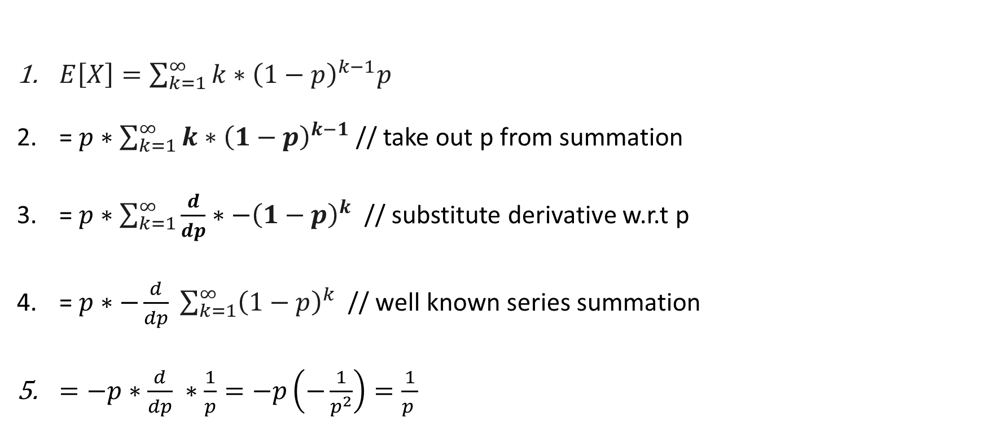
Geometric Expectation Derivation
$E\left[X\right]=\sum_{k=1}^{∞}{k∗{\left(1−p\right)}^{k−1}p}$
= $p∗\sum_{k=1}^{∞}{{k∗\left(1−p\right)}^{k−1}}$ // take out p from summation
=$p∗\sum_{k=1}^{∞}{{\frac{d}{dp}∗−\left(1−p\right)}^{k} }$ // substitute derivative w.r.t p
=$p∗−\frac{d}{dp} \sum_{k=1}^{∞}{{\left(1−p\right)}^{k} }$ // well known series summation
$=−p∗$ $\frac{d}{dp} ∗\frac{1}{p}=−p\left(−\frac{1}{p^{2}}\right)=\frac{1}{p }$

Slide 14
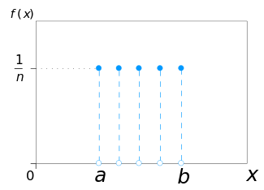
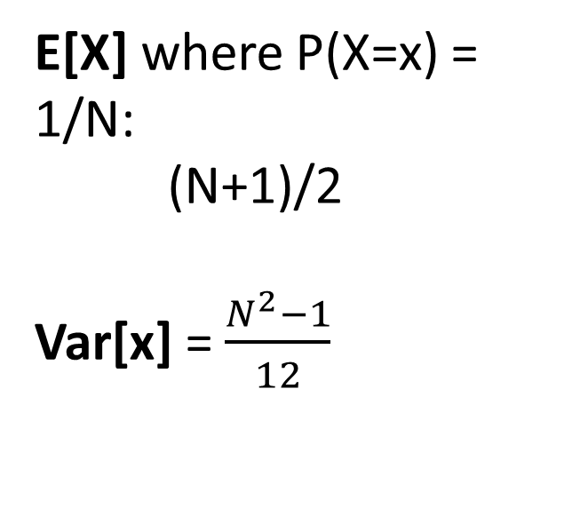
Uniform - Discrete
E[X] where P(X=x) = 1/N:
(N+1)/2
Var[x] = $\frac{N^{2}−1}{12}$

Slide 15
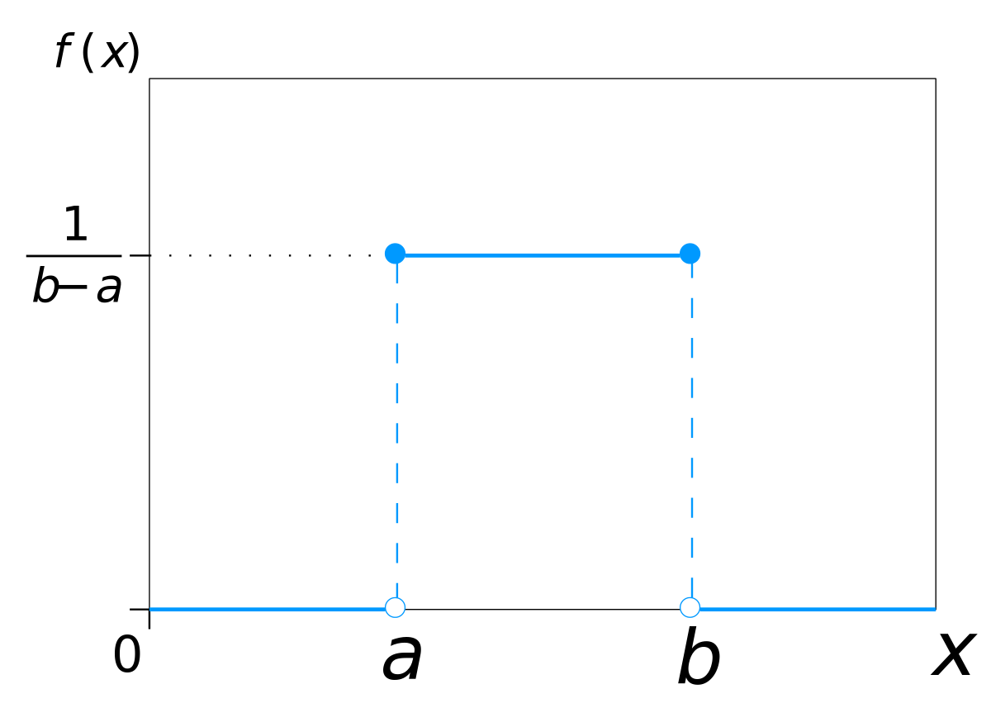
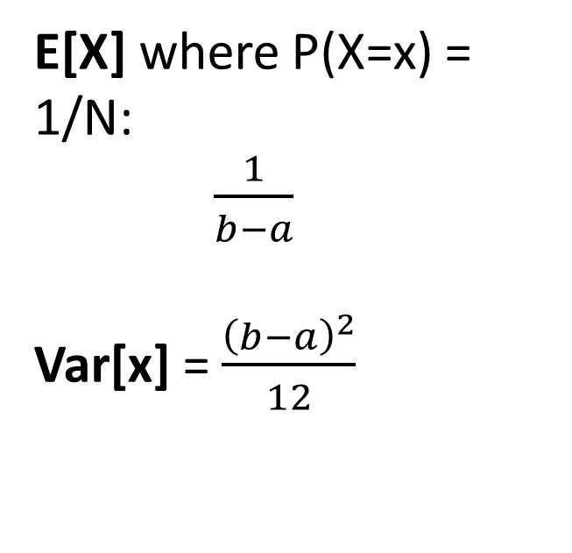
Uniform - Continuous
E[X] where P(X=x) = 1/N:
$\frac{1}{b−a}$
Var[x] = $\frac{{\left(b−a\right)}^{2}}{12}$

Slide 16
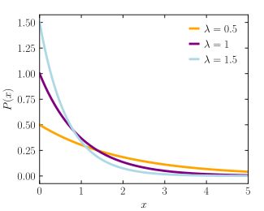
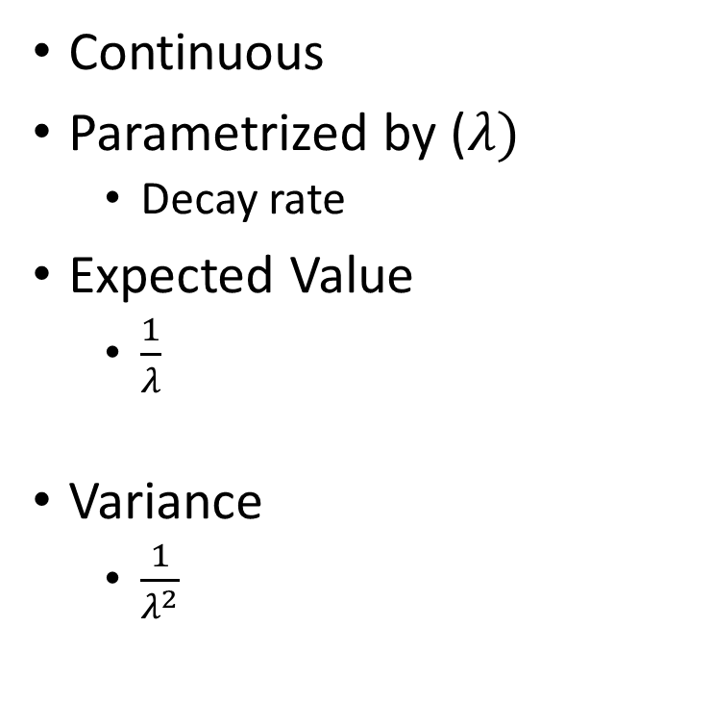
Exponential
Continuous
Parametrized by ($λ)$
Decay rate
Expected Value
$\frac{1}{λ}$
Variance
$\frac{1}{λ^{2}}$

Slide 17
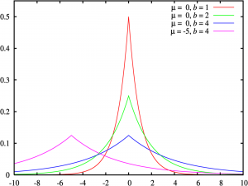
Laplace(
Parametrized by mu and beta:
Mu = Location (shift along the x axis)
B = scaling, maximum peak value
Uniform, closely related to Exponential
Notes:
https://www.statisticshowto.com/laplace-distribution-double-exponential/

Slide 18
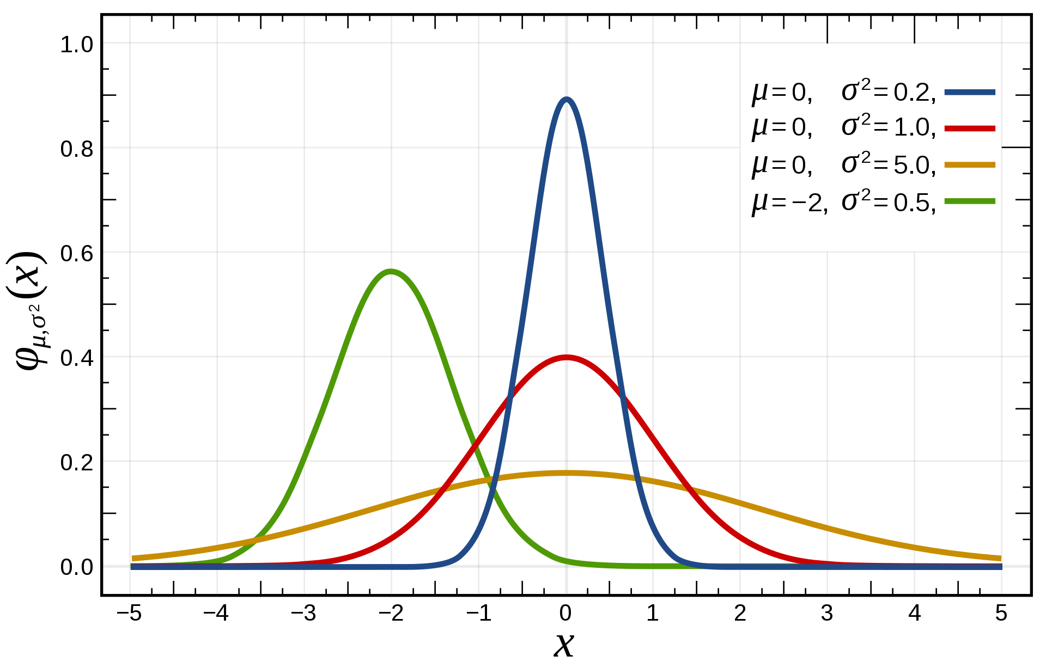
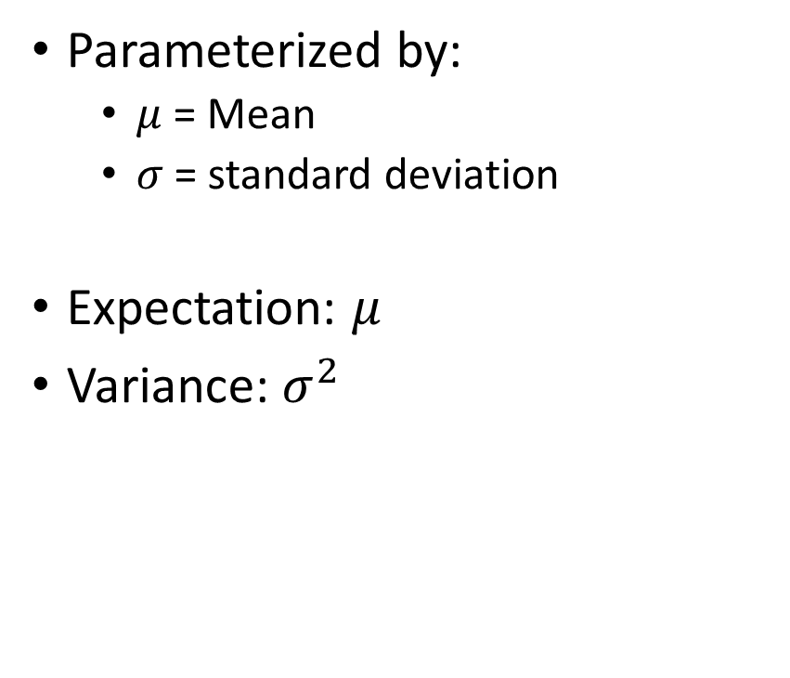
Gaussian – One dimension
Parameterized by:
$μ$ = Mean
$σ$ = standard deviation
Expectation: $μ$
Variance: $σ^{2}$
Notes:
https://en.wikipedia.org/wiki/Normal_distribution

Slide 19
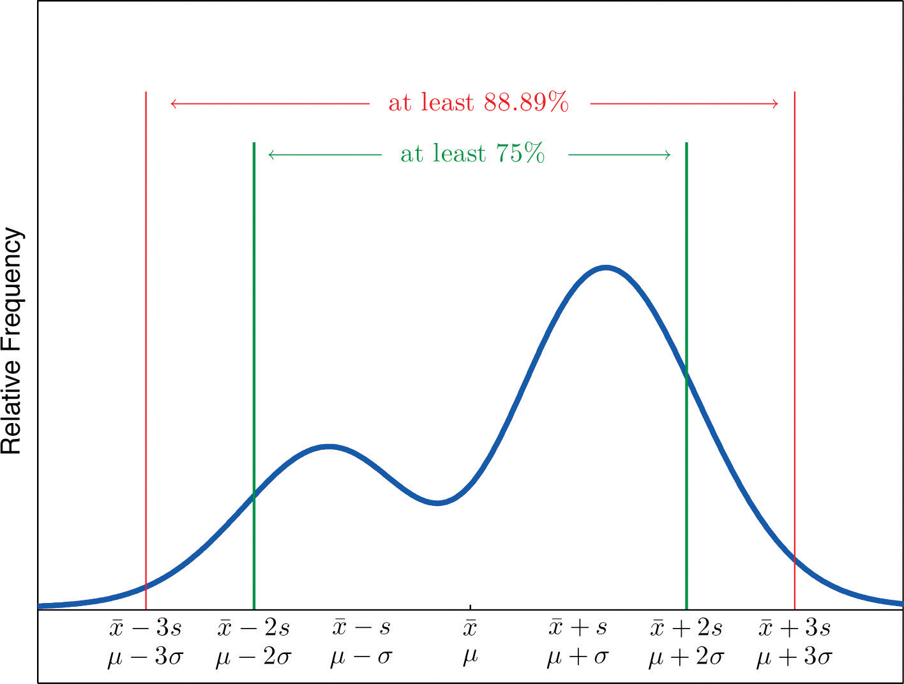

Chebyshev Inequality
$P\left(\left|X − μ\right| ≥k∗σ\right)≤ \frac{1}{k^{2}}$

Slide 20
Poisson Chebyshev problem
Let us say that X is modeled by a Poisson variable with mu/lambda/mean = 100
What is the lower bound of P(75 < X < 125)?

Slide 21
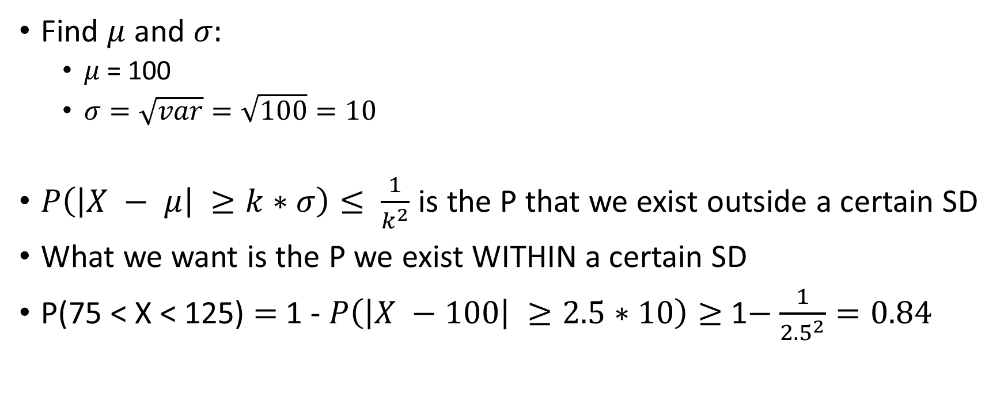
Poisson Chebyshev solution
Find $μ$ and $σ:$
$μ$ = 100
$σ=\sqrt{var}=\sqrt{100}=10$
$P\left(\left|X − μ\right| ≥k∗σ\right)≤ \frac{1}{k^{2}}$ is the P that we exist outside a certain SD
What we want is the P we exist WITHIN a certain SD
P(75 < X < 125) $=$ 1 - $P\left(\left|X −100\right| ≥2.5∗10\right)≥$1$−$ $\frac{1}{{2.5}^{2}}=0.84$
Notes:
Explain the strict inequalities in

Slide 22
End

Slide 23
Practice Problem
Broken device, calling customer support
1% chance a human representative being available and picking up my call, or else robot will disconnect me
Question:
What is the expected number of times I will have to call in before I talk to a human being?

Slide 24
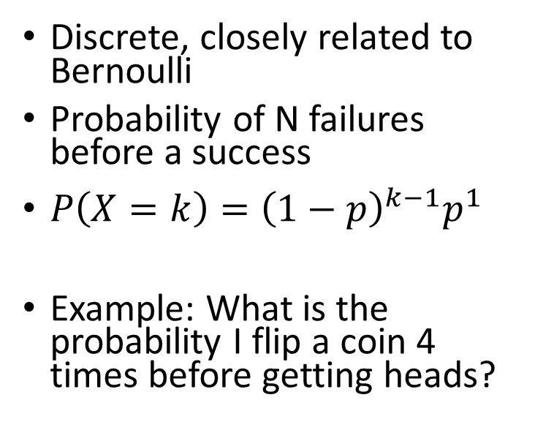
Practice Solution
Identify an analytical distribution:
Geometric in our case (fails until a success)
Discrete, closely related to Bernoulli
Probability of N failures before a success
$P\left(X=k\right)={\left(1−p\right)}^{k−1}p^{1}$
Example: What is the probability I flip a coin 4 times before getting heads?

Slide 25
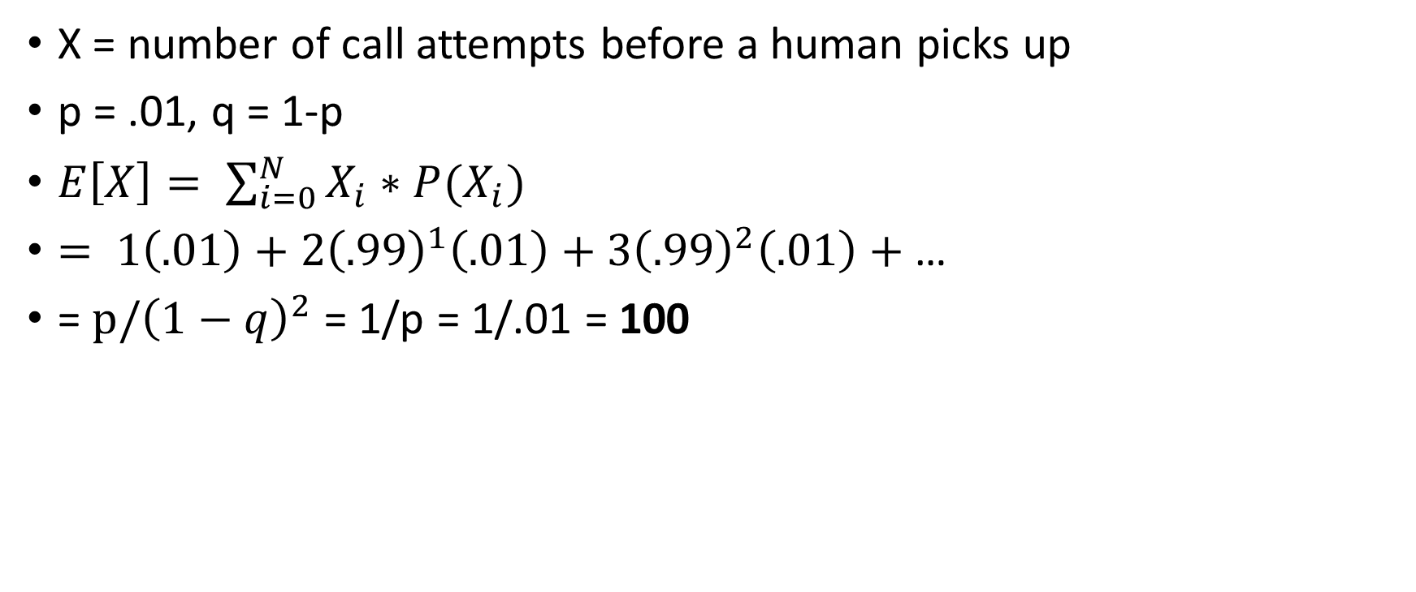
Practice Solution
X = number of call attempts before a human picks up
p = .01, q = 1-p
$E\left[X\right]= \sum_{i=0}^{N}{X_{i}∗P(X_{i})}$
$= 1\left(.01\right)+2{\left(.99\right)}^{1}\left(.01\right)+3{\left(.99\right)}^{2}\left(.01\right)+$…
= $p/{\left(1−q\right)}^{2}$ = 1/p = 1/.01 = 100

