Slide 1
Theoretical Modeling and Experimental Validation of Physiologically Relevant Flows and Their Applications
By Obed Armando Campos
Committee Members:
Eugene R. Pawlak, Mechanical and Aerospace Engineering, co-chair
Antonio L. Sánchez, Mechanical and Aerospace Engineering, co-chair
Stephanie Lindsey, Mechanical and Aerospace Engineering
Mitsue Miyazaki, Radiology
David Saintillian, Mechanical and Aerospace Engineering

Slide 2
Outline
Introduction
Part 1: Engineering Physiologically Relevant Flow Environments for Pulmonary Arterial Endothelial Studies
Chapter 1: A Multi-Chamber Pulsating-Flow Device with Optimized Spatial Shear Stress and Pressure for Endothelial-Cell Testing
Chapter 2: Poiseuille Flow with a Stretching Bottom Wall
Part 2: Cerebrospinal Fluid (CSF) Transport and Noninvasive Flow Quantification
Chapter 3: Phantom Based Evaluation of Time-SLIP MRI for Measuring Spinal-Canal Lagrangian Drift
1/40

Slide 3
Blood Flow in Main Pulmonary Artery
Cerebrospinal Fluid Flow in the Spinal Canal
openart.ai
2/40

Slide 4
Part 1: Engineering Physiologically Relevant Flow Environments for Pulmonary Arterial Endothelial Studies
3/40

Slide 5
Background
Heart pumps blood through the body
Contraction and relaxation of the heart leads to periodic fluctuations in the blood flow.
Endothelial cells that line the blood vessels can sense changes in flow through mechanical loads.
Section of Blood Vessel
Endothelium
Pressure
(Normal Stress)
Shear Stress
FLOW
~2.5cm
Stretching
Endothelial Cells
4/40

Slide 6
Why Do We Care About MPA and PAECs?
Motivation:
Children with congenital heart disease can develop pulmonary hypertension (PH). Current pharmaceuticals do not offer longer term alleviation for PH.
Goal:
We can study pulmonary hypertension by looking at the genetic response of PAECS varying changes in flow shear stress, pressure and stretching. With hopes of developing better pharmaceuticals.
With flow apparatus that apply these loads uniformly to large testing sample using a flow rate that idealizes main pulmonary artery flow.
5/40

Slide 7
Chapter 1: A Multi-Chamber Pulsating-Flow Device with Optimized Spatial Shear Stress and Pressure for Endothelial-Cell Testing
6/40

Slide 8


Our Focus
We want to expedite experiments and maintain accuracy of applied forces to a large cell sample size.
Q(t)
Top View
Side View
Coverslips
Testing
Region
z
$$τ_{x}={\left.μ\frac{∂u}{∂x}\right|}_{z=−h}$$
$$2W$$
$$\sim 5 cm$$
$$2h$$
x
$$2L\sim 10 cm$$
7/40
Notes:
Talk about cells being in the bottom

Slide 9


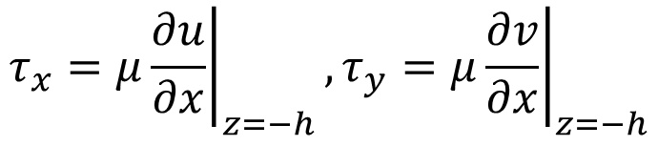






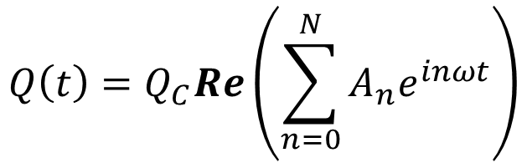
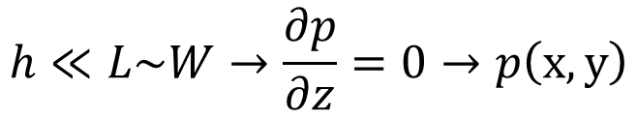


Theoretical Model
Setup
Objective
$$Q\left(t\right)=Q_{C}Re\left(\sum_{n=0}^{N}{A_{n}e^{inωt}}\right)$$
$$τ_{x}={\left.μ\frac{∂u}{∂x}\right|}_{z=−h},τ_{y}={\left.μ\frac{∂v}{∂x}\right|}_{z=−h}$$
$$Q\left(t\right)$$
Considerations
$$h≪L\sim W→\frac{∂p}{∂z}=0→p\left(x,y\right)$$
$$2W$$
z$,w$
y$,v$
The relevant lubrication Reynolds number satisfies
$$x,u$$
$$2h$$
$$2α$$
$$\frac{ρU_{C}h}{μ}\frac{h}{W}≪1$$
$$2L$$
where
$$U_{C}=\frac{Q_{C}}{4hW}$$
8/40

Slide 10
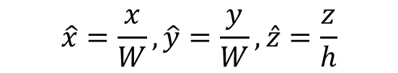
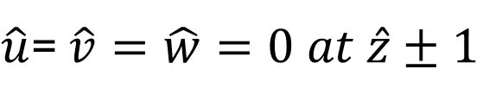

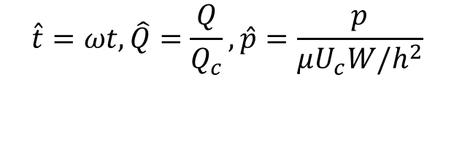
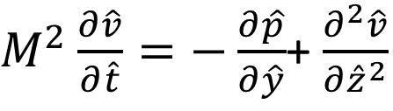
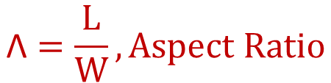
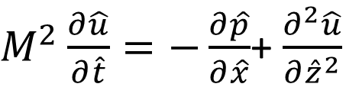
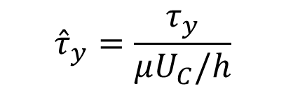

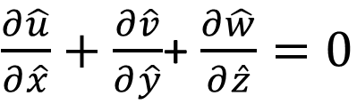
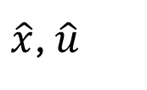






Dimensionless Governing Equations
Top View
Dimensionless Objective
$${\hat{τ}}_{x}=\frac{τ_{x}}{μU_{C}/h}$$
$$1$$
$\hat{y,}$ $\hat{v}$
$$α$$
$\hat{x}$, $\hat{u}$
$${\hat{τ}}_{y}=\frac{τ_{y}}{μU_{C}/h}$$
Point Source
Point Sink
$$\hat{Q}\left(\hat{t}\right)$$
$$\text{Λ}=\frac{L}{W}, Aspect Ratio$$
$$\hat{Q}\left(\hat{t}\right)$$
Dimensionless Variables
Governing Equations for 2D Unsteady Lubrication
Womersley Number
$$\hat{x}=\frac{x}{W},\hat{y}=\frac{y}{W},\hat{z}=\frac{z}{h}$$
$$M=\sqrt{\frac{ρωh^{2}}{μ}}$$
$\frac{∂\hat{u}}{∂\hat{x}}+\frac{∂\hat{v}}{∂\hat{y}}$+ $\frac{∂\hat{w}}{∂\hat{z}}=0$
$\hat{u}=\frac{u}{U_{c}}$, $\hat{v}=\frac{v}{U_{c}}$, $\hat{w}=\frac{w}{U_{c}}$
$M^{2}\frac{∂\hat{u}}{∂\hat{t}}=−\frac{∂\hat{p}}{∂\hat{x}}$+ $\frac{∂^{2}\hat{u}}{∂{\hat{z}}^{2}}$
$$\hat{t}=ωt,\hat{Q}=\frac{Q}{Q_{c}},\hat{p}=\frac{p}{μU_{c}W/h^{2}}$$
Boundary Conditions
$M^{2}\frac{∂\hat{v}}{∂\hat{t}}=−\frac{∂\hat{p}}{∂\hat{y}}$+ $\frac{∂^{2}\hat{v}}{∂{\hat{z}}^{2}}$
$\hat{u}$= $\hat{v}=\hat{w}=0 at \hat{z}±1$
9/40
Notes:
We then dimensionless the problem using these dimensionless variables shown here.
Which lead us to our 2D unsteady lubrication governing eqautions, with the boundary conditions coming from no slip on the top and bottom plates. As well, as our dimensionless wall shear stress
Two important dimensionless parameters arise here, the womersely number M, wich describes the pulsating frequency in relation to the viscous effects and the aspect ratio lambda which I will become relevant later.
Further we only looking at half of the planform of the chamber due to symmetry.
As well, the inlets and outlets are described as point and sink sources that are placed at their respective lengthwise end corners.

Slide 11
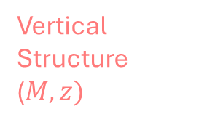
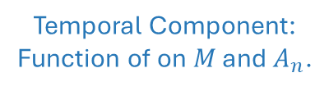
Flow Theory: 3D Model for PPFC
Oh
3D Solution:
Temporal Component: Function of on $M$ and $A_{n}$.
Spatial Component [Horizontal Structure ψ(x,y)]: Function of Λ.
Vertical Structure ($M,z)$
10/40

Slide 12

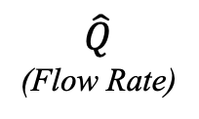

Temporal Fluctuations
$$\hat{Q}$$
(Flow Rate)
$$\hat{P}$$
(Pressure)
z
$$\hat{\text{τ}}$$
(Shear Stress)
V(z)
11/40
Notes:
Explain the axis and the plot contents

Slide 13
Shear Stress Spatial Anomaly
12/40
Notes:
This is normalize anomaly showing here for the shear stress metric

Slide 14
MCS
CAD Model of Mutiplex Cell Shearer
Flow Output
to piston pump
Flow Input, Q(t), from piston pump
Side View of Perfusion Chamber
13/40
Notes:
Add scaling here

Slide 15
Experimental Setup for Particle Tracking Velocimetry (PTV)
Computer
Pressure Sensor
Arduino
Directional Valve
Contaminated Reservoir
Direction of Flow
Pulsatile (Piston) Pump
Ball Valve
Camera
Single Perfusion Chamber
Pump Input:
Mixer with Particles
Clean Water
14/40

Slide 16
Flow with Tracer Particles
Testing Region
15/40
Notes:
Let it run at least twice

Slide 17
Streamlines
Testing Region
16/40
Notes:
Go through this carefully

Slide 18
Pressure Measurements
Q(t)
17/40

Slide 19
Chapter 2: Poiseuille Flow with a Stretching Bottom Wall
18/40
Notes:
Transition, take the pause, introduce how we are missing stretching

Slide 20
Background
Heart pumps blood through the body
Contraction and relaxation of the heart leads to periodic fluctuations in the blood flow.
Endothelial cells that line the blood vessels can sense changes in flow through mechanical loads.
Section of Blood Vessel
Endothelium
Pressure
(Normal Stress)
Shear Stress
FLOW
~2.5cm
Stretching
Endothelial Cells
4/40

Slide 21
Stretching
19/40

Slide 22
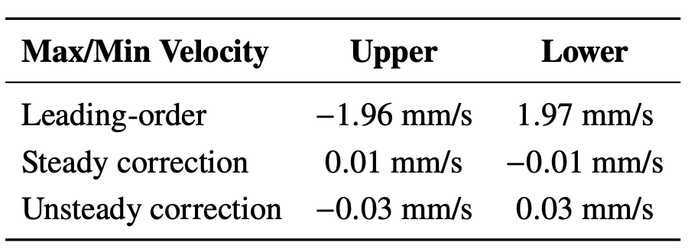
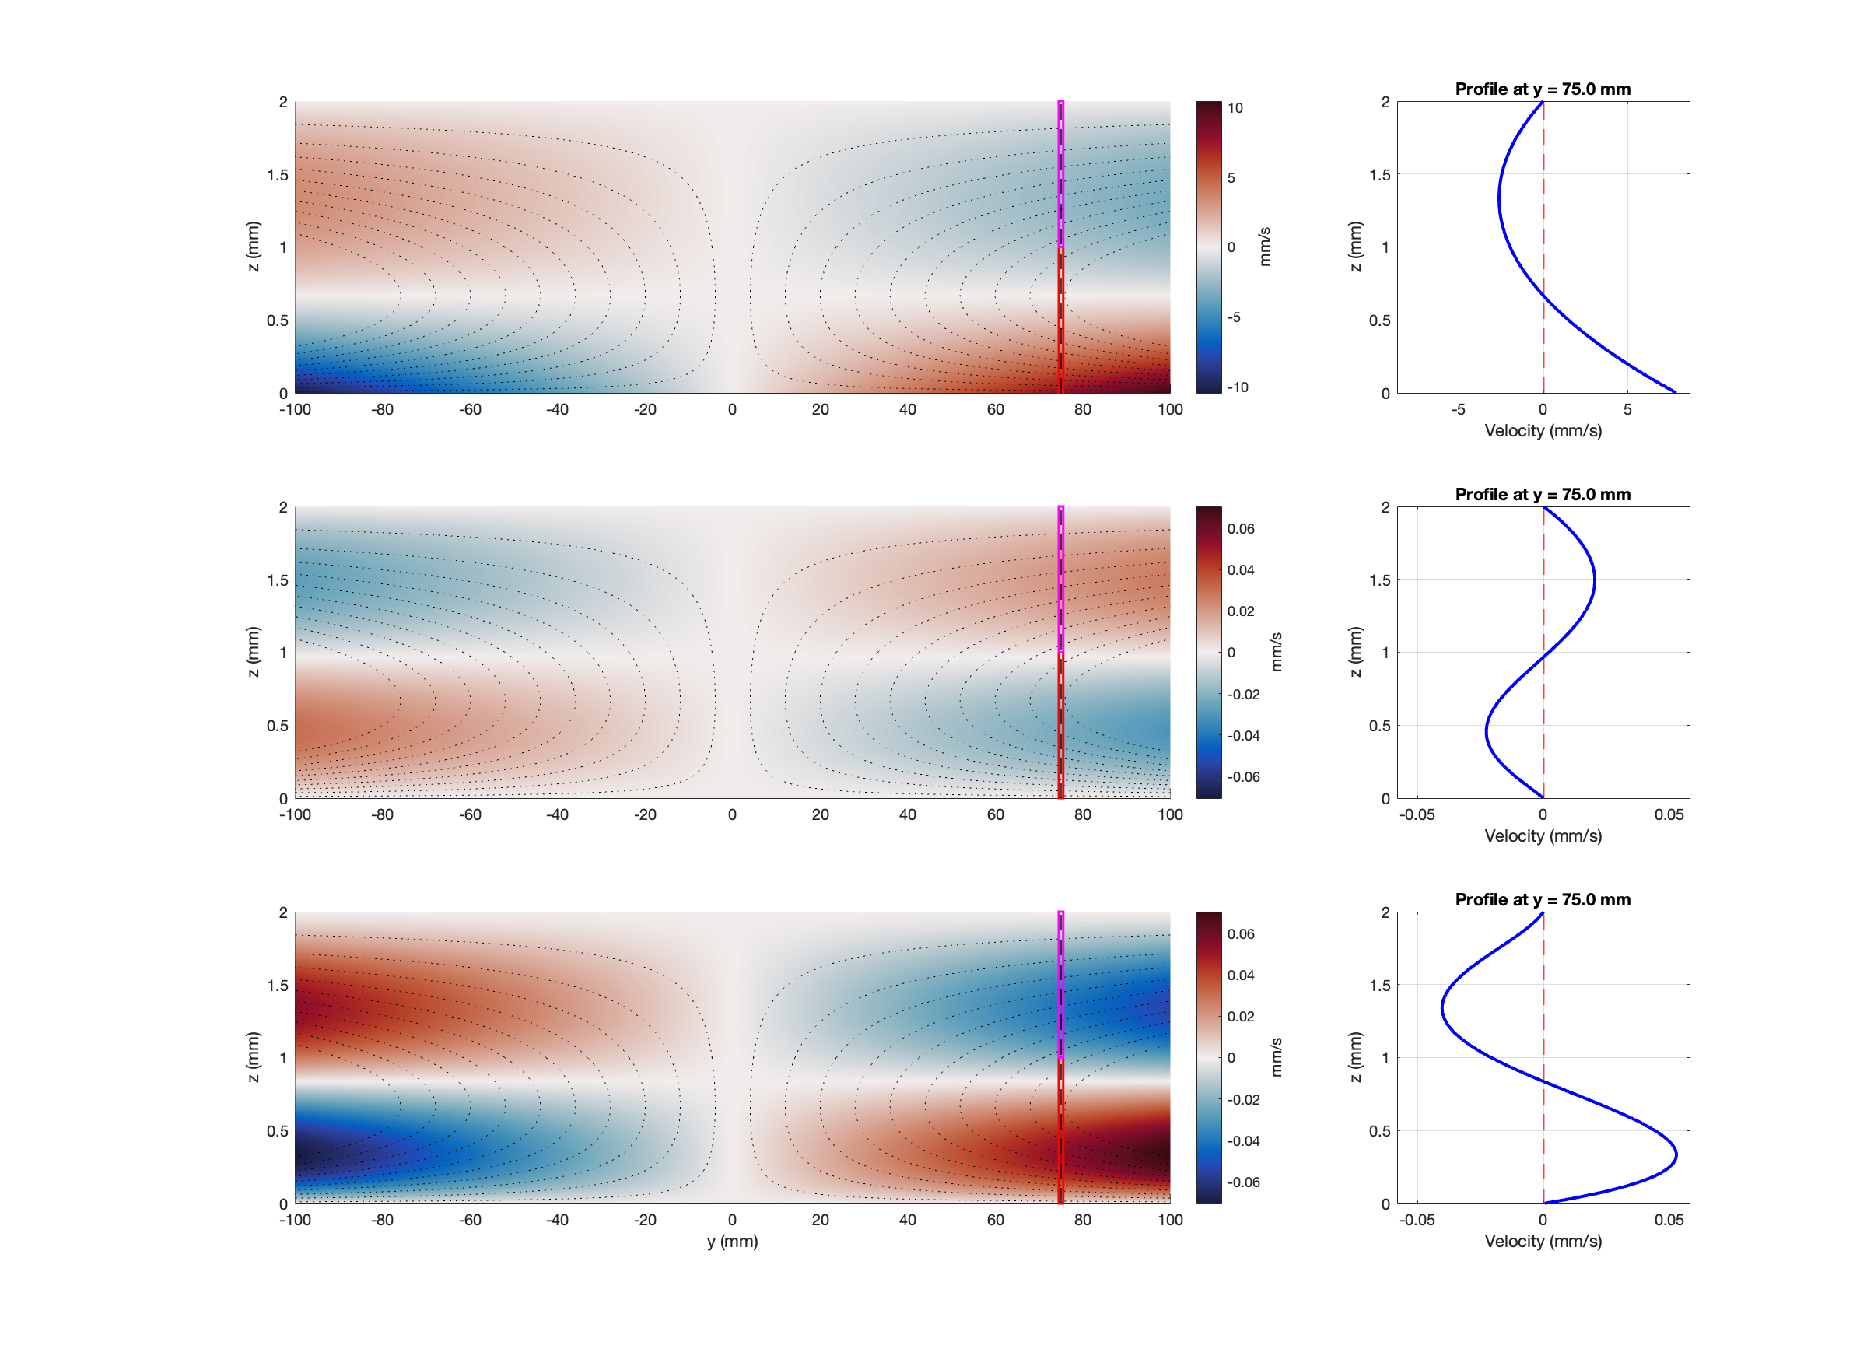
Moving lower boundary
Longitudinal flow is uncoupled
Analysis is similar as before
Linear
Lubrication problem due to Hele-Shaw cell
Transverse Flow: Leading Order
20/40
Notes:
Longitudinal flow is unchanged, if it was infinitely long channel they are uncoupled

Slide 23
Orthogonal View
Rollers
Tank
Motors with Membrane Holder
Membrane Holder on Motor
Membrane Through Device
Flow Chamber
with Membrane
21/40
Transverse of Flow Slice View

Slide 24
Dye
Flow Chamber
Camera
Flow Meter
Tank
Pump
Membrane
Drain
22/40

Slide 25
Upper Dye
Lower Dye
Together
23/40

Slide 26
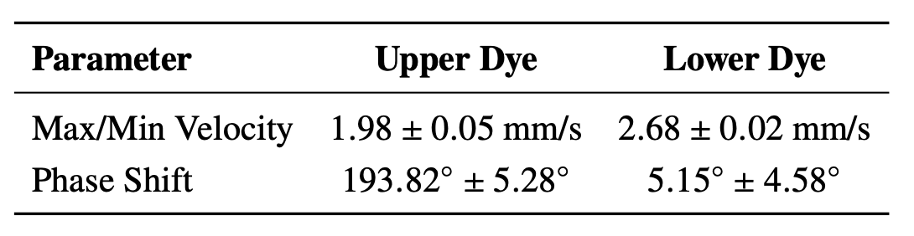
a)
b)
Single Cycle
For a Single Frame
Reference
Upper Dye
Lower Dye
100 mm
24/40
Notes:
Add summary of the results

Slide 27
Part 2: Cerebrospinal Fluid (CSF) Transport and Noninvasive Flow Quantification
25/40

Slide 28
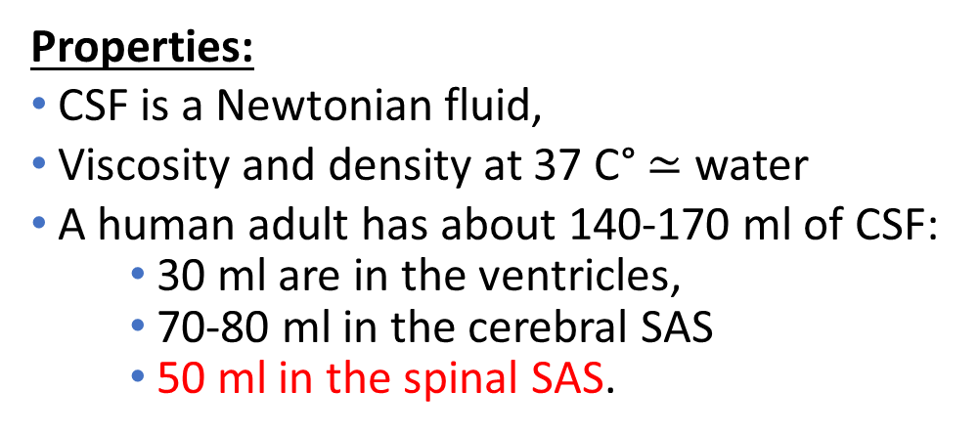
Introduction
Cerebrospinal Fluid (CSF)
The entire surface of central nervous system is bathed by a clear, colorless fluid called cerebrospinal fluid (CSF).
Properties:
CSF is a Newtonian fluid,
Viscosity and density at 37 C° $≃$ water
A human adult has about 140-170 ml of CSF:
30 ml are in the ventricles,
70-80 ml in the cerebral SAS
50 ml in the spinal SAS.
26/40
Notes:
Shock Absorber that protects brain tissue.
Regulates distribution of substances, removes metabolic waste, and maintains Intracranial Pressure (ICP).

Slide 29
Chapter 3: Phantom Based Evaluation of Time-SLIP MRI for Measuring Spinal-Canal Lagrangian Drift
27/40

Slide 30
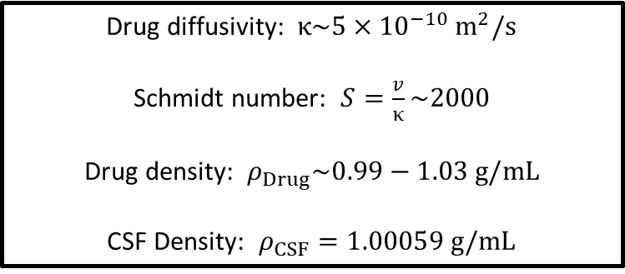
Intrathecal Drug Delivery
Injection of drugs into the subarachnoid space
Injection methods:
Single dose
Continuous infusion
Target locations:
Brain (chemotherapy)
Spine (spinal anesthesia)
Drug diffusivity: $κ\sim 5×{10}^{−10} m^{2}/s$
Schmidt number: $S=\frac{v}{κ}\sim 2000$
Drug density: $ρ_{Drug}\sim 0.99−1.03 g/mL$
CSF Density: $ρ_{CSF}=1.00059 g/mL$
28/40

Slide 31



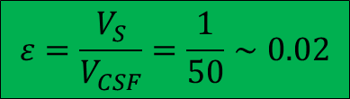

Motion in the Spinal Canal
Slow drift
Driven by cardiac and respiratory cycles
$$L_{S}=εL$$
~ 2 cm/min
~ 30 min
Fast oscillatory motion
$u_{c}\sim \frac{L_{s}}{ω^{−1}}=εωL∼$cm/s
T$∼2π/ω∼1$ sec
~ 5 cm/s
~ 1 s
$$V_{S}∼1 mL$$
$V_{CSF}∼50 mL$
Need a non-invasive method to measure Lagrangian drift
Patient specific drug dispersion predictions
$$ε=\frac{V_{S}}{V_{CSF}}=\frac{1}{50}∼0.02$$
Notes:
Diffusivity is so small

Slide 32

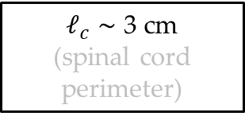
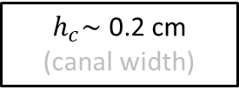
Spinal Canal Phantom
Entrance
Flow
Compliant Exterior
Thickness 8mm
Interior Diameter 2.1 cm
$ℓ_{c}$ $\sim$ 3 cm
(spinal cord perimeter)
$h_{c}\sim$ 0.2 cm
(canal width)
$$h_{c}≪ℓ_{c}≪L$$
Rigid Rod
Diameter of 1 cm
$$x=L$$
Closed End
30/40
Notes:
Objective to develop methodology,

Slide 33


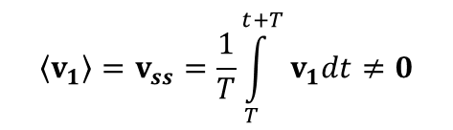

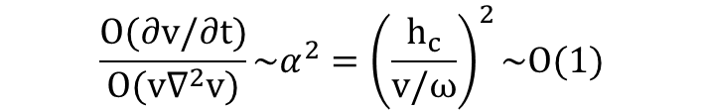
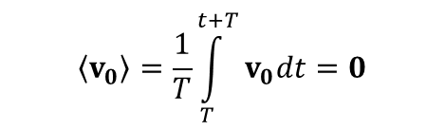









Theoretical CSF Motion Model
Leading-order solution:
$$\left\langle v_{0}\right\rangle =\frac{1}{T}\int_{T}^{t+T}{v_{0}dt=0}$$
$$\frac{∂v_{0}}{∂t}=−∇p_{0}+\frac{1}{α^{2}}\frac{∂^{2}v_{0}}{∂y^{2}}$$
First-order corrections:
Momentum balance
$$\left\langle v_{1}\right\rangle =v_{ss}=\frac{1}{T}\int_{T}^{t+T}{v_{1}dt≠0}$$
$$\frac{∂v_{1}}{∂t}+v_{0}∙∇v_{0}=−∇p_{1}+\frac{1}{α^{2}}\frac{∂^{2}v_{1}}{∂y^{2}}$$
$$\frac{∂v}{∂t}+εv∙∇v=−∇p+\frac{1}{α^{2}}\frac{∂^{2}v}{∂y^{2}}$$
$$\frac{O(∂v/∂t)}{O(v∙∇v)}\sim ε^{−1}≫1$$
$$\frac{O(∂v/∂t)}{O(v∇^{2}v)}\sim α^{2}={\left(\frac{h_{c}}{v/ω}\right)}^{2}\sim O(1)$$
neglected$O\left(ℓ_{c}^{2}/L^{2}\right)$ and $O\left(h_{c}^{2}/ℓ_{c}^{2}\right)$ terms
Mean Lagrangian drift:
$t \sim ε^{−2}ω^{−1}$ $∼$ 30 min
Oscillation time:
$t∼ω^{−1}$ $∼$ 1 s
$$h_{c}≪ℓ_{c}≪L$$
Steady Streaming
$$v_{SS}=\left\langle v_{1}\right\rangle$$
Asymptotic expansions for $ε≪1$:
Mean Lagrangian Velocity
Lagrangian
Drift
$$v_{SD}=\left\langle \int_{0}^{t}{v_{0}dt^{′}∙∇v_{0}}\right\rangle$$
$$v_{L}= v_{SS} + v_{SD}$$
J. J. Lawrence, et al, J. Fluid Mech., 861 679-720 (2019)
31/40
Notes:
Cite theory

Slide 34
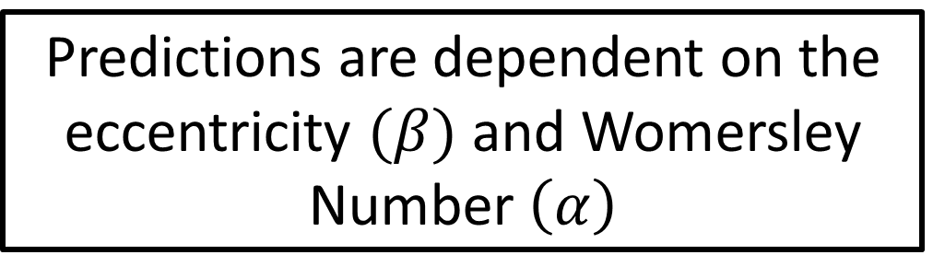
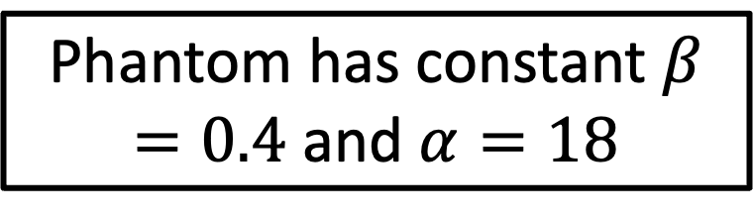
Theoretical Predictions: Slow Drift
Predictions are dependent on the eccentricity $(β)$ and Womersley Number $\left(α\right)$
Phantom has constant $β=0.4$and $α=18$
Javier Alaminos-Quesada
32/40
Notes:
Cite theory

Slide 35
Non-Invasive Measurements: Setup
Piston Pump
(Vivitro Labs)
Pump Input
MRI Room
33/40

Slide 36
Phase Contrast to capture slow drift ?
34/40
Notes:
Pc gives us mean eulerian velocity
Spatial and temporal accuracy is not enough

Slide 37
35/40
Notes:
Explain why would wait longer,

Slide 38
How Do We Get a Profile?
36/40

Slide 39
Qualitative Results
37/40
Notes:
Add a circle to highlight the discrepancies

Slide 40
Displacement Results
38/40

Slide 41
Acknowledgements
Committee
Dr. Geno Pawlak,
Dr. Antonio Sanchez
Dr. Stephanie Lindsey
Dr. Mitsue Miyazaki
Dr. David Saintillian
Family
Angel Flores
Esther Campos
Eva Campos
Mario Flores
Eli Alfaro
Collaborators
Pawlak Lab
Sanchez Lab
Lindsey Lab
Wilfred Conen
Stephanie Sincomb
Javier Alaminos Quesada
Vadim Malis Candido Gutierrez Montes
Carlos Martinez Bazan
Amy Shwartz
Facilities and Staff
MAE Machine Shop
MAE Design Studio
Thomas Chalfant
Steve Mercask
Akemi Alpaslan
Chris Cassidy
39/40

Slide 42
Thank You!
40/40

