Slide 1
🏟️
Local Sports League
Management System
Final database demonstration
Group 13
Bryan G Vera • Cameron J Bergeron • Dalton J Opudo • Lance L Martin
CS-3743 Database Systems
Notes:
Hello everyone. We are Group 13, Our project is the Local Sports League Management System: Bryan Vera, Cameron Bergeron, Dalton Opudo, and Lance Martin.

Slide 2
LOCAL SPORTS LEAGUE MANAGEMENT SYSTEM
Presentation Roadmap
1
Business summary
Why local sport leagues needs the database
2
Rules + ERD/DDD
How the data is organized and normalized
3
Sample data
How repeated real-world records are handled
4
Query demo
Fourteen reports/actions that answer business questions
5
Reflection
What we learned and how the system delivers value
Group 13 • CS-3743 Database Systems • 2
Notes:
Cameron- The goal is to show how the database makes league information easier to store, search, update, and report.
First, we will briefly summarize the business and the problem our database is solving. Then we will review the business rules and the ERD. After that, we will show the sample data and explain how the database handles repetition. The largest part of the presentation is the query demonstration, where each query is connected to a real business question. We will finish with team reflections and the overall value delivered by the system.

Slide 3
LOCAL SPORTS LEAGUE MANAGEMENT SYSTEM
Business Summary: What the League Needs
Client
Database benefit
Local community sports league organization
Manages recreational sports across seasons
Tracks teams, players, coaches, matches, locations, and statistics
One reliable place to manage schedules, rosters, standings, and player statistics.
Current problem
Reduces duplicate work and data entry errors
Improves communication with coaches, players, and families
Supports planning for facilities, staffing, and future leagues
Information is spread across manual records and spreadsheets
Schedules, rosters, results, and standings can become inconsistent
Staff need faster access to accurate reports
Group 13 • CS-3743 Database Systems • 3
Notes:
Bryan - Our database is designed for a local community sports league organization. This league manages recreational sports such as soccer, basketball, baseball, volleyball, flag football, and tennis across different seasons. Before using a centralized database, information like rosters, schedules, scores, and player stats could be scattered across spreadsheets or manual records. This database helps by keeping the information in one structured system. That makes daily administration more accurate, reduces recordkeeping errors, and gives users quick access to the information they need.

Slide 4
LOCAL SPORTS LEAGUE MANAGEMENT SYSTEM
Business Questions the Database Answers
Participation
Rosters
How many teams and players are in each sport or season?
Which players and coaches are assigned to each team?
Scheduling
Results
What matches are scheduled, and where will they be played?
Which matches are completed, and what were the final scores?
Standings
Player stats
How do wins, losses, ties, and points compare by team?
Which players lead in goals, assists, fouls, or minutes?
These questions guide the ERD, sample data, and query demonstrations.
Group 13 • CS-3743 Database Systems • 4
Notes:
Lance - These are the main business questions our database is designed to answer. League staff need to know how many teams and players are participating, which players and coaches belong to each team, what matches are scheduled, where those matches take place, and what the completed results were. The database also supports performance questions, such as team standings and individual player statistics. These questions matter because they help administrators communicate with coaches, players, and families while also supporting better planning for future seasons.

Slide 5
LOCAL SPORTS LEAGUE MANAGEMENT SYSTEM
Business Rules: League Structure
Sport → Season
A sport can have many seasons; each season belongs to one sport.
Player assignment
A player may participate in many seasons but only one team per season.
Season ↔ Team
A season can include many teams, and teams can return across seasons.
Roster record
Each player-season assignment references exactly one team-season record.
Team-season record
A team participates at most once per season and includes division/age group.
Coach assignment
A coach may work across seasons; each team-season has one assigned coach.
Bridge tables let the same teams, players, and coaches appear across seasons without duplicating core records.
Group 13 • CS-3743 Database Systems • 5
Notes:
Dalton - These business rules describe the main structure of the league. A sport can have many seasons, but each season belongs to one sport. A season can include many teams, and a team can participate in many seasons. To avoid duplicating team records, we use the TEAM_SEASON table to represent a team in a specific season and division. Players are also assigned through a season-based roster table. This lets the same player or team appear in future seasons while still keeping each season’s records separate and accurate.

Slide 6
LOCAL SPORTS LEAGUE MANAGEMENT SYSTEM
Business Rules: Matches, Results, and Controls
Match scheduling
Each match belongs to one season and has a valid date, time, and location.
Standings
Wins, losses, ties, and points are tracked by team-season.
Home + away teams
Each match has exactly two different teams from the season.
Player stats
A player can have at most one stat record per match.
Status and scores
Scheduled matches may exist before scores are recorded.
No double-booking
A location cannot host more than one match at the same date/time.
These rules become database safeguards: keys, foreign keys, unique constraints, and checks.
Group 13 • CS-3743 Database Systems • 6
Notes:
Cameron - These rules focus on matches, results, and database controls. Each match belongs to one season, has a valid date and time, and takes place at a location. Each match includes exactly two teams: one home team and one away team. The database also prevents common errors. For example, a team cannot play against itself, a location cannot host two matches at the same date and time, and a player can only have one stat record per match. These controls help protect data quality as the league grows.

Slide 7
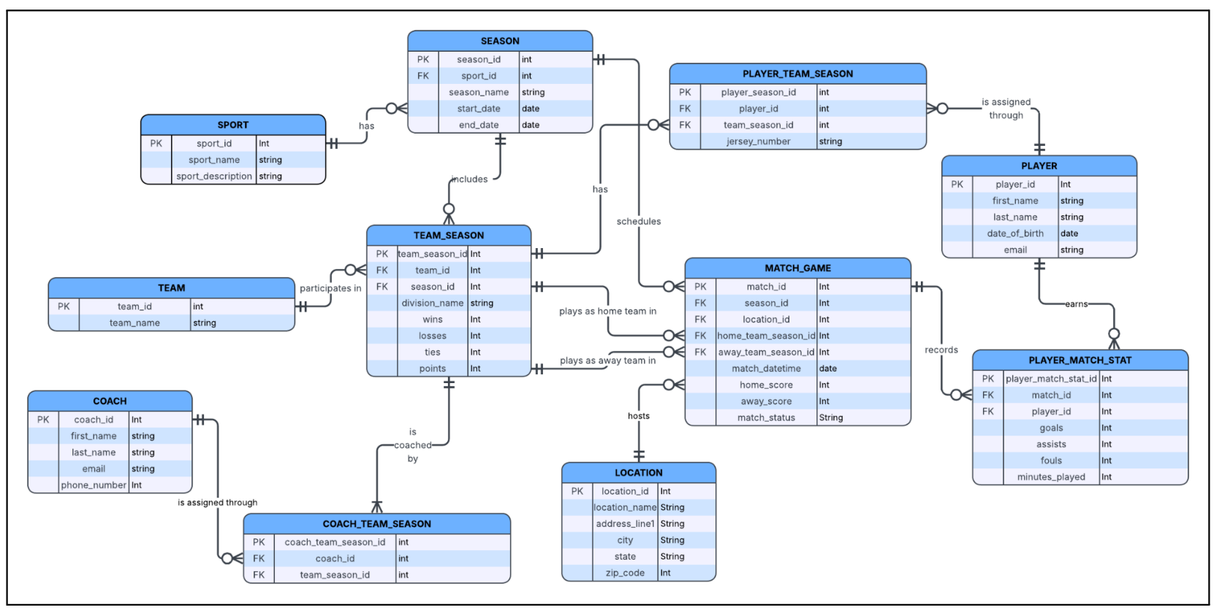
LOCAL SPORTS LEAGUE MANAGEMENT SYSTEM
Final ERD
Group 13 • CS-3743 Database Systems • 7
Notes:
Bryan - This is our final ERD. Our design achieved third normal form. Each table represents one main subject, such as sport, season, team, player, coach, location, match, or player match statistics. We separated repeating and many-to-many information into bridge tables like TEAM_SEASON, PLAYER_TEAM_SEASON, and COACH_TEAM_SEASON. This means non-key attributes depend on the key, the whole key, and nothing but the key. In practical terms, the design reduces duplication and keeps updates safer and more consistent.

Slide 8
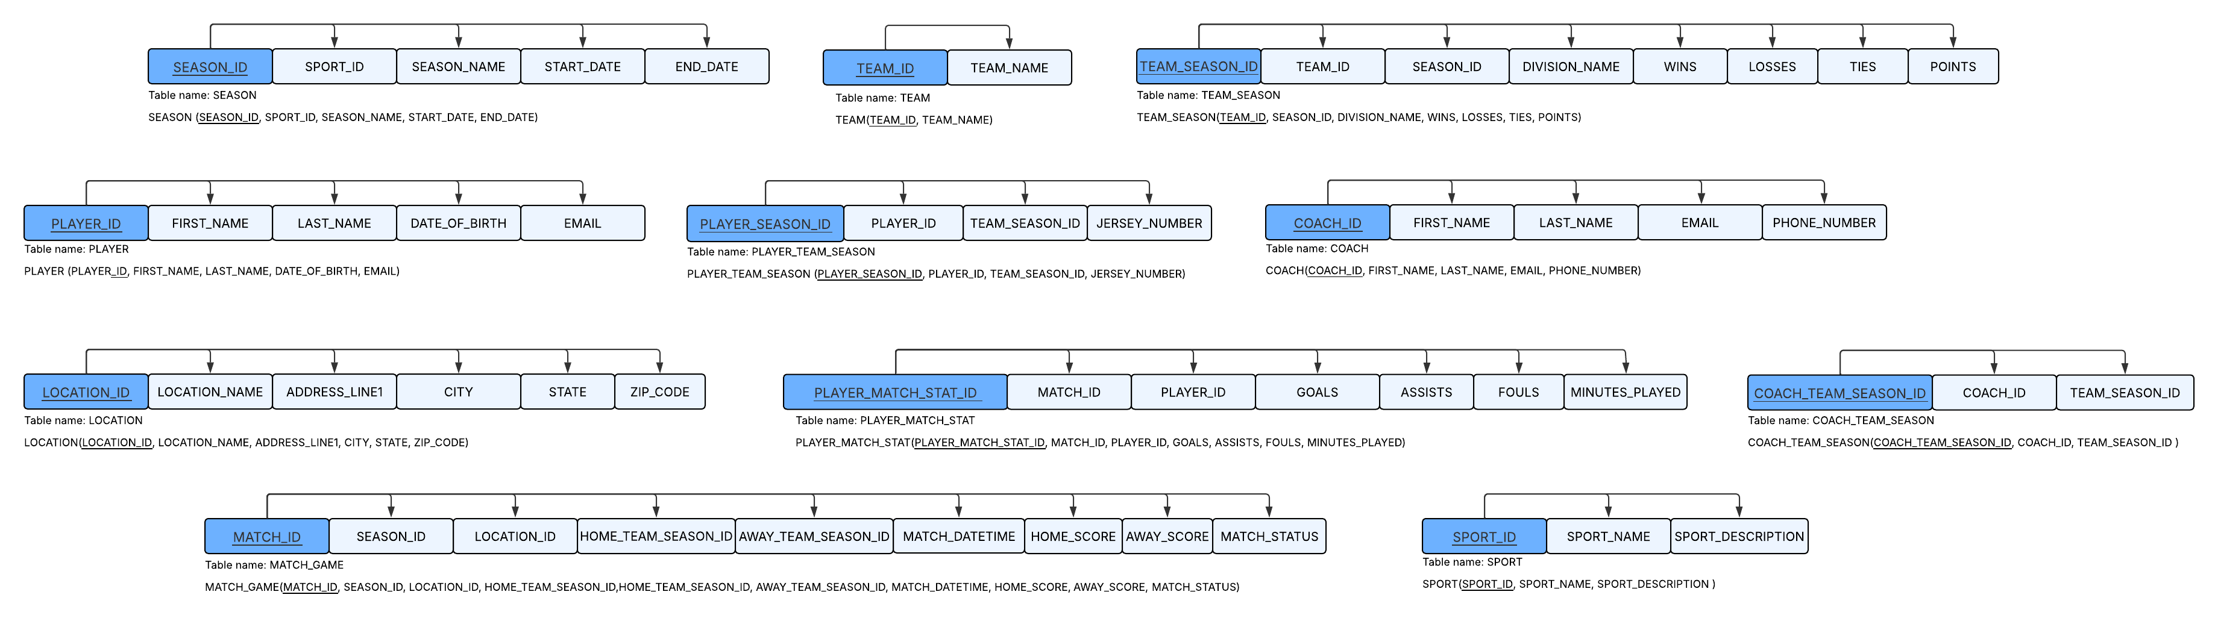
LOCAL SPORTS LEAGUE MANAGEMENT SYSTEM
Final DDD and Normalization
3rd Normal Form achieved: Yes — tables separate core entities from season assignments, rosters, coach assignments, matches, locations, and player stats.
Group 13 • CS-3743 Database Systems • 7
Notes:
Lance - This is our final Data Dependency Diagram. Through our design, we achieved 3rd Normal Form. The tables separate core entities from season assignments, rosters, coach
assignments, matches, locations, and player stats.

Slide 9
LOCAL SPORTS LEAGUE MANAGEMENT SYSTEM
Sample Data Coverage
10
16
24
48
24
Sports
Seasons
Teams
Players
Coaches
15
24
48
30
96
Locations
Team-season records
Roster assignments
Matches
Player stat rows
The data set is large enough to test schedules, rosters, standings, statistics, and reporting across multiple sports.
Group 13 • CS-3743 Database Systems • 8
Notes:
Cameron - Our sample data was expanded so the database demonstration would be meaningful. The data includes ten sports, sixteen seasons, twenty-four teams, forty-eight players, twenty-four coaches, fifteen locations, twenty-four team-season records, forty-eight roster assignments, thirty matches, and ninety-six player match stat rows. This gives us enough data to demonstrate schedules, completed matches, future matches, coach assignments, rosters, player statistics, and scoring summaries. The goal was not just to add rows, but to create data that supports useful reporting.

Slide 10


LOCAL SPORTS LEAGUE MANAGEMENT SYSTEM
Handling Repetition Without Duplicating Records
Example 1: The same team appears in multiple matches
Example 2: The same team has multiple top scorers
Normalized design stores the team and player once, then connects repeated activity through MATCH_GAME and PLAYER_MATCH_STAT.
Group 13 • CS-3743 Database Systems • 9
Notes:
Dalton - This slide shows how the database handles repetition. In a sports league, the same team appears in many matches, and the same player can have statistics in many matches. Instead of copying the team name, player name, and other details every time, the database stores each main record once and connects it with foreign keys. For example, a team is stored in TEAM, then connected to matches through TEAM_SEASON. This keeps the data cleaner and prevents inconsistent duplicate records.

Slide 11
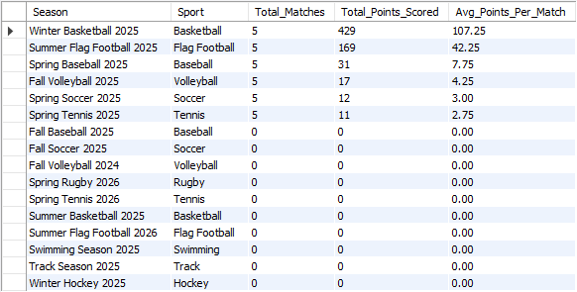
QUERY DEMONSTRATION — CAMERON BERGERON
Query 1: Season Scoring Summary
COUNT + SUM + AVG
Business rationale
Shows how active each season is
Compares total scoring across sports
Supports resource planning by sport or season
Real-world use
League managers can identify high-activity seasons and plan staffing, scorekeeping, and facility needs.
Key output: Winter Basketball has the highest total scoring activity.
Group 13 • CS-3743 Database Systems • 10
Notes:
This is Query 1, presented by Cameron. The purpose of this query is to summarize scoring by season. It groups data by season and sport, then uses aggregate functions including COUNT, SUM, and AVG. For league administrators, this report shows which seasons have the most match activity, how many total points were scored, and the average points scored per match. In the real world, this could help compare sports, evaluate participation, and decide where staff, scorekeepers, or facility resources may be needed most.

Slide 12
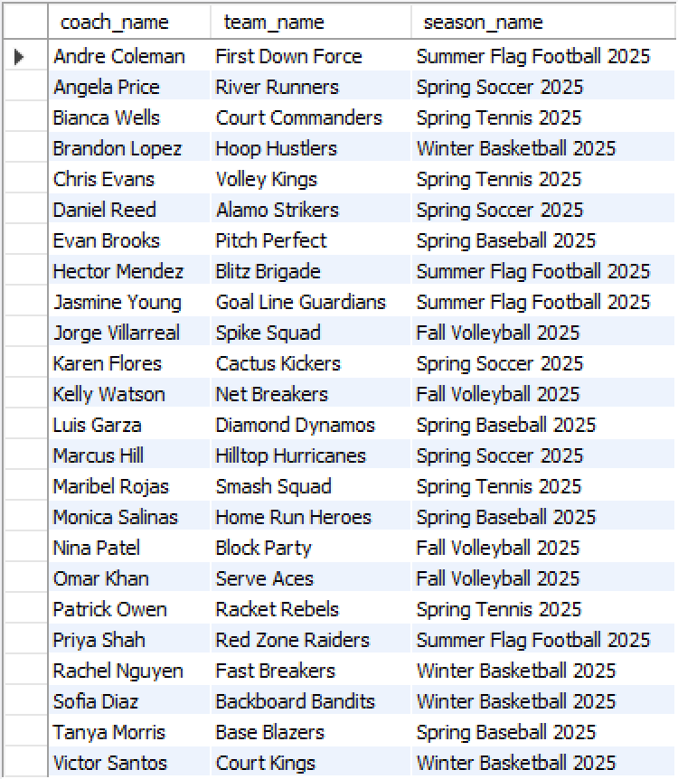
QUERY DEMONSTRATION — DALTON J OPUDO
Query 2: Unique Coach Assignments
JOIN + CONCAT + DISTINCT
Business rationale
Lists unique coaches, teams, and seasons
Converts IDs into readable names
Prevents confusion over assignments
Real-world use
Administrative staff can confirm coach coverage before seasons begin and quickly find who is responsible for each team.
Key output: each coach is tied to a readable team and season.
Group 13 • CS-3743 Database Systems • 11
Notes:
This is Query 2, presented by Dalton. This query displays unique coach assignments by joining coaches, team-season records, teams, and seasons. It also uses CONCAT to display the coach’s full name in a readable format and DISTINCT to avoid duplicate rows. The business value is that league staff can quickly see which coach is assigned to which team and season. This is much easier for a non-technical user than looking through ID numbers across separate tables.

Slide 13
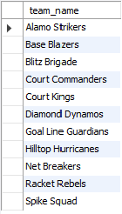
QUERY DEMONSTRATION — BRYAN VERA
Query 3: Teams With No Losses
Subquery + UNION
Business rationale
Identifies undefeated teams
Supports standings and awards
Checks both home and away losses
Real-world use
League leadership can quickly find standout teams, support playoff decisions, and publish standings updates.
Key output: teams returned never appear on the losing side of a completed match.
Group 13 • CS-3743 Database Systems • 12
Notes:
This is Query 3, presented by Bryan. This query identifies teams that have not lost a match. It uses a subquery and UNION to find teams that lost either as the home team or as the away team. Then the outer query returns teams that are not in that losing list. This is useful for standings, awards, and league summaries because administrators can quickly identify undefeated teams without manually checking each result.

Slide 14
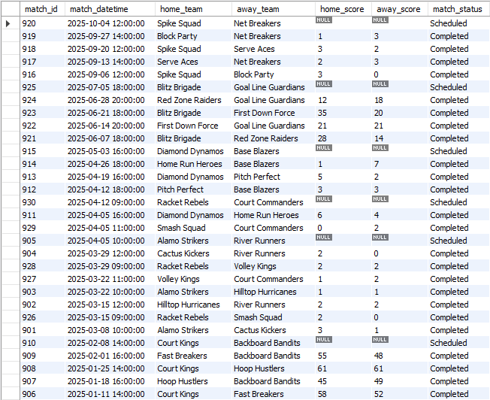
QUERY DEMONSTRATION — LANCE LAMON MARTIN
Query 4: Match Results by Most Recent Date
JOIN + ORDER BY
Business rationale
Shows recent matches first
Uses team names instead of IDs
Combines schedules and results
Real-world use
Families, coaches, and staff can see the latest game outcomes and upcoming scheduled games.
Key output: scheduled games can appear before scores are entered.
Group 13 • CS-3743 Database Systems • 13
Notes:
This is Query 4, presented by Lance. The purpose of this query is to display match results sorted by the most recent match date first. It joins the match table to team-season and team tables so the output shows team names instead of only team IDs. This makes the report useful for league users who want a quick schedule and results view. In practice, this could be used by staff when answering questions about recent or upcoming matches.

Slide 15
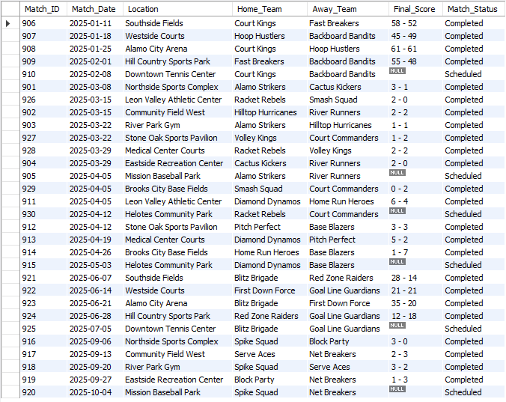
QUERY DEMONSTRATION — CAMERON BERGERON
Query 5: Readable Match Results Report
JOIN + CONCAT score
Business rationale
Shows date, location, teams, and score
Creates a user-friendly final score field
Separates scheduled and completed matches
Real-world use
League staff can publish or review match reports without looking across several tables.
Key output: match details are combined into one readable report.
Group 13 • CS-3743 Database Systems • 14
Notes:
This is Query 5, presented by Cameron. This query creates a readable match results report. It shows the match date, location, home team, away team, final score, and match status. The query joins matches with locations and teams, then uses CONCAT to display the score in a user-friendly format. This report would be useful for administrators, coaches, and families because it presents match information in one clear place instead of requiring them to search through multiple tables.

Slide 16
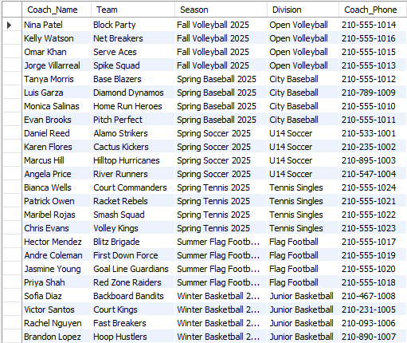
QUERY DEMONSTRATION — CAMERON BERGERON
Query 6: Coach Assignment With Contact Info
JOIN across assignment tables
Business rationale
Shows coach, team, season, and division
Includes phone number for contact needs
Supports staffing and communication
Real-world use
Administrators can contact the correct coach for schedule changes, roster issues, or match updates.
Key output: each team-season has a clear coach contact.
Group 13 • CS-3743 Database Systems • 15
Notes:
This is Query 6, presented by Cameron. This query creates a coach assignment report with contact information. It joins the coach, coach-team-season, team-season, team, and season tables. The report shows the coach name, team, season, division, and phone number. In the real world, this helps league staff quickly contact the correct coach for a specific team and season, which is important for scheduling updates, cancellations, and administrative communication.

Slide 17
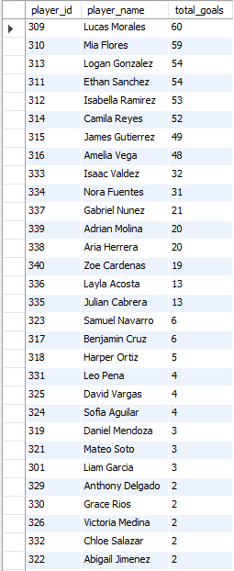
QUERY DEMONSTRATION — DALTON J OPUDO
Query 7: Total Goals by Player
SUM + GROUP BY
Business rationale
Ranks players by total goals
Summarizes multiple stat records
Supports awards and performance tracking
Real-world use
Coaches and league staff can identify top scorers for recognition, standings articles, or player development discussions.
Key output: Lucas Morales leads the shown sample with 60 goals.
Group 13 • CS-3743 Database Systems • 16
Notes:
This is Query 7, presented by Dalton. This query calculates total goals by player. Because each player can appear in multiple player match stat records, the query groups by player and uses SUM to add up all goals across matches. The result can be used as a leaderboard or performance report. For coaches and administrators, this gives a quick way to recognize high-scoring players and track player production over the season.

Slide 18
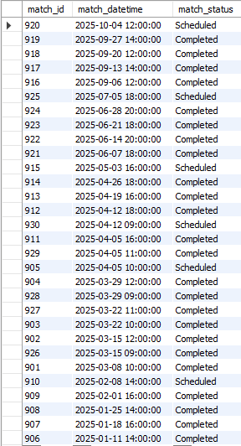
QUERY DEMONSTRATION — DALTON J OPUDO
Query 8: Matches Sorted by Date
ORDER BY date descending
Business rationale
Provides a quick schedule view
Shows match status beside each date
Places newest or upcoming items first
Real-world use
Staff can quickly check the most recent schedule entries and confirm whether matches are scheduled or completed.
Key output: latest scheduled volleyball match appears at the top.
Group 13 • CS-3743 Database Systems • 17
Notes:
This is Query 8, presented by Dalton. This query shows matches sorted by date in descending order. It focuses on match ID, date and time, and match status. Even though this is a simple query, it is still valuable because users often need a quick schedule view. By sorting the most recent or upcoming matches first, league staff can quickly review the match calendar and check whether games are completed or still scheduled.

Slide 19
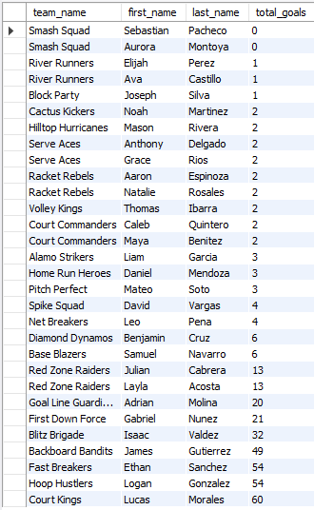
QUERY DEMONSTRATION — BRYAN VERA
Query 9: Find the Top Goal Scorer for each Team
Multi-table JOIN + Aggregation + Correlated Subquery
Business rationale
Aggregates goals by player
Supports player evaluation
Orders by team name
Key output: Lists top scorer for each team, orders results from lowest to highest total goals
Real-world use
Coaches can evaluate offensive production and identify key offensive players for each team.
Group 13 • CS-3743 Database Systems • 18
Notes:
This is Query 9, presented by Bryan. This query also summarizes player goals, but it keeps first and last names in separate columns. It joins players to player match statistics, groups by player, and orders the results from highest total goals to lowest. This format is useful when exporting reports or sorting by player names. The business value is that it turns detailed match-by-match statistics into a simple player evaluation report.

Slide 20
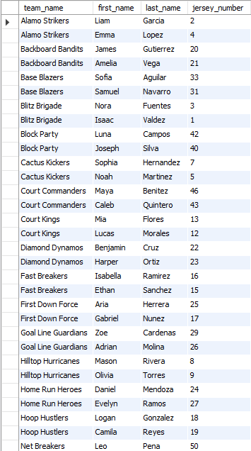
QUERY DEMONSTRATION — BRYAN VERA
Query 10: Player Team Roster
Multi-Table Join
Business rationale
Lists players by assigned team
Includes jersey numbers
Orders by team name
Real-world use
Coaches and administrators can verify rosters before games and correct player assignment issues.
Key output: each roster row connects a player to a team and jersey number.
Group 13 • CS-3743 Database Systems • 19
Notes:
This is Query 10, presented by Bryan. This query lists all players along with the teams they are assigned to and their jersey numbers. It joins the player table to PLAYER_TEAM_SEASON, TEAM_SEASON, and TEAM. This demonstrates why the normalized design is useful. The roster data is stored cleanly through assignment tables, but the query can still produce a simple report that coaches and administrators can actually use.

Slide 21
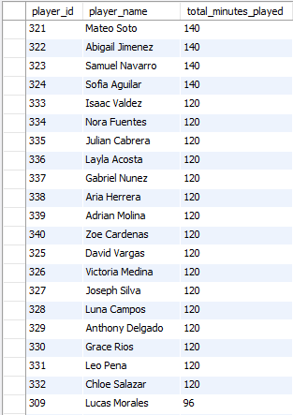
QUERY DEMONSTRATION — LANCE LAMON MARTIN
Query 11: Total Minutes Played by Player
SUM + GROUP BY
Business rationale
Tracks player participation
Sums minutes across matches
Helps monitor playing time balance
Real-world use
Coaches can review whether players are receiving reasonable playing time across the season.
Key output: players with the most recorded minutes appear first.
Group 13 • CS-3743 Database Systems • 20
Notes:
This is Query 11, presented by Lance. This query displays the total minutes played by each player. It joins players with their match statistics, groups by player, and sums the minutes played. This report focuses on participation instead of scoring. In the real world, coaches and administrators could use this information to monitor playing time, check player involvement, and make sure participation is being tracked fairly across matches.

Slide 22
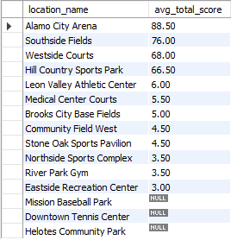
QUERY DEMONSTRATION — LANCE LAMON MARTIN
Query 12: Average Score by Location
AVG + GROUP BY location
Business rationale
Compares scoring by venue
Highlights high-scoring locations
Supports scheduling analysis
Real-world use
League staff can evaluate whether certain locations tend to host higher-scoring matches or need special planning.
Key output: Alamo City Arena has the highest average total score shown.
Group 13 • CS-3743 Database Systems • 21
Notes:
This is Query 12, presented by Lance. This query calculates the average total score per match at each location. It joins the location and match tables, groups by location, and averages the combined home and away score. The report could help league staff identify venues where games tend to be higher scoring or where more scorekeeping attention may be needed. It also shows how the database can support planning decisions beyond basic schedules and rosters.

Slide 23
BONUS TRIGGER DEMONSTRATION
Query 13: Insert Trigger Updates Team Stats
AFTER INSERT trigger
Before trigger
Business rationale
team_season | team_name | wins | losses | ties | points
601 | Alamo Strikers | 1 | 0 | 1 | 4
602 | Cactus Kickers | 1 | 1 | 0 | 3
Automatically updates wins, losses, ties, and points
Reduces manual standings errors
Keeps standings synchronized with completed matches
After trigger
team_season | team_name | wins | losses | ties | points
601 | Alamo Strikers | 2 | 0 | 1 | 7
602 | Cactus Kickers | 1 | 2 | 0 | 3
Example action
Insert a completed match where Alamo Strikers defeat Cactus Kickers, 2–1.
Key output: standings change automatically when a new completed match is inserted.
Group 13 • CS-3743 Database Systems • 22
Notes:
Cameron - This is Query 13, the insert trigger demonstration. The trigger runs after a match is inserted into the MATCH_GAME table. It checks whether the home team won, the away team won, or the game ended in a tie. Based on that result, it updates the correct team-season record by increasing wins, losses, ties, and points. The business value is that standings update automatically when a new completed match is entered, which reduces manual work and helps prevent mistakes.

Slide 24
BONUS TRIGGER DEMONSTRATION
Query 14: Delete Trigger Reverses Team Stats
AFTER DELETE trigger
Before delete
Business rationale
team_season | team_name | wins | losses | ties | points
601 | Alamo Strikers | 2 | 0 | 1 | 7
602 | Cactus Kickers | 1 | 2 | 0 | 3
Reverses standings when a match is removed
Protects reports from stale totals
Supports correction of mistaken match entries
After delete trigger
team_season | team_name | wins | losses | ties | points
601 | Alamo Strikers | 1 | 0 | 1 | 4
602 | Cactus Kickers | 1 | 1 | 0 | 3
Example action
Delete the inserted match; the trigger subtracts the related win, loss, and points.
Key output: standings return to their previous values after the match is deleted.
Group 13 • CS-3743 Database Systems • 23
Notes:
Dalton - This is Query 14, the delete trigger demonstration. This trigger runs after a match is deleted from the MATCH_GAME table. If a match was entered incorrectly and then removed, the trigger reverses the standings impact from that match. For example, it subtracts the win and points from the winning team, subtracts the loss from the losing team, or reverses tie points for both teams. This helps keep the standings consistent with the actual matches stored in the database.

Slide 25
LOCAL SPORTS LEAGUE MANAGEMENT SYSTEM
Team Reflection: Objectives, Challenges, and Solutions
Overall: The team met the original objectives by building a centralized sports league database that supports sports, seasons, teams, players, coaches, schedules, locations, match results, standings, and player statistics while reducing repetition through bridge tables and constraints.
Cameron Bergeron
Bryan Vera
Season activity & match results
Player and team performance
My main reflection is that the database successfully met the goal of helping league organizers view season activity and match results in a clear way. One of the biggest challenges was making sure the database could track teams across different seasons without repeating the same team information over and over. We solved this by using the TEAM_SEASON table, which connects each team to a specific season and stores season-based information like division, wins, losses, ties, and points.
My reflection is that the database met the objective of answering performance-related questions, especially through player and team statistics. The most significant challenge was making sure player stats were tied to the correct match without creating duplicate stat records. We solved this by creating the PLAYER_MATCH_STAT table and using a unique relationship between each player and match, so each player can only have one stat record per match.
Dalton J. Opudo
Lance Lamon Martin
Coach, team, and season assignments
Scheduling and location control
My reflection is that the database supports the business rule that coaches, teams, and seasons must be connected in an organized way. A challenge was making sure coach assignments were clear because coaches may work with different teams across different seasons. We solved this by using the COACH_TEAM_SEASON table, which connects a coach to a team’s specific season record instead of only connecting the coach directly to a team.
My reflection is that the database met the scheduling objective by allowing league staff to see when and where matches are played. The biggest challenge was preventing scheduling conflicts, especially if two matches were accidentally assigned to the same location at the same time. We solved this by including a rule in the database that makes the combination of location_id and match_datetime unique, which helps prevent double-booking.
Group 13 • CS-3743 Database Systems • 24
Notes:
Bryan - Overall Reflection: Our team met the original objectives by creating a database that organizes sports, seasons, teams, players, coaches, locations, matches, standings, and player statistics. The business rules were mostly achieved through primary keys, foreign keys, unique constraints, and bridge tables that reduce repetition and keep the data organized.
Cameron Bergeron:
The database met the goal of tracking season activity and match results. The biggest challenge was avoiding repeated team data across seasons, which we solved with the TEAM_SEASON table.
Bryan Vera:
The database successfully tracks player performance by match. The main challenge was preventing duplicate player stat records, which we solved with the PLAYER_MATCH_STAT table and unique player-match records.
Dalton J. Opudo:
The database clearly connects coaches to teams and seasons. The biggest challenge was handling coach assignments across multiple seasons, which we solved with the COACH_TEAM_SEASON table.
Lance Martin:
The database supports match scheduling by tracking dates, times, teams, and locations. The main challenge was preventing location double-booking, which we solved with a unique constraint on location_id and match_datetime.

Slide 26
LOCAL SPORTS LEAGUE MANAGEMENT SYSTEM
Closing: Value Delivered to Users
The database turns league activity into organized, reliable, and useful information.
Centralized records
User-focused reports
Better decisions
Teams, players, coaches, seasons, locations, matches, and stats are stored consistently.
Queries answer real questions about participation, schedules, results, standings, and performance.
League staff can plan facilities, staffing, standings, and future seasons with confidence.
Group 13 • CS-3743 Database Systems • 25
Notes:
Lance - To close, our database delivers value by turning league activity into organized, reliable, and useful information. It centralizes teams, players, coaches, schedules, locations, match results, standings, and player statistics. It also answers practical business questions that league staff would ask every season. We met our original objective of creating a database that supports day-to-day league management while reducing duplication and improving accuracy. Thank you for watching our presentation.

