Slide 1
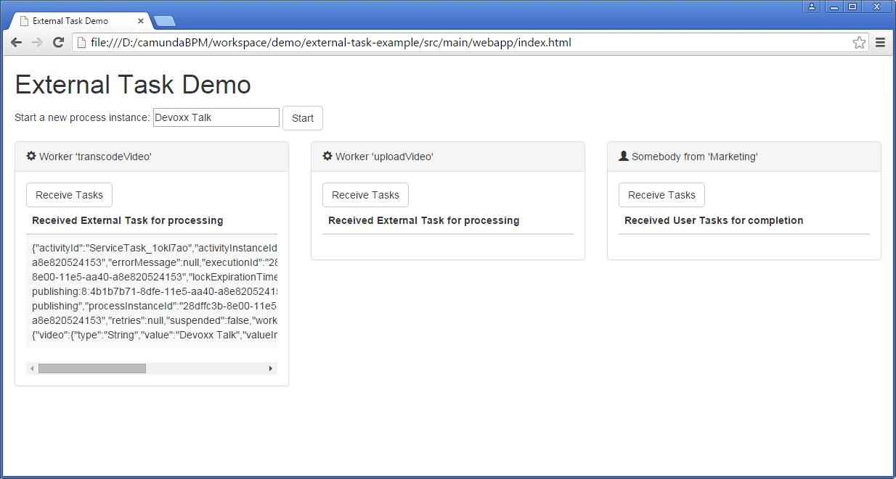
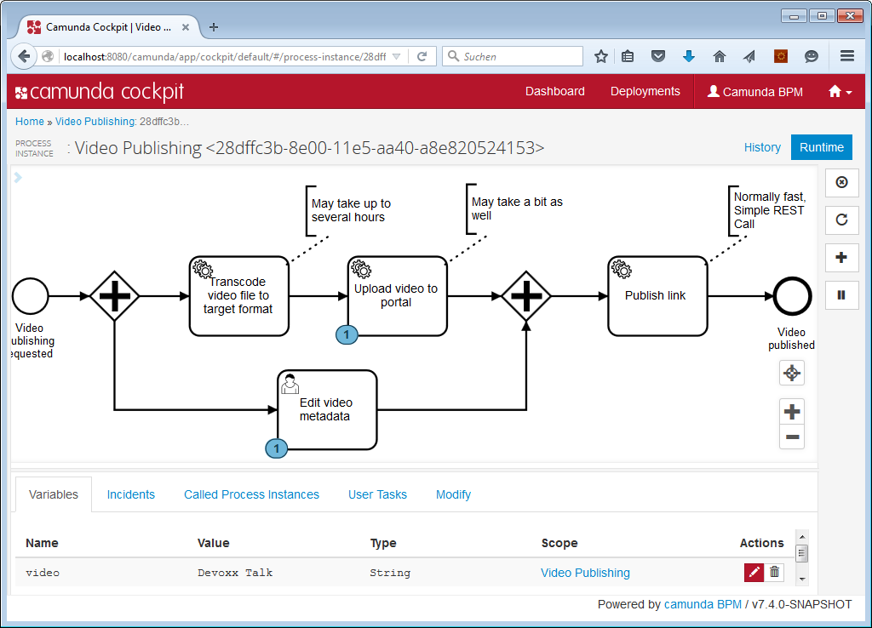

Slide 2

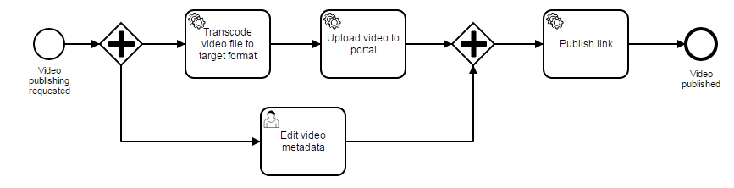
Some Worker
(External Programm in whatever programming language)
1.
/external-task/fetchAndLock
2.
/external-task/{id}/complete
Topic Name

