Slide 1
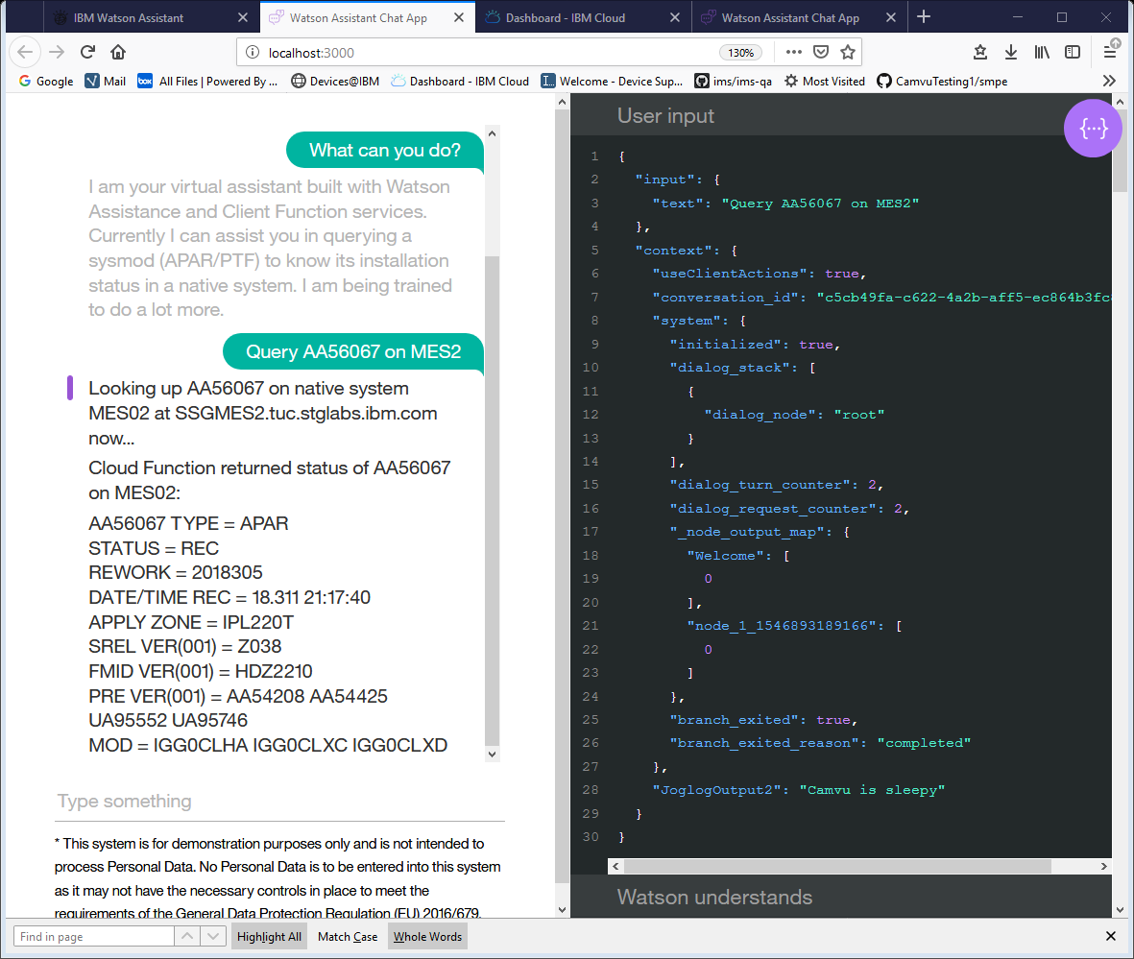
SMPE Virtual Agent Using Watson Assistant and Cloud Function
Idea: A conversation interface that users can use to communicate with z/Os native systems in human language. For example, users can IPL a system by telling the Virtual Agent, “I want you to IPL system MES3 for me now.”
Supporters:
Mauricio Adames Kevin Miner
Trinh Nguyen
Camvu Pham

Slide 2
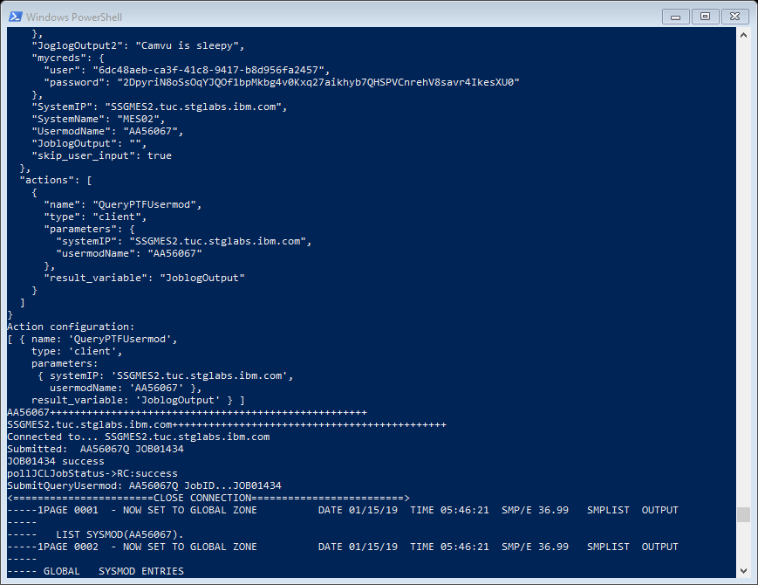
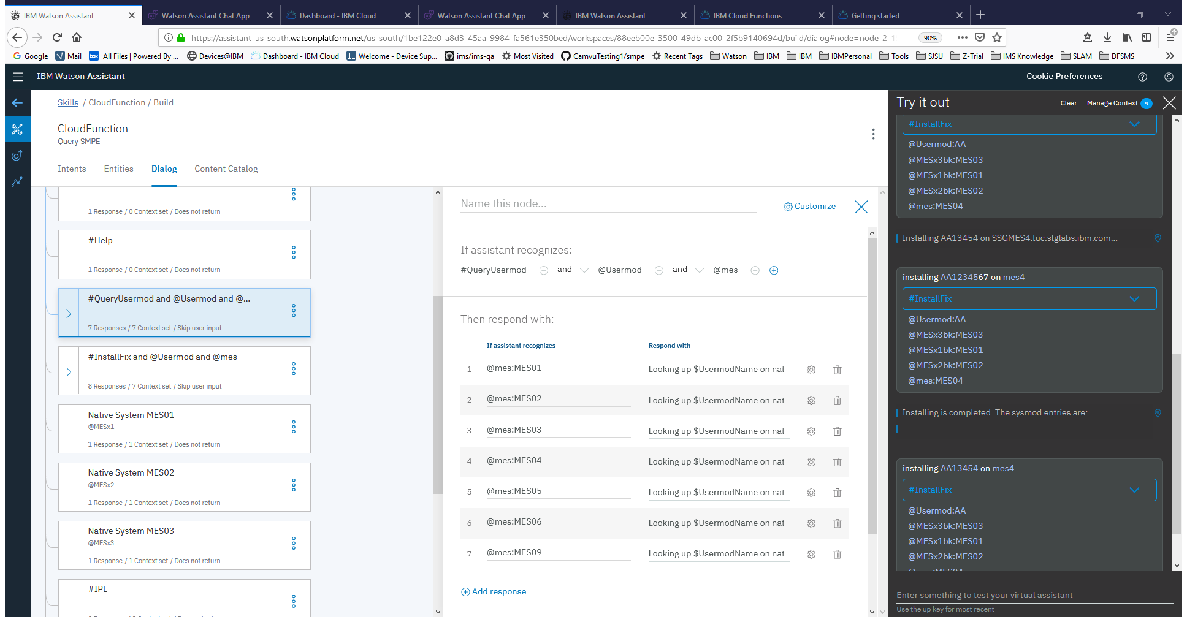
Screenshots
Flow
Demo
Attempts
Plans
Thank you’s
Console window on Window PowerShell
Dialog settings in Watson Assistant Skill

Slide 3
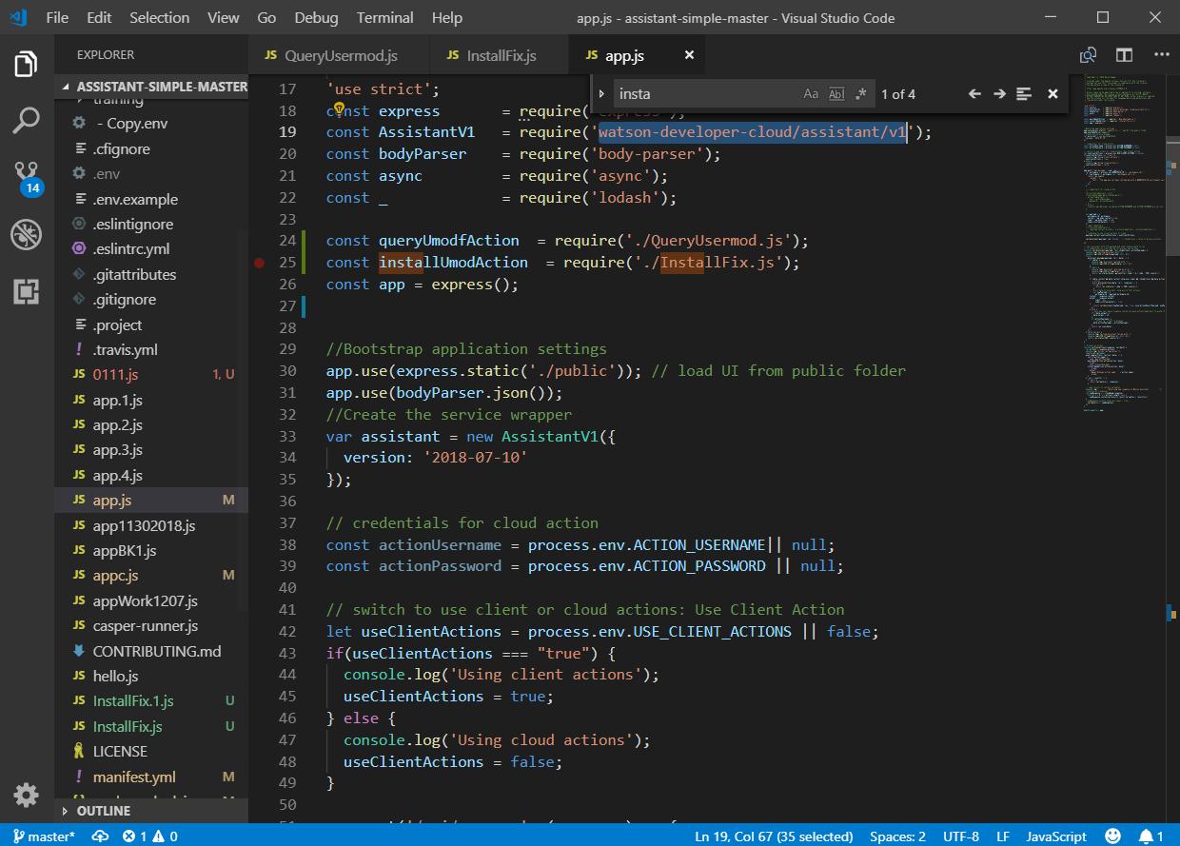
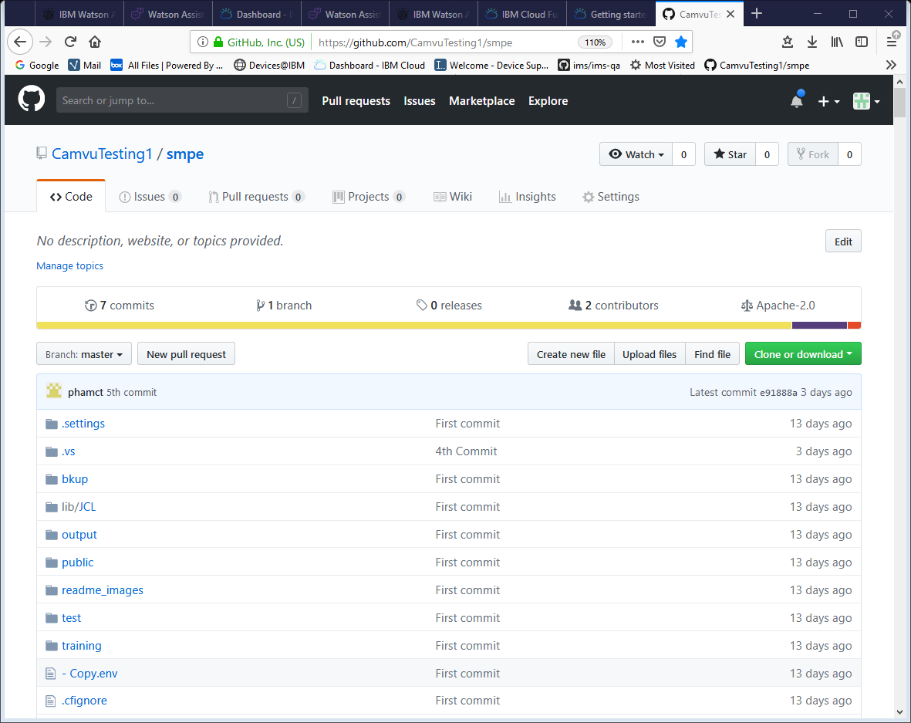
Screenshots
Flow
Demo
Attempts
Plans
Thank you’s
Node.js code in Visual Studio IDE
Project repository on https://github.com/CamvuTesting1/smpe

Slide 4



Screenshots
Flow
Demo
Attempts
Plans
Thank you’s
Cloud Function (service)
Watson Assistant (service)
IBM Cloud
User
Conversation Interface
Local server (Windows)
z/Os Native System

Slide 5
Screenshots
Flow
Demo
Attempts
Plans
Thank you’s
Cloud Function (service)
Watson Assistant (service)
IBM Cloud
User
Conversation Interface
Local server (Windows)
z/Os Native System
Query/Command

Slide 6
Screenshots
Flow
Demo
Attempts
Plans
Thank you’s
Cloud Function (service)
Watson Assistant (service)
IBM Cloud
Answer
User
Conversation Interface
Local server (Windows)
z/Os Native System

Slide 7
Screenshots
Flow
Demo
Attempts
Plans
Thank you’s
Cloud Function (service)
Watson Assistant (service)
IBM Cloud
Answer
User
Conversation Interface
Local server (Windows)
z/Os Native System
Query/Command

Slide 8
Screenshots
Flow
Demo
Attempts
Plans
Thank you’s
https://assistant-us-south.watsonplatform.net/us-south/1be122e0-a8d3-45aa-9984-fa561e350bed/home
https://console.bluemix.net/docs/openwhisk/index.html#getting-started-with-openwhisk
Cloud Function (service)
JSON context
Watson Assistant (service)
IBM Cloud
Watson Node.js SDK watson-developer-cloud/assistant/v1
https://github.com/watson-developer-cloud/assistant-simple
localhost:3000/
User
Conversation Interface
Local server (Windows)
z/Os Native System
Query/Command
Node.js package zos-node-accessor
SDK: https://github.com/watson-developer-cloud/node-sdk
https://github.com/IBM/zos-node-accessor

Slide 9
Screenshots
Flow
Demo
Attempts
Plans
Thank you’s
Open Window PowerShell or Command Prompt
Change directory to directory path of assistant-simple-master
Command: npm start
Open web browser, go to localhost:3000/
Talk to the Watson bot

Slide 10
Screenshots
Flow
Demo
Attempts
Plans
Thank you’s
Attempt 1:
http://devicesupport.mybluemix.net
http://devicesupport.mybluemix.net
IBM Cloud
Bluemix App
Cloud Function (service)
Watson Assistant (service)
Cloud CLI https://console.bluemix.net/docs/cli/reference/ibmcloud/download_cli.html#install_use
Answer
User
Conversation Interface
Local server (Windows)
z/Os Native System
Query/Command

Slide 11
Screenshots
Flow
Demo
Attempts
Plans
Thank you’s
Attempt 2:
https://assistant-chat-us-south.watsonplatform.net/web/public/934cd628-a474-4eee-8912-f4a36ae6273c
Cloud Function (service)
Watson Assistant (service)
IBM Cloud
Assistants
Watson Assistant service https://console.bluemix.net/docs/services/assistant/create-assistant.html#creating-assistants
Answer
User
Conversation Interface
Local server (Windows)
z/Os Native System
Query/Command

Slide 12
Screenshots
Flow
Demo
Attempts
Plans
Thank you’s
Plan 1:
Remote access to local server
Cloud Function (service)
Watson Assistant (service)
IBM Cloud
96.34.23.22:3001/
Answer
User
Conversation Interface
Local server (Windows)
z/Os Native System
Query/Command

Slide 13
Screenshots
Flow
Demo
Attempts
Plans
Thank you’s
Plan 2:
Using a virtual machine for the server
Virtual Machine
Cloud Function (service)
Watson Assistant (service)
IBM Cloud
Answer
User
Conversation Interface
Local server (Windows)
z/Os Native System
Query/Command

Slide 14
Screenshots
Flow
Demo
Attempts
Plans
Thank you’s
Plan 3:
Sending record emails to users
Cloud Function (service)
Watson Assistant (service)
IBM Cloud
Answer
User
Conversation Interface
Local server (Windows)
z/Os Native System
Query/Command
Unix command .sh cat /u/mvsbuild/cstl/postserv_query/result | mailx -s "SYSMOD Query Result for ${2}" $1

Slide 15
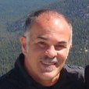

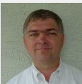

Screenshots
Flow
Demo
Attempts
Plans
Thank you’s
Mauricio
Kevin
Trinh

