Slide 1

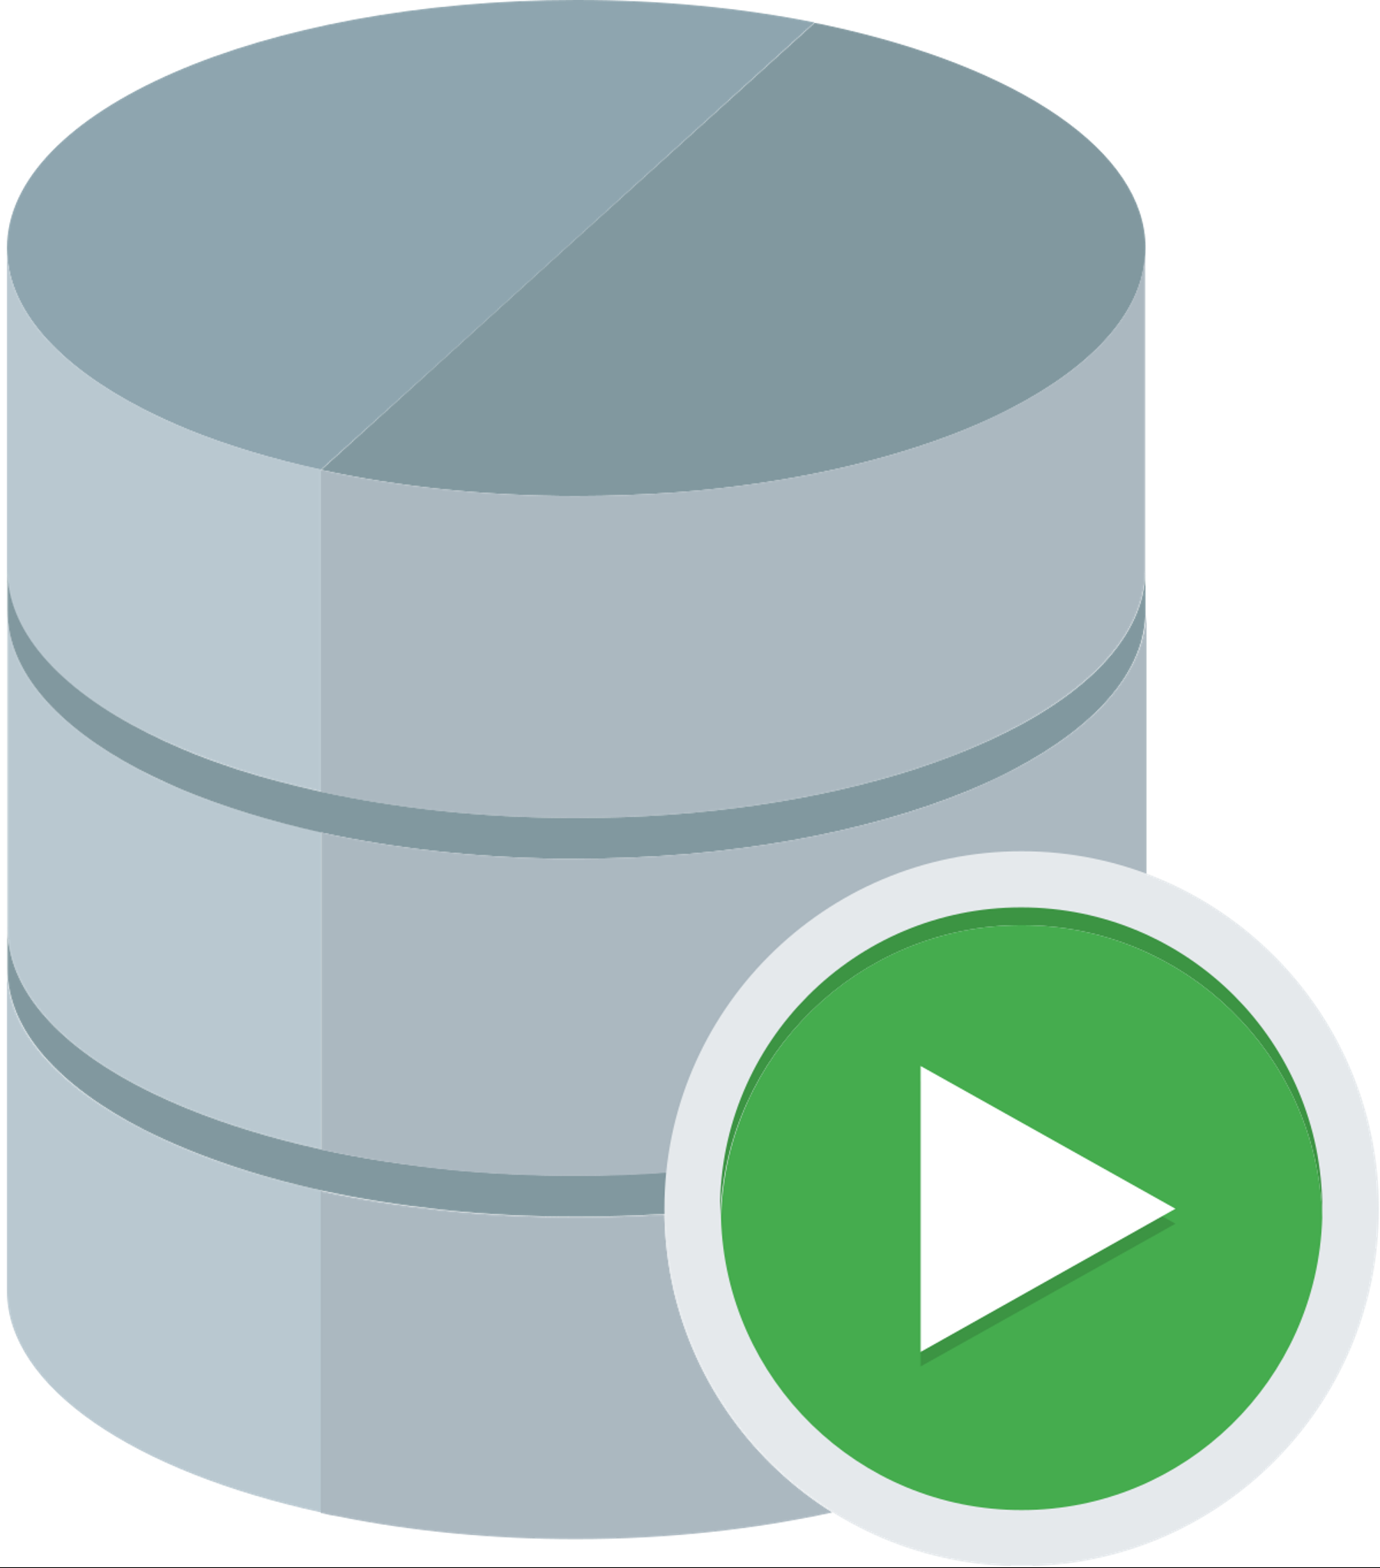






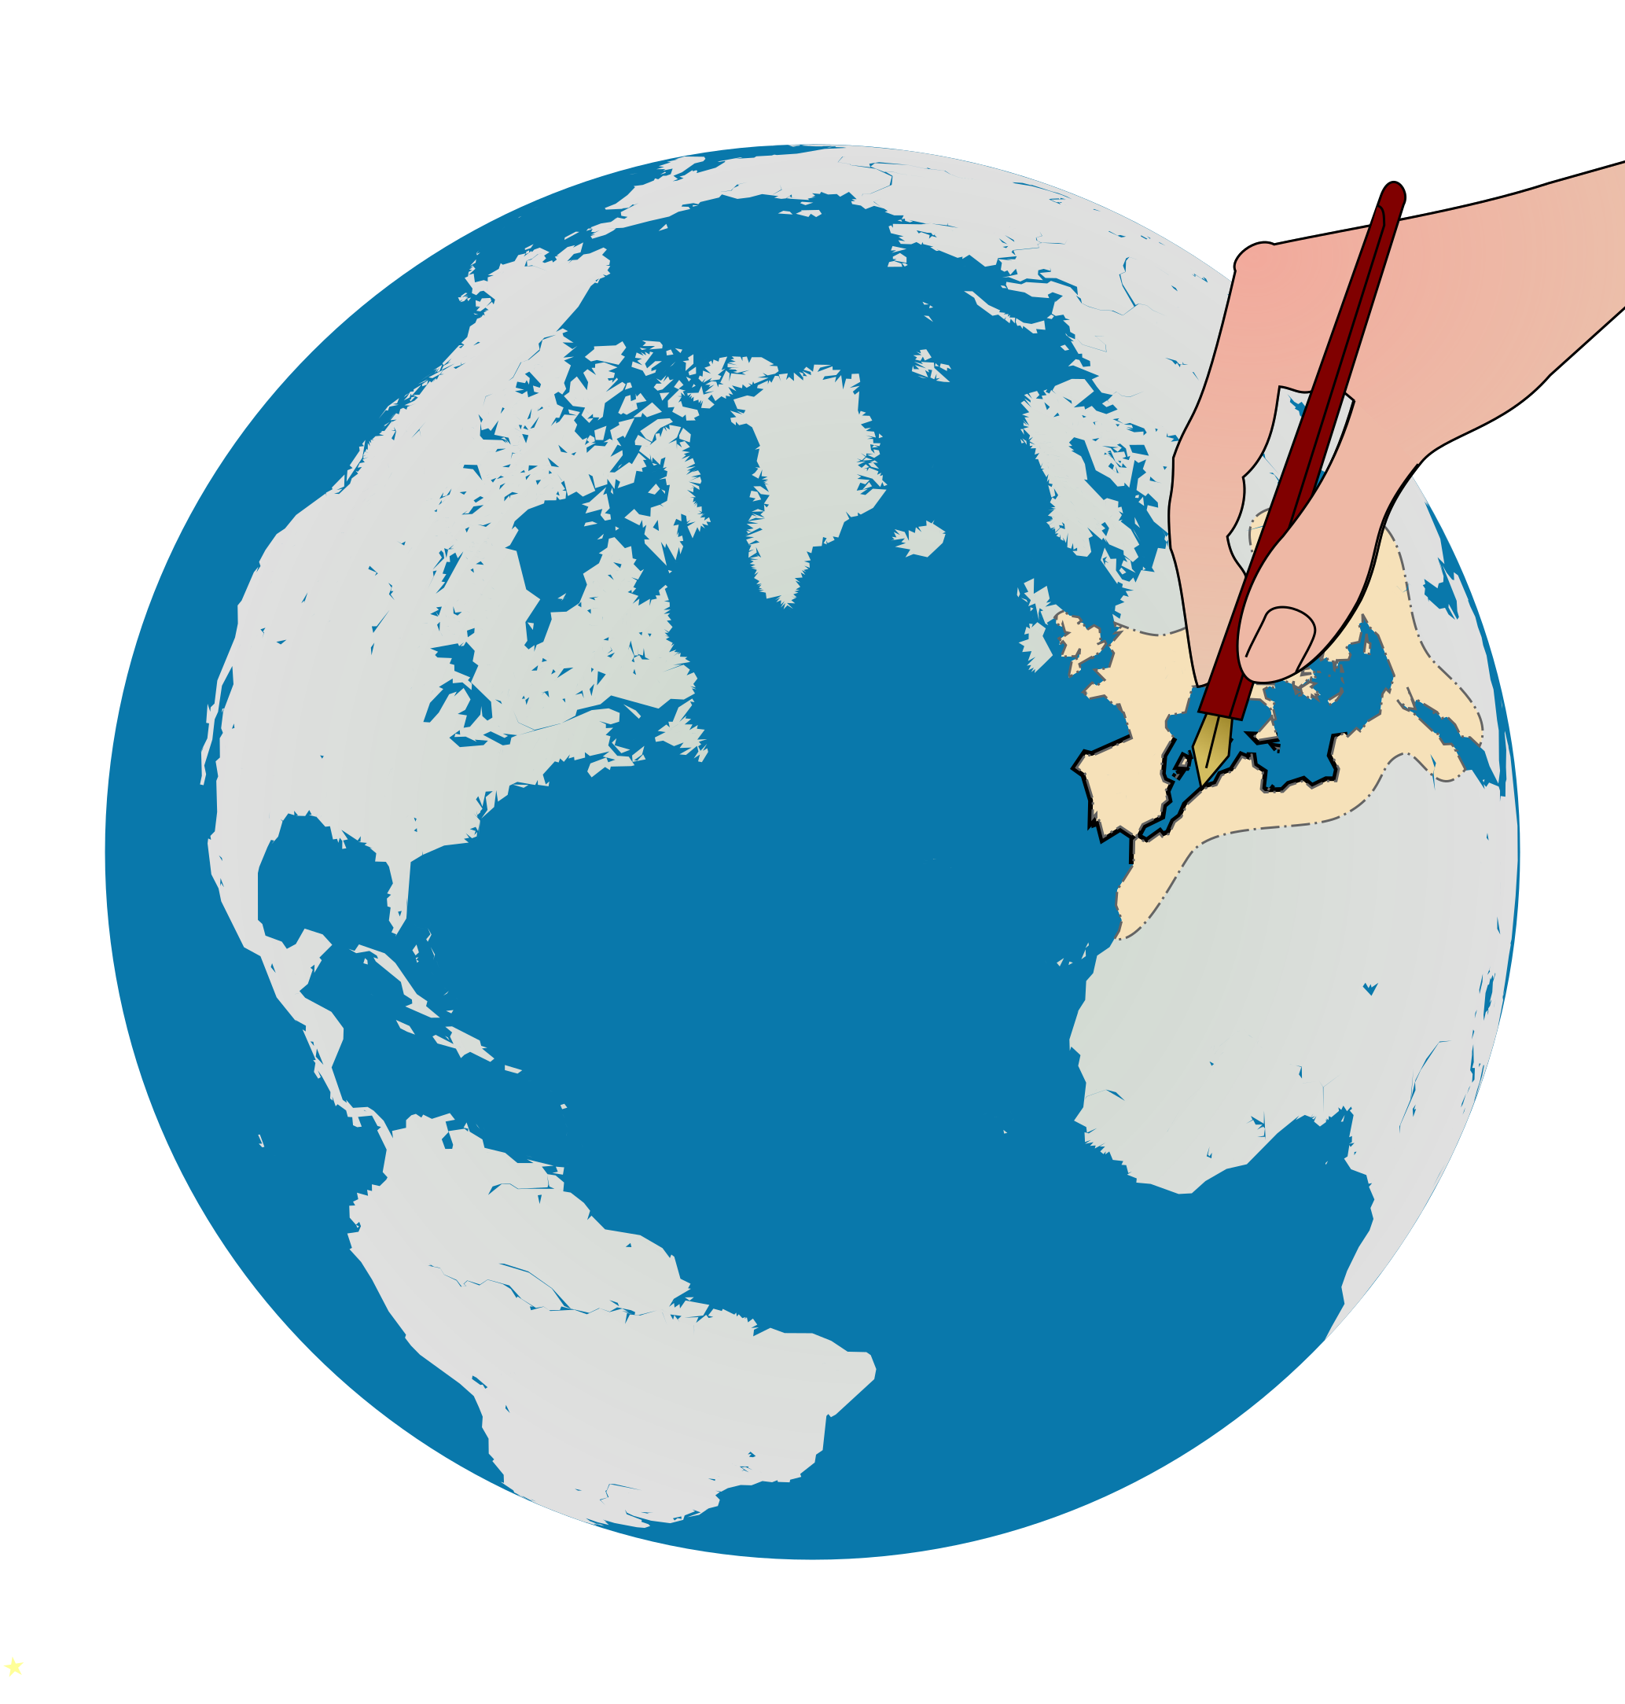
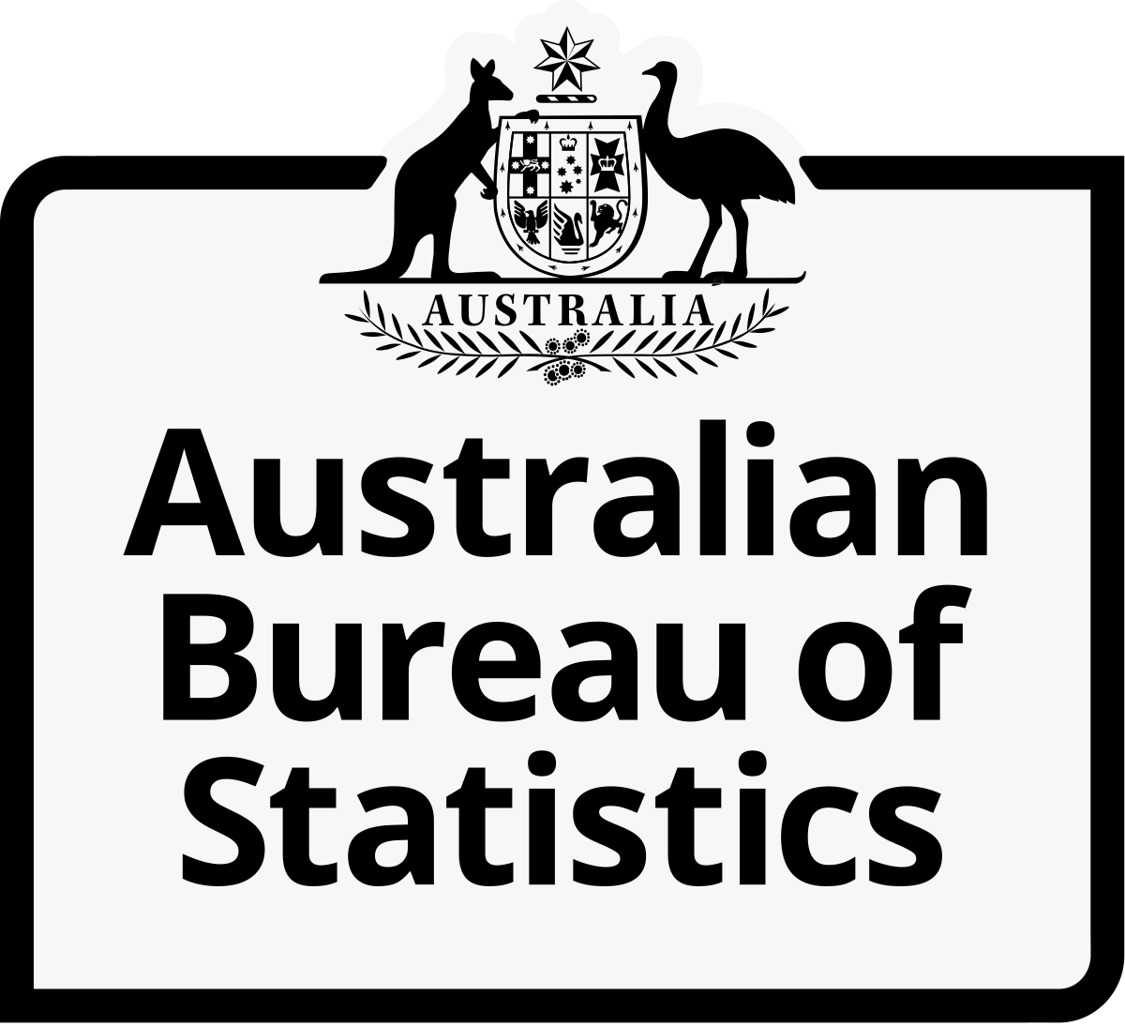



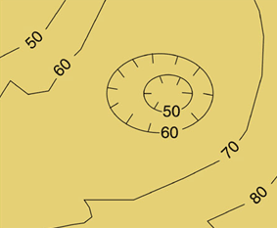


















Using Open Data
Periodic Data Sets
Data Platform
Consumers
Real Time Datasets
Any government agency/department

Slide 2
Using Open and Sensitive Data
Periodic Data Sets
Data Platform
Consumers
Real Time Datasets
Any government agency/department

