Slide 2



Slide 4
CaMPACT
Interchange
Build Clinical Data Connectors | Data Sharing Across Platform | Synchronize and Analyze
Application
PhenoTips for Genomic Data | Enable PhenoTips on Platform | Capture, Process Oncology Data
Integration
CanDIG
Platform
Implement GenAP for PHI | Enable GenAP to use GA4GH | Provision GenAP on Platform
Extension
Virtual Platform | Scheduling/ Job Deployment | Governance Framework
Foundation

Slide 5
Variants
Workflows
?
!

Slide 9
Variants
Workflows

Slide 10
?
?
!
!

Slide 12
UHN
Task Execution
Reads, Variants,
& Metadata

Slide 14
~ no
privacy
1 site with ϵ < 10
2 sites with ϵ < 10
all sites ϵ < 10

Slide 15
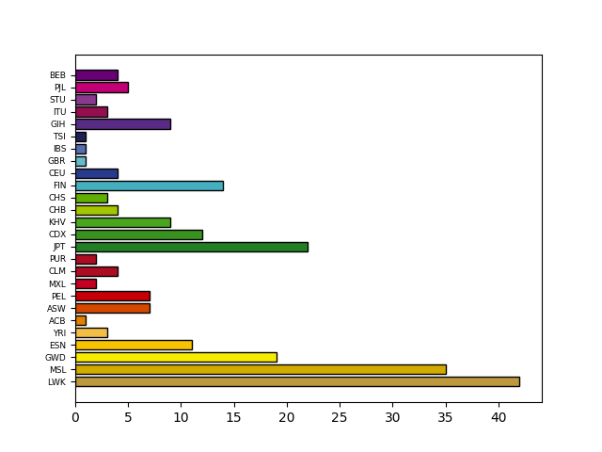
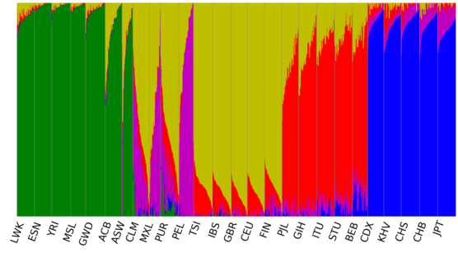
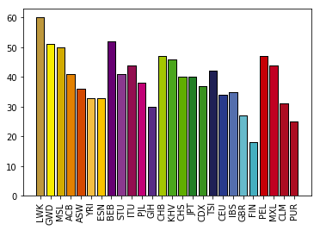

Slide 16
External services
Metadata Service
R + V API v2
Workflows
Data Access Layer
Cluster backend
Internal

Slide 18
?
?
!
!

Slide 19















Slide 20
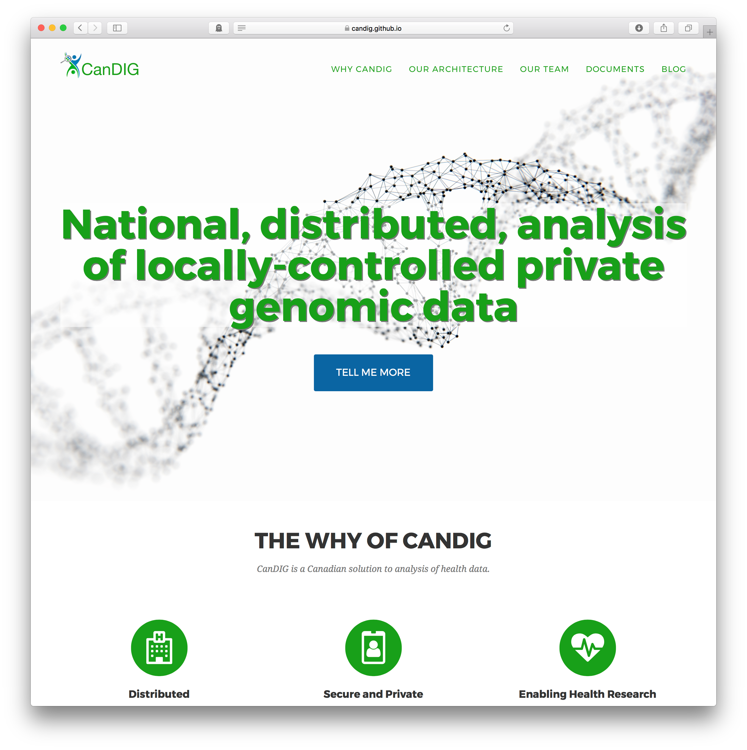

Slide 21
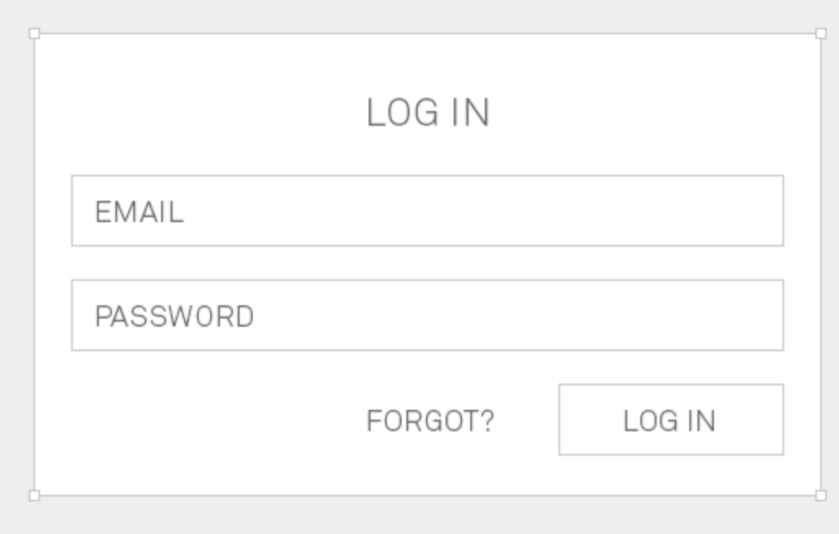
1
2
6
3
4
?
5
Sending the ID token
Validating ID token,
Deciding Authorization

Slide 22
1
2
6
3
4
?
5
!

Slide 23
REST APIs
jsp servlet
persistence layer
Spring ORM
Importer

Slide 24
REST APIs
jsp servlet
persistence layer
Spring ORM
Importer

Slide 25
REST APIs
jsp servlet
persistence layer
Spring ORM
Importer

Slide 26


Slide 27
/svc1
/svc2
/othersvc

Slide 28
?
/svc1
/svc2
/othersvc

