Slide 1

CFIA Team 01
Alex Church
Brian Laliberte
Charaf Eddine

Slide 2
Problem
Lack of data available re: food suppliers, leaving opportunity for improvement vis à vis the CFIA’s predictive modeling capabilities

Slide 3
Solution
Find additional predictors to help flag potential candidates for targeted inspection

Slide 4
FDA Data
We built a scraper to parse the public data made available by the FDA of violators over the past 6 years
This could also be applied to other foreign regulatory bodies to help identify foreign exporters of risk, an area where gaps may currently exist re: data available to the CFIA

Slide 5
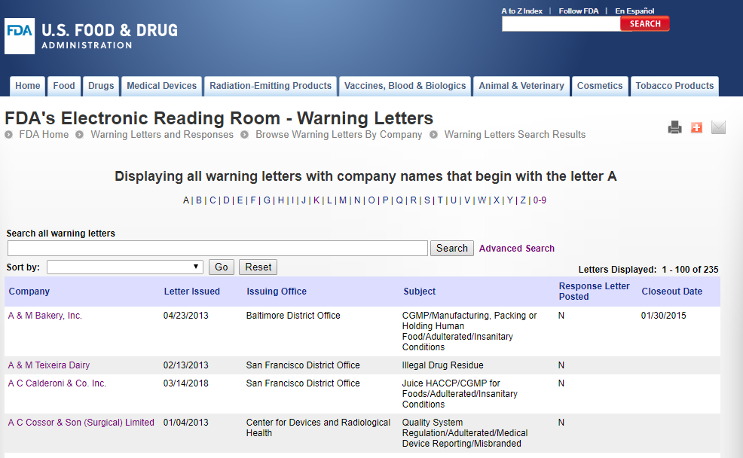

Slide 6
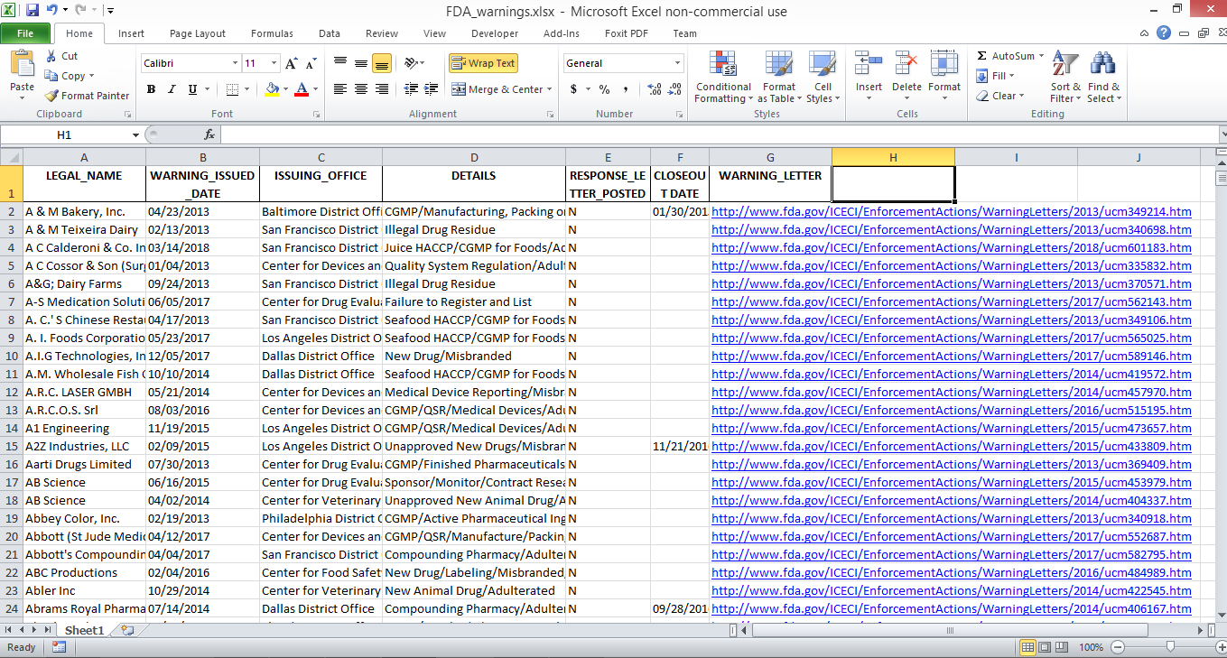

Slide 7
Shortcomings
The FDA website does not allow filtering by category, meaning food violations are lumped in with all other violations(drug, tobacco, etc.)
Was not able to parse proprietor/address info. from the warning letters themselves. The data set in its current form is lacking pertinent information beyond the company’s legal name.

Slide 8
Thank you
https://github.com/alexchurch29/CANDEV_challenge

