Slide 1



Slide 2


Slide 3

Who are LRN?
Learning Resource Network (LRN) is accredited as an Awarding Body by the Office of Qualifications and Examinations Regulation (OFQUAL) in the United Kingdom.

Slide 4
What do we provide?
We offer internationally recognised examinations in:
English for Speakers of Other Languages(ESOL)
Business
Teaching

Slide 5

Where in the World?
We have:
150 test centres in
58 countries

Slide 6
What do our qualifications offer?
Our qualifications can help students to:
get a better job
study in another country
demonstrate their personal progress using an international standard

Slide 7

ELTAB
Why use an ELTAB?

Slide 8
Why become an EFL teacher?
Being an EFL teacher provides opportunities
to teach in the UK or to travel overseas
to earn a living while travelling
to be part of the local community
be immersed in the local culture
learn the language of the country
meet interesting, motivated students

Slide 9
Why do an ELTAB Course?
to improve your knowledge of English grammar, phonology and discourse
to learn about current language teaching methodologies
to practise practical planning and teaching
to gain the confidence to be an effective teacher
to be more employable

Slide 10
Delivery of ELTAB Course
One week intensive (five full days a week plus homework)
Part time over a longer period (one or two days a week - from 3 months to a year)
Blended online and f2f (tuition online, teaching practice f2f 3 months - a year)

Slide 11
Overview of an ELTAB Course
Number of Units | 03
Credit Value | 15
RQF Level | 03
EQF Level | 04

Slide 12
What’s in an ELTAB course?
An ELTAB course includes:
Knowledge, understanding and skills of teaching, learning and assessment in ELT
Developing teaching, learning and assessment in ELT
Planning resources for effective delivery in ELT
Language Awareness and Analysis to support Skills in ELT: Listening, Speaking, Reading and Writing
Practical Component: Applied teaching practice in the ELT classroom

Slide 13
Assessment Method
An ELTAB course includes:
teaching practice (three hours formative assessment)
observation by experienced teachers
multiple choice paper based/computer based exam

Slide 14
LRN ELTAB or or Cambridge TKT TEFL Course?
 | LRN ELTAB | Cambridge TKT
Who validates it? | Learning Resource Network | Cambridge English
RQF Level | 3 | Not Available because it is not qualification, it is only modules.
What are the guided learning hours? | 53 | NA
How many hours of teaching do trainees have to do? | 3 | to be discontinued from December 2016.
How many weeks does it take? | A minimum of 1 (on the intensive course) | A minimum of 1 (on the intensive course)

Slide 15
 | LRN ELTAB | Cambridge TKT
What are the units of learning included on the course? | Unit 1:Language Awareness and Analysis in practical support of ELT Unit 2: Planning and Managing Teaching and Learning in ELT Unit 3: Applied teaching practice in the ELT classroom | Unit 1: Language and background to language learning and teaching Unit 2: Lesson planning and use of resources for language teaching Unit 3: Managing the teaching and learning process Unit 4: Practical (to be discontinued from December 2016)

Slide 16
 | LRN ELTAB | Cambridge TKT
How are trainees assessed? | There is no final exam. Your work for units 1 and 2 are multiple choice questions will be assessed and mark and moderated by LRN and the work for unit 3 will marked by your internal trainer. You must pass all units to gain the certificate. You can be awarded either a pass or a fail. | There is no final exam. Units 1, 2, 3 are multiple choice and 4 will be assessed by your. You will get certificate for each unit if you pass but you won’t get any recognised qualification.

Slide 17
 | LRN ELTAB | Cambridge TKT
Recognition | Office of Qualifications and Examinations Regulation (Ofqual) All employers in the UK and overseas accept Ofqual recognised qualifications. | Not Recognised by the regulator as it is not a qualification.
What is new in ELTAB? | You will get recognised qualification, which can be use for progression or employment purpose.

Slide 18
Teaching and Learning Support
TUTOR FORUM
ASSIGNMENTS
QUALIFICATION HANDBOOK
RECOMMENDED RESOURCES
SPECIALIST ADVISER SUPPORT

Slide 19
Support from LRN
WEBINAR
WEBSITE
TEXT BOOKS
Tutor Forum
LRN SUPPORT
LOCAL OFFICE CENTRE SUPPORT
SPECIALIST ADVISORS
LOCAL NETWORKS
REGIONAL EVENTS
MONTHLY FOCUS NEWSLETTER

Slide 20
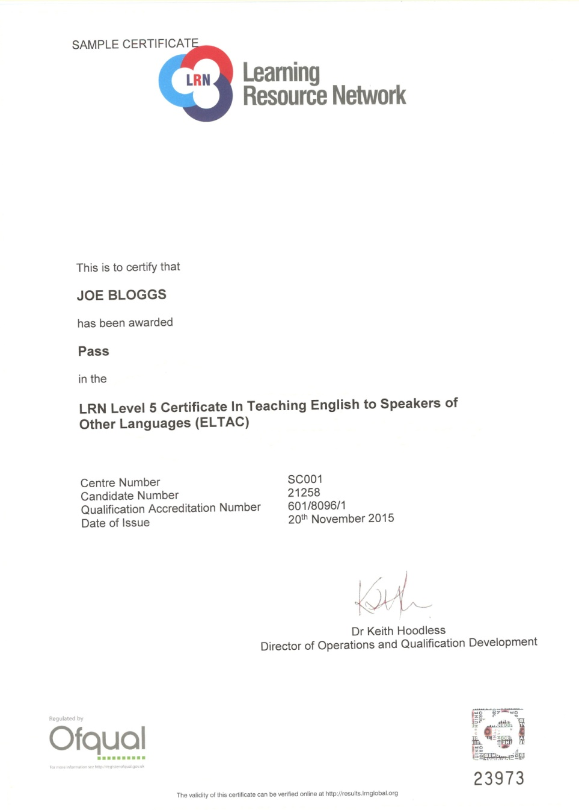

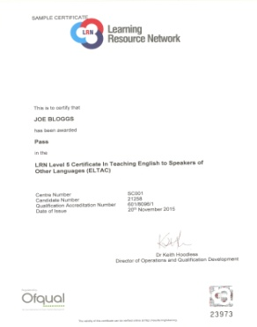
Recognition and levels

Slide 21
Government Recognition
The Office of Qualifications and Examinations Regulation (OFQUAL)
Maritime & Coastguard Agency, UK
ASEP Greece
Ministry of Education, Italy (MIUR)
NEAS, Australia
Malta Qualifications Recognition Information Centre (MQRIC) Ministry of Education & Science, Lithuania
CRUE Spain
KHDA, Dubai

Slide 22

Affiliations & Memberships
Association of Language Testers in Europe (ALTE)
English UK
ISO 9001:2015 Certified
EALTA Institutional Member
IATEFL

Slide 23


Slide 24
Benefits
The fundamental nature of ELTAB is of Communication:
Teachers will be trained in focussing mainly on output and the ability to communicate effectively through Speaking and Listening
Staff trained through ELTAB will better interconnect with others and have more self-assurance in their abilities using English Language
You can have confidence in the values of a regulated qualification that is externally assured by LRN
It has been designed by ELT experts to make it candidate friendly, practical and fulfilling

Slide 25

For more information, please visit www.lrnglobal.org
or contact us at
enquiries@lrnglobal.org

