Slide 1



Slide 2


Slide 3

Who are LRN?
Learning Resource Network (LRN) is accredited as an Awarding Body by the Office of Qualifications and Examinations Regulation (OFQUAL) in the United Kingdom.

Slide 4
What do we provide?
We offer internationally recognised examinations in:
English for Speakers of Other Languages(ESOL)
Business
Teaching

Slide 5
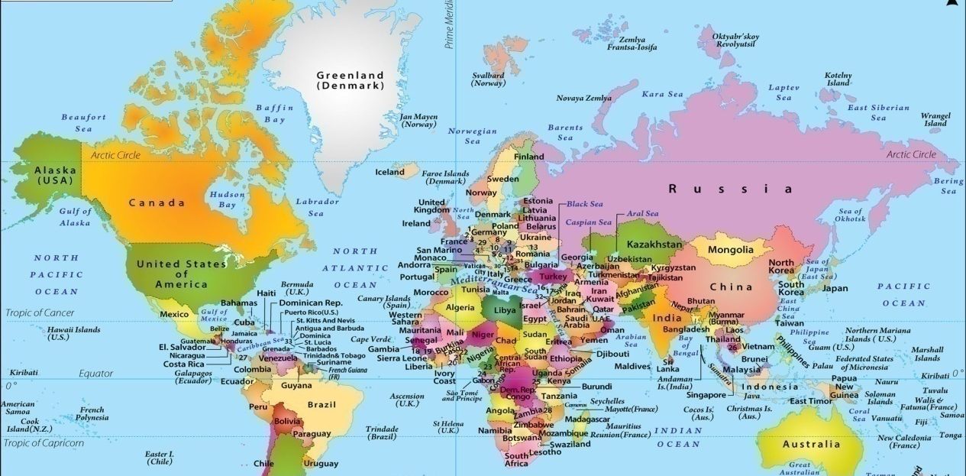
Where in the World?
We have:
150 test centres in
58 countries

Slide 6
What do our qualifications offer?
Our qualifications can help students to:
get a better job
study in another country
demonstrate their personal progress using an international standard

Slide 7

ELTAC
Why use an ELTAC?

Slide 8
Why become an EFL teacher?
Being an EFL teacher provides opportunities
to teach in the UK or to travel overseas
to earn a living while travelling
to be part of the local community
be immersed in the local culture
learn the language of the country
meet interesting, motivated students

Slide 9
Why do an ELTAC Course?
to improve your knowledge of English grammar, phonology and discourse
to learn about current language teaching methodologies
to practise practical planning and teaching
to gain the confidence to be an effective teacher
to be more employable

Slide 10
Delivery of ELTAC Course
Four week intensive (five full days a week plus homework)
Part time over a longer period (one or two days a week - from 3 months to a year)
Blended online and f2f (tuition online, teaching practice f2f 3 months - a year)

Slide 11
Overview of an ELTAC Course
Number of Units | 05
Credit Value | 30
RQF Level | 05
EQF Level | 05

Slide 12
What’s in an ELTAC course?
An ELTAC course includes:
Knowledge, understanding and skills of teaching, learning and assessment in ELT
Developing teaching, learning and assessment in ELT
Planning resources for effective delivery in ELT
Language Awareness and Analysis to support Skills in ELT: Listening, Speaking, Reading and Writing
Practical Component: Applied teaching practice in the ELT classroom

Slide 13
Assessment Method
An ELTAC course includes:
teaching practice (six hours formative assessment)
observation of experienced teachers
4 written assignments

Slide 14
LRN ELTAC or Trinity Cert TESOL or Cambridge CELTA TEFL Course?
 | LRN ELTAC | Trinity Cert TESOL | Cambridge CELTA
Who validates it? | Learning Resource Network | Trinity College London | Cambridge English
RQF Level | 5 | 5 | 5
What’s the minimum course length? | 120 | 130 | 120
How many hours of teaching do trainees have to do? | 6 | 6 | 6
How many weeks does it take? | A minimum of 4 (on the intensive course) | A minimum of 4 (on the intensive course) | A minimum of 4 (on the intensive course)

Slide 15
 | LRN ELTAC | Trinity Cert TESOL | Cambridge CELTA
What are the units of learning included on the course? | Unit 1:Knowledge, understanding and skills of teaching, learning and assessment in ELT Unit 2: Developing teaching, learning and assessment in ELT Unit 3: Planning resources for effective delivery in ELT Unit 4: Language Awareness and Analysis to support Skills in ELT Unit 5: Applied teaching practice in the ELT classroom | Unit 1: Teaching skills Unit 2: Language Awareness Unit 3: The Learner Profile Unit 4: The Materials Assignment Unit 5: Unknown Language | Unit 1: Learners and teachers and the teaching and learning context Unit 2: Language analysis and awareness Unit 3: Language skills Unit 4: Planning and resources for different contexts Unit 5: Developing teaching skills and professionalism

Slide 16
 | LRN ELTAC | Trinity Cert TESOL | Cambridge CELTA
How are trainees assessed? | There is no final exam. Your work for units 1, 2, 3 and 4 will be assessed and mark and moderated by LRN and the work for unit 5 will marked by your internal trainer. You must pass all units to gain the certificate. You can be awarded either a pass or a fail. | There is no final exam. Your work for units 1, 2, 3 and 5 will be assessed by your trainer and the work for unit 4 will marked by an external moderator from Trinity. You must pass all units to gain the certificate. You can be awarded either a pass or a fail. | There is no final exam. Instead your trainers will assess you continuously throughout the course for two components - Teaching Practice and Written Assignments. An external assessor from Cambridge English will moderate each course as a whole. You must pass both components to be awarded the certificate. There are three grades: Pass, Pass A and Pass B.

Slide 17
 | LRN ELTAC | Trinity Cert TESOL | Cambridge CELTA
Recognition | Office of Qualifications and Examinations Regulation (Ofqual) All employers in the UK and overseas accept Ofqual recognised qualifications. | Office of Qualifications and Examinations Regulation (Ofqual) All employers in the UK and overseas accept Ofqual recognised qualifications. | Office of Qualifications and Examinations Regulation (Ofqual) All employers in the UK and overseas accept Ofqual recognised qualifications.
What is new in ELTAC? | Apart from Teaching and Learning, candidates will learn about assessment in ELT and gain knowledge of the Common European Framework of Reference for Languages (CEFR). With ELTAC, 80% assignments are set and mark by LRN i.e. more credibility to the qualification and less work for centre.

Slide 18
Teaching and Learning Support
TUTOR FORUM
ASSIGNMENTS
QUALIFICATION HANDBOOK
RECOMMENDED RESOURCES
SPECIALIST ADVISER SUPPORT

Slide 19
Support from LRN
WEBINAR
WEBSITE
TEXT BOOKS
Tutor Forum
LRN SUPPORT
LOCAL OFFICE CENTRE SUPPORT
SPECIALIST ADVISORS
LOCAL NETWORKS
REGIONAL EVENTS
MONTHLY FOCUS NEWSLETTER

Slide 20
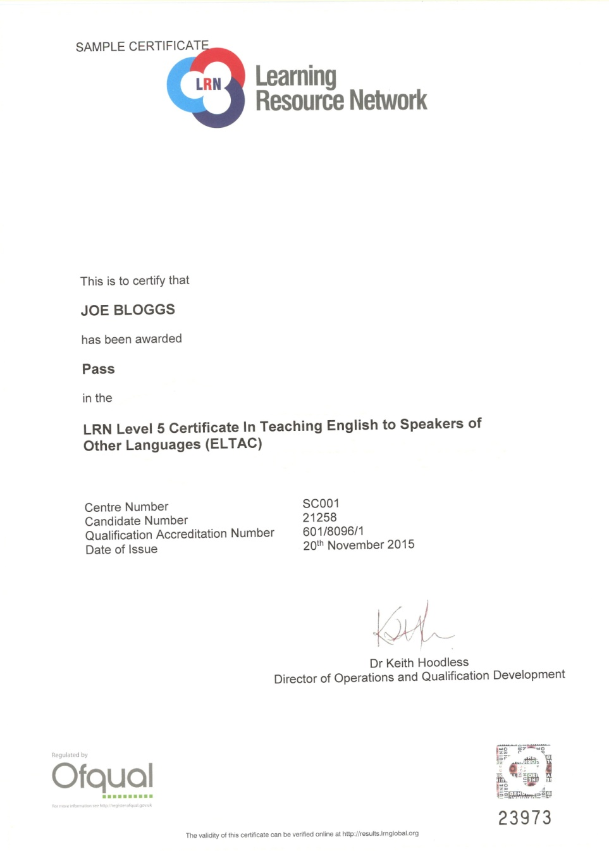

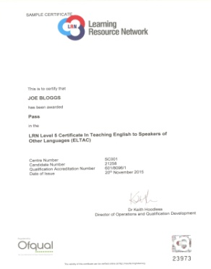
Recognition and levels

Slide 21
Government Recognition
The Office of Qualifications and Examinations Regulation (OFQUAL)
Maritime & Coastguard Agency, UK
ASEP Greece
Ministry of Education, Italy (MIUR)
NEAS, Australia
Malta Qualifications Recognition Information Centre (MQRIC)
Ministry of Education & Science, Lithuania
CRUE Spain
KHDA, Dubai

Slide 22

Affiliations & Memberships
Association of Language Testers in Europe (ALTE)
English UK
ISO 9001:2015 Certified
EALTA Institutional Member
IATEFL

Slide 23


Slide 24
Benefits
The fundamental nature of ELTAC is of Communication:
Teachers will be trained in focussing mainly on output and the ability to communicate effectively through Speaking and Listening
Staff trained through ELTAC will better interconnect with others and have more self-assurance in their abilities using English Language
You can have confidence in the values of a regulated qualification that is externally assured by LRN
It has been designed by ELT experts to make it candidate friendly, practical and fulfilling

Slide 25

For more information, please visit www.lrnglobal.org
or contact us at
enquiries@lrnglobal.org

