Slide 1



Slide 2


Slide 3

Who are LRN?
Learning Resource Network (LRN) is accredited as an Awarding Body by the Office of Qualifications and Examinations Regulation (OFQUAL) in the United Kingdom.

Slide 4
What do we provide?
We offer internationally recognised examinations in:
English for Speakers of Other Languages(ESOL)
Business
Teaching

Slide 5

Where in the World?
We have:
150 test centres in
58 countries

Slide 6
What do our qualifications offer?
Our qualifications can help students to:
get a better job
study in another country
demonstrate their personal progress using an international standard

Slide 7

ETAB
Why do you want to be a teacher and why choose ETAB?

Slide 8
Why become a teacher?
Being a teacher provides opportunities:
to make a difference
to earn a competitive salary
to gain a great career and quality of life
to feel rewarded every day

Slide 9
Why take an ETAB Course?
To improve your career opportunities if you:
are already teaching, but would like to take an internationally recognised qualification or to gain formal recognition for your experience
want to improve your career opportunities by widening your teaching experience into specialist areas
want to keep your teaching skills up to date.

Slide 10
Why take an ETAB Course
To practise practical planning and teaching and start a journey towards other teaching qualifications
After taking the ETAB you can take other LRN English Teaching Qualifications, such as ETAC or ELT Qualifications and Assessor Awards

Slide 11
Why take an ETAB Course
To gain the confidence to be an effective teacher
Preparing for ETA B will improve your confidence as a teacher and give you the knowledge and skills to help you develop your career.
You can take ETA B whatever your background and teaching experience. You do not need to have a certain level of English to take it.

Slide 12
Delivery of ETAB Course
One week intensive (five full days a week plus homework)
Part time over a longer period (one or two days a week - from 3 months to a year)
Blended online and f2f (tuition online, teaching practice f2f 3 months - a year)

Slide 13
Overview of an ETAB Course
Number of Units | 03
Credit Value | 12
RQF Level | 03
EQF Level | 04

Slide 14
What’s in an ETAB course?
The ETAB course consists of:
3 modules:
Understanding roles, responsibilities and relationships in education and training
Understanding and using inclusive teaching and learning approaches in education and training
Understanding assessment in education and training

Slide 15
Assessment Method
The qualification will be assessed by a combination of:
Three separate assignments; and
Observation of teaching or training - The teaching will be a simulation of teaching (micro-teaching) to your peers on the course (referred to as a 30 minute micro teach)

Slide 16
Teaching and Learning Support
TUTOR FORUM
ASSIGNMENTS
QUALIFICATION HANDBOOK
RECOMMENDED RESOURCES
SPECIALIST ADVISER SUPPORT

Slide 17
Support from LRN
WEBINAR
WEBSITE
TEXT BOOKS
Tutor Forum
LRN SUPPORT
LOCAL OFFICE CENTRE SUPPORT
SPECIALIST ADVISORS
LOCAL NETWORKS
REGIONAL EVENTS
MONTHLY FOCUS NEWSLETTER

Slide 18
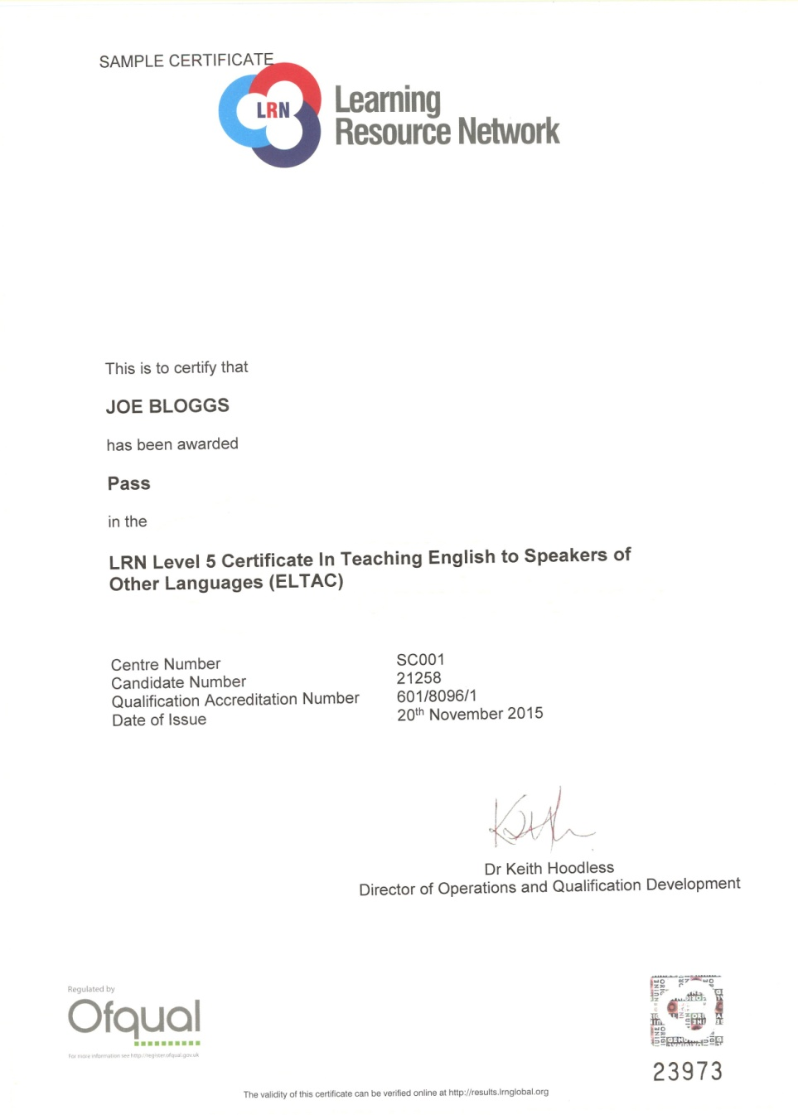

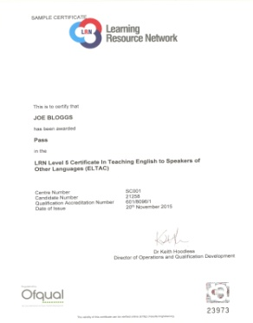
Recognition and levels

Slide 19
Government Recognition
The Office of Qualifications and Examinations Regulation (OFQUAL)
Maritime & Coastguard Agency, UK
ASEP Greece
Ministry of Education, Italy (MIUR)
NEAS, Australia
Malta Qualifications Recognition Information Centre (MQRIC) Ministry of Education & Science, Lithuania
CRUE Spain
KHDA, Dubai

Slide 20

Affiliations & Memberships
Association of Language Testers in Europe (ALTE)
English UK
ISO 9001:2015 Certified
EALTA Institutional Member
IATEFL

Slide 21


Slide 22
Benefits
The fundamental nature of ETAB is of
Involvement in the Process:
Teachers will be trained to take responsibility for their learning and will be able to demonstrate a high degree of independence in applying the skills of research and evaluation.
Staff trained through ETAB will better interconnect with others and have more self-assurance in their abilities to teach and progress in teaching.
You can have confidence in the values of a regulated qualification that is externally assured by LRN.
It has been designed by teaching experts to make it candidate friendly, practical and fulfilling.

Slide 23

For more information, please visit www.lrnglobal.org
or contact us at
enquiries@lrnglobal.org

