Slide 1






General Cubic Equation of State Model

Slide 2
Cubic Equations of State
Cubic EoS describe the compressibility (i.e. deviation from ideality) of a real fluid in the form:
0 = Z³ + a(T,P,z)Z² + b(T,P,z)Z + c(T,P,z)
Has between 1 and three solutions
Theory links all thermodynamic properties to the compressibility, i.e.:
h = f(Z,T,P,z)
Compressibility and thermodynamic properties are calculated for each phase individually

Slide 3
Disappearing Phases
What happens when a phase does not exist?
Z does not exist (becomes imaginary)
Thermodynamic properties also do not exist
Solver will fail when any phase does not exist
Need to ensure that all phases have a valid solution
must cover all possible system states
must avoid introducing significant errors

Slide 4
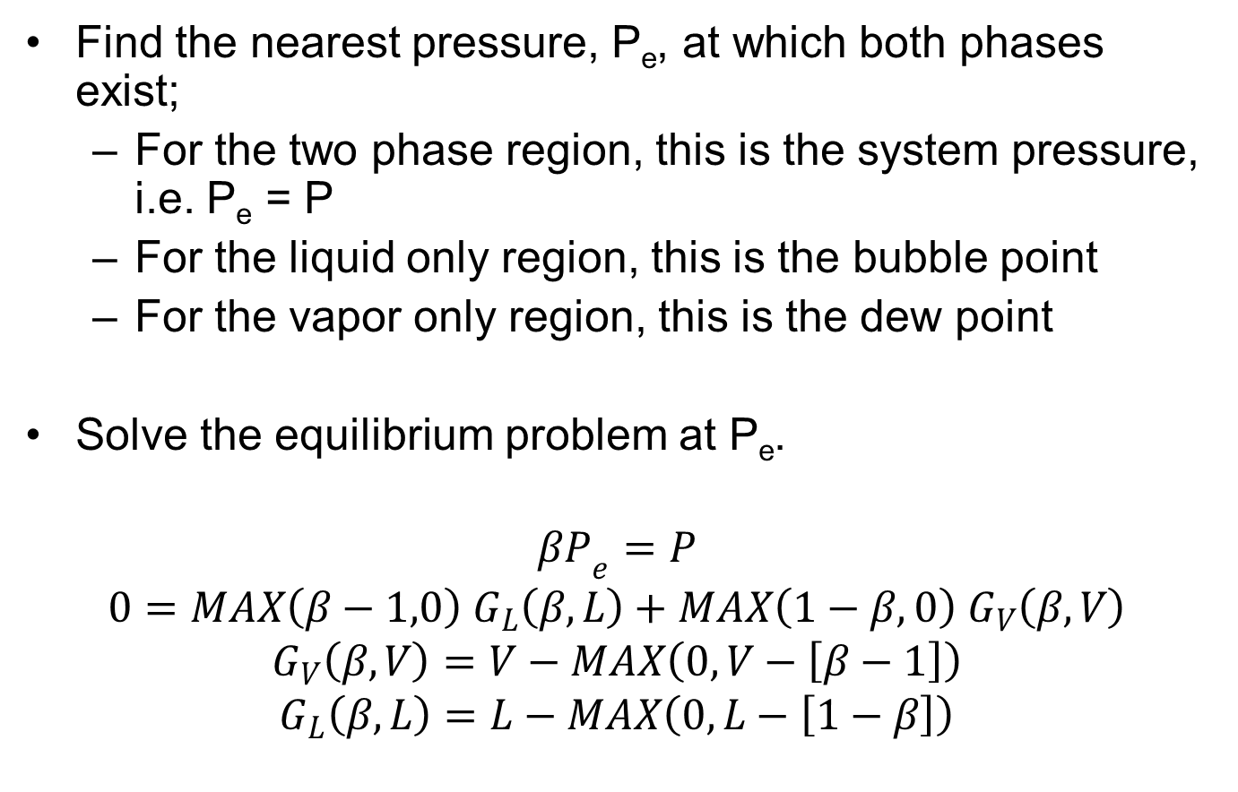
Our Solution
Find the nearest pressure, P_{e}, at which both phases exist;
For the two phase region, this is the system pressure, i.e. P_{e} = P
For the liquid only region, this is the bubble point
For the vapor only region, this is the dew point
Solve the equilibrium problem at P_{e}.
$${βP}_{e}=P$$
$$0=MAX\left(β−1,0\right) G_{L}\left(β,L\right)+MAX\left(1−β,0\right) G_{V}\left(β,V\right)$$
$$G_{V}\left(β,V\right)=V−MAX\left(0,V−\left[β−1\right]\right)$$
$$G_{L}\left(β,L\right)=L−MAX\left(0,L−\left[1−β\right]\right)$$

Slide 5
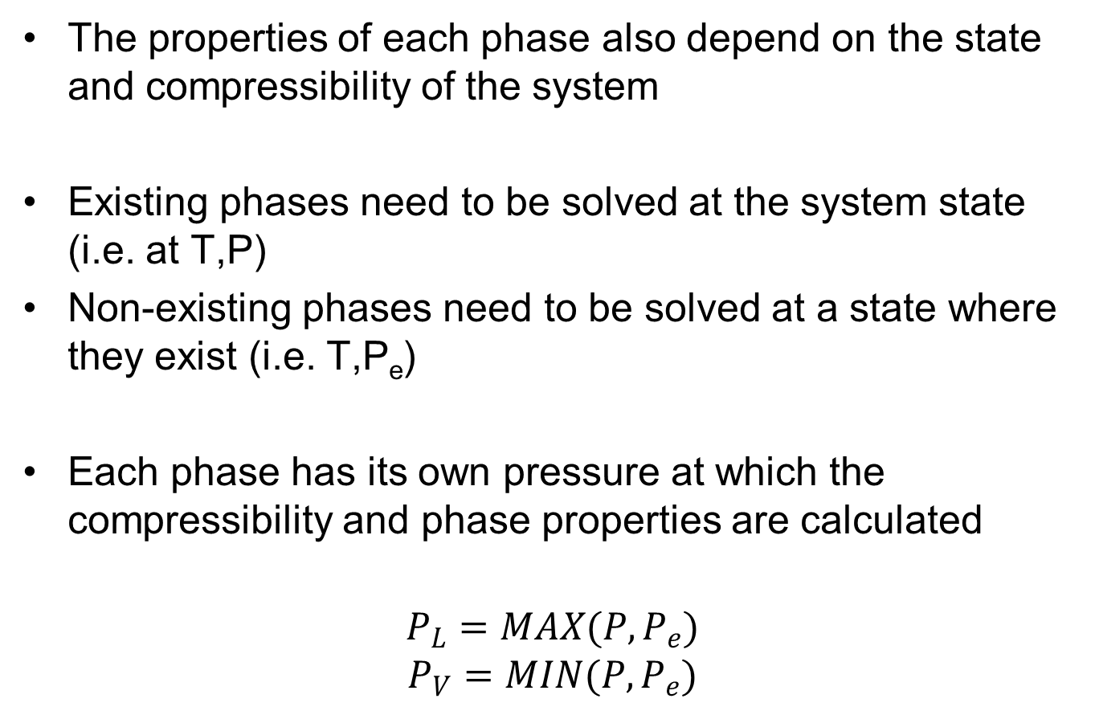
Phase Properties
The properties of each phase also depend on the state and compressibility of the system
Existing phases need to be solved at the system state (i.e. at T,P)
Non-existing phases need to be solved at a state where they exist (i.e. T,P_{e})
Each phase has its own pressure at which the compressibility and phase properties are calculated
$$P_{L}=MAX(P,P_{e})$$
$$P_{V}=MIN(P,P_{e})$$

Slide 6
Supercritical Conditions
In the supercritical region, the liquid and vapor roots of the EoS are identical
This means that the liquid and vapor properties of the two phases are identical, and the phase equilibrium equation becomes singular
This problem has not yet been addressed

Slide 7
Using the General Cubic EoS Property Package
Working version of GitHub:
IDAES/models/idaes_models/properties/physical
Requires cubic root finder external function:
In cubic_eos sub-directory
Demonstration flowsheet:
testbed_cubic.py
Should only need to run: python testbed_cubic.py

Slide 8
Model Details
Model consists of three parts:
The core cubic EoS model: Cubic_EoS.py
A user supplied parameter model
External function call library
Users should not need to modify the core model file
Core model and external function calls are general to a number of cubic EoS of standard form
Currently support Peng-Robinson and SRK equations

Slide 9
The User Supplied Model
Example: PR_ASU.py
# Import IDAES cores
import idaes_models.properties.physical.Cubic_EoS as base_prop
class PropPack(base_prop.PropPack):
# List of all chemical species included in package
comp = ['N2','O2','Ar']
def _thermo_params(self):
# Create package parameters
blk = self
# Set Equation of State to use
blk.EoS_ID = 'PR‘
# Critical properties and thermodynamic parameters
def _ideal_pc_props(self):
# Ideal gas properties
def _trans_params(self):
# Parameters for transport property models
Imports core model
User package inherits methods from core model
Component list – allows unit model to look up list
Specifies which EoS to user (current: PR or SRK)
Define all the necessary critical properties, etc.
Provide Pyomo constraints for pure component, ideal gas properties (cp, h and s)
Support for adding parameters for transport properties

Slide 10
Additional Features
Core model has three optional arguments
plib: file name (and path if needed) for external function library
phases: allows the user to specify which phase(s) to calculate
V (vapor only), L (liquid only) or VL (both phases, default)
Phase equilibrium only solved when VL selected
mix_props: allows the user to choose whether to calculate mixture properties
1 (calculate, default) or 0 (do not calculate)
For option 1, needs phases = VL (otherwise will ignore this choice)

Slide 11
Standard Nomenclature
All properties have a phase suffix:
_liq (liquid phase), _vap (vapor phase) or _mix (mixture of both phases)
Four pressures used in calculations:
P: specified system pressure
Pe: calculated two-phase pressure
Pl: liquid phase pressure
Pv: vapor phase pressure
P_vap and P_liq not used to avoid confusion with vapor pressure
Compositions (mole fractions):
z: total mixture composition (combination of phases)
x: liquid phase composition
y: vapor phase composition

Slide 12
Supported Properties (so far)
Thermodynamic
Compressibility: Z_liq, Z_vap
Fugacity Coefficients: Φ_liq, Φ_vap
Specific Enthalpy: h_liq, h_vap, h_mix
Specific Entropy: s_liq, s_vap, s_mix
Specific Gibbs Energy: g_liq, g_vap, g_mix
Molar Volume: V_liq, V_vap, V_mix
Liquid and Vapor Fractions: L, V
Transport
Molecular Weight: MW_liq, MW_vap, MW_mix

Slide 13
Further Development
Need people to start using model and identify any bugs/issues
Additional properties:
What properties are needed for each task?
Supercritical region:
How important is this?
Combine with eNRTL model for ionic solvents

