Slide 1
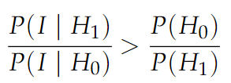
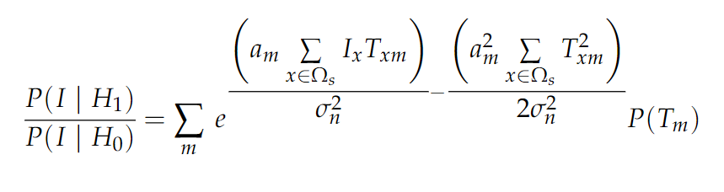

Appendix
Fast simulation of the ideal observer
Analytical approximation vs. Monte Carlo vs. Chapter 4 Method
The ideal observer decision rule for the detection of visual targets:
The additive target in white noise (uncertainty about the visual pattern):
: image (stimulus) presented in each trial. It is a random variable.
: a dot product between template m and image of that trial. There are m random variables total, in general they are correlated.

Slide 2
Appendix
Fast simulation of the ideal observer
Analytical approximation vs. Monte Carlo vs. Chapter 4 Method
Chapter 4 Method: For each trial, dot products between stimulus image and templates are computed with pre-computed variables. Correlations naturally occur. A response generated for each trial and hits and correct rejections rate are calculated from responses.
Monte Carlo Simulation: For each trial, dot products are sampled from multivariate Gaussian with known mean and covariance matrix (makes sure that correlations structure is intact). Hits and correct rejections are calculated from responses.
Analytical Approximation: The ratio of likelihood is a random variable that is a sum of correlated log normal random variables. It is approximated with distribution whose parameters are calculated from the ones for multivariate gaussian (thus, the correlation structure is inherited). Hits and correct rejections are calculated from overlaps between distributions.
Monte Carlo simulations or analytical approximations might be faster than Chapter 4 simulation method.

Slide 3
Appendix
Fast simulation of the ideal observer
The distribution of the sum of correlated log normal random variables
Also relevant for:
wireless systems (Mehta et al., 2007)
financial risk management (Gulisashvili & Tankov, 2016)
Analytical Approximations
Approximation with log skew normal distribution
Independent log normal random variables
(Hcine & Bouallegue, 2015a)
Correlated log normal random variables
(Hcine & Bouallegue, 2015b)

Slide 4
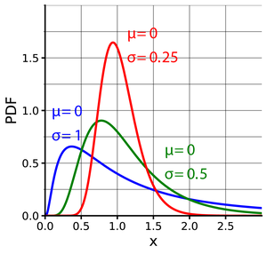
Appendix
Fast simulation of the ideal observer
Analytical Approximations
Approximation with a single log normal distribution
see wikipedia page
Independent log normal random variables
Wilkinson approach (Marlow, 1967; Fenton, 1960)
Correlated log normal random variables
Lo, 2013, only for two correlated variables
Its implementation can be found here.
Also see Mehta et al., 2007 and Gulisashvili & Tankov, 2016
Many other analytical approximations are available.
(see reviews: Beaulieu et al., 1995; Amussen et al., 2011)

Slide 5
Appendix
Fast simulation of the ideal observer
Monte Carlo Simulations
Faster Monte Carlo Simulations
Independent log normal random variables
Asmussen et al., 2016 and Botev & L'Ecuyer, (2017)
Correlated log normal random variables
Alouini et al., (2018)
What literature suggests,
Approximations only work in limited cases.
Most of the approaches are only designed to well approximate some parts of the distribution.
Not straightforward implementation (non-linear equations, no built-in functions)

Slide 6
Appendix
Fast simulation of the ideal observer
Preliminary Work
Simple Monte Carlo Simulation
Sampling from multivariate gaussian with known mean and covariance matrix
Taking exponents and summing them up
Fitting single log normal (MATLAB built-in function)
Aim 1: Derivation of the mean and covariances and simulation simple Monte Carlo
Aim 2: Testing the effectiveness of single-log normal approximation

Slide 7

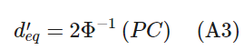
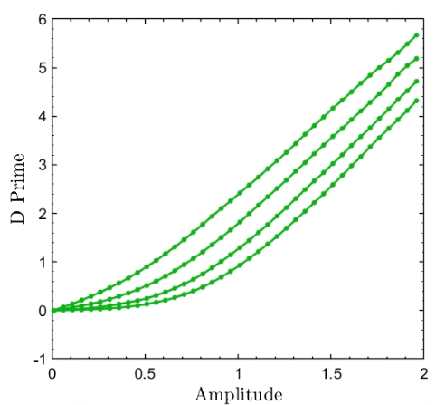
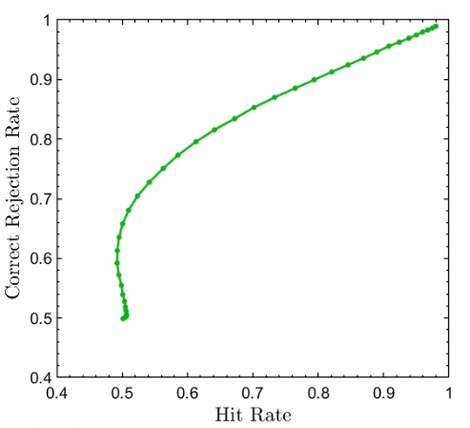
Appendix
Fast simulation of the ideal observer
Independent Locations
Templates are 201 by 201 pixels.
60 pixels are assumed to be one degree.
3.5 cpd target, diameter is 0.969 visual degrees.
Standard deviation background is 5 gray levels.
Target prior is 0.5.
All locations are equally probable.
Amplitude is in gray levels.
Chapter 4 Method for Simulations
6 inp. loc.
26 inp. loc.
126 inp. loc.
500 inp. loc.
500 inp. loc.

Slide 8
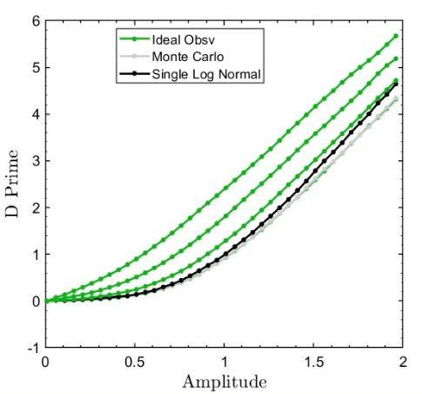
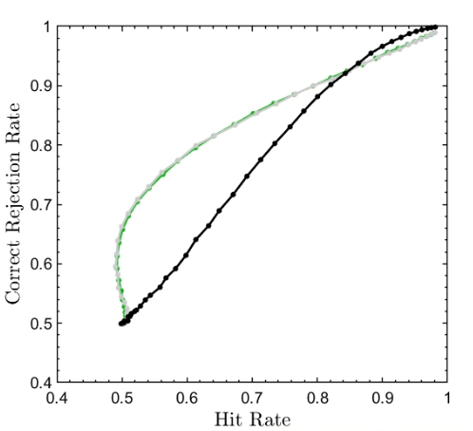
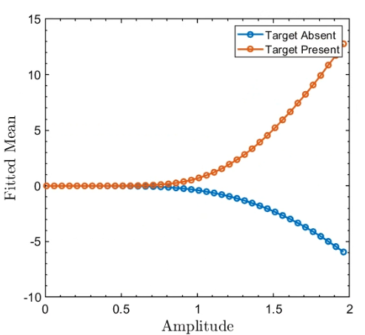
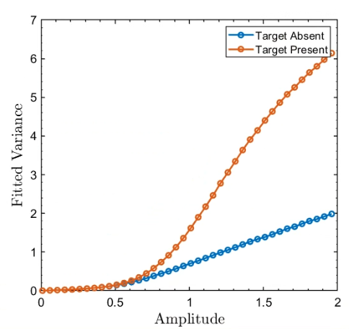
Appendix
Fast simulation of the ideal observer
Independent Locations - Aim 1 and Aim 2
500 inp. loc.
6 inp. loc.
26 inp. loc.
126 inp. loc.
500 inp. loc.
Monte Carlo simulations works for independent locations.
Single log normal fitted with MATLAB built-in function doesn't work very well.

Slide 9
Appendix
Fast simulation of the ideal observer
Analytical approximation vs. Monte Carlo vs. Chapter 4 Sim Method
Hard to provide an equal ground for comparisons (my codes are not optimized)
Lessons from the implementation of Monte Carlo
+ avoiding dot product between image and templates
With analytical approximations, you also avoid simulating trials.
- requires convolution of templates to calculate the covariance matrix
If there is no further restrictions on the covariance matrix, computation of the covariance matrix for 500 templates seems very time consuming.
- requires recalculation of covariance if either one of them is changed: which target is presented, the amplitude of the target or the standard deviation of white noise (not sure about this one, it can be partly pre-computed).
For Monte Carlo simulation, this suggests sampled numbers from multivariate gaussian cannot be easily adjusted so one needs to resample every time.
Notes:
33 minutes *500 times!

Slide 10
Appendix
Fast simulation of the ideal observer
Analytical approximation vs. Monte Carlo vs. Chapter 4 Sim Method
It is not clear whether Monte Carlo or any analytical approximation is superior to the Method introduced in Chapter 4.
For 2D signals, the selection of the simulation method depends on:
(i) the image size (which slows down the dot products),
(ii) the number of templates which determines the covariance matrix size (number of convolutions), and
(iii) properties of templates which determines the properties of the covariance matrix (if not arbitrary, one might avoid some convolutions).

Slide 11
Appendix
Fast simulation of the ideal observer
Summary
Faster Simulations: Analytical approximation vs. Monte Carlo vs. Chapter 4 Method
Literature about Monte Carlo and Analytical approximations
Preliminary work,
Derived covariances and means of multivariate Gaussian (see derivation.pdf).
Monte Carlo simulation works well for independent position uncertainty.
Approximation with a single log normal distribution doesn't work well for independent position uncertainty.
For 2D signals, it is not clear whether Monte Carlo or any analytical approximation is superior to the Method introduced in Chapter 4. (see previous two slides).

