Slide 1
AUTOMATED STRUT&TIE ANALYSIS and DESIGN ALGORITHM
Mustafa Can Şanlitürk

Slide 2
OUTLINE
Main objective
What I have done so far
What I would have done differently
Advantages
Questions

Slide 3
Objective
Generating a Strut & Tie System automatically
Designing the reinforcements for the system

Slide 4
What Have I Done So Far?
Coded 2-D Finite Element Analysis engine in C++
Generated an iterative algorithm to obtain main load carrying system.
Checked the stresses and designed the system for reinforcements

Slide 5
What Would I Have Done Diifferently?
Worked on an algorithm but could not make it on time. It is a recursive algorithm which could help to do check and design according to real strut-tie system instead of representative 2-D Model.
Plain strain elements could have been an option

Slide 6
Advantages
It is fast
Tensile reinforcements are obtained really sensitively.

Slide 7
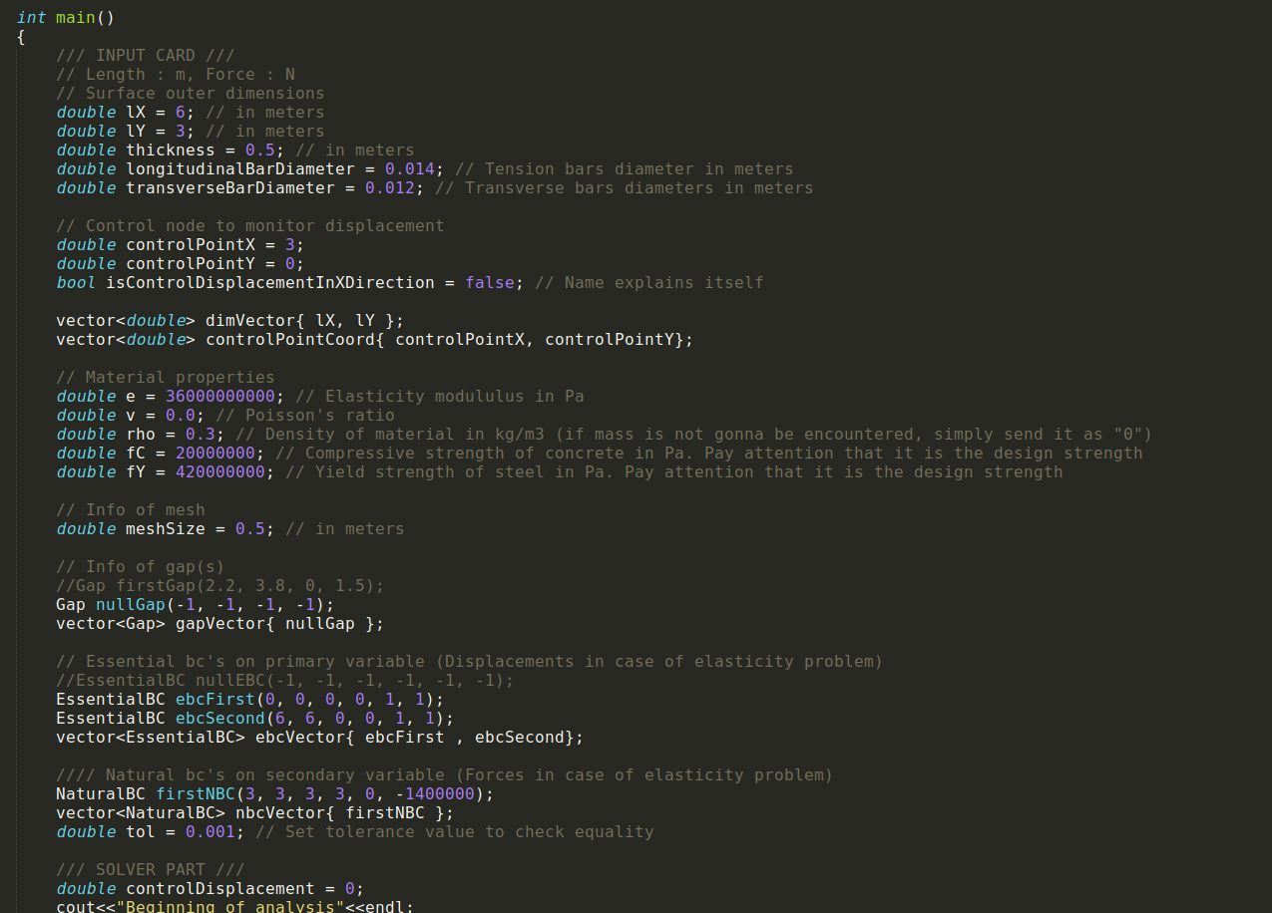
Images

Slide 8
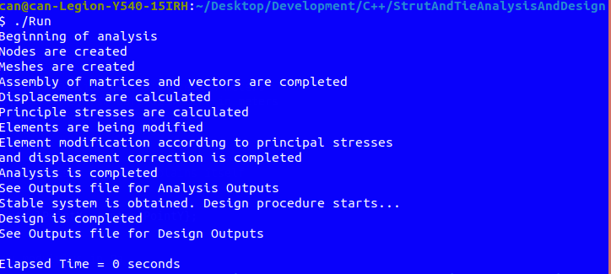
Images

Slide 9
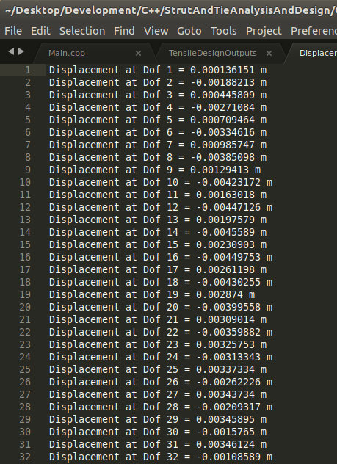
Images

Slide 10
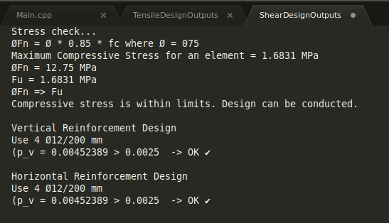
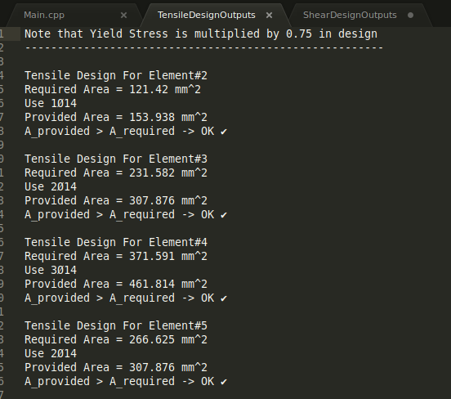
Images

Slide 11
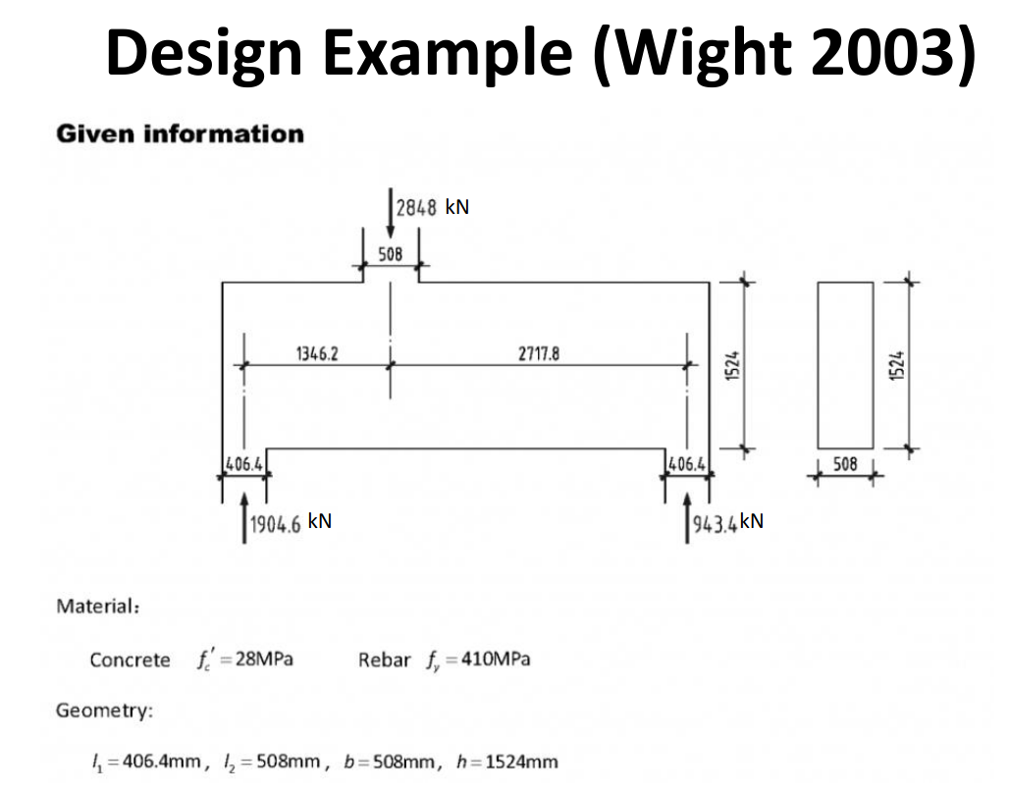
Design Comparison
Example in the lecture notes is used

Slide 12
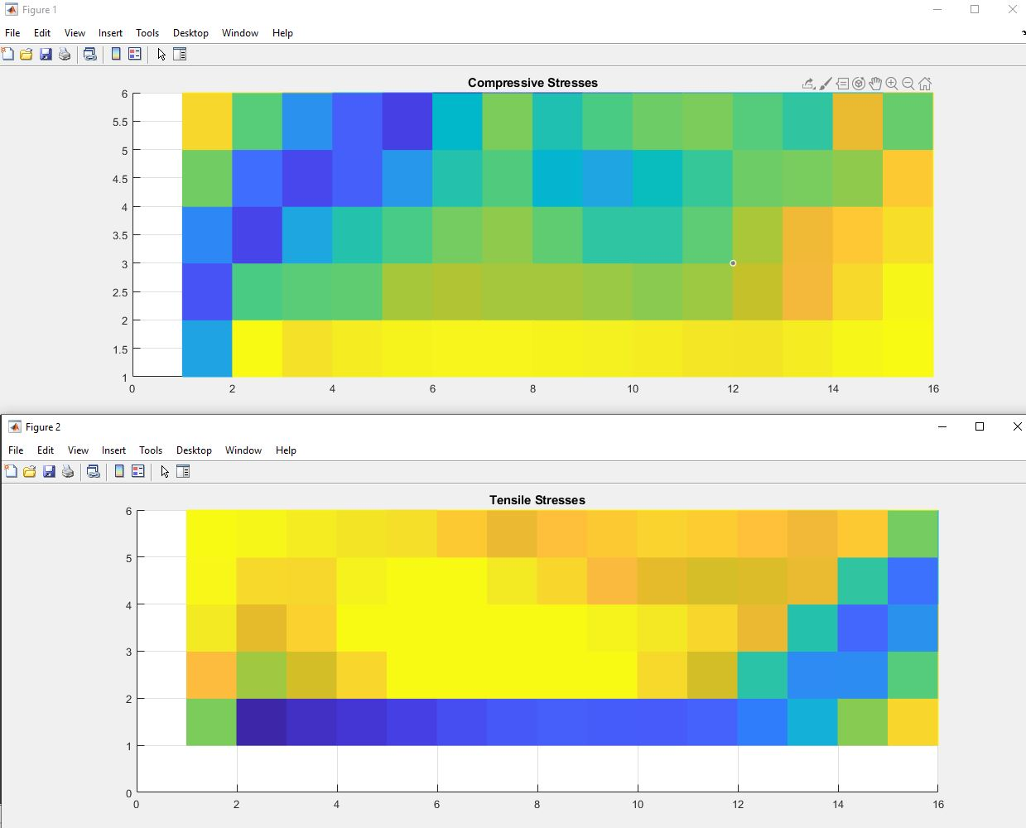
Design Comparison
Post-processed data in Matlab

Slide 13
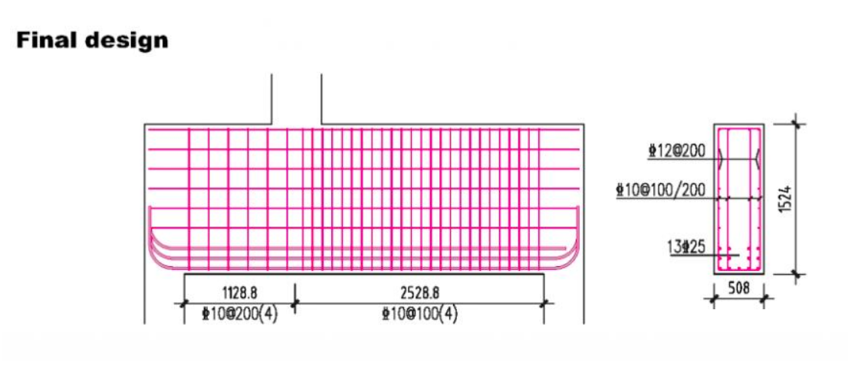
Design Comparison
Design in Lecture Notes

Slide 14
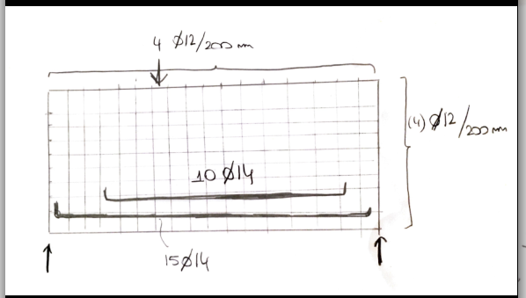
Design Comparison
Idealized sketch of my programs design

Slide 15
Questions
Source code is available at
https://github.com/CanSanliturk/StrutAndTieAnalysisAndDesignFramework

