Slide 1
DveOps for GenAI Hackathon
June 2, 2025
Team member:
David ZHOU
John REQUIO
Jason OU

Slide 2

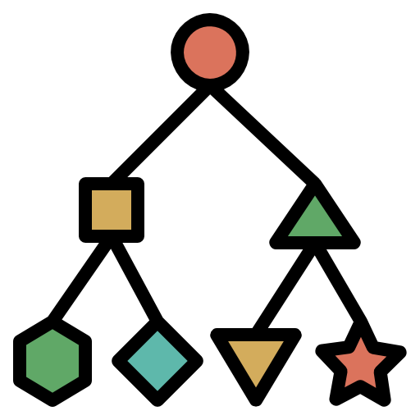



Project Design: Multi-agent helpline System

