Slide 1
State of the Stock 2023
Lukas Van Riel, Effie Gao, Jesus Pascual, Jack A. Goldman

Slide 2
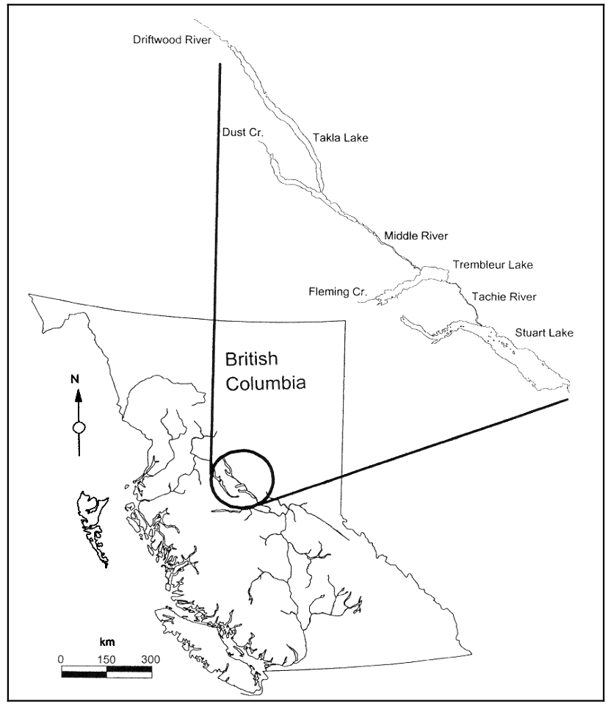
Fraser River Sockeye Fishery
2019 and 2020 lowest recorded Fraser Sockeye return ever
Management plans led to reduced fishing opportunities
Early Stuart
fish that return to spawn in early summer
2019 forecast found evidence of population declines
2021 forecast suggest the stock will not reach recovery target

Slide 3
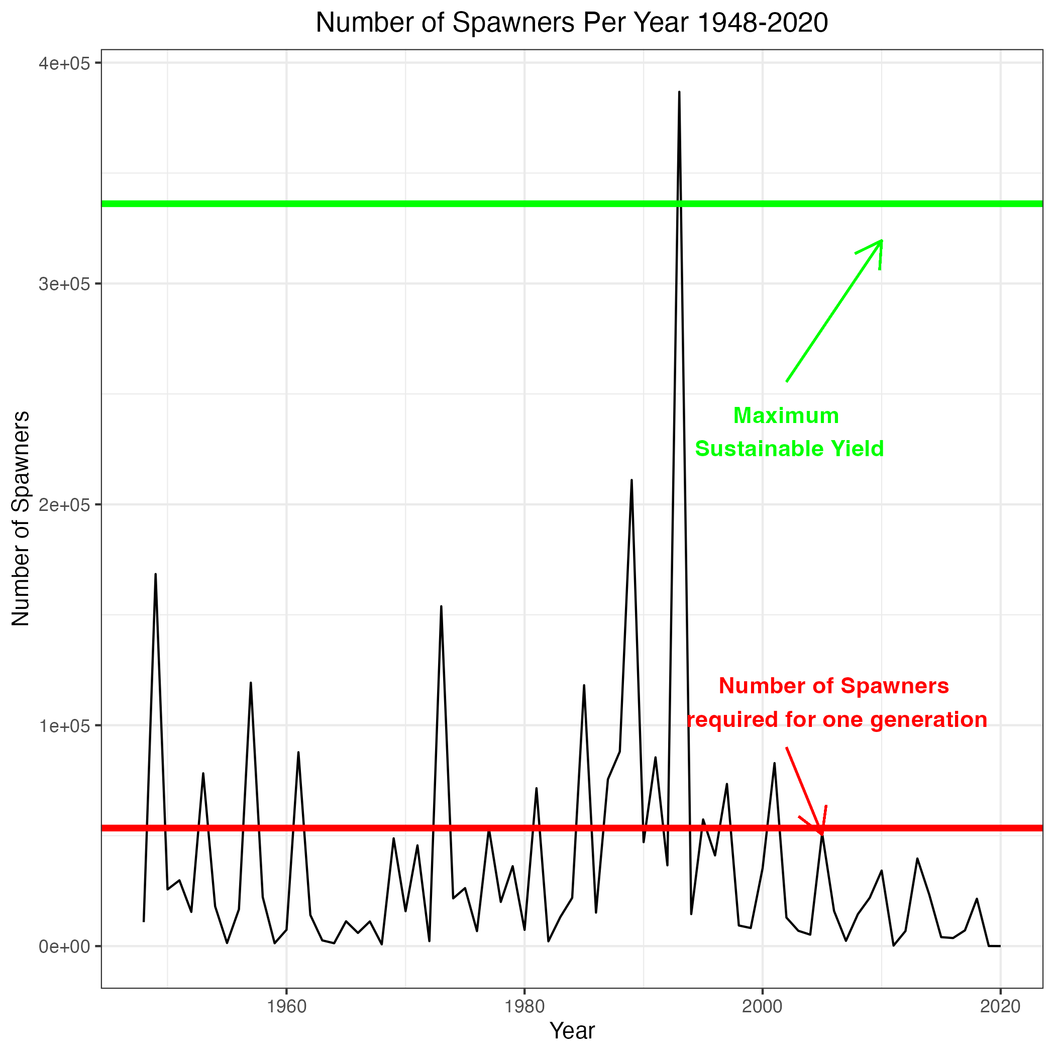
State of the population

Slide 4
Goals
Previous forecasting methods are old and out of date
Goal: develop new forecasting methods and evaluate performance

Slide 5
Candidate models
Five models:
Basic Ricker
Ricker with Env. Covariate
Power Model
Naive
Naive Linear Model
We compared the performance of the models using RMSE

Slide 6
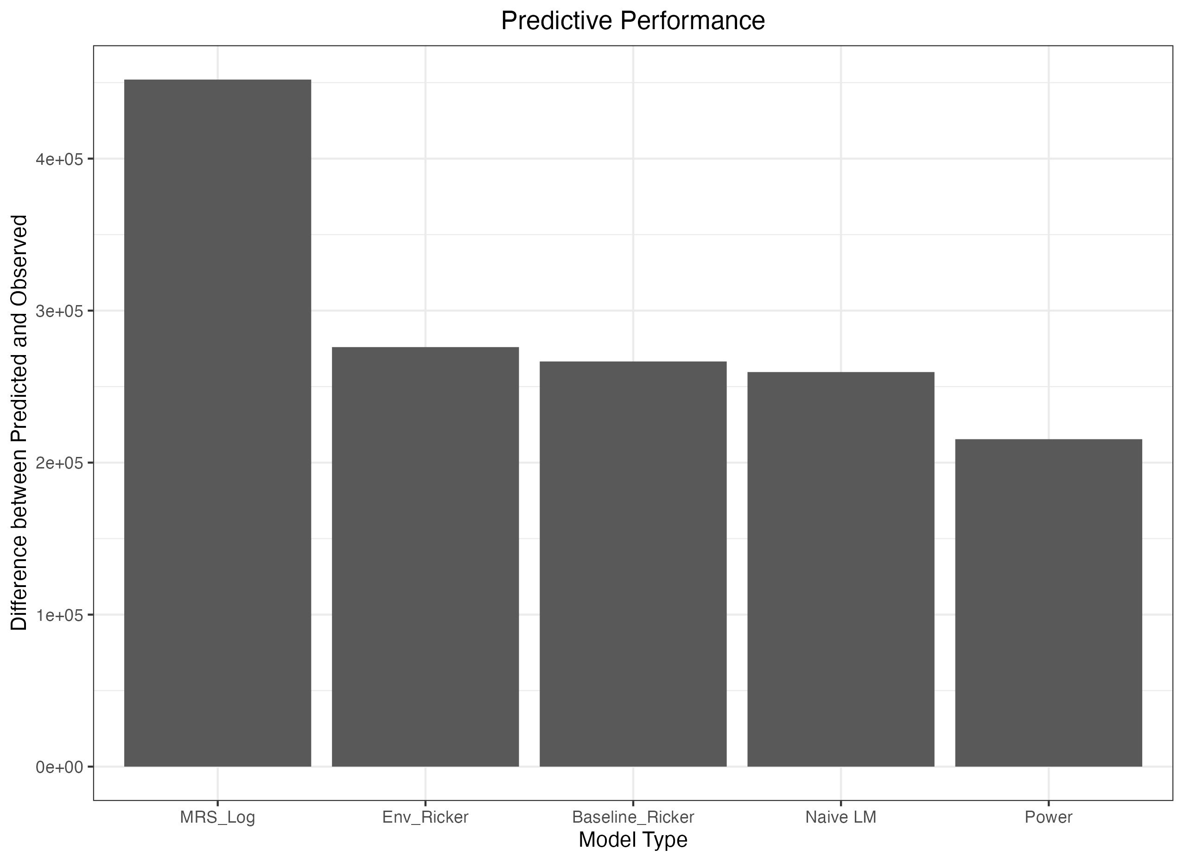
Model comparisons

Slide 7
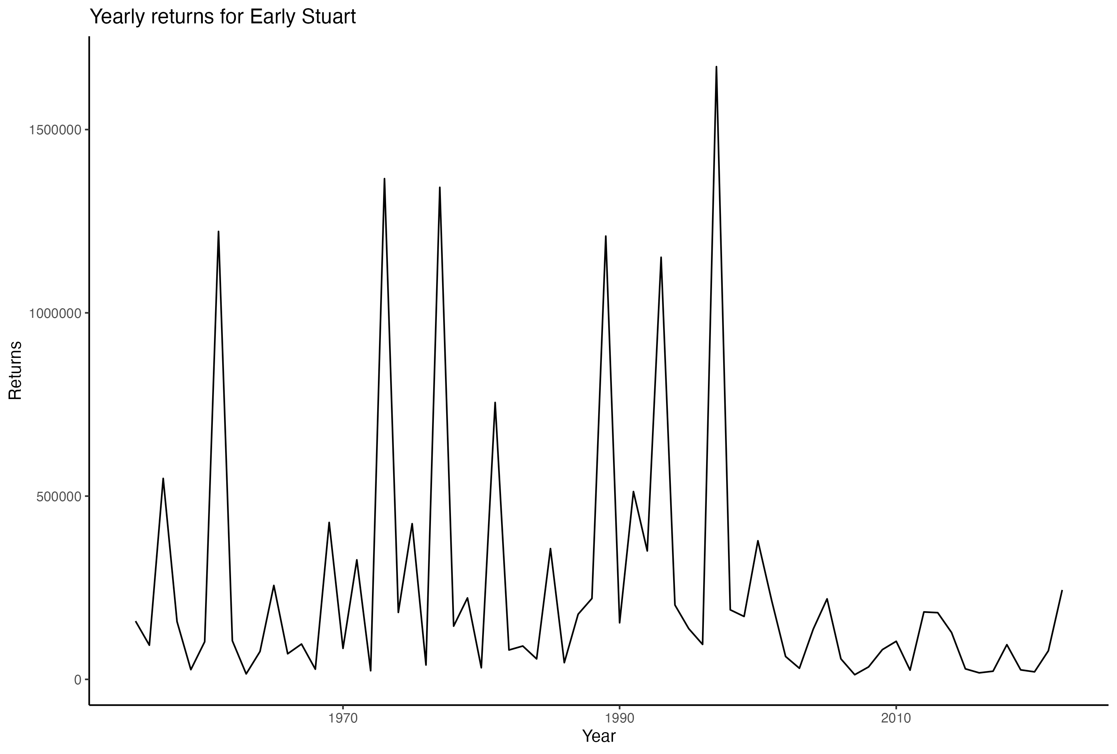
Proof of Concept Forecast

Slide 8
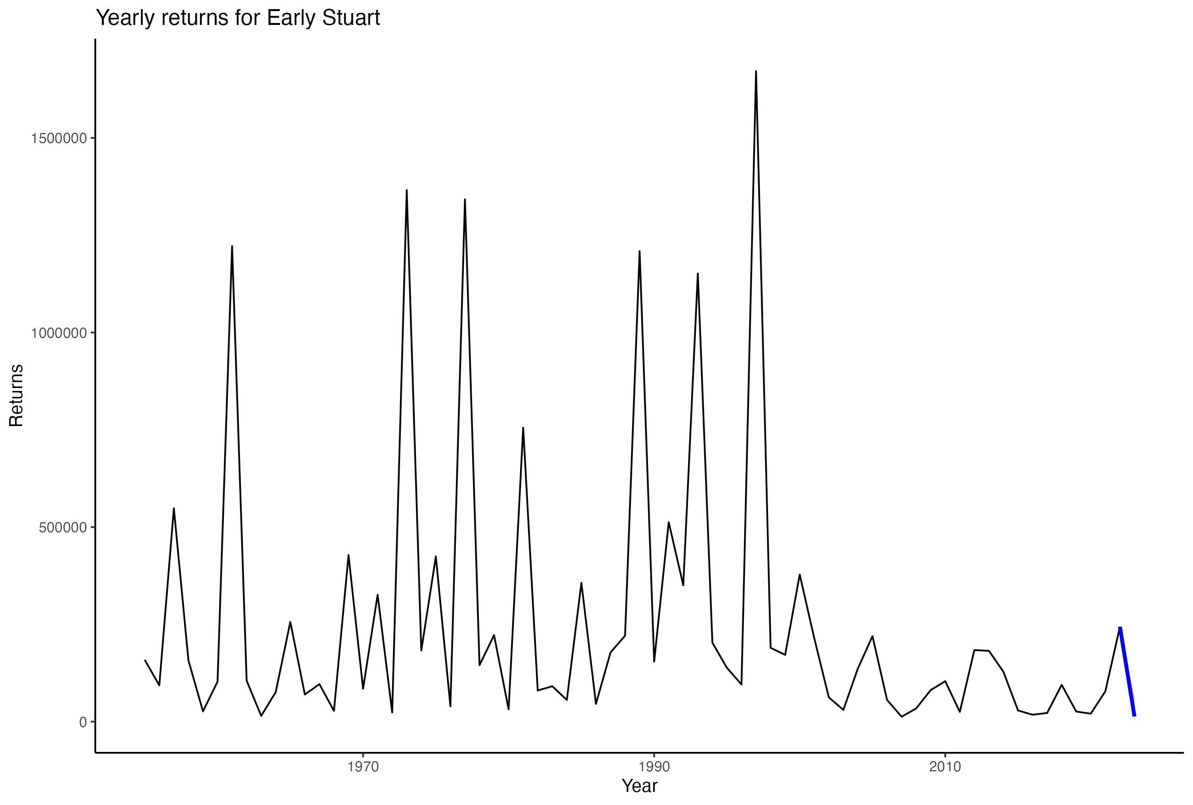
Proof of Concept Forecast

Slide 9
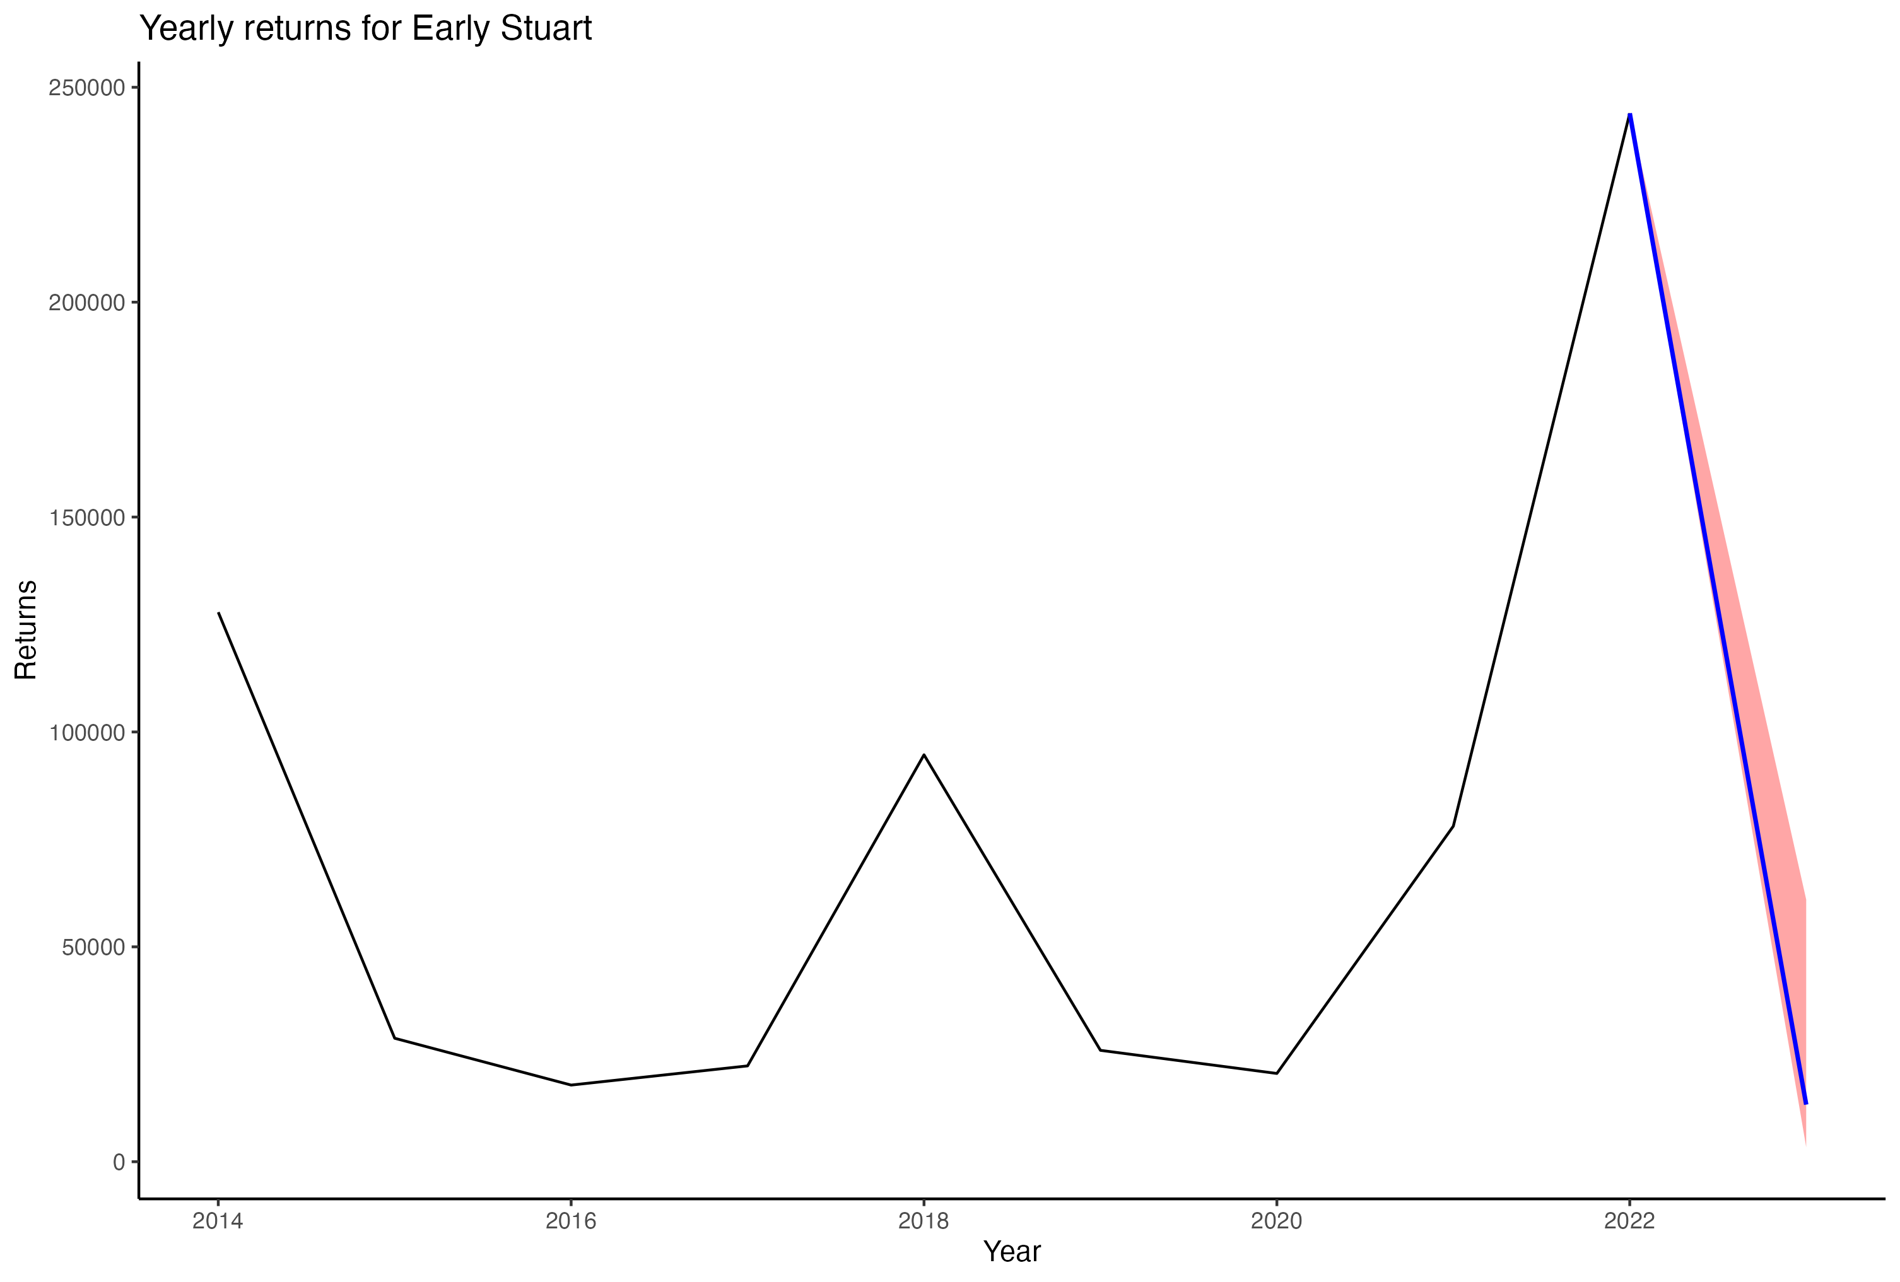
Proof of Concept Forecast

Slide 10
Recommendation

Slide 11
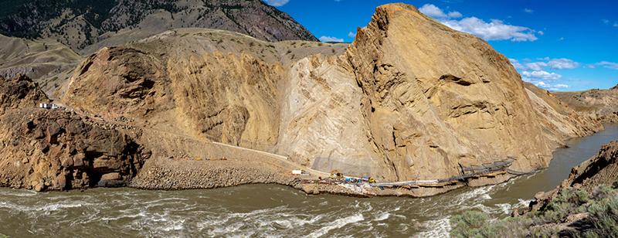
Recommendation

Slide 12
Thank you

