Slide 1

Group 2
Daniel Marquez
Gustavo Mendes
John James

Slide 2
Impacts of Covid19 Pandemic – Health and Social-Economics
Analysing data from Our World In Data and World Bank API, we studied how the lockdowns affected the number of cases and deaths by Covid19 in the world, using sample data filtered by GDP and number of cases.
To support our hypothesis, we compared number of cases and deaths in the top and bottom five countries by GDP, and the Stringency Index, ”a composite measure based on nine response indicators including school closures, workplace closures, and travel bans, rescaled to a value from 0 to 100”, to identify patterns and correlations between those aspects.
https://ourworldindata.org/covid-stringencyindex#:~:text=The%20stringency%20index%20is%20a,100%20(100%20%3D%20strictest).

Slide 3
Hypothesis Testing and Statistical Tests
In order to get declarative analysis with a short time, we chose three different samples of 5 countries each, due to the scope of the project, resources available and the time constraint of two weeks.
For more conclusive results, further analysis is required, including all countries.
Top 5 Countries by GDP
CYM – Cayman Islands
LUX – Luxembourg
BMU – Bermuda
LIE – Liechtenstein
MCO - Monaco
Bottom 5 Countries by GDP
BDI – Burundi
SOM – Somalia
CAF – Central African Republic
AFG – Afghanistan
SLE - Sierra Leone
4 Countries by Cases + Canada
USA – United States of America
IND – India
FRA – France
DEU – Germany
CAN - Canada

Slide 4
Hypothesis
Does having a higher GDP impacted the number of deaths?
Alternate hypothesis – The GDP of a country has an impact on the number of Covid deaths.
Null Hypothesis – The GDP of a country has no impact on the number of Covid deaths.
Does having a higher Stringency Index impacted the number of cases?
Alternate hypothesis – The Stringency Index of a country has an impact the number of Covid cases.
Null Hypothesis - The Stringency Index of a country has no impact the number of Covid cases.
Assumptions
The Data from ‘Our World In Data’ and ‘World Bank GDP Data’ is accurate.
Limitations
Some countries under-reported Covid data.
Impacts of vaccination/immunization were not included in this research

Slide 5
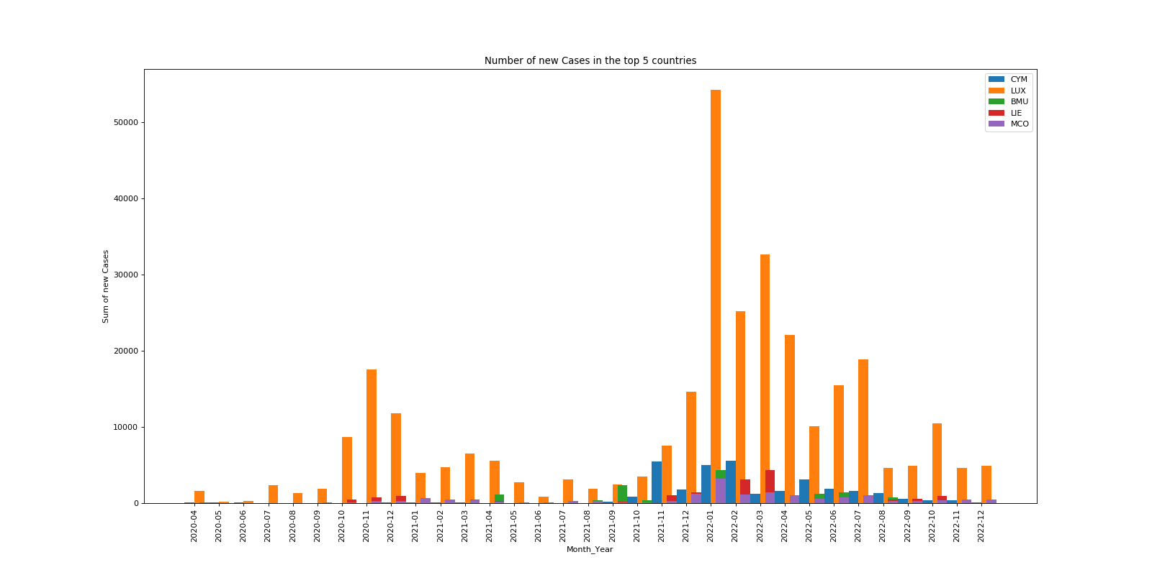
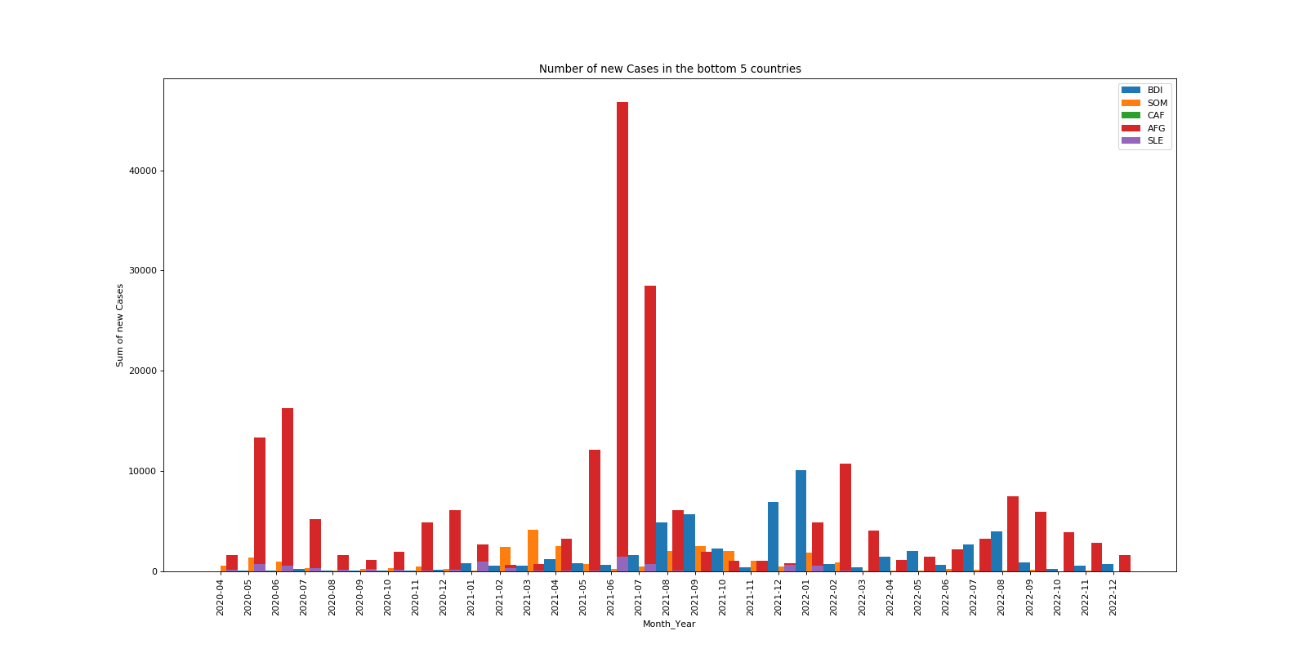
Number of new cases per month
Top vs Bottom Countries (GDP)
The number of new cases on both samples averaged bellow 20000 cases per month.
In the Top 5 Countries, Luxemburg spiked the number of new cases in the first few months of 2022.
While in the Bottom 5 Countries, Afghanistan also saw an increase in case numbers in June and July 2021.

Slide 6
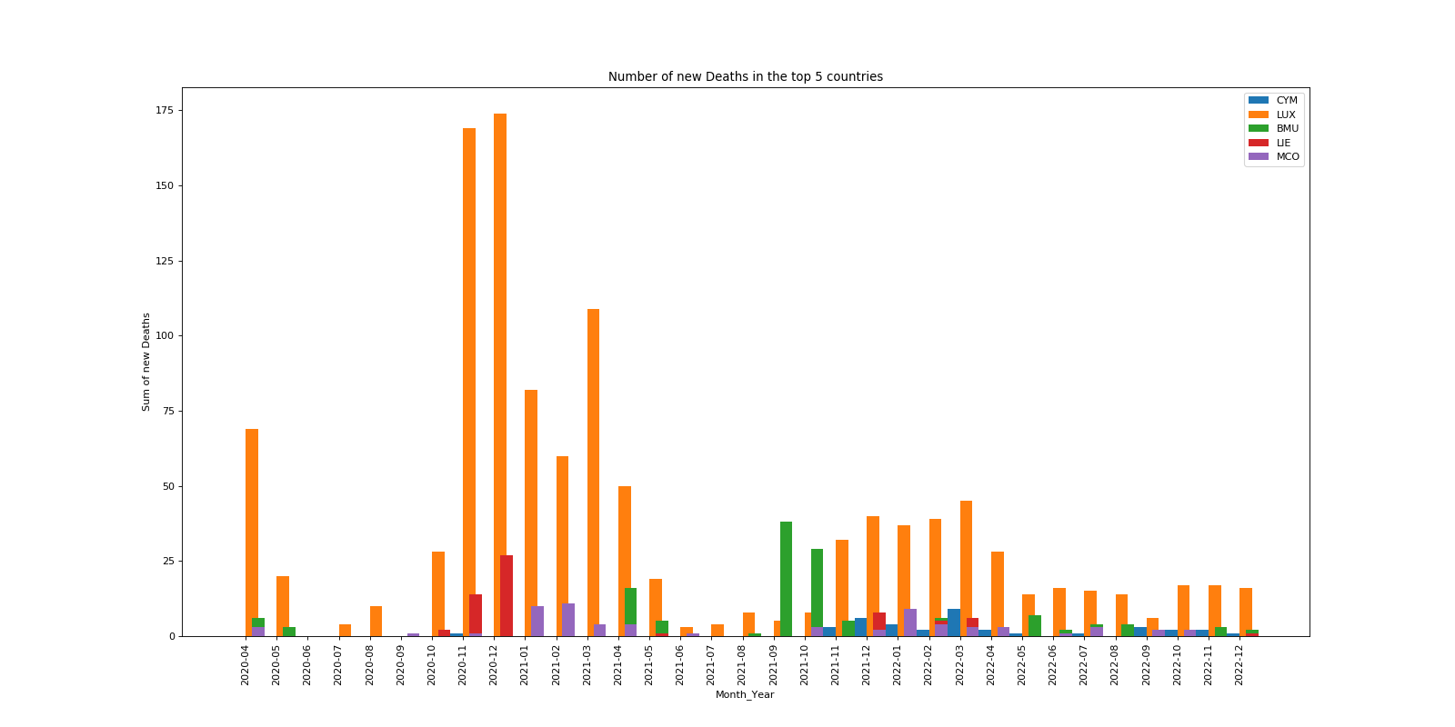
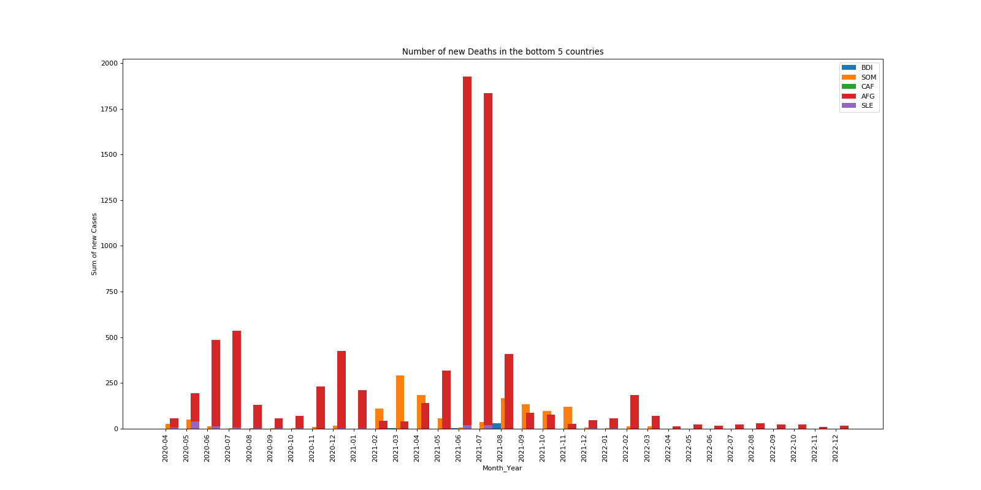
Number of new deaths per month
Top vs Bottom Countries (GDP)
Comparing the number of deaths in both groups, we identify that even though both groups had a similar number of cases of Covid19, the countries with the highest GDP had less deaths than the lowest GDP countries.
In the Top 5 Countries, the death toll averaged below 50 new deaths a month.
While in the Bottom 5 Countries, the death toll averaged below 500 new deaths a month.

Slide 7
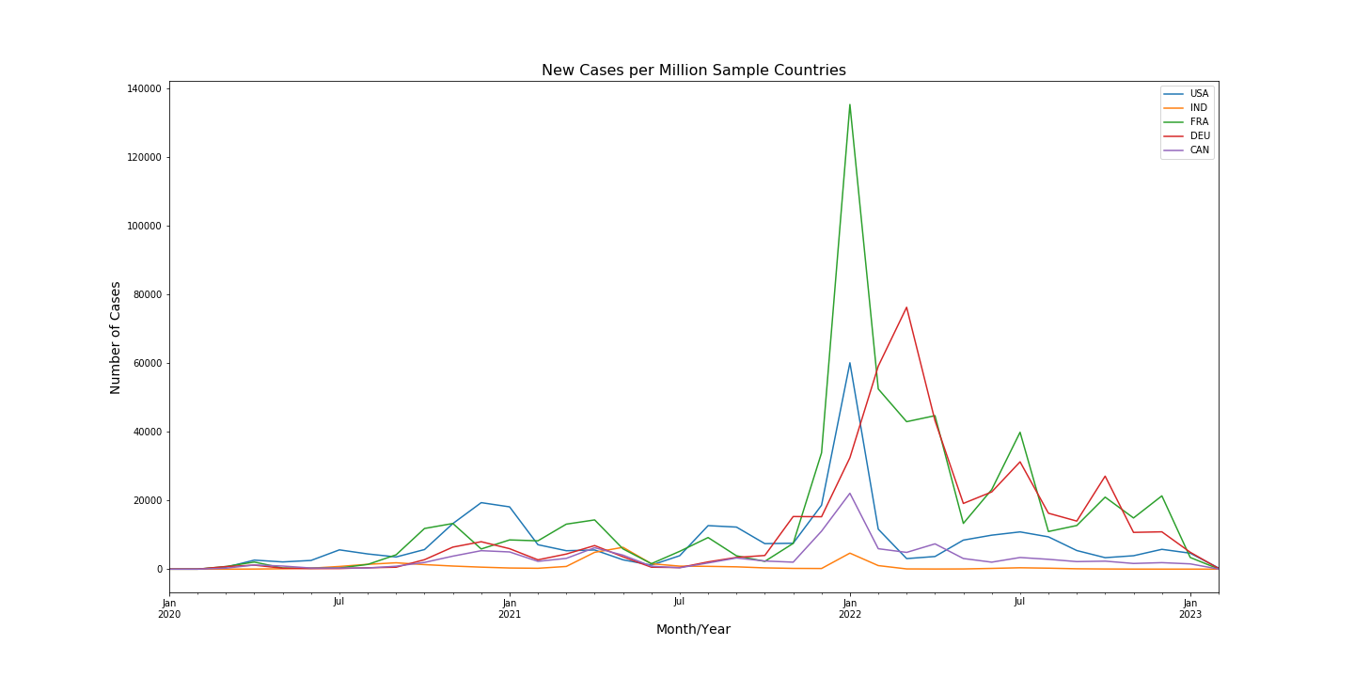
Number of new cases per million in Sample Countries
Sample countries numbers presented a similar pattern throughout the first half of the pandemic, with case numbers averaging below 20000 cases per million per month, with an uptick in the first few months of 2021, due to new variants of concern.
Canada had less cases them the other countries in the sample, and next, we will observe the stringency index of all five countries to understand if Canada’s tight pandemic restrictions have impacted the results.

Slide 8
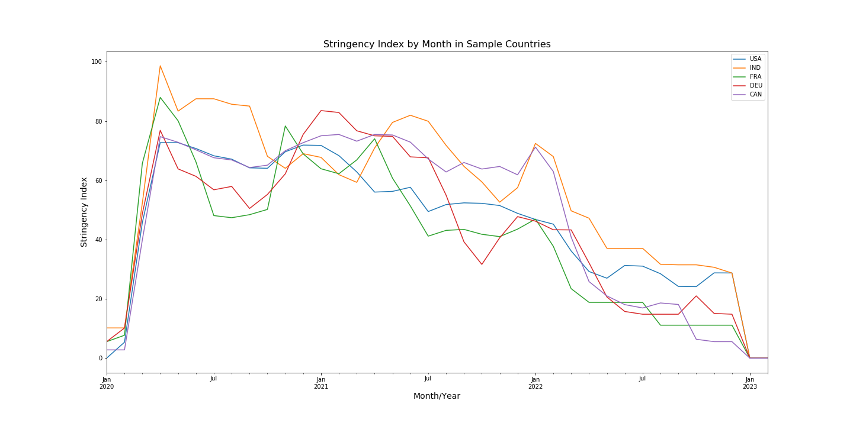
Stringency Index in Sample Countries
Sample countries stringency index also presented a similar pattern throughout the the pandemic, with immediate introduction of strictive measures in the first semester of 2020, ranging index 40 to 80 during most of the period analyzed.
Canada averaged the same index as the other countries in the sample, contrasting to the smaller number of cases.

Slide 9
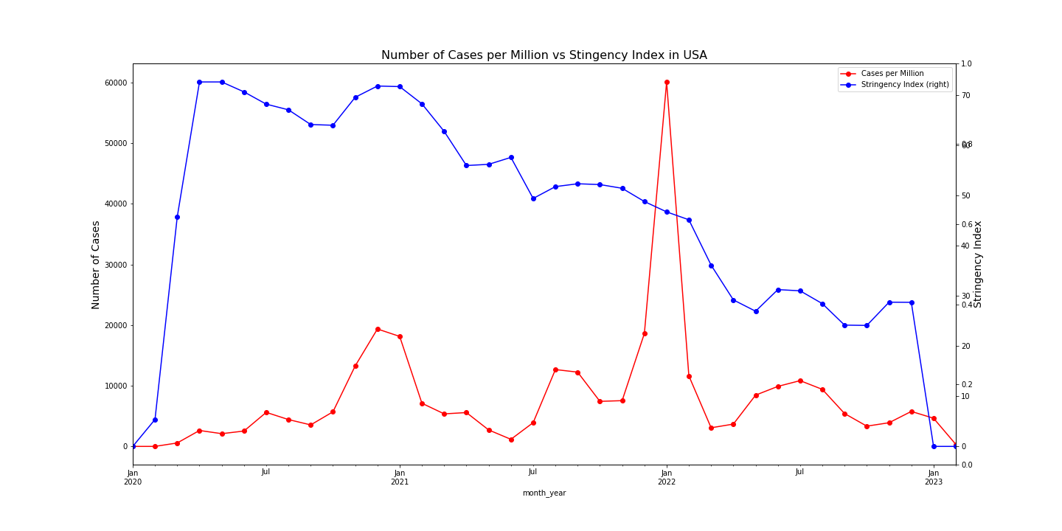
Number of Cases vs Stringency Index in the United States of America
Stringency Index was gradually reduced month by month.
Following an increase in the number of cases at the end of 2020, the stringency index was also increased, coinciding with a decrease in the number of cases.
In January 2022, case numbers spiked again, stringency index did not follow the trend this time, but still the number of cases quickly fell in the next few months.

Slide 10
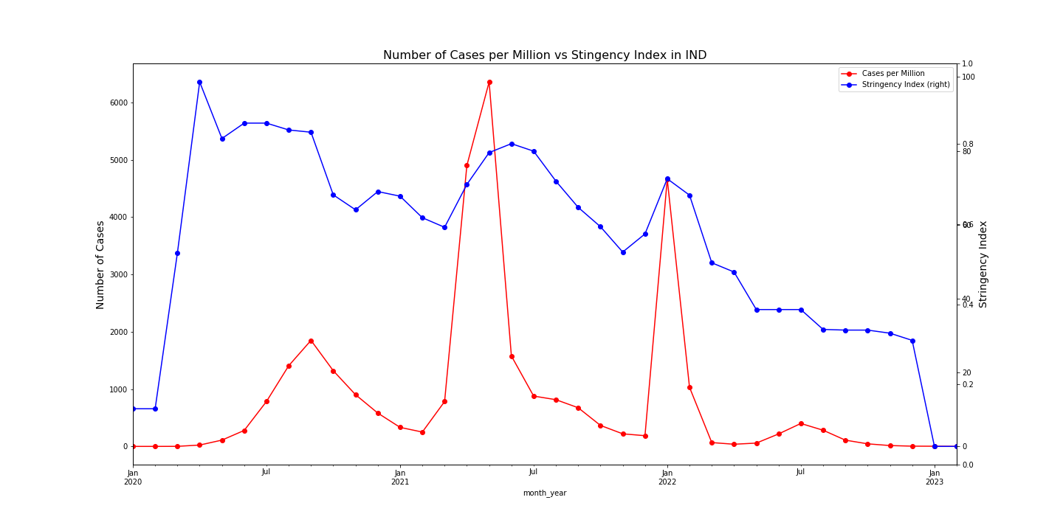
Number of Cases vs Stringency Index in India
Stringency Index was also gradually reduced month by month.
Following an increase in the number of cases in the first semester of 2021 and end right before the beginning of 2022, the stringency index was also increased, coinciding with a decrease in the number of cases.

Slide 11
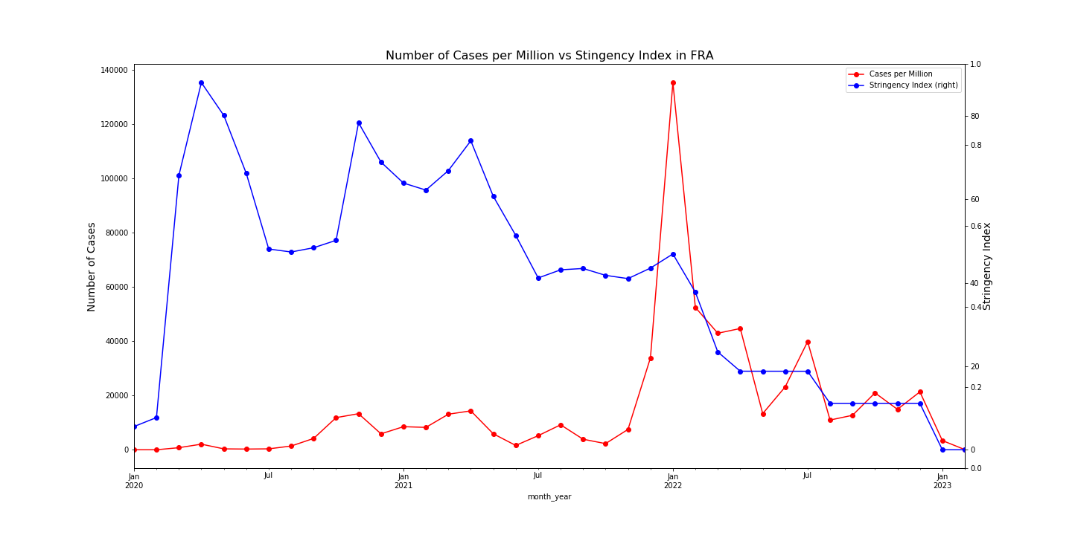
Number of Cases vs Stringency Index in France
Stringency Index stayed high in the first half of the pandemic.
Even with an increase in the number of cases in the end of 2021, the stringency index started to drop on early 2022, and the number of cases dropped either way.

Slide 12
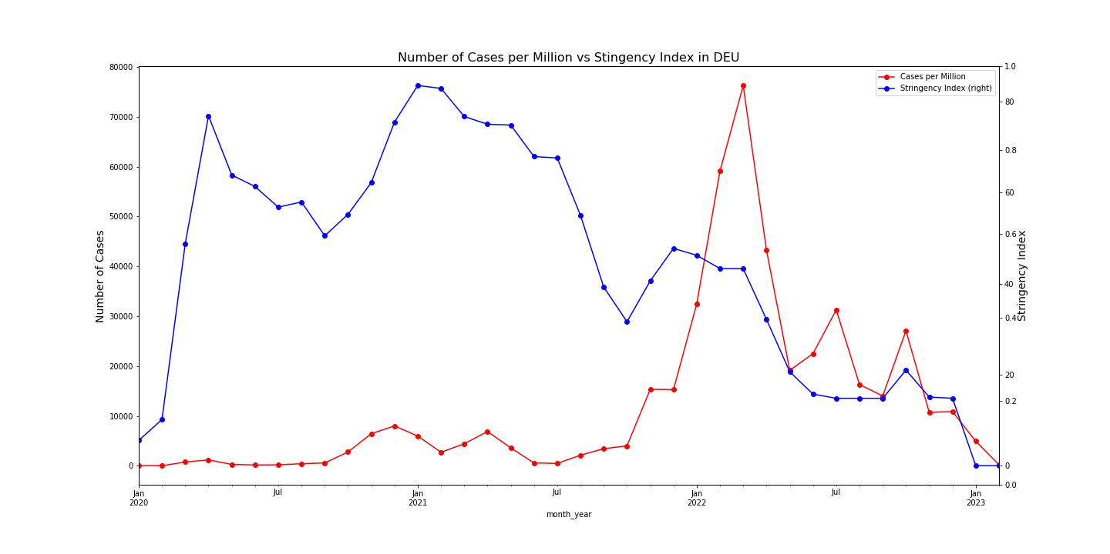
Number of Cases vs Stringency Index in Germany
Like France, the Stringency Index stayed high in the first half of the pandemic.
After the index started to drop, there was a spike in the number case, slightly bumping the index up, bringing the cases down.

Slide 13
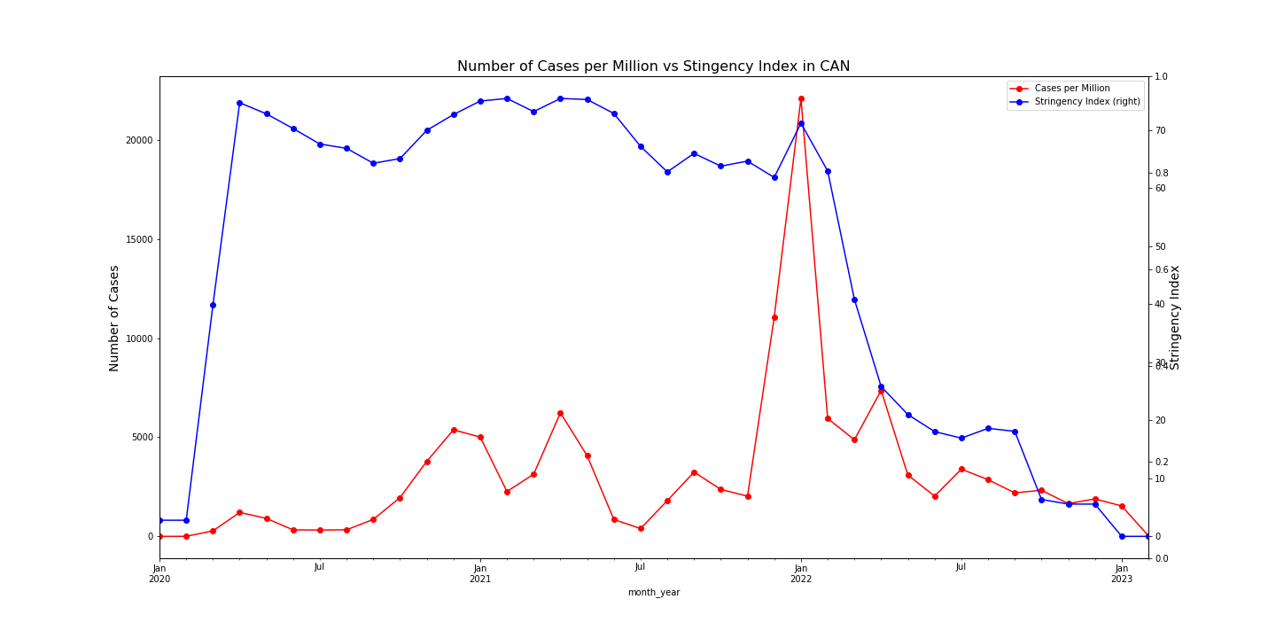
Number of Cases vs Stringency Index in Canada
Canada’s Stringency Index stayed high throughout most of the pandemic, slightly going up and down following the trend of cases.
After the general uptick experienced in early 2022 by all countries in the sample, the stringency index was progressively decreased.

Slide 14
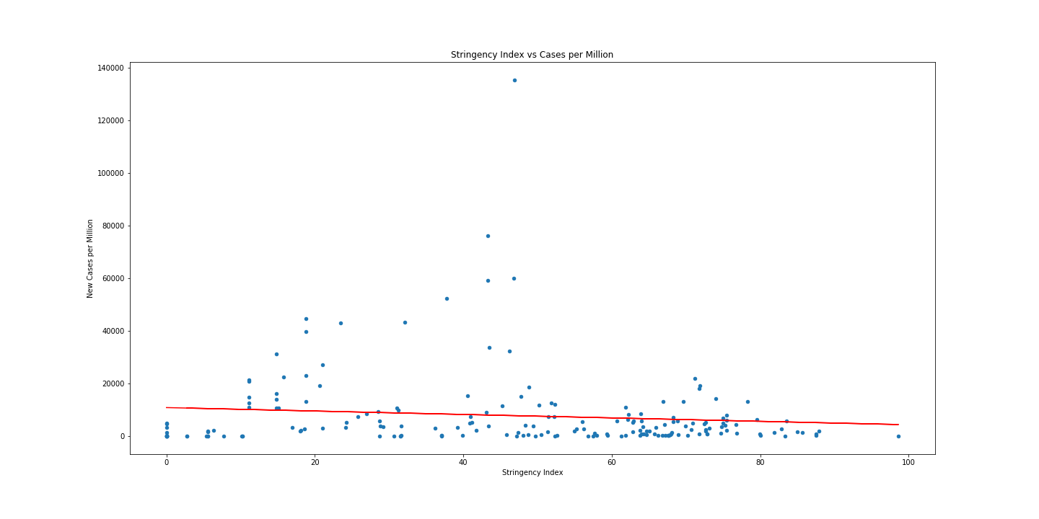
The correlation between stringency index and the total of new cases per million is -0.11
There is a weak negative correlation between stringency index and total of new cases,
indicating that the trends moving in the opposite direction of their mean is not likely.

Slide 15
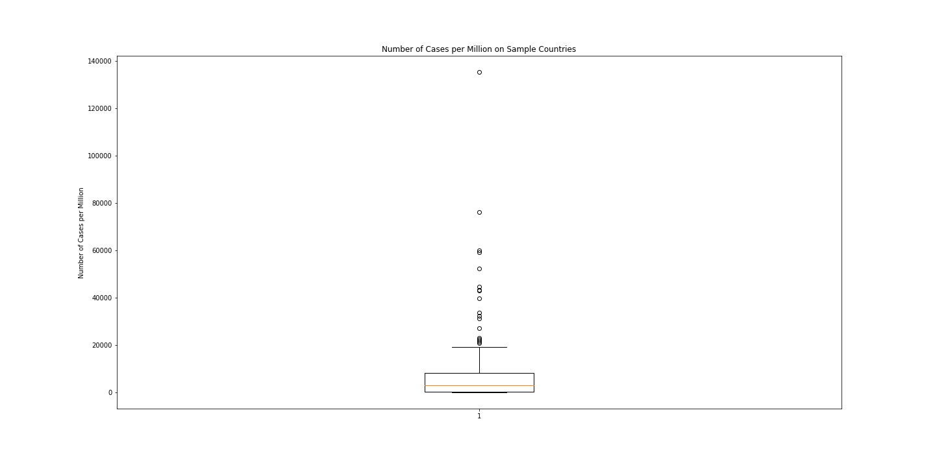
Number of Cases per Million on Sample Countries
The lower quartile of new cases per million is: 487.91575
The upper quartile of new cases per million is: 8183.06725
The interquartile range of new cases per million is: 7695.1515
The median of new cases per million is: 3083.772
Values below -11054.8115 could be outliers.
Values above 19725.7945 could be outliers.

Slide 16
Hypothesis Testing
Does having a higher GDP impacted the number of deaths?
Using the sum of new deaths on top and bottom GDP countries, with
PVALUE: 0.004785686708112386, it is confirmed the Alternate Hypothesis that the GDP of a country has an impact on the number of Covid deaths.
Does having a higher Stringency Index impacted the number of cases?
Using the Stringency Index of two countries in the sample group, with
PVALUE: 0.00010234781408566989, it is confirmed the Alternate Hypothesis - The Stringency Index of a country has impact the number of Covid cases.

Slide 17
Resources:
Important DataFrames and files:
- owid-covid-data.csv: This file located in the folder resources contains all the COVID Data downloaded from https://github.com/owid/covid-19-data/tree/master/public/data "> Our World in Data
- clean_covid_data: Contains only the columns we thing we need from the covid data source csv file
- clean_covid_data_no_date: Similar to clean_covid_data. The Date in this DF now is group by Month and Year and by Country
- df_clean_data:
- gdp_by_year: Iso of the countries and GDP for 2019, 2020, 221
- covid_and_gdp: Contains a merge between gdp_by_year, df_clean_data on the ISO country
- wbdata: pulls GDP per capita data from world bank

Slide 18
Dependencies:
Libraries and datasets:
pandas
requests
time
matplotlib
wbdata
datetime
numpy
scipy.stats

