Slide 1
CENG 483
Behavioral Robotics
Final Presentation
Project Title
Group 10
Fall 2025
Izmir Institute of Technology

Slide 2
Outline
Meet the team
Overview of the Project
Specifications(H/s, S/w, tools, apps, etc.)
Evaluation
Business Opportunities
Conclusion
Demonstration

Slide 3
Team
Canberk Yılmaz 300201027
  Robotic Vision, System Architecture
Vagif Aliyev 300201131
  Research, Integration
Kaan Cesur 290201066
  Research, Inverse Kinematics
Emir Efe Ulusoy 300201103
  Mechanical Design, Motion Control
Notes:
2 slides

Slide 4
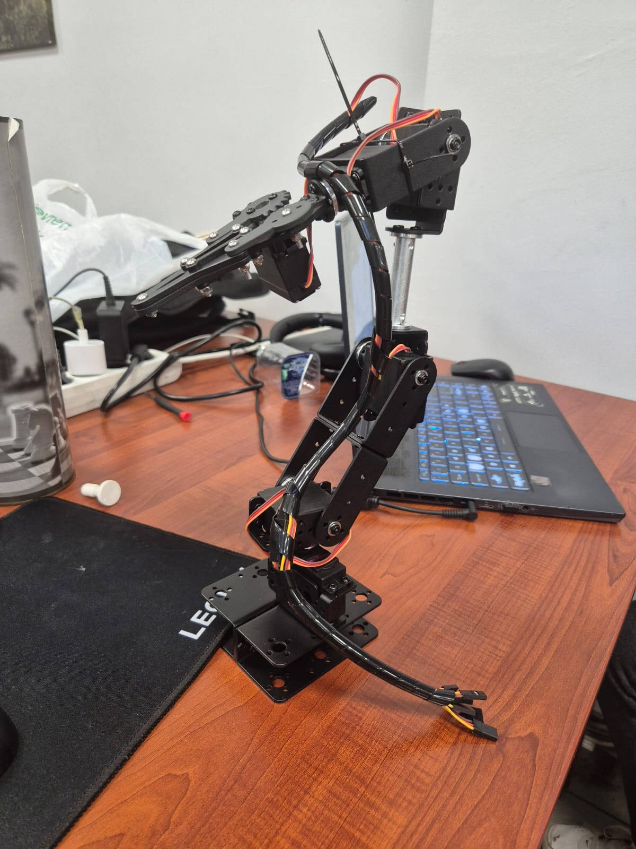
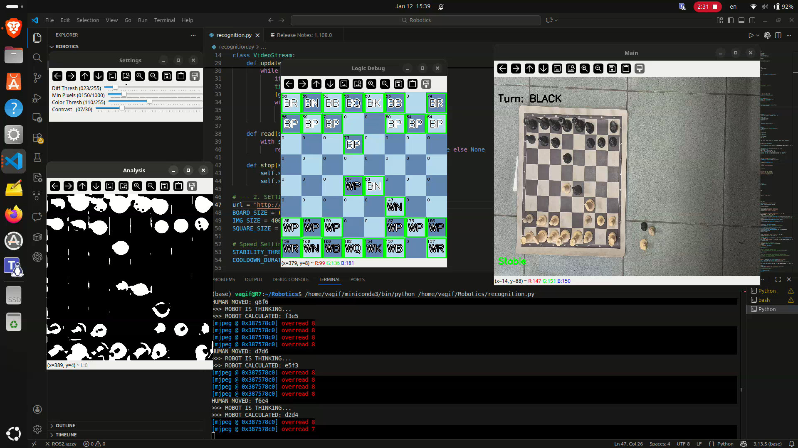
Overview of the Project
Introduction
To play a game of chess, the robot must master three distinct domains:
Computer Vision (The Eyes): A camera system detects the board state and identifies piece locations using image processing algorithms.
The Engine (The Brain): The system processes the board state and uses a chess engine to calculate the winning move.
Kinematics (The Muscles): The robotic arm calculates the precise coordinates (x,y,z) and joint angles required to pick and place the piece without disturbing others.
Notes:
1 slide

Slide 5
Overview of the Project
Problem Definition
The Problem: Most powerful Chess Engines (like Stockfish) exist only on screens. They lack the humane element of moving physical pieces.
The Solution: An autonomous robotic system capable of imagining a physical chessboard, calculating optimal moves, and executing them with human like dexterity.
The Goal: To create a seamless loop between seeing, thinking, and acting.
Notes:
1 slide

Slide 6
Overview of the Project
Challenges
Precision: Moving within millimeter accuracy to ensure pieces are centered on squares and not dropping other chess pieces.
Environmental Factors: Shadows cast by the robotic arm(self-occlusion problem) and environmental light interfering with piece detection.
Power Distribution: Managing high current draws during simultaneous servo actuation.
Mechanical Oscillation: Upright arm design caused "jerks" during movement.
Notes:
1 slide

Slide 7
Overview of the Project
Solutions
Kinematics: Custom Python based IK solver utilizing the Law of Cosines.
HSV Thresholding: The system transitioned to HSV color thresholding to distinguish between physical chess pieces and dynamic shadows cast by the robotic arm.
Serial Handshake: A PING/PONG handshake protocol ensures connection stability before high current movements are attempted.
Linear Interpolation: Developed a smoothMove firmware function that divides travel into discrete steps rather than jumping instantly between angles.
Notes:
1 slide

Slide 8
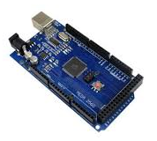

Specifications
Tools
IDE: Visual Studio Code / Arduino IDE
Libraries: NumPy (for math), PySerial (for communication),
OpenCV(for robotic vision)
Power Supply: Digital Laboratory Power supply
Hardware
Microcontroller: Arduino Mega 2560
Manipulator: 5-DOF Robotic Arm (Five Degrees of Freedom)
Vision Sensor: Mobile Phone cam
Actuators: Servo Motors
Software
Programming Language: Python 3.8+, C++
Computer Vision: OpenCV (Open Source Computer Vision Library)
Motion Control: Inverse Kinematics Algorithms
Game Logic: Chess Engine Integration (e.g., Stockfish)
Picture of H/w and tools
Logos of s/w and apps
Notes:
1 slide

Slide 9
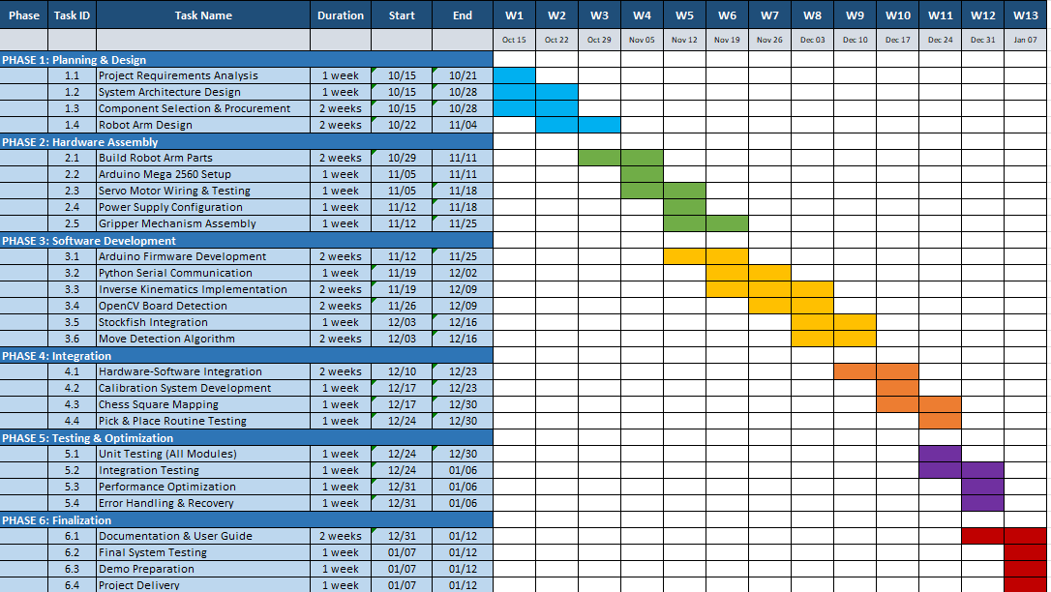
Evaluation
Gantt Chart
Notes:
1 slide

Slide 10
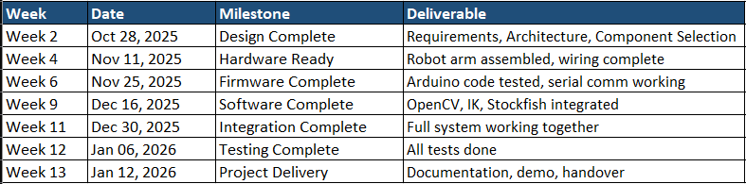
Evaluation
Timeline
Notes:
1 to 2 slides

Slide 11
Evaluation
Final Product
Computer Vision & AI (Fully Functional)
Real-time chessboard detection and calibration
Accurate piece position recognition
Move detection and validation
AI-powered move suggestions via Stockfish engine
Robotic Arm (Partially Complete)
Hardware assembled and Arduino communication established
Inverse kinematics calibration incomplete due to time and resource constraints
Autonomous piece movement not achieved
Current System Capability
The software successfully observes chess games, identifies piece positions, and suggests optimal moves. The robotic arm framework is in place but requires additional development for physical piece manipulation.
Notes:
1 slide

Slide 12
Business Opportunities
Review
1. Automated Magnetic Boards
Advantages: Sleek design; pieces move "magically" without an arm.
Drawbacks: High cost ($300+); closed system (hard to repair or reprogram); limited educational value.
2. Industrial Robotic Arms
Advantages: Extremely high precision and speed.
Drawbacks: Prohibitively expensive for home use; complex safety requirements; requires specialized middleware.
Notes:
1 slide

Slide 13
Business Opportunities
Comparison
Our Approach:
A "Brain-on-PC" system using a standard webcam and low-cost robotic arm
Why did you propose this project?
Rapid Prototyping Platform: A lightweight Python framework that replaces complex middleware, allowing for faster modification and algorithm testing.
Cost Efficiency: Offloading processing to a PC and using generic hardware drastically reduces the price point compared to embedded systems.
Open Customization: The Python-centric architecture allows developers to easily modify the AI or vision algorithms
Notes:
1 slide

Slide 14
Conclusion
Successes: Streamlined Python centric architecture and robust robotic vision.
Critical Failure: A current spike during simultaneous servo actuation caused a thermal burnout of the base and shoulder servos.
Impact: The project scope was pivoted to prioritize perception optimization and safety protocols.
Notes:
1 to 2 slides

Slide 15
Demonstration

