Slide 1
Drone Technology
Stephen Dade
CanberraUAV

Slide 2

CanberraUAV
CUAV is a volunteer group centered around the R&D of civilian Unmanned Aerial Vehicles (UAVs)
Emphasis on R&D, education, collaboration
Purpose is to advance the civilian UAV industry and the benefits of UAV's
Collaboration with other organisations around the world
Open source approach.
Notes:
Outline what is meant by a UAV – military > civilian evolution
Outline benefits of taking an open source approach – contrast with closed source (i.e. open source encourages creativity, innovation, promotes deeper learning).

Slide 3
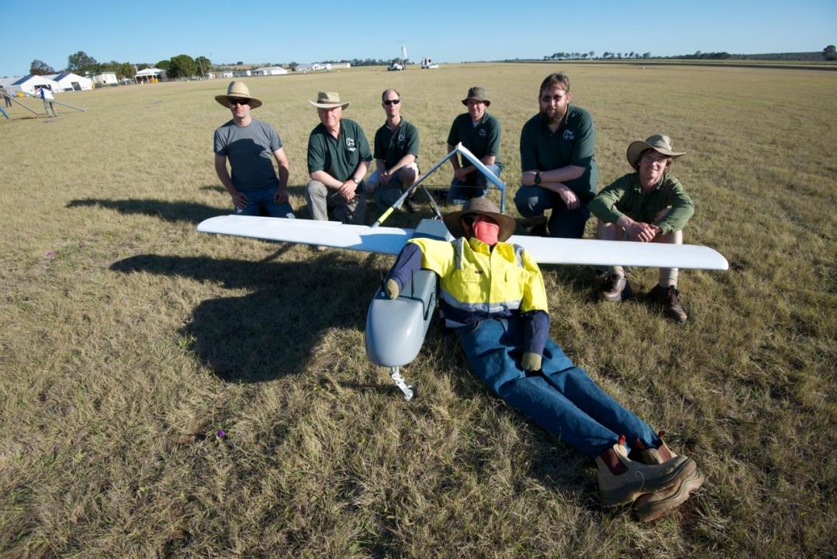
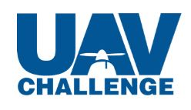
UAV Challenge
CUAV was originally formed to compete in the 2012 UAV Challenge
The UAV Challenge is an international competition held every 2 years - organised by QUT & CSIRO
Challenged civilian teams to design, build and operate a UAV capable of finding a missing bushwalker and drop a bottle of water to them.

Slide 4
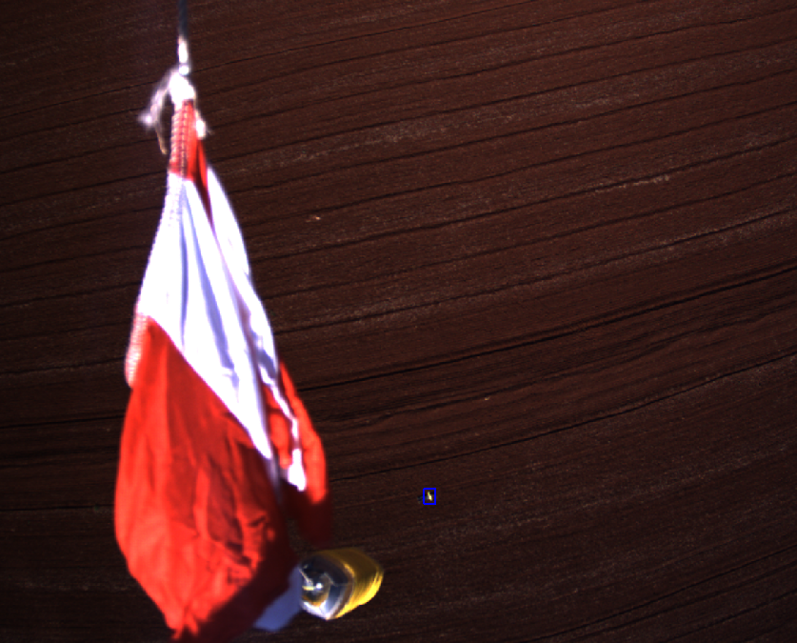
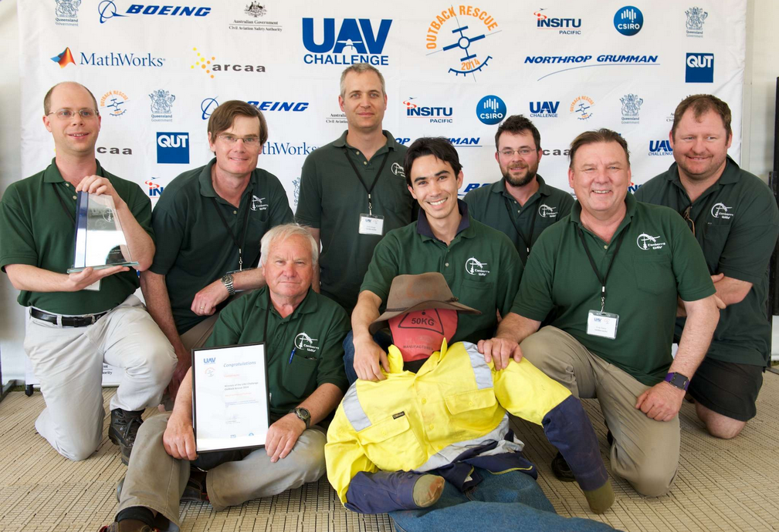
2014 UAV Challenge
CUAV entered again in 2014 and won the first place prize of $50,000
Proved the potential for autonomous aircraft in search & rescue (and other) applications.

Slide 5
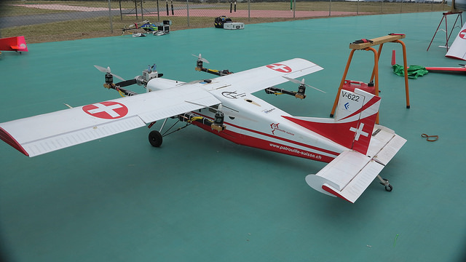
2016 UAV Challenge
The 2016 competition, the Medical Express, presents new challenges to teams
It requires competitors to first locate the lost bushwalker then land safely, accept a small package and return to base.

Slide 6
Team Composition
Software engineers
Communications engineers
Both radio controlled & full scale aircraft pilots
Public servants and photographers
New industry - no team members had formal training or a knowledge base in UAV technology and are all self taught
Some members have gone on to get certification from the Civil Aviation Safety Authority allowing them to operate commercially.

Slide 7
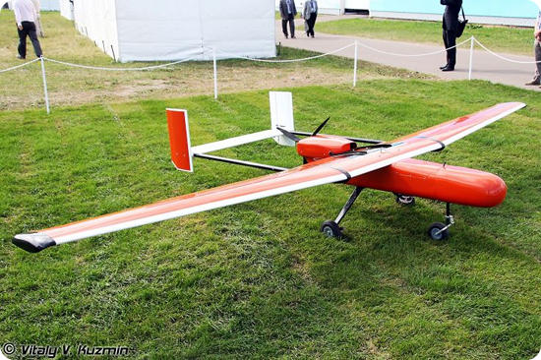
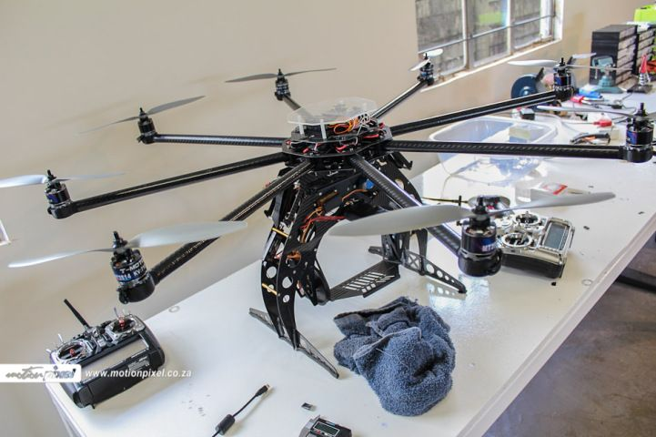
UAV Technology
Based on miniaturisation of electronics driven by mobile phones
Recent developments in battery technology make small drones practical and economical

Slide 8
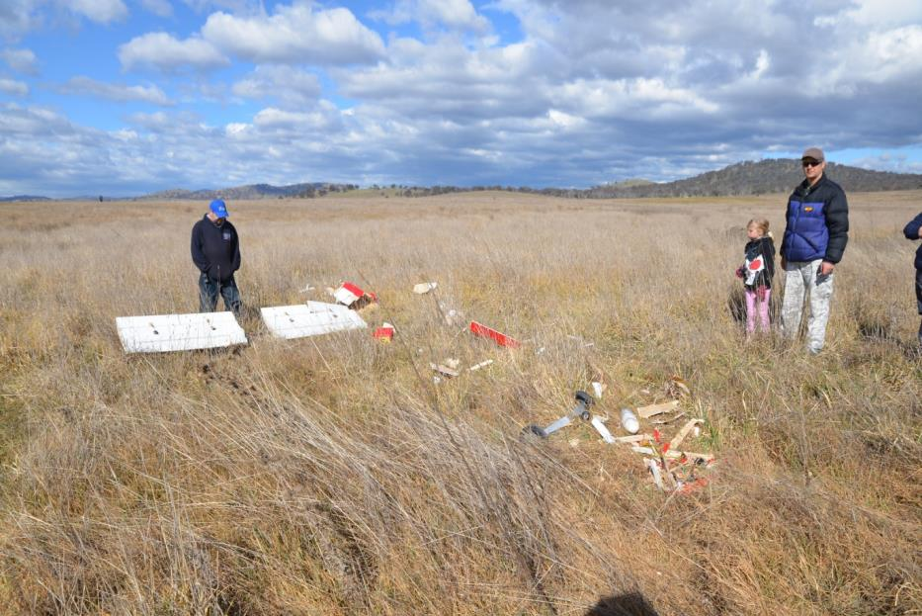
UAV Technology
Current Challenges include
Reliability of hardware and software
Automation to make it easier for pilot
Data processing and management

Slide 9
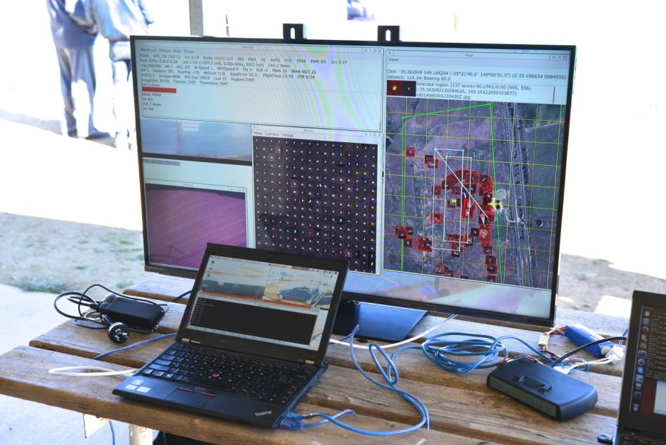
UAV Technology
Trends for the next 2 to 3 years
Fast moving industry with constant innovation
Consolidation of market by major players
Data processing and accessory software
Less DIY, more plug-n-play
More use by corporations and large businesses

Slide 10
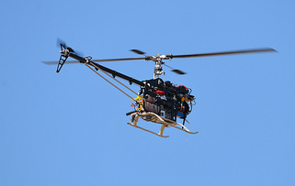
Q&A Time

