Slide 1

CanberraUAV
Stephen Dade
August 2016

Slide 2
UAV’s in General
Unmanned Aerial Vehicle (UAV)
Unmanned Aerial System (UAS)
Drone
Remotely Piloted Aircraft(RPA)

Slide 3

UAV’s in General
Recent advances in battery and embedded computing have made small and cheap UAV’s practical

Slide 4
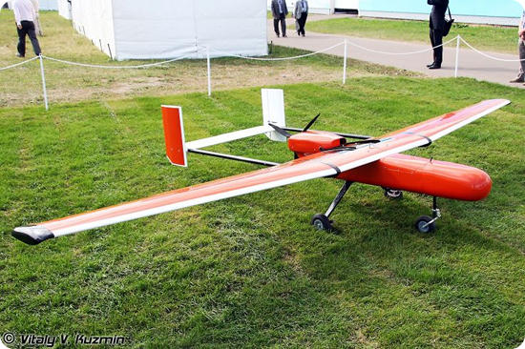
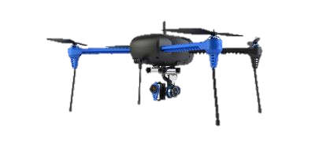
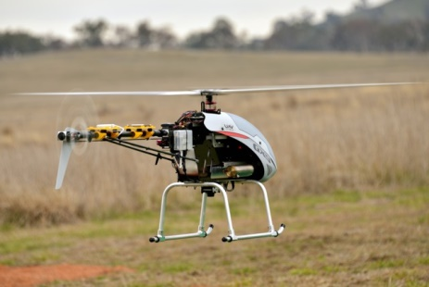
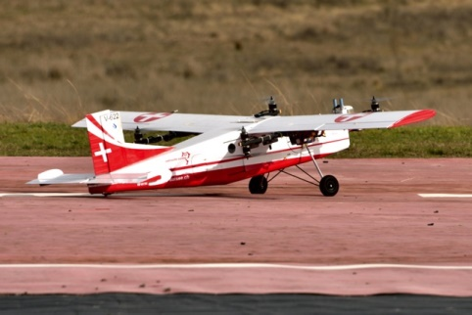
UAV’s in General
Can be
Fixed Wing
Helicopter
Multirotor
Quadplane

Slide 5
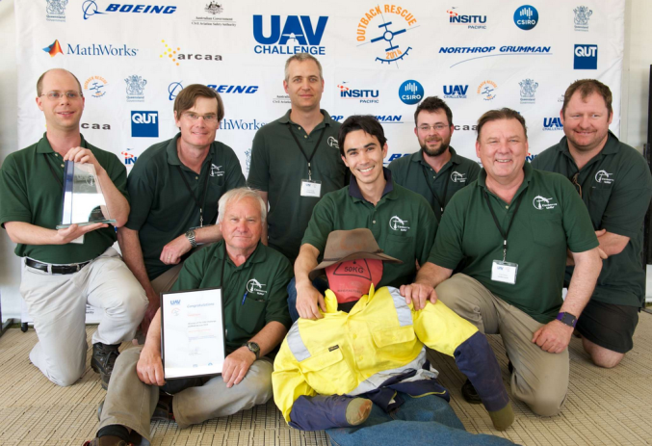
CanberraUAV
Volunteer group
Emphasis on R&D, education, collaboration
Originally formed to compete in the 2012 Outback UAV Challenge
Collaboration with other organisations around the world

Slide 6

UAV Challenge 2014
The UAV Challenge required teams to design, build and operate a UAV capable of finding a missing bushwalker and drop a bottle of water to them
$50,000 first place prize
116 teams (2014) from around the world

Slide 7
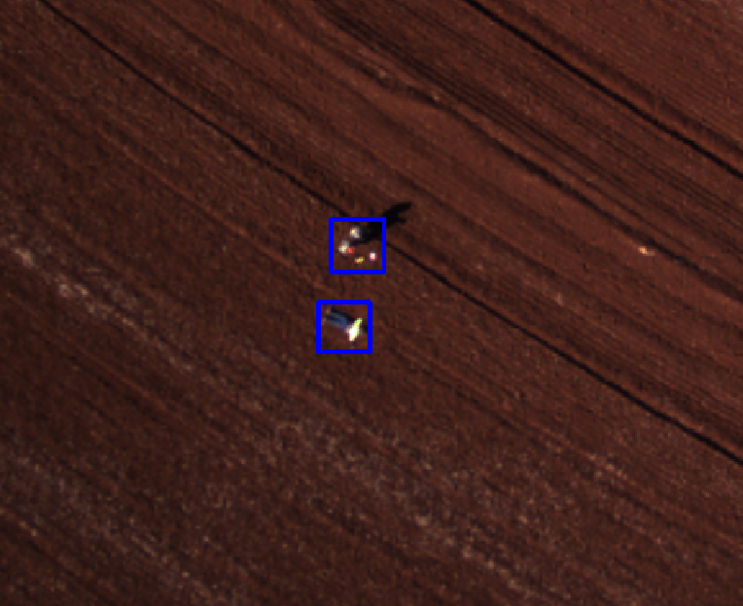
UAV Challenge 2014

Slide 8
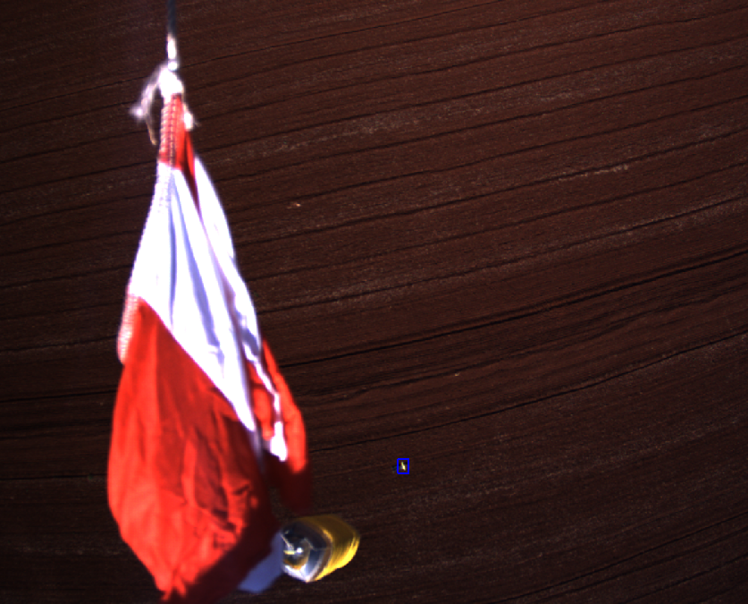
UAV Challenge 2014

Slide 9
UAV Challenge 2016
For 2016, the competition is now more difficult
Vertical takeoff and landing
Must be able to land safely near a person, and take off again
20teams currently in the competition
Past 20 months spent evaluating airframes
Currently fitting out final electronics

Slide 10
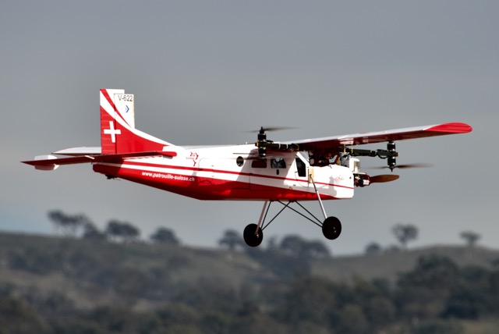
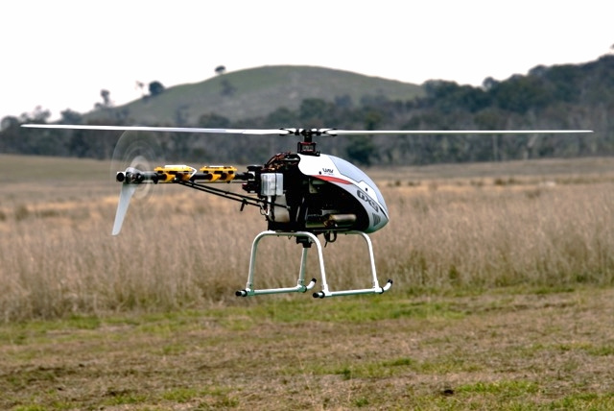
UAV Challenge 2016

Slide 11
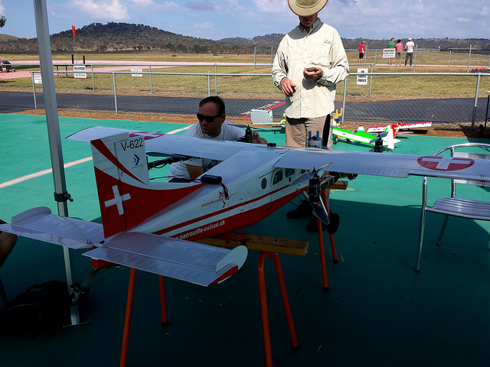
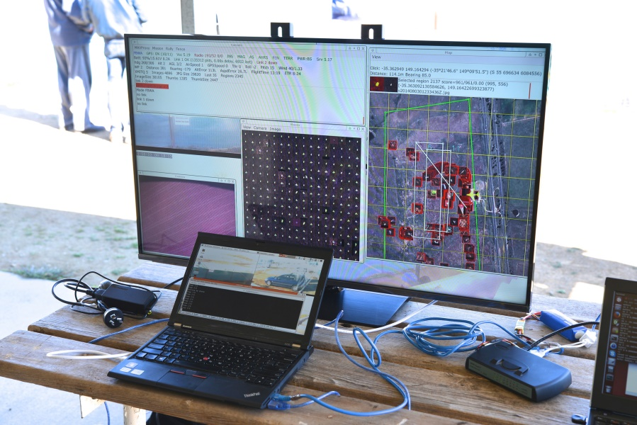
UAV Challenge 2016

Slide 12
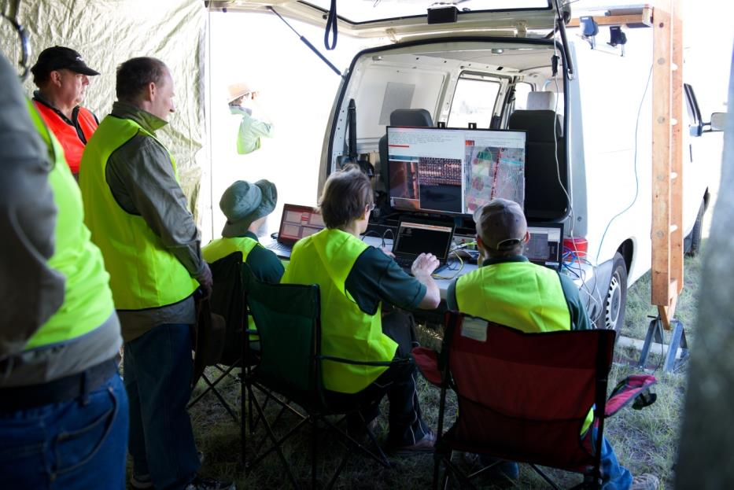
Other things we do
Local and international collaboration
Education
Open-source software

Slide 13
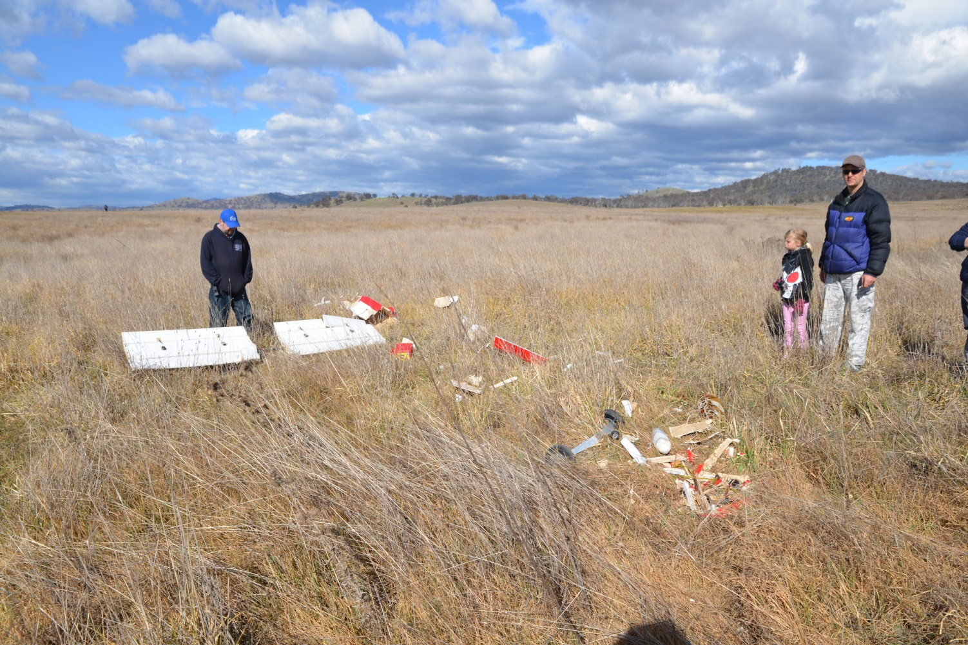
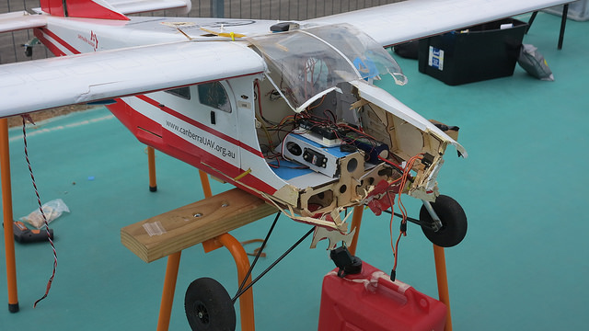
Other things we do

Slide 14
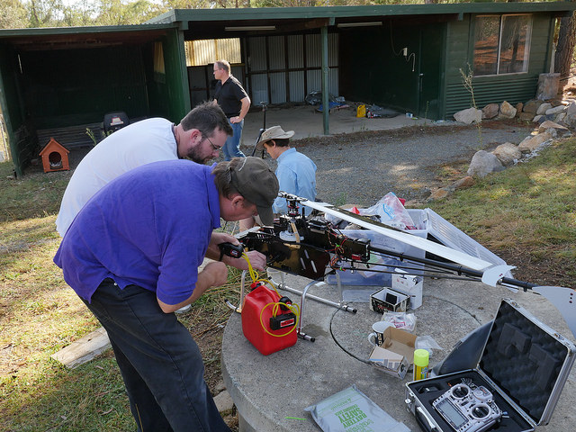
The End!

