Slide 1

Belconnen SES presentation
Andrew Tridgell
CanberraUAV

Slide 2
Who is CanberraUAV?
A Canberra based non-profit
  Dedicated to research and development of open source civilian UAV technology
  Started as a team for the 2012 Outback Challenge
  Ten volunteer members, with diverse backgrounds
  Not a commercial UAS provider

Slide 3
Why are we talking to the SES?
We would like to:
  learn more about how UAVs could help with real life S&R missions
  work out if we could usefully contribute to SES activities
  if we can contribute, work out what sort of airframe and capabilities would be most useful

Slide 4
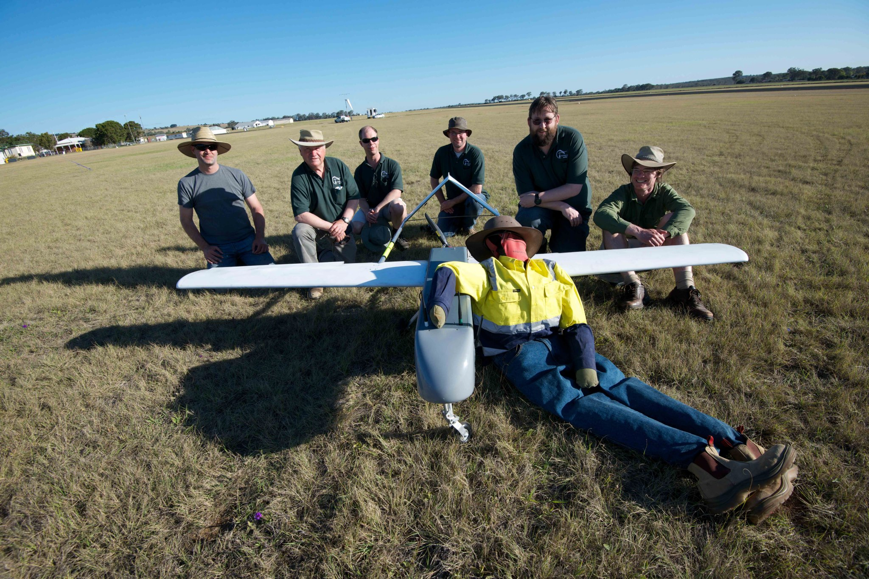
Outback Challenge 2012

Slide 5
Our OBC UAV
A medium range UAV for S&R
  based on 'Mugin' airframe with 50cc petrol engine
  around 17kg takeoff weight
  range of around 120km
  on-board stabilised S&R imaging system
  fully autonomous missions
  automatic search and target recognition
  two ground station comms systems (915Mhz and 5.8GHz)
  needs 120m runway for takeoff/landing

Slide 6
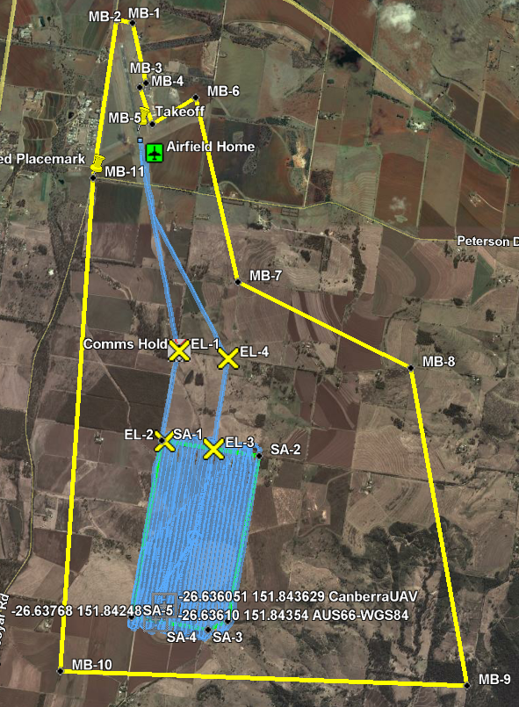
OBC 2012
  one hour limit
  find 'Joe' lost walker
  drop water bottle
  autonomous flight
  auto search
  auto takeoff
  auto land
  strict safety rules

Slide 7
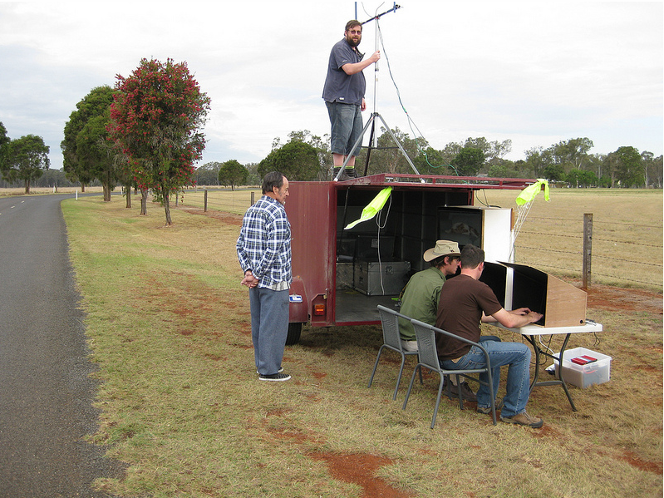
Ground station

Slide 8
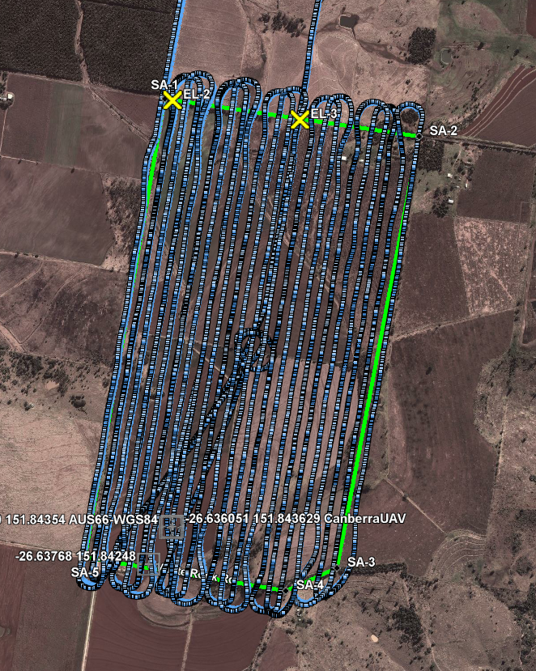
Competition flight
  flew for 52 minutes
  all but 10s in automatic
  found Joe after 31 min
  coped well with 50km/h winds

Slide 9
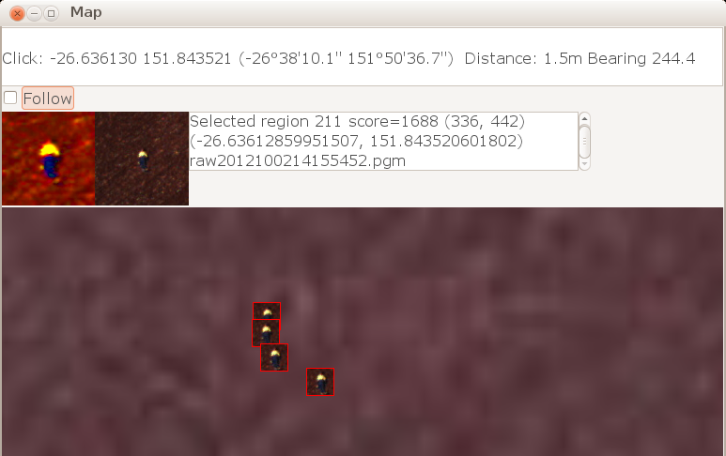
Imaging system

Slide 10
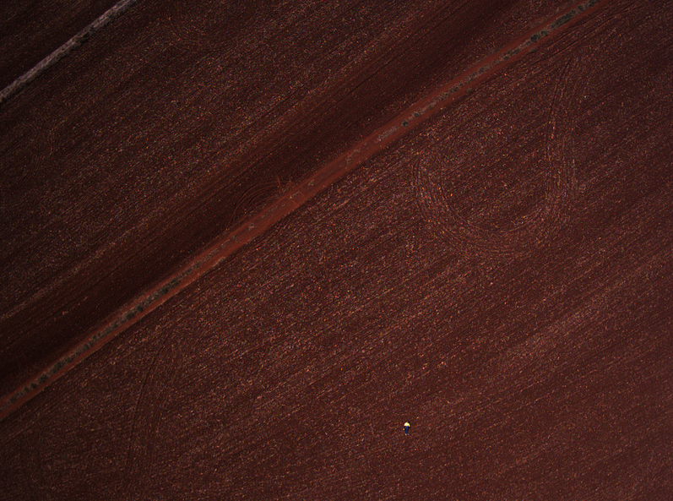
Joe from the air

Slide 11
Challenges for real S&R
OBC was great, but ….
  'Joe' was 10km from an airport with runway available for takeoff/landing
  Joe was on open ground, and wore bright clothing
  Search area was only 2.5 square kilometers
  terrain was fairly flat (height change of 60m over area)
  search area was known weeks in advance, allowing for extensive search preparation

Slide 12
Real S&R continued...
New challenge is to develop a real S&R system
  What endurance and range is needed?
  What search area needs to be covered?
  What sort of terrain?
  What imaging capabilities are needed?
  What launch and recovery options are practical?
  What communications capabilities are needed?
  What transport options are possible?

Slide 13
Some thoughts to discuss
Some of the things we are considering
  Do we need IR imaging?
  Do we need realtime images? Or return to launch and post-processing?
  Do we aim for car boot sized, or trailer sized?
  Is slow and high for a long time better? Or low and fast for shorter times?
  Does engine technology matter? (petrol, electric etc and fire risks)
  Do we need to be able to fly at night?
  How will we address safety and insurance concerns?

Slide 14

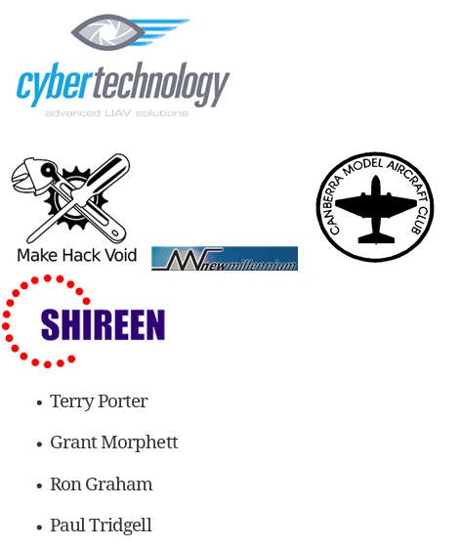
Thanks to our sponsors!

