Slide 1

UAV Challenge
June 2017

Slide 2
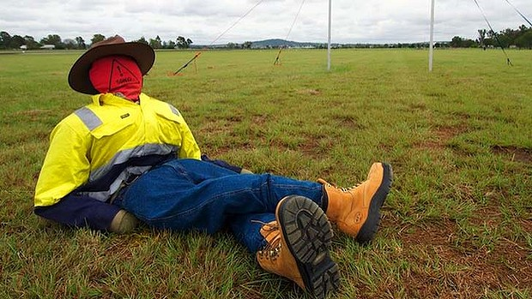

What is the UAV Challenge?
Find a missing Bushwalker
Collect a blood sample
Return to base

Slide 3
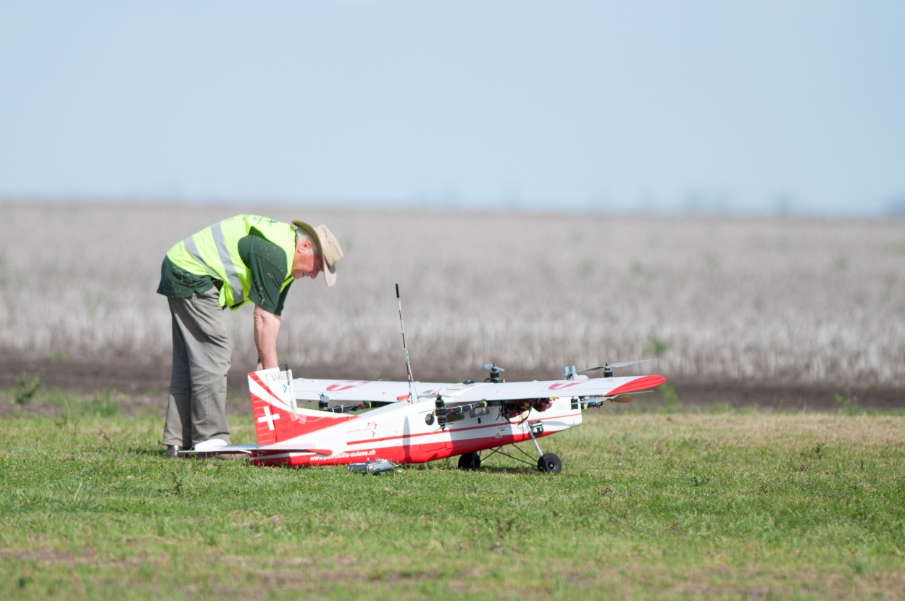
What is the UAV Challenge?

Slide 4
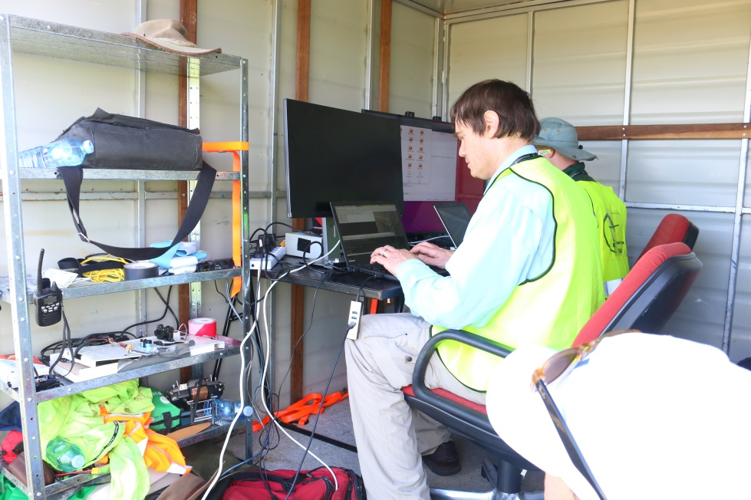
What is the UAV Challenge?
Many technical challenges
Airframe
Flight Controller
Imaging
Communications

Slide 5
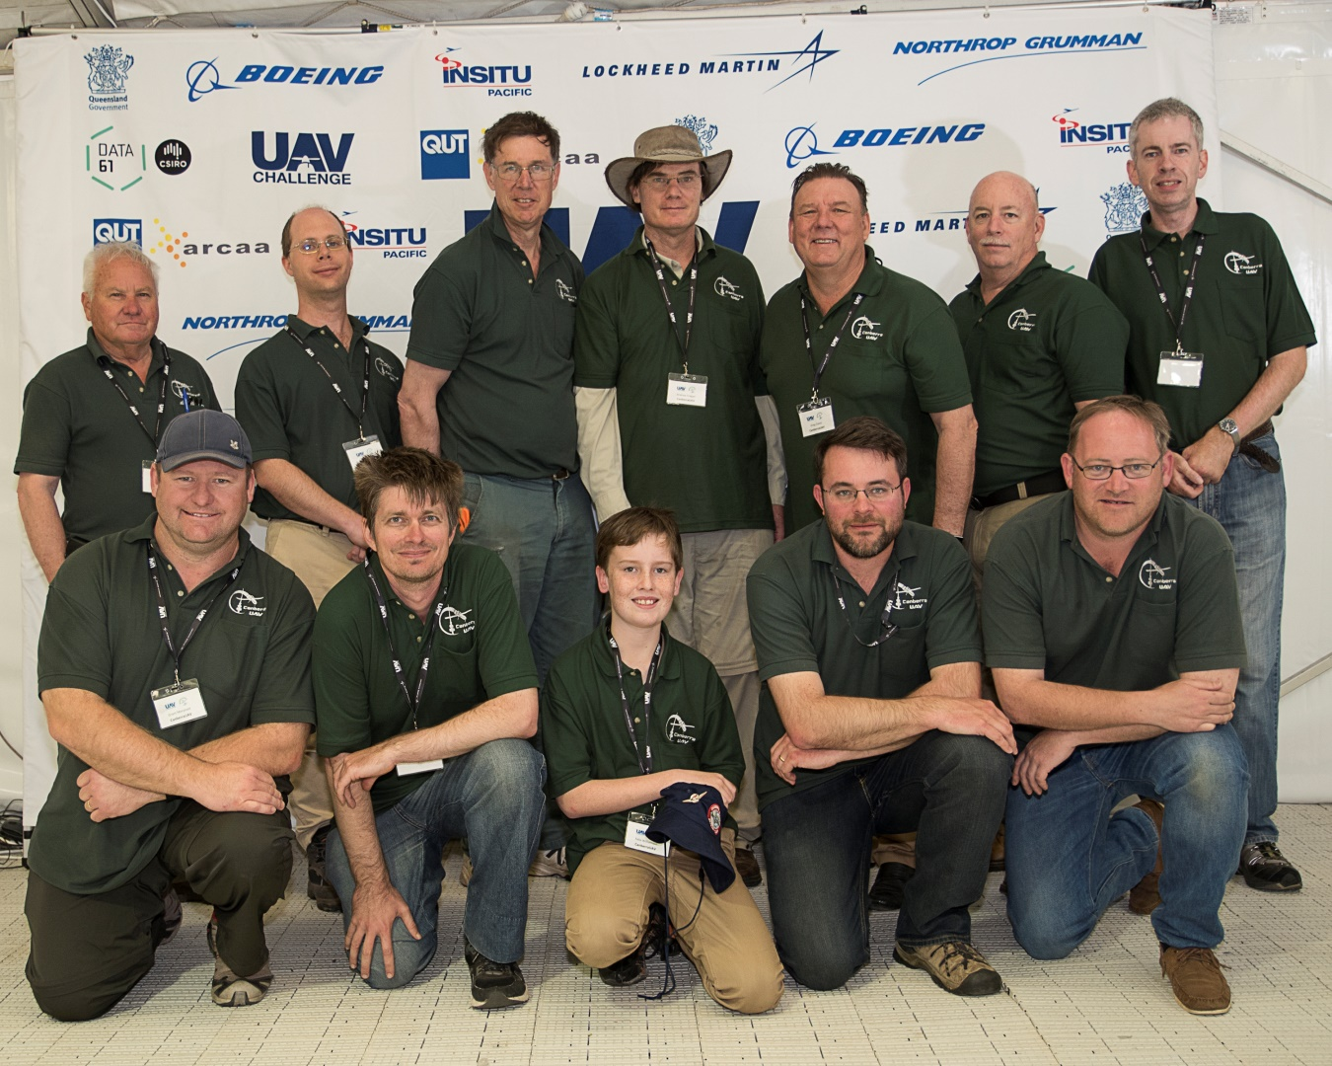
2016 UAV Challenge

Slide 6
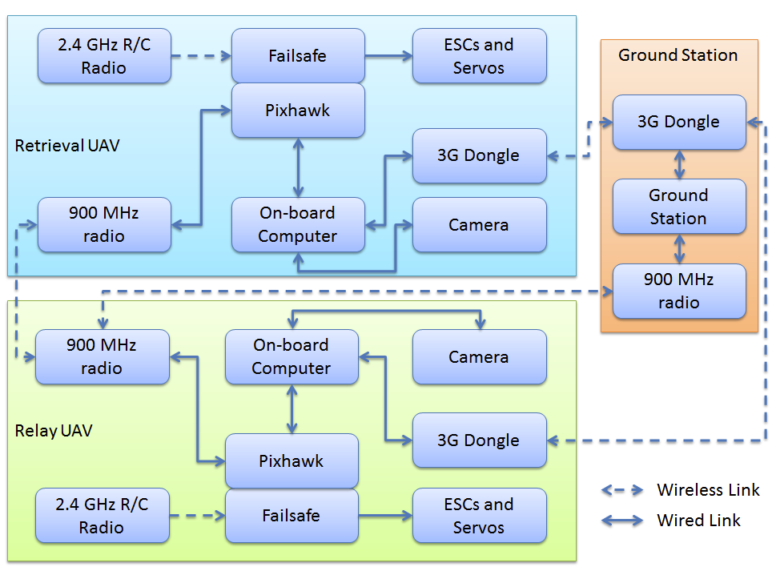
Designing UAV’s

Slide 7
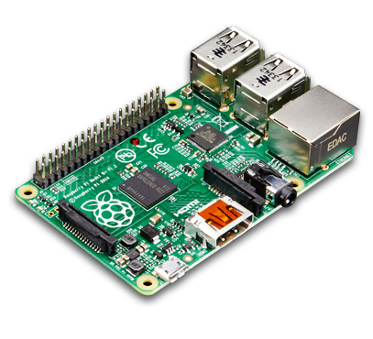
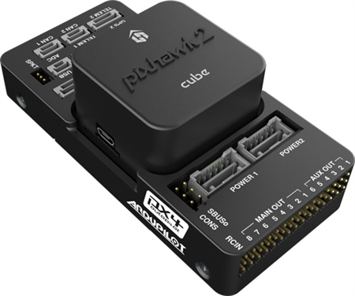
Designing UAV’s
Start small and simple
Ground testing if possible
Keep to a schedule
Don’t forget integration!

Slide 8
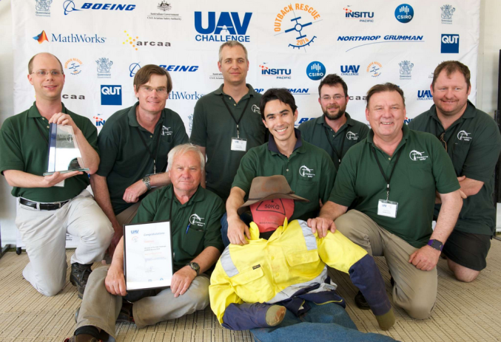
CanberraUAV
Volunteer group
Emphasis on R&D, education, collaboration
Originally formed to compete in the 2012 Outback UAV Challenge
Collaboration with other organisations around the world

Slide 9
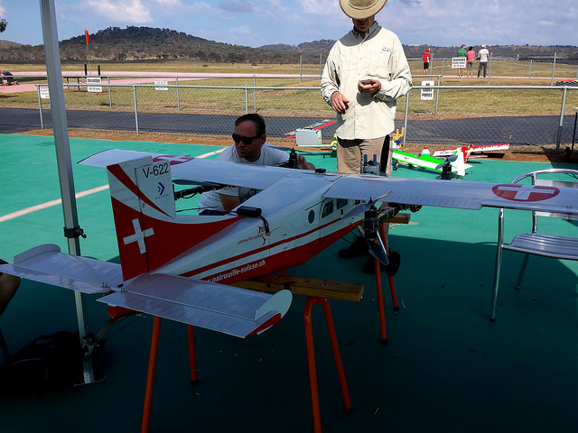
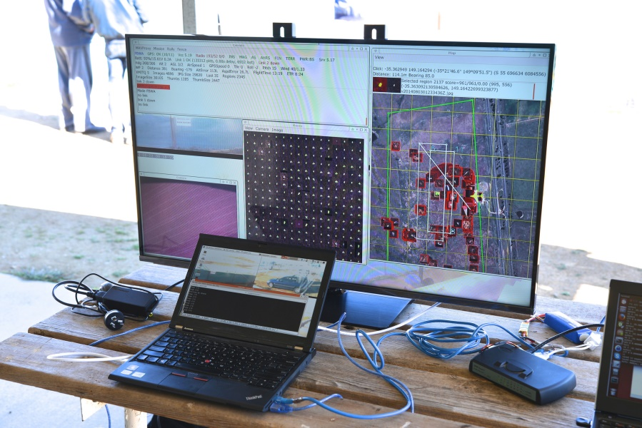
CanberraUAV

Slide 10
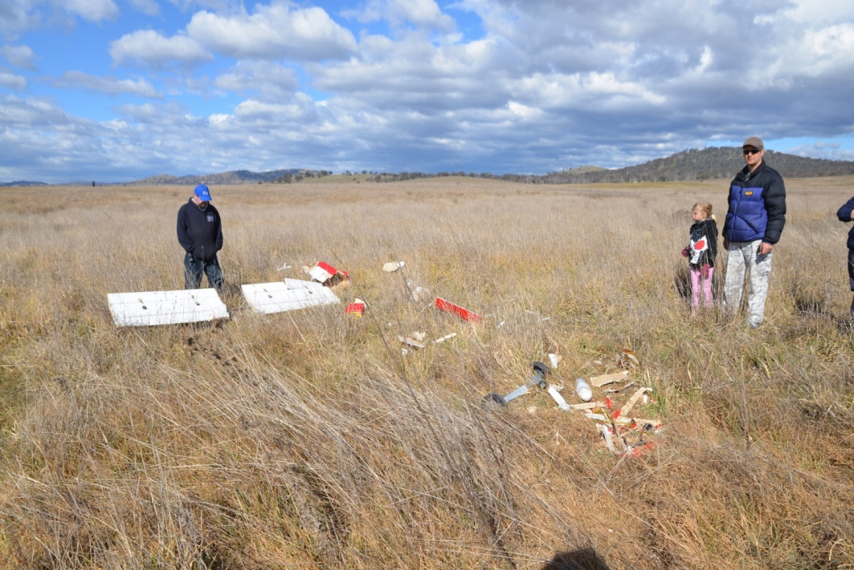
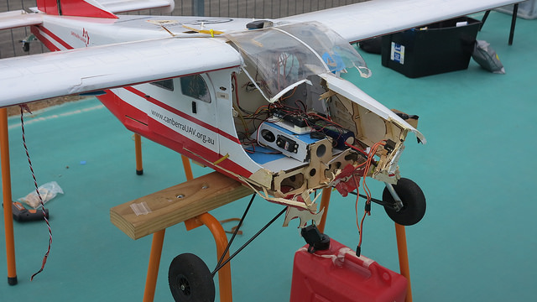
CanberraUAV

