Slide 1

CRI Bioinformatics Bootcamp
Single-cell & spatial analysis with python with scverse
python
import scanpy as sc
import squidpy as sq
import scvi
adata = sc.datasets.pbmc3k()
scanpy · muon · scirpy · scvi-tools · squidpy · spatialdata

Slide 2
01 · THE ECOSYSTEM
What is scverse?
A community of Python packages for single-cell and spatial omics — all built on the same data structures, so they interoperate by design.
scanpy
preprocessing & clustering
decoupler
scvi-tools
pathway & TF activity
deep generative models
AnnData · MuData
shared data structures
scirpy
spatialdata
TCR / BCR repertoire
images & large datasets
squidpy
spatial neighborhoods
02

Slide 3
02 · DATA STRUCTURES
AnnData — one object for the analysis
Annotated data matrix
python — print(adata) after a full run
The expression matrix plus every layer of metadata, held together in one object.
AnnData object 2700 cells × 1838 genes
obs: 'leiden', 'n_genes', 'pct_mt'
var: 'highly_variable', 'means'
obsm: 'X_pca', 'X_umap'
obsp: 'distances', 'connectivities'
layers: 'counts'
uns: 'pca', 'neighbors'
Cells × genes
Rows are cells, columns are genes — the transpose of how the Seurat object is laid out.
Start to finish
Counts, embeddings, clusters and QC all stay attached to it as the analysis grows.
03

Slide 4
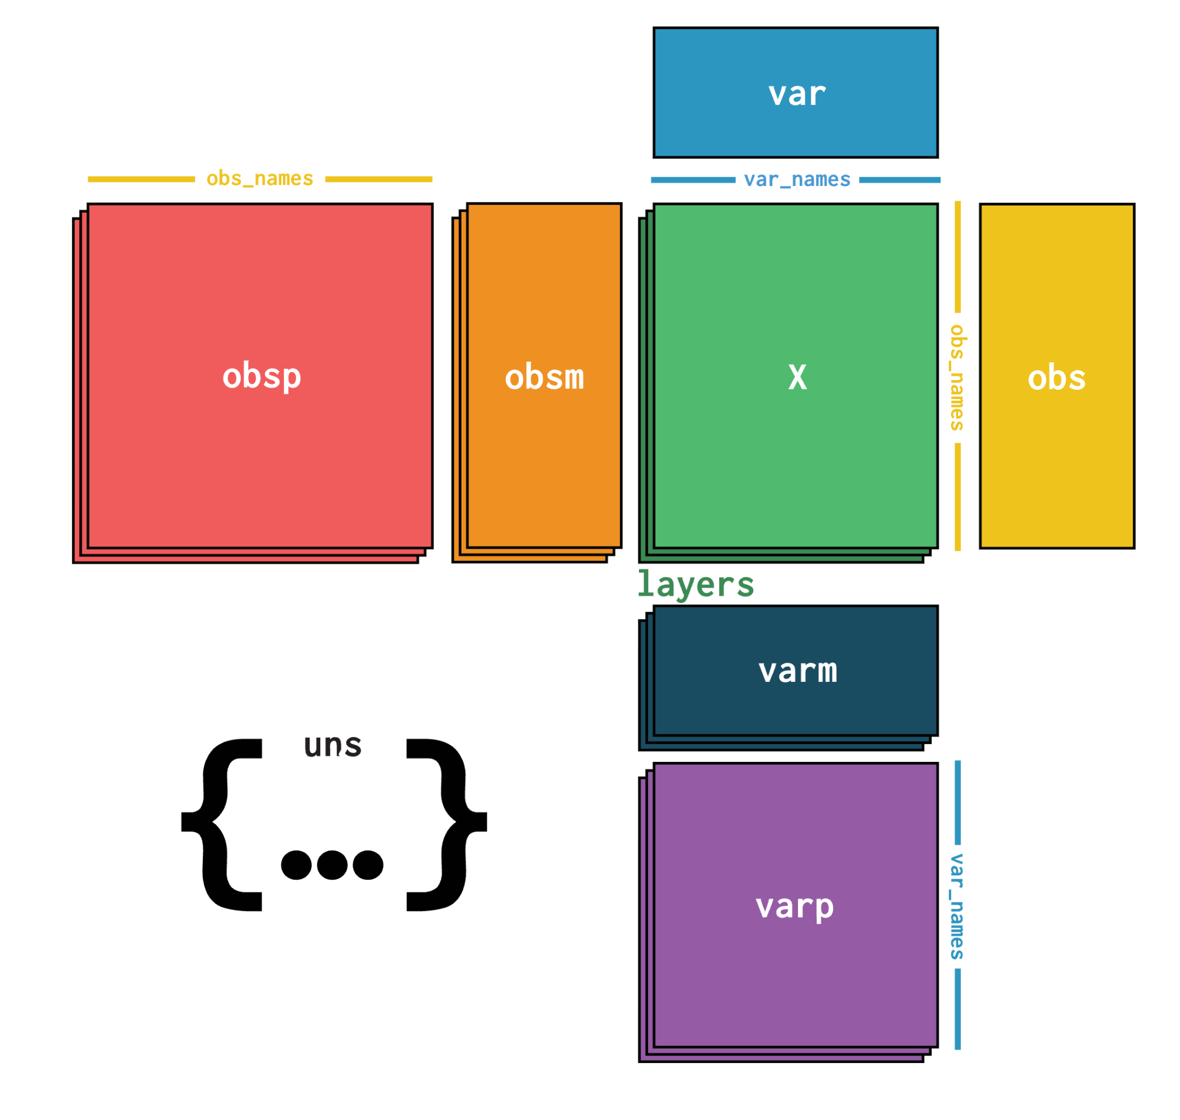
02 · DATA STRUCTURES
Inside an AnnData object
Eight slots, each holding a different layer of the dataset — once you know them, every scverse package becomes predictable.
.X
the expression matrix — cells × genes
.obs
per-cell table — clusters, sample, QC metrics
.var
per-gene table — gene IDs, highly-variable flag
.obsm
per-cell matrices — X_pca, X_umap, spatial
.varm
per-gene matrices — PC loadings (PCs)
.layers
alternative matrices, same shape as .X — counts
.obsp
cell × cell graphs — the neighbor graph
.uns
unstructured — parameters, palettes, run history
04

Slide 5
02 · DATA STRUCTURES
Anndata Seurat
Almost everything has a direct equivalent — the move is mostly a change of vocabulary.
Seurat (R)
scverse / AnnData (Python)
genes × cells
→
cells × genes
matrix is transposed
assay @counts / @data
→
.X + .layers
raw and processed matrices
meta.data
→
.obs
per-cell metadata table
assay meta.features
→
.var
per-gene metadata table
@reductions$pca / umap
→
.obsm['X_pca' / 'X_umap']
embeddings
pca@feature.loadings
→
.varm['PCs']
gene loadings
@graphs (nn / snn)
→
.obsp['connectivities']
neighbor graph
multi-assay object
→
MuData
one AnnData per modality
05

Slide 6
03 · PREPROCESSING
Scanpy:
Calculate QC metrics
python
Counts per cell, genes per cell, and the fraction of mitochondrial reads.
mt = adata.var_names.str.startswith("MT-")
adata.var["mt"] = mt
sc.pp.calculate_qc_metrics(
adata, qc_vars=["mt"], inplace=True)
sc.pp.filter_cells(adata, min_genes=200)
sc.pp.filter_genes(adata, min_cells=3)
adata = adata[adata.obs.pct_counts_mt < 25]
Filter cells and genes
Drop low-quality cells and genes detected in only a handful of cells.
Same idea as Seurat
PercentageFeatureSet plus subset() — one explicit function at a time.
06

Slide 7

03 · PREPROCESSING
Quality control and filtering
Calculate QC metrics
python
Counts per cell, genes per cell, and the fraction of mitochondrial reads.
mt = adata.var_names.str.startswith("MT-")
adata.var["mt"] = mt
sc.pp.calculate_qc_metrics(
adata, qc_vars=["mt"], inplace=True)
sc.pp.filter_cells(adata, min_genes=200)
sc.pp.filter_genes(adata, min_cells=3)
adata = adata[adata.obs.pct_counts_mt < 25]
Filter cells and genes
Drop low-quality cells and genes detected in only a handful of cells.
Same idea as Seurat
PercentageFeatureSet plus subset() — one explicit function at a time.
scanpy is a scalable toolkit for analyzing single-cell gene expression data built jointly with anndata.
06

Slide 8
03 · PREPROCESSING
Normalize, transform, select features
Normalize & log-transform
python
normalize_total then log1p — equivalent to NormalizeData.
adata.layers["counts"] = adata.X.copy()
sc.pp.normalize_total(adata, target_sum=1e4)
sc.pp.log1p(adata)
sc.pp.highly_variable_genes(
adata, n_top_genes=2000)
adata.raw = adata
sc.pp.scale(adata, max_value=10)
Select variable genes
highly_variable_genes — equivalent to FindVariableFeatures.
Scale, but keep the counts
Save raw counts to a layer before scale() overwrites .X.
07

Slide 9
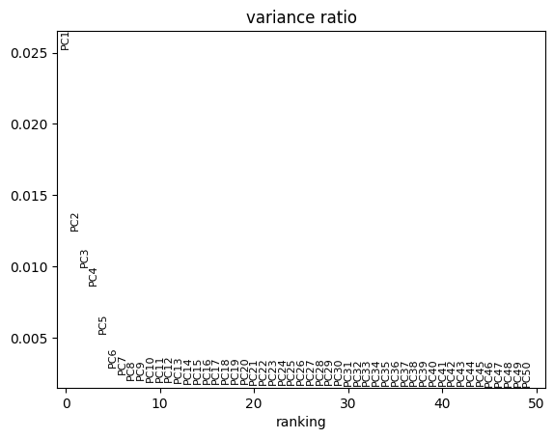
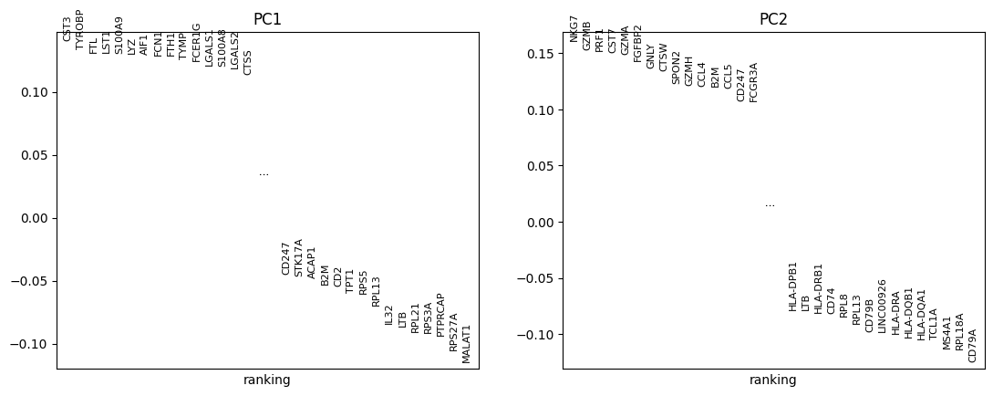
04 · DIMENSION REDUCTION
PCA — and what the loadings tell you
Run PCA
python
Compress thousands of genes down to roughly fifty components.
sc.pp.pca(adata, n_comps=50)
sc.pl.pca_variance_ratio(adata, n_pcs=50)
# loadings: each gene's weight per PC
adata.varm["PCs"] # genes × PCs
sc.pl.pca_loadings(adata, components=[1, 2])
Pick the number of PCs
The variance-ratio elbow plot — the equivalent of Seurat's ElbowPlot.
Read the loadings
varm['PCs'] holds each gene's weight; the top genes name what an axis means.
08

Slide 10
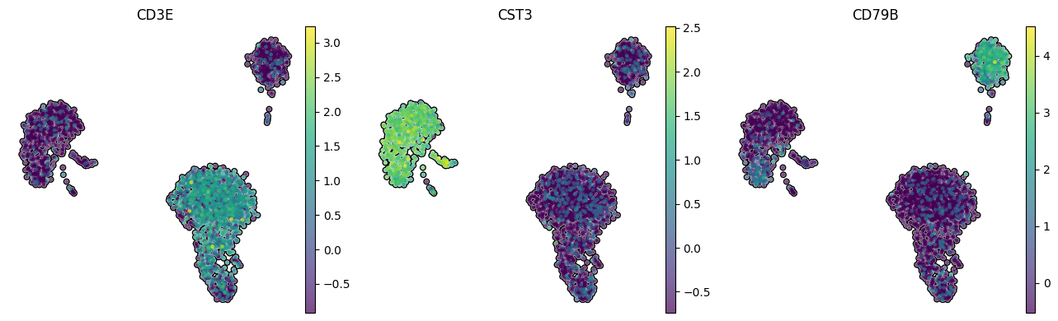
04 · DIMENSION REDUCTION
From PCA to a 2D UMAP
python
Build the neighbor graph
sc.pp.neighbors(adata, n_neighbors=15)
sc.tl.umap(adata)
sc.pl.umap(adata, color=["CD3E", "CST3", “CD79A”])
k-nearest-neighbors in PCA space — this graph is what clustering runs on.
UMAP Embedding
A map for visualization; treat distances on it as qualitative, not exact.
Seurat equivalents
FindNeighbors, then RunUMAP — the same two-step sequence.
09

Slide 11
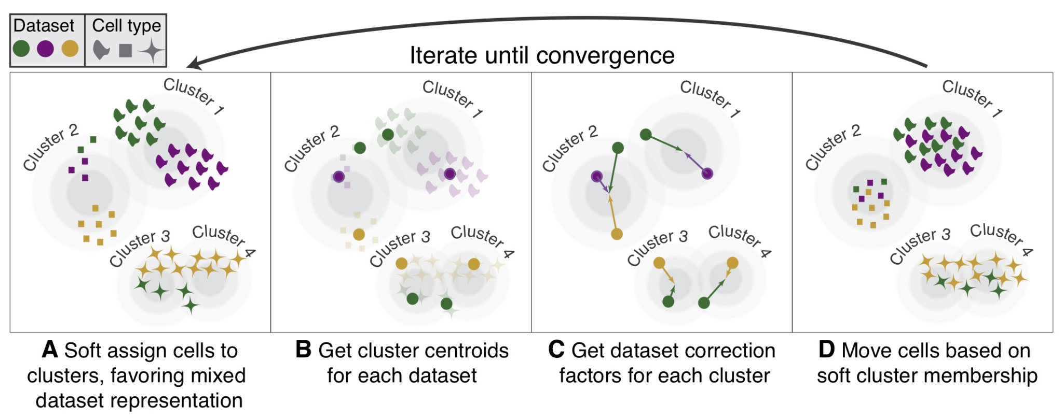

05 · INTEGRATION
Batch correction with Harmony
python
import scanpy.external as sce
sce.pp.harmony_integrate(adata, key="batch")
# -> adata.obsm["X_pca_harmony"]
sc.pp.neighbors(adata, use_rep="X_pca_harmony")
sc.tl.umap(adata) #rerun on batch corrected neighbors graph
Why correct batches
Raw PCA space mixes real biology with technical, per-sample variation.
Harmony adjusts the embedding
It nudges cells within PCA space — the count matrix is left untouched.
Use the corrected space
Point neighbors at X_pca_harmony and run the rest of the pipeline as usual.
scVI is a generative model that batch corrects and provides model-corrected counts for downstream analyses.
10

Slide 12
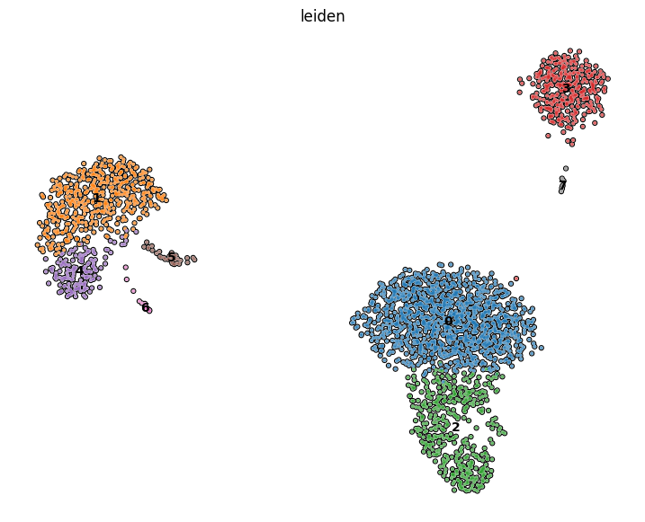
06 · CLUSTERING
Clustering with Leiden
python
sc.tl.leiden(adata, resolution=.7)
sc.pl.umap(adata, color="leiden")
Clusters from the graph
Leiden partitions the neighbor graph into communities of similar cells.
Resolution sets granularity
Higher resolution yields more, smaller clusters.
Versus Seurat
FindClusters does the same job; Leiden is the improved successor to Louvain.
11

Slide 13
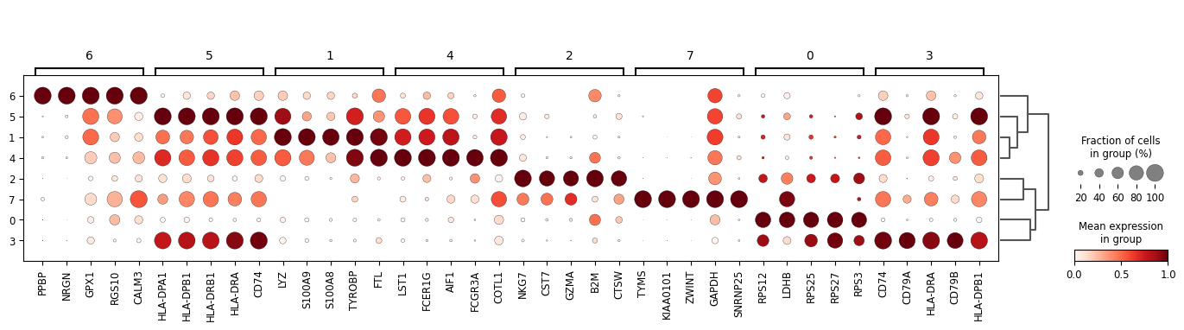
07 · ANNOTATION
Marker genes with rank_genes_groups
Rank genes per cluster
python
A Wilcoxon test of every gene, each cluster against all other cells.
sc.tl.rank_genes_groups(
adata, groupby="leiden",
method="wilcoxon")
df = sc.get.rank_genes_groups_df(
adata, group="0")
sc.pl.rank_genes_groups_dotplot(adata)
Pull results into a table
rank_genes_groups_df returns a DataFrame you can sort and filter.
Like FindAllMarkers
Use the top-ranked genes of each cluster to assign cell-type identity.
12

Slide 14
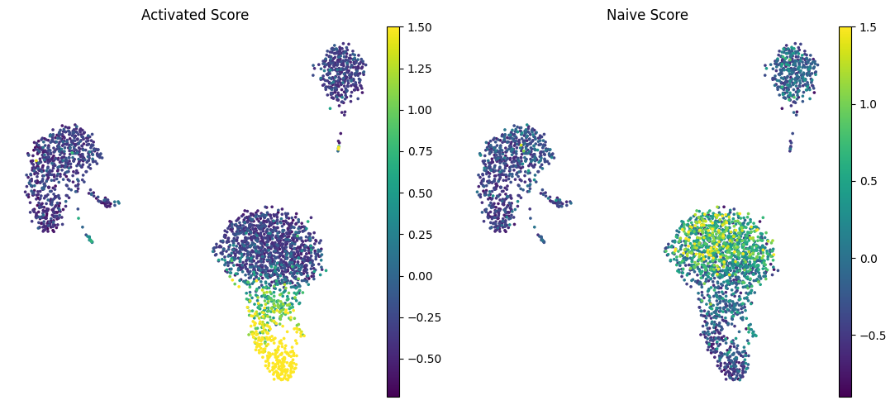
07 · ANNOTATION
Scoring gene signatures
python
Score a gene set per cell
tcell = ["CD3D", "CD3E", "CD8A", "IL7R"]
sc.tl.score_genes(
adata, tcell, score_name="tcell")
sc.tl.score_genes_cell_cycle(
adata, s_genes=s_genes, g2m_genes=g2m_genes)
Mean expression of the set, minus a matched control set, for every cell.
Seurat's AddModuleScore
Score a signature, then colour the UMAP by the resulting score.
Seurat's AddModuleScore
Score a signature, then colour the UMAP by the resulting score.
13

Slide 15
08 · MULTIMODAL
Multiple modalities with MuData
One AnnData per modality
RNA, ATAC and surface protein are each kept as their own AnnData.
python
import muon as mu
mdata = mu.MuData({"rna": adata_rna,
"atac": adata_atac})
mdata["rna"] # just an AnnData
mu.pp.intersect_obs(mdata)
MuData ties them together
Shared cells, reached as mdata['rna'] and mdata['atac'].
muon is scanpy for multimodal
Per-modality steps, plus joint embeddings across the modalities.
14

Slide 16
09 · IMMUNE REPERTOIRE
Loading TCR / BCR data with scirpy
Repertoire on AnnData
scirpy pairs immune-receptor sequences with the transcriptome.
python
import scirpy as ir
tcr = ir.io.read_10x_vdj(
"filtered_contig_annotations.csv")
ir.pp.merge_with_ir(adata, tcr)
ir.tl.chain_qc(adata)
Read 10x VDJ output
Load filtered_contig_annotations.csv straight into an AnnData.
Merge and QC the chains
Receptor info joins .obs; chain_qc flags each cell's chain configuration.
15

Slide 17
09 · IMMUNE REPERTOIRE
Clonotypes and repertoire analysis
Define clonotypes
python
Group cells that share receptor sequences into clones (clone_id).
ir.pp.ir_dist(adata)
ir.tl.define_clonotypes(adata)
# -> adata.obs["clone_id"]
ir.tl.clonal_expansion(adata)
ir.tl.clonotype_network(adata)
ir.pl.clonotype_network(adata, color="clone_id")
Measure clonal expansion
Quantify how large each clone is — the footprint of an immune response.
Clonotype networks
Graph clones by sequence similarity, then lay them out and plot.
16

Slide 18
10 · FUNCTIONAL ANALYSIS
Pathway & TF activity with decoupler
Functional analysis, one API
Enrichment and activity scoring with many methods behind a single interface.
python
import decoupler as dc
net = dc.get_collectri()
dc.run_ulm(mat=adata, net=net)
acts = dc.get_acts(
adata, obsm_key="ulm_estimate")
Curated prior networks
TF-target sets (CollecTRI), pathway responses, MSigDB gene sets.
Per-cell activities
Infer transcription-factor or pathway activity for each cell or pseudobulk.
17

Slide 19
11 · PROBABILISTIC MODELS
scvi-tools — deep generative models
A model, not just a transform
python
scVI learns a probabilistic latent space directly from raw counts.
import scvi
scvi.model.SCVI.setup_anndata(
adata, layer="counts", batch_key="batch")
model = scvi.model.SCVI(adata)
model.train()
latent = model.get_latent_representation()
adata.obsm["X_scVI"] = latent
Batch-aware by design
Library size and batch are part of the model, not regressed out afterward.
Latent space replaces PCA
Feed X_scVI into neighbors, UMAP and clustering — already integrated.
18

Slide 20
11 · PROBABILISTIC MODELS
One framework, many models
scvi-tools hosts a family of models for different data types — and they all share the same four-step API.
python
scVI
scANVI
# every model, one pattern
Model.setup_anndata(adata, ...)
model = Model(adata)
model.train()
model.get_latent_representation()
scRNA-seq latent space + integration
semi-supervised cell-type labels
totalVI
MultiVI / peakVI
CITE-seq — RNA and protein jointly
ATAC and multiome data
DestVI
Solo
deconvolution of spatial spots
doublet detection
19

Slide 21
11 · PROBABILISTIC MODELS
Why these models live in Python
scvi-tools is built on PyTorch and Pyro — the same frameworks that drive modern machine learning.
scvi-tools
GPU acceleration, included
Models train on the GPU with no extra work — it comes with PyTorch.
single-cell probabilistic models
Pyro
New methods land here first
The ML field publishes in Python; scverse builds on it directly.
probabilistic programming — custom models
Open and extensible
PyTorch · JAX
Pyro lets you write and fit your own generative models when you need to.
tensors, autodiff, GPU execution
Python
the shared language of the ML field
20

Slide 22
12 · SCALING UP
GPU acceleration for large datasets
A GPU drop-in for scanpy
python
rapids-singlecell mirrors sc.pp and sc.tl, run on the GPU.
import rapids_singlecell as rsc
rsc.get.anndata_to_GPU(adata)
rsc.pp.pca(adata)
rsc.pp.neighbors(adata)
rsc.tl.umap(adata)
rsc.tl.leiden(adata)
Built on NVIDIA RAPIDS
cuPy, cuML and cuGraph do the heavy numerical work underneath.
Millions of cells
Ten to a hundred times faster — large atlases on a single GPU.
21

Slide 23
PART TWO
Spatial transcriptomics
The same objects and the same packages — now with a physical coordinate for every cell.

Slide 24
13 · SQUIDPY
Squidpy — spatial analysis on AnnData
Spatial analysis on AnnData
squidpy works on the very same object you have used all along.
python
import squidpy as sq
adata = sq.datasets.visium_hne_adata()
sq.pl.spatial_scatter(adata, color="cluster")
Spots and single cells
Visium spot data, plus Xenium, MERFISH and CosMx imaging platforms.
Neighborhoods and more
Spatial graphs, neighborhood enrichment, spatially variable genes.
23

Slide 25
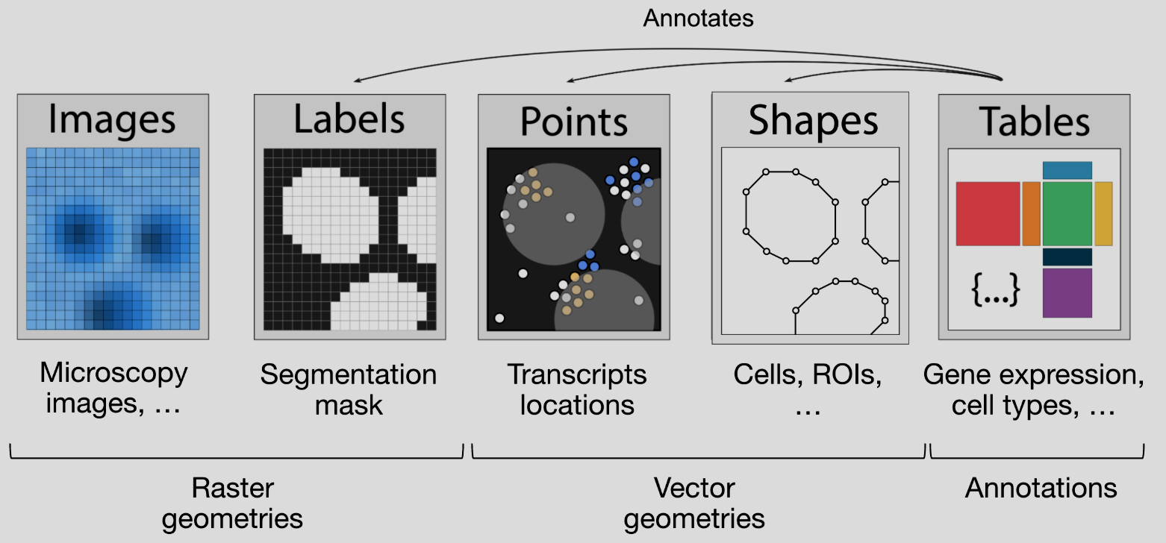
13 · SQUIDPY
What spatial data adds to AnnData
Coordinates
obsm['spatial'] stores an x, y position for every cell or spot.
A spatial graph
obsp holds the who-is-next-to-whom graph, built in physical space.
Tissue images
uns['spatial'] keeps the H&E image and its scale factors.
python
adata.obsm["spatial"] # x, y per cell
adata.obsp["spatial_connectivities"]
adata.uns["spatial"] # image + scale
Everything else — .X, .obs, clusters, X_umap — is exactly as before. Spatial information is purely additive.
24

Slide 26
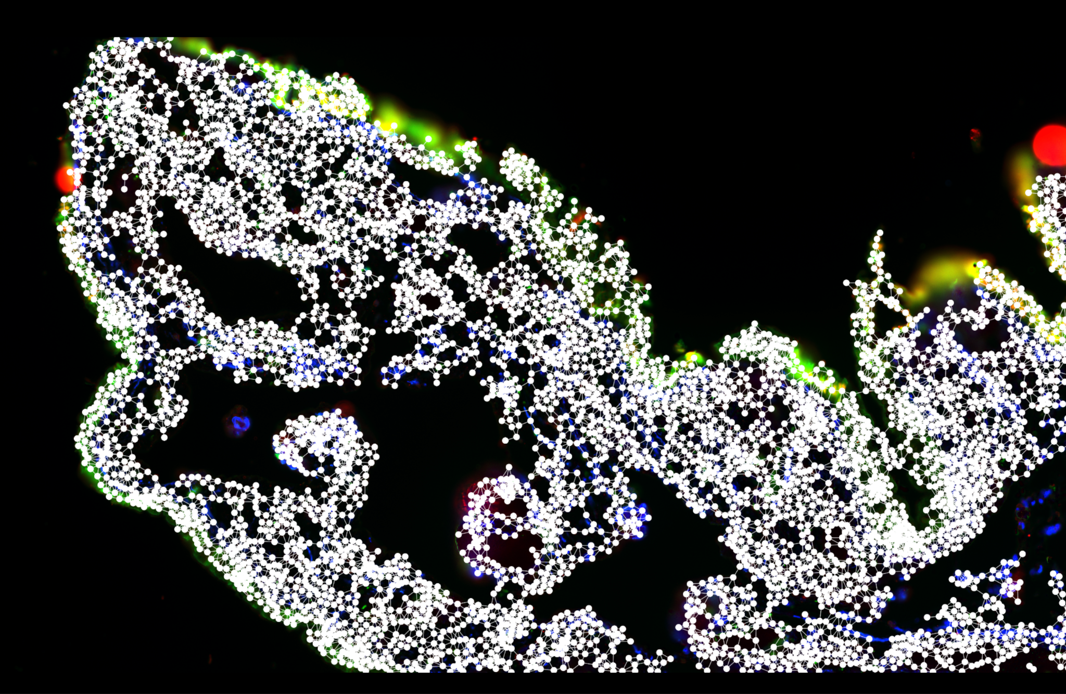
13 · SQUIDPY
Building the spatial graph
python
sq.gr.spatial_neighbors(adata)
sq.gr.nhood_enrichment(adata, cluster_key="cell_type")
sq.gr.spatial_autocorr(adata, mode="moran")
Connect neighbors in space
spatial_neighbors builds the graph and writes it into .obsp.
The basis for spatial stats
Neighborhood enrichment, Moran's I, cell-type co-occurrence.
Geometry sets the parameters
Grid versus point cloud — the choice is shown on the next slide.
25

Slide 27
13 · SQUIDPY
Visium spots vs. Xenium cells
The graph is built differently because the geometry is different — a regular grid versus an irregular point cloud.
Visium — spots on a grid
Xenium — segmented cells
sq.gr.spatial_neighbors(
adata, coord_type="grid", n_neighs=6)
sq.gr.spatial_neighbors(
adata, coord_type="generic", delaunay=True)
26

Slide 28
13 · SQUIDPY
Visualizing in spatial coordinates
Plot in real coordinates
python
spatial_scatter draws each cell or spot where it sits in the tissue.
sq.pl.spatial_scatter(
adata, color=["cell_type", "EPCAM"])
# imaging data with segmentation masks
sq.pl.spatial_segment(
adata, color="cell_type", library_id="fov1")
Over the tissue image
For Visium, spots are overlaid on the H&E image automatically.
Segmentation for imaging data
spatial_segment uses the cell masks; crop with library_id to a FOV.
27

Slide 29
14 · SPATIALDATA
SpatialData — saving and loading
Whole datasets, not just cells
python
Images, segmentation masks, transcripts, regions, and the cell table.
import spatialdata as sd
import spatialdata_io as sdio
sdata = sdio.xenium("xenium_run/")
sdata = sdio.visium_hd("visium_hd_run/")
sdata.write("dataset.zarr")
sdata = sd.read_zarr("dataset.zarr")
Readers for every platform
Xenium, Visium HD, MERSCOPE and CosMx, each with a one-line reader.
Stored as Zarr
A single on-disk format — write once, then reload it instantly.
28

Slide 30
14 · SPATIALDATA
Coordinate systems and transformations
Many coordinate systems
python
The microscope image and the transcripts live on different axes.
from spatialdata.transformations import (
get_transformation)
get_transformation(sdata["image"])
crop = sdata.query.bounding_box(
axes=("x", "y"),
min_coordinate=[0, 0],
max_coordinate=[2000, 2000],
target_coordinate_system="global")
Transformations align them
Scale, translation and affine maps, tracked for every element.
Query across elements
Crop one region and every aligned layer comes back together.
29

Slide 31
14 · SPATIALDATA
Built for large spatial datasets
Bigger than memory
Visium HD and Xenium produce huge images and transcript tables.
python
# images load lazily as Dask arrays
sdata["image"] # multiscale + chunked
# only the queried region is read into memory
crop = sdata.query.bounding_box(...)
Lazy, chunked, multiscale
Dask-backed images load only the region and resolution you ask for.
Laptop to cluster
Explore a whole slide locally, then scale the identical code up.
One set of objects, scanpy through spatialdata — that is what makes the scverse ecosystem worth learning.
30

