Slide 1
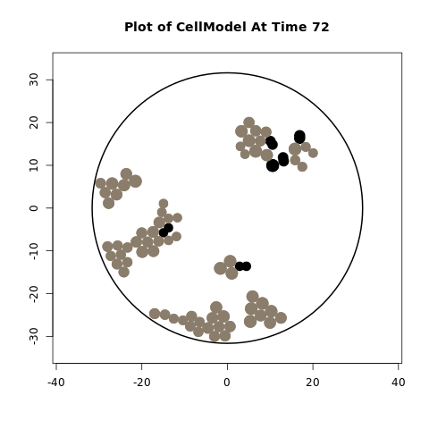
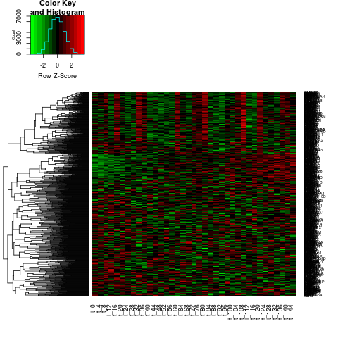
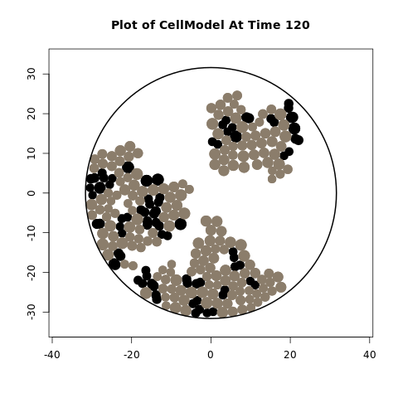
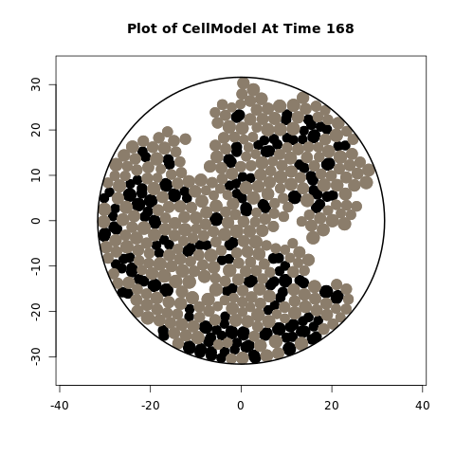
Figure 1a – Overview of model inputs to inSilicoCellModel and output as pictures of cellular distributions
CancerInSilico
Cell Population
- Boundary
- Density
- Cycle Synchronization
Cell Properties
- Cycle Length
- Cell Size
Drug Properties
- Cycle Length Effect
- Time Added

Slide 2
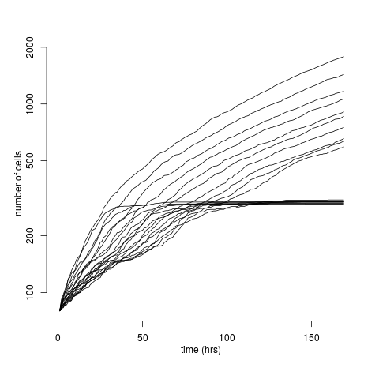
Figure 2a – Multiple growth rates in boundary and no boundary

Slide 3
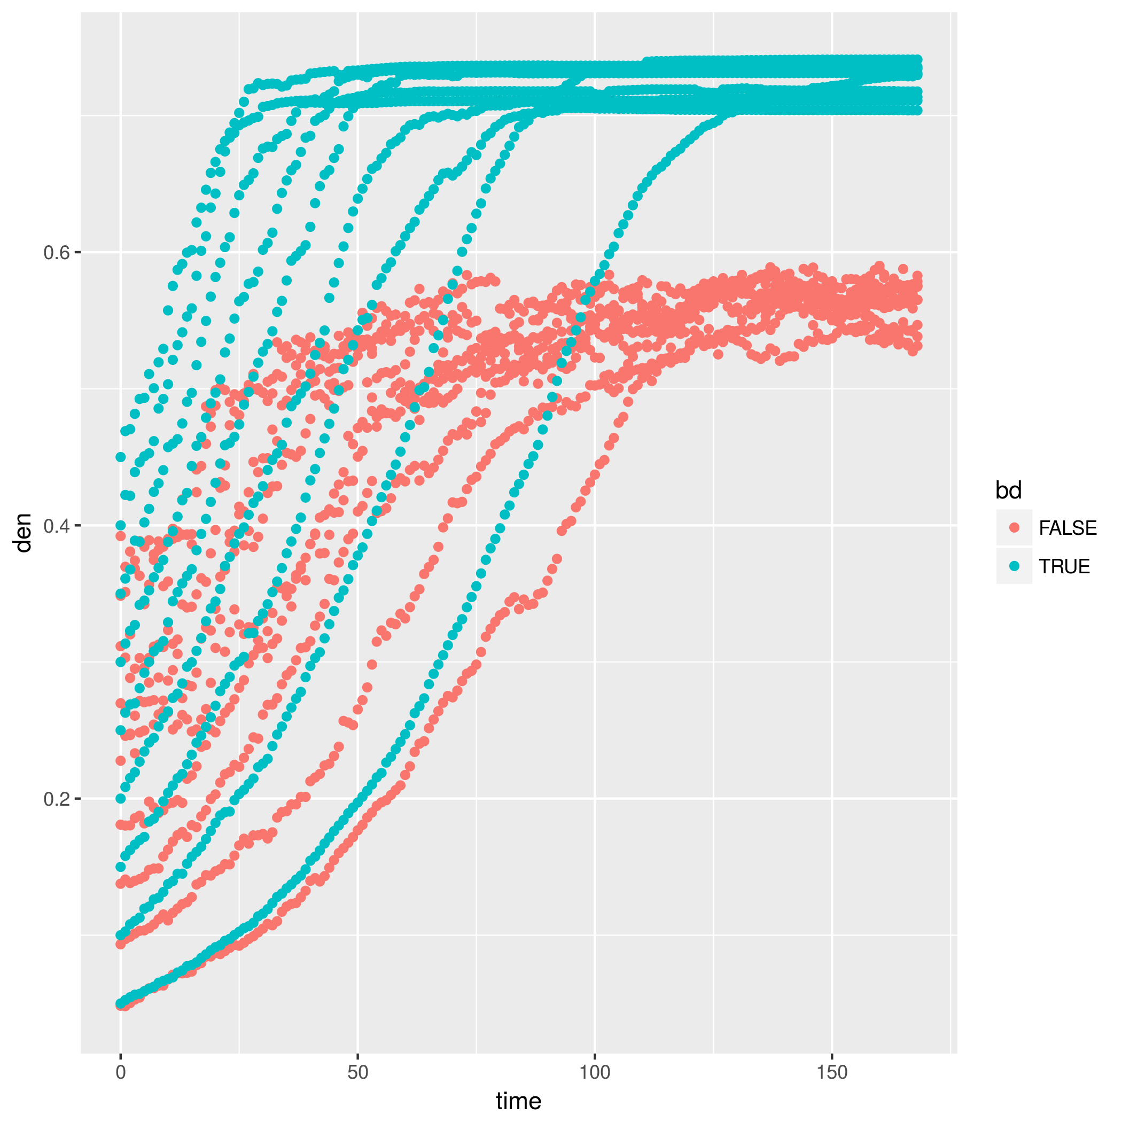
Figure 2b – Show density over time in both bounded and unbounded

Slide 4
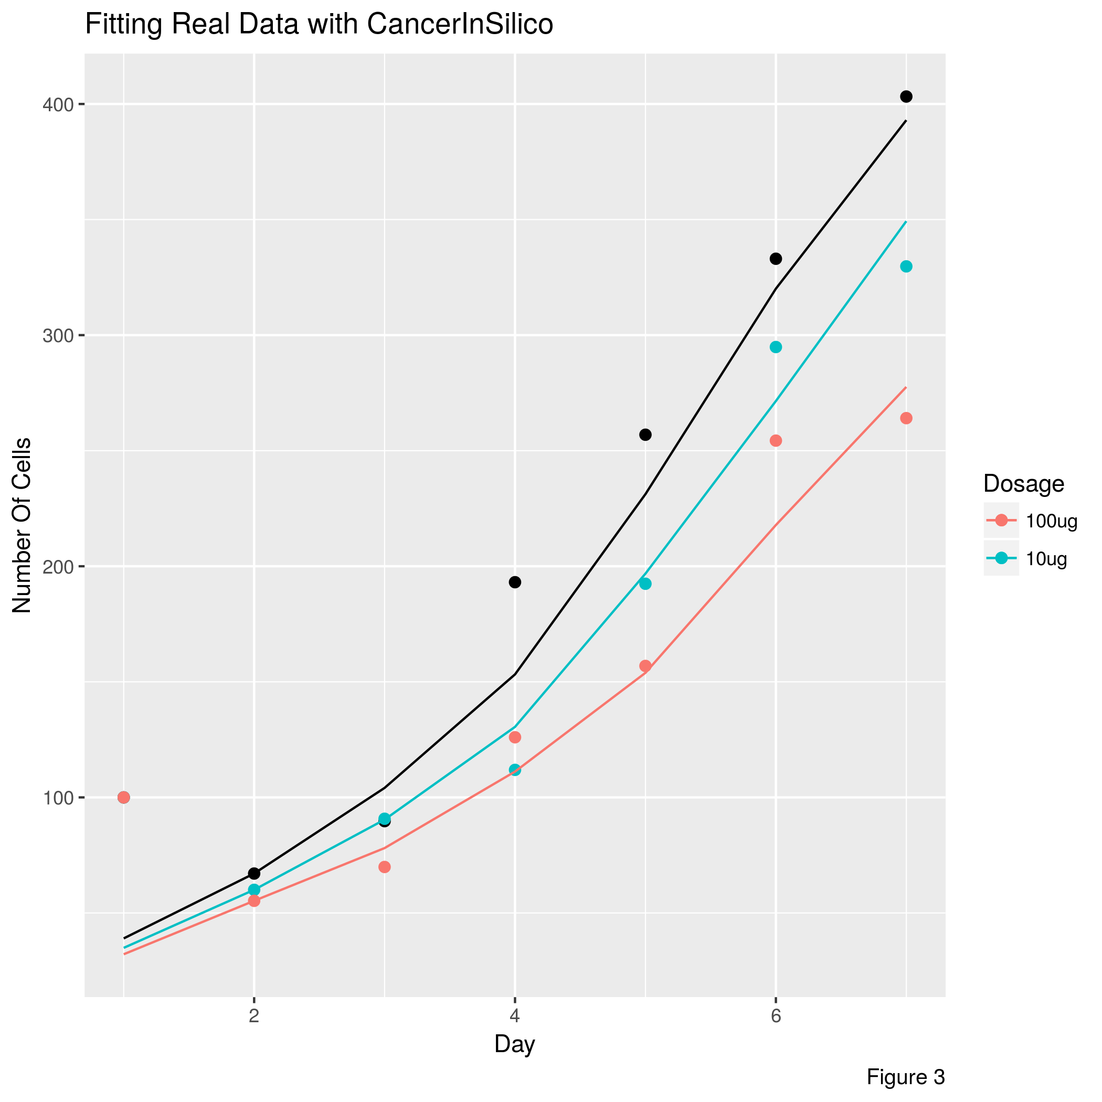
Figure 3 – Real Data from experiment plotted with points, simulation fits plotted with lines. PBS fitted from all simulations without drug effect, then initial density and cycle length are fixed and all drug simulations are fit with some drug effect. Fit done by minimizing L2.

Slide 5
Figure 4a – Cartoon overview of how we simulate gene expression.
Sample N Cells
Calculate Activity For each Cell in each Pathway
Scale to Reference Data
Combine genes in multiple pathways by taking the maximum expression
Simulate Error
- Limma Voom
- Splatter
Add Dummy Genes for Noise
Final Expression
If bulk data, average activity across cells

Slide 6
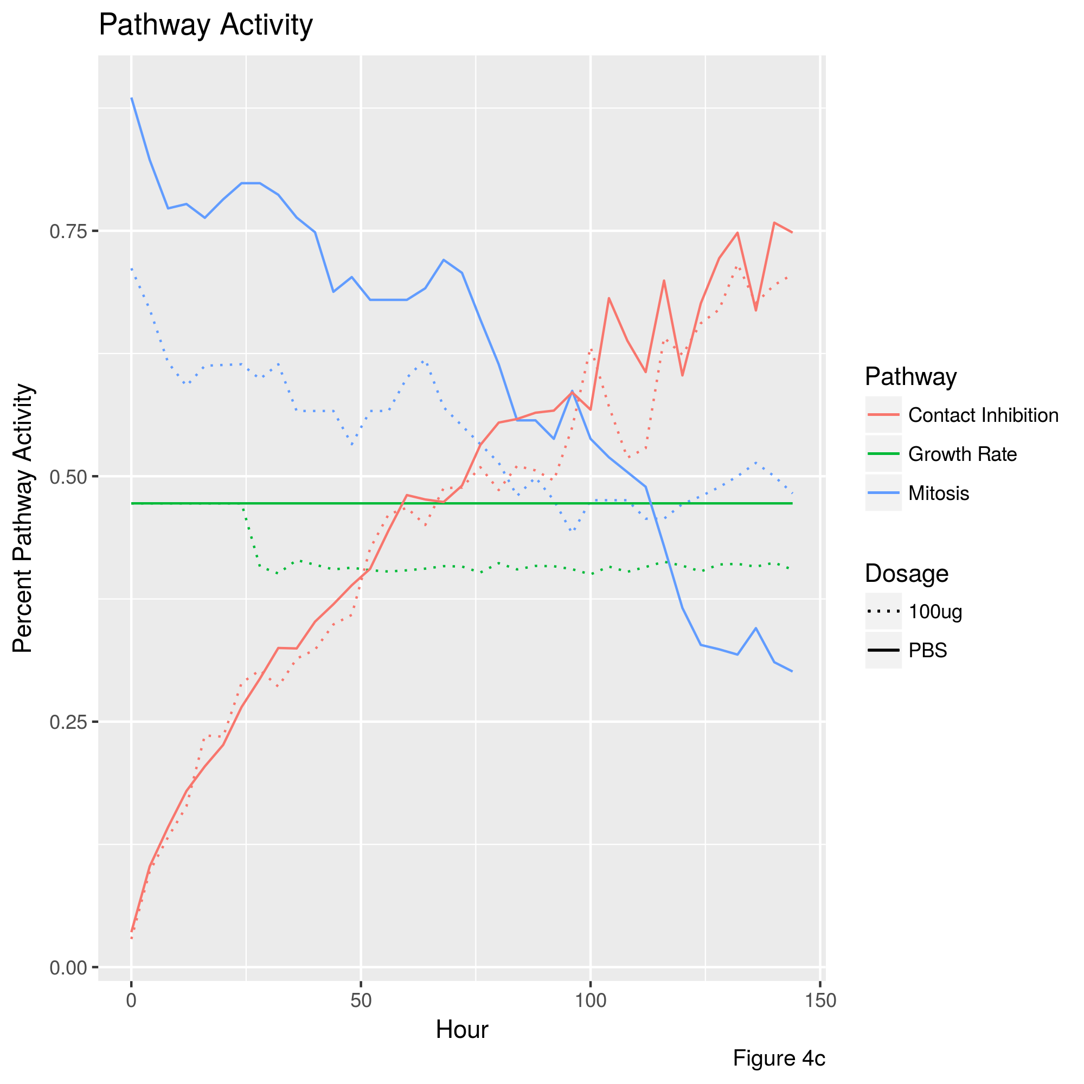
Figure 4b – Pick one dosage (10 um/mL) from Figure 3 and plot each of the effective pathways vs time for that selection. Y-axis is % of pathway activity and all pathways can be plotted together. Show difference in pathways for drug effect.

Slide 7
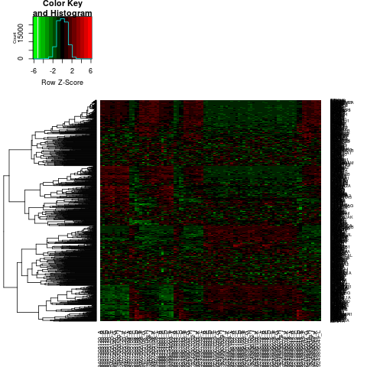
Figure 4c – Comparison to real gene expression data along each pathway. Subset real data
Thought: either do a dendrogam / clustering to compare sample to sample and/or
A GSEA analysis on pathways based on correlation stats for real and simulated data
Simulated, Drug
Real

Slide 8
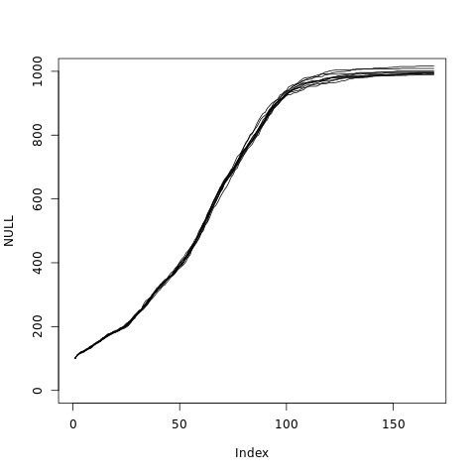
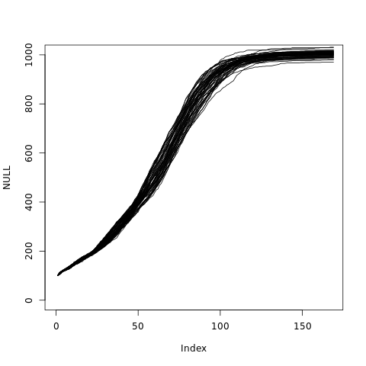
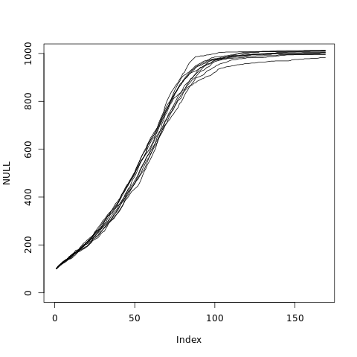
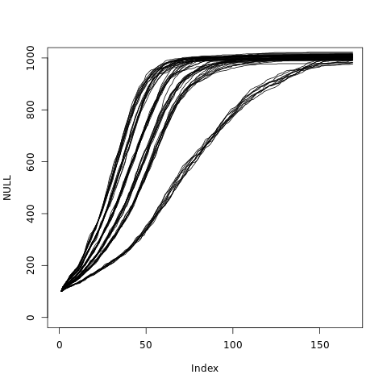
Figure 5a – Difference in population variance between one cell type with a high individual variance in growth, and two cell types with different means and low individual variance in growth
Two types,
Similar Mean Growth,
Varying Proportion
One type,
Low variance
Two types,
Different Mean Growth,
Varying Proportion
One type,
High Variance

Slide 9
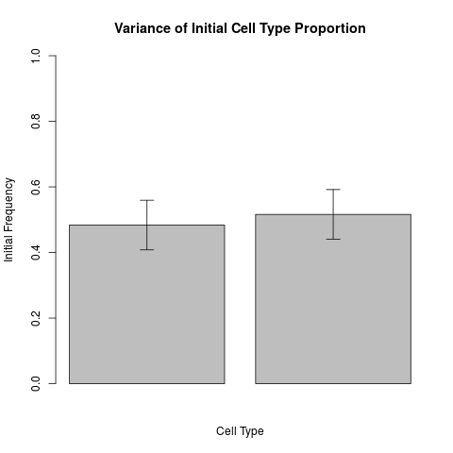
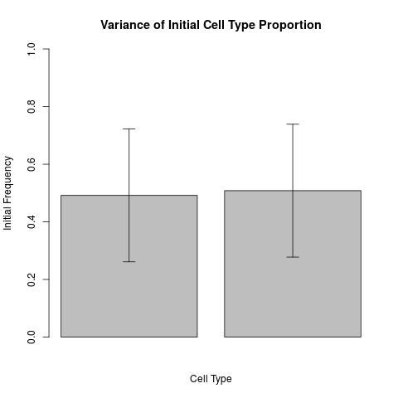
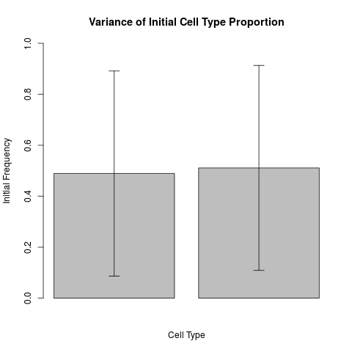
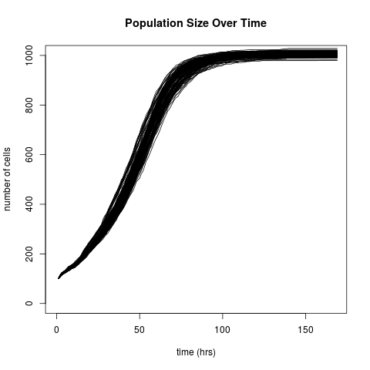
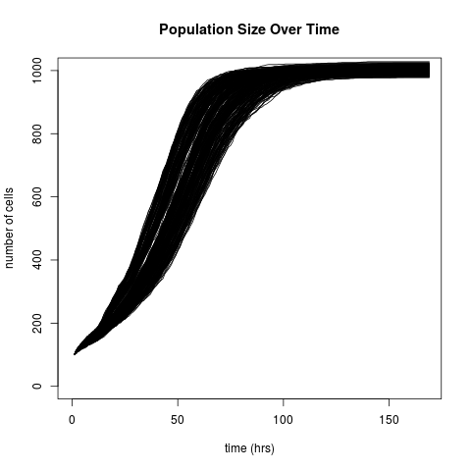
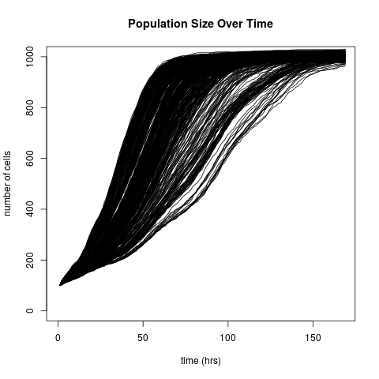

Slide 10
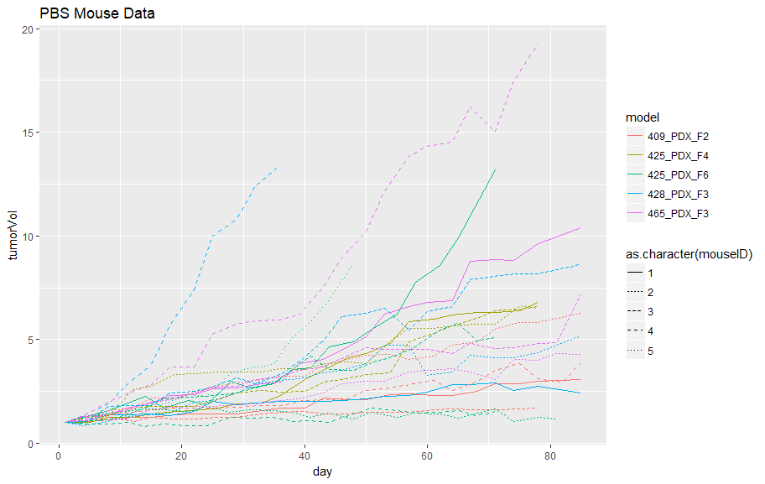
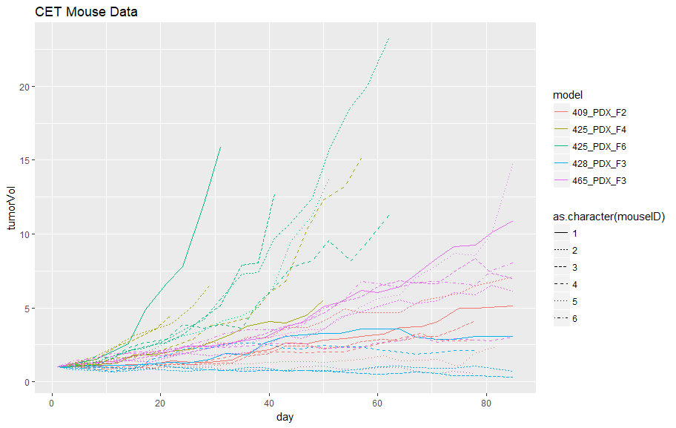
Figure 5b – Multiple cell types mirrors variance seen in real data (not included in paper)

Slide 11
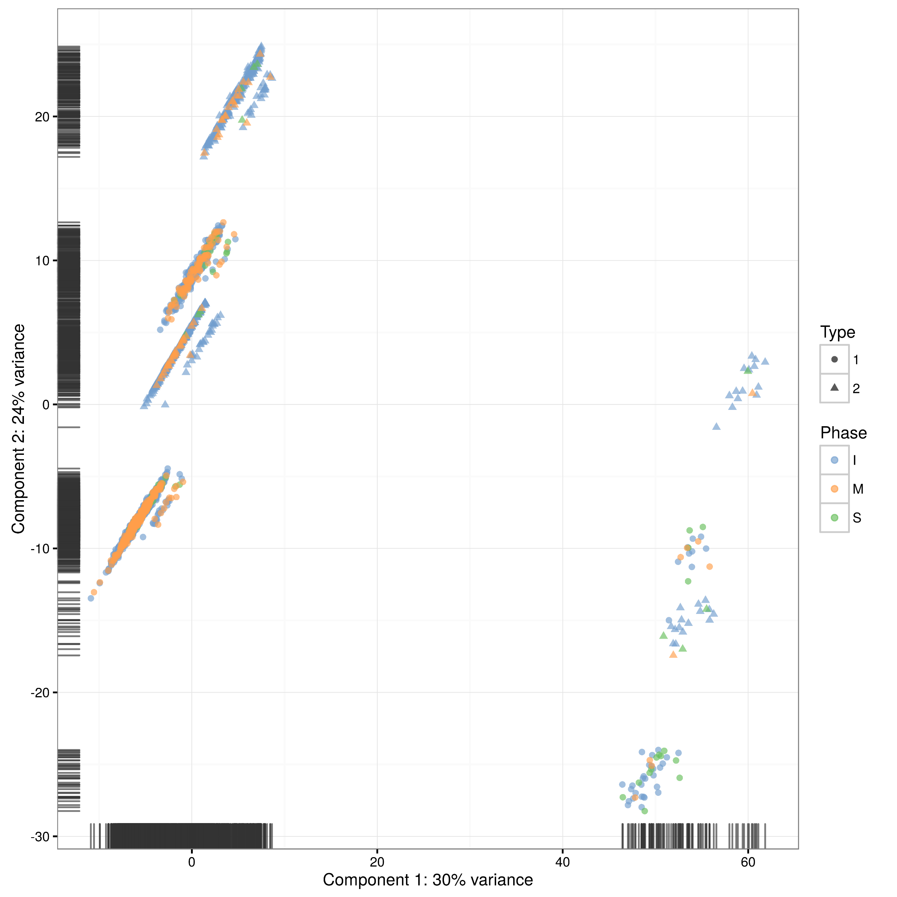
Figure 6 – single cell RNA seq data from figure 5 simulations

