Slide 1
Orlando Magic Player Performance

Slide 2
Orlando Magic 2023 Guards

Slide 3
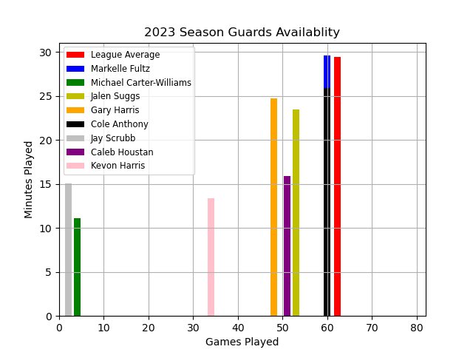
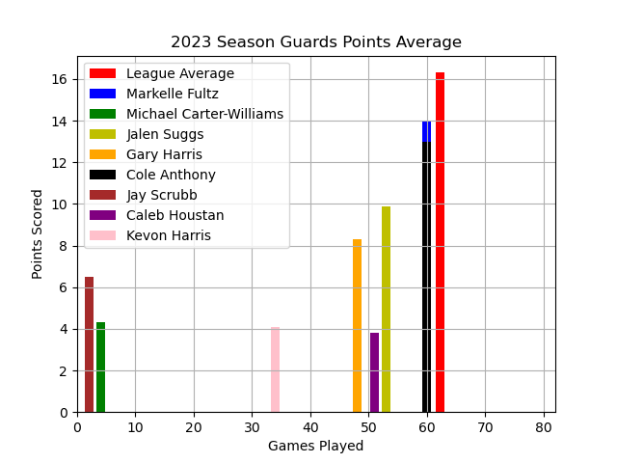
Guards Season Availability & Scoring

Slide 4
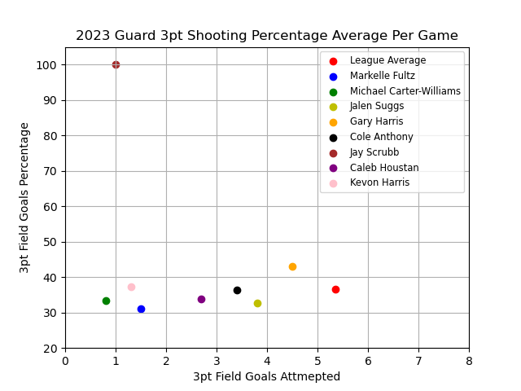
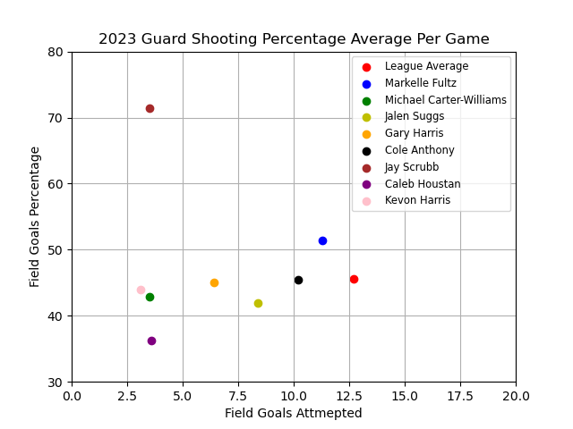
Guards Season Shooting

Slide 5
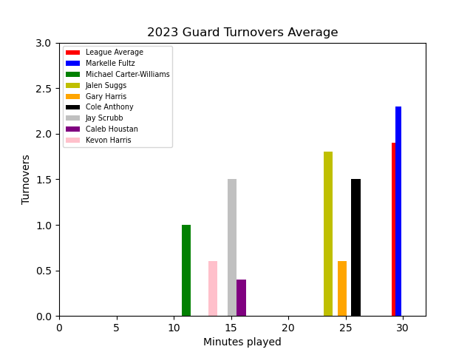
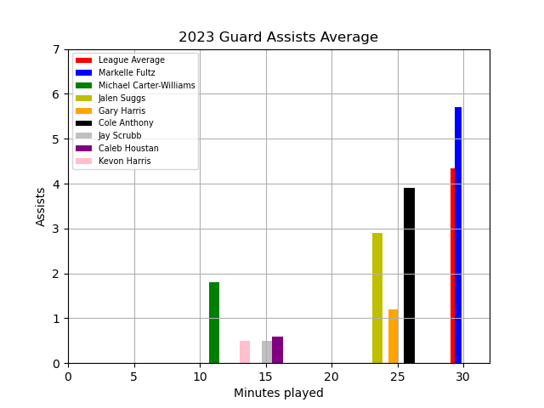
Guards Season Assist to Turnover

Slide 6
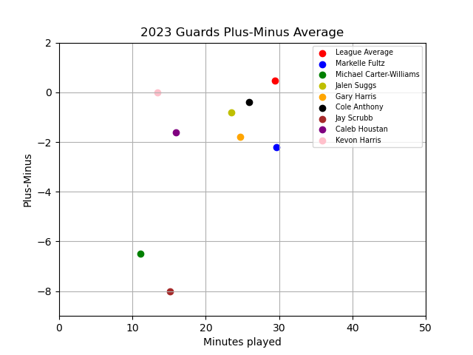
Guards Season Plus-Minus

Slide 7
Orlando Magic 2023 Forwards

Slide 8
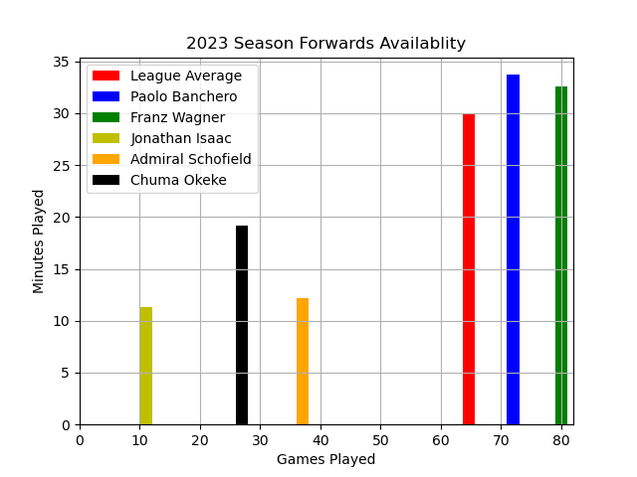
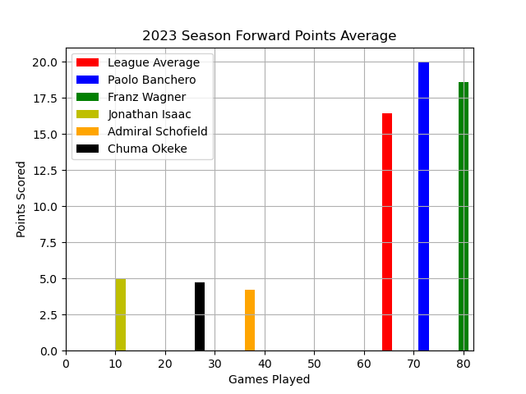
Forwards Season Availability & Scoring

Slide 9
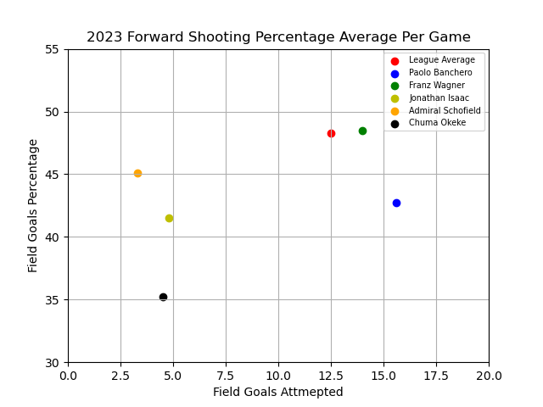
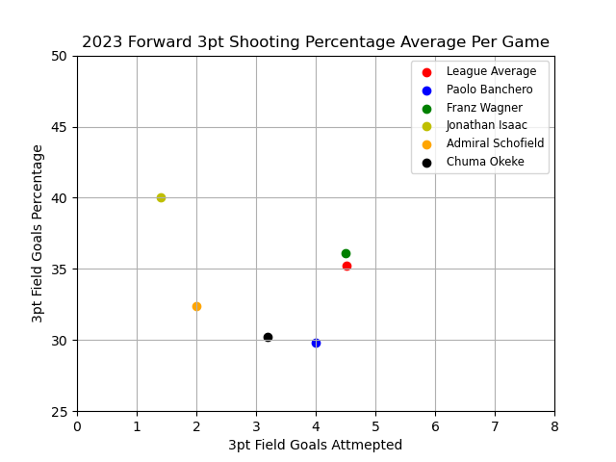
Forwards Season Shooting

Slide 10
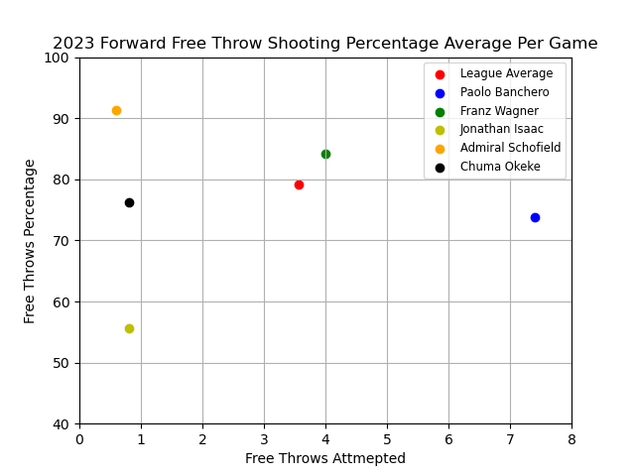
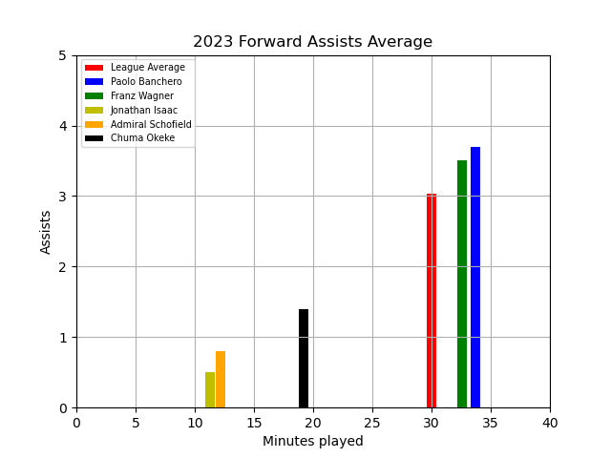
Forwards Season Scoring ( Outside of Field Goals)

Slide 11
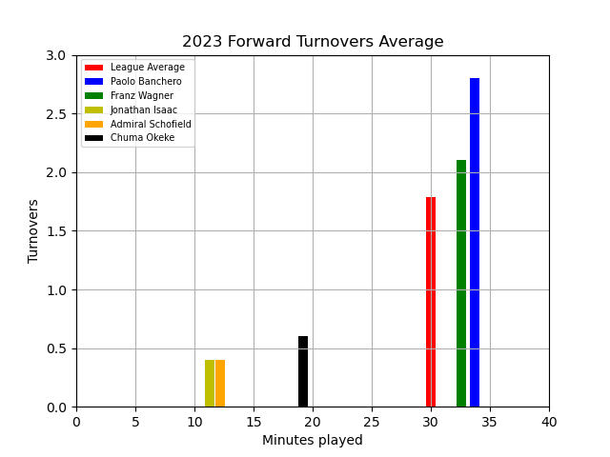
Forwards Turnovers

Slide 12
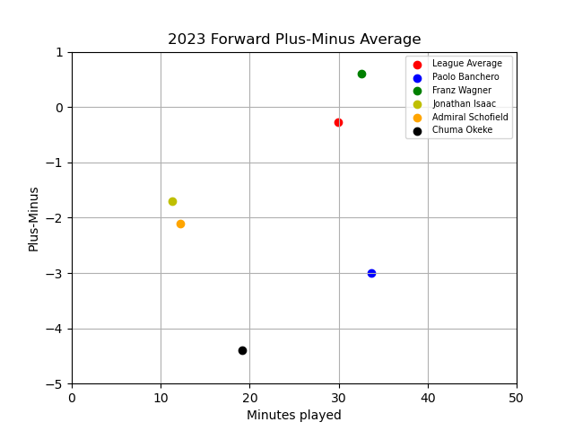
Forwards Season Plus-Minus

Slide 13
Orlando Magic 2023 Centers

Slide 14
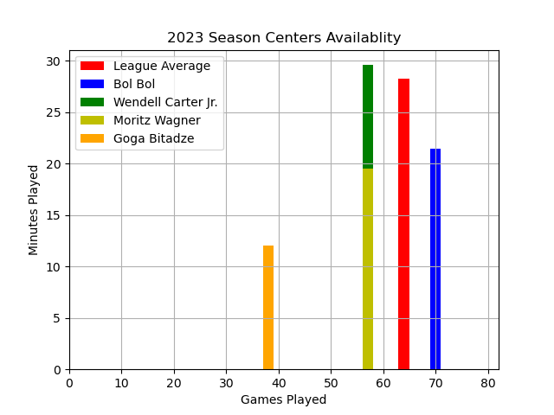
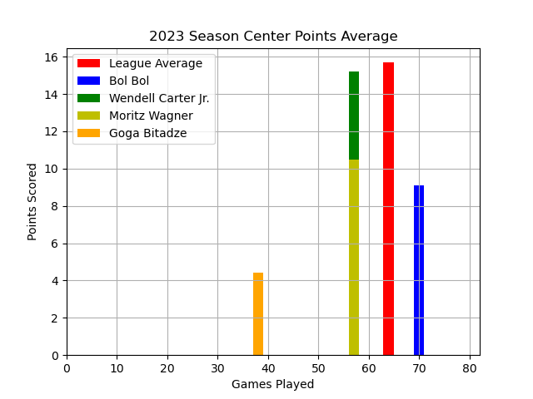
Centers Season Availability & Scoring

Slide 15
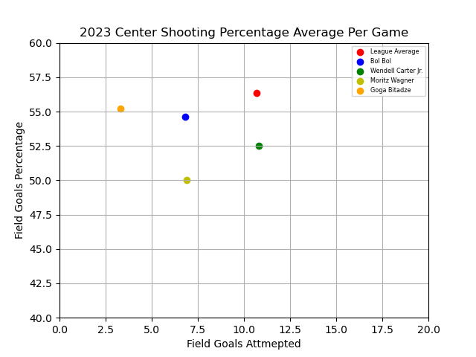
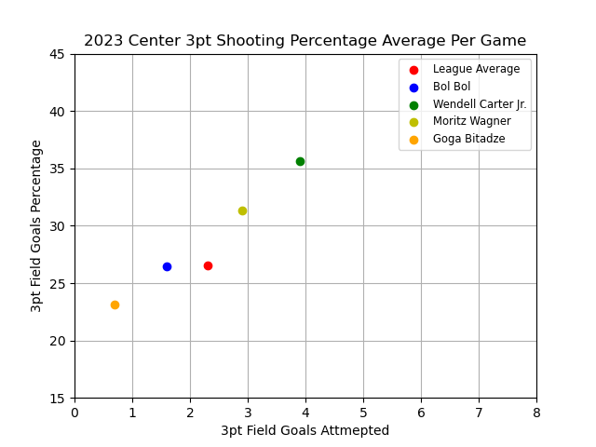
Centers Season Shooting

Slide 16
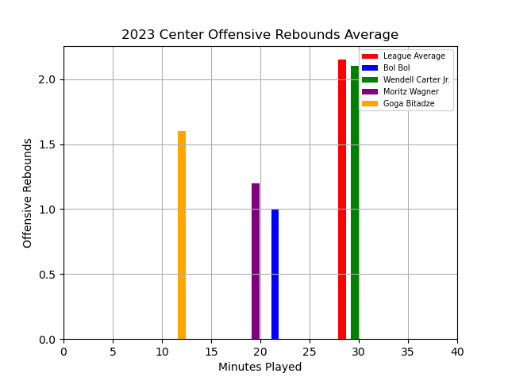
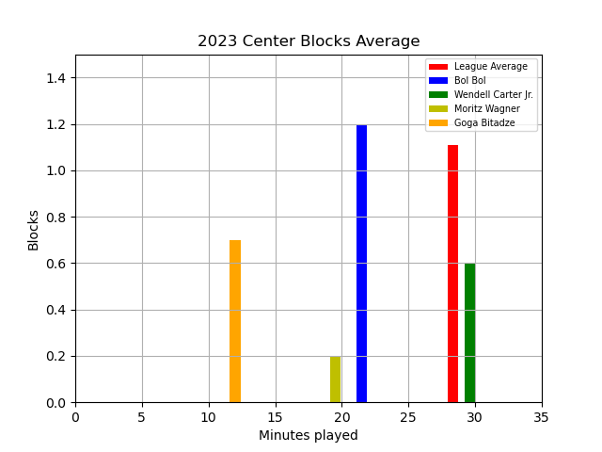
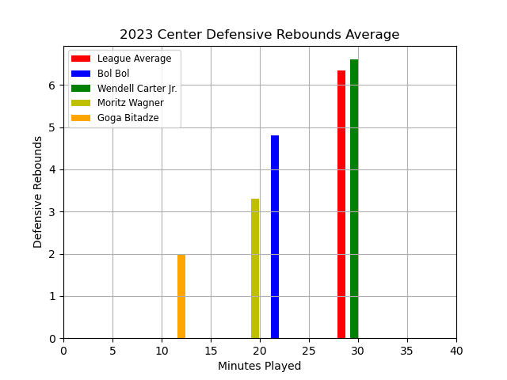
Centers Season Total Rebounds & Blocks

Slide 17
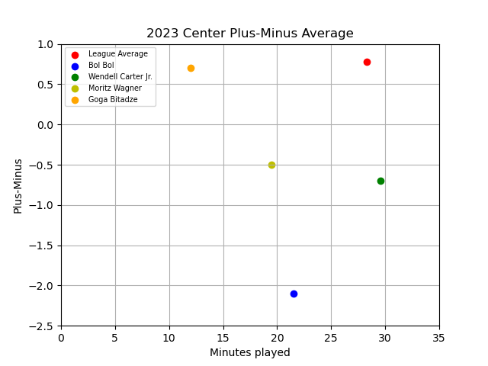
Centers Season Plus-Minus

Slide 18
Data Collection
Used https://www.nba.com/stats/players/traditional?SeasonType=Regular+Season to collect the traditional statistics of the 2023 regular season from the top 200 players made it into a CSV file.
Used the same site to get the traditional stats for the 2023 Orlando Magic Team and made it into a CSV file.
Added a Position column in excel to each of the CSV files. Created Dataframe with the CSV files of League Leaders and Orlando Magic Team.
Used the Groupby and .Loc function to sort the data by position so each player was being compared to similar player type.

Slide 19
Orlando’s Players Strengths
Franz Wagner and Paolo Banchero were above the league average in every metric related to scoring directly and/or indirectly.
Starter Markelle Fultz was above league average in field goal percentage.
Starter Markelle Fultz was above league average in assists.
Reserve Guard Gary Harris was above league average in 3pt shooting.
All but one Center was below league average in 3pt shooting.
All but one Guard were below the league average in turnovers.

Slide 20
Orlando’s Players Deficiencies
Reserve Guards performance in most major statistics categories were at or below league average.
Reserve Forwards performance in most major statistics categories were at or below league average.
Starting Center performance in key role statistics were at or slightly above league average.
All players but Franz Wagner were below the Plus-Minus league average.
All players but Franz Wagner, Kevon Harris, and Goga Bitadze had a negative Plus-Minus.

Slide 21
Player Performance Results
Starting Forwards are the strongest unit of the Orlando Magic Team, performed slightly or above the league average.
Starting Guards and Center were at or slightly above league average
Reserve players production in all roles were mainly below league average.

Slide 22
Conclusion
Recommend contracting better reserve players in all categories. Their production is not up to par when they are on the floor.
Contracting a starting Guard or Center that is performing way above the league average and converting your starters into role players. This could increase your reserve production and their individual production shouldn’t dip to much.

