Slide 1
An Exploratory Data Analysis (EDA) of the Orlando Magic
Notes:
Business Title Page

Slide 2
SECTION 1
Course requirement
An executive summary or overview of the project and project goals:
Explain how the project relates to the industry you selected.
Cindy’s requirement
Questions that you found interesting and what motivated you to answer them
Time: 30 Seconds
Assignment – Mark

Slide 3
Project Overview
The Orlando Magic has contracted this group to perform an EDA to look into key performance indicators (KPIs) to determine areas of play that need improvement so the Magic can become a winning team. The group quickly put together a list of questions to look into some of the more popular indicators known throughout the basketball industry. One motivational factor about this project is that the Magic is local to the Orlando area and an improvement in their performance would help drive fan support.
1. Is there a correlation between regular season and playoff winning percentage?
2. Is there a question 2
3. How does the Orlando Magic, as a team, compare to other teams in the league and the league as a whole?
4. Which KPIs most closely related to wins for the Orlando Magic Team in the 2022 - 2023 Games 5. Is there a question 5

Slide 4
SECTION 2
Course requirement
An overview of the data collection, cleanup, and exploration processes:
Describe the source of your data and why you chose it for your project.
Describe the collection, exploration, and cleanup process.
Cindy’s requirement
Where and how you found the data you used to answer these questions
The data exploration and cleanup process (accompanied by your Jupyter Notebook)
Time: 2 minutes
Assignment
Intro – Jessica
Slides
Jessica
Candace
Brenton
Dario
Mark

Slide 5
API’s Used for Data Collection
One source of data came from the python module nba_api
The nba_api contains official data from the NBA and is the source of data for the website NBA.com
The API was easy to learn but going through the documentation was time consuming, which the group to use other methods in addition to this one
The nba_api package is Open Source with an MIT License and does not require an API key

Slide 6
Jessica

Slide 7
Candace
I pulled the data directly from NBA.com and put the data into CSV files.
I was able to choose which data was needed based on the results that I got from my first objective of finding the rankings of the NBA teams.
I started the cleaning process in excel making sure that all of the data was formatted correctly. I then imported it into a Jupyter Notebook to continue my analysis.

Slide 8
Brenton

Slide 9
Dario

Slide 10
SECTION 3
Course requirement
The approach that your group took to achieve the project goals:
Include any relevant code or demonstrations of the application or analysis.
Discuss any unanticipated insights or problems that arose and how you resolved them.
Cindy’s requirement
The analysis process (accompanied by your Jupyter Notebook)
Time: 2 Minutes
Assignment
Intro – Candace
Slides
Candace
Brenton
Dario
Mark
Jessica

Slide 11
Question 1 – Regular Season vs Playoff Percentage
Data was collected through the python module nba_api
The data was filtered to include only seasons where the Magic made the playoffs
A two-plot line chart was created to show the different winning percentages
A bar chart was created to show the number of games played in each playoff season
A T test was applied to determine whether or not there was a correlation

Slide 12
Question 4 - KPIs most closely related to wins KPIs studied for the Orlando Magic
Steals
Blocks
Turnover
Field Goals Made
3 Points Made
Free Throw Made
Rebounds – includes offensive and defensives

Slide 13
Candace
I chose to analyze what I thought were the 5 major factors in game performance.
Points for an overall metric
2 Offensive Skills – 3 Pointers, and Field Goals
2 Defensive Skills – Rebounds and Turnovers
When I’m comparing just the Magic to 3 other teams, I use 3 Point Percentage and Field Goal Percentage to get a wider view of the points being made.
When I’m comparing the Magic to the entire league, I use 3 Points Made and Field Goals Made to get a more specific look at where the points are coming from.

Slide 14
Brenton

Slide 15
Dario

Slide 16
Jessica

Slide 17
SECTION 4
Course requirement
The results/conclusions of the application or analysis:
Include relevant images or examples to support your work.
If the project goal was not achieved, discuss the issues and how you attempted to resolve them.
Cindy’s requirement
Your conclusions, including a numerical summary and visualizations of the summary
Time: 2 Minutes
Assignment
Intro – Candace
Slides
Brenton
Dario
Mark
Jessica
Candace

Slide 18
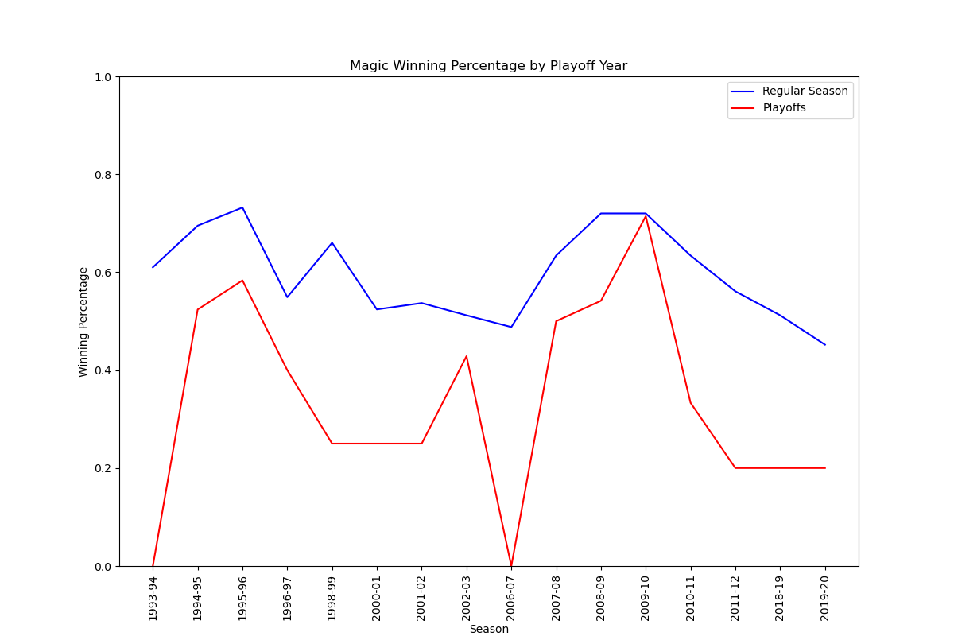
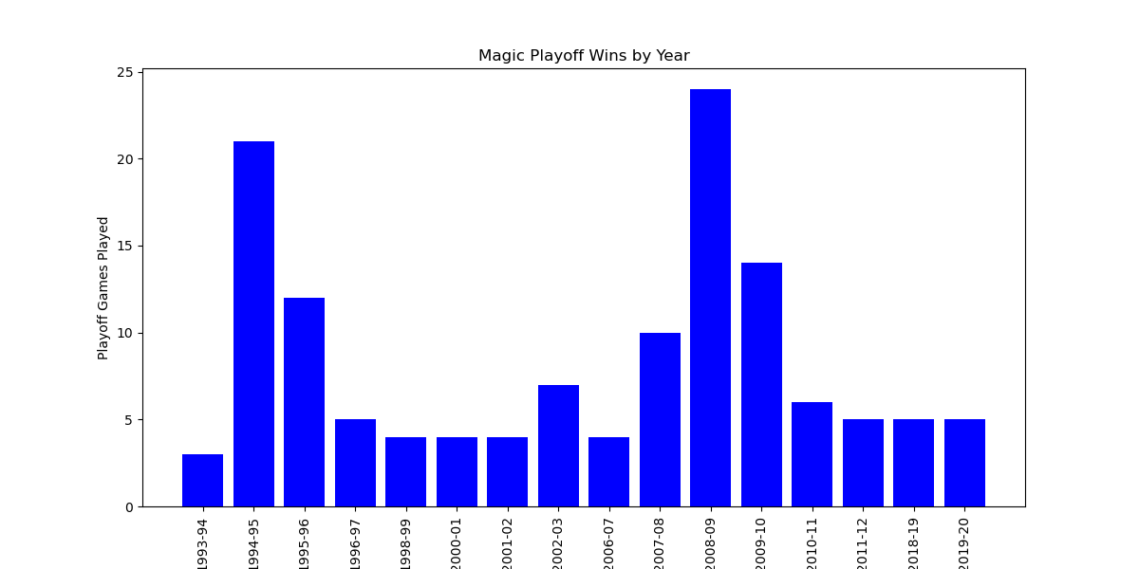
Question 1 – Regular Season vs Playoff Percentage
The two-line plot data of regular season vs playoff games was used to determine the p value
The p value was calculated as 6.11315173e-05, which shows a strong correlation.

Slide 19
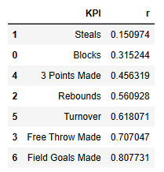
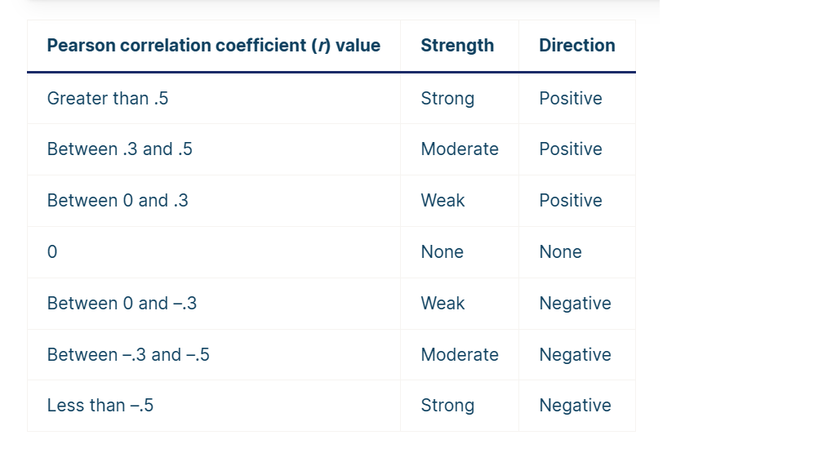
Question 4 - KPIs most closely relate to wins Linear Regression: Summary of the R-values of the KPIs studied

Slide 20
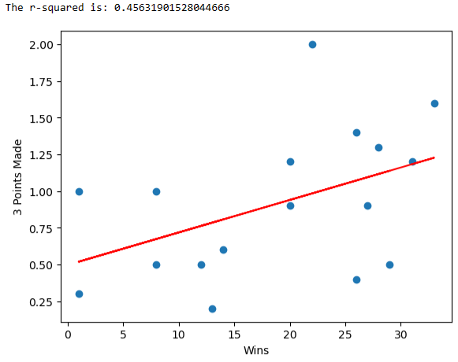
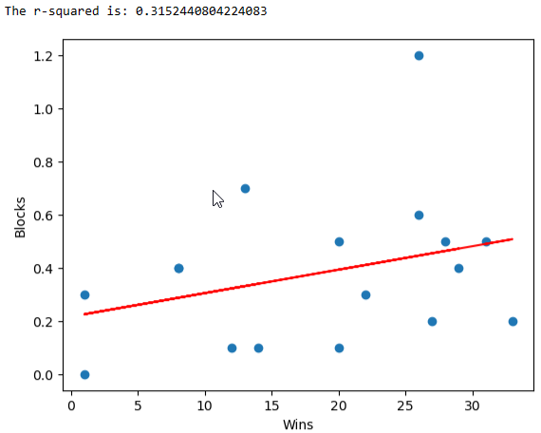
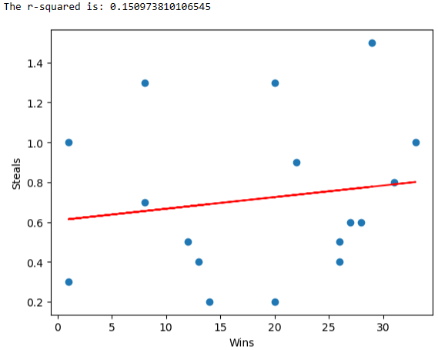
Blocks and Steals have a weak positive relation to Wins.
3 Points made have a moderate positive relation to Wins.

Slide 21
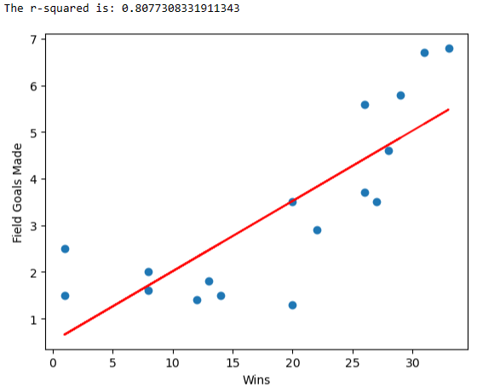
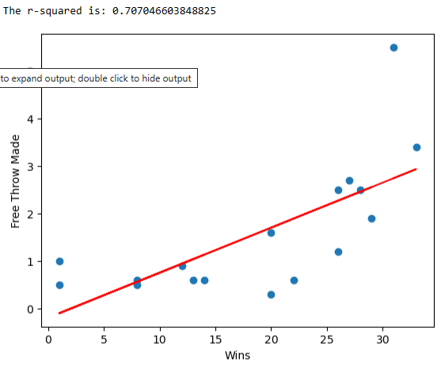
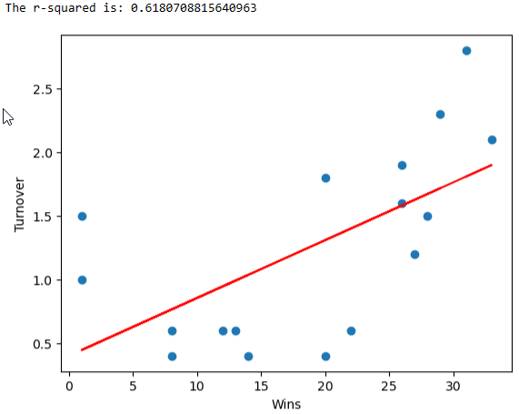

These variables a strong positive relationship to Wins :
1) Field Goals Made
2) Free Throws Made
3) Rebounds

Slide 22
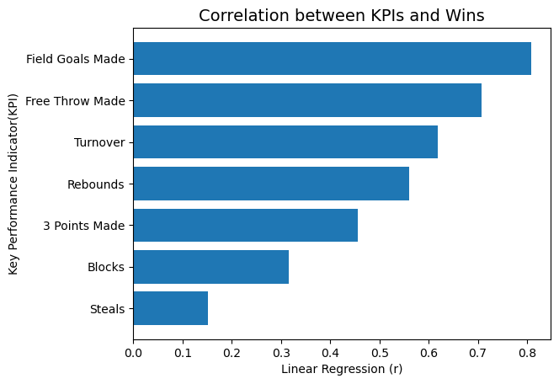
Summary: According to the Pearson Correlation Coefficient Table, the KPIs all had a positive relation to wins.
However, a strong positive relationship to Wins were shown by:
1) Field Goals Made
2) Free Throws Made
3) Rebounds
3 Points made have a moderate positive effect on Wins.
Steals and Blocks are least related to Win.

Slide 23
Dario

Slide 24
Jessica

Slide 25
Candace
Orlando Magic vs 1st, 15th, and 30th ranked teams
Orlando Magic vs League
5 chosen KPIs
Points Scored
3 Pointers
Field Goals
Rebounds
Turnovers

Slide 26
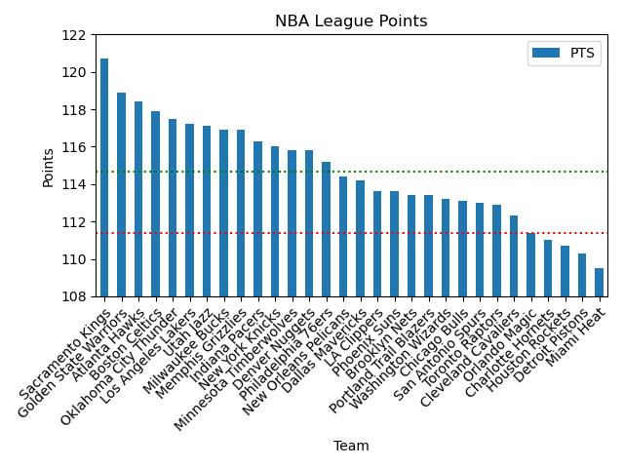
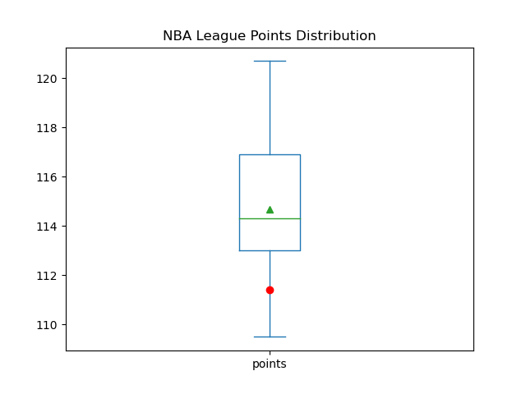
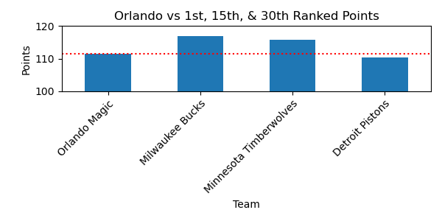
POINTS
Mean : 114.686667
STD : 2.778207
Z-Score : -1.2032409750947137

Slide 27
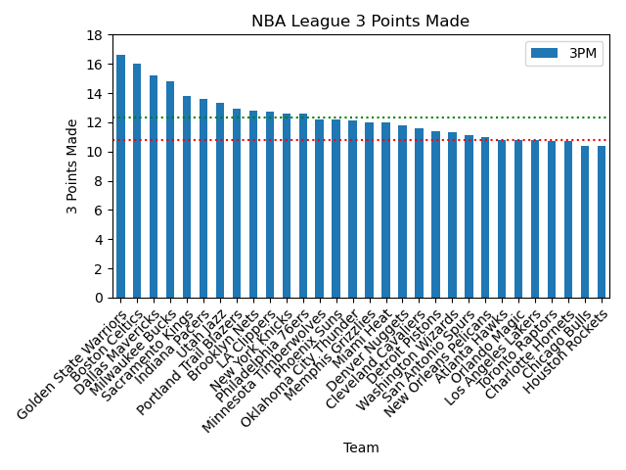
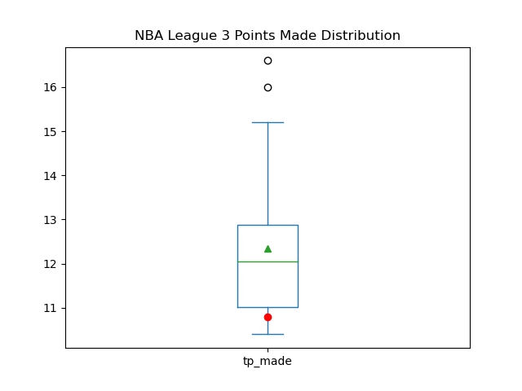
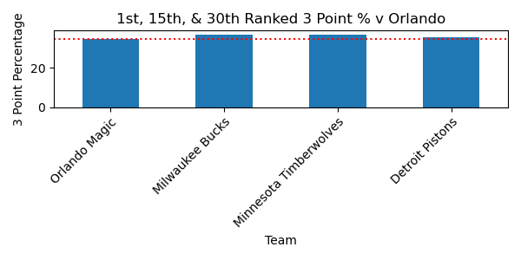
3 POINTERS
Mean : 12.340000
STD : 1.636776
Z-Score : -0.9569587051933831

Slide 28
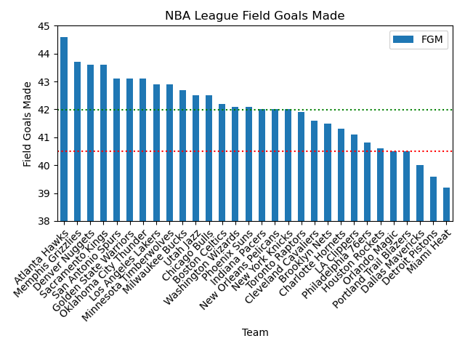
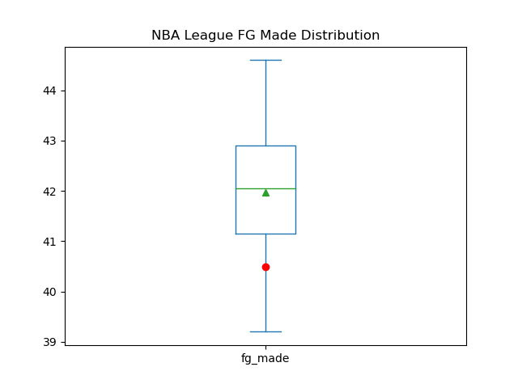
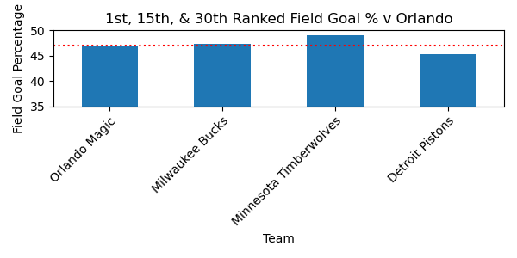
FIELD GOALS
Mean : 41.976667
STD : 1.290197
Z-Score : -1.164093743854465

Slide 29
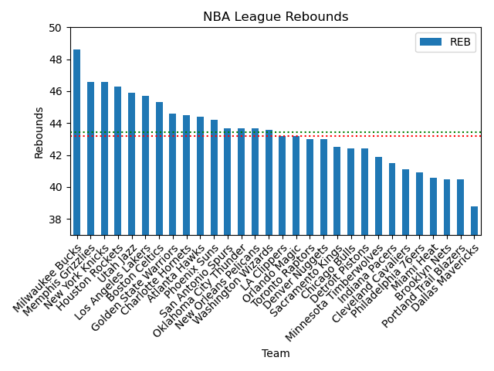
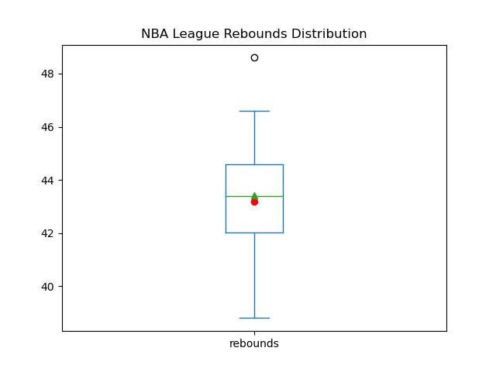
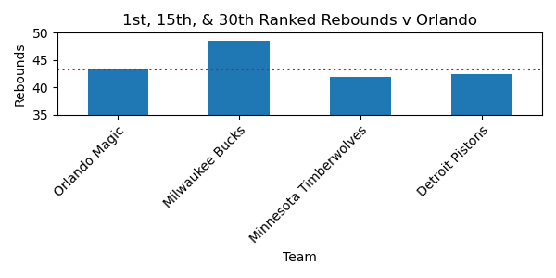
REBOUNDS
Mean : 43.430000
STD : 2.213462
Z-Score : -0.10568598615921526

Slide 30
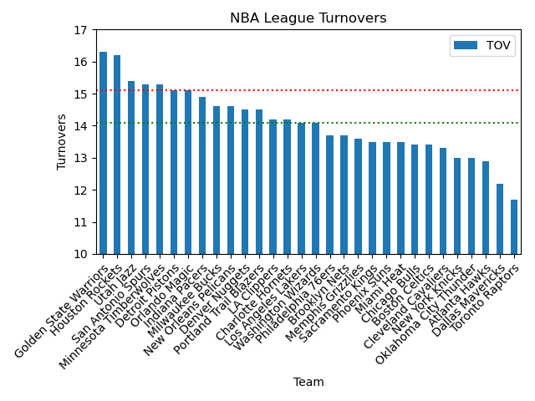
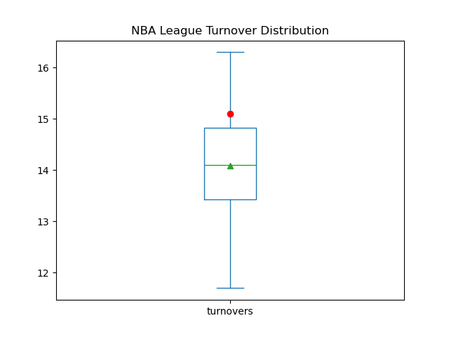
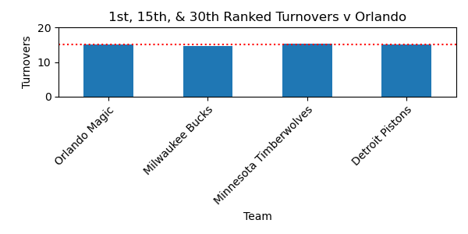
TURNOVERS
Mean : 14.093333
STD : 1.079570
Z-Score : 0.9484108889758592

Slide 31
SECTION 5
Course requirement
Next steps:
Briefly discuss potential next steps for the project.
Cindy’s requirement
The implications of your findings: what do your findings mean?
Time: .5 minutes
Assignment
Intro – Candace
Slides
Dario
Mark
Jessica
Candace
Brenton

Slide 32
Question 1 – Regular Season vs Playoff Percentage
The correlation of season winning percentage versus playoff winning percentage is important because the regular season winning percentage determines home court advantage throughout the playoffs.
Statistics show the team with the home court advantage has won 53 of 74 championships, or 71.6% of the time.
There are no next steps with regard to this KPI

Slide 33
Dario

Slide 34
Jessica

Slide 35
Question 3 – Orlando Magic v League
Going forward, the team overall should work on reducing the number of turnovers that they make every game.
In addition, they need to focus on their shooting percentage and generally scoring more points.
While scoring more points per game doesn’t correlate to winning games, even attempting more shots per game will have an effect on their outcome.

Slide 36
Brenton

