Slide 1
An Exploratory Data Analysis (EDA) of the Orlando Magic
Notes:
Business Title Page

Slide 2
SECTION 1
Overview of the project and project goals

Slide 3
Project Overview
The Orlando Magic has contracted this group to perform an EDA to look into key performance indicators (KPIs) to determine areas of play that need improvement so the Magic can become a winning team. The group quickly put together a list of questions to look into some of the more popular indicators known throughout the basketball industry. One motivational factor about this project is that the Magic is local to the Orlando area and an improvement in their performance would help drive fan support.
1. Is there a correlation between regular season and playoff winning percentage?
2. How does the team makeup and performance from last season compare to previous seasons?
3. How does the Orlando Magic, as a team, compare to other teams in the league and the league as a whole?
4. Which KPIs most closely relate to wins for the Orlando Magic Team in the 2022 - 2023 Games 5. How do the players compare by position?

Slide 4
SECTION 2
An overview of the data collection, cleanup, and exploration processes

Slide 5
Website Data Collection from Basketball-Reference.com
One source of data was from the website: https://www.basketball-reference.com/teams/ORL/
This site is part of a larger reference site called Sports-Reference.com.
The site is easy to navigate, and the data is available in csv format.

Slide 6
Website Data Collection from NBA.com
One source of data was pulled directly from NBA.com and put the into CSV files
Data was selected as needed based on the results that from my first objective of finding the rankings of the NBA teams
Data was cleaned using excel to make sure all of the data was formatted correctly. The data was then imported into a Jupyter Notebook for analysis

Slide 7
API Data Collection using nba_api
One source of data came from the python module nba_api
The nba_api contains official data from the NBA and is the source of data for the website NBA.com
The API was easy to learn but going through the documentation was time consuming, which the group to use other methods in addition to this one
The nba_api package is Open Source with an MIT License and does not require an API key

Slide 8
Website Data Collection from NBA.com
Used https://www.nba.com/stats/players/traditional?SeasonType=Regular+Season to collect the traditional statistics of the 2023 regular season from the top 200 players made it into a CSV file.
Added a Position column in excel to each of the CSV files. Created Dataframe with the CSV files of League Leaders and Orlando Magic Team.
Used the Groupby and .Loc function to sort the data by position so each player was being compared to similar player type.

Slide 9
SECTION 3
The approach to achieve the project goals

Slide 10
Question 1 – Regular Season vs Playoff Percentage
Data was collected through the python module nba_api
The data was filtered to include only seasons where the Magic made the playoffs
A two-plot line chart was created to show the different winning percentages
A bar chart was created to show the number of games played in each playoff season
A T test was applied to determine whether or not there was a correlation between regular season wins and playoff wins

Slide 11
Question 2 – Last Season vs Best/Worst Seasons
Data was collected from basketball-reference.com
Overall team performance from all seasons, as well as individual player demographics from the top/bottom performing and most recent seasons were analyzed
A bar chart was created to compare win/loss percentages
A scatter plot was created to compare offensive and defensive ratings
A box plot was created to compare players’ years of experience coming into the season

Slide 12
Question 3 – How Does the Magic Compare to the League
The following 5 major factors were analyzed in game performance.
Points for an overall metric
2 Offensive Skills – 3 Pointers, and Field Goals
2 Defensive Skills – Rebounds and Turnovers
The comparison of the Magic to 3 other teams consisted of 3 Point Percentage and Field Goal Percentage to get a wider view of the points being made.
The comparison of the Magic to the entire league consisted of 3 Points Made and Field Goals Made to get a more specific look at where the points are coming from.

Slide 13
Question 4 - KPIs most closely related to wins KPIs studied for the Orlando Magic
Steals
Blocks
Turnover
Field Goals Made
3 Points Made
Free Throw Made
Rebounds – includes offensive and defensives

Slide 14
SECTION 4
Results and conclusions of the analysis

Slide 15
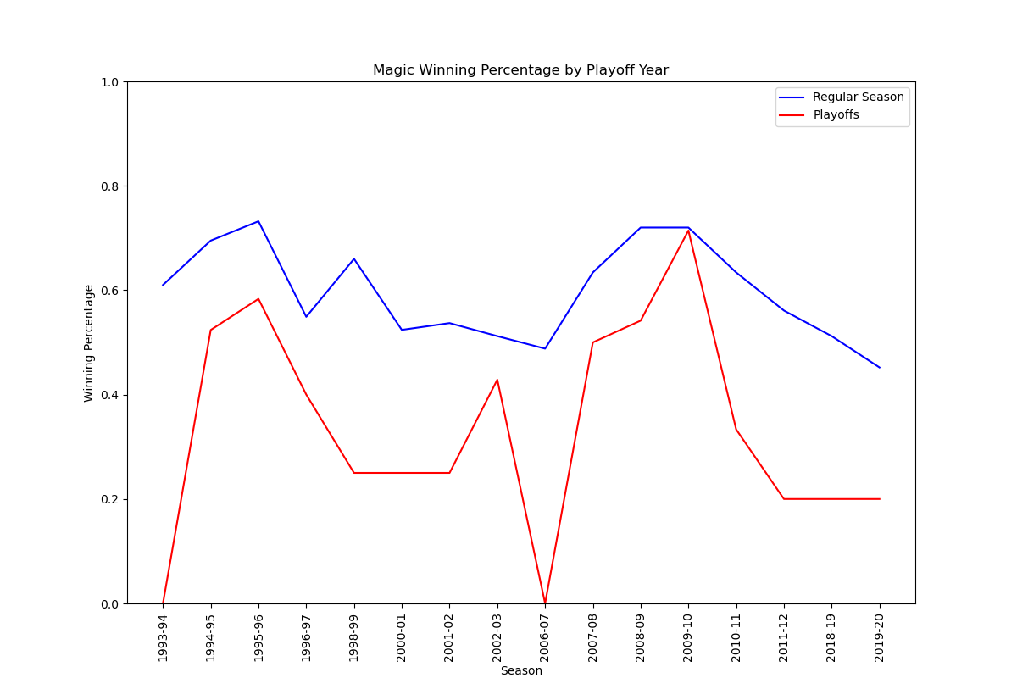
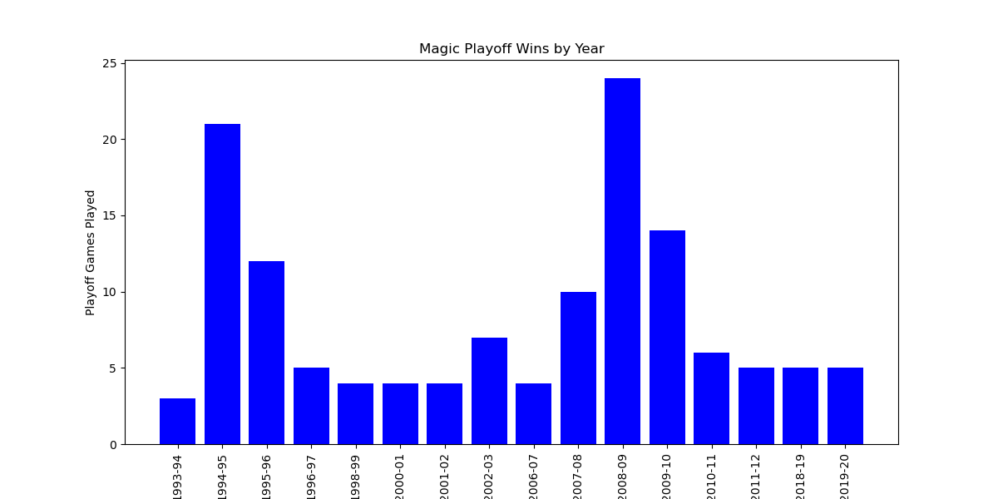
Question 1 – Regular Season vs Playoff Percentage
The two-line plot data of regular season vs playoff games was used to determine the p value
The p value was calculated as 6.11315173e-05, which shows a strong correlation.

Slide 16
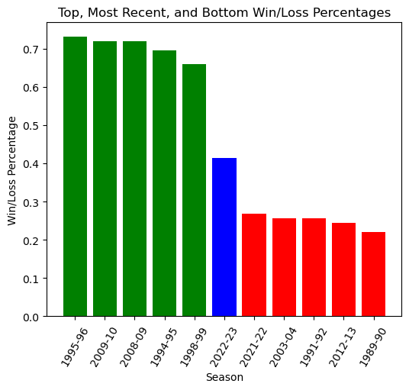
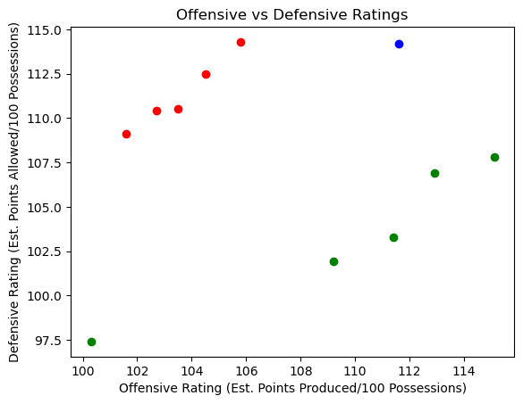
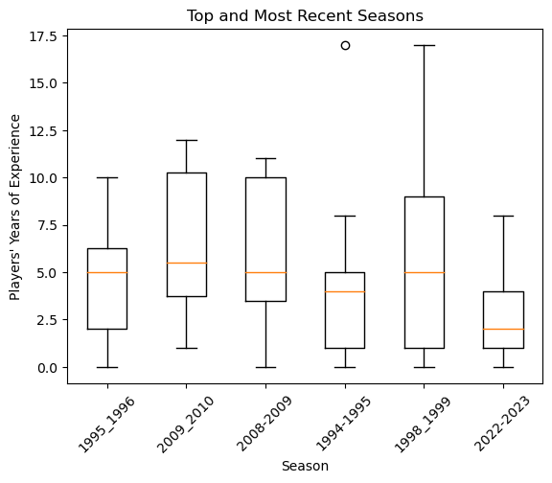
Question 2 – Last Season vs Best/Worst Seasons
Compared to their 5 best seasons, players’ average years of experience prior to the start of the season was 2.5 years lower in 2022-2023.
In the 2022-2023 season, the Orlando Magic performed slightly below average (0.415 W/L%) compared to their 32 previous seasons dating back to 1989 (0.468 W/L%).

Slide 17
Question 3 – How Does the Magic Compare to the League
Orlando Magic vs 1st, 15th, and 30th ranked teams
Orlando Magic vs League
5 chosen KPIs
Points Scored
3 Pointers
Field Goals
Rebounds
Turnovers

Slide 18
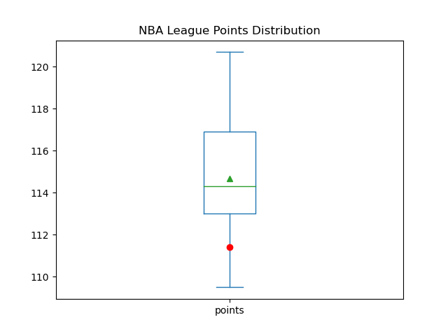
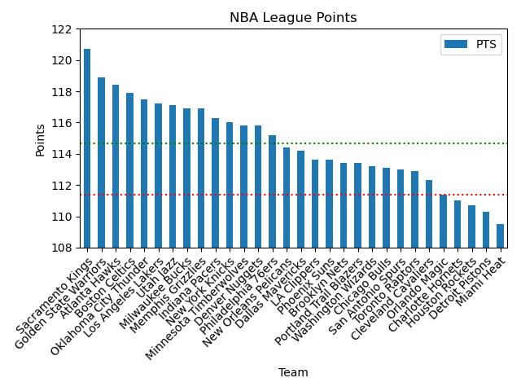
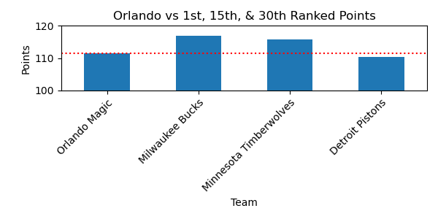
POINTS
The Orlando Magic score well below average points per game.
While the Magic scored less points than the league leader, the Milwaukee Bucks, the Bucks themselves did not score the most points per game throughout the season.
Orlando : 111.4
Mean : 114.6867
STD : 2.7782
Z-Score : -1.20324
Notes:
The Magic, as a team, are WELL below average in terms of scoring points per game.
There is a high variance amongst points scored which gives us a standard deviation on the higher side, 2.7. This variance is apparent when we look at the league points bar chart.
One interesting point, while the Magic didn’t score as many points as the Milwaukee Bucks who are ranked first in the league, the Bucks themselves didn’t score the most points in the league.
The Sacramento Kings scored by far the most points per game on average. This shows that scoring the most points per game is not the ONLY factor in winning games and being ranked higher.

Slide 19
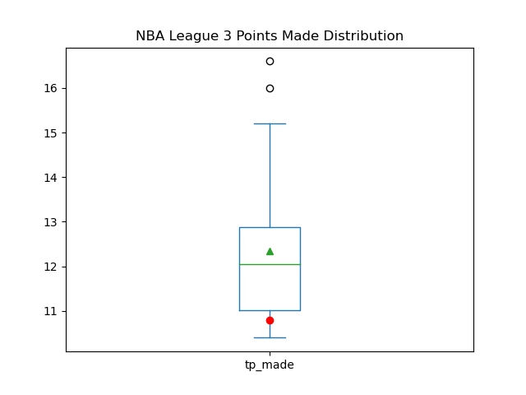
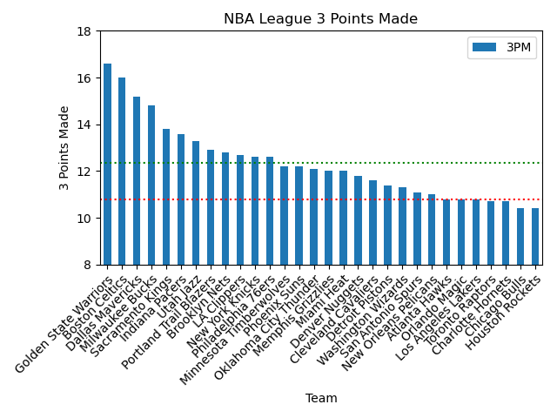
3 POINTERS
The Magic are once again below the lower quartile in regard to making 3-point shots.
Orlando’s 3-point percentage is 34.6%.
The two outliers, The Golden State Warriors and the Boston Celtics, should be looked at more in depth to better analyze a successful 3-point program.
Orlando : 10.8
Mean : 12.3400
STD : 1.6368
Z-Score : -0.95696
Notes:
The Magic as a team are still below the lower quartile when it comes to making 3-point shots, but this statistic has a smaller variance between average shots made. The standard deviation is still on the high side but comes in at a more acceptable 1.6.
Orlando’s 3-point percentage is 34.6%. Calculating their 3-point attempts, they only attempt, on average, 31.21 3-point shots per game. This is lower than the average of 34.206. So not only are they not making as many 3-point shots, but they’re also not making as many attempts.
The outliers in this case, The Golden State Warriors and the Boston Celtics, should be investigated further for a better analysis as to what a successful 3-point team looks like.

Slide 20
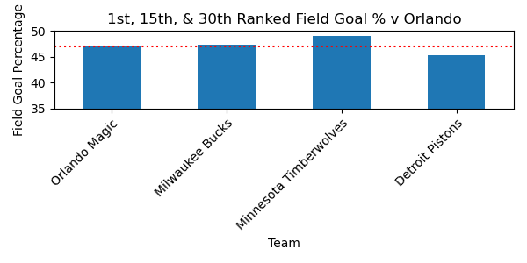
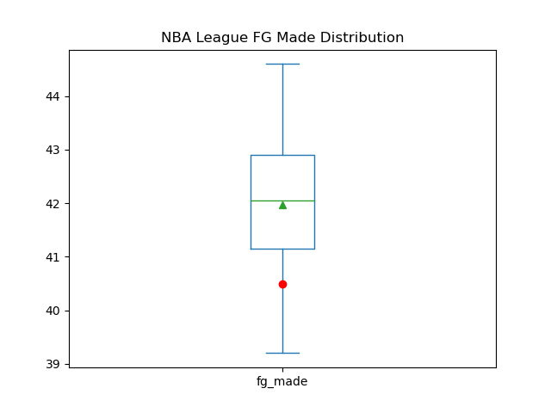
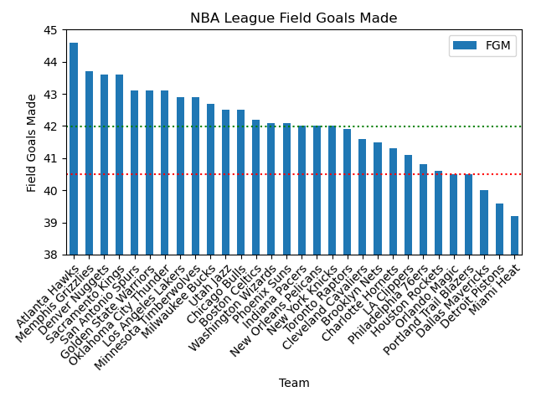
FIELD GOALS
The average Field Goals per games in more evenly distributed across the league.
The Magic have a close Field Goal % to the Milwaukee Bucks, but both teams are beat by the 15th place Minnesota Timberwolves.
Orlando : 40.5
Mean : 41.9767
STD : 1.2902
Z-Score : -1.16409
Notes:
- This statistic is more evenly distributed as we see the Standard Deviation coming down to 1.2. However, our Z-Score remains around the -1 mark and the Magic are once again below the lower quartile.
Both the Bucks and the Magic have lower amount of field goals made than the 15th team, the Minnesota Timberwolves.
I also find it interesting that the Detroit Pistons have not come in last regarding points, 3-pointers, or field goals. So, if they don’t score the least points in the league, what are they struggling with that leaves them in last place? And what can we learn from them to avoid doing?

Slide 21
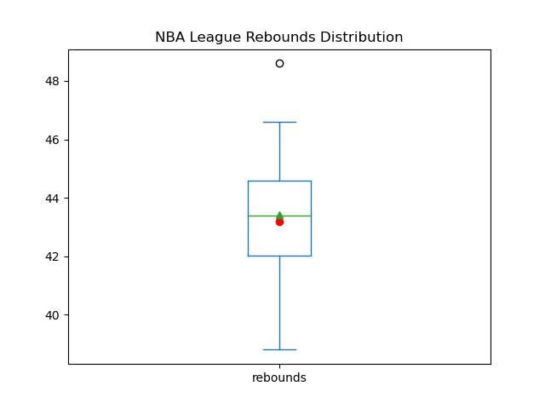
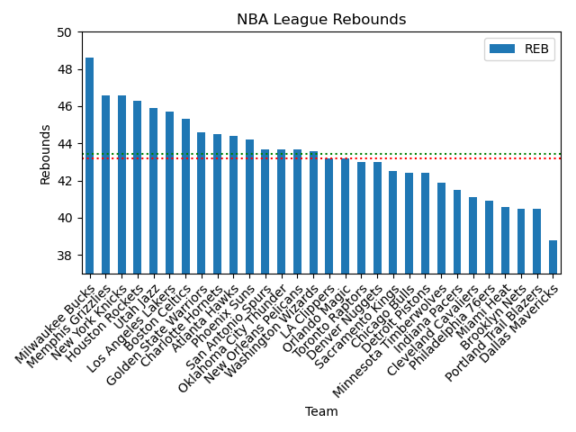
REBOUNDS
The Orlando Magic is comfortably in the middle of the pack when it comes to rebounds.
There is a higher variance with this KPI with a Standard Deviation of 2.2.
The Milwaukee Bucks are the high outlier of the league with an average 48.6 rebounds per game.
Orlando : 43.2
Mean : 43.4300
STD : 2.2135
Z-Score : -0.10569
Notes:
This is the first KPI that has landed inside of the IQR. The Orlando Magic is comfortably in the middle of the pack when it comes to rebounds.
There is a higher variance with this KPI with a Standard Deviation of 2.2. You can see from the bar chart that there is a significant drop from the highest rebounding team to the lowest.
The Milwaukee Bucks are the high outlier of the league with an average 48.6 rebounds per game. I’m wondering if their dominance in this regard has any correlation to the height of the players on their team.

Slide 22
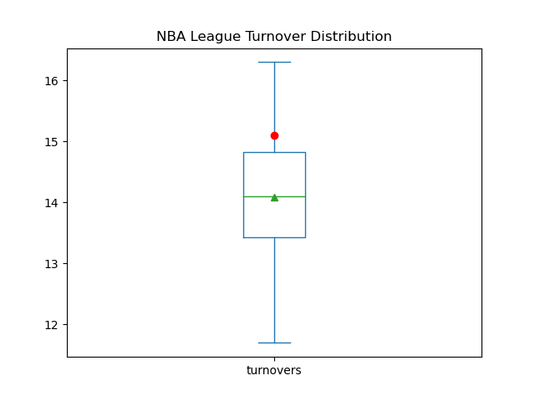
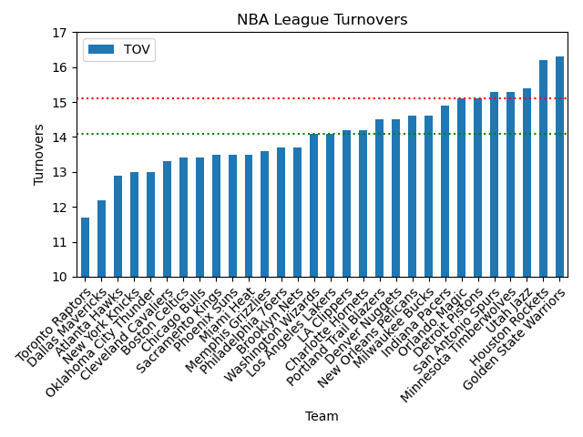
The Magic are above average when it comes to turnovers.
The Bucks, Timberwolves, and Pistons have very similar Turnover rates.
TURNOVERS
Orlando : 15.1
Mean : 14.0933
STD : 1.0796
Z-Score : 0.94841
Notes:
This Is the first KPI that I have measured where the Magic have come in above the average. The only caveat is that this is not a metric that is good to have a high average in.
The team’s struggle to hold onto the ball may have an impact on their ability to keep the other team from scoring points.
One thing about the bar graph that I find interesting is that the Golden State Warriors, a team who ranks highly in all of our scoring charts, also comes in the highest team in terms of turnovers per game.
One metric that I feel is missing from the data is ‘How Many Points the Other Team Scored Per Game’. We can look at how many points the team scored and how many ball fumbles they had, but the most important metric appears to be, simply, how many points they gave up to the other team. From here I would look into Blocks and Personal Fouls.

Slide 23
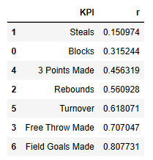
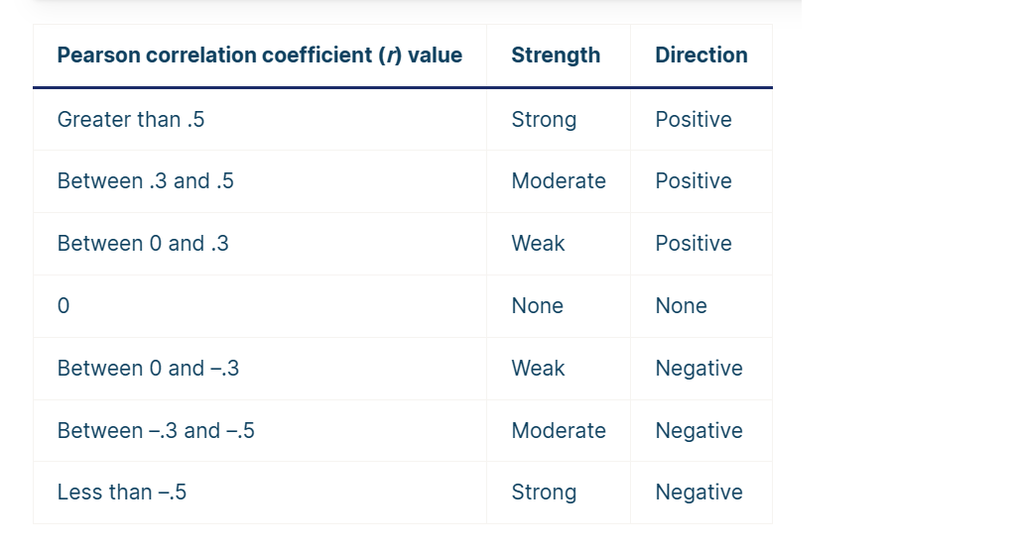
Question 4 - KPIs most closely relate to wins Linear Regression: Summary of the R-values of the KPIs studied

Slide 24
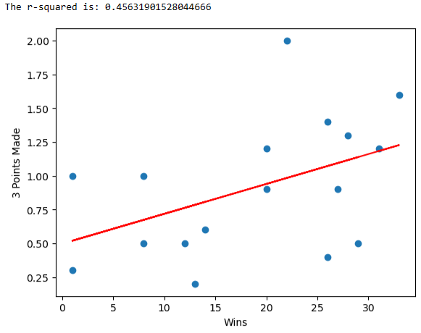
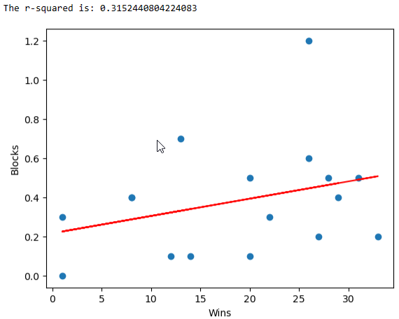
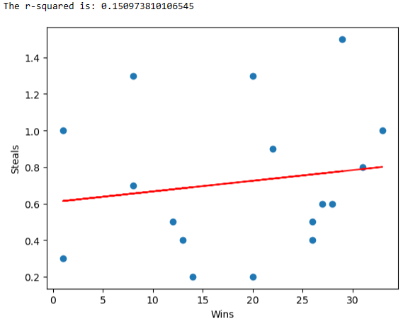
Blocks and Steals have a weak positive relation to Wins.
3 Points made have a moderate positive relation to Wins.

Slide 25
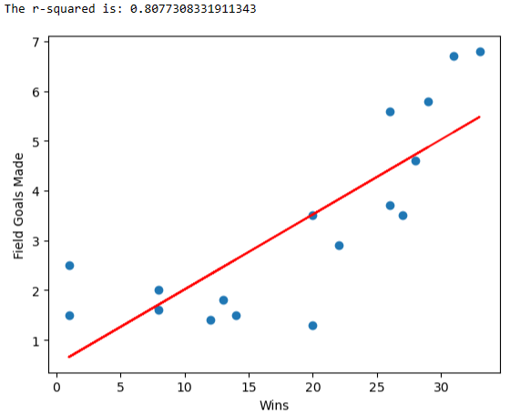
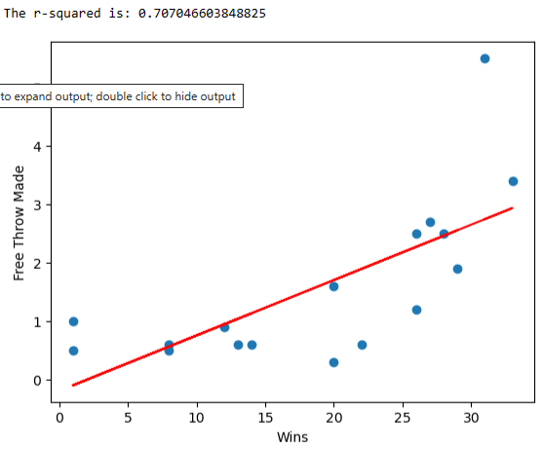
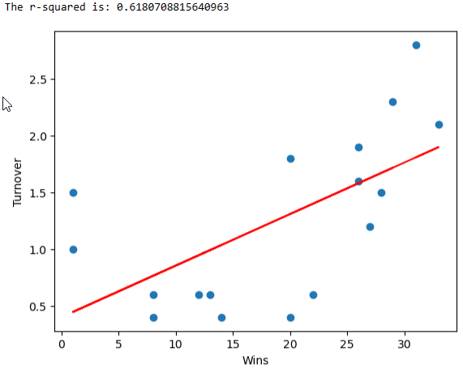

These variables a strong positive relationship to Wins :
1) Field Goals Made
2) Free Throws Made
3) Rebounds

Slide 26
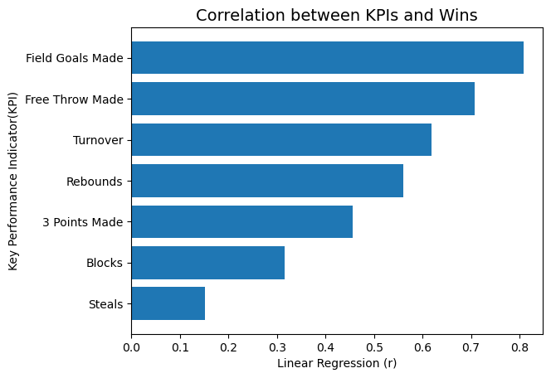
Summary: According to the Pearson Correlation Coefficient Table, the KPIs all had a positive relation to wins.
However, a strong positive relationship to Wins were shown by:
1) Field Goals Made
2) Free Throws Made
3) Rebounds
3 Points made have a moderate positive effect on Wins.
Steals and Blocks are least related to Win.

Slide 27
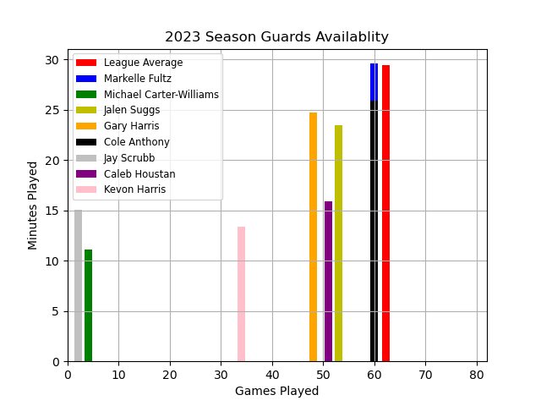
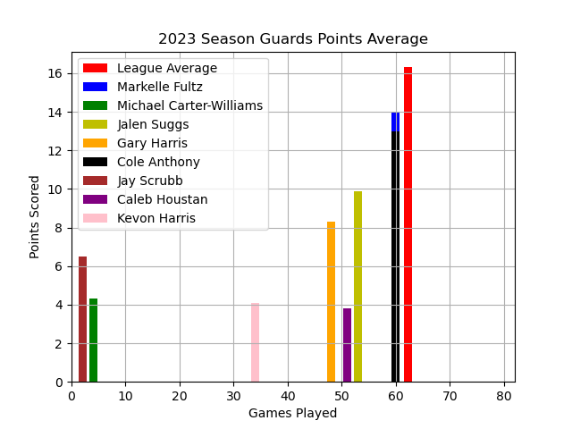
Question 5 - How do the players compare by position? Guards Season Availability & Scoring

Slide 28
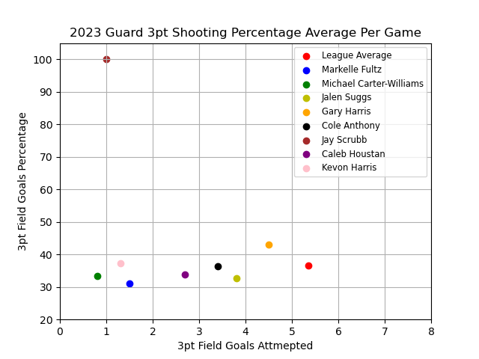
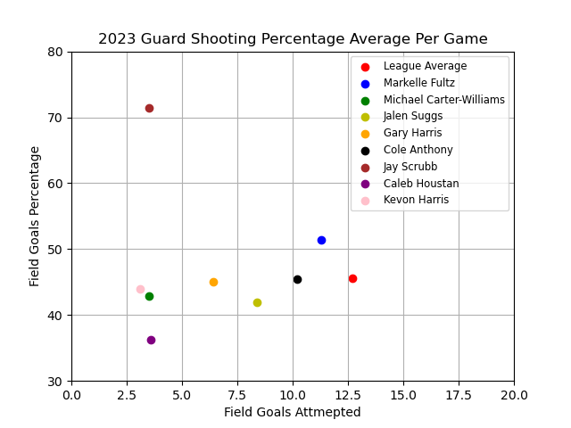
Orlando Magic Player Performance Guards Season Shooting

Slide 29
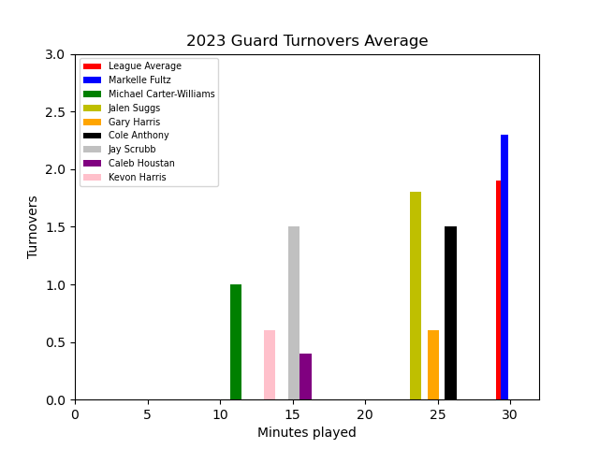
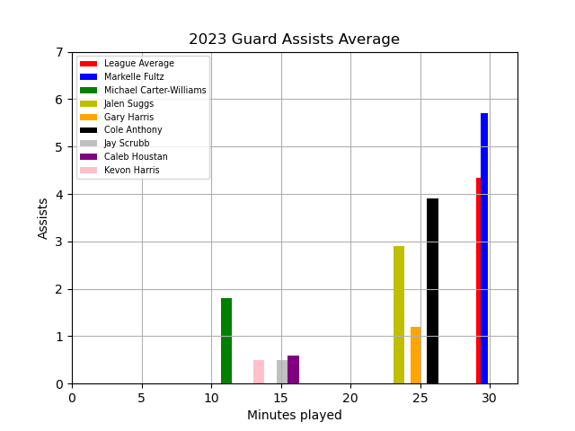
Orlando Magic Player Performance Guards Season Assist to Turnover

Slide 30
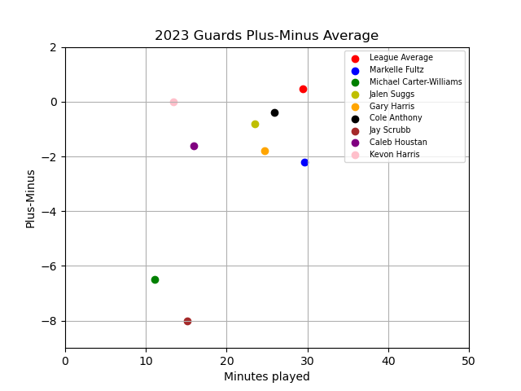
Orlando Magic Player Performance Guards Season Plus-Minus

Slide 31
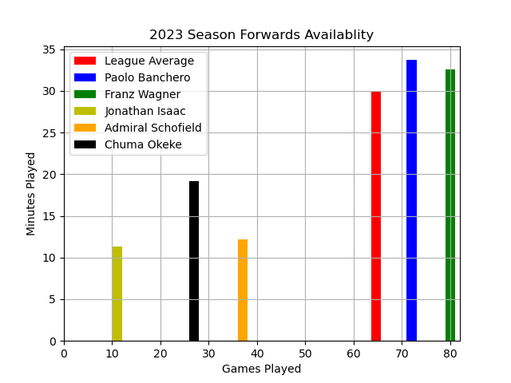
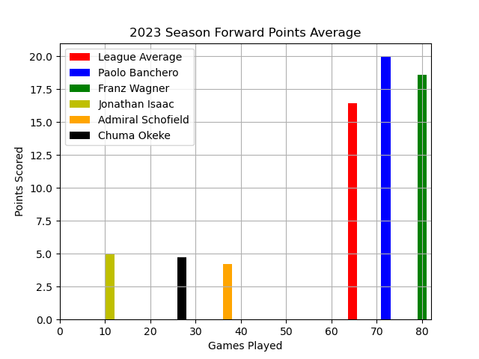
Orlando Magic Player Performance Forwards Season Availability & Scoring

Slide 32
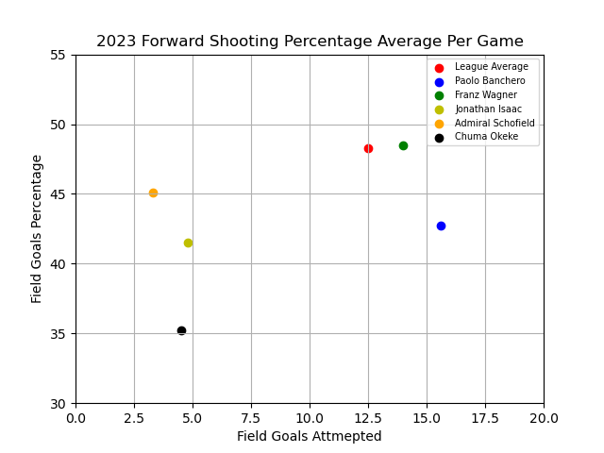
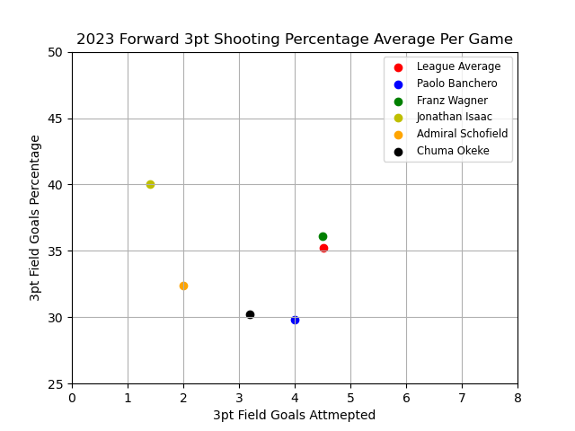
Orlando Magic Player Performance Forwards Season Shooting

Slide 33
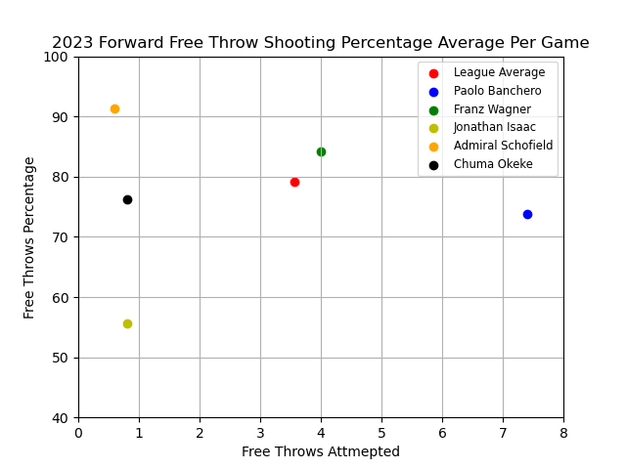
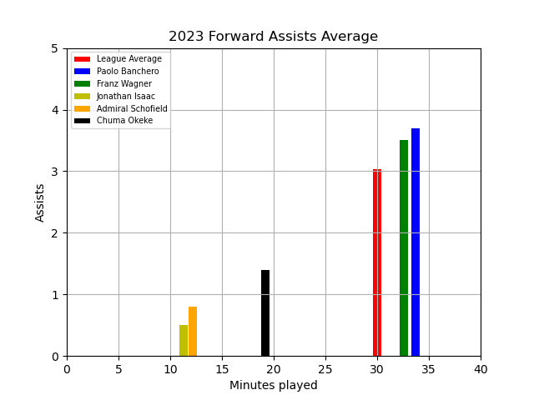
Orlando Magic Player Performance Forwards Season Scoring ( Outside of Field Goals)

Slide 34
Orlando Magic Player Performance Forwards Season Plus-Minus

Slide 35
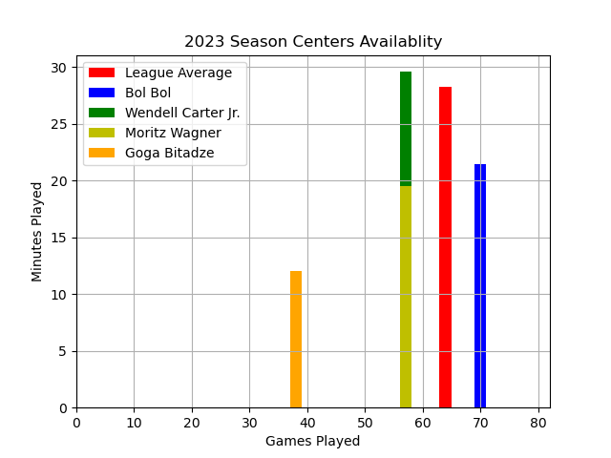
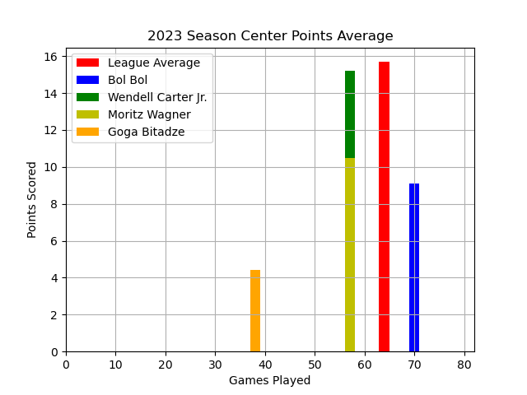
Orlando Magic Player Performance Centers Season Availability & Scoring

Slide 36
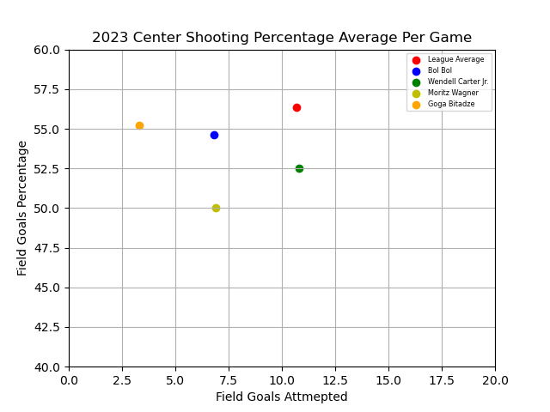
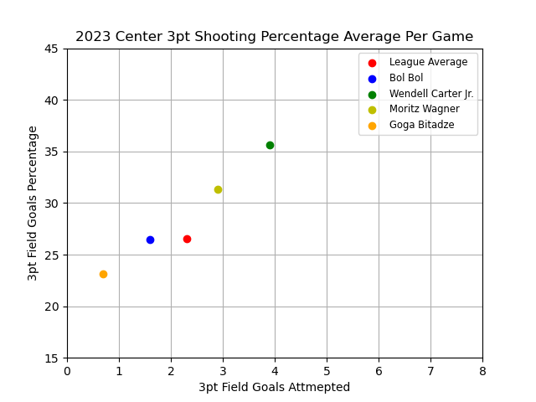
Orlando Magic Player Performance Centers Season Shooting

Slide 37
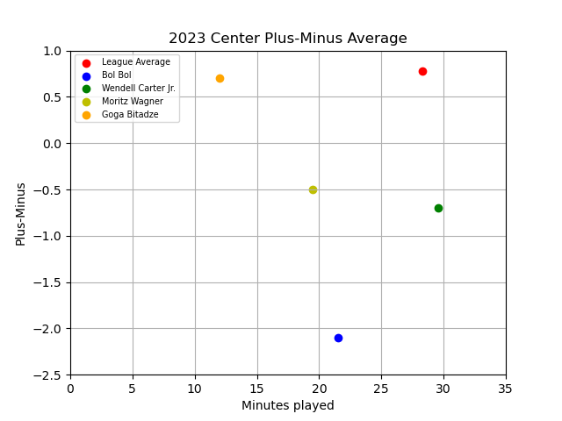
Orlando Magic Player Performance Centers Season Plus-Minus

Slide 38
SECTION 5
Implications of the findings/next steps

Slide 39
Question 1 – Regular Season vs Playoff Percentage
The correlation of season winning percentage versus playoff winning percentage is important because the regular season winning percentage determines home court advantage throughout the playoffs.
Statistics show the team with the home court advantage has won 53 of 74 championships, or 71.6% of the time.
There are no next steps with regard to this KPI

Slide 40
Question 3 – How Does the Magic Compare to the League
My analysis implies that the Orlando Magic is below average in regards to all aspects of scoring. They would benefit greatly from improving both their 3-point percentage and field goal percentage.
Next Steps:
Analysis of Free Throw Percentage, Block Rate, and Personal Fouls.
Finding additional data resources to compare average number of points scored by the other team.

Slide 41
Question 5 - Orlando’s Players Strengths
Franz Wagner and Paolo Banchero were above the league average in every metric related to scoring directly and/or indirectly.
Starter Markelle Fultz was above league average in field goal percentage.
Starter Markelle Fultz was above league average in assists.
Reserve Guard Gary Harris was above league average in 3pt shooting.
All but one Center was below league average in 3pt shooting.
All but one Guard were below the league average in turnovers.

Slide 42
Orlando’s Players Deficiencies
Reserve Guards performance in most major statistics categories were at or below league average.
Reserve Forwards performance in most major statistics categories were at or below league average.
Starting Center performance in key role statistics were at or slightly above league average.
All players but Franz Wagner were below the Plus-Minus league average.
All players but Franz Wagner, Kevon Harris, and Goga Bitadze had a negative Plus-Minus.

Slide 43
Player Performance Results
Starting Forwards are the strongest unit of the Orlando Magic Team, performed slightly or above the league average.
Starting Guards and Center were at or slightly above league average
Reserve players production in all roles were mainly below league average.

Slide 44
Conclusion
Recommend contracting better reserve players in all categories. Their production is not up to par when they are on the floor.
Contracting a starting Guard or Center that is performing way above the league average and converting your starters into role players. This could increase your reserve production and their individual production shouldn’t dip to much.

Slide 45
Presented by
Brenton Bethel
Candace Stingley
Dario Rangel
Jessica Richter
Mark Meinhardt

