Slide 1
Strongest and Weakest Player Comp.
Question 3.

Slide 2
Orlando Magic 2023 Guards

Slide 3
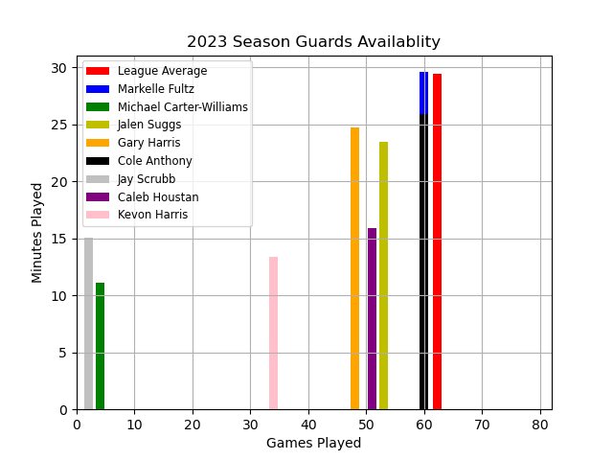
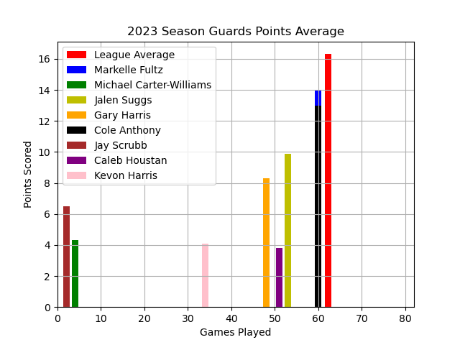
Guards Season Availability & Scoring

Slide 4
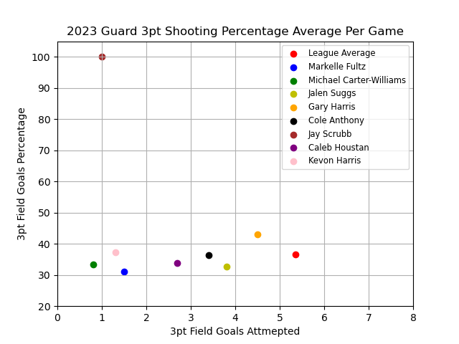
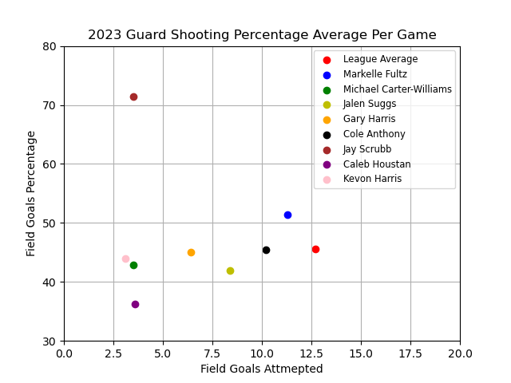
Guards Season Shooting

Slide 5
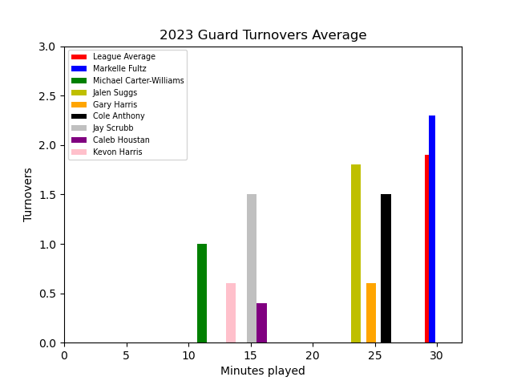
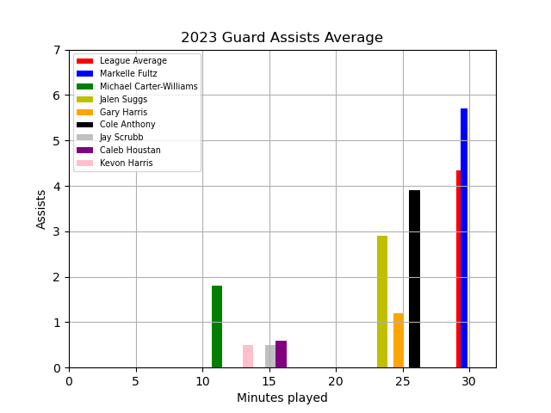
Guards Season Assist to Turnover

Slide 6
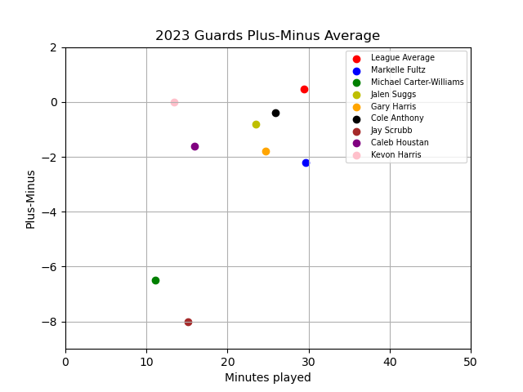
Guards Season Plus-Minus

Slide 7
Orlando Magic 2023 Forwards

Slide 8
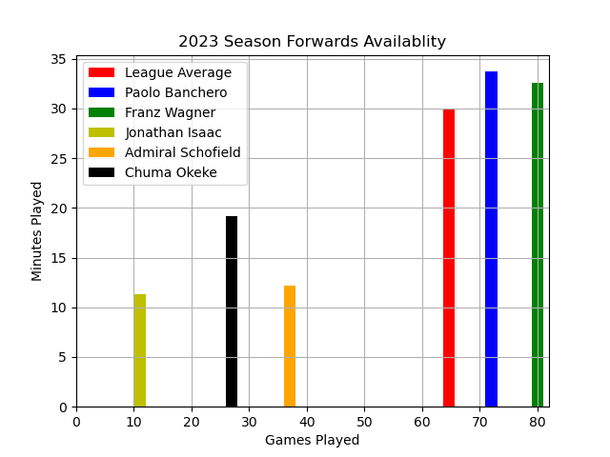
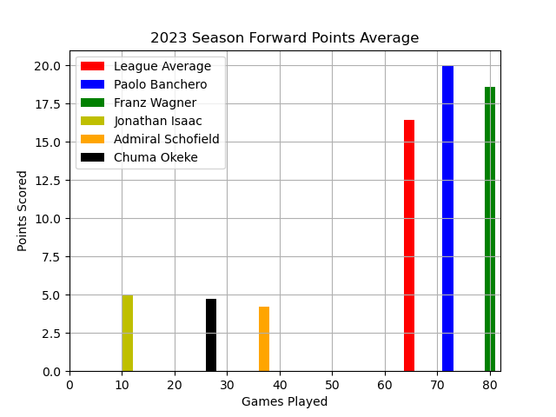
Forwards Season Availability & Scoring

Slide 9
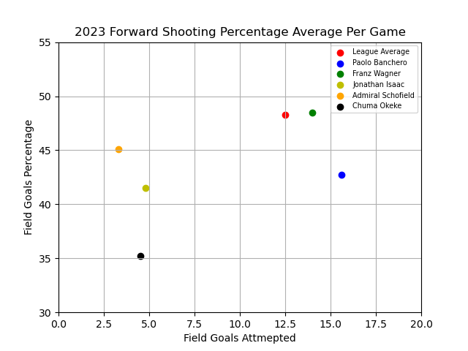
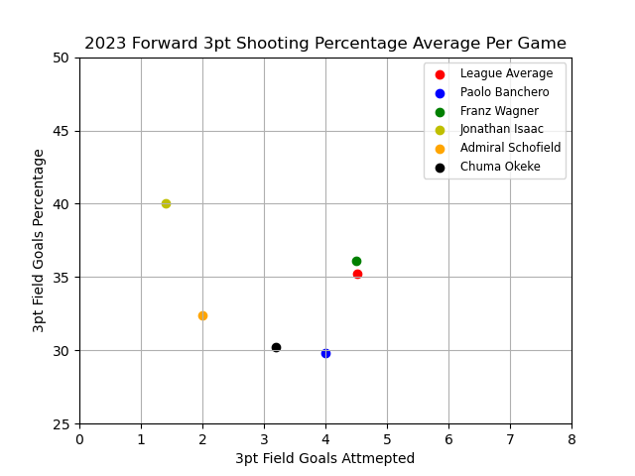
Forwards Season Shooting

Slide 10
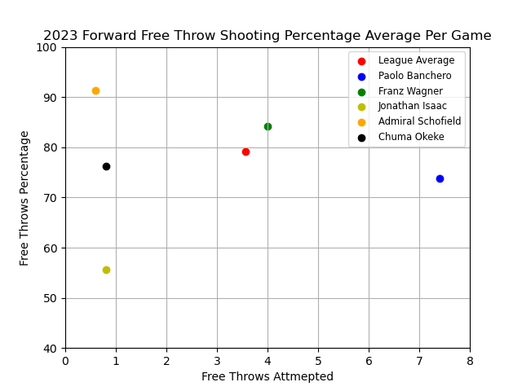
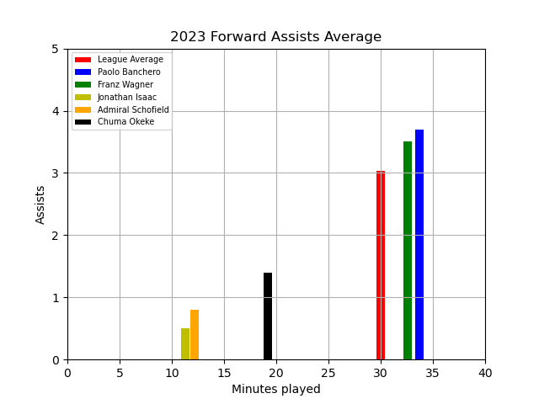
Forwards Season Scoring ( Outside of Field Goals)

Slide 11
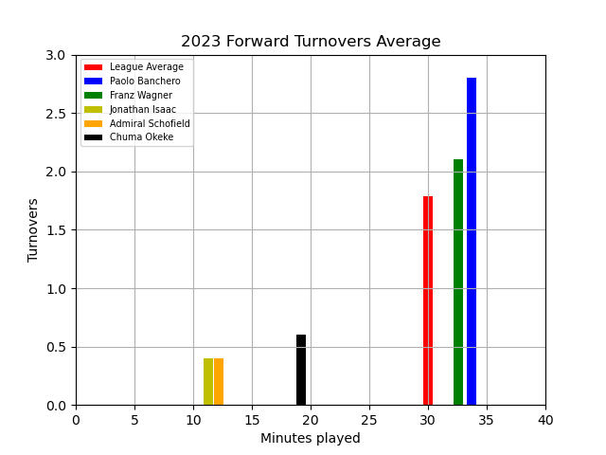
Forwards Turnovers

Slide 12
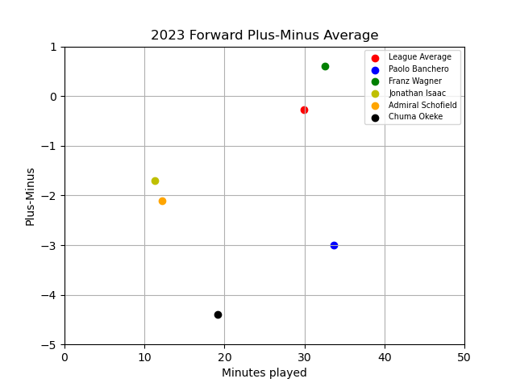
Forwards Season Plus-Minus

Slide 13
Orlando Magic 2023 Centers

Slide 14
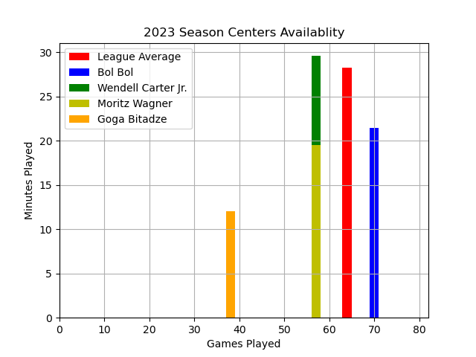
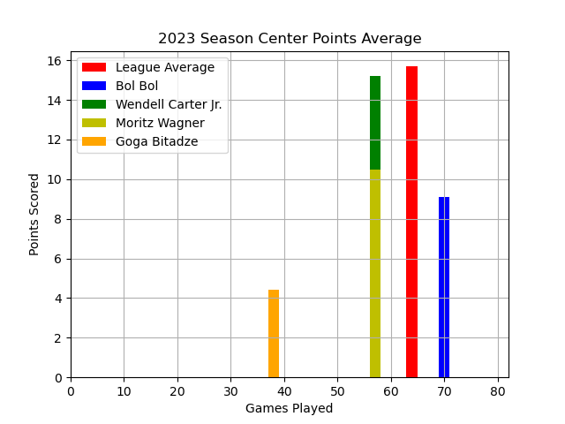
Centers Season Availability & Scoring

Slide 15
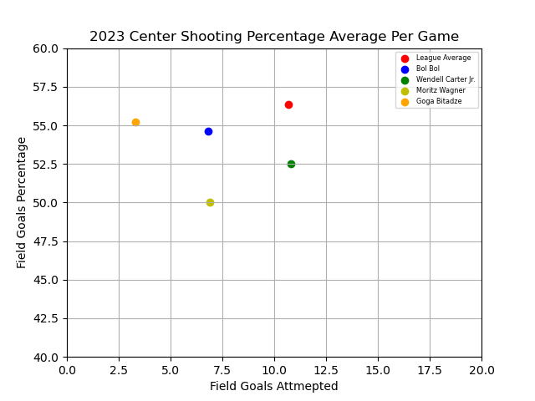
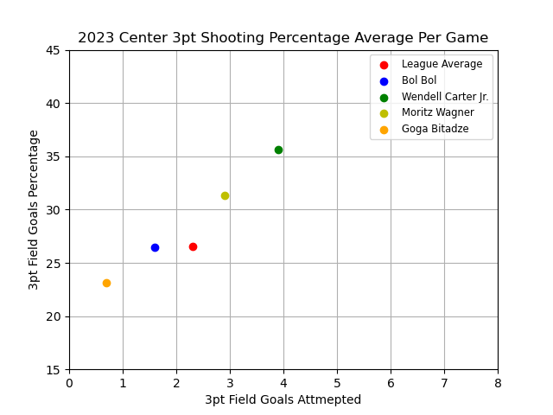
Centers Season Shooting

Slide 16
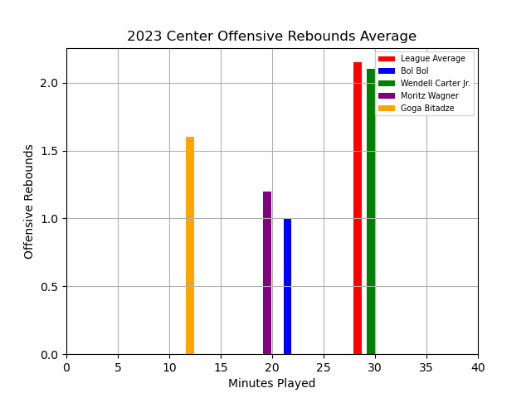
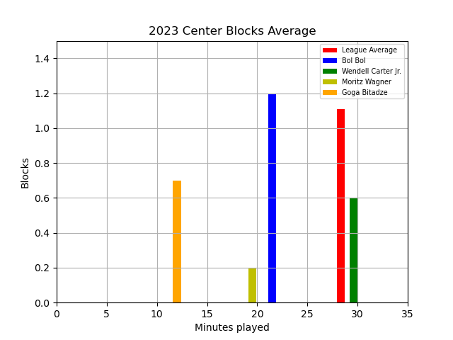
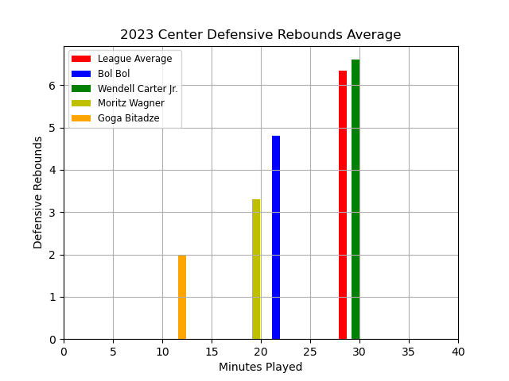
Centers Season Total Rebounds & Blocks

Slide 17
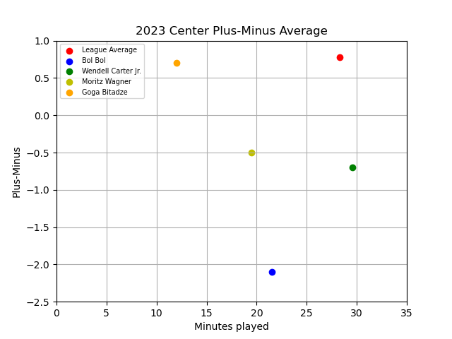
Centers Season Plus-Minus

