Slide 1
An Exploratory Data Analysis on the Orlando Magic by Exploratory Magic
Let our analysis transform your business into a champion.
Notes:
Business Title Page

Slide 2
Problem Statement
In 1989, the Orlando Magic joined the National Basketball Association (NBA) and are one of 12 teams to have never won a championship. At the conclusion of the 2022-2023 season, the front office contracted Exploratory Magic to analyze player performance based on a number of metrics and to use this information to improve the team performance and win a championship.
Methodology
Analyze metrics of player performance over the 2022-2023 regular season. Compare the Magic players to other players in the league grouping them by position and measuring the most important metrics of each position.

Slide 3
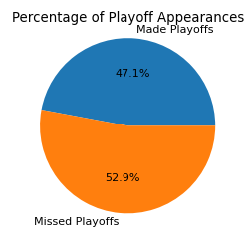
Introduction – The Orlando Magic
Joined the NBA in 1989 for a total of 34 seasons
One of 12 teams to never win a championship
Has been to the final championship game twice, once in 1995 and once in 2009
Has been to the playoff 16 times
Last playoff appearance was in 2020
Average winning percentage has dropped below .500 over the last 10 seasons with the Magic making the playoffs in 2 of those years
Looking for areas of improvement to win a championship and return to the glory years
Notes:
The first step was to look at historical data of average winning percentage by season and years the Magic made the playoffs

Slide 4
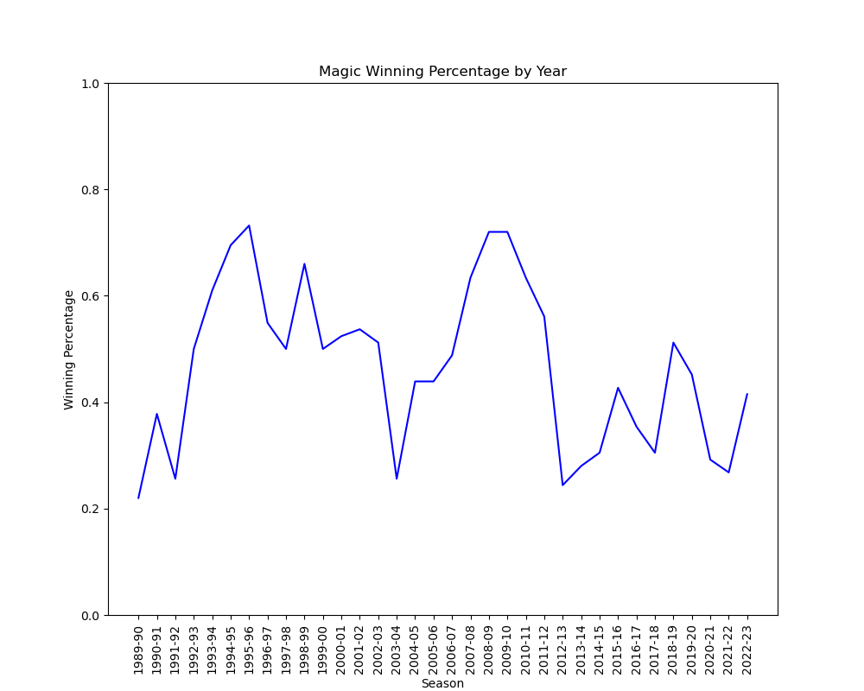
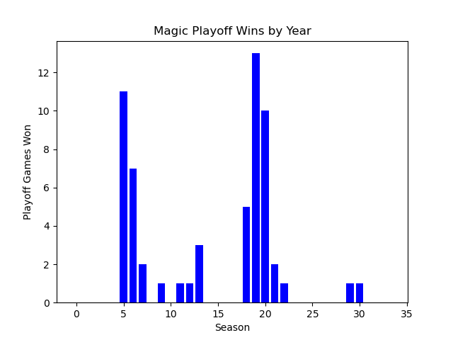

Winning Percentage/Playoff History by Year
Winning Percentage
Playoff History

