Slide 1

26DPWPROJECT · FINAL PRESENTATION
TMDB Movie Analytics Dashboard
DATASET
FINANCIAL ROWS
VIEWS
DEMO
45,346
5,375
8
5 min
analysis-ready films
budget + revenue
dashboard sections
live system walkthrough
ZHOU Can · CHEN Ziming · DAI Ling · LIAO Shuaiyu · PAN Meihao · ZHU Junyu
01 / 22

Slide 2

TALK MAP
02 / 22
TALK MAP
02 / 22
Presentation Flow Aligned with Team Responsibilities
A 15-minute technical narrative followed by a 5-minute live demo and Q&A.
1
Project + Data Cleaning
2
3
Database + ER Design
4
Dashboard Exploration
01
02
03
5
6
Project + Data Cleaning
Database + ER Design
Dashboard Exploration
Chi-Square
Regression + Prediction
Insights + Export
2.5 min
2.5 min
3 min
Problem framing, TMDB source data, SQL-to-CSV cleaning.
Relational schema, core tables, SQL export path.
Overview, Revenue, Genres and Time views.
2.5 min Schema, core tables, SQL export
3 min Overview, Revenue, Genres and Time
2 min Independence tests and residuals
2.5 min Regression and Gradient Boosting
2.5 min Findings, export, limits, future work
04
Chi-Square Tests
05
Regression + Prediction
06
Insights + Export
2 min
2.5 min
2.5 min
Categorical hypotheses, p-values and residuals.
Linear fit, model metrics and comparable-film output.
Automated findings, CSV export, limits and future work.
02 / 22

Slide 3

Steph ZHU
03 / 22
Project Background: From Scattered Film Data to an Interactive Decision-Making System
Goal: Aims to help analyze box office patterns, genre profitability, release date selection, and enable basic box office forecasting.
RAW SOURCE
TMDB SQL
Data scattered across different dataset → no single source provides both financial and metadata.
movie, genres, rate, credit...
Do not need to query multiple sources, align genres manually.
FINAL TABLE
45,346
Existing tools: Only show historical charts. Ours adds: Provide statistical significance tests, machine-learning predictions, and exportable insights.
processed movies
COMPLETE FINANCE
5,375
Our project is an interactive system which solves users' questions and lets users search different data in targeted periods
budget / revenue rows
03 / 22

Slide 4
Steph ZHU
Data Cleaning
04 / 22
Removed missing values, duplicate records, and invalid data and filter invalid ratings to improve data quality and consistency. For example, ratings had to be between 0.5 and 5.0, with increments of 0.5 only. Standardized the data format. For example, we converted all movie IDs into TMDB IDs using the links.csv mapping table, so all tables could connect correctly through the same key. Processed nested JSON data, such as genres, keywords, cast, and crew information. and extracted and flattened these fields into separate relational tables to match our ER diagram design. Sorted the data, unified column names and data types, and exported the cleaned results as CSV files for database import.
04 / 22

Slide 5
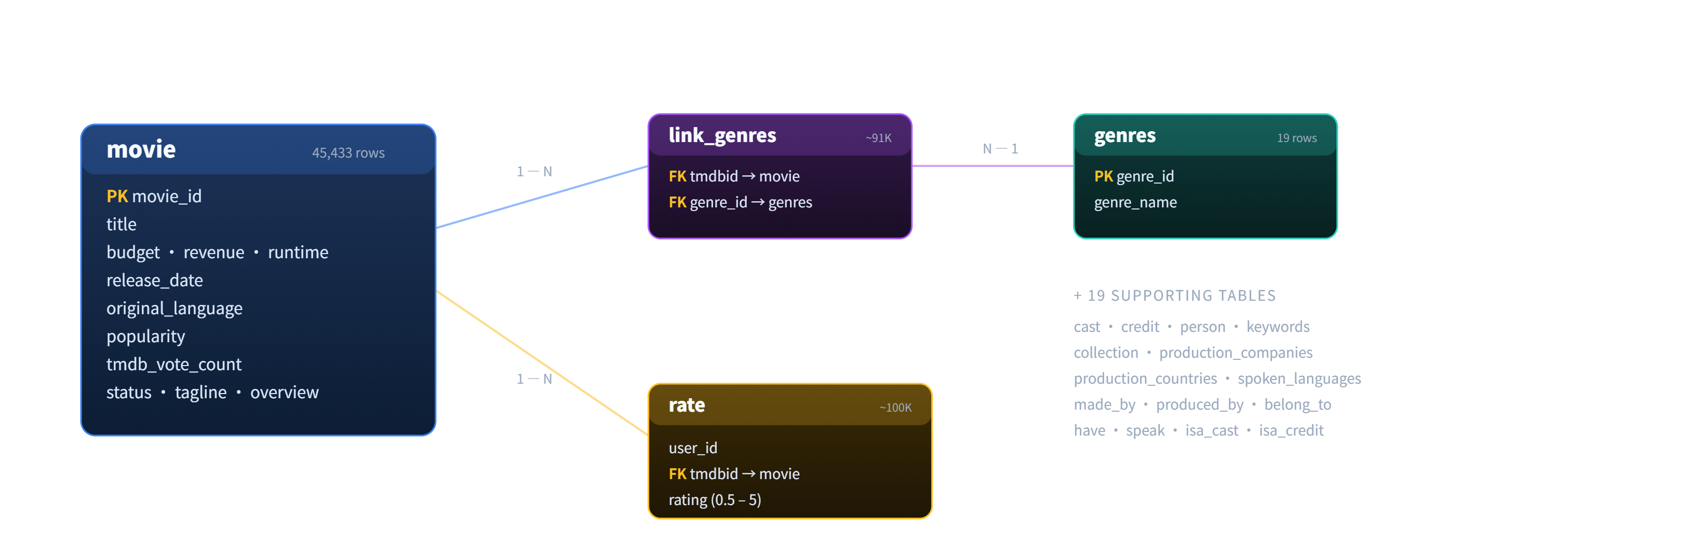
Gareth
05 / 22
Database Design: From ER Diagram to Relational Schema
The ER diagram was implemented as a MySQL relational schema to support structured analysis and reproducible data processing.
CORE RELATION
movie ↔ genres
many-to-many via link_genres
RATING RELATION
movie ↔ rate
one movie, many user ratings
PEOPLE RELATION
cast / credit
actors, directors, writers
The database was exported as SQL files for restoration, validation, and later project use.
05 / 22

Slide 6
Gareth
06 / 22
How Core Tables Support the Analysis
Each table provides a specific part of the information needed by the dashboard.
Table | Key fields | Used for
movie | budget, revenue, runtime, release_date | Box office, ROI, runtime and release timing analysis
genres | genres_id, genres_name | Standardized genre dictionary
link_genres | tmdbid, genres_id | Many-to-many movie-genre mapping
rate | user_id, tmdbid, rating, timestamp | Rating aggregation and audience response
person | person_id, name, gender, profile_path | Basic people information
cast / credit | character, department, job | Actors, directors, writers and crew information
production_companies | company_id, company_name | Future company-level analysis
The schema defines what can be imported, validated, and reused later.
06 / 22

Slide 7
Gareth
07 / 22
Data Import, Validation and SQL Export
The prepared data was imported into MySQL, validated, and exported as SQL files for project reuse.
1
2
3
4
5
6
Prepared CSV Files
MySQL Import
Validation
Crew / Credit
SQL Export
Project Reuse
Entity tables and relation tables
movie, genres, rate, person, cast, credit
Imported ER-based tables through phpMyAdmin
21+ relational tables
Checked row counts, keys and relationships
primary keys · foreign-key checks
Updated missing crew-related records
credit · isa_credit · person · made_by
Exported complete database and table dumps
tmdb.sql + separate SQL files
Files can be restored and checked later
for teammates and final demo
SQL export makes the database reproducible for teammates and final demonstration.
07 / 22

Slide 8
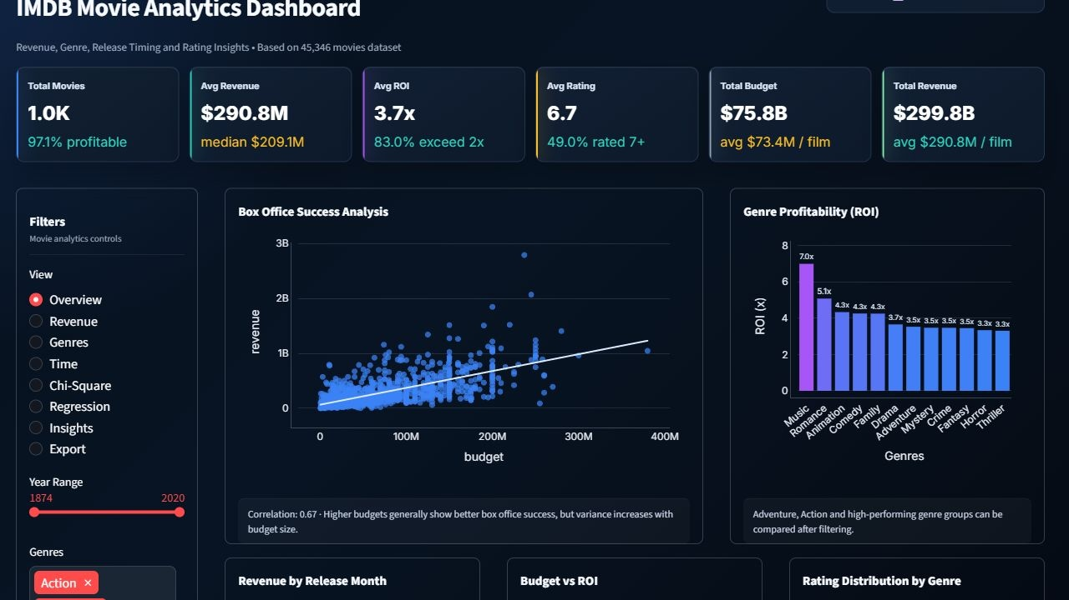
ZHOU CAN
08 / 22
System Interface: One Entry Point, Eight Analytical Views
The Overview page connects filters, KPI cards and every analytical chart through one shared state.
FILTER RAIL
Shared state
year, genre, min votes
KPI ROW
6 cards
movies, revenue, ROI, rating
VIEWS
8
Overview to Export
MESSAGE
One control loop
filters refresh charts, KPIs and exports
ZHOU Can · approx. 3 min
Overview / Revenue / Genres / Time
08 / 22

Slide 9
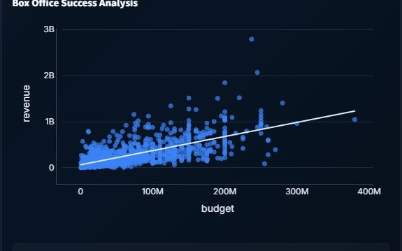
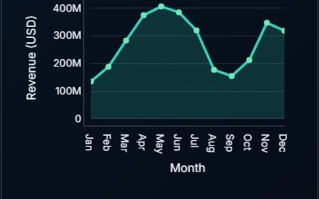
ZHOU CAN
09 / 22
Revenue View: Scale and ROI Tell Different Stories
Budget explains market scale; ROI and release timing explain efficiency.
BUDGET -> REVENUE
MONTHLY REVENUE
ROI LENS
CONCLUSION
r = 0.67
May peak
98th cap
Scale != efficiency
positive correlation in the live view
release window changes scale
keeps outliers readable
revenue and return differ
ZHOU Can · approx. 3 min
Revenue view
09 / 22

Slide 10
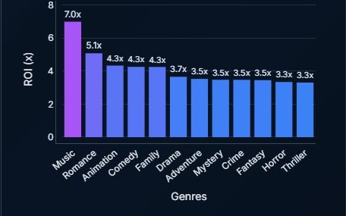
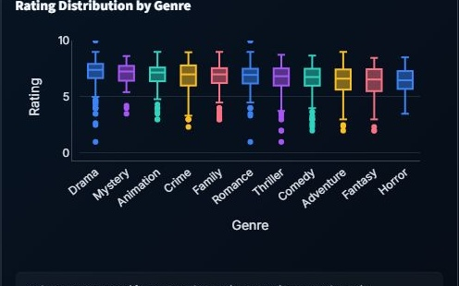
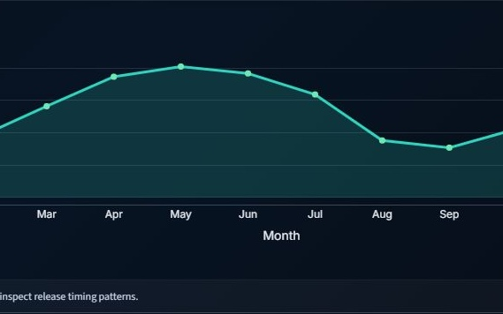
ZHOU CAN
10 / 22
Genres and Time: Category Mix Meets Release Window
Genre ranking, rating distribution and monthly revenue support release strategy.
TOP ROI
RATING SPREAD
BEST WINDOW
INTERACTION
Music
Genre-level
May-Jun
Metric toggle
7.0x in current filter slice
box plots show distribution, not only average
spring-to-summer revenue peak
ROI or average revenue ranking
ZHOU Can · approx. 3 min
Genres view + Time view
10 / 22

Slide 11

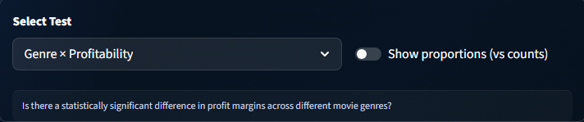
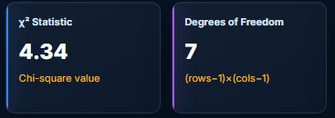
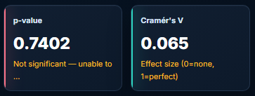
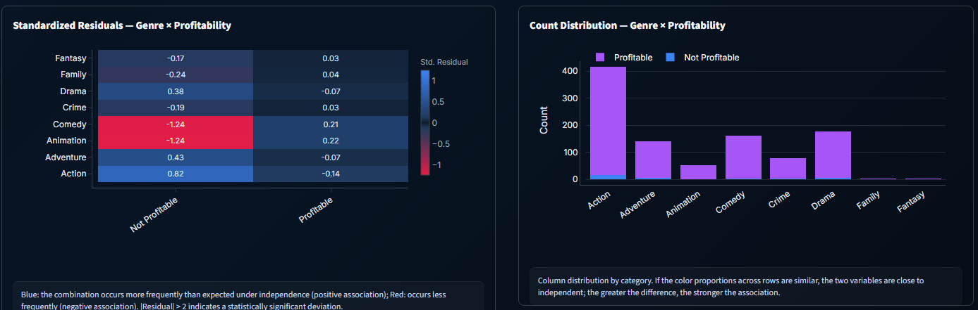
Chi-Square：Transform intuitive conclusions into significance tests
Detect whether there is a statistically significant association between two categorical variables
Genre does not determine profitability
11 / 22

Slide 12


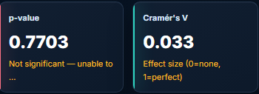
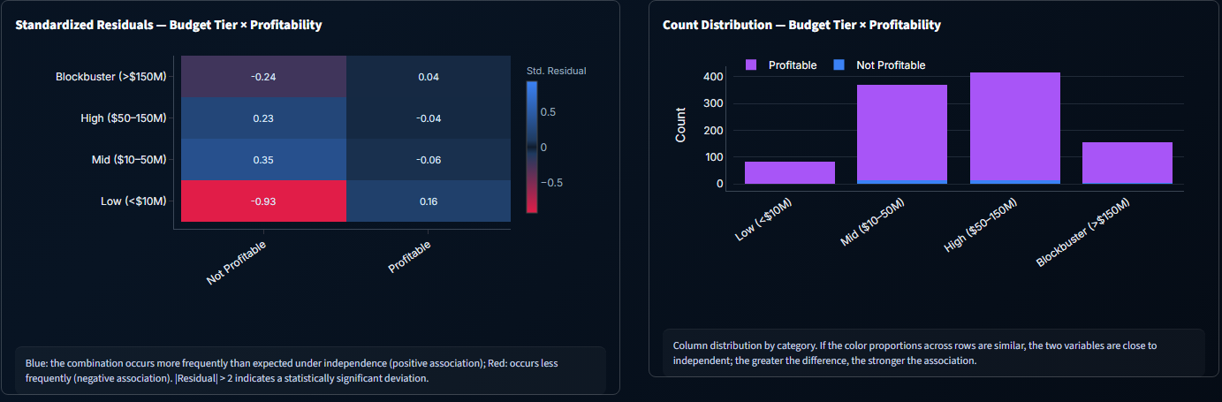
Chi-Square：Transform intuitive conclusions into significance tests
Detect whether there is a statistically significant association between two categorical variables
Budget Tier does not determine profitability
12 / 22

Slide 13


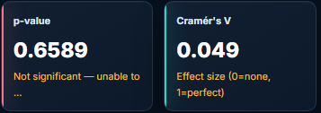
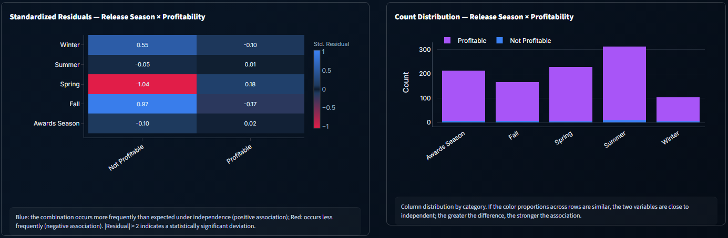
Chi-Square：Transform intuitive conclusions into significance tests
Detect whether there is a statistically significant association between two categorical variables
Release Season does not determine profitability
13 / 22

Slide 14

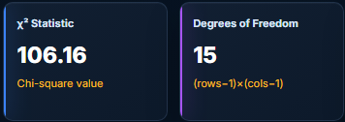
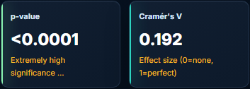
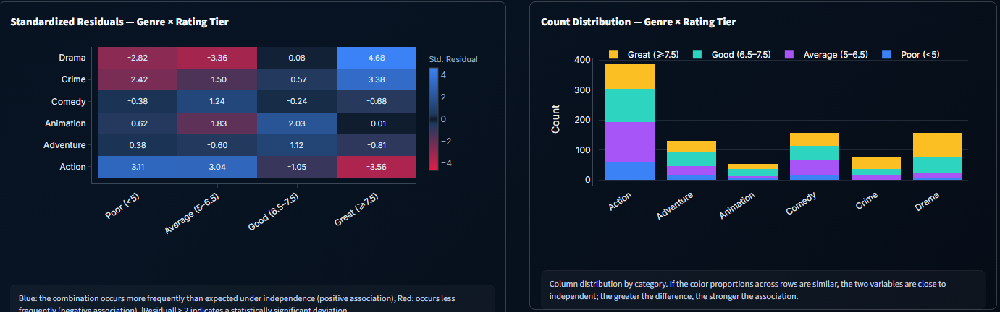
Chi-Square：Transform intuitive conclusions into significance tests
Detect whether there is a statistically significant association between two categorical variables
Genre can determine Rating Tier
14 / 22

Slide 15


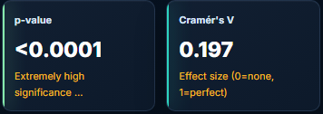
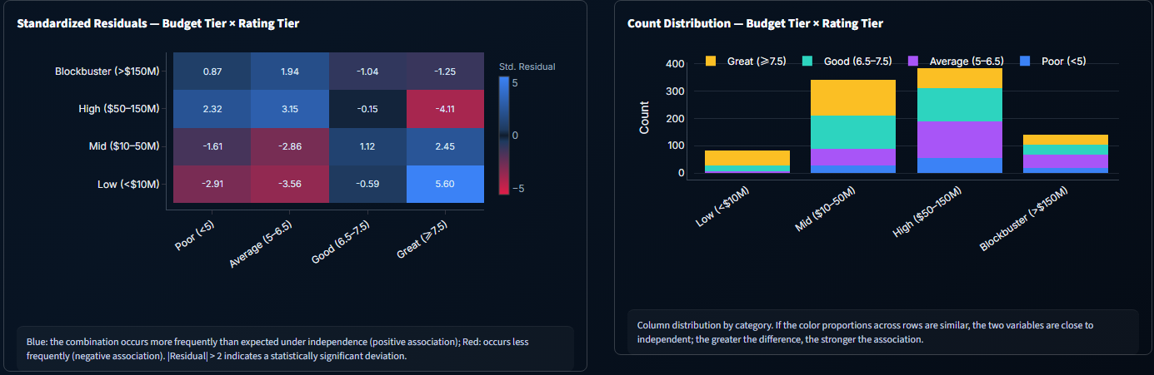
Chi-Square：Transform intuitive conclusions into significance tests
Detect whether there is a statistically significant association between two categorical variables
Budget Tier can determine Rating Tier
15 / 22

Slide 16
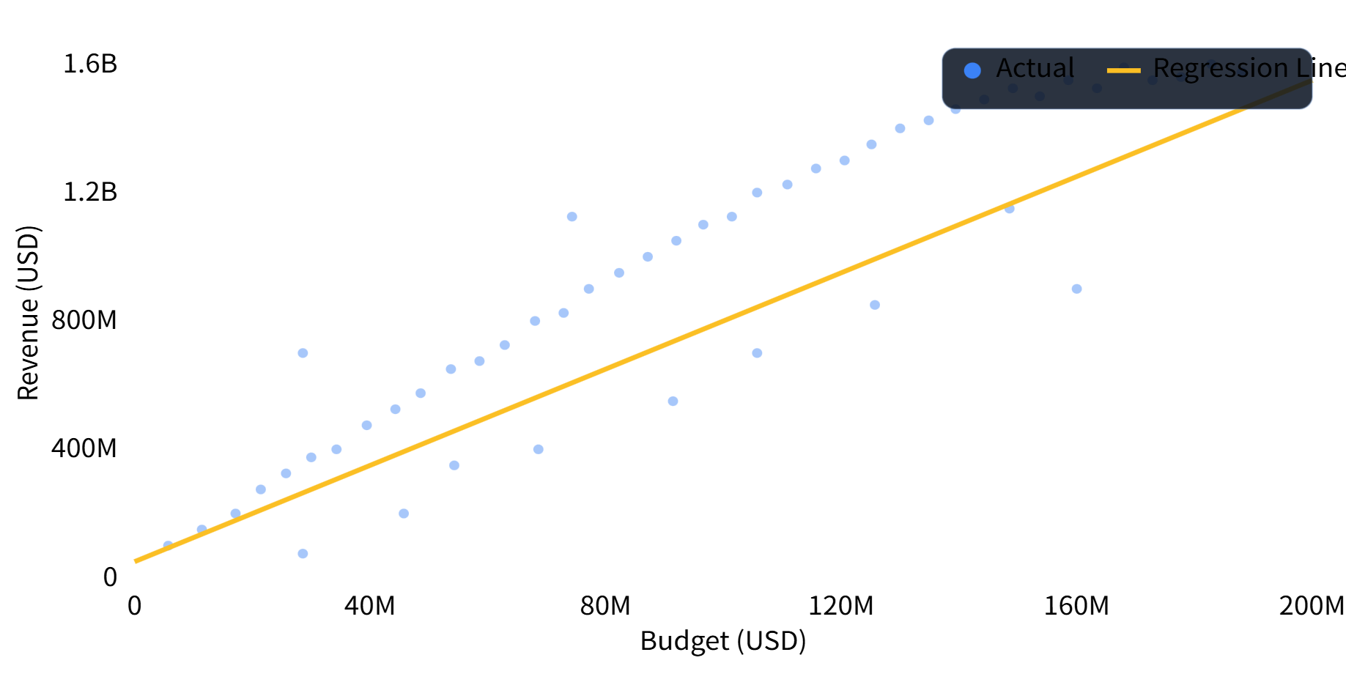
LIAO Shuaiyu
16 / 22
Linear Regression
VARIABLES
8
budget, revenue, ROI...
SPLIT
80/20
train / test
OUTPUT
R² + line
fit quality visible
16 / 22

Slide 17
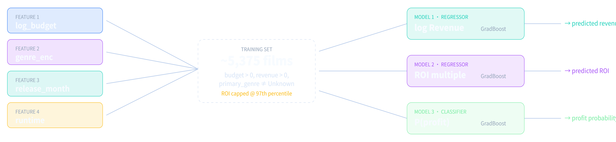
17 / 22
Prediction：Gradient Boosting
REVENUE
PROFIT
GB Regressor
GB Classifier
FEATURE 1
FEATURE 2
log(budget)
genre
log revenue target
revenue > budget
scale stabilisation
OrdinalEncoder
ROI
PARAMS
FEATURE 3
FEATURE 4
GB Regressor
300 · 4 · 0.05
month
runtime
97th percentile cap
trees· depth · lr
release timing
minutes
17 / 22

Slide 18
18 / 22
Prediction
INPUT
REVENUE
ROI
PROFIT PROB.
$80M
$184.1M
3.35x
84.9%
Action·July·125 min
$132.5M - $261.4M
predicted multiplier
P(revenue > budget)
Title | Year | Budget | Revenue | ROI | Rating | Genre
Batman Returns | 1992 | $80.0M | $280.0M | 3.50x | 6.2 | Action
The Mummy | 1999 | $80.0M | $415.9M | 5.20x | 6.6 | Action
Face/Off | 1997 | $80.0M | $245.7M | 3.07x | 6.9 | Action
Mission: Impossible | 1996 | $80.0M | $457.7M | 5.72x | 7.1 | Action
The Time Machine | 2002 | $80.0M | $123.7M | 1.55x | 4.3 | Action
Comparable rows are real films selected by nearest budget within the same primary genre.
18 / 22

Slide 19

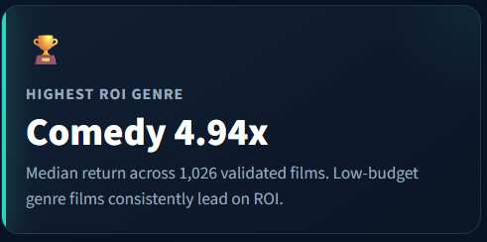
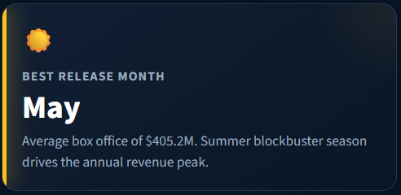
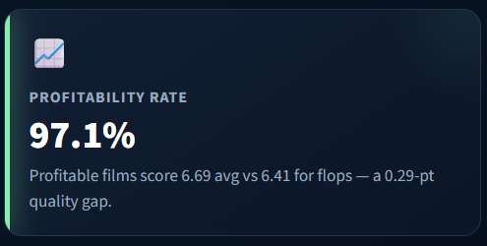
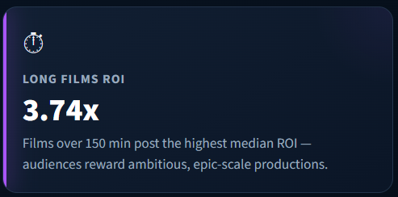
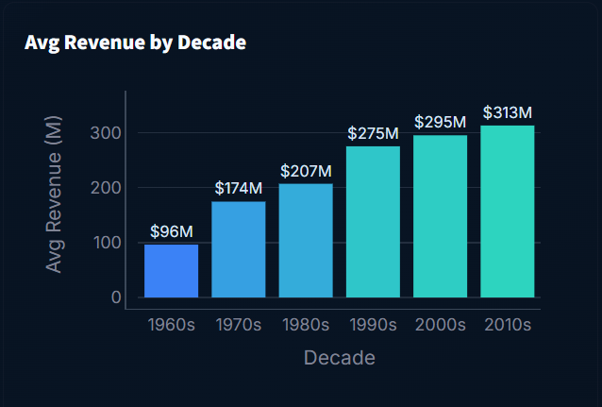
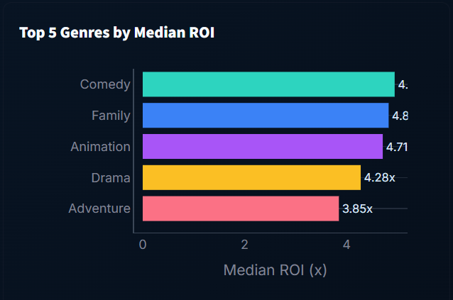
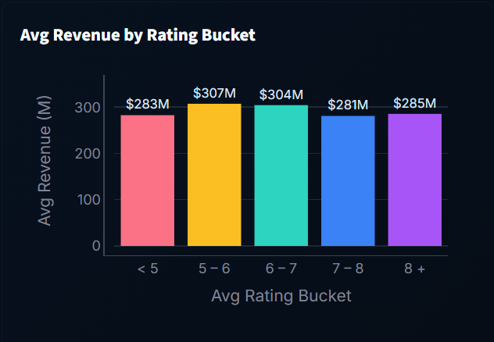
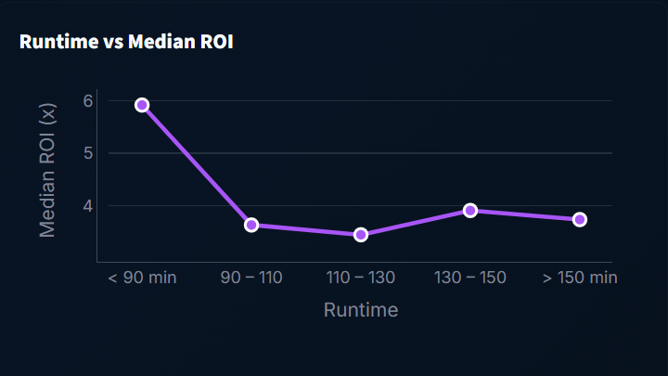
Chen Ziming
19 / 22
Insights View — Automated Data Discovery
Four headline KPIs + four trend charts + two qualitative findings, all recomputed live from 5,375 validated films.
🎭 FINDING · MULTI-GENRE STRATEGY
⭐ FINDING · THE RATING SWEET SPOT
91% of films span two or more genres. Blending genres broadens audience reach — pure single-genre films are now the minority. The most common pairings are Comedy + Drama and Drama + Romance, both of which combine broad appeal with lower production costs.
Films rated 6 – 7 earn the highest average box office ($304.3M), outperforming even 8+ critically acclaimed films. Mass-market entertainment that satisfies without polarizing audiences consistently captures the widest theatrical audience.
19 / 22

Slide 20
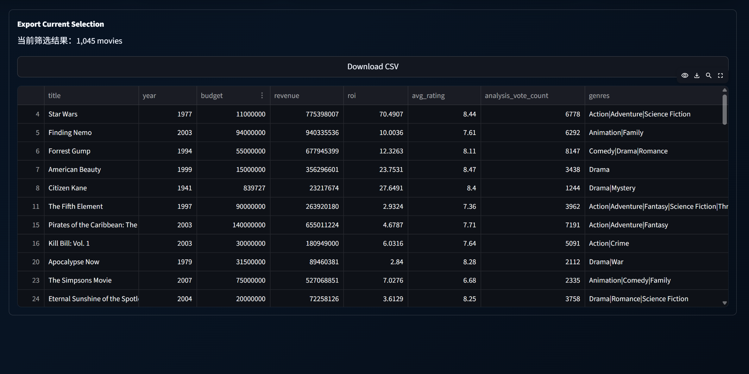
Chen Ziming
20 / 22
Export
Every filter slice can be downloaded as a CSV — bring your own analysis stack: Excel, R, Python, Tableau, anything that reads UTF-8 CSV.
20 / 22

Slide 21



Chen Ziming
21 / 22
Conclusion
Summary & future work
8 analytical views
Live TMDB API
3 model outputs
Director and cast data
2 statistical test groups groups groups
Sentiment analysis
21 / 22

Slide 22
26DPWPROJECT · END OF PRESENTATION
Thank you.
Questions welcomed.
Team: ZHOU Can · CHEN Ziming · DAI Ling · LIAO Shuaiyu · PAN Meihao · ZHU Junyu
22 / 22

