Slide 1

26DPWPROJECT · FINAL PRESENTATION
TMDB Movie Analytics Dashboard
DATASET
FINANCIAL ROWS
VIEWS
DEMO
45,346
5,375
8
5 min
analysis-ready films
budget + revenue
dashboard sections
live system walkthrough
ZHOU Can · CHEN Ziming · DAI Ling · LIAO Shuaiyu · PAN Meihao · ZHU Junyu

Slide 2
TALK MAP
02 / 23
按演讲分工重构后的汇报路线
顺序跟随 dashboard 侧边栏视图，同时让每位成员有清晰负责段落。
1
2
3
4
5
6
Project + Data Cleaning
Database + ER
Dashboard Views
Chi-Square
Regression + Prediction
Insights + Export + Summary
2.5 min 背景、数据来源、Python 清洗
2.5 min 关系设计、核心表、SQL 导出
3 min Overview / Revenue / Genres / Time
2 min 分类变量显著性检验
2.5 min 线性回归与 Gradient Boosting
2.5 min 自动洞察、导出、局限与未来方向
Demo & Q&A: 5 min · 第三位或第六位主操作，其他成员辅助回答。

Slide 3

Steph ZHU
03 / 23
Project Background: From Scattered Film Data to an Interactive Decision-Making System
Goal: Aims to help analyze box office patterns, genre profitability, release date selection, and enable basic box office forecasting.
RAW SOURCE
TMDB SQL
Data scattered across different dataset → no single source provides both financial and metadata.
movie, genres, rate, credit...
Do not need to query multiple sources, align genres manually.
FINAL TABLE
45,346
Existing tools: Only show historical charts.
Ours adds: Provide statistical significance tests, machine learning predictions and exportable insights.
processed movies
COMPLETE FINANCE
5,375
Our project is an interactive system which solves users' questions and lets users search different data in targeted periods
budget / revenue rows

Slide 4
Steph ZHU
Data Cleaning
04 / 23
Removed missing values, duplicate records, and invalid data and fliter invalid ratings to improve data quality and consistency.
For example, ratings had to be between 0.5 and 5.0, with increments of 0.5 only.
Standardized the data format.
For example, we converted all movie IDs into TMDB IDs using the links.csv mapping table, so all tables could connect correctly through the same key.
Processed nested JSON data, such as genres, keywords, cast, and crew information.
and extracted and flattened these fields into separate relational tables to match our ER diagram design.
Sorted the data, unified column names and data types, and exported the cleaned results as CSV files for database import.

Slide 5

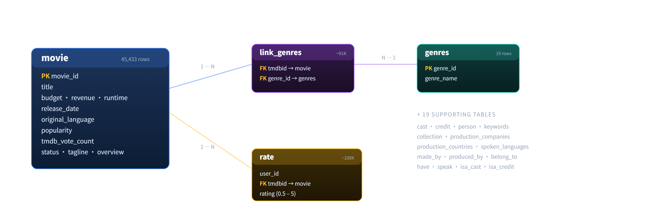
Gareth
05 / 23
Database Design: From ER Diagram to Relational Schema
The ER diagram was implemented as a MySQL relational schema to support structured analysis and reproducible data processing.
CORE RELATION
movie ↔ genres
many-to-many via link_genres
RATING RELATION
movie ↔ rate
one movie, many user ratings
PEOPLE RELATION
cast / credit
actors, directors, writers
The database was exported as SQL files for restoration, validation, and later project use.

Slide 6
Gareth
06 / 23
How Core Tables Support the Analysis
Each table provides a specific part of the information needed by the dashboard.
Table | Key fields | Used for
movie | budget, revenue, runtime, release_date | Box office, ROI, runtime and release timing analysis
genres | genres_id, genres_name | Standardized genre dictionary
link_genres | tmdbid, genres_id | Many-to-many movie-genre mapping
rate | user_id, tmdbid, rating, timestamp | Rating aggregation and audience response
person | person_id, name, gender, profile_path | Basic people information
cast / credit | character, department, job | Actors, directors, writers and crew information
production_companies | company_id, company_name | Future company-level analysis
The schema defines what can be imported, validated, and reused later.

Slide 7
Gareth
07 / 23
Data Import, Validation and SQL Export
The prepared data was imported into MySQL, validated, and exported as SQL files for project reuse.
1
2
3
4
5
6
Prepared CSV Files
MySQL Import
Validation
Crew / Credit
SQL Export
Project Reuse
Entity tables and relation tables
movie, genres, rate, person, cast, credit
Imported ER-based tables through phpMyAdmin
21+ relational tables
Checked row counts, keys and relationships
primary keys · foreign-key checks
Updated missing crew-related records
credit · isa_credit · person · made_by
Exported complete database and table dumps
tmdb.sql + separate SQL files
Files can be restored and checked later
for teammates and final demo
SQL export makes the database reproducible for teammates and final demonstration.

Slide 8
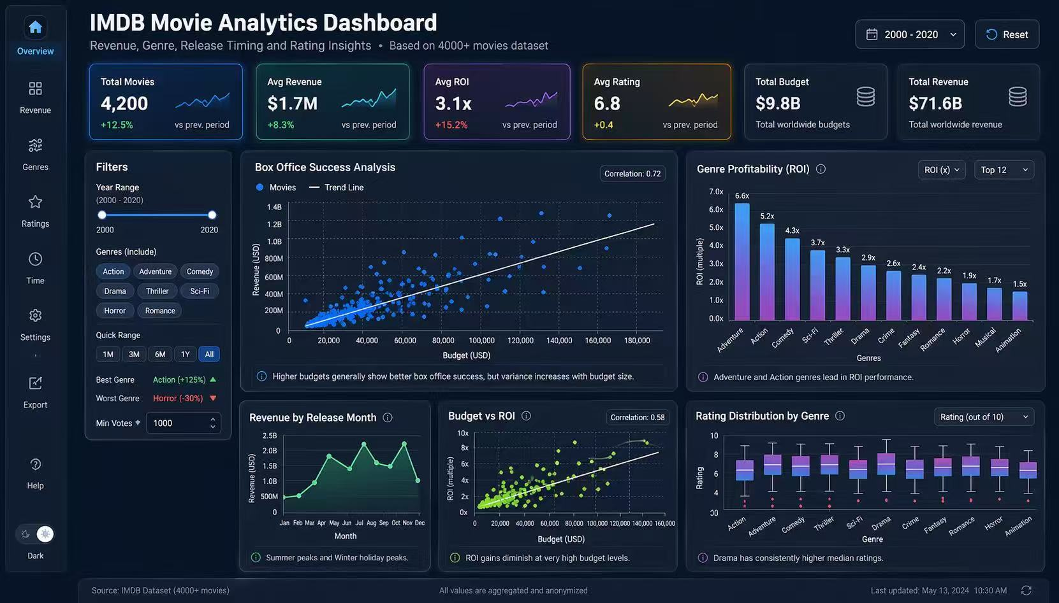
SPEAKER 3
08 / 23
系统整体界面:一个入口，八个分析视图
This section follows the sidebar order: Overview, Revenue, Genres and Time.
FILTER RAIL
Shared state
year, genre, min votes
KPI ROW
6 cards
movies, revenue, ROI, rating
VIEWS
8
Overview to Export
Presenter cue: explain that every filter updates KPIs, charts and exports together.
第三位 · approx. 3 min
Overview / Revenue / Genres / Time

Slide 9
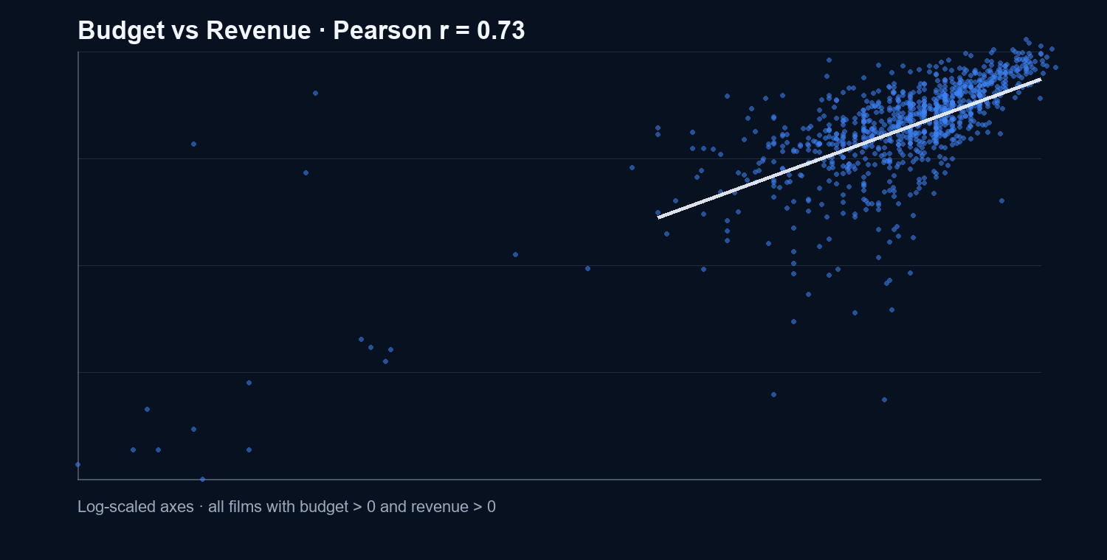
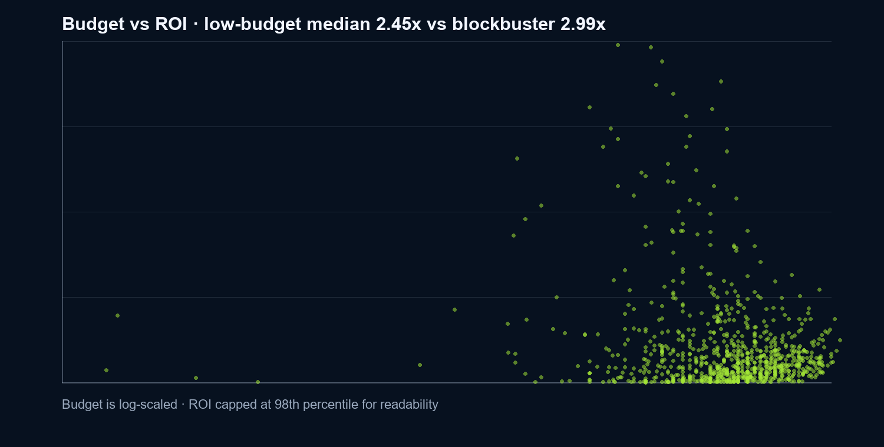
SPEAKER 3
09 / 23
Revenue 视图:预算推高票房，但不保证 ROI
Use budget-revenue for market scale, then budget-ROI for efficiency and risk.
BUDGET → REVENUE
LOW BUDGET ROI
BLOCKBUSTER ROI
CONCLUSION
r = 0.73
2.45x
2.99x
Scale ≠ efficiency
clear positive correlation
< $10M median
> $150M median
two goals differ
第三位 · approx. 3 min
Revenue view

Slide 10
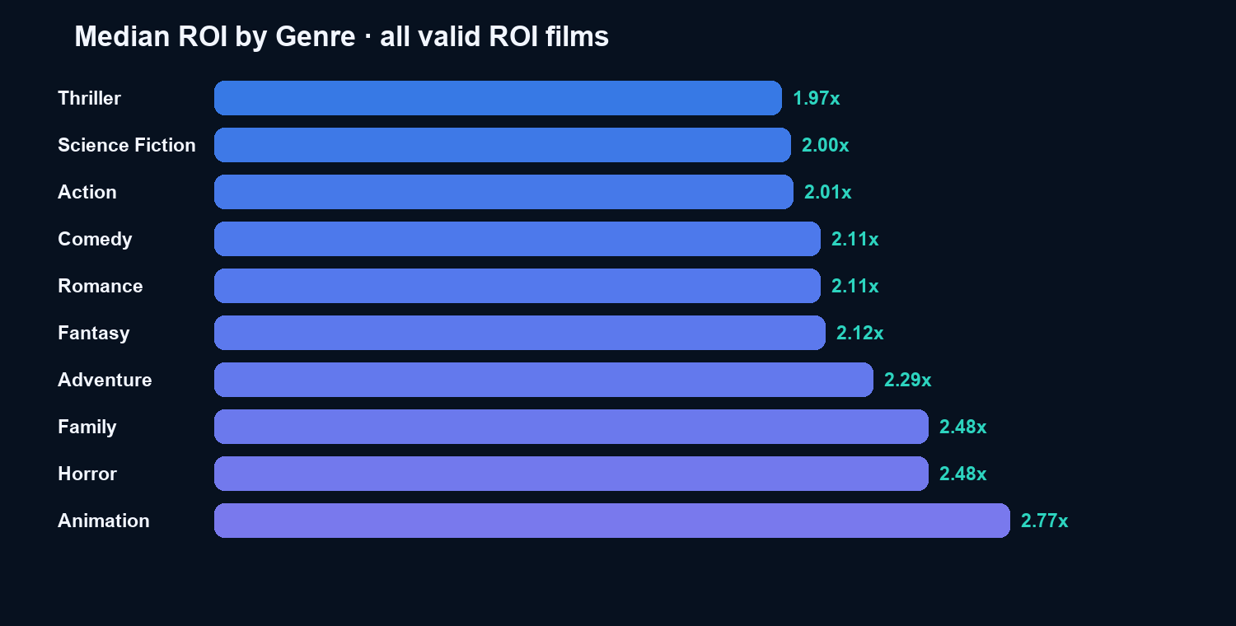
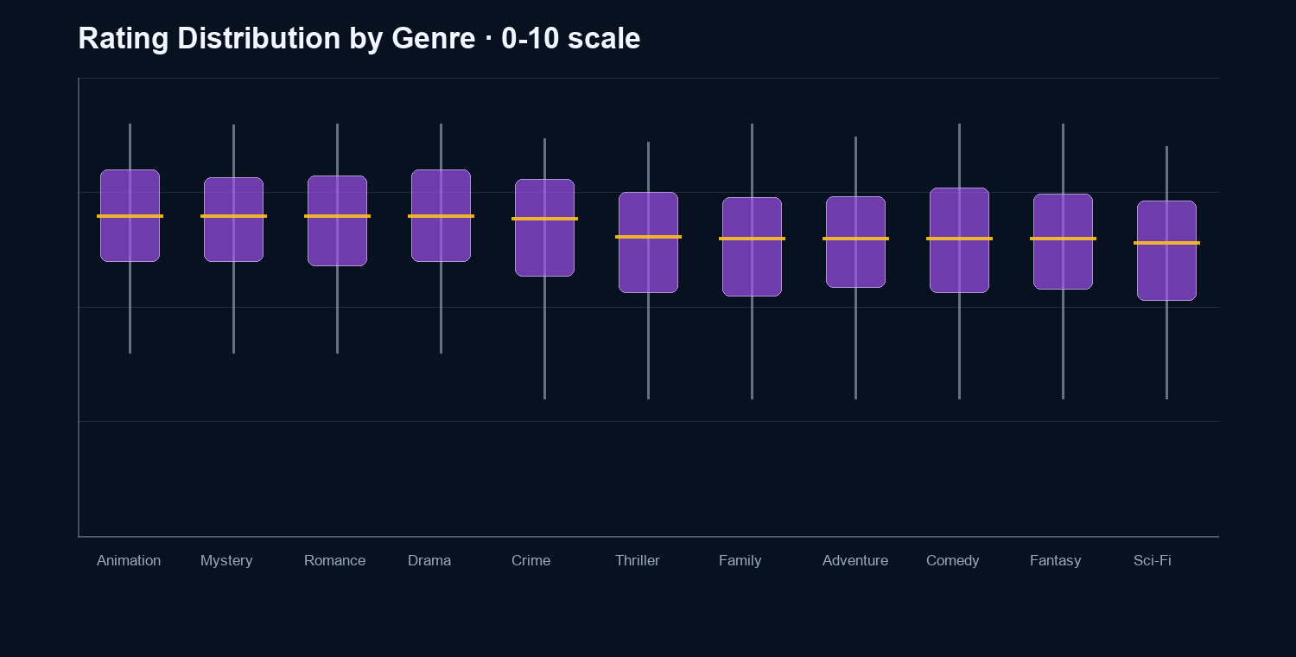
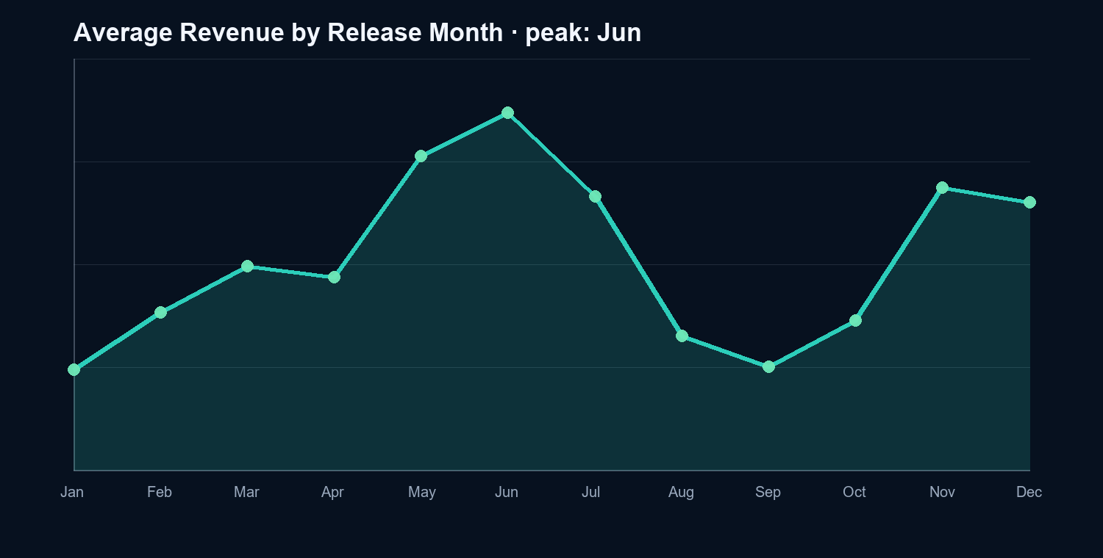
SPEAKER 3
10 / 23
Genres 与 Time:类型和档期决定盈利侧重点
Combine genre ranking, rating distribution and release-month revenue into one analytical readout.
TOP ROI GENRE
BEST MONTH
BEST RATING BAND
INTERACTION
Animation
Jun
6-7
Metric toggle
2.77x median
$153.8M
highest avg revenue
ROI or avg revenue
第三位 · approx. 3 min
Genres view + Time view

Slide 11

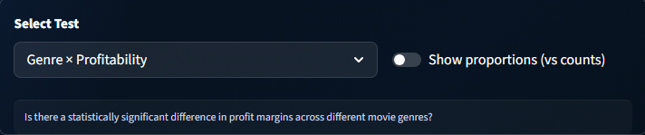
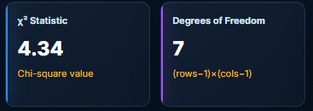
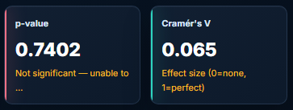
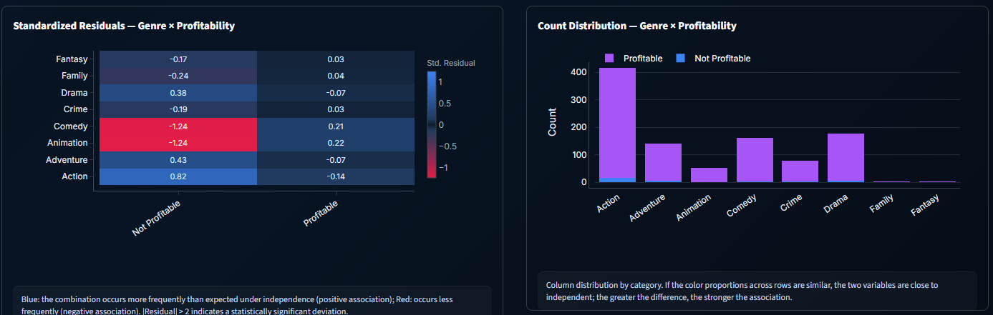
Chi-Square:Transform intuitive conclusions into significance tests
Detect whether there is a statistically significant association between two categorical variables
Genre does not determine profitability

Slide 12


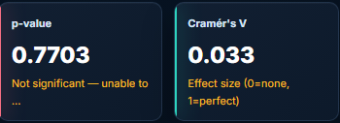
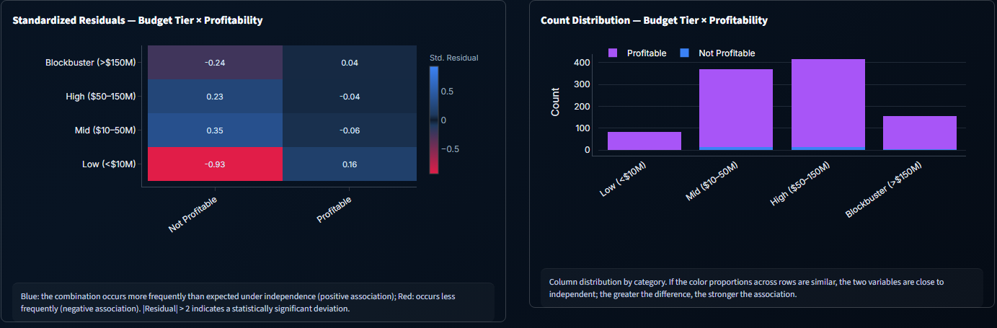
Chi-Square:Transform intuitive conclusions into significance tests
Detect whether there is a statistically significant association between two categorical variables
Budget Tier does not determine profitability

Slide 13

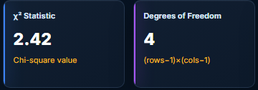
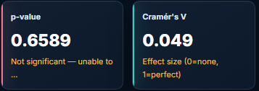
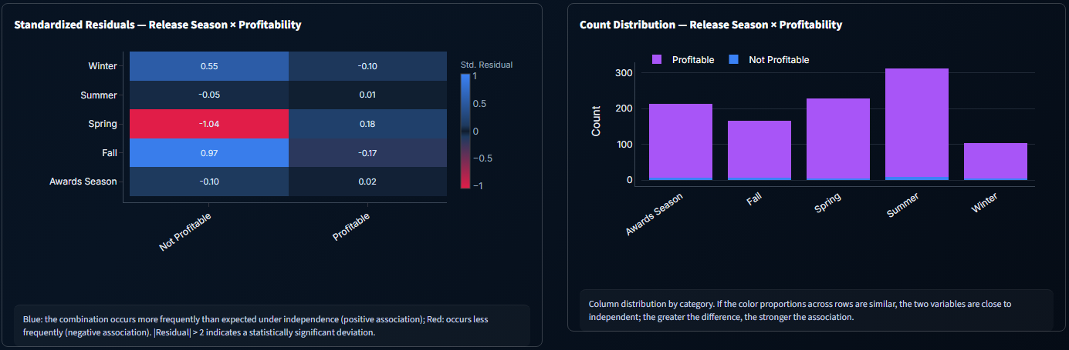
Chi-Square:Transform intuitive conclusions into significance tests
Detect whether there is a statistically significant association between two categorical variables
Release Season does not determine profitability

Slide 14

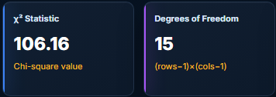
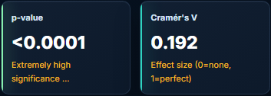
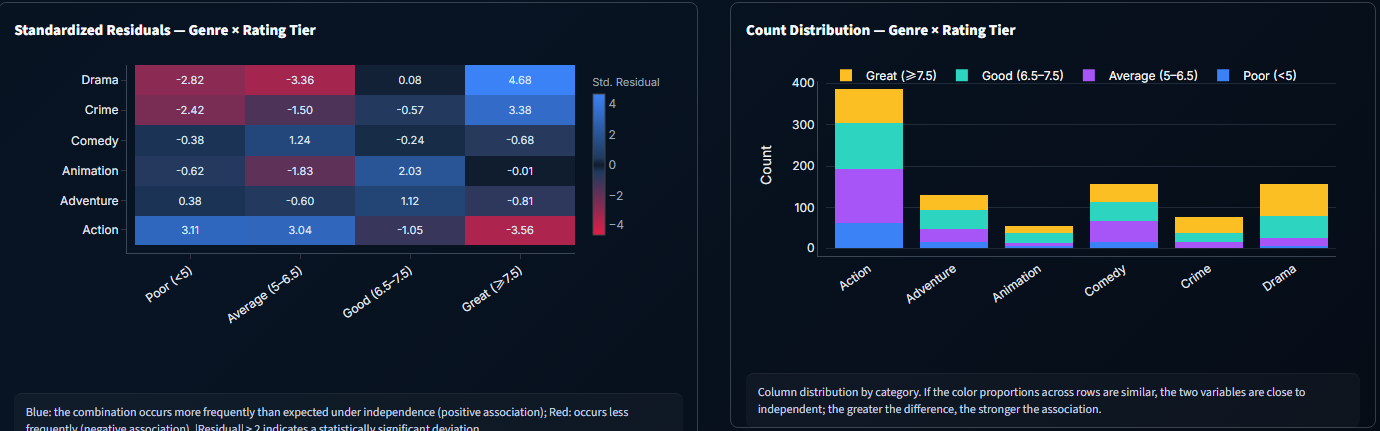
Chi-Square:Transform intuitive conclusions into significance tests
Detect whether there is a statistically significant association between two categorical variables
Genre can determine Rating Tier

Slide 15


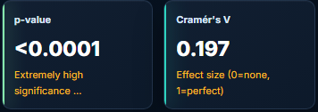
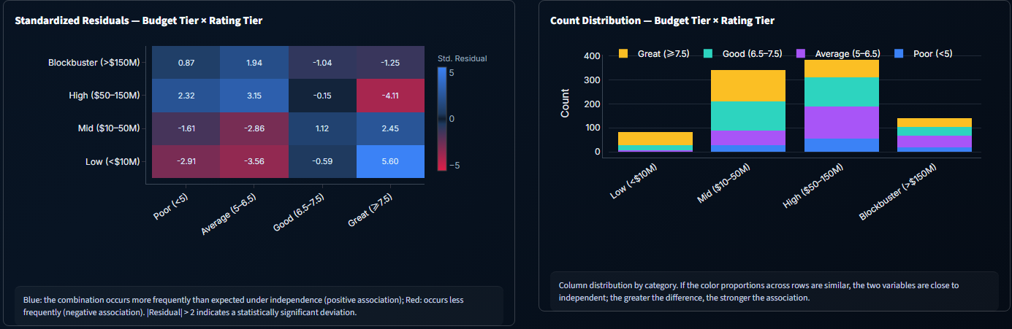
Chi-Square:Transform intuitive conclusions into significance tests
Detect whether there is a statistically significant association between two categorical variables
Budget Tier can determine Rating Tier

Slide 16
ZHOU Can
16 / 23
派生字段让统计检验可解释
把连续变量转成类别变量，才能进入卡方检验和交叉表热力图。
BUDGET_TIER
SEASON
PROFITABLE
<$10M / $10-50M / $50-150M / >$150M
Winter / Spring / Summer / Fall / Awards
revenue > budget
低/中/高/大片预算
月份映射为档期
盈利 / 未盈利
讲图时先读 p-value:是否显著。
再读 Cramér's V:关联强度大小。
最后读 residual heatmap:哪些类别组合贡献了差异。
这一页的作用:帮助听众理解系统里的统计模块不是单纯画热力图，而是在检验变量关系。
ZHOU Can · approx. 2 min
Derived variables and interpretation

Slide 17
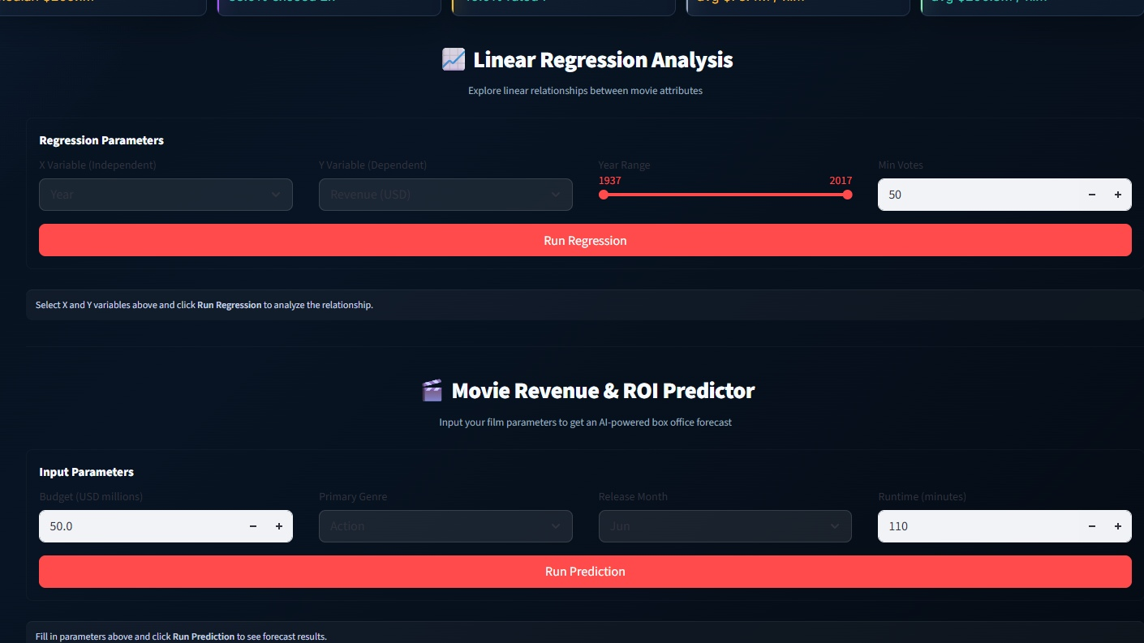
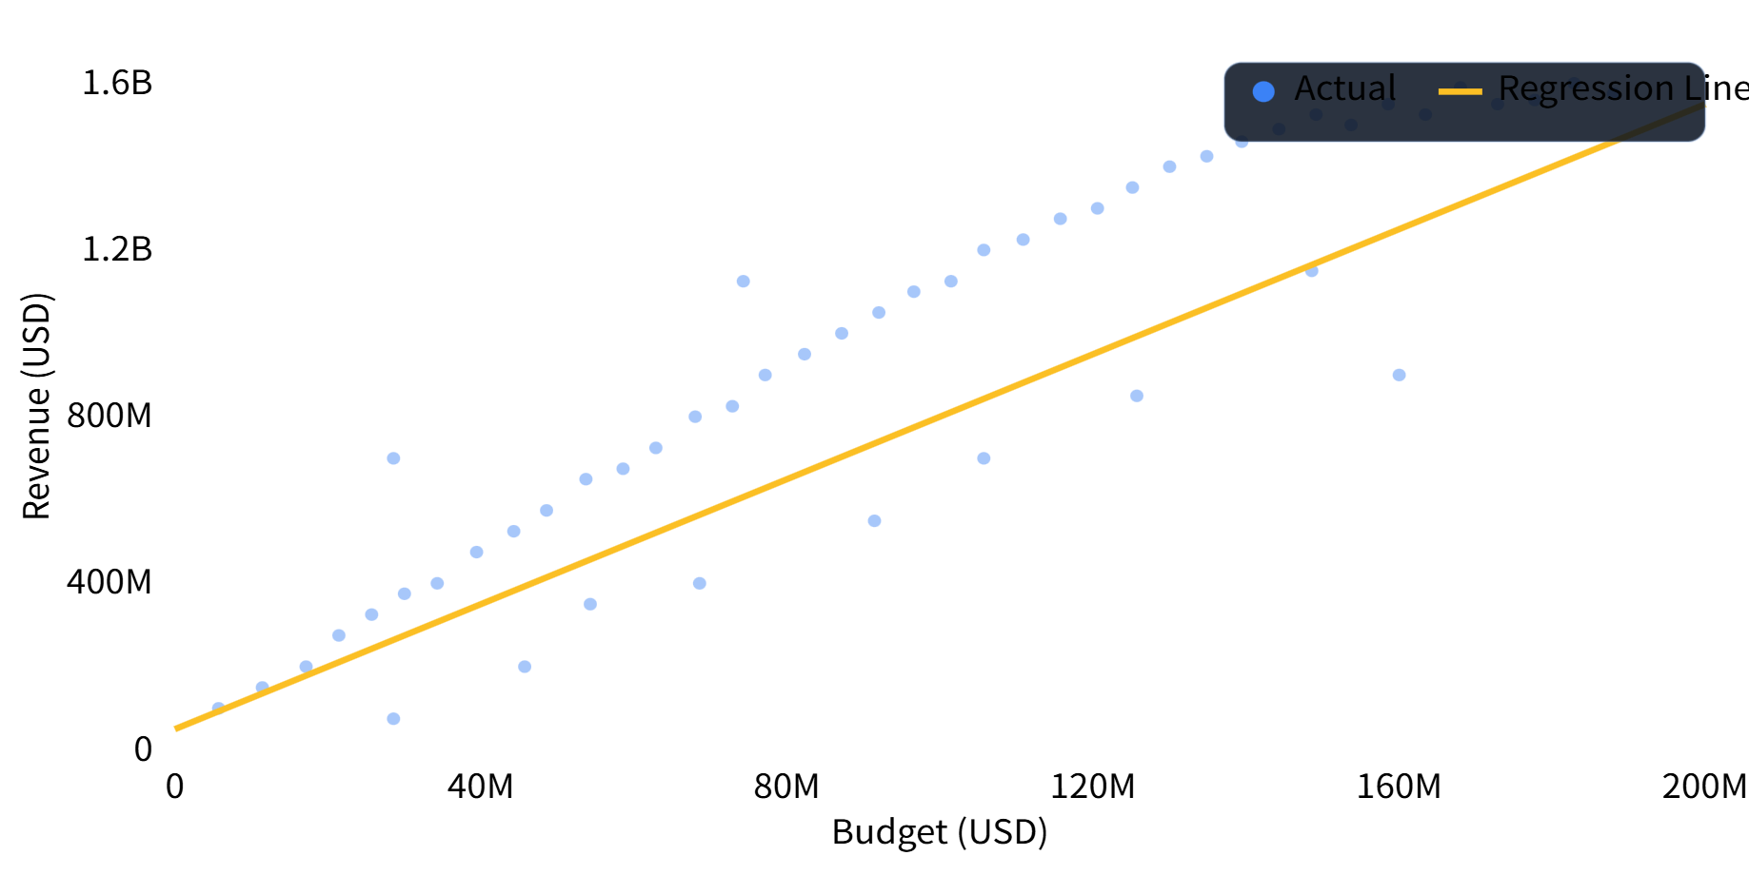
LIAO Shuaiyu
17 / 23
Linear Regression
VARIABLES
8
budget, revenue, ROI...
SPLIT
80/20
train / test
OUTPUT
R² + line
fit quality visible

Slide 18
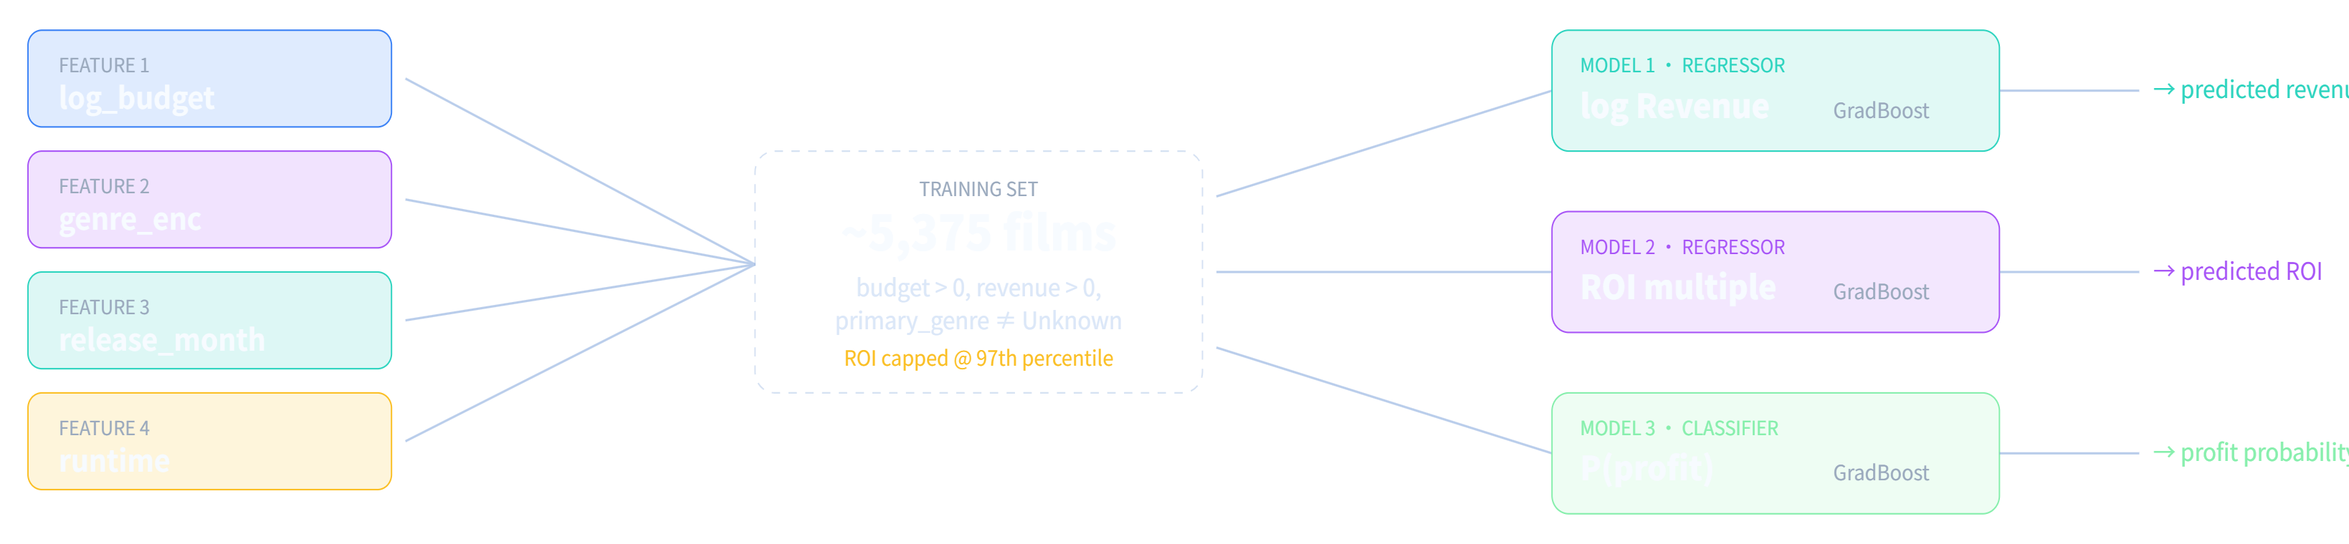
18 / 23
Prediction:Gradient Boosting
REVENUE
PROFIT
GB Regressor
GB Classifier
FEATURE 1
FEATURE 2
log(budget)
genre
log revenue target
revenue > budget
scale stabilisation
OrdinalEncoder
ROI
PARAMS
FEATURE 3
FEATURE 4
GB Regressor
300 · 0.05 · 4
month
runtime
97th percentile cap
trees · lr · depth
release timing
minutes

Slide 19
19 / 23
Prediction
INPUT
REVENUE
ROI
PROFIT PROB.
$80M
$184.1M
3.35x
84.9%
Action·July·125 min
$132.5M - $261.4M
predicted multiplier
P(revenue > budget)
Title | Year | Budget | Revenue | ROI | Rating | Genre
Batman Returns | 1992 | $80.0M | $280.0M | 3.50x | 6.2 | Action
The Mummy | 1999 | $80.0M | $415.9M | 5.20x | 6.6 | Action
Face/Off | 1997 | $80.0M | $245.7M | 3.07x | 6.9 | Action
Mission: Impossible | 1996 | $80.0M | $457.7M | 5.72x | 7.1 | Action
The Time Machine | 2002 | $80.0M | $123.7M | 1.55x | 4.3 | Action
Comparable rows are real films selected by nearest budget within the same primary genre.

Slide 20

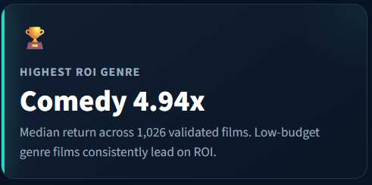
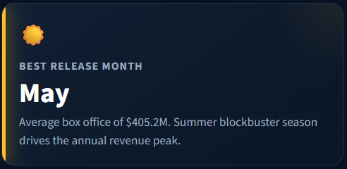
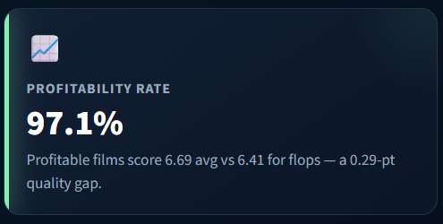
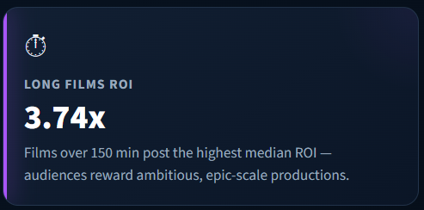
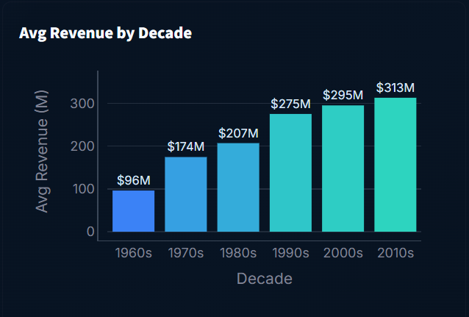
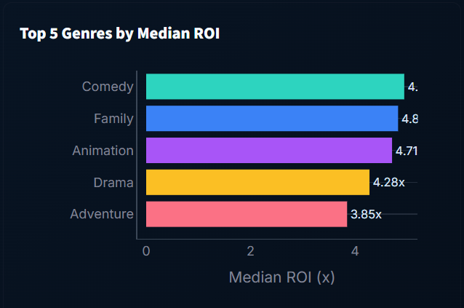
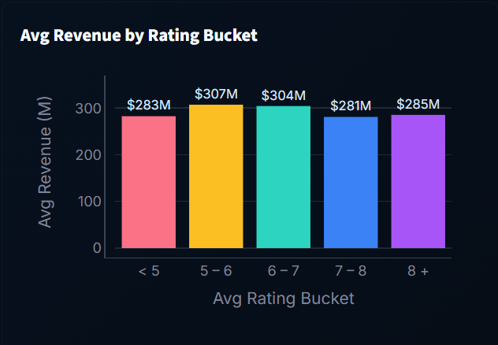
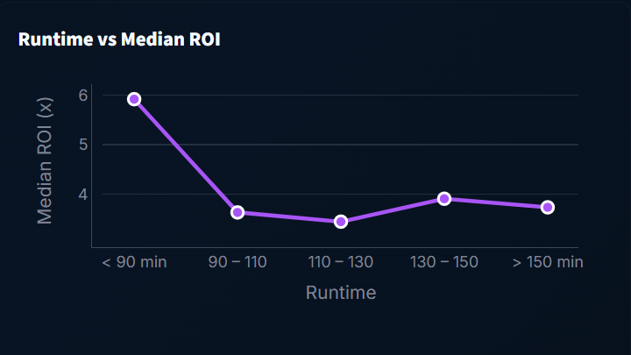
Chen Ziming
20 / 23
Insights View — Automated Data Discovery
Four headline KPIs + four trend charts + two qualitative findings, all recomputed live from 5,375 validated films.
🎭 FINDING · MULTI-GENRE STRATEGY
⭐ FINDING · THE RATING SWEET SPOT
91% of films span two or more genres. Blending genres broadens audience reach — pure single-genre films are now the minority. The most common pairings are Comedy + Drama and Drama + Romance, both of which combine broad appeal with lower production costs.
Films rated 6 – 7 earn the highest average box office ($304.3M), outperforming even 8+ critically acclaimed films. Mass-market entertainment that satisfies without polarising audiences consistently captures the widest theatrical audience.

Slide 21
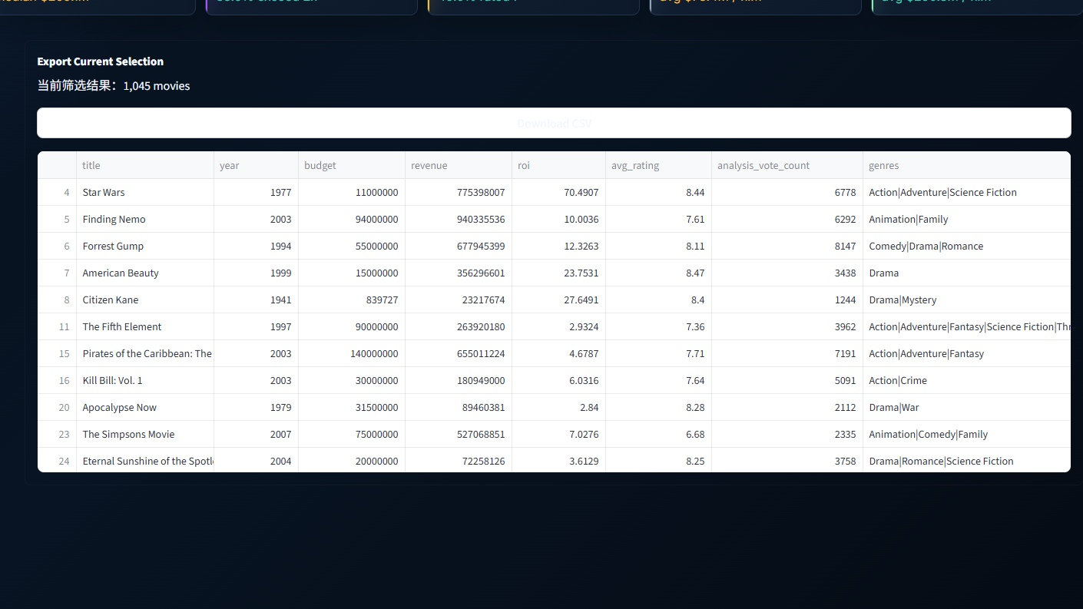
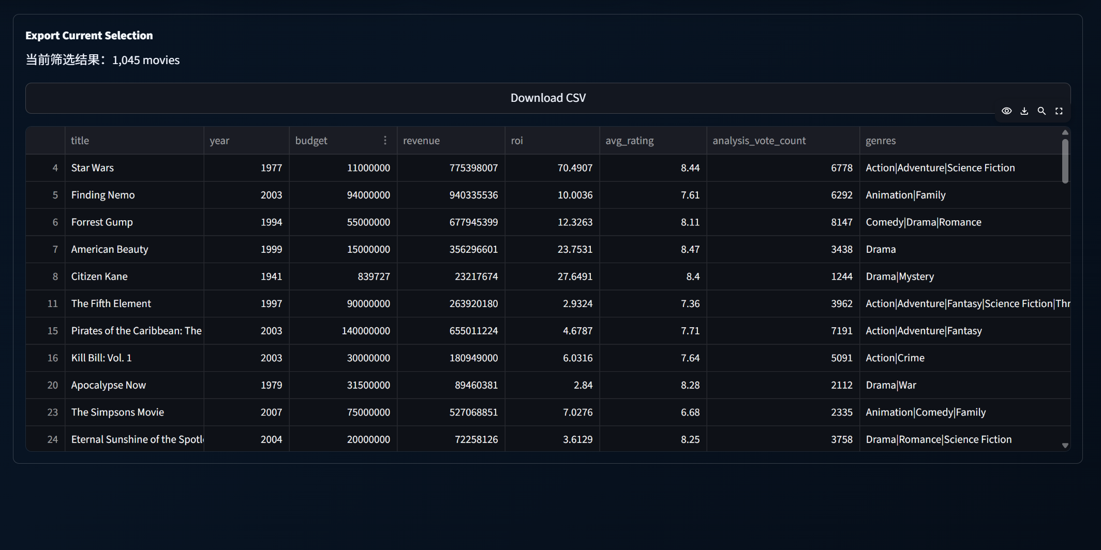
Chen Ziming
21 / 23
Export
Every filter slice can be downloaded as a CSV — bring your own analysis stack: Excel, R, Python, Tableau, anything that reads UTF-8 CSV.

Slide 22



Chen Ziming
22 / 23
Conclusion
Summary & future work
8 analytical views
Live TMDB API
3 machine learning
Director and cast data
2 statistical test
Sentiment analysis

Slide 23
26DPWPROJECT · END OF PRESENTATION
Thank you.
Questions welcomed.
Team: ZHOU Can · CHEN Ziming · DAI Ling · LIAO Shuaiyu · PAN Meihao · ZHU Junyu

