Slide 1
The Role of Cultural Factors in Happiness Scores: A Comparative Analysis of Sub-Saharan Africa and Western Europe
Candice Wu
Notes:
Hello, I am a data analyst for the United Nations, I would like to present to you a comparative analysis of the role of cultural factors in happiness scores between Sub-Saharan Africa and Western Europe. Happiness is a fundamental human goal, and understanding the factors that contribute to happiness is crucial for policymakers and development practitioners. To address this analysis, I compared the happiness scores of these two regions and examined the relationship between five factors: economic production, social support, healthy life expectancy, corruption, and generosity. My findings shed light on the key determinants of happiness and provide insights into how these factors influence it.

Slide 2
Agenda
The Distribution of Happiness scores
Conclusion
The Happiest & Unhappiest Countries in the World
Recommendations
Key Factors Affecting Happiness
Notes:
Today, I am going to talk about the happiest and unhappiest countries in the world, the distribution of happiness scores, key factors affecting happiness, conclusions and recommendations.

Slide 3
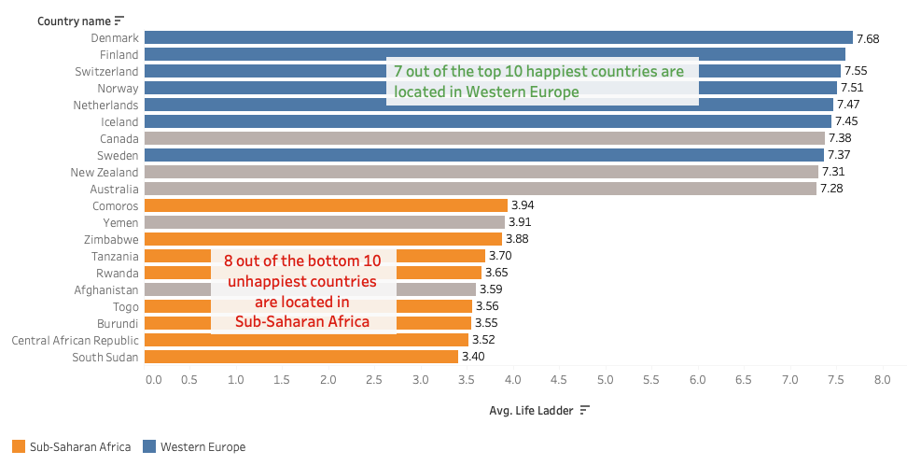
The Happiest & Unhappiest Countries in the World
Notes:
First, let’s discuss the happiest and unhappiest countries in the world. I created a bar chart that shows that 7 out of the top 10 happiest countries are located in Western Europe, while 8 out of the bottom 10 unhappiest countries are in Sub-Saharan Africa.

Slide 4
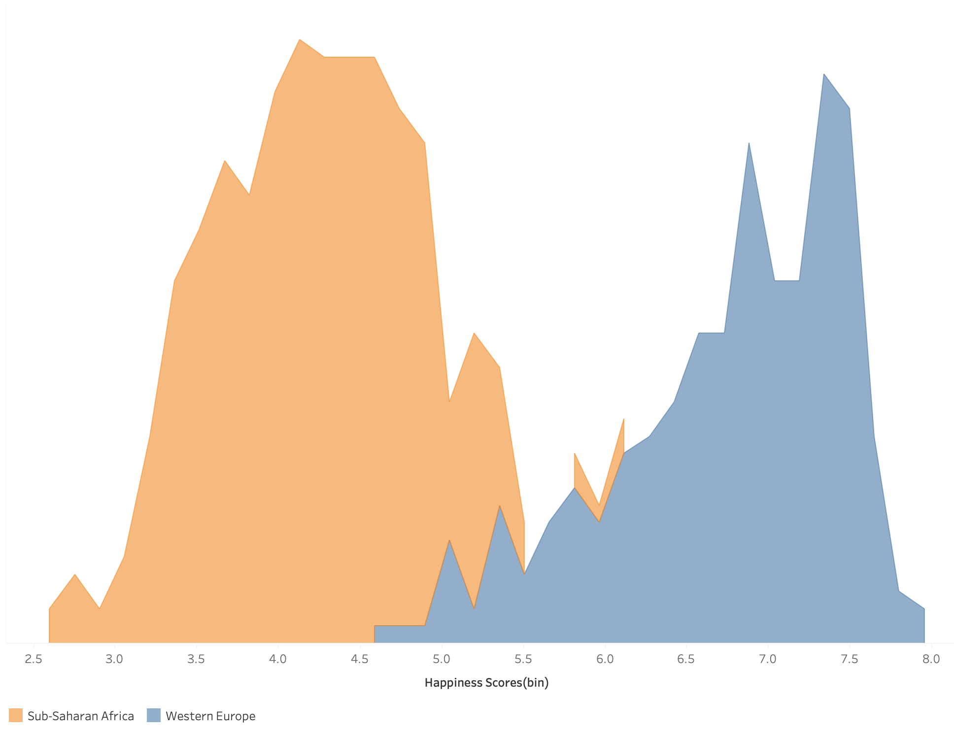
Happiness Score Distributions
Central tendency:
The shape of the distribution in Sub-Saharan Africa is a normal distribution, which means the mean and median happiness score are closer together.
The shape of the distribution in Western Europe is left-skewed, which means the mean happiness score is lower than the median score.
Notes:
The shape of the distribution in Sub-Saharan Africa is a normal distribution, which suggests that the mean and median happiness scores are closer together. In contrast, the shape of the distribution in Western Europe is left-skewed. This skewness suggests that there are a greater number of lower happiness scores in Western Europe, with a few countries having very low happiness scores that bring down the overall mean score. These findings suggest that while Sub-Saharan Africa may have a relatively consistent distribution of happiness scores across the region, Western Europe may have a wider range of happiness scores, with some countries experiencing lower levels of happiness. Now, we’ve analyzed the happiness score, let’s look at how additional factors such as life expectancy, economic production, social support, and generosity influence happiness levels in those two regions.

Slide 5
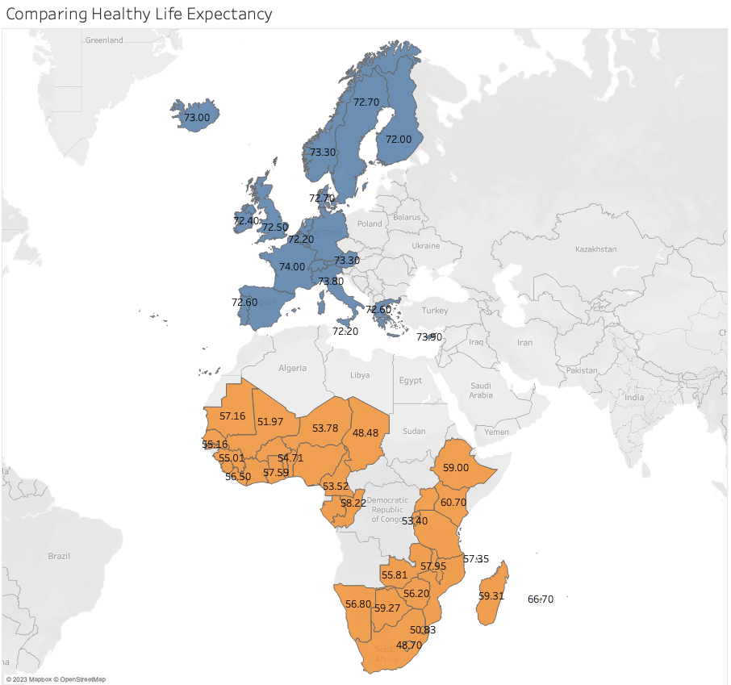
Key Factors Affecting Happiness
Western Europe has higher healthy life expectancy than Sub-Saharan Africa.
The lowest healthy life expectancy in Western Europe is 72 years.
The highest happiness score in Sub-Saharan Africa is 66.7 years.
Notes:
In Western Europe, the lowest healthy life expectancy is 72 years, indicating that even the country with the lowest life expectancy in this region has a relatively high value. In contrast, Sub-Saharan Africa has a significantly lower healthy life expectancy, with many countries reporting values well below 60 years, which suggests that happiness levels in this region are not solely determined by healthy life expectancy.

Slide 6
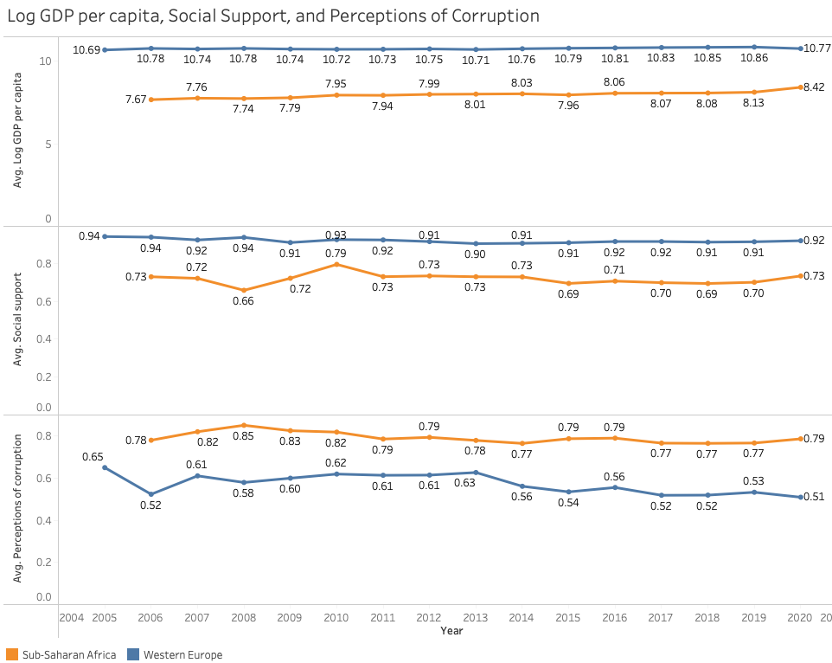
Key Factors Affecting Happiness
Notes:
The line chart displays the trends of average Log GDP per capita, average Social support, and average Perceptions of corruption for the years available, with Sub-Saharan Africa and Western Europe. The line chart reveals that Western Europe has a higher average Log GDP per capita and Social support compared to Sub-Saharan Africa. The trend lines for both indicators are consistently higher in Western Europe than in Sub-Saharan Africa over the years. On the other hand, Sub-Saharan Africa has a higher average perceptions of corruption compared to Western Europe. The trend line for perceptions of corruption is consistently higher in Sub-Saharan Africa than in Western Europe over the years.

Slide 7
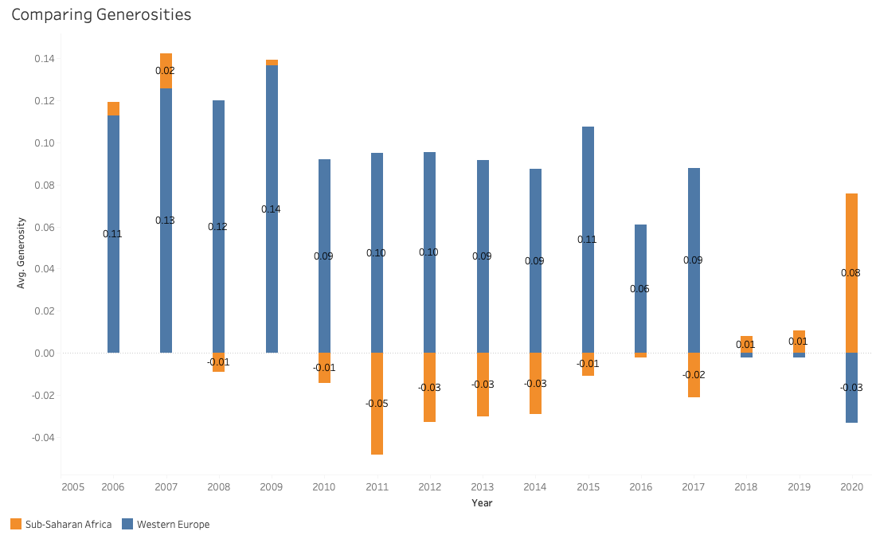
Key Factors Affecting Happiness
Notes:
The plot displays the average generosity between Sub-Saharan Africa and Western Europe over the years. On average, Western Europe has a higher generosity score than Sub-Saharan Africa. However, there is an interesting observation during the year 2020, which coincided with the COVID-19 pandemic. During this year, Western Europe had a lower average generosity score compared to Sub-Saharan Africa.

Slide 8

Conclusion
Western Europe consistently ranks as the happiest region, while Sub-Saharan Africa ranks lowest.
Western Europe has higher GDP per capita, social support, healthy life expectancy and generosity than Sub-Saharan Africa
Improving happiness levels globally can contribute to overall well-being.
Notes:
In conclusion, improving happiness levels globally can contribute to overall well-being. It is important to understand local contexts and prioritize research into improving social support and life expectancy in regions with lower happiness scores. Through continued analysis and efforts to improve happiness levels, we can create a better world for all.

Slide 9
Recommendations
Step 1
Step 2
Step 3
Prioritize life expectancy improvements in Sub-Saharan African Countries
Improving access to healthcare
Increase awareness of health lifestyles
Improve social supports in Sub-Saharan African Countries
Enhancing social safety nets
Strengthening social protection systems
Encouraging family and community support
Combat Corruption in Sub-Saharan African Countries
Strengthening anti-corruption laws
Improving transparency and accountability
Promoting public awareness and education
Notes:
Here are three recommendations for United Nations leaders based on the information provided:
Prioritize improving life expectancy in Sub-Saharan Africa: One of the factors that can influence happiness levels is healthy life expectancy. Thus, leaders should prioritize improving access to healthcare, increasing awareness of healthy lifestyles, and investing in disease prevention and treatment programs.
Improve social support in Sub-Saharan Africa: Social support is a crucial factor in promoting happiness, and leaders should prioritize efforts to enhance social support systems in Sub-Saharan Africa. This could include initiatives such as enhancing social safety nets, strengthening social protection systems, encouraging family and community support, and promoting mental health awareness and support services.
Combat corruption in Sub-Saharan Africa: Corruption is a major obstacle to happiness and development in Sub-Saharan Africa. Leaders should prioritize efforts to combat corruption by strengthening anti-corruption laws, improving transparency and accountability in government and business, promoting public awareness and education on the negative impacts of corruption, and supporting civil society and media efforts to expose and deter corruption.

Slide 10
Resources:
Fahadmehfoooz. “World Happiness.” Kaggle, Kaggle, 10 Oct. 2021, https://www.kaggle.com/code/fahadmehfoooz/world-happiness.
​
Resources:
World Happiness | Kaggle

Slide 11
Thank
you
March 1, 2023
Notes:
I hope this presentation will contribute to the ongoing efforts to enhance human development and promote happiness worldwide. Thank you for your attention.

