Slide 1
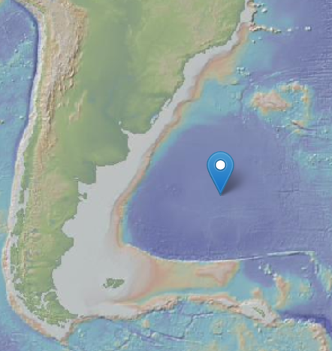
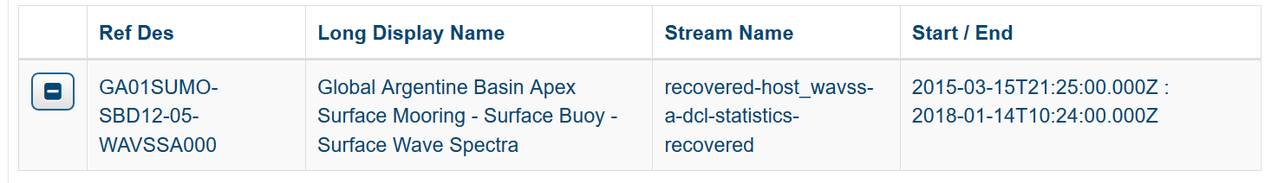
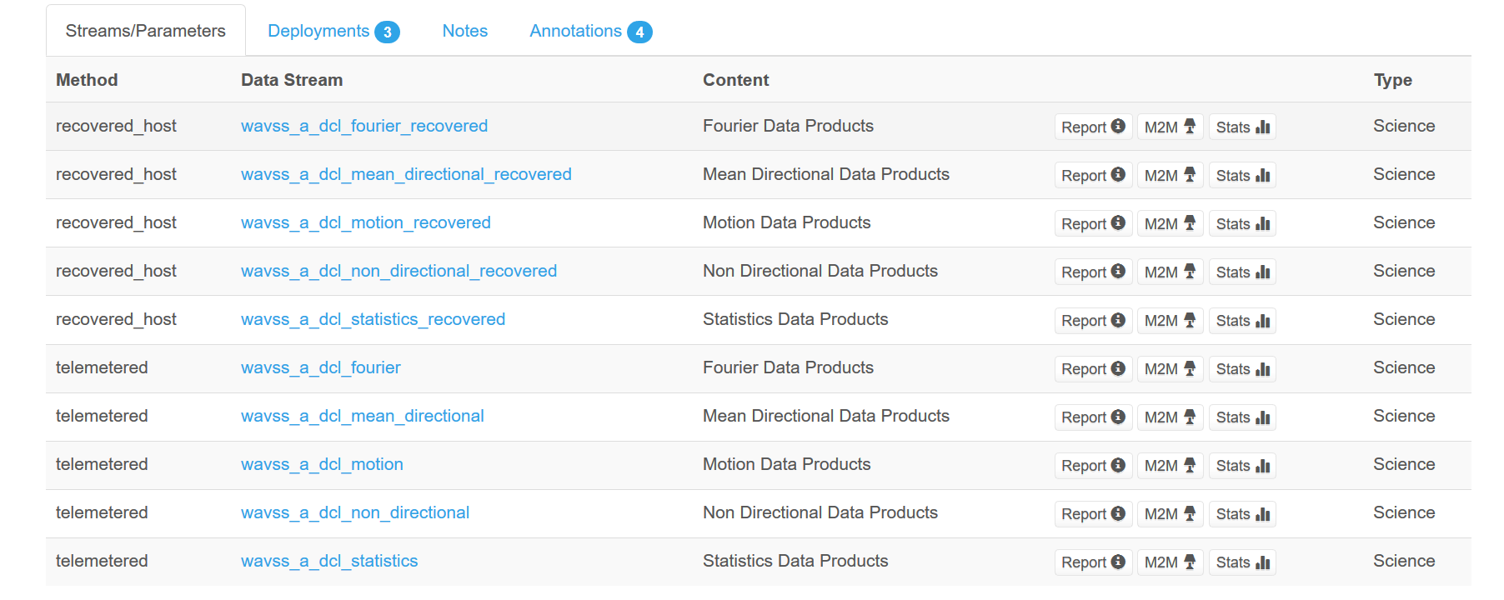
Notes:
The data analyzed came from the Global Argentine Basin Surface Mooring. I looked a simple wave properties from the recovered host stream which are listed under Statistics Data Products.

Slide 2
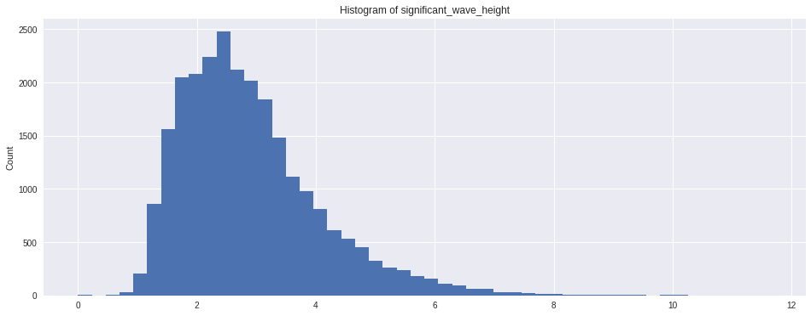
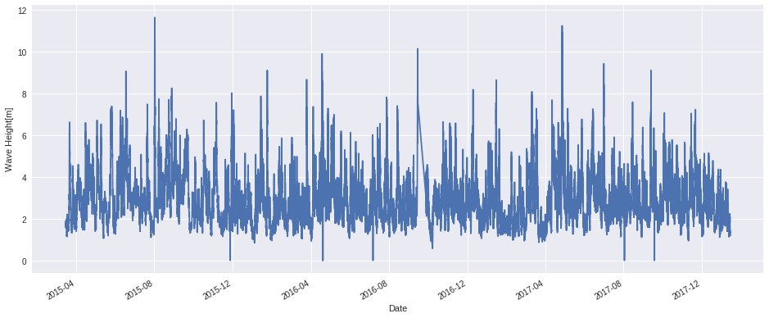
Notes:
First-look at the significant wave height is reasonable. Data is normally distributed and positively skewed, as expected. All values are within those reasonably found in that part of the ocean. There are a few instances with zero wave height but otherwise everything looks OK.

Slide 3
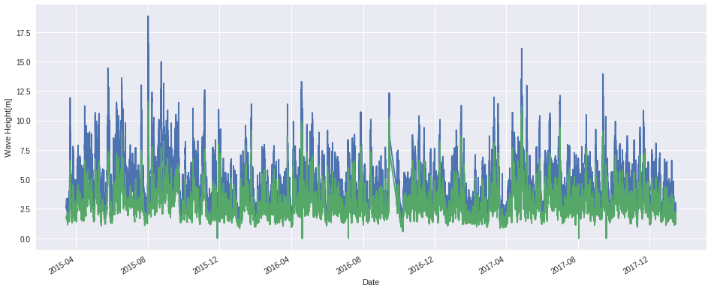
Significant wave height (green) and maximum wave height (blue)
Notes:
Maximum wave heights, as expected, are larger than significant wave height.

Slide 4
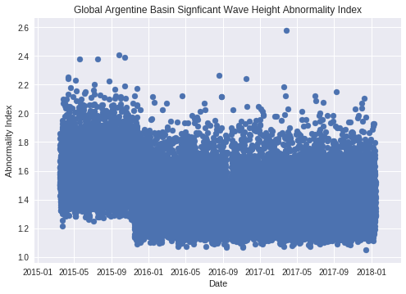
Notes:
The abnormality index is a measure of who abnormally large individual waves are. AI = Hmax/Hs. AI=>2 is a rogue wave. There is a clear step function when the data moves from the 1st to 2nd deployments. AI are much larger meaning that either the significant wave height is too small, or the maximum wave height is too large. From Nov 2015 onward the number of rogue waves are few, as expected. There is one extremely abnormal wave that occurred in April 2017 which deserves extra attention -- which it didn’t receive ☹-- I was unable to access the individual wave height data.

Slide 5
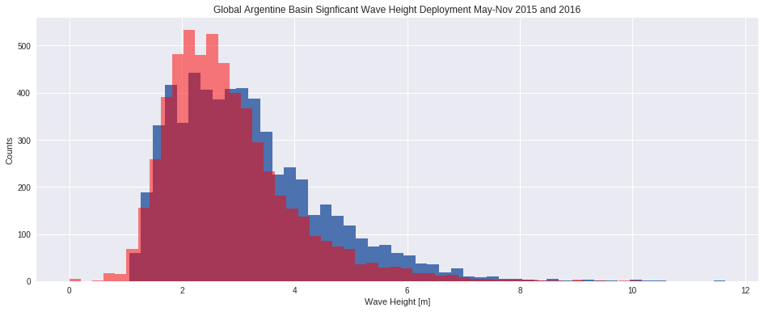
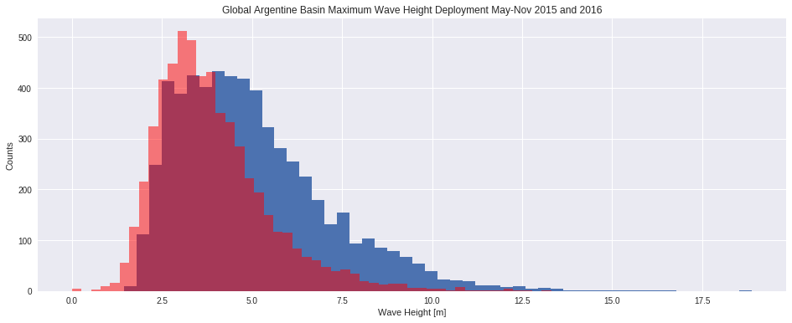
Significant Wave Height
April-Nov
2015
2016
Maximum Wave Height
Notes:
Comparing significant wave height and maximum wave height for April – Nov 2015 and 2016 it appears as though the maximum wave height is to blame for the large AIs. Significant wave heights for both years fall atop one another. Maximum wave heights are shifted to higher values and positively skewed.

Slide 6
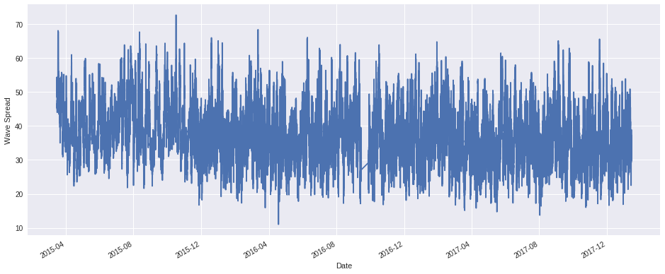
Wave Spread
Notes:
Whether it’s caused by the buoy or mooring design or the buoy layout or the post-processing, there issue appears to extend into wave directional spread.

Slide 7
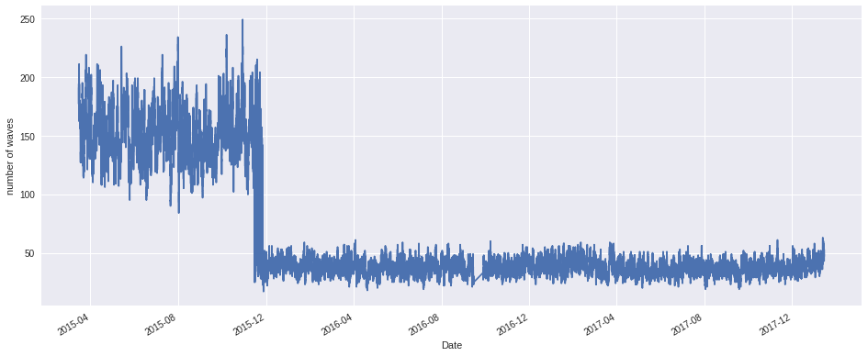
Number of zero crossings in the underlying displacement data, used primarily for verification and QC
Notes:
I would interpret number of zero crossing as number of times the buoy crosses the mean water line, meaning the total number of wave in any 1-hour run. However, the values appear to be too low for this to be the case (50 waves per hour is implausible). Regardless, zero crossings (which is used for underlying data analysis) clearly shows a step function between the 1st and 2nd deployments.

Slide 8
Annotation:
Deployment 1: Buoy log files showed that seawater was first detected inside the buoy well on 3/26/2015. Both leak detectors showed increasing presence of water over the period of deployment. Upon recovery of the mooring, no external damage was visible and the buoy did not appear to be floating lower than normal.

Slide 9
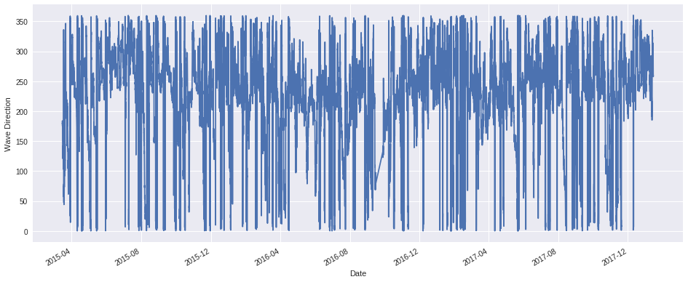
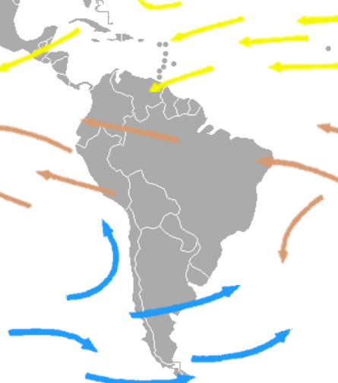
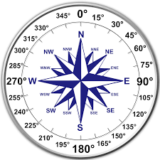
Mean Direction of Waves from True North
Notes:
1st look wave direction seems unaffected.

Slide 10
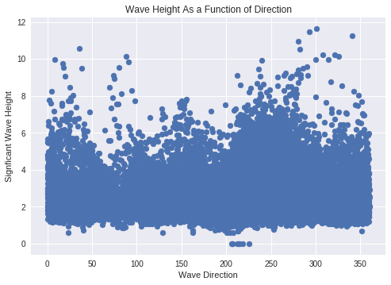
Notes:
Largest waves travel approximately west.

