Slide 1

Machine learning and advanced analytics using Python
U.S Small Business Admin (SBA) Loan Analytics:
Should This Loan be Approved or Denied?

Slide 2
Story Telling
A data analyst is tasked to perform data analysis and to build machine learning models for loan approval prediction in order to minimize default risk and have their resources allocated efficiently.
Target audience: Credit risk management
Research: https://www.kaggle.com/mirbektoktogaraev/should-this-loan-be-approved-or-denied
Sample dataset: SBA loan records from year 2005 to 2010

Slide 3
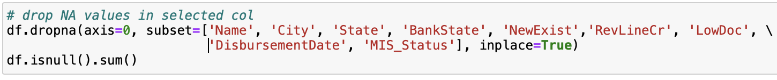
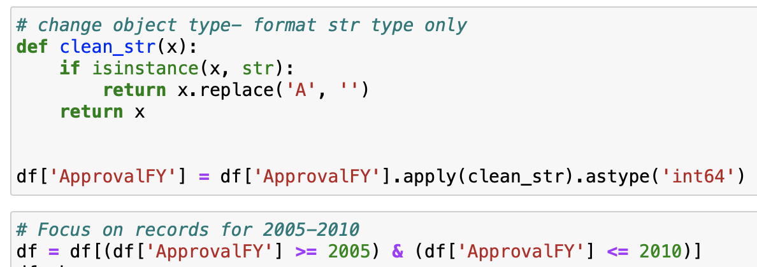
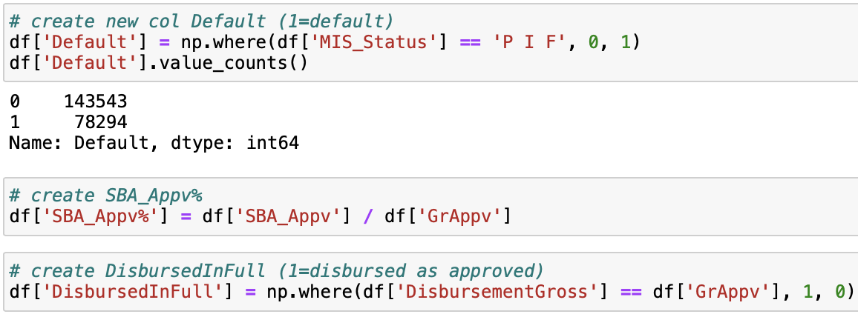
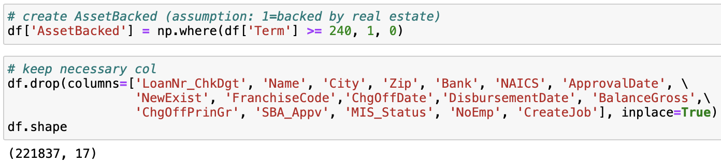
Exploratory data analysis (EDA) and data preprocessing
Drop rows with NaN/ null values
Format data types, eg currency fields, ApprovalFY
Map industry (NAICS) codes to corresponding industry name for clearer reference
Perform feature engineering
Create flag columns- IsFranchise, NewBusiness, Default etc.
Create necessary measurements- SBA_Appv%, asset-backed, disbursed_in_full etc.
Remove inconsistencies or unwanted data that won't provide much value to the analysis
Df shape 221k rows * 17 features

Slide 4
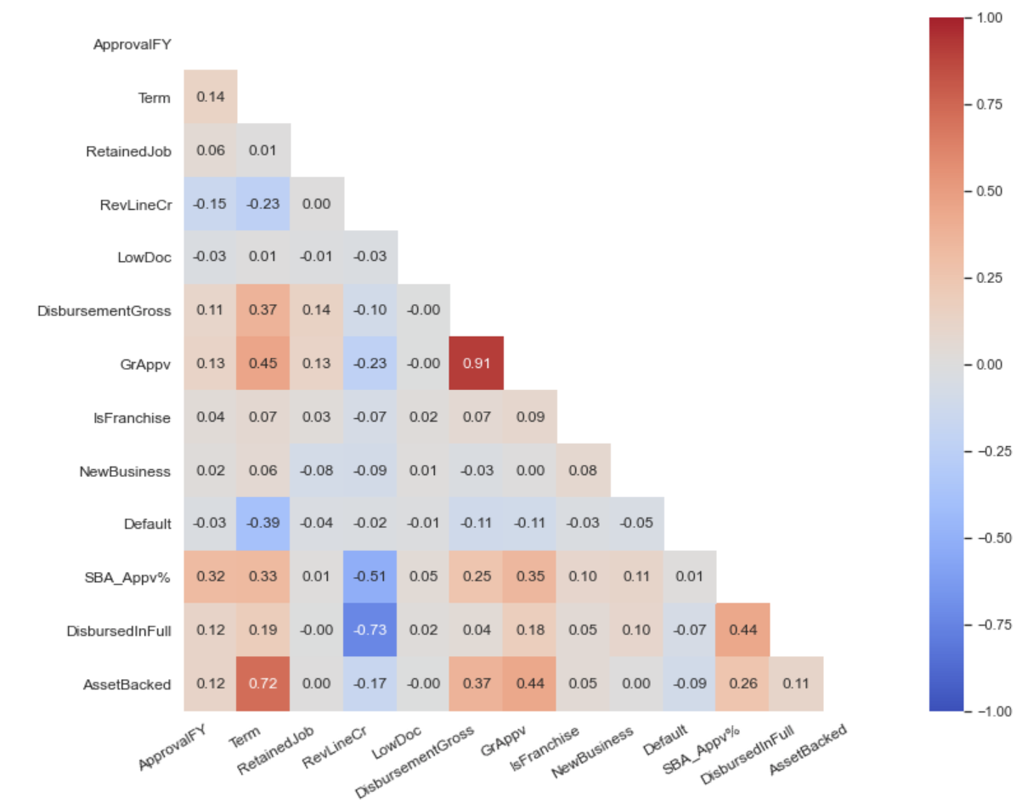
Data Analysis using Visualizations
Correlation matrix
Some notable correlations are:
GrAppv & DisbursementGross- Positive correlation: Typically, the amount disbursed is close to what was approved.
Term & asset-backed- Positive correlation: make sense that the longer the term, most likely it is secured with collateral.
Disbursedinfull & Revolving LineCr- Negative correlation: Typically, the limit for a revolving credit line is lower than a term loan on average since the business can continually draw funds from the line of credit.

Slide 5
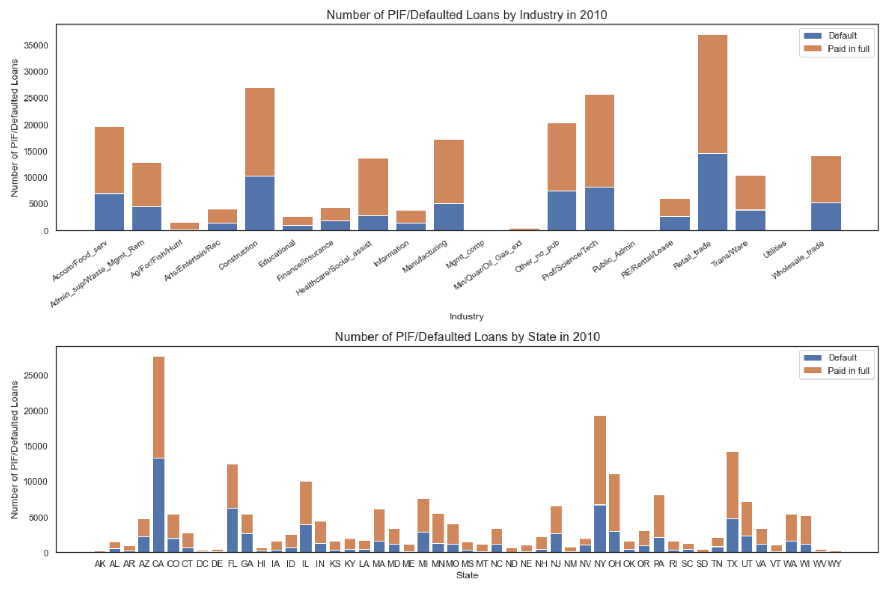
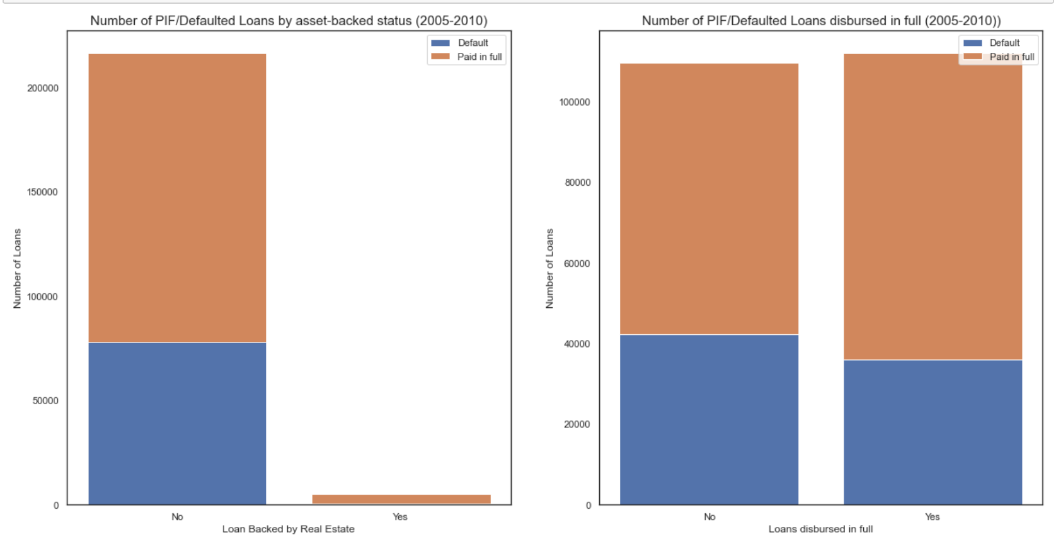
Data Analysis using Visualizations
Stacked bar chart- Paid in full vs defaulted loans by industry, state
Retail trade, construction, Professional, scientific and technical services industries had significantly more loan funds distributed to them during the sample period
States with the highest number of loans during sample period: California, New York and Texas
State with the highest Default percentage: California (48.1%), Arizona (46%) and Nevada (51.2%)
Stacked bar chart- Paid in full vs defaulted loans by asset-backed status, disbursed-in-full status
Volume of loans backed by real estate was much less than those not backed by real estate
makes sense that most people aren't willing to take on that much risk
However, the default rate is also much less for loans backed by real estate. This is likely because the businesses who have their loans backed by real estate are more willing to do what it takes to pay the debt.

Slide 6
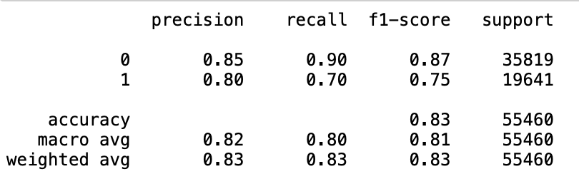
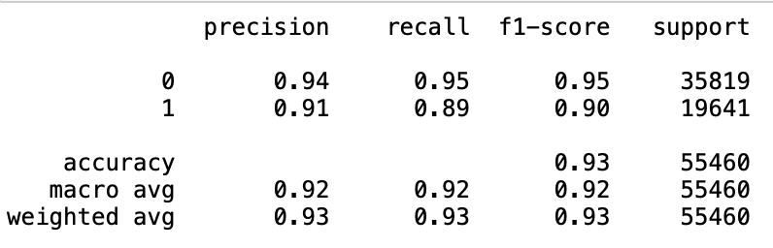
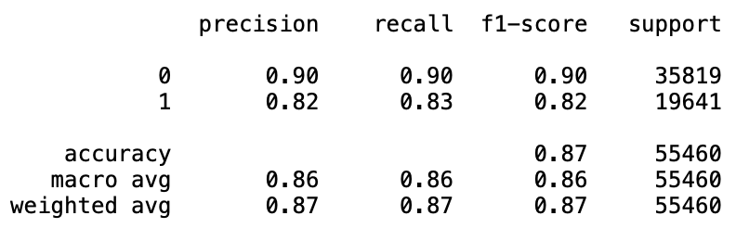
Machine learning models and performance evaluation
Logistic regression
Machine Learning model:
Logistic regression (baseline model)
Random forest
Multi-level perceptron
Tools: Python libraries (pandas, numpy, matplotlib, seaborn, scikit-learn)
GridSearchCV is utilized to automate the tuning of hyperparameters in order to determine the optimal values for a given model.
Performance metrics: To fully evaluate the effectiveness of a model and to evaluate the 'cost' of the outcomes. The Random Forest performs better across the board with:
Precision suggests that the model is correct 91% of the time when the loan defaults.
Recall suggests that the model identifies 89% of defaulted loans correctly (11% of loans that defaulted were incorrectly classified as loans that would be paid in full).
F1-score of 90% for defaulted loan appears to be more promising out of the 3 models.
Random forest
Multi-level perceptron

Slide 7
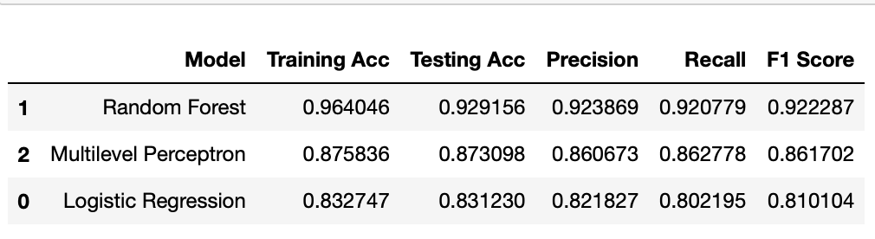
Insights and recommendations
Random forest model would be recommended:
It recognizes the underlying trend and correlation through a general accuracy of 93%, and with best precision, recall and F1-score across the board.
it's preferable if we are able to predict a loan will default and it doesn't than if we predict a loan will be paid in full and ends up in default.
Essentially, we would prefer the model that predicts the correct outcome most of the time, but when it gets it wrong it's not as bad (benefits of success far outweigh the disadvantages of failure).

Slide 8
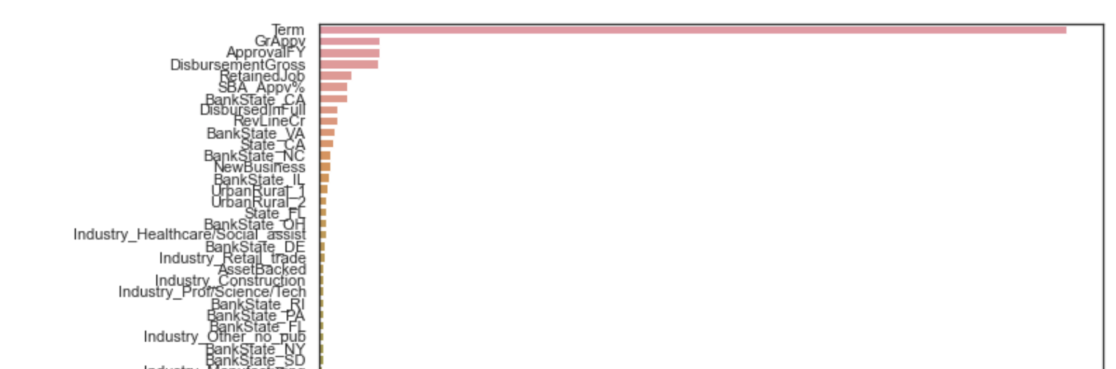
Future opportunities
Feature importance scores could be adopted to simplify the problems (reducing the number of features to the most important 30), speed up the modeling process through dimensionality reduction, in order to improve the performance of the predictive model.
Further explore different machine learning models such as Naïve Bayes and KNN.

Slide 9

Thank you!

