Slide 1

Patient Notify App Flow
Provided For

Slide 2
Location Activation

Slide 3
New Order - 1st/3rd Monday of Month
Report
Last Day of Month
New Order Flow
Invoice - 1st/3rd Wednesday of Month
Customer Welcome Email
Follow Up
Last Day of Month
Printing & Shipment
New orders will be submitted on new order form by the 1st (and optionally) 3rd Monday of the month. Any customer reorders will be included in shipments.
Update will be shared with LendingClub team at end of month with report that includes deliveries with adoption. This will also be part of new 2026 reporting dashboard.
Orders will be printed and shipped within 5 business days of paid invoice. Delivery based on chosen delivery speed.
Within two business days of new/reorder request, invoice will be sent to LendingClub.
Customer welcome email will be delivered 1-3 days prior to arrival with tracking & portal is also referenced in mailed letter.
Follow up email(s) will be sent to users who have not signed in and LC should also reach out at this point.
This timeline details the factors
you should consider when planning the new order

Slide 4
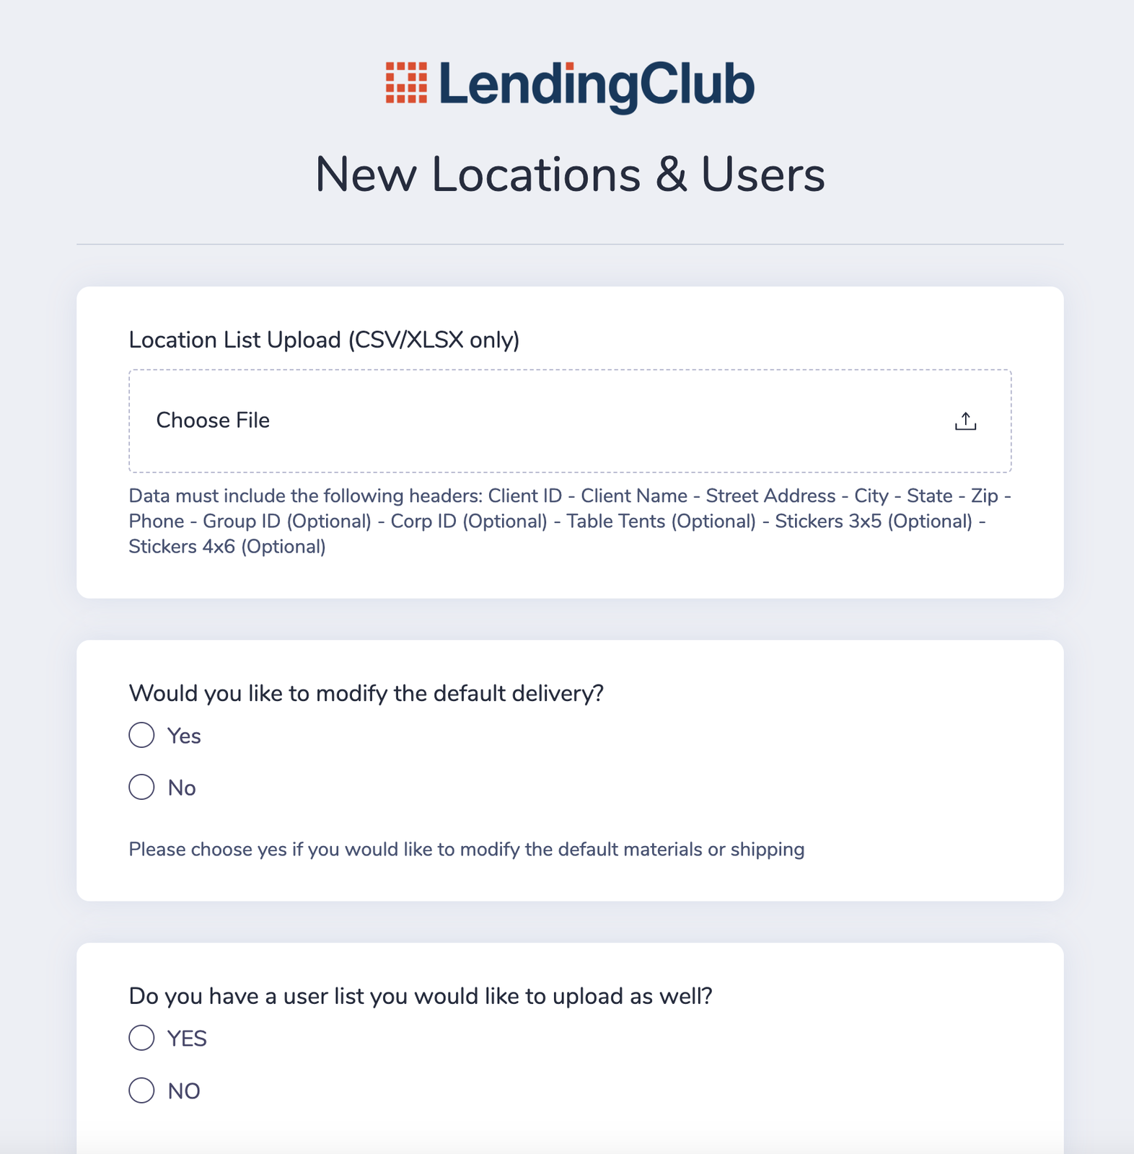
New Location Add and Order Process
1. Lending club Team navigate to upload locations and associated users via a simple form
View Form Here
2. Submitted New Orders will get sent to print and automatically added to Patient Notify if they don't exist
3. Packages will be shipped to the office and automated email letting them know when to expect it with tracking information and their welcome information from Patient Notify Portal
4. The day of arrival another email will go out and let them know and also reminder to login

Slide 5
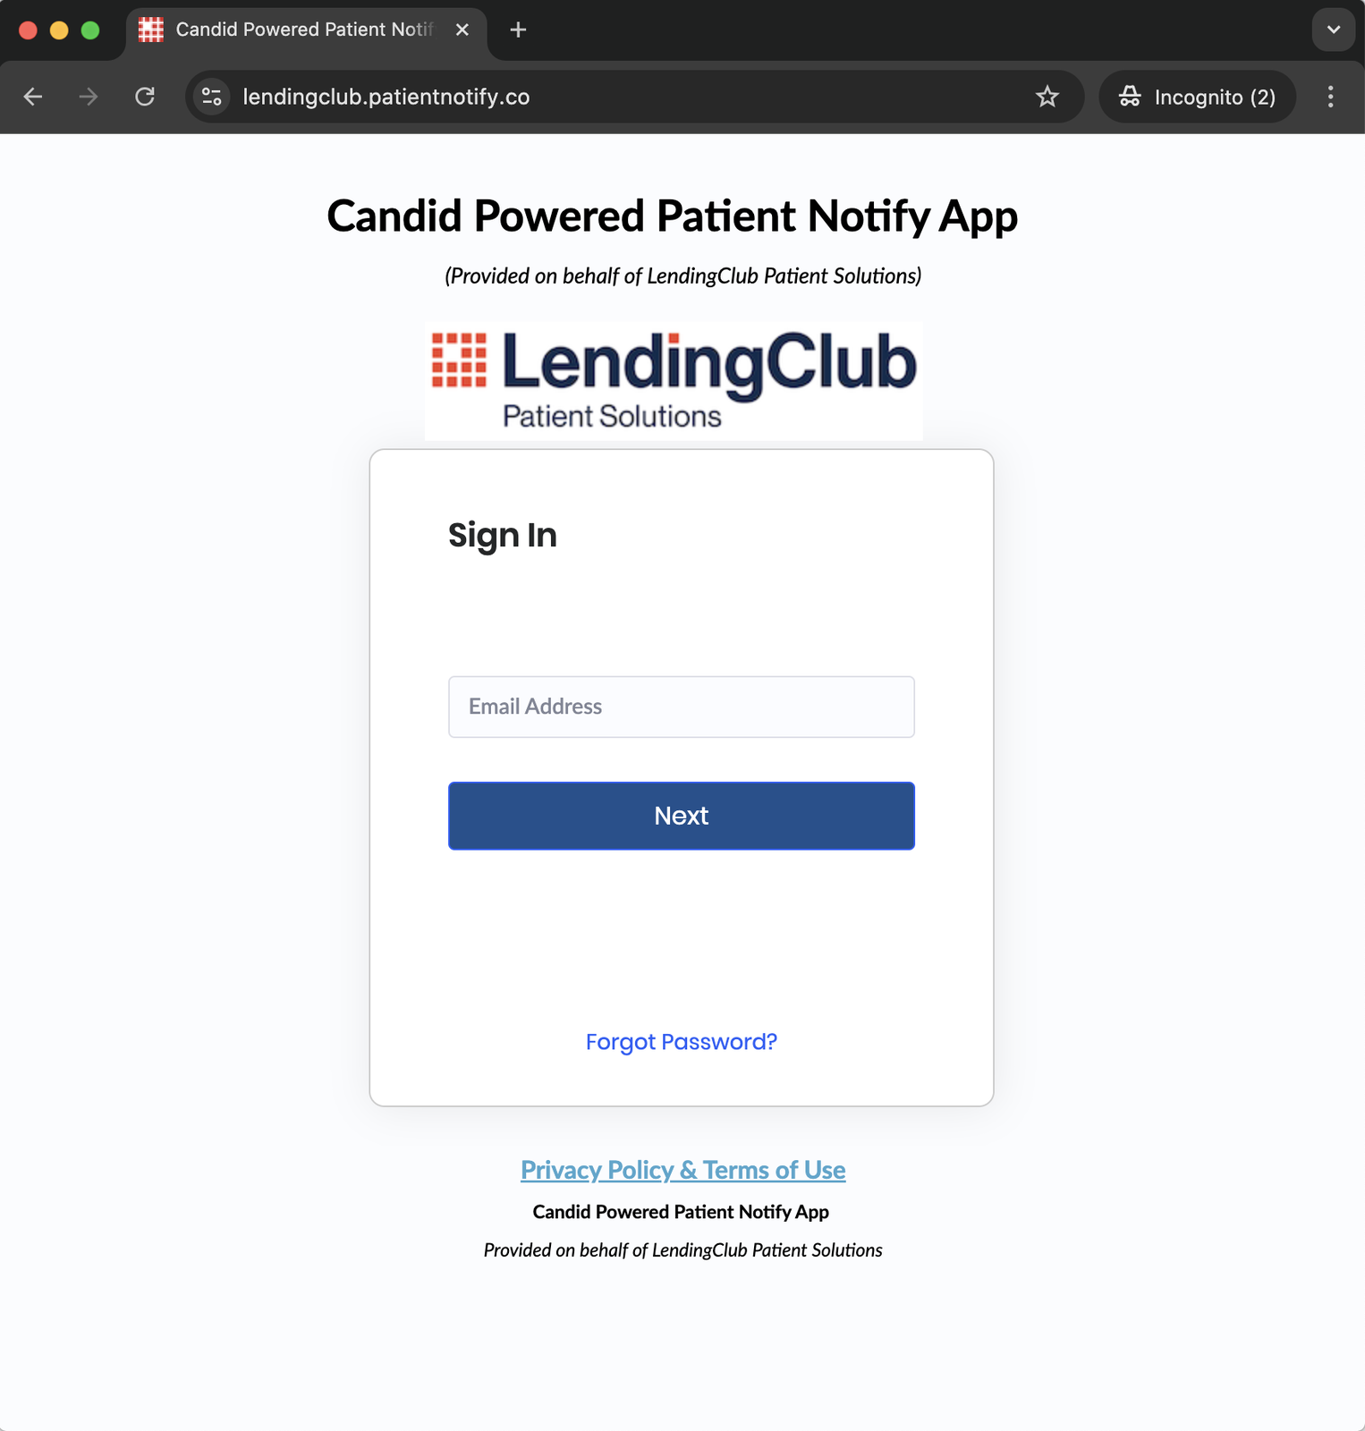
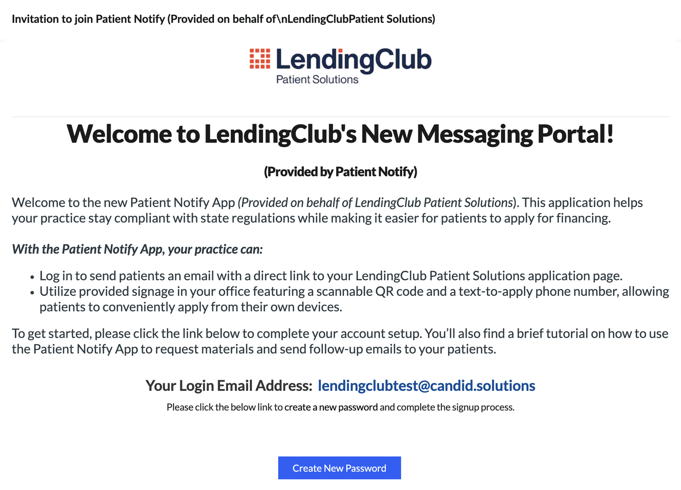
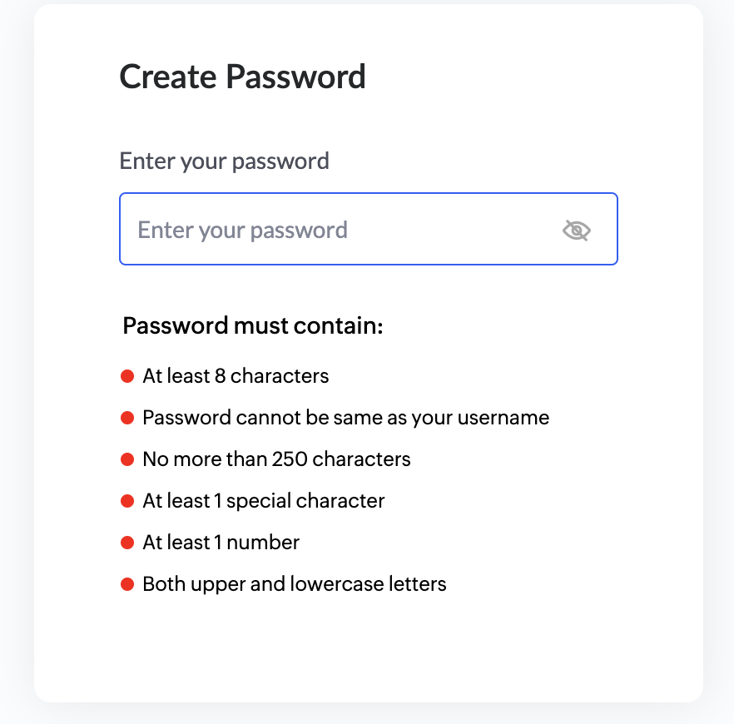
Client Portal User: Invitation and Login
New welcome email will be timed with shipment and include tracking information so business knows that their delivery is on the way. Additionally, the welcome package will reference this email.

Slide 6

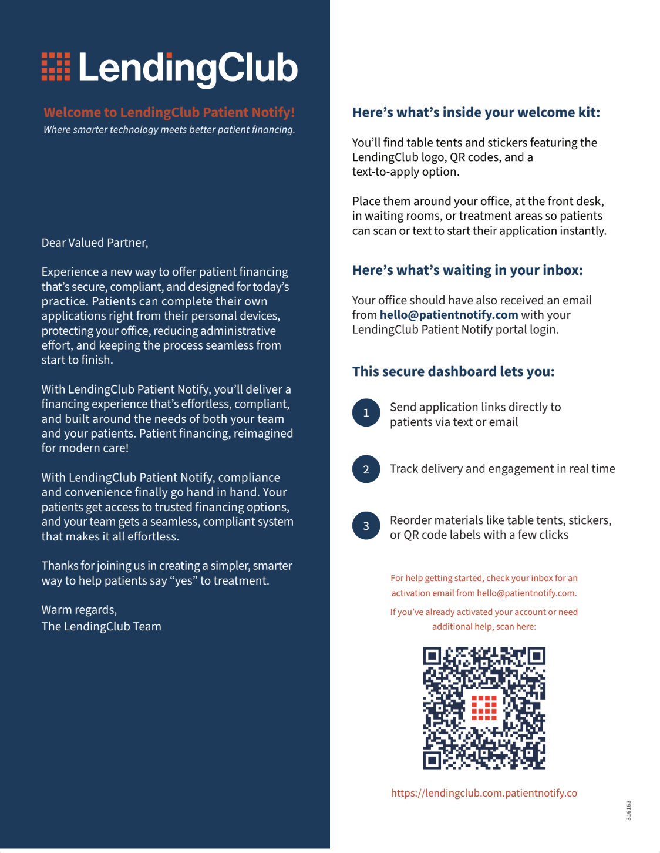
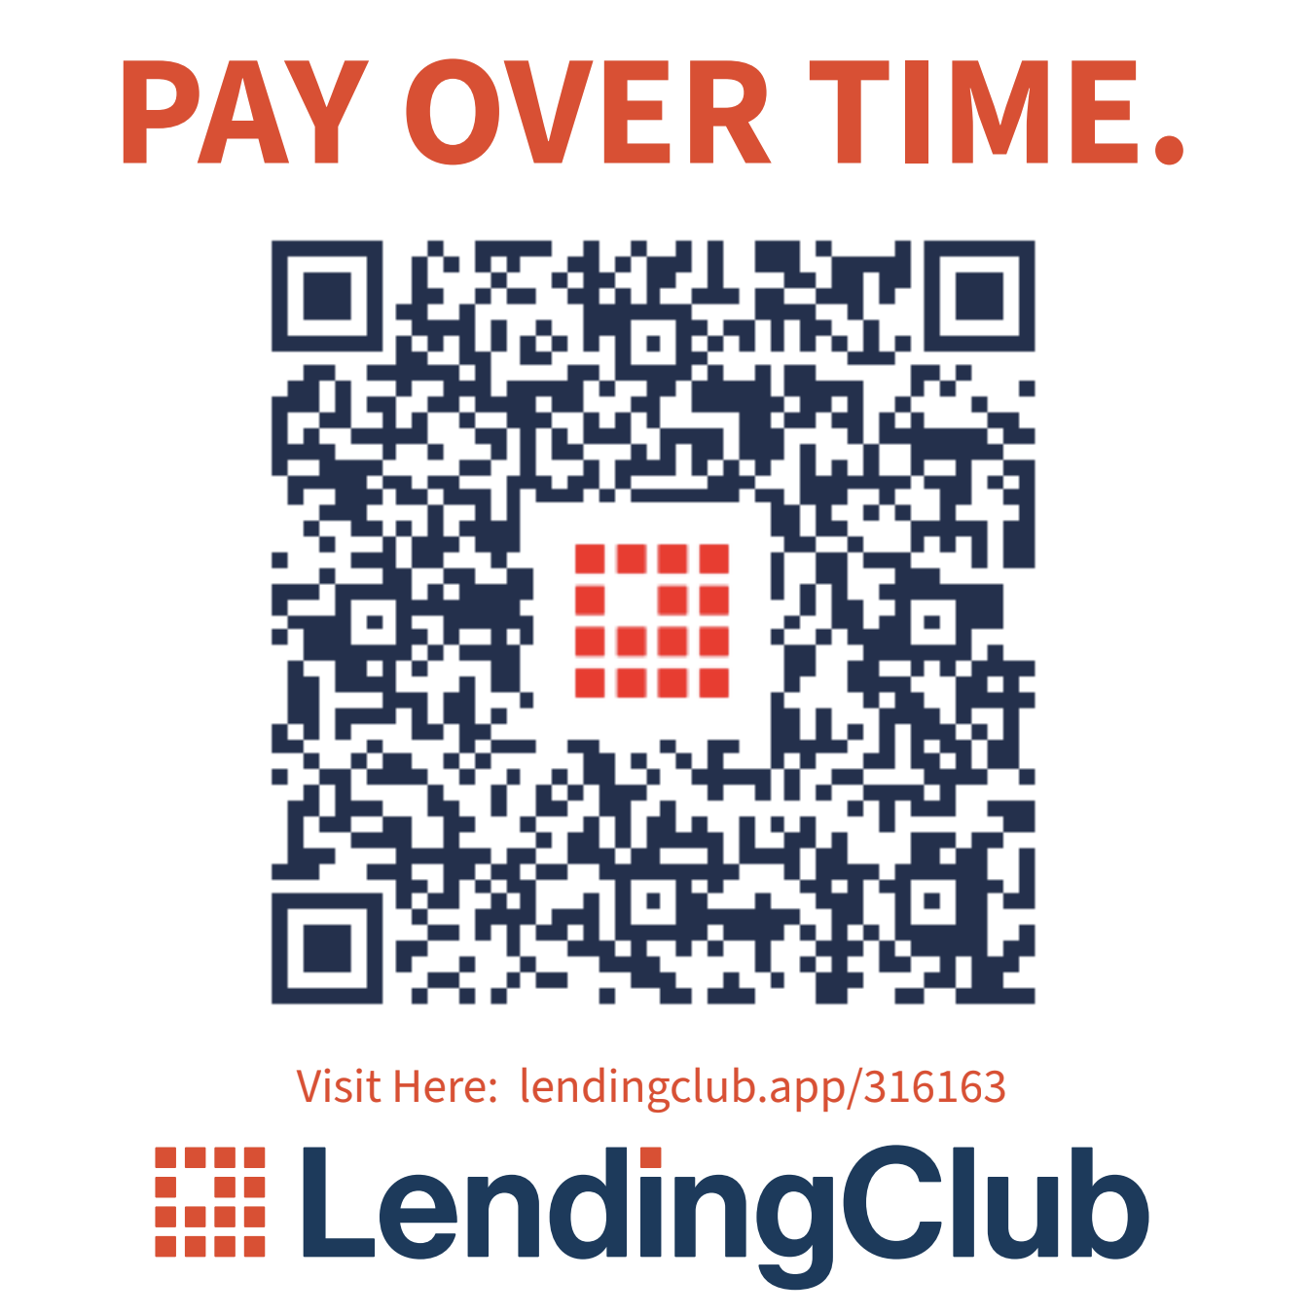
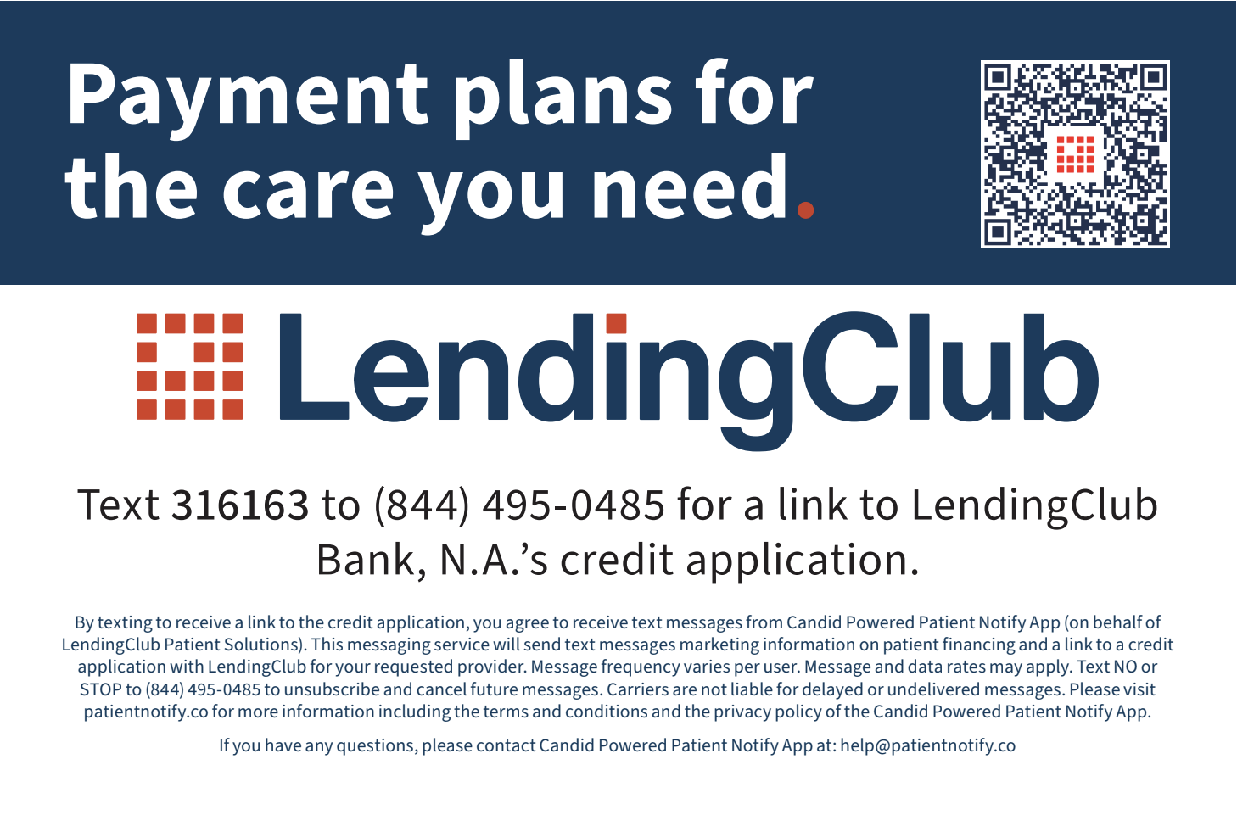
Newly Branded Marketing Collateral

Slide 7
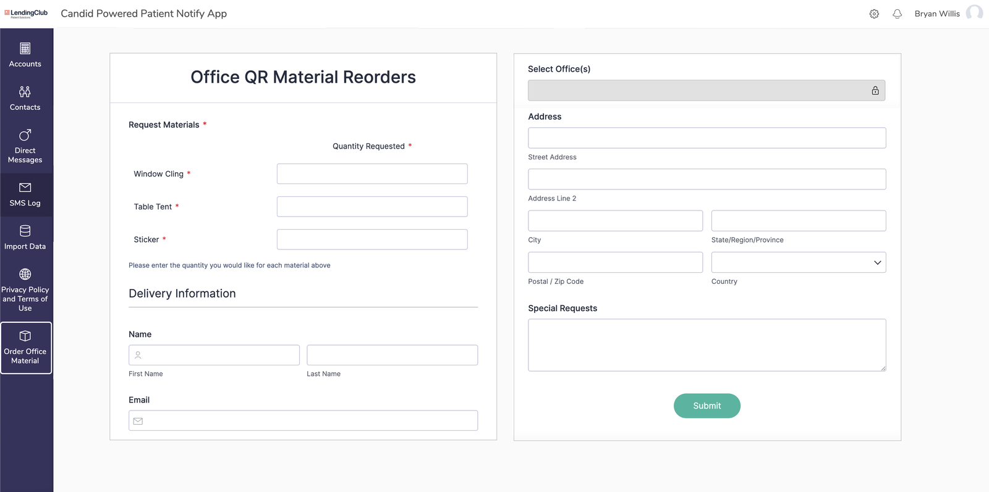
Reorder forms for offices
Reorders are simple and can be submitted through the app. All reorders will be shipped ever two weeks

Slide 8
Messaging to Account Customers
SMS, Email, QR Code

Slide 9
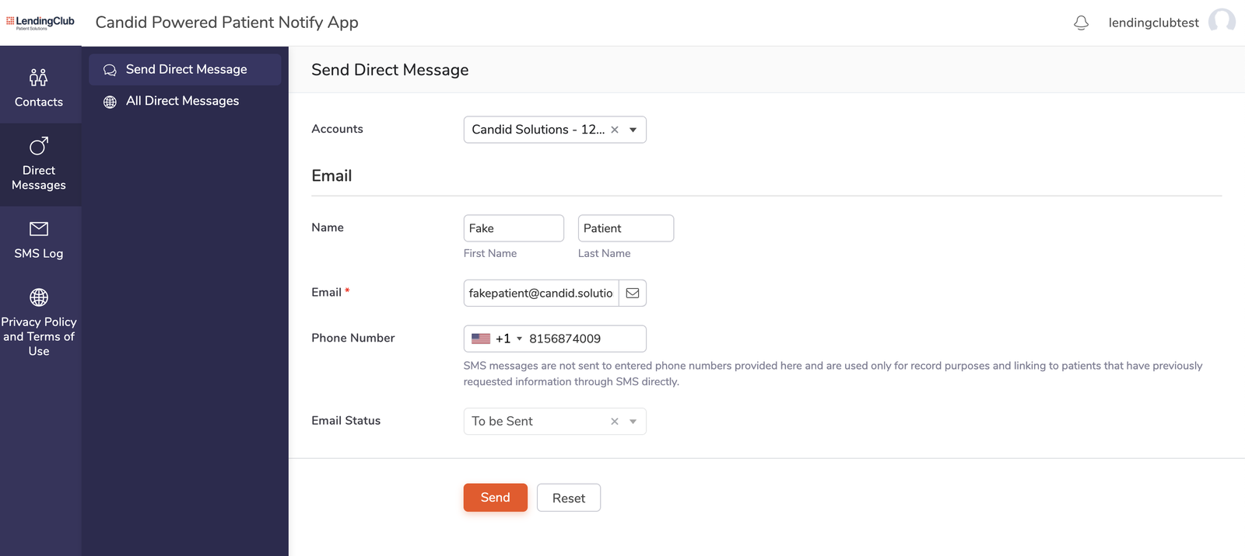
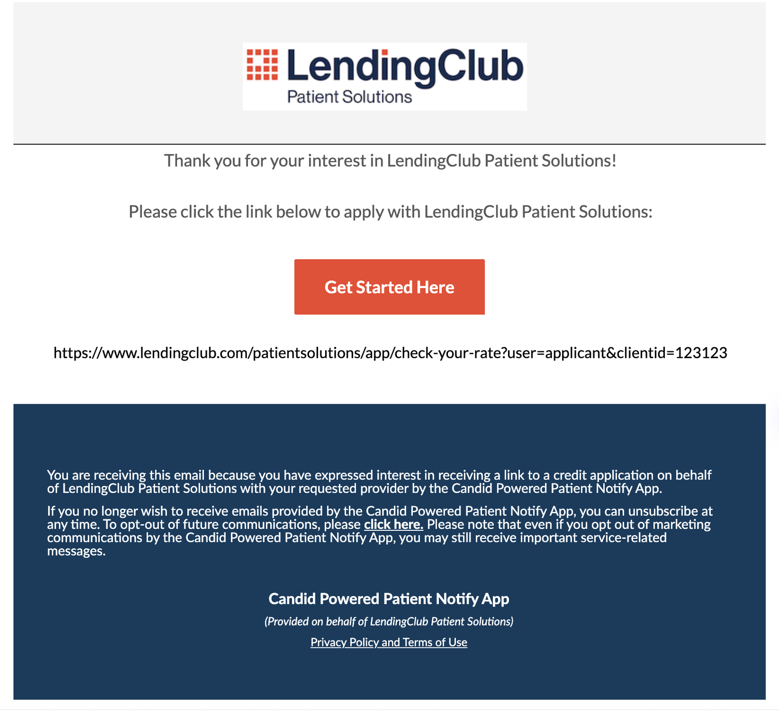
Direct Message Flow: Customer Direct Email/SMS Message Module
Send Message Screen
Client has ability to choose accounts associated to their email address to send on behalf of which will show in Contacts Sent Messages Module. Currently phone number is for record purposes only as only email will be sent. SMS log is for messages received from QR code placard only.
Email Screen
Customer receives email from LendingClub with link to application

Slide 10
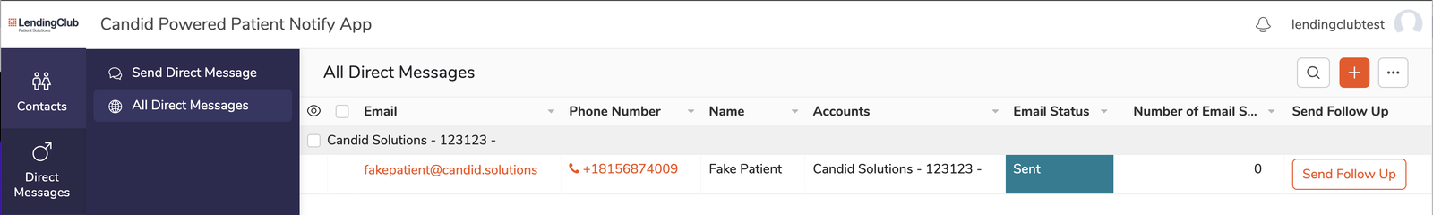
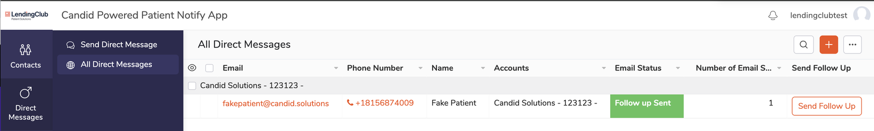
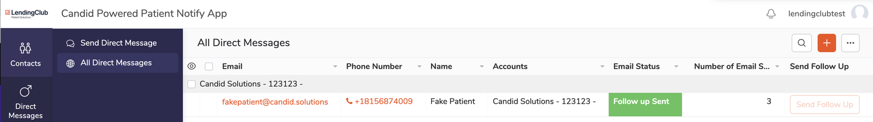
Message Sent Status
Follow Ups Sent
Message Limit Reached

Slide 11
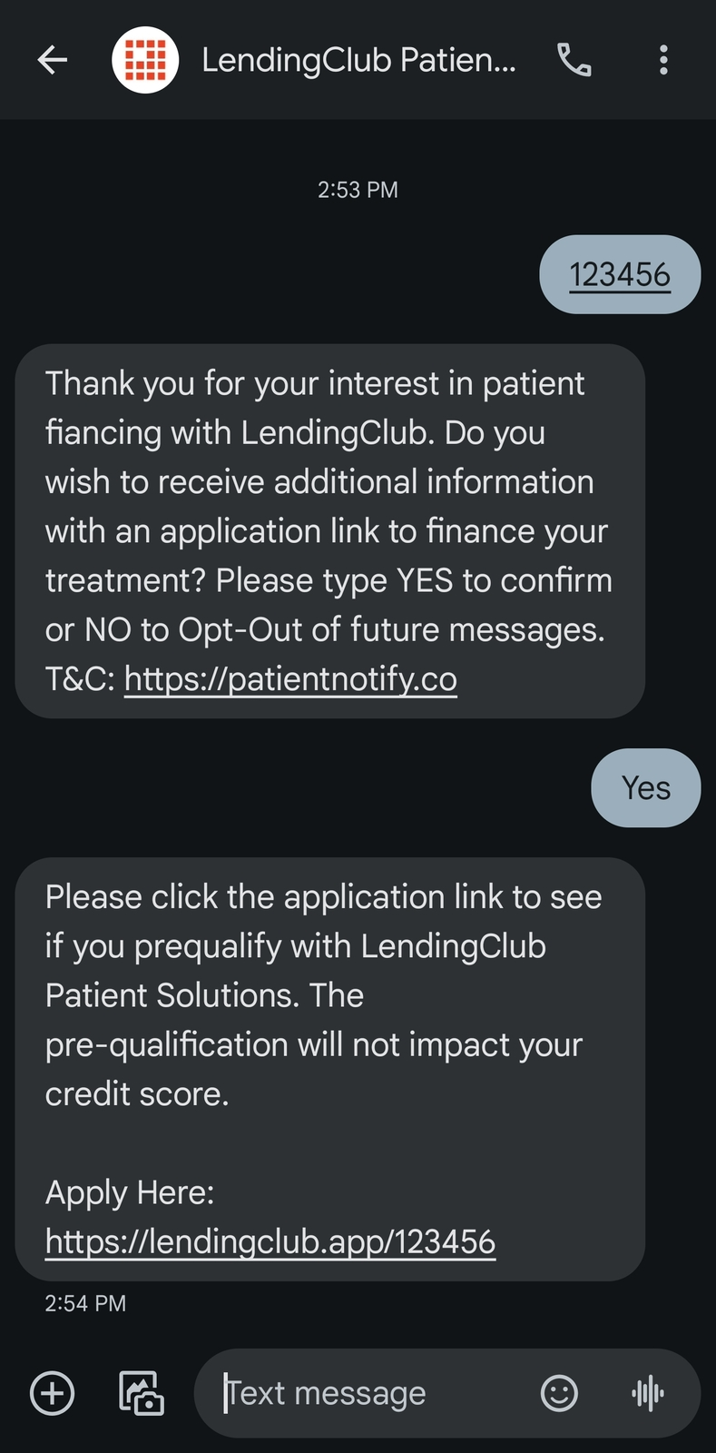
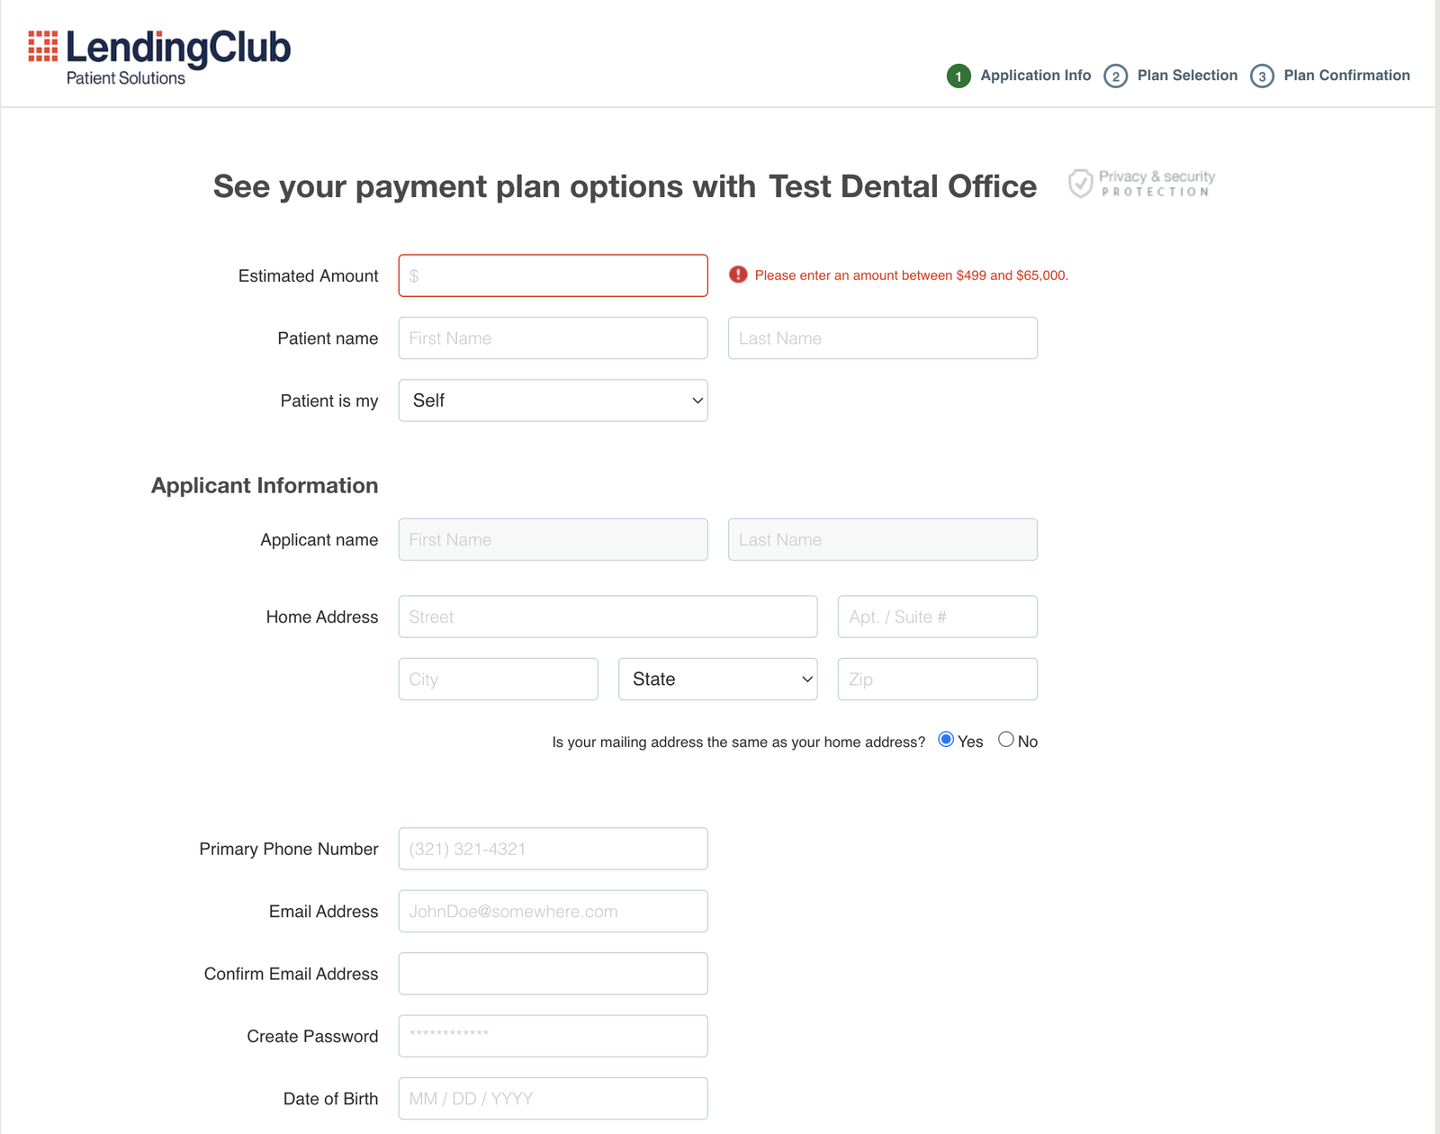

SMS/QR Flow
2. SMS Shortcode
Upon texting short-code to Lending Club number, patient receives double opt-in message and if accepting by typing YES receives the Lending Club SMS with the application URL
SMS Link Redirect to Landing Page
Patient Arrives at LendingClub page based on relevant "Client_ID".
1. Signage in Account Offices
Signage is displayed in Lending Club "Account" offices giving patients options to scan the QR code or text "Client_ID" to receive patient financing application link.
Notes: Patient initiates text conversation based on instruction from placard signage below. Upon initiating the message and opting in, they receive a link. This ends the conversation and no marketing or additional messages are sent.

Slide 12
Program Performance and Reporting

Slide 13
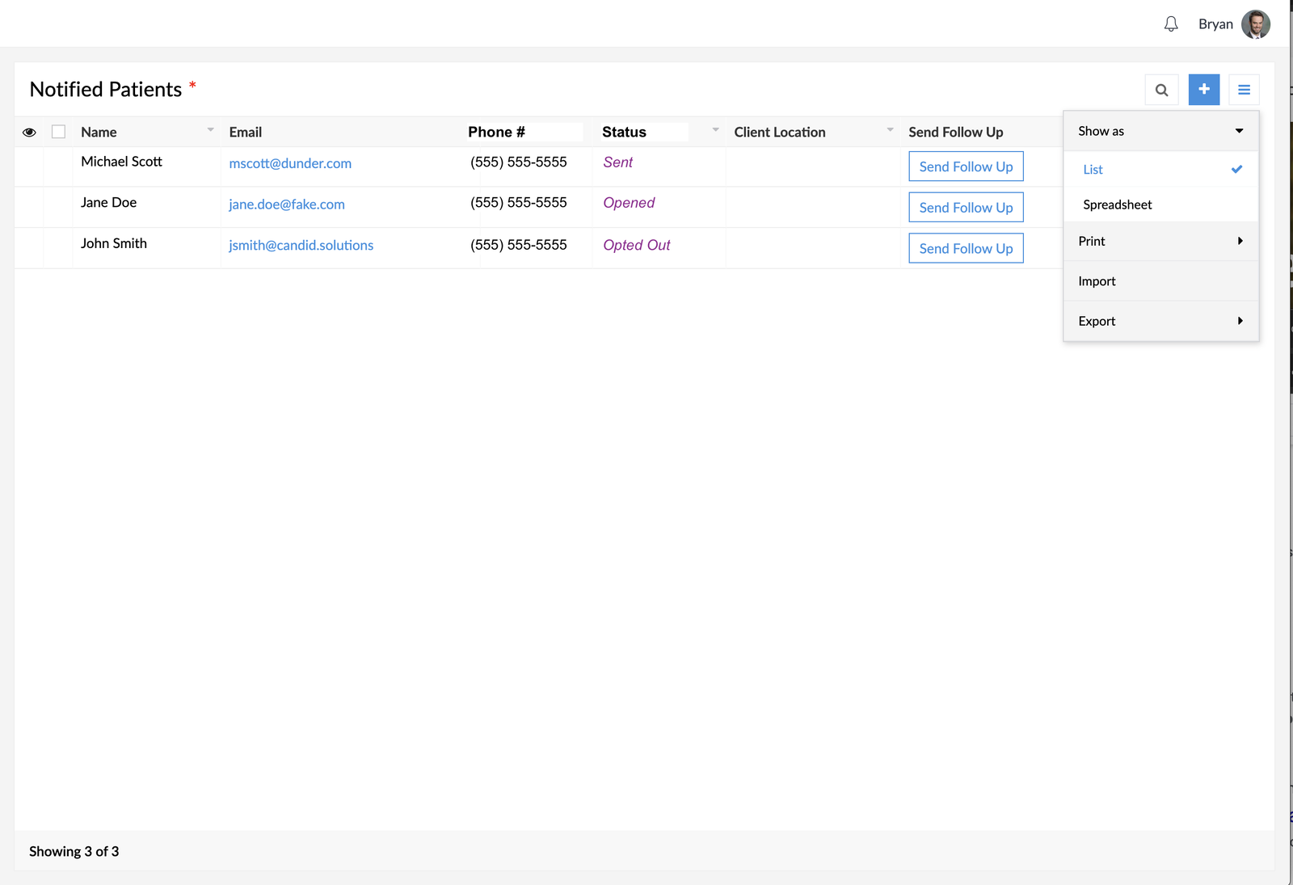

Email / QR / SMS Reporting for Merchants
1. Patient Emailed from Portal: If a customer is emailed the lendingclub link from the client portal, they will get added to the Notified Patients Report in Zoho Creator App. Here will list the information originally entered in the "Direct message" screen along with a status and user driven follow up option. The follow up should have a max limit of 1 follow-up attempt and then the button should be grayed out/disabled.
For emails, the status options should be similar to following:
- Email Sent
- Email Opened
- Clicked App Link
Email
SMS Status Date Added IP Address
2. SMS Messages from Patient: If a customer initiates process through sms, their name and email will not appear here, but only their phone. There will be no follow up option.
For sms, the status options should be similar to following:
- SMS initiated
- SMS opted in
- Link Clicked

Slide 14
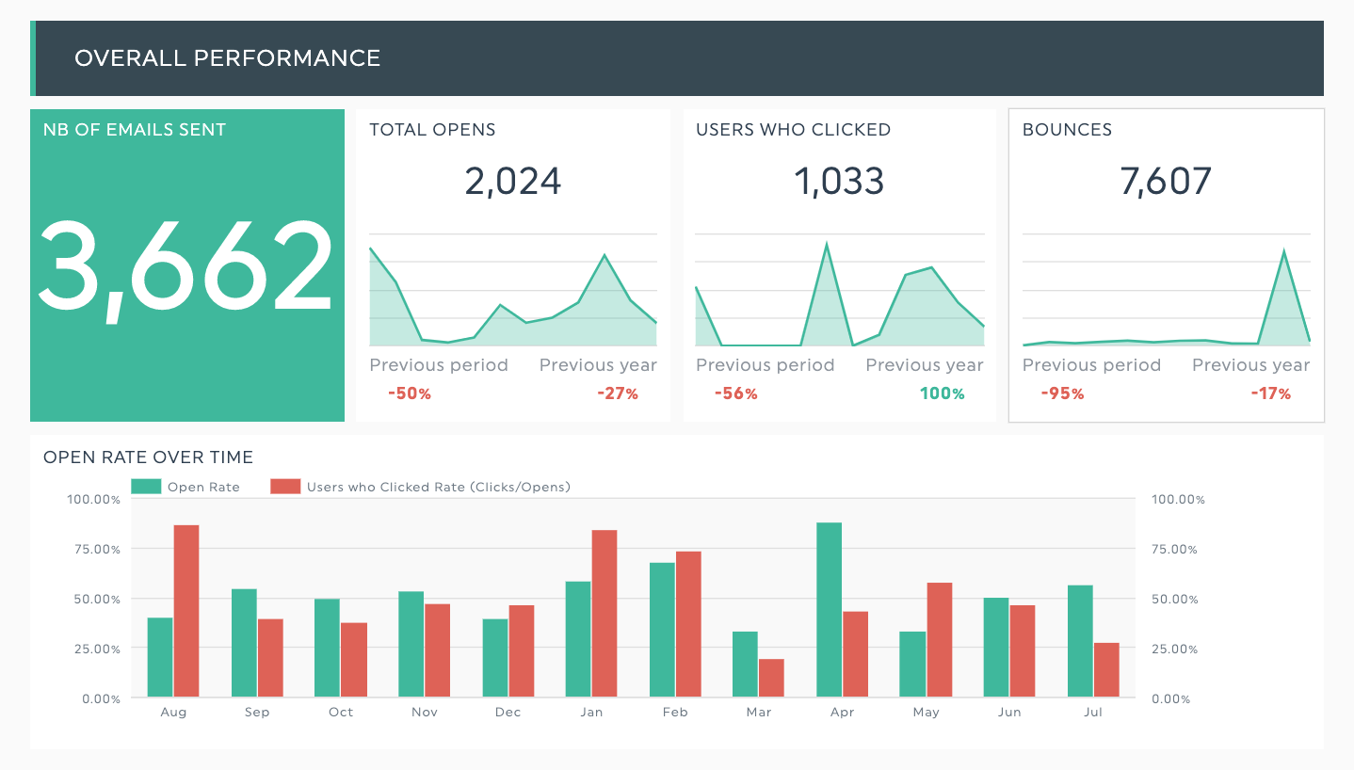
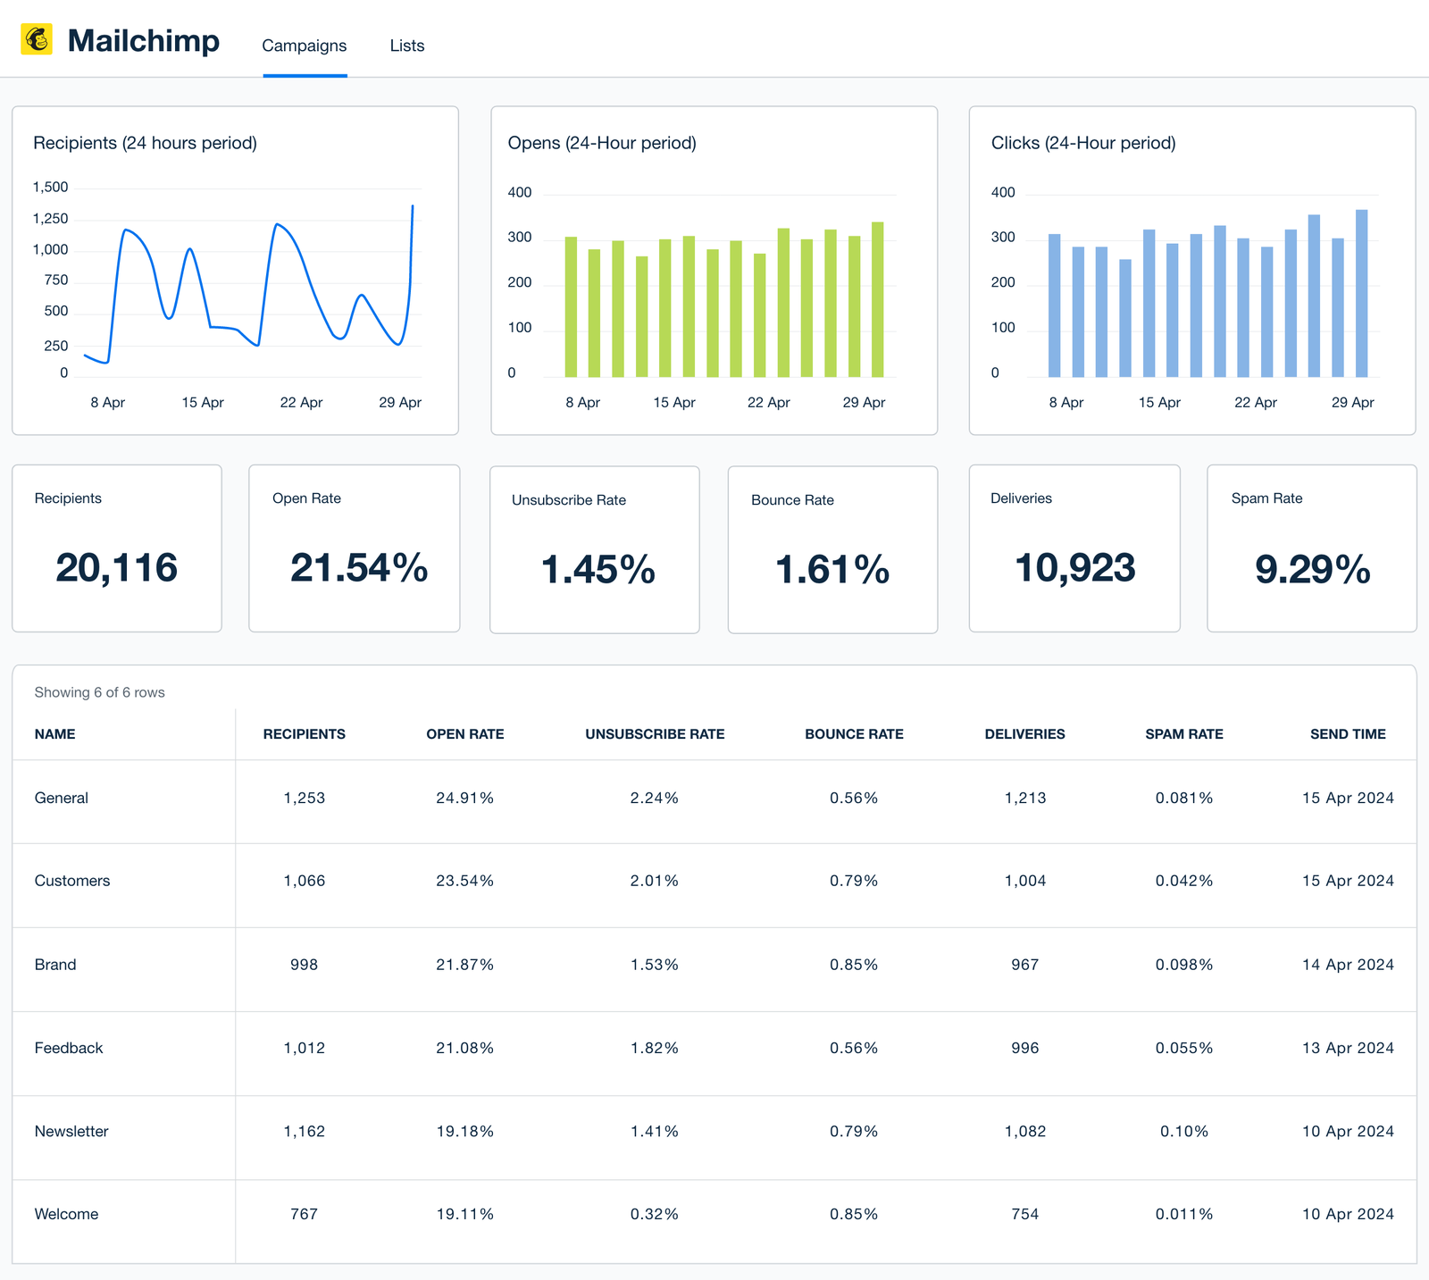
Customized Performance Reporting
Customized reporting for LendingClub in 2026 to track performance of the program. The onboarding changes along with new features like direct sms and automated follow-ups will improve the overall effectiveness of the program.

